Slide 1
Palliative and End of Life Care Overview
February 2025

Slide 2
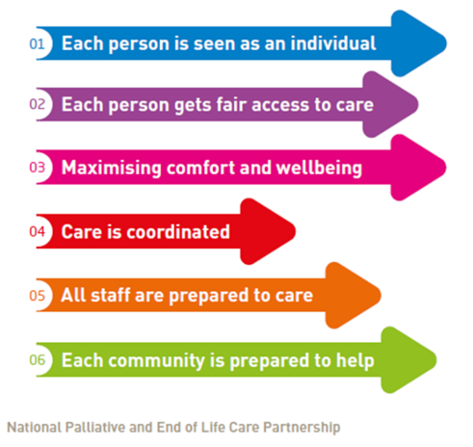
The Northamptonshire All Age Last Years of Life Strategy 2023 - 2026
Based around the Ambitions for Palliative and End of Life Care: A national framework for local action 2021-2026 document.
Clearly set out actions supported by task and finish groups ensuring a consistent focus upon both availability and accessibility.
Achieving the actions will enable us as a system to ensure that individuals nearing the end of their life receive high quality compassionate care and are supported to live well and to die with dignity in a place of their choosing.
NHS England, 2021

Slide 3
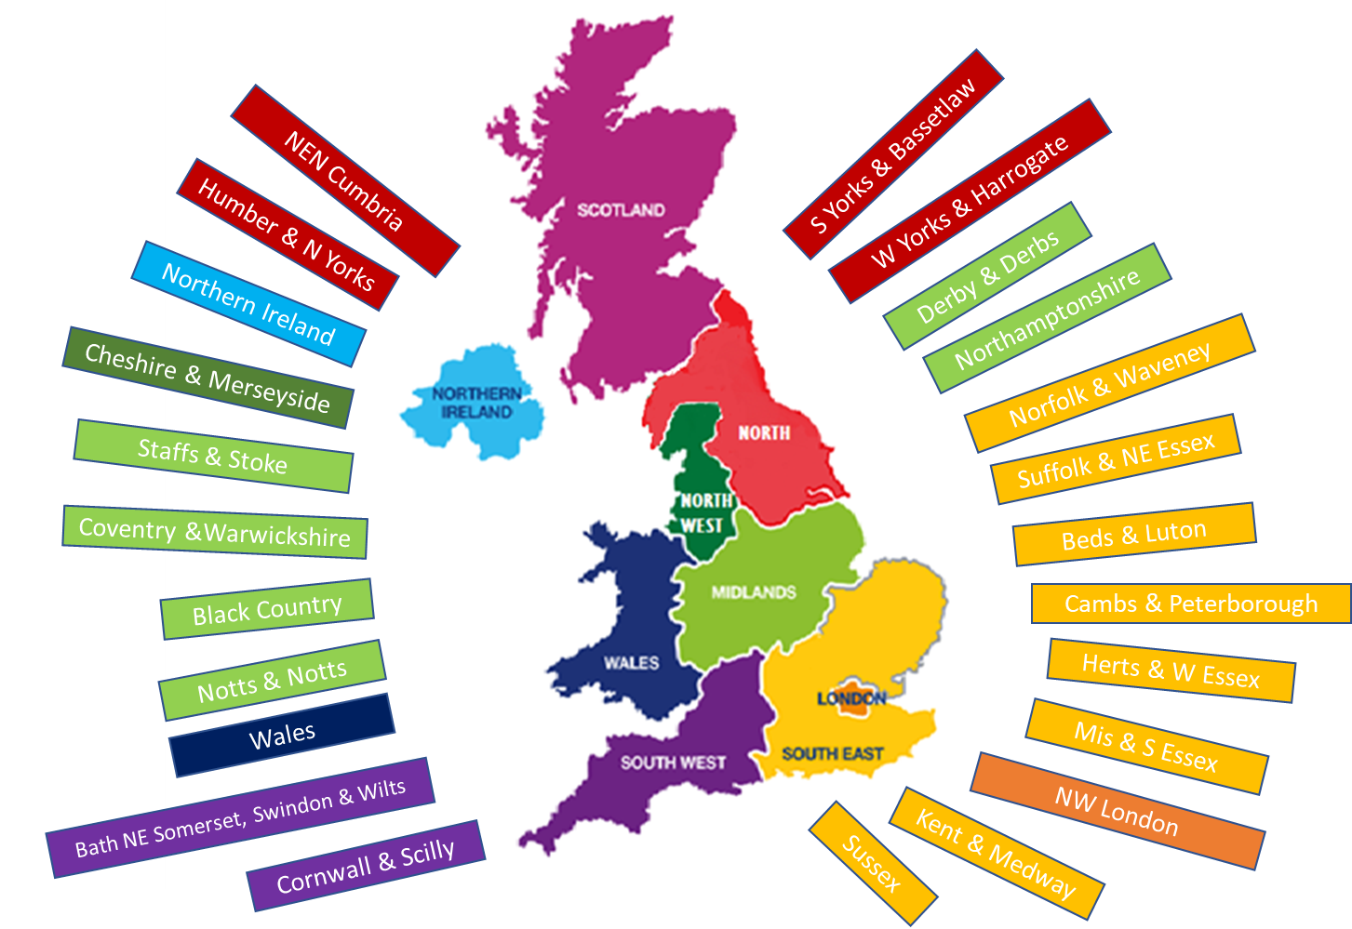
Macmillan Palliative and End of Life Care Transformational Leader
Macmillan palliative and end of life care transformational leader in post since June 2024
24 posts nationally
System wide all age approach
  Children and young people
  Care homes
  Community and acute providers
  Stakeholder engagement
  Public and user involvement
  Equality of access
24 Transformational Leaders
Macmillan Cancer Support, 2023

Slide 4
PEOLC
What have we achieved so far?
Sharing of patient experience / user involvement continues to influence practice and future service design. Links established with LGBTQ+ forums, religious and cultural groups, patient collaboratives, dementia workstreams and learning disability and autism.
NHSE has reduced programme reviews from quarterly level 3 (progress required) to level 2 monitoring.
As part of the Urgent and Emergency Care workstream, recruitment to specialist palliative care support over weekend hours a fixed term role to develop and evaluate the value of this provision within ICT (Intermediate Care Team)
Hospice charity funding provided for a phase 1 bereavement project, service to commence early 2025.
Digital ReSPECT is live on the Northamptonshire care Record (NCR). Active ReSPECT champions group attended by multiple stakeholders. ReSPECT delegated authority training completed by SPC CNS teams.

Slide 5
PEOLC
What have we achieved so far?
Countywide PEOLC information platform developed and hosted by hospice websites.
Work has commenced on the competitive procurement process for the new Countywide Community-based Specialist Level Palliative and End of Life Care Service for Adults Specification.
Macmillan Palliative and end of life care transformational leader in post since June 2024
Public awareness events planned– Dying Matters Week – May 2025. Multi-cultural Health and Wellbeing Mela, Wellingborough, June 2025
CYP transition event in development
Enhanced links with boarder areas

Slide 6













PEOLC Collaborative Programme
What challenges does our system face?
Workforce
and Training
Training is not
available to all, specifically
those outside of the NHS
and the public.
Non-malignant(non-cancerous) conditions
Reduced support is available for those with a non-malignant condition.
Children
and Young People
No children’s hospice
within county, no
established transitional care model (to support move
from child
to adult care).
Funding
Reduced availability of future service funding. Any grants are limited, less available and short term.
Bereavement
and wellbeing
Ensuring wellbeing needs
(including bereavement)
are recognised and met for patients/those important
to them.
Digital
Available data is
not well used.
No shared system wide
palliative care record available
(Electronic Palliative Care Coordination System
(EPaCCS).
User
Involvement
Limited user
involvement.
Challenging area to
establish user
groups.
Accessibility
24/7 community access is available only to PEOLC is available for those in last
weeks of life. No 24/7
hospice access.
Inequalities
A need to ensure equitable access to all services and the ability to communicate effectively and respectfully with people from different cultures.

Slide 7
The solution
What can we do?
Co-produce a collaborative programme structure ensuring all stakeholders are involved at an appropriate level, this will redefine the current commissioning oversight group and all age last years of life delivery group
Ensure a clearly defined governance structure
Seek feedback and assurance around key priorities going forward-focus future task and finish projects around these
Integrate senior strategic colleagues with the ability to make funding and commissioning decisions for the system
Ensure equity by design and user focus
Establish closer links with UEC workstreams
Utilise existing stakeholder engagement - operational/clinical support forums

Slide 8

Additional workstreams
Digital – Promotion of the Northamptonshire Care Record (NCR), the first shared digital platform available across the system
Verification of death in nursing homes
Development of a self / lay carer medication administration policy
Partnership working across systems to support patients living in border areas
Co-production of a collaborative programme structure ensuring all stakeholders are involved at an appropriate level, supported by a clearly defined governance structure

Slide 9
Special Patient Note
Look out for a future simplified
version of the SPN for
palliative care patients

Slide 10
Support available within the last weeks of life
Marie Curie (complete and email special patient note) 0330 123 1014
Hospice at Home - For all patients in last 4 weeks of life 03000 271 284
24/7 palliative care medical advice (via Berrywood switchboard out of hours) 03000 271 717
Community specialist palliative care team www.nhft.nhs.uk/spc-palliative-care-referral-form
Northamptonshire Carers Professional Referral Form (Carer)
MMG035 Symptom Management Guidelines for a Person thought to be in the Last Days and Hours of Life nhft-symptom-management-guidelines-for-a-person-thought-to-be-in-the-last-few-days-and-hours-of-life-v31-review-mar-25-mmg035.pdf

Slide 11


Slide 12
ReSPECT (Recommended Summary Plan for Emergency
Care and Treatment)
The ReSPECT process creates personalised recommendations for a person’s clinical care and treatment in a future emergency in which they are unable to make or express choices.
These recommendations are created through conversations between a person, their families, and their health and care professionals to understand what matters to them and what is realistic in terms of their care and treatment.
Patient preferences and clinical recommendations are discussed and recorded within a non-legally binding plan which can be reviewed and adapted if circumstances change.
The ReSPECT process can be for anyone but will have increasing relevance for people who have:
complex health needs
people who are likely to be nearing the end of their lives
people who are at risk of sudden deterioration or cardiac arrest
ReSPECT is available as a live document on the Northamptonshire Care Record (NCR).

Slide 13
Important Additional Information
The ReSPECT plan does replace DNACPR (Do Not Attempt Cardio-pulmonary Resuscitation) forms. However, there is no expectation that existing DNACPR forms are recompleted, and these existing forms will continue to be valid. The current system DNACPR policy is active until 31 October 2025.
Someone having a ReSPECT plan in place does not necessarily mean they have a DNACPR decision.
Plans will be completed and stored digitally via Northamptonshire Care Record (NCR).
A ReSPECT plan should be coded in the local system and the document completed in the NCR.

Slide 14
Accessing ReSPECT resources
The ReSPECT process is being increasingly adopted by systems across England and Scotland.
A range of resources are available to support the implementation of ReSPECT on the Resuscitation Council UK’s website.
The ReSPECT Resources page also contains the following:
• ReSPECT Guide for Clinicians Completing the Plan
• ReSPECT Ten Top Tips for GPs
• ReSPECT Information for Care Homes
• Patient leaflets – including translations and easy read versions
• Patient guides – including for Young People
ReSPECT resources | Resuscitation Council UK

Slide 15
Hints and Tips
Use the person’s own words where appropriate
Be aware the plan will be considered in both acute and community settings
The plan must be completed by an authorised clinician
Key points are helpful and clear to a reader in an urgent situation
What information would you like to know at 03:00?
The plan can be completed following one or more conversations

Slide 16
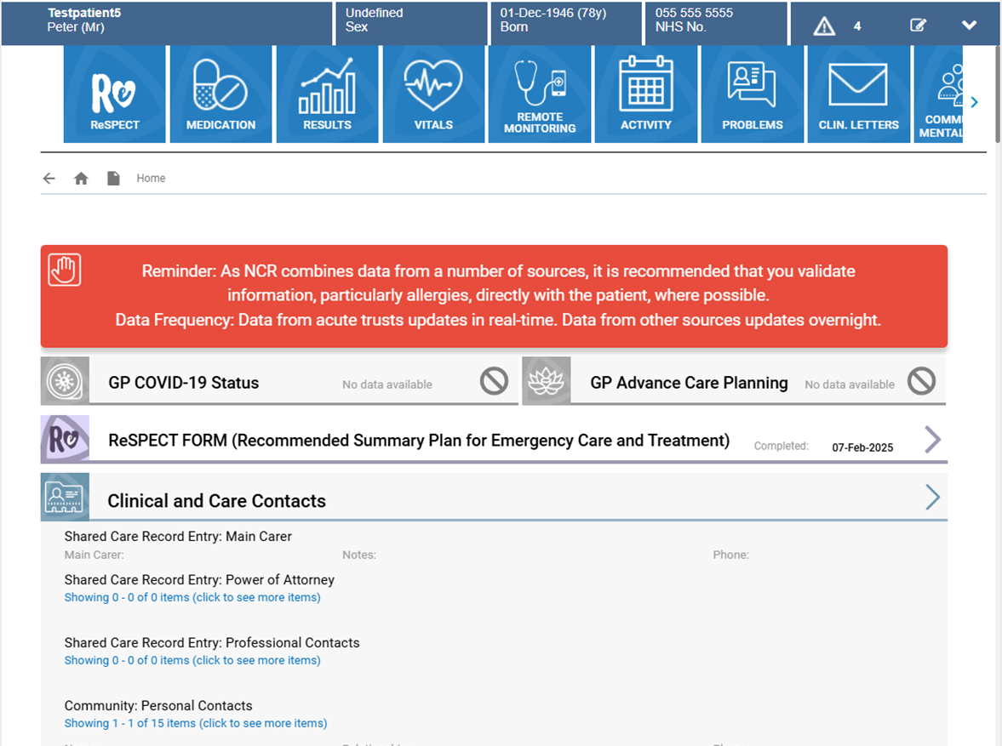
NCR Landing Page

Slide 17
Demonstration

Slide 18


Slide 19
Further Information
Care & Support - Cransley Hospice Trust
How we can help you - Cynthia Spencer Hospice | Northampton
NHS England » Ambitions for palliative and end of life care
ICN All-Age Palliative and End of Life Care Strategy 2023-2026 (icnorthamptonshire.org.uk)

Slide 20
Useful ReSPECT resources
Joe’s ReSPECT journey – a ReSPECT explainer for people and their families – YouTube
ReSPECT | Resuscitation Council UK
National FAQs: ReSPECT: Frequently asked questions for adopters | Resuscitation Council UK

Slide 21
Contact details
Palliative and end of life care / ReSPECT :
Claire Mansfield claire.mansfield8@nhs.net
Technical :
Katie Di Stefano katie.distefano@nhs.net

