Slide 1
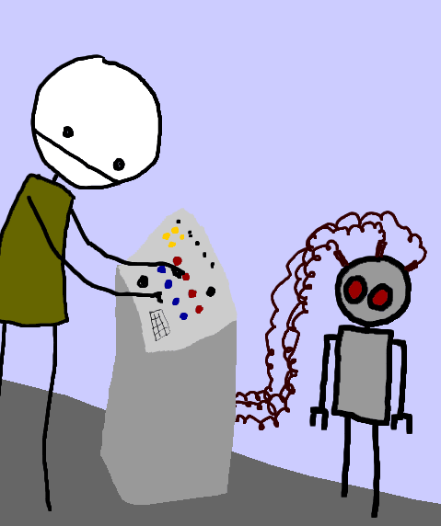
How humans make decisions (and what this means for clinical practice)
Jonathan Underhill FRPharmS
Medicines Consultant Clinical Adviser, Medicines Optimisation Team, NICE.
Honourary Lecturer
Keele University School of Pharmacy

Slide 2
What I want to talk about
Understanding how humans make decisions
What this means for:
  Staying up to date in an efficient way
  Having meaningful conversations with people about their medicines choices
  Decision hygiene and safer prescribing
Breakout session!

Slide 3
What I want to talk about
Understanding how humans make decisions
What this means for:
  Staying up to date in an efficient way
  Having meaningful conversations with people about their medicines choices
  Decision hygiene and safer prescribing

Slide 4
Uncertainty and probability

Slide 5
Daniel Bernoulli (1730)
Situation 1
You have no savings but if you are careful you can live week to week, month to month, within your means.
You acquire a lottery ticket which gives you a 50% chance of winning £200,000.
Would you prefer to:
A: take the chance with the lottery (you either win £200k or nothing)
B: accept a certain £90,000.

Slide 6
Situation 2
You must choose between having
£5million for sure
or this gamble
2. An 89% chance of winning £5million
A 10% chance of winning £25million
A 1 per cent chance to win zero.

Slide 7
Situation 3
You must choose between having
1. An 11% chance of winning £5million, with an 89% chance of winning zero
or
2. A 10% chance of winning £25million, with a 90% chance of winning zero.
Maurice Allais (1953)

Slide 8
Probability……. and yet still Uncertainty
A 90 year old relative offers to leave you her beautiful house on the seafront in Cannes worth £900,000 – but only if you provide her with £2,500 a month (£30,000 a year) to live on.
She will bear the cost of drawing up watertight legal documents.
Average female life expectancy is 82 years, and as it happens you are currently able to save regularly £2,500 a month (which earns only a very small amount of interest).
Would you……
A: accept the offer
B: not accept the offer.

Slide 9
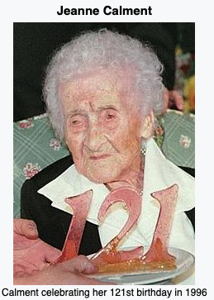
Jeanne Calment made such an agreement with her lawyer Andre-Francois Raffray in 1965 when she was
90 and he was 47 years old.
She survived for 32 years after the deal was signed, dying aged 123 years and 164 days.
She outlived Raffray who died aged 77. By then he had paid twice the market value for her house which he never lived in.

Slide 10
Principles of human decision making

Slide 11
- please find a piece of paper and a pen (or open up a electronic note pad!)

Slide 12
- a list of words follows look at them once, do not re-read them
- when you have read the list close your eyes

Slide 13
Flange
Routemaster
Laggard
Sausages
Automaton
Approach
Antichrist
Research
Slipper
Haggle
Fridge
Locomotive
Bracket
Confused
Telesales
Professor
Stool pigeon
Hale
Banquet
Irrelevance

Slide 14
Write down as many words from that list as you can remember

Slide 15
Flange
Routemaster
Laggard
Sausages
Automaton
Approach
Antichrist
Research
Slipper
Haggle
Fridge
Locomotive
Bracket
Confused
Telesales
Professor
Stool pigeon
Hale
Banquet
Irrelevance

Slide 16
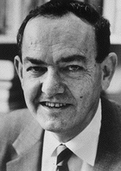
Herbert Simon
1978
Economics
Bounded rationality
Satisfycing

Slide 17
Please list all the medicines which have a potential interaction with warfarin – both increasing and decreasing its effect

Slide 18
Drug interactions with warfarin – decreased effect
Amobarbital
Butabarbital
Carbamazepine
Cholestyramine
Dicloxacillin
Griseofulvin
Mercaptopurine
Mesalamine
Nafcillin
Phenobarbital
Phenytoin
Primidone
Ribavirin
Rifabutin
Rifampin
Secobarbital
Sucralfate
Vitamin K
Coenzyme Q10
Ginseng
St. John’s wort
Green tea

Slide 19
Drug interactions with warfarin – increased effect
Acetaminophen
Alcohol (binge)
Allopurinol
Amiodarone
Argatroban
Aspirin
Azithromycin
Bactrim
Chloral hydrate
Chloramphenicol
Cimetidine
Ciprofloxacin
Citalopram
Clarithromycin
Clofibrate
Danazol
Diltiazem
Disopyramide
Disulfiram
Doxycycline
Entacapone
Erythromycin
Felbamate
Fenofibrate
Fluconazole
Fluorouracil

Slide 20
Drug interactions with warfarin – increased effect
Gemfibrozil
Influenza vaccine
Isoniazid
Itraconazole
Levofloxacin
Metronidazole
Miconazole
Moxalactam
Neomycin
Norfloxacin
Ofloxacin
Omeprazole
Phenylbutazone
Piroxicam
Propafenone
Propranolol
Quinidine
Ritonavir
Sertraline
Simvastatin
Sulfamethoxazole
Sulfinpyrazone
Tamoxifen
Testosterone
Tetracycline
Vitamin E

Slide 21
Drug interactions with warfarin – increased effect
Voriconazole
Zafirlukast
Anise
Asafoetida
Chamomile
Clove
Danshen
Devil’s claw
Dong quai
Fenugreek
Feverfew
Fish oil
Garlic
Ginger
Ginkgo
Grapefruit
Horse chestnut
Licorice root
Mango
Meadowsweet
Onion
Papain
Quassia
Red clover
Rue
Sweet clover
Tumeric
Willow bark

Slide 22
Definition of expertise - expert skill or knowledge in a particular field.
Technical aspects dominate curricula
“If I know more stuff I’ll be better”

Slide 23

Making an important life decision

Slide 24

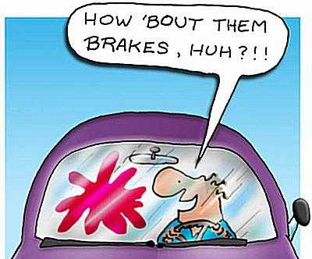
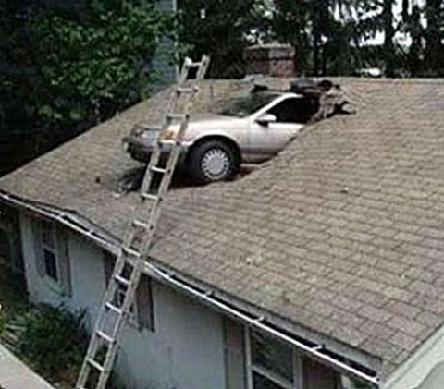
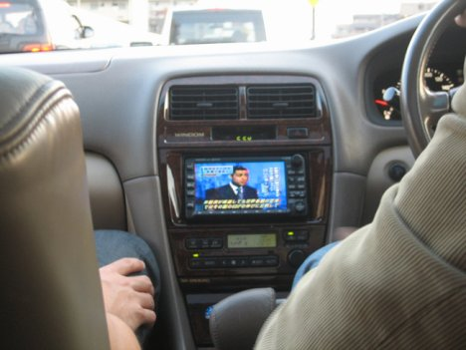
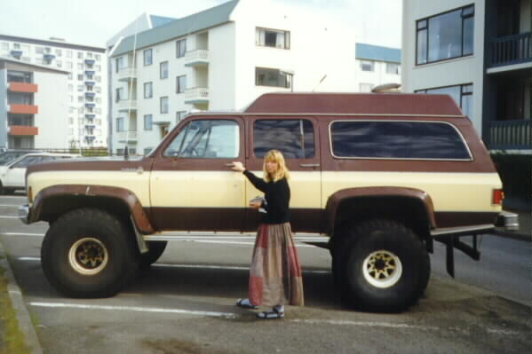
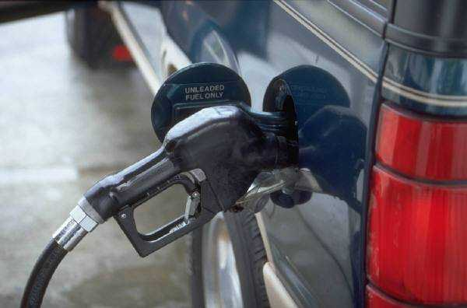

Slide 25
Humans make decisions by……
HOW?
Small number of variables
+
Allocate value to those variables
+
Time frame
=
DECISION

Slide 26

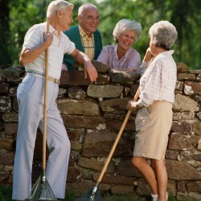

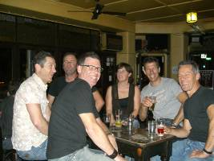
Allocating value to those variables
Brief reading
Talking to other people

Slide 27


Slide 28
How is knowledge managed in primary care?
Gabbay and le May BMJ 2004; 329: 1013 – 6.
Not once was a guideline read
Expert computer systems rarely used (never in real time)
Shortcuts to evidence
  free magazines
  network of trusted colleagues (rarely if ever questioned)
  Pharma reps – considerable scepticism (but not without influence)
  Pharmaceutical adviser – highly trusted source.
“Clinicians rarely accessed, appraised, and used explicit evidence directly from research or other formal sources; rare exceptions were where they might consult such sources after dealing with a case that had particularly challenged them.”

Slide 29
“Instead, they relied on what we have called "mindlines," collectively reinforced, internalised tacit guidelines, which were informed by brief reading, but mainly by their interactions with each other and with opinion leaders, patients, and pharmaceutical representatives and by other sources of largely tacit knowledge that built on their early training and their own and their colleagues' experience.”

Slide 30
Summary
Yes, we need to know lots of important technical stuff if we are to function adequately as a health professional.
But in the end, human cognitive capacity is bounded.
And even if it wasn’t, knowing all the facts wouldn’t always improve decision making – not least because decision making involves feelings.
Satisficing – reducing our uncertainty to the point at which we can make a decision – is our normal mode.
Occasionally we need to maximise.

Slide 31
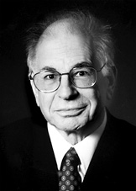
Dual Process theory
Daniel Kahneman
Economics
2002

Slide 32
Shout out the answer to these questions quickly

Slide 33
Who is this?

Slide 34
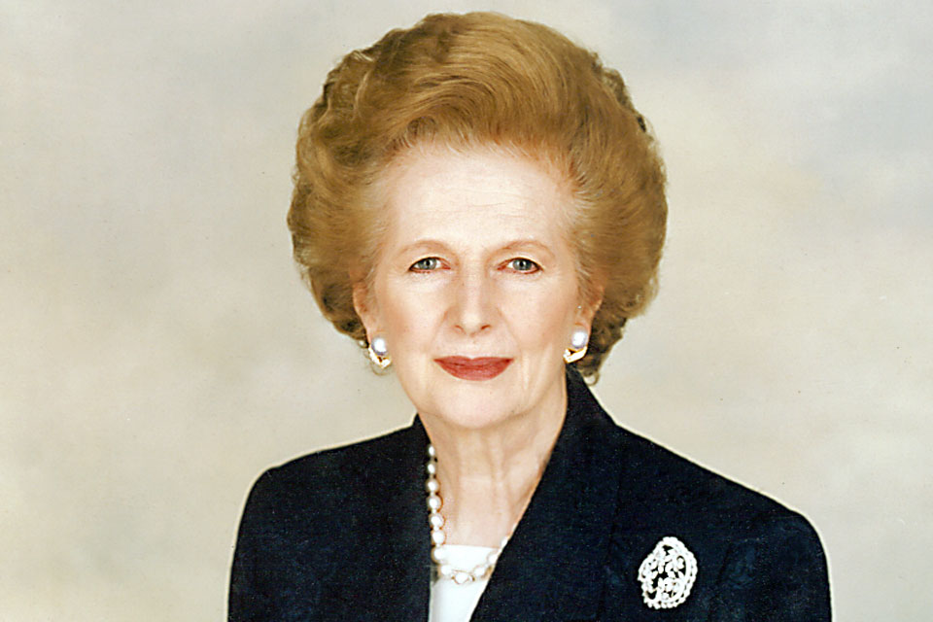
Notes:
Permission for picture as “This image is a work of an employee of the Executive Office of the President of the United States, taken or made during the course of the person's official duties. As a work of the U.S. federal government, the image is in the public domain. “
http://en.wikipedia.org/wiki/File:Official_Portrait_of_President_Reagan_1981.jpg

Slide 35
What is the diagnosis?

Slide 36
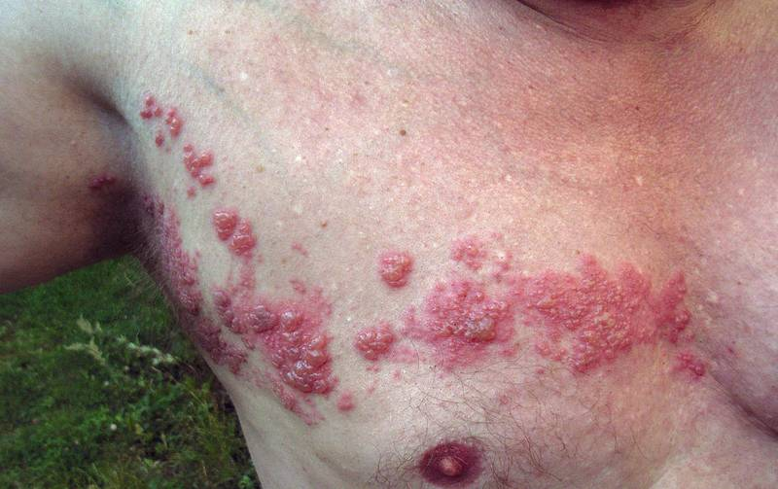
Notes:
From wikipedia commons

Slide 37
What treatment would you use here?

Slide 38
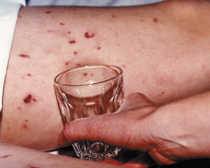
Notes:
Image from http://www.meningitis-trust.org/Signs-Symptoms.html

Slide 39
Context
Ambient conditions
Task difficulty
Task ambiguity
Affective state
Modular responsivity
TYPE
1
processes
RECOGNIZED
Pattern Recognition
Patient
Presentation
Pattern
Processor
Rational
override
Dysrationalia
override
Calibration
Diagnosis
Repetition
NOT
RECOGNIZED
TYPE
2
processes
Intellectual Ability
Education
Training
Critical thinking
Logical competence
Rationality
Feedback
Notes:
Neal
How can dual process models mitigate diagnostic error?
A single model that explains the wide variety of decisions that are made is a major simplification
The specific operating characteristics of the model can be tested in particular clinical situations
The model can be readily taught to learners across a wide range of disciplines
Understanding the model allows more focused metacognition
The described features of the model can generate specific research questions about decision making processes in particular situations
Croskerry 2009

Slide 40
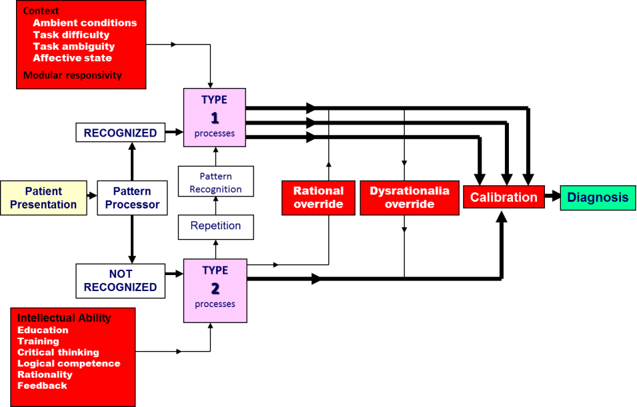

Treatment
Diagnosis

Slide 41
Who knows the story of Noah in the Bible?

Slide 42
Imagine you are working as a doctor in a remote village. It’s the weekend. There are no other health care professionals around. But you do have a new piece of technology called THE MARVELTRON.

Slide 43
The MARVELTRON will save the life of any patient you are treating
But you have to answer correctly the question the MARVELTRON asks of the attending doctor before it works its magic.

Slide 44
A young child is brought to you. She is seriously ill and will die imminently
You switch on the MARVELTRON and await the question
You must write down your answer immediately the question is asked, or the child will die
You will be blamed for the patient’s death only if you do not write down an answer. No blame will be attached to you if you get the answer wrong
ARE YOU READY?
Have you got paper and something to write with?

Slide 45
According to the Bible, how many sheep did Noah take into the Ark?

Slide 46
Answer quickly
Write it down
The child is dying.

Slide 47
End of answer period

Slide 48
How many sheep?
0
1
2
3
4
5
6
7
More than 7

Slide 49
The correct answer
Genesis ch 7
v1 And the LORD said unto Noah, Come thou and all thy house into the ark; for thee have I seen righteous before me in this generation.
v2 Of every clean beast thou shalt take to thee by sevens, the male and his female: and of beasts that are not clean by two, the male and his female.
v3 Of fowls also of the air by sevens, the male and the female; to keep seed alive upon the face of all the earth.
Notes:
If there is an argument about unclean animals:
http://en.wikipedia.org/wiki/Unclean_animals

Slide 50
Why this MARVELTRON story?

Slide 51
Context
Ambient conditions
Task difficulty
Task ambiguity
Affective state
Modular responsivity
TYPE
1
processes
RECOGNIZED
Pattern Recognition
Patient
Presentation
Pattern
Processor
Rational
override
Dysrationalia
override
Calibration
Diagnosis
Repetition
NOT
RECOGNIZED
TYPE
2
processes
Intellectual Ability
Education
Training
Critical thinking
Logical competence
Rationality
Feedback
Notes:
Neal
How can dual process models mitigate diagnostic error?
A single model that explains the wide variety of decisions that are made is a major simplification
The specific operating characteristics of the model can be tested in particular clinical situations
The model can be readily taught to learners across a wide range of disciplines
Understanding the model allows more focused metacognition
The described features of the model can generate specific research questions about decision making processes in particular situations
Croskerry 2009

Slide 52

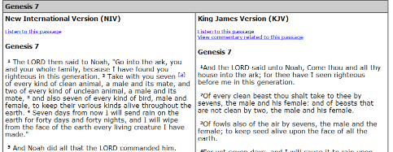
How we acquire and use information
Where did you get the information from to make that decision about Noah and the sheep?
If you had had time, what would you have done to make sure you had the right answer?

Slide 53
Out of every £100 of benefit claims, how much is fraudulently claimed?
The public think that £24 of every £100 of benefits is fraudulently claimed.
The reality: 70p in every £100 is fraudulently claimed
Perception is 34 x greater than the reality.
Ipsos Mori Survey 2013

Slide 54
What per cent of girls under 16 become pregnant?
The average public estimate is 15%
The reality = 0.6%
Perception is 25 x times higher than the official estimates
Ipsos Mori Survey 2013

Slide 55
Summary
Dual process theory and the importance of pattern recognition is central to understanding and improving decision making.
Pattern recognition leads to efficient and technically correct decision making most of the time.
But it can also lead us astray if we allow it to guide our decision making without checks and balances.

Slide 56
What I want to talk about
Understanding how humans make decisions
What this means for:
  Staying up to date in an efficient way
  Having meaningful conversations with people about their medicines choices
  Decision hygiene and safer prescribing

Slide 57
"We surveyed one acute medical take in our hospital. In a relatively quiet take, we saw 18 patients with a total of 44 diagnoses. The guidelines that the on-call physician should have read remembered and applied correctly for those conditions came to 3,679 pages. This number included only NICE, the Royal Colleges and major societies from the last 3 years. If it takes 2 minutes to read each page, the physician on call will have to spend 122 hours reading to keep abreast of the guidelines" (for one 24h on-call period).
Allen D, Harkins KJ. Lancet 2005; 365: 1768
Notes:
57

Slide 58
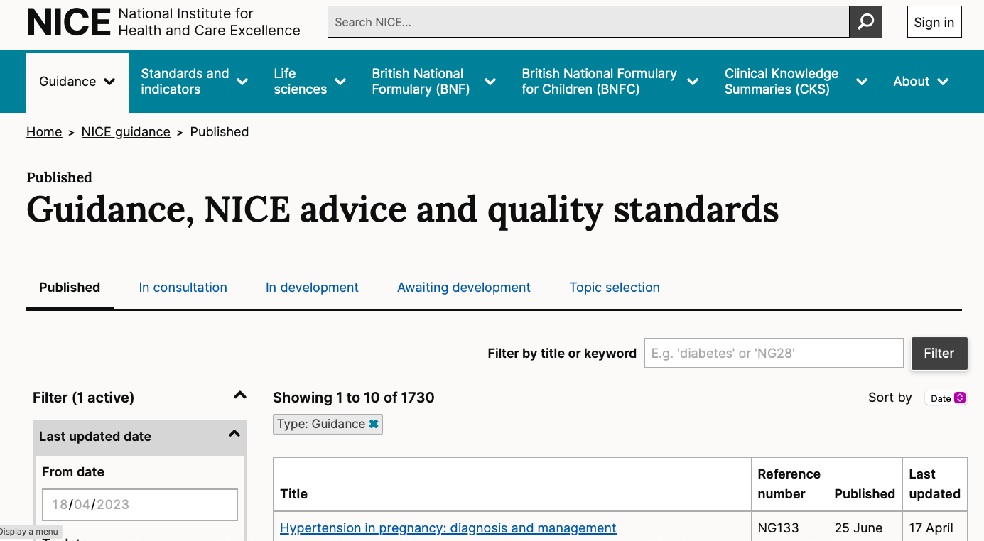


Slide 59
Information
"Thinking about the fact that we don't have a lot of time, and this is the thing I feel really ashamed about, I'm in a job where people's lives depend on the fact that I make the right decision, and sometimes I feel completely overwhelmed with the fact that I don't know enough information about some critical decisions that I make every day"
GPST West Yorkshire 2010

Slide 60
How can we keep up?
Sackett D et al BMJ 1996;312:71-72
“The difficulties that clinicians face in keeping abreast of all the medical advances reported in primary journals are obvious from a comparison of the time required for reading
  for general medicine, enough to examine 19 articles per day, 365 days per year
with the time available
  well under an hour a week by British medical consultants, even on self reports.”
How to best use use your Golden Hour?
Notes:
The sheer volume of published research has for a long time out paced the ability of the intended recipients to read the research. Nobody is going to find the time to read 19 articles a day, every day. Reports indicate that British doctors can spend an hour a week trying to keep up to date.
And of course the reader has then to critically appraise the new research, incorporate it (if appropriate) into the context of the rest of the evidence on that topic, correctly remember it and apply it when in the clinical situation when that new data is required.

Slide 61
Keeping up to date: what do we need?
A way of ‘just knowing’ what to do most of the time
  Because we haven’t got time to keep looking things up
A way of finding out if something new and important has come along
  Because we need to be up to date, but we don’t want to be swamped with irrelevant information
A way of finding what we need when we’re stuck
  Finding the best answer quickly

Slide 62

Be like Baldrick and get yourself a cunning plan…….
  Hunting: find the best possible answer to a specific question and recognise it as such, quickly and efficiently.
  Foraging: be alerted to new, important, relevant, valid information that requires a change in practice
  Hot synching: update your brain once or twice a year on the 30-40 conditions you see most frequently

Slide 63
Can you assess validity?
“I remember doing it as one of the things…[at medical school] it’s a distant memory, and to do it again at that level would be just… [sigh]”
GPST West Yorkshire 2010
“I certainly don’t do any of it, you know – don’t remember the last time I really looked at a paper. I have a pile of BMJs at home this high [gesture] but I don’t ever read them. I sometimes carry them around in my bag in case I kind of osmotically get the information [ironic expression] but you know, time-wise it’s easier to look on GP Notebook.”
GPST West Yorkshire 2010

Slide 64
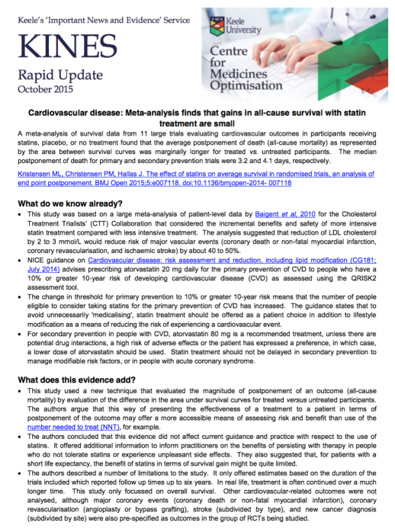
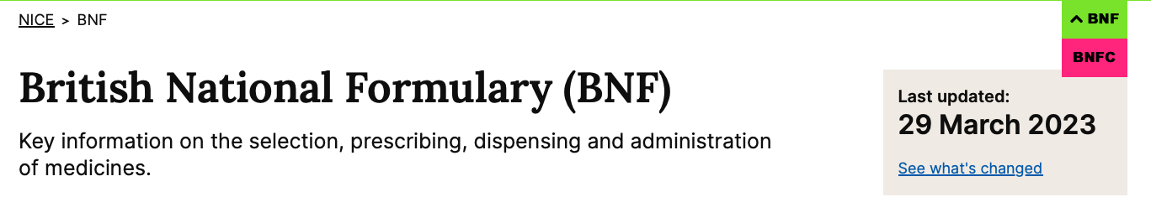






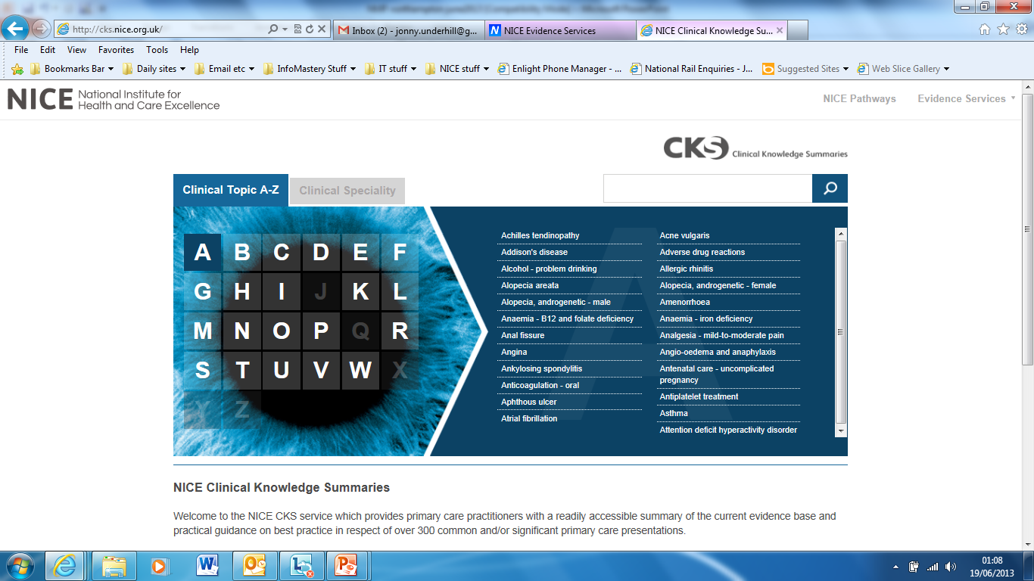
Critical appraisal????? - get someone you trust to do it for you…….
Pre-digested sources of evidence from trusted sources:
  Public-sector ethos
  Published methodology of how produced
  Translation of evidence into practice
  Context of the rest of the evidence

Slide 65


Slawson and Shaughnessy’s Information Pyramid
Cochrane Library, NICE, SIGN etc
Evidence summaries, Clinical Evidence
CKS
EBM, DTB, MECs, EoE
KINES, etc
“Ivy League” journals
Usefulness
Textbooks
Medline/Google scholar
Notes:
A recap

Slide 66
Words of wisdom
Muir Gray JA: Evidence-based medicine for professionals in Edwards A & Elwyn G (eds) Evidence-based patient choice Oxford: OUP 2001
‘What is clear is that individuals cannot keep up to date except in the most highly restricted and specialized areas of knowledge. The job of the human being is to become skilled at locating relevant, valid data for their needs.
‘In the sphere of medicine, the required skill is to be able to relate the knowledge generated by the study of groups of patients or populations to that lonely and anxious individual who has come to seek help.’

Slide 67
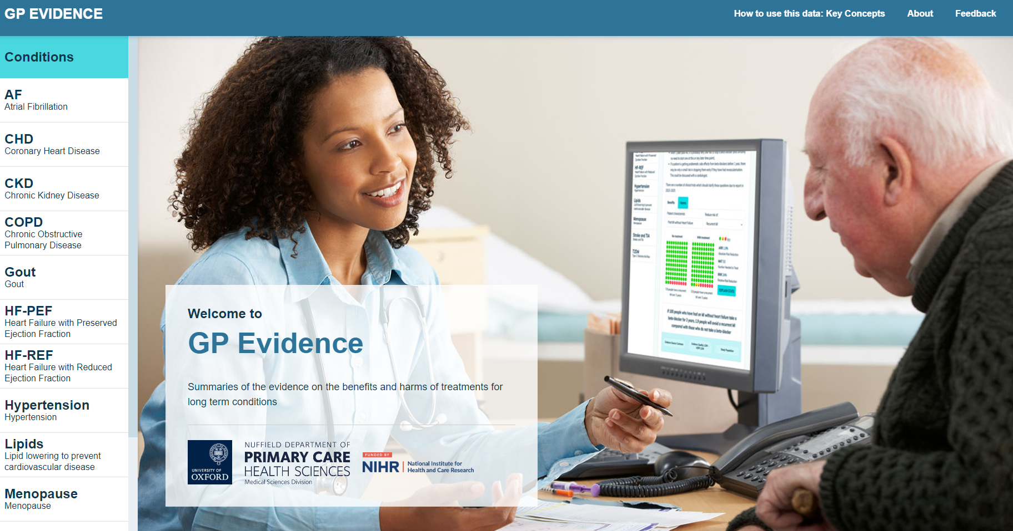
Best use of a clinician’s ‘Golden Hour’?
Give up on reading primary research:
  You don’t have time and you wont be able to do it
Design your CPD based on these principles:
  Foraging:
    Evidence awareness service
    2-3 bits of key new research, summarised for you and set in the context of the rest of the evidence
  Hot synching:
    Be alerted to when new NICE/SIGN guidance comes out
    Take time to digest it, talk to others about it
    Ask yourself, “what are the important changes since I last updated my brain?”
    ONLY about conditions YOU see commonly
    See https://gpevidence.org
  Hunting:
    Much more difficult
    Use the information pyramid ( eg TRIP)

Slide 68
What I want to talk about
Understanding how humans make decisions
What this means for:
  Staying up to date in an efficient way
  Having meaningful conversations with people about their medicines choices
  Decision hygiene and safer prescribing

Slide 69
Last Six Quick Questions
Please find a piece of paper and write down your answers to each of these six questions
You have 10 seconds for each response

Slide 70
On a fire engine, there are 2 drivers up front, one at the rear and four additional fire-fighters. What is the total personnel required for 5 standard trucks?
10
9
8
7
6
5
4
3
2
1
End

Slide 71
How many turtle doves did my true love send me on the 2nd day of Christmas?
10
9
8
7
6
5
4
3
2
1
End

Slide 72
In 2008, the average time required to complete a root cause analysis was 15½ hours, how much time should be allowed for the three that are expected next month?
10
9
8
7
6
5
4
3
2
1
End

Slide 73
A bat and a ball cost £1.10 in total. The bat costs £1.00 more than the ball.
How much does the ball cost?
10
9
8
7
6
5
4
3
2
1
End

Slide 74
If it takes 5 machines 5 minutes to make 5 widgets, how long would it take 100 machines to make 100 widgets?
10
9
8
7
6
5
4
3
2
1
End

Slide 75
In a lake, there is a patch of lily pads. Every day, the patch doubles in size. If it takes 48 days for the patch to cover the entire lake, how long would it take for the patch to cover half the lake?
10
9
8
7
6
5
4
3
2
1
End

Slide 76
Answers
35 personnel on the fire engine
2 turtle doves
46½ hours (15.5 x 3)
A bat and a ball cost £1.10 in total. The bat costs £1.00 more than the ball.
How much does the ball cost?
The ball costs 5p (and the bat £1.05)
If it takes 5 machines 5 minutes to make 5 widgets, how long would it take 100 machines to make 100 widgets?
5 minutes
In a lake, there is a patch of lily pads. Every day, the patch doubles in size. If it takes 48 days for the patch to cover the entire lake, how long would it take for the patch to cover half the lake?
47 days

Slide 77
Cognitive Reflective Test
The test distinguishes intuitive (system 1) from analytical (system 2) processing….
…….the ability to resist first response that comes to mind
Of 3,428 people tested only 17% got all 3 correct
33% answered all three incorrectly
Frederick 2002 (MIT)
Journal of Economic Perspectives
Volume 19, No.4 2005;25–42

Slide 78
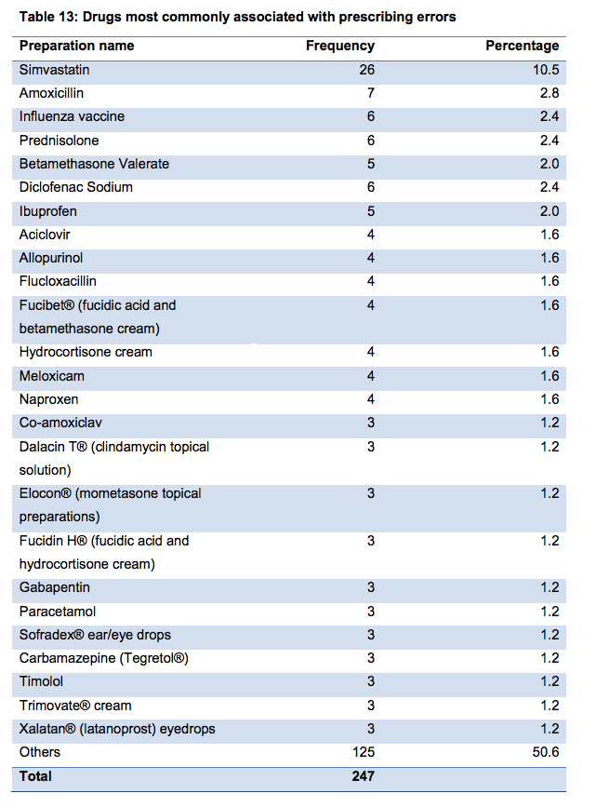
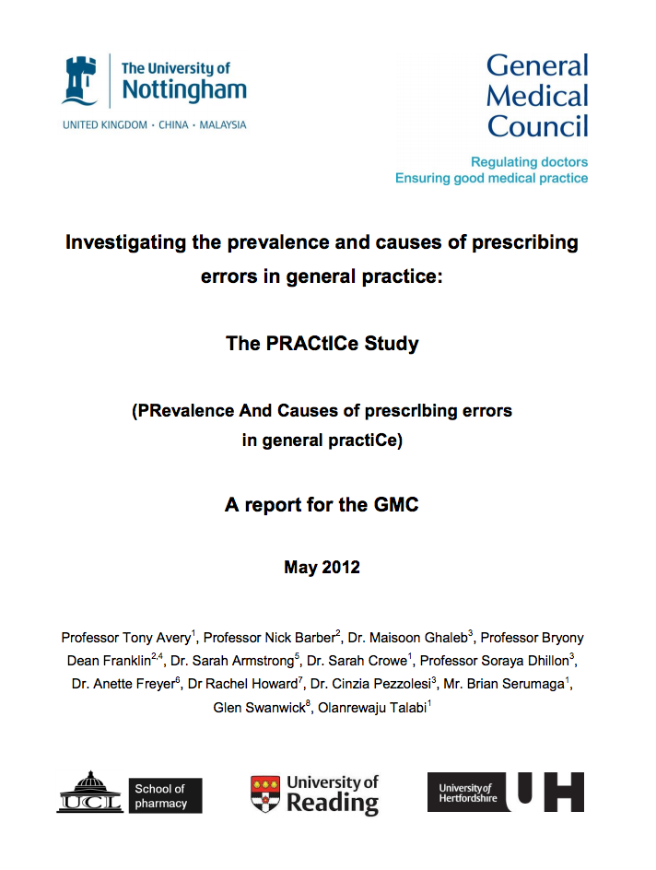

Slide 79
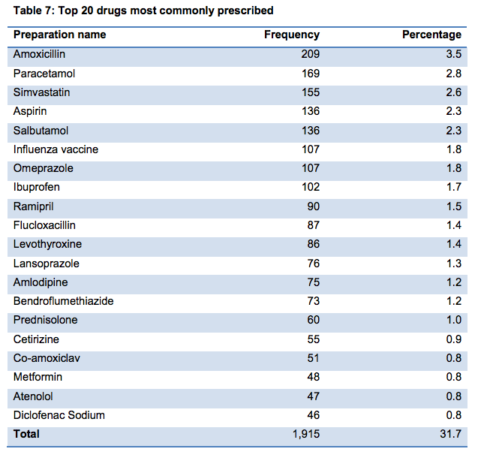
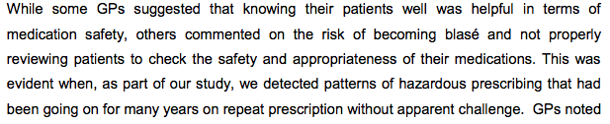

Slide 80
What’s our single best hope for reducing errors?

Slide 81
“Think as well as blink”?
T

Slide 82
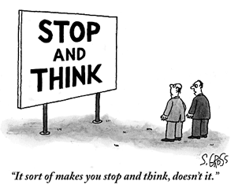

Slide 83
Calibration……
………….also now called “Decision Hygiene”.

Slide 84
Decision Hygiene 1
Reconsider dissonant facts - calibration
Take a step back from the problem
Risk of a cognitive bias?
Take the time to think aloud
Use time as a diagnostic / management tool
Careful, watchful, wait and see is NOT the same as inactivity
Notes:
Kurt/Simon
Clinical examples

Slide 85
Decision hygiene 2
Decrease reliance on memory
Use cognitive aids (but use them wisely):
Decision support, mnemonics, guidelines, algorithms etc.
Try to make tasks easier
e.g. Calculate drug doses on paper (not in your head)
Notes:
Kurt/Simon
Clinical examples

Slide 86
Decision hygiene 3
Be aware of own affective state
  Especially time pressures
Be aware of our decision mode
Know and understand diagnostic test accuracy
Improve risk : benefit communication skills

Slide 87
Be careful not to do something that could have been done differently, better, or not at all, because you were temporarily angry, stressed, scared, lonely, tired or hungry.

Slide 88
Better is possible
Knowing about decision making means improved decision making
Staying up to date
  Hunting, foraging and hot-synching
Decision hygiene
Self-awareness (meta-cognition)
  “the right system at the right time”
Using these principles in conversations with others about their medicines choices
Get a feedback system and be open to feedback

Slide 89
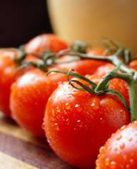
“Knowledge is knowing a tomato is a fruit;
“Wisdom is not putting tomatoes in a fruit salad”
J.L.Underhill@keele.ac.uk
Jonathan.Underhill@nice.nhs.uk

