Slide 1
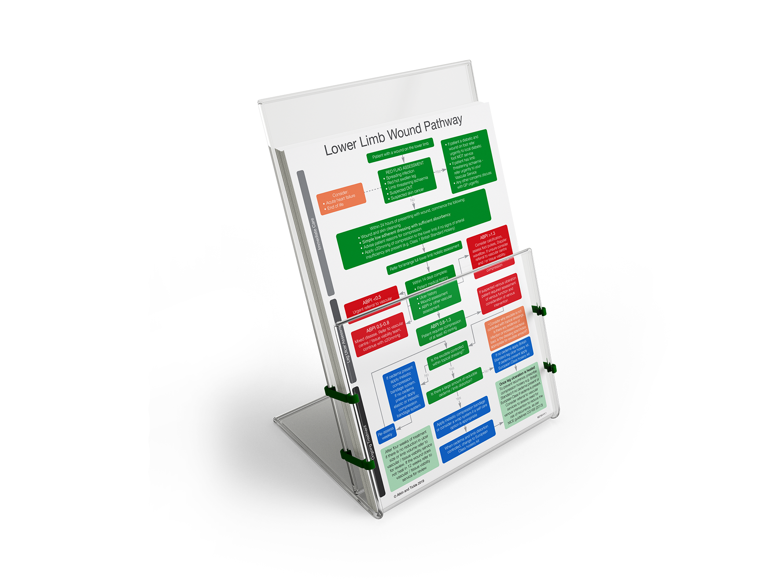
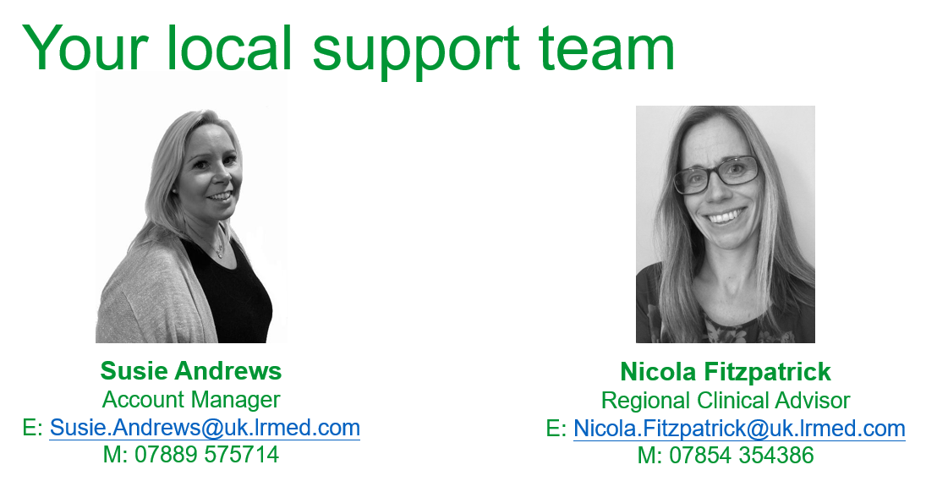
A pathway based approach to
venous leg ulcer management

Slide 2
Compression for VLU
Following assessment to determine suitability and wound management, compression therapy is the cornerstone of treatment for both venous and lymphatic disease. It helps to improve venous and lymphatic return, reduce oedema and advance wound healing.
  The term compression describes the external application of continuous graduated pressure to
  a limb so that the fluids within (blood and/or lymph) are moved upwards towards the heart.
  Compression therapy has been used for many years in the treatment of venous leg ulcers,
  chronic oedema and other conditions of the lower limb
  A full holistic assessment by a suitably trained and competent healthcare professional is required before applying any compression systems to manage VLU.

Slide 3

Compression Selection
Appropriate compression options depending on the clinical scenario
Scenario | Hosiery Kits | Adjustable Wraps | Bandages
Normal leg shape
Low to moderate exudate
Self caring |  |  | x
Carer involvement |  |  | x
Oedematous | x
High Exudate | x | x
Deep skin folds/distortion | x | x

Slide 4
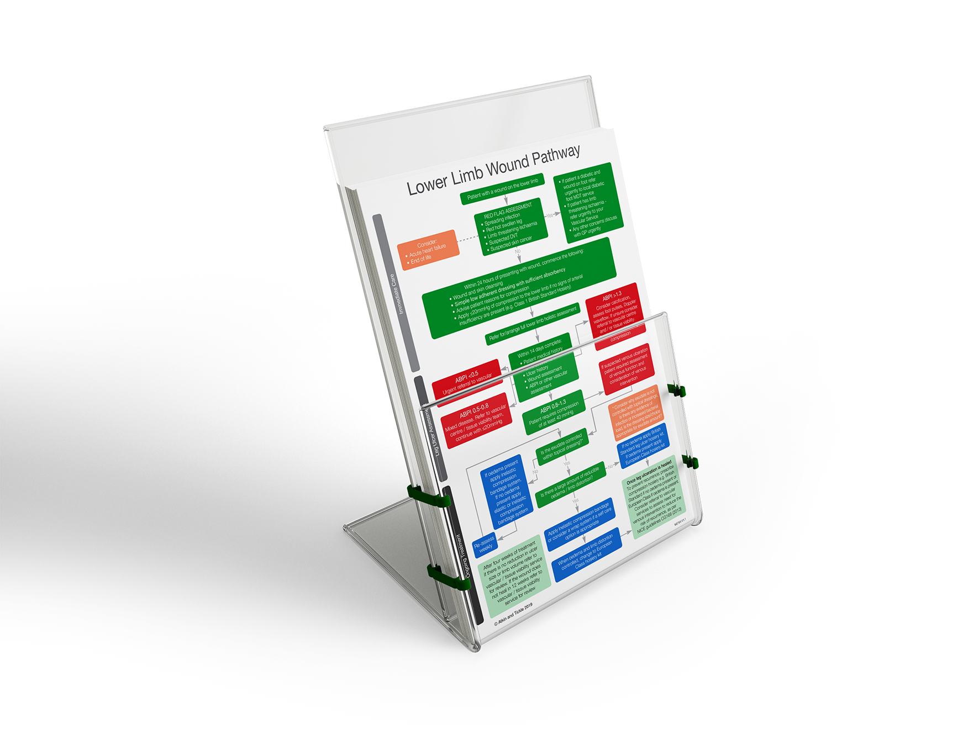
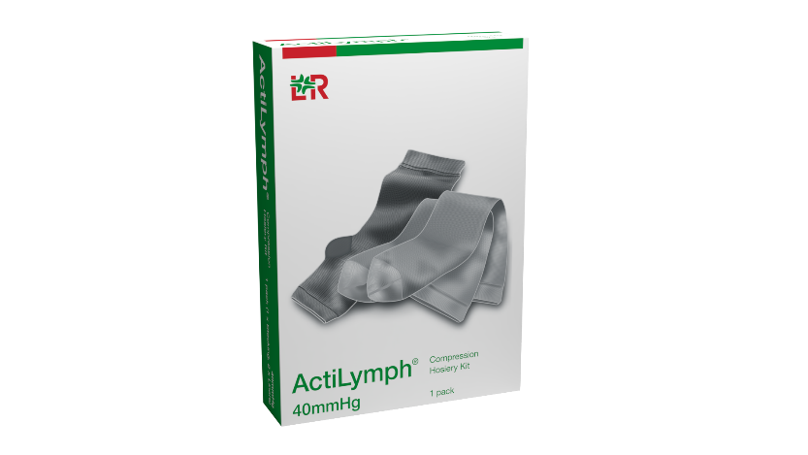
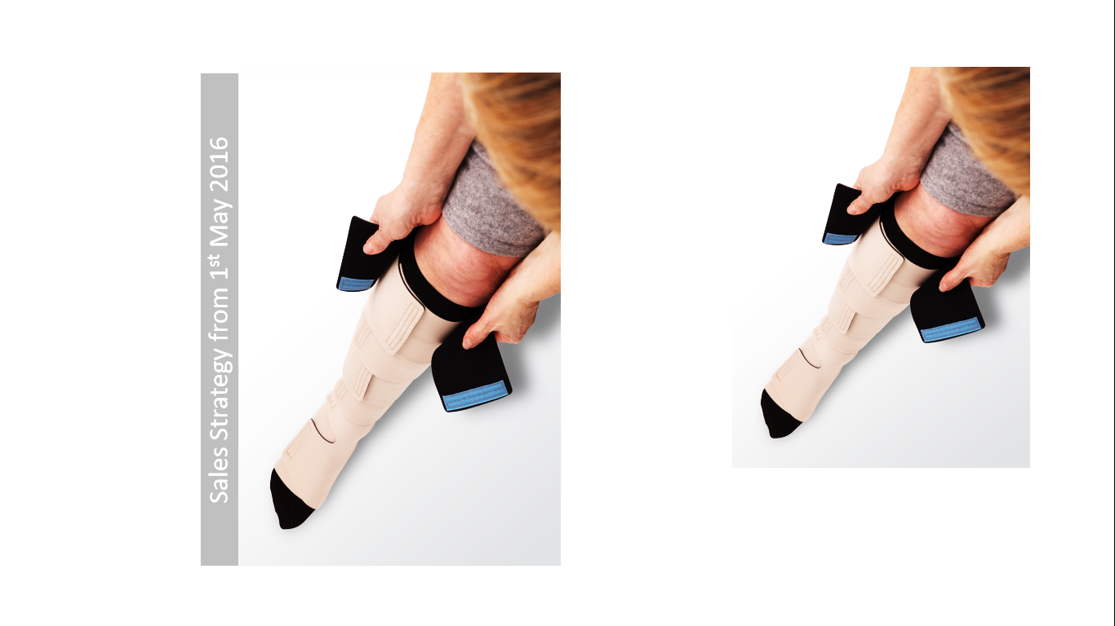
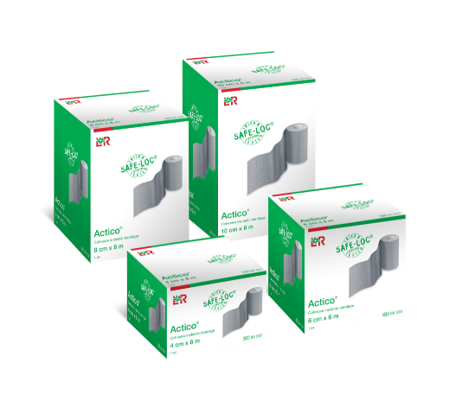
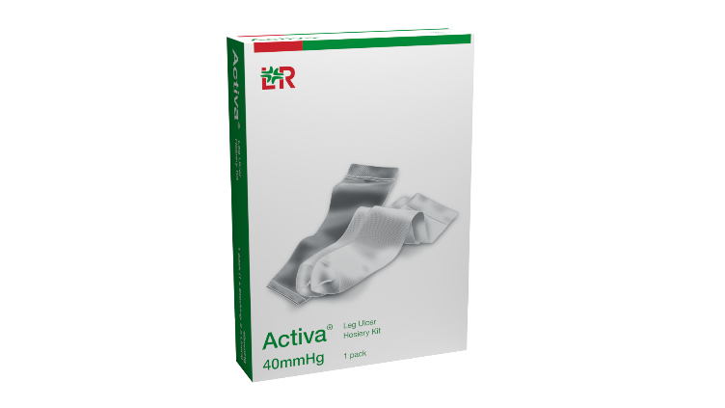
An evidenced based approach
The leg ulcer treatment pathway is an evidenced based pathway to support best practice for immediate care,
VLU management and prevention of recurrence.
Based upon the strength of evidence, the pathway recommends self care solutions as a first line approach

Slide 5
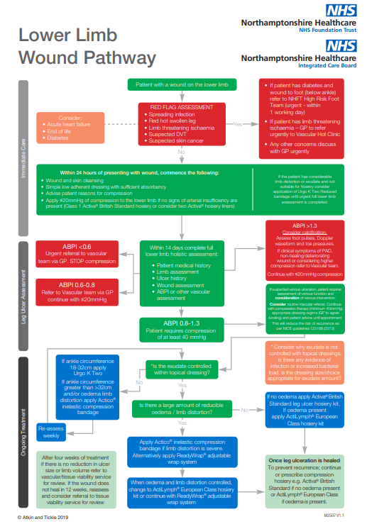

Slide 6
Immediate care

Slide 7
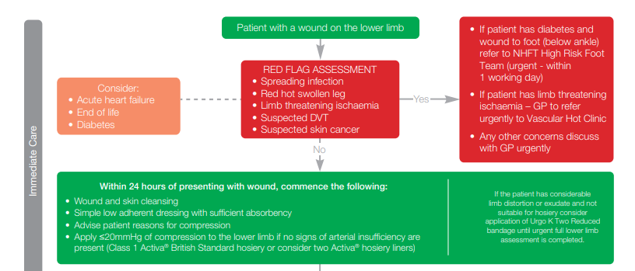
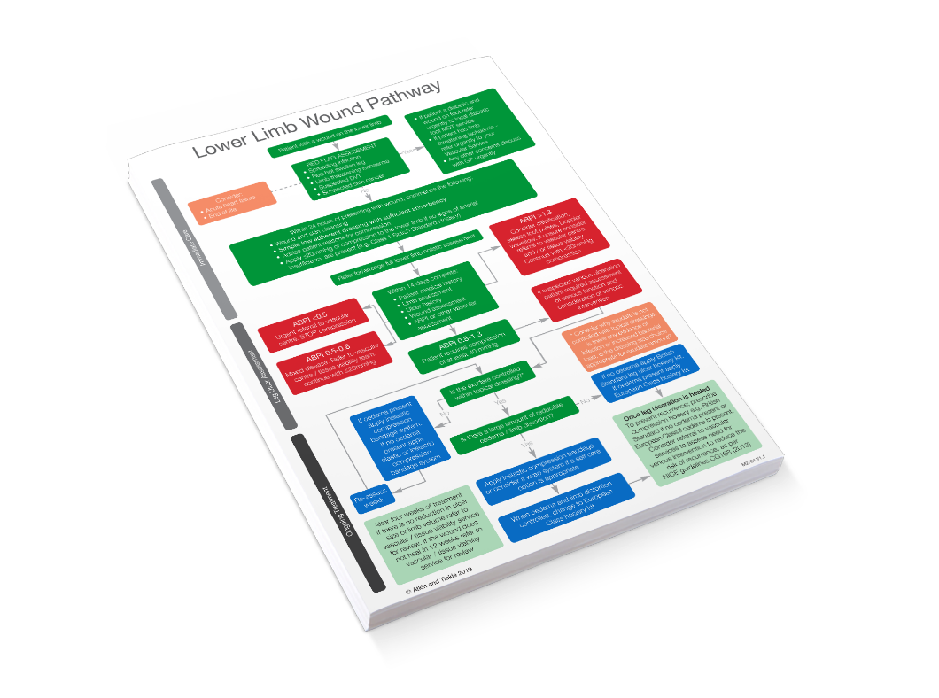

Slide 8
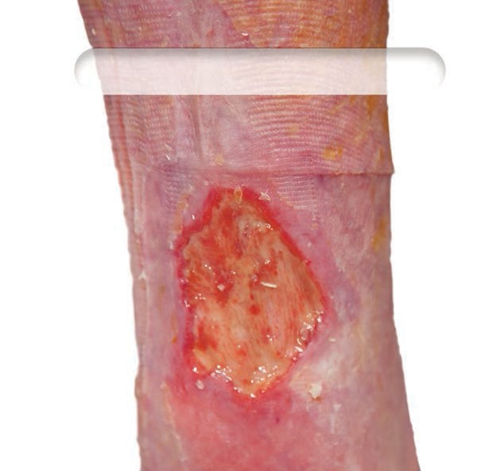
Immediate care (NWCSP)
The National Wound Care Strategy Programme
(2021) recommend the use of mild compression as a component of immediate care for wounds on the leg, providing ‘red flag symptoms’ (such as symptoms of arterial insufficiency) are excluded. If the wound fails
to heal within a 2-week period, a full lower limb assessment, incorporating an ABPI should be carried
out, with a view to diagnosing and treating the wound
as a VLU if appropriate.
https://www.ahsnnetwork.com/app/uploads/2020/10/@NWCSP-Lower-Limb-Recommendations-13.10.20.pdf

Slide 9
Red Flags!
Immediately escalate to a relevant clinical specialist if any of the following are present/suspected:
Acute infection (e.g. increasing redness, swelling pain, pus, heat)
Acute or chronic limb threatening ischaemia
Suspected DVT
Suspected skin cancer
For people in the last few weeks of life, seek input from their other clinicians to agree an appropriate care plan.

Slide 10
Immediate care (NWCSP)
Immediate care should incorporate:
Wound bed, peri-wound and limb skin cleaning and emollient, as required.
Simple low-adherent dressing with sufficient absorbency.
First line mild graduated compression
When appropriate, people with leg and foot wounds should be supported to self-care.

Slide 11
Achieving immediate mild compression (Up to 20mmHg)*
Product | Benefit
Activa® 10mmHg liner pack | 10mmHg gives options where very low levels of compression are required Option to layer to increase compression where appropriate Very easy to apply Sizing compatible with Activa range (reduced training requirement) Open and closed toe/ 3-colour options
Using liners from Activa® or Actilymph® hosiery kits | Ideal cost effective solution if the patient will be able to progress to wearing a hosiery kit following a full lower limb assessment and Ankle Brachial Pressure Index (ABPI) Option to layer to increase compression where appropriate Very easy to apply Sizing compatible with Activa range (reduced training requirement) Prepares the patient for ongoing use of a hosiery kit Hosiery kit options for patients with and without oedema
Activa® Class 1 hosiery (14-17mmHg) | Easy to apply Sizing compatible with current range (reduced training requirement) Number of styles/colours available
*The National Wound Care Strategy Programme (2021) recommend the use of mild compression as a component of immediate care for wounds on the leg, providing ‘red flag symptoms’ (such as symptoms of arterial insufficiency) are excluded. If the wound fails to heal within a 2-week period, a full lower limb assessment, incorporating an ABPI should be carried out, with a view to diagnosing and treating the wound as a VLU if appropriate. Please refer to NWCSP recommendations for ‘red flag symptoms’.

Slide 12
Leg ulcer assessment

Slide 13
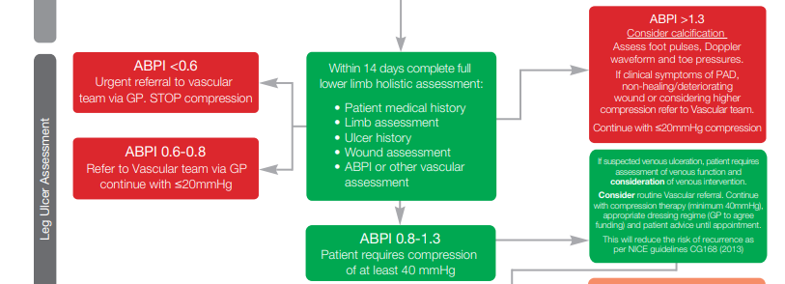

Slide 14
Ongoing Treatment

Slide 15
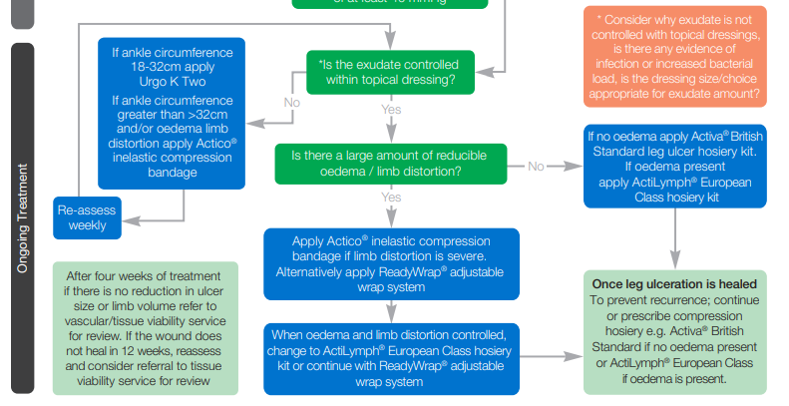

Slide 16
Bandages
Bandages | Evidence | Advantages | Disadvantages | Patient benefits
Generally present as 2 or 4 layers Full compression (40mmHg) or reduced compression (20-30 mmHg) available | Meta-analysis of trials including RCT’s proving that multi-component bandages are effective in the treatment of venous leg ulceration | Anatomical fit for unusual-shaped limbs. Inelastic compression bandages can facilitate volume reduction/reshaping High-stiffness systems can produce improve venous blood flow Good for high levels of exudate | Compression value is dependent on skill & application technique Some bandage systems do not involve compression to the foot potentially delaying healing of wounds around the malleolus. | Can be bulky and may limit footwear and clothing. Does not facilitate self-care.

Slide 17
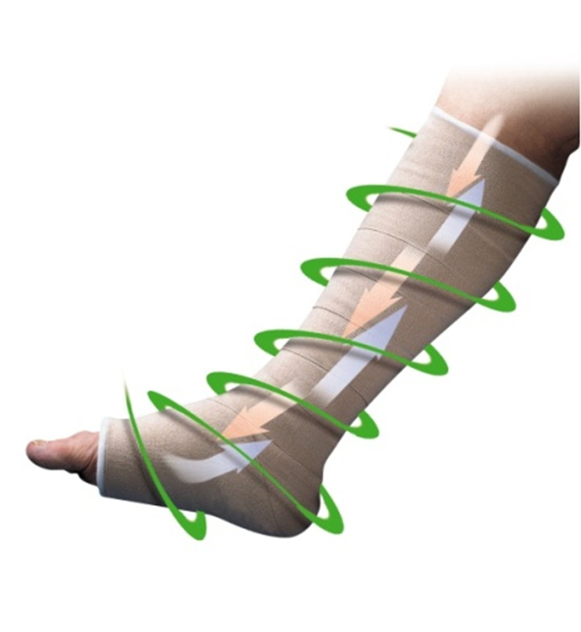
When to bandage?
Actico® bandages are ideal for limbs with:
High exudate levels
Large amount of reducible oedema
Large amount of limb distortion
In line with Best Practice, once these
symptoms are under control, self-care
solutions such as compression hosiery kits
or wrap systems are recommended.
Notes:
Compression should be first-line treatment to optimise healing and can benefit patients in both acute and chronic management.
As long as the clinician has established that compression is safe to use in the individual patient, the question should not be whether to use compression but what sort of compression to use. (Wounds UK, 2016).
This is shown to be as effective as bandaging in healing VLU, but with reduced recurrence.

Slide 18
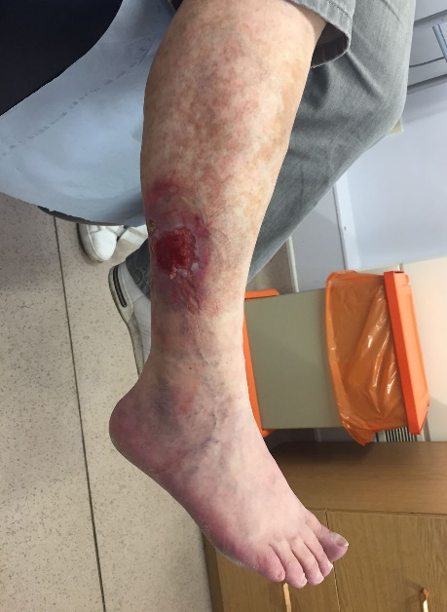
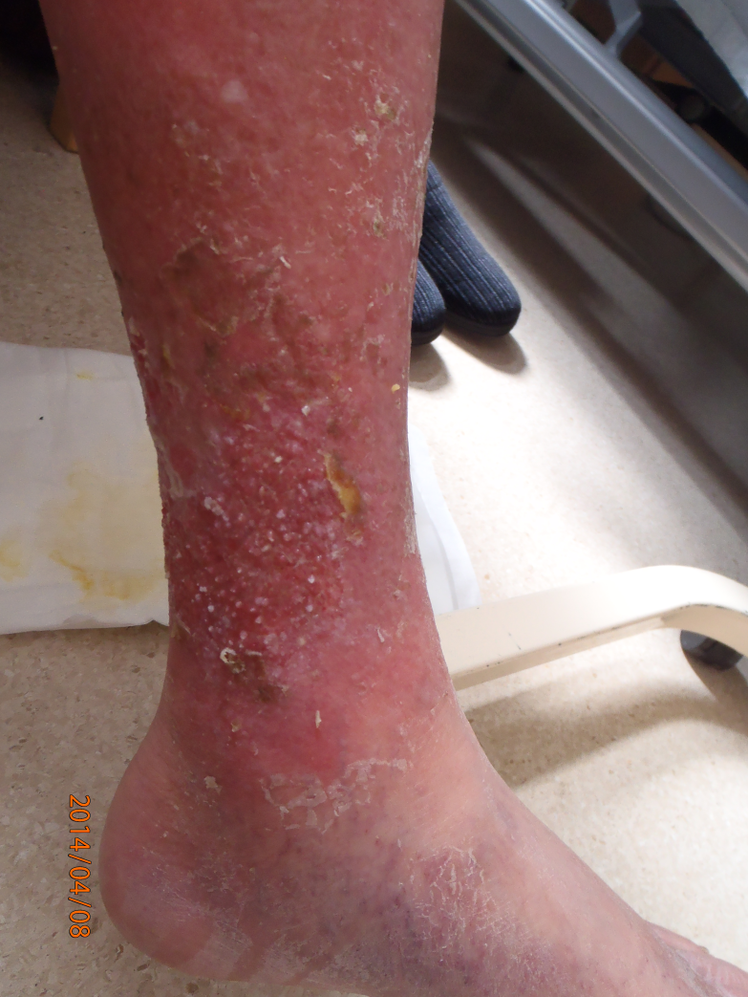
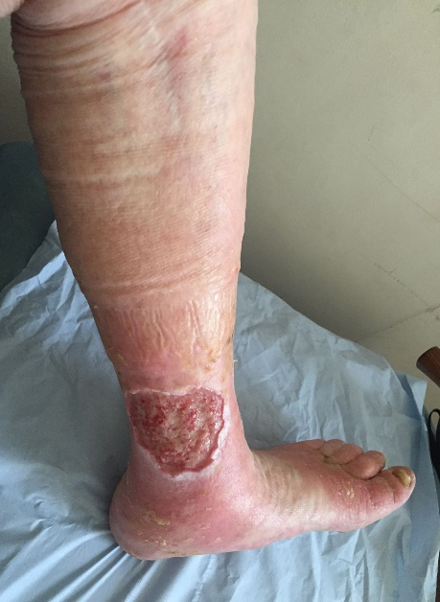
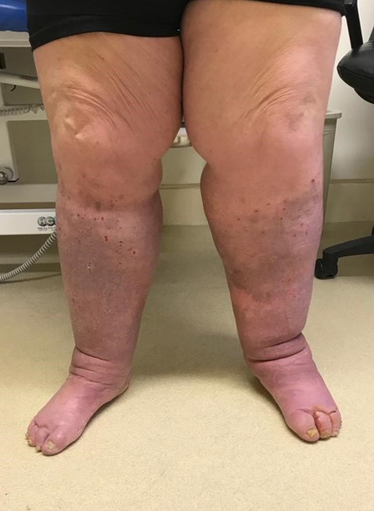
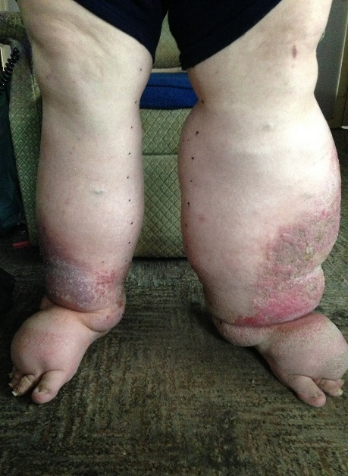
When to adapt your technique
Actico® meets the needs of patients and clinicians across the oedema spectrum
Consider the use of Hosiery Kits and ReadyWrap® here if exudate is controlled within the dressing
Mild
Severe
Apply as per VLU training
Apply as per chronic oedema / lymphoedema training
Notes:
Hide/unhide as relevant:
Oedema/chronic oedema can often cause confusion amongst healthcare professionals.
Note to RCA’s: If you are in an area where there is a lot of K2 used for ‘normal’ VLU and Actico is pigeon-holed for oedema only, you may consider embellishing on this slide to get people to consider how oedema is actually a problem across the whole spectrum and clinicians need to use a bandage (Actico) that can be used for all conditions.
If you do this, for each image ask “Is oedema a risk here?”
Notes per picture (from left to right):
At this point, it is clear this patient has an underlying venous condition, and therefore they are at risk of developing oedema, even though swelling is not present as yet.
You can see marking on the skin caused by the bandages used. This is more prevalent for patients when oedema is present.
The bandages have pushed some oedema up the patient’s limb, and you can see a swollen area above their wound.
Oedema is developing on this patient, and you can see skin folds and changes to the skin are taking place.
Oedema has progressed to a substantial level for this patient, with huge limb distortion and challenges to their quality of life.

Slide 19
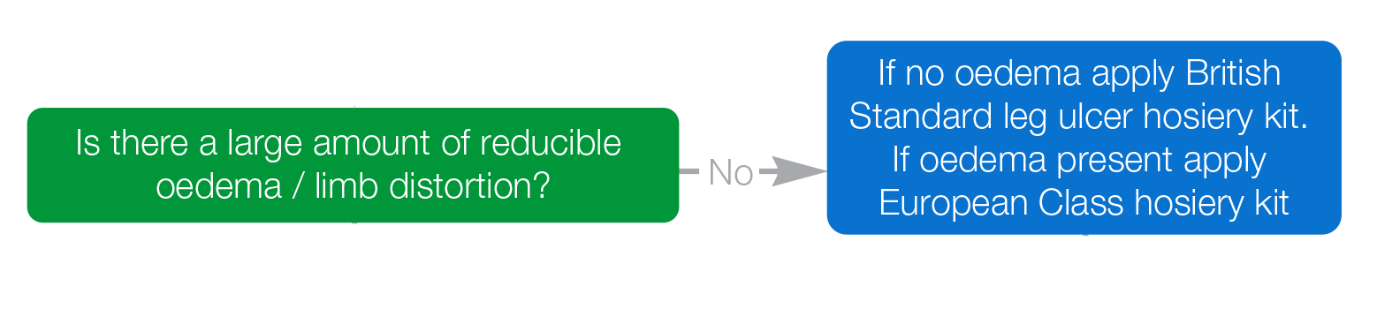

Slide 20
Leg Ulcer Hosiery Kits
Hosiery | Evidence | Advantages | Disadvantages | Patient benefits
Compression hosiery and Hosiery kits should be first line where possible | As effective as multi-component bandages Less expensive Promotes self care | Low level of skill to apply Consistent compression levels Allows patient self care Cost effective | Not suitable for distorted limb shapes Not suitable for rapidly decreasing oedema Exudate needs to be contained within the primary dressing | Low profile Minimal changes to footwear or clothing Allows self care Aesthetically pleasing

Slide 21
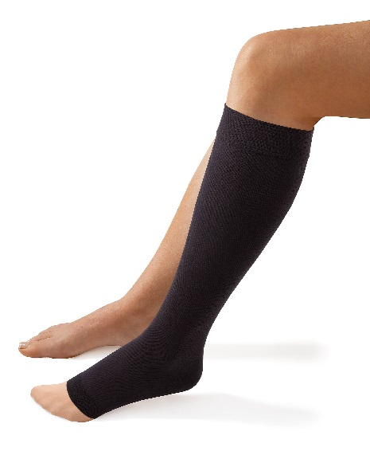
Leg Ulcer Hosiery Kits
Ideal first line approach for VLU management
A silky, easy to put on 10mmHg liner goes on first
The liner holds dressings in place and helps the second layer to go on easily
A second compression layer is added over the liner to achieve a consistent therapeutic ~40mmHg pressure, optimised for venous leg ulcer healing
For legs without oedema, use British Standard Activa® leg ulcer hosiery kit
For legs with oedema, use European Class ActiLymph® hosiery kit
Notes:
These slides are intended to just give a brief overview of the different types of compression and are also the point at which you can get the products out to allow customers to see and feel different examples each type
Please emphasise the difference between maintenance hosiery and kits and how they are designed for treatment of VLU rather than post-healing
There is a separate slide deck for more indepth hosiery kit sessions

Slide 22

Leg Ulcer Hosiery Kits
(Activa® Leg Ulcer Hosiery Kits were used as part of the VenUS IV trial)
4 - layer bandage
98 days
70.4%
23%
£1,795
2 - layer hosiery kit
99 days
70.9%
14%
£1,494
Median time to healing
Ulcers healing
Ulcers recurring
Mean annual cost
“Increased use is likely to result in a substantial saving for
the NHS with improved quality of life for people with
venous ulcers.”
Ashby et al. 2014

Slide 23
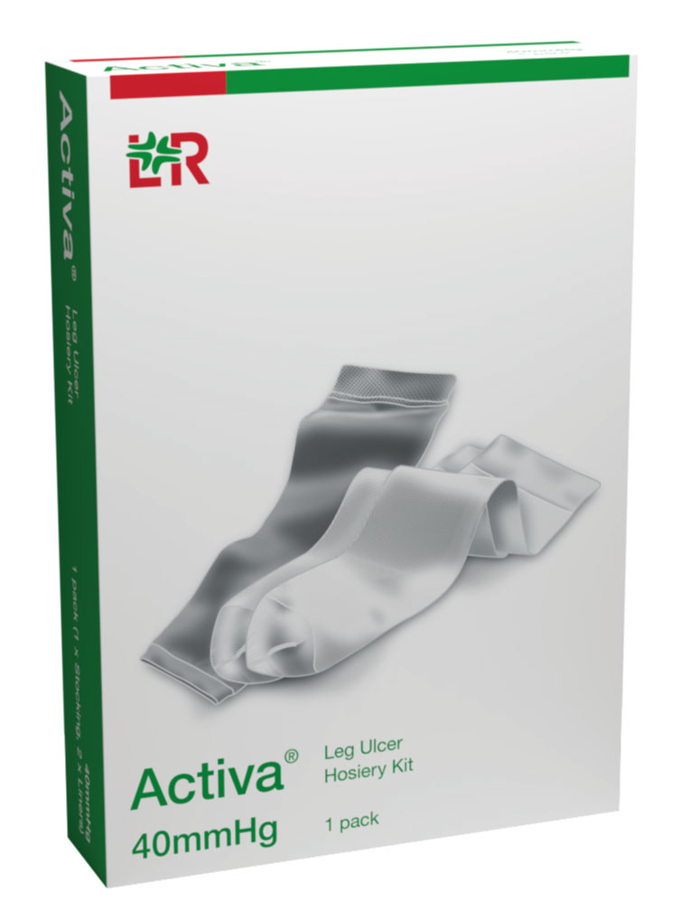
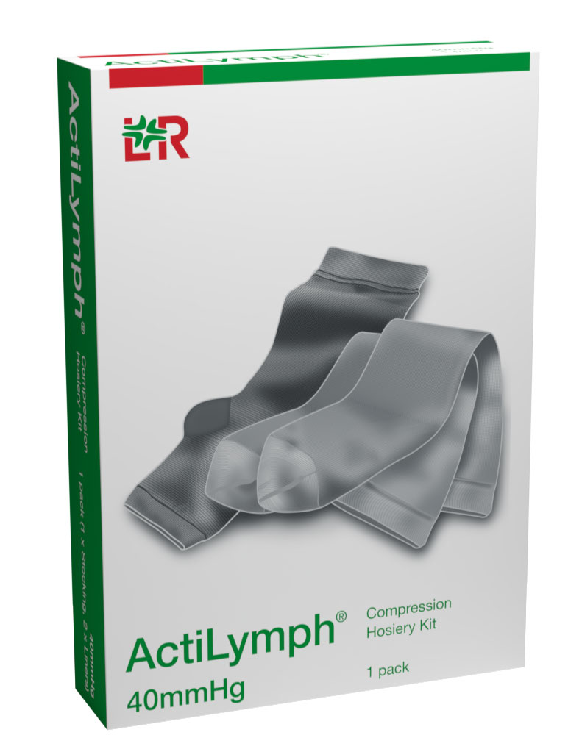
Current or
history of oedema
No Oedema

Slide 24
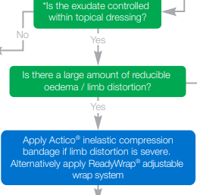

Slide 25
Adjustable Wrap Systems
Wraps | Evidence | Advantages | Disadvantages | Patient benefits
Adjustable systems that can be applied below knee or to the full leg | As effective as multi-component bandages Less expensive Promotes self care | Low level of skill to apply Consistent compression levels Allows patient self care Cost effective Can be applied to the full leg | Not suitable for distorted limb shapes Not suitable for rapidly decreasing oedema Exudate needs to be contained within the primary dressing | Low profile Minimal changes to footwear or clothing Allows self care Aesthetically pleasing

Slide 26
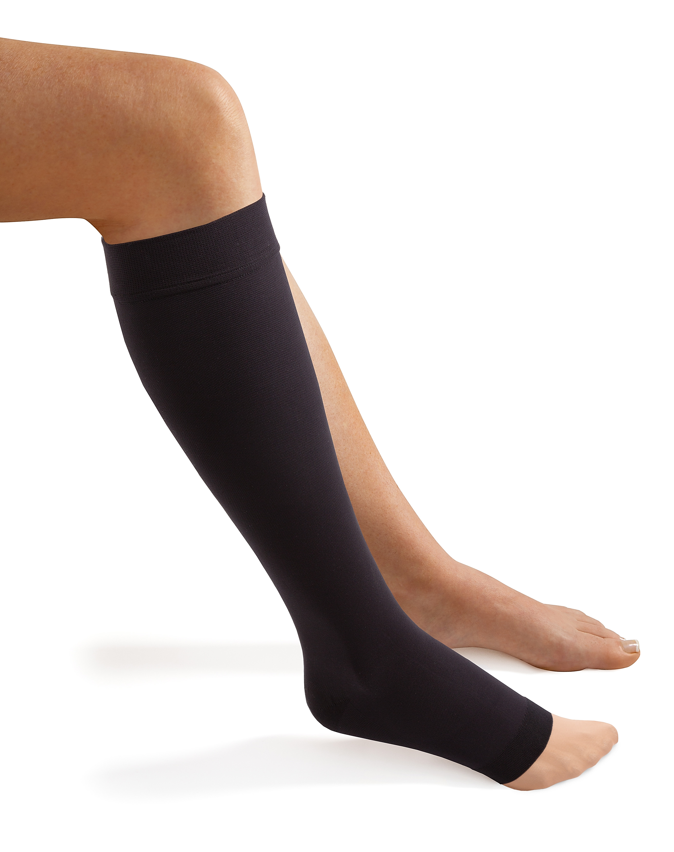
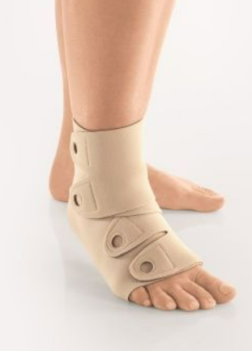
Compression solutions
A range of options appropriate to the differing needs of patients’ to support the best outcomes
Hosiery Kits
Low profile.
Prepares for maintenance hosiery.
Silky liner secures dressings & is combined with a 2nd compression layer.
For limbs with oedema (ActiLymph) & without oedema (Activa).
Compression Wrap e.g ReadyWrap
Short Stretch properties &
high SSI..
(Muldoon & Hampton, 2017)
Colour-coded VELCRO® fasteners.
8 garment options, including toe pieces and extender straps.
* Support
self care
* Effective
* Easy to use
Notes:
Introducing the L&R range of self care solutions and their potential benefits to support you with self care
Position Hosiery kits and ReadyWrap in combination.
‘As evidenced Venus4 trial’ High level of evidence – self care originated from hosiery kits
Emphasise the difference between maintenance hosiery and kits and how they are designed for treatment of VLU rather than post-healing.

Slide 27
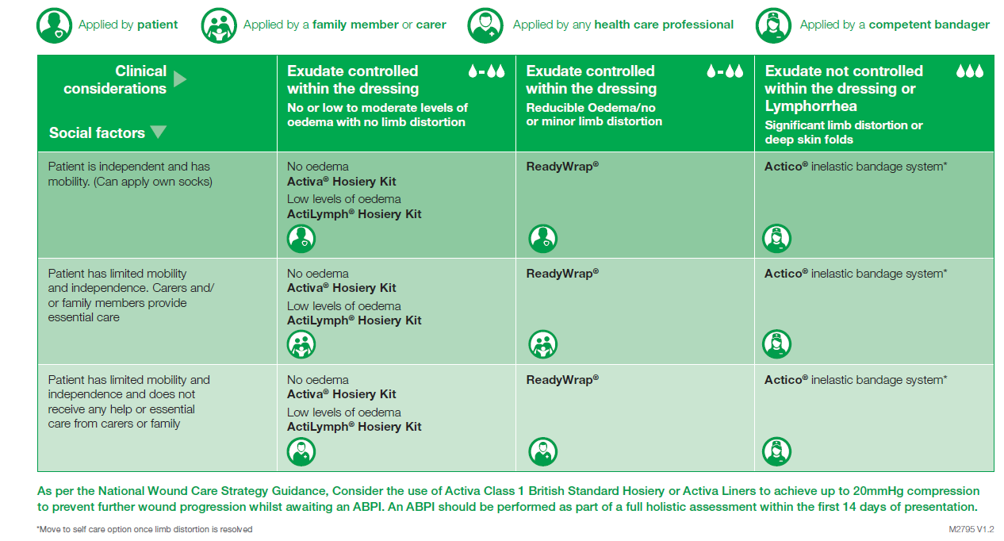
Compression options
Notes:
If a patient isn’t suitable for compression wraps or hosiery kits, what self care promotion could you provide? E.g. movement, healthy eating
Cleansing legs, looking out for signs and symptoms.

Slide 28
Prevention of recurrence

Slide 29
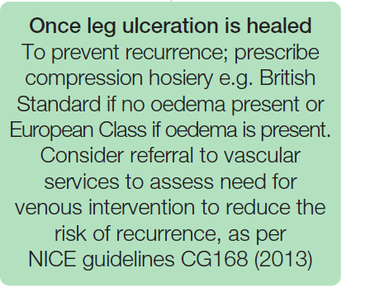

Slide 30
Prevention and Maintenance
Venous disease requires long term compression therapy, even when the leg ulcer heals. Unfortunately repeated episodes of ulceration are common for many patients with recurrence rates as high as 69% (Harding et al 2015)
Long term self care management should include:
  Wearing suitable compression and replacing garments 2-3 times a year
  Checking your legs regularly and reporting any changes (dryness, swelling, breaks)
  Eating a balanced diet
  Keeping skin hydrated with regular moisturising
  Avoid standing or sitting still for long periods; try to move around every 30 minutes
  Take regular breaks throughout the day, and raise the legs on pillows while resting
  Exercising regularly can improve circulation and help maintain a healthy weight

Slide 31
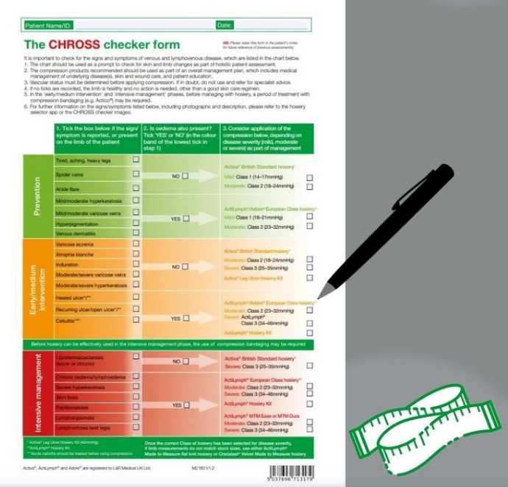
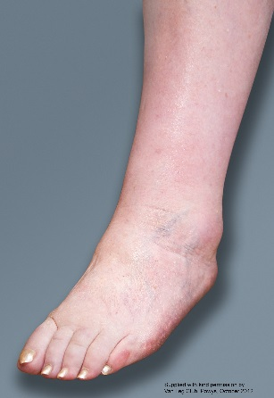
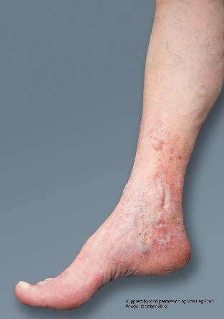
Hosiery Classification
With Oedema | Without Oedema
ActiLymph®/ Adore® European Hosiery | Activa® British Standard Hosiery
 |  | Liner | 10mmHg
 |  | BS Class 1 | 14 – 17mmHg
EU Class 1 | 18 – 21mmHg | BS Class 2 | 18 – 24mmHg
EU Class 2 | 23 – 32mmHg | BS Class 3 | 25 – 35mmHg
EU Class 3 | 34 – 46mmHg
EU Hosiery Kit | ~40mmHg | BS Hosiery Kit | ~40mmHg
Notes:
This slide can be used to briefly outline the differences between BS and EU hosiery
The significance in terms of suitability for managing oedema is the stiffness of the fabric
You can explain the similarities in compression value between class 2 Activa and Actilymph for example

Slide 32
An evidenced based approach
The leg ulcer treatment pathway is an evidenced based pathway to support best practice for immediate care,
VLU management and prevention of recurrence.
Based upon the strength of evidence, the pathway recommends self care solutions as a first line approach
Wounds UK (2019) Best Practice Statement: Addressing complexities in the management of venous leg ulcers. London: Wounds UK. Available to download from: www.wounds-uk.com

Slide 33
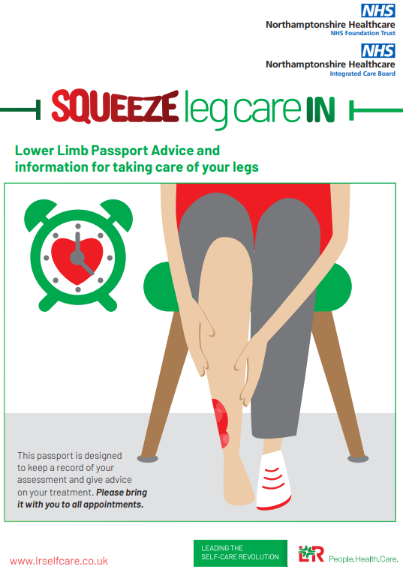
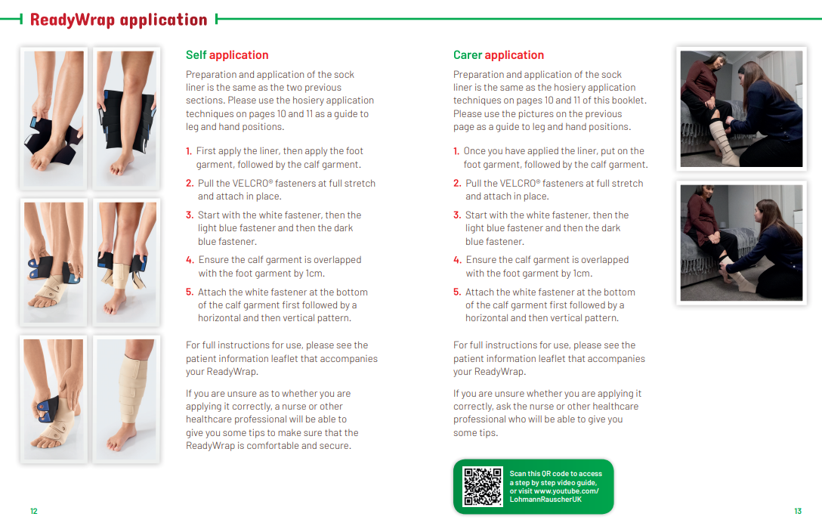
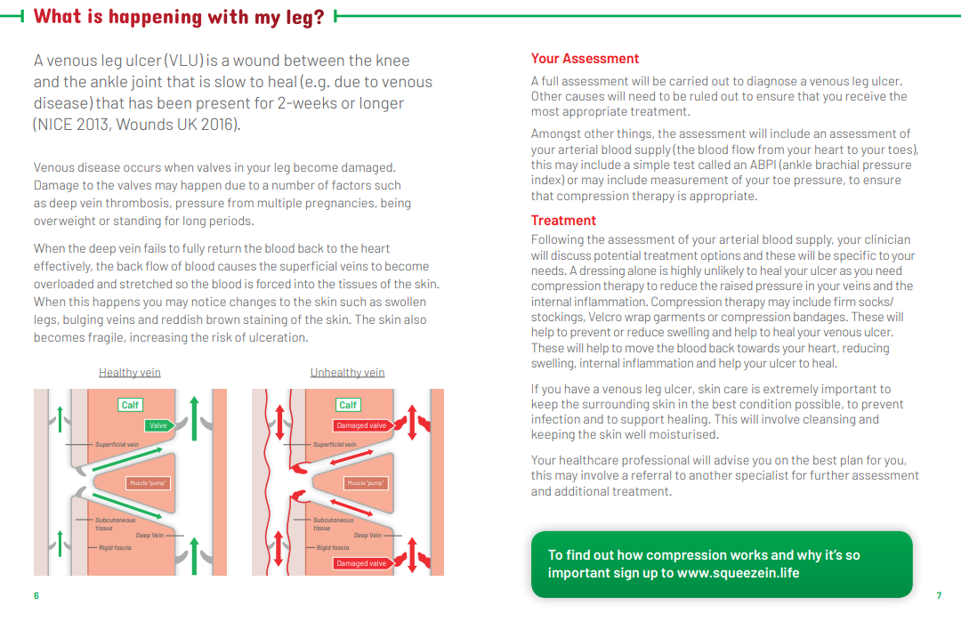
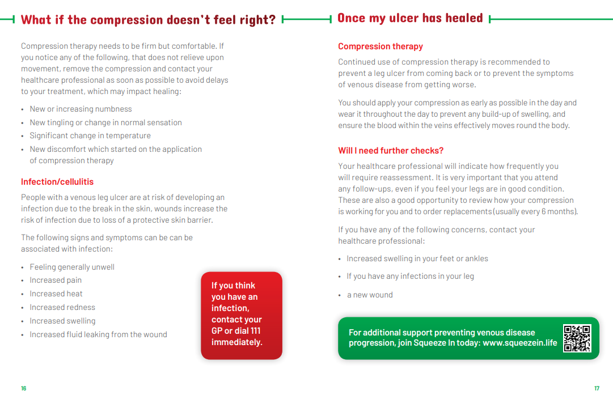

Slide 34


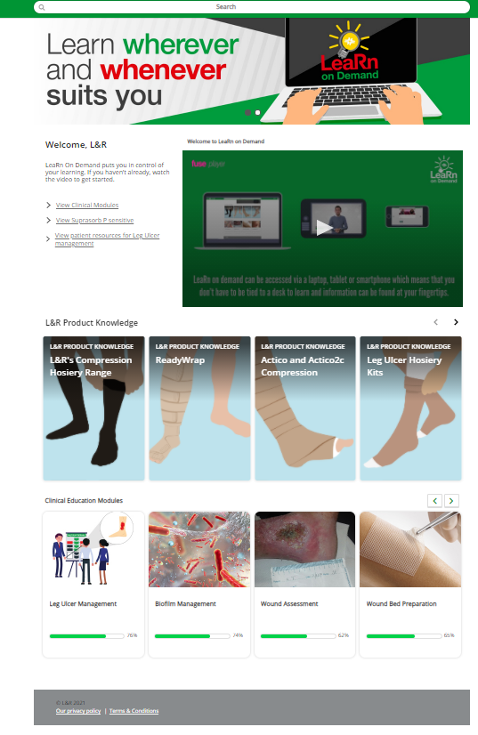
Sign Up Today
LeaRn on Demand is a new educational platform from L&R, that gives you access to the latest clinical and educational content, as well as product specific information, resources and support all in one central hub.
The platform has been designed
to put you at the heart of your
learning experience, giving you
quick and easy access to
engaging content that's relevant
to you 24/7. It can accessed via
tablet, phone, or laptop.

Slide 35
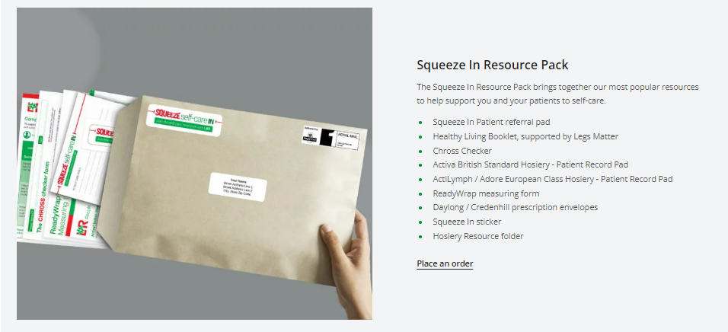

Sign up to Squeeze In to access your self care resource pack
www.squeezein.life

Slide 36
