Slide 1
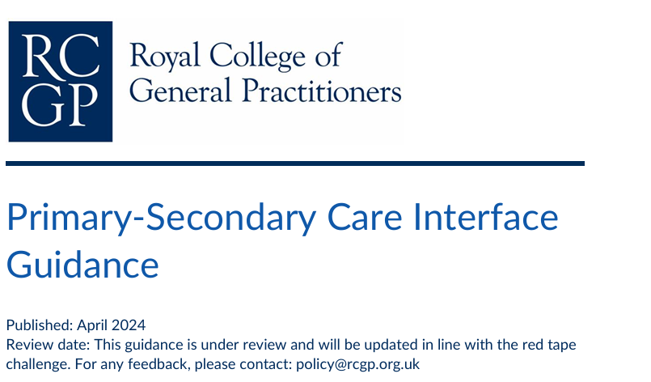
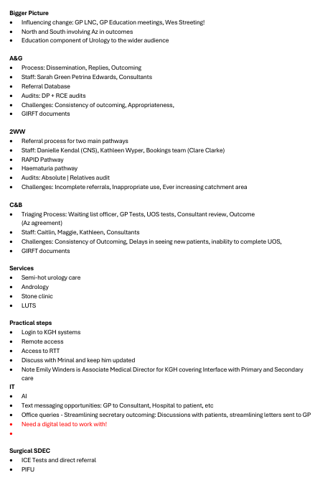
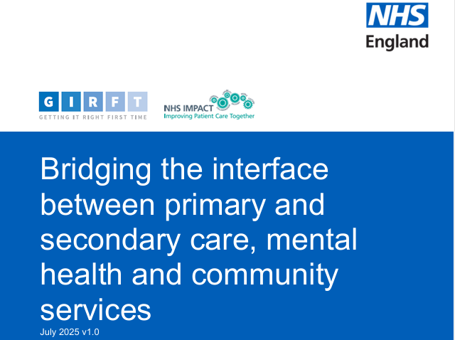
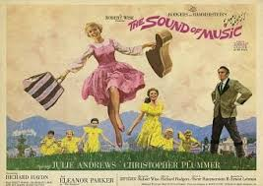
Notes:
Welcome
Good afternoon and thank-you for giving me this opportunity to start the session on the Interface work I have been supporting over the past 6 months.
Who am I
For those who don’t know me I am a Urology consultant in training and perhaps more relevant for the current session I am the UHN Clinical Director responsible for cross site cover for Gastro, Gen Surgery, Urology and Breast teams.
Oscars
Firstly, I’d like to congratulate Cathy for starting this project. I do believe this is the start of something that could potentially make a big difference to the way we work in Northamptonshire and provide better care for our patients..
I believe the biggest wins for us are not NGH & KGH which has consumed time and money but supporting the way we work together in Primary & Secondary care and that’s why I got involved with this exciting project.
I also want to thank Ammar for throwing his hat in the ring and working in the Lions den namely KGH hospital! As stated, I will keep my talk brief and let Ammar expand on the areas of interest!
More recently Georgina has been welcomed into the fold and she will be supporting the Breast team
Primary Secondary Care Interface
Cathy has given us a good overview of the project and what's happening nationally and there are documents out there to guide us on such work.
The idea of improving the interface between Primary and secondary care is not new. I am a big fan of GIRFT and their work and where there's a will there's a GIRFT document which highlights key areas of review.
So for those of us who are old enough lets start at the very beginning ….
Areas Identified for Interface work
So on starting with Ammar we went through a lot of areas I saw potential for interace work and compiled the list shown on the left side.
I would like to pick up on a few of these areas on the next slide …

Slide 2
1º & 2º Standards
1st Primary | Secondary Care Interface
Commun
I
Cat
I
on
Clinical Entity
A&G
C&B
Clinical Entity
RAS vs Directly Bookable
Pre-Referral Work-up
Diagnostic tests
NICE etc
Triage
GIRFT
Outcome Appropriate patient allocation Efficient use of resources Improved patient flow and experience
Outcome
Notes:
What have we been up to
To start with Amaar has met with a lot of our 60 strong team to get to know them, he’s negotiated the awful induction process, got numerous passwords and started to get a feel for our IT systems which are awful.
Considering the Challenges and Pointers
I’d like to just highlight some specific challenges then hand over to Ammar…
Appreciation of IT Systems
Firstly, the cornerstone of any interface between Primary and secondary care starts effectively with IT. What became very apparent is the inadequacies of KGH systems and the lack of joined up integrated systems.
Currently we are looking at Nerve centre for KGH to mirror NGH and UHL . What if we could have seamless integrated systems between Primary and secondary care. Lettes sent from the practice that were integrated into our systems populating medicines and comorbidities for example
Essentially, we need a movement and get people onboard to consider such work that currently does not exist. I believe what Cathy has started is the beginning of this movement.
County wide Implementation.
Moving on from this, not only do we need an integrated IT system, another key principle to the work was that for any changes agreed, they need to be implemented across the whole county and with this in mind I have been introducing Ammar to colleagues at NGH. Its difficult to get a single department lined up let alone two trusts.
I then showed Ammar how it works in terms of A&G + C&B Referrals coming in from GPs to accepting referrals at KGH and outcoming them and then what do the GPs see from the outcoming. It would be safe to say that Ammar would probably quite underwhelmed at the sophistication of the IT systems we have.
C&B
We have also spent some time considering C&B with many a conversation looking at examples.
From a trust perspective, we have a significant back log of patients sitting on our directry waiting to be triaged. This was recently 700 patients for Gastro. It does seem some specialities are more challenged than others.
Some of the issues with this are getting the staff to triage and engraining this on job plans which are maxed out.
Another key issue is Consistency of reviewing the patients with some consultants looking at them and a tick for clinic where as others will go to great lengths to review. Equally, the consistency from the referrals is quite wide.
Waiting times for new clinic slots varies between 6 to 12 months, and currently there is a big push from the surgery division to get this down.
Please note that urgent referrals does not mean an urgent referral as we found out on auditing.
Adding into the mix is that SDEC and hot clinics are not greatly established for some specialities leaving the GPs with little option but to refer patients in via 2WWs.
There are also som big discussions we have had about specific pathways and diagnostic tests.
A&G
The trust has seen a significant increase in the numbers of A&G referrals and this is going to continue.
Again, this causes an issue as to when they will be done and hard to add to busy job plans as already stated.
My last point on this is the IT for A&G is awful and one platform we all use with few clinics where all the information can be seen would be welcomed.

Slide 3

Specilaity
Meeting Place
Gp Directory
Commun
I
Cat
I
on
Clinical Entity
Hub
Agreed work up/ tests
Successful Referral [AI]
Hospital Directory
Notes:
Summary Slide
Top-down system change & Bottom-up process required.
Chance meeting with Jayne Chambers who was working with Az and supported the direction is ee this work going.
Top down:
Fortuitous that Jayne Chambers and Az were looking at something similar to what we had been talking about and were looking at using the GP Hub
Bottom-up
considering each clinical entity specifying exact referral pathways – considering Cornwalls Hub and looking at DOS systems and Ammar has been looking into this
Communication Portal
Cathy has been feeding in to the interface work some of the National conversations and had a good example of a Whatsapp group in Nottingham for urgent communication
For less urgent communications, thre could be a Directory on the Hub Portal that we can use to make communication much more easily between primary and secondary care. In this day and age we are still reliant on letters or phone calls. Remember A&G is a one directional tool!
Hand over to Ammar …

