Slide 1
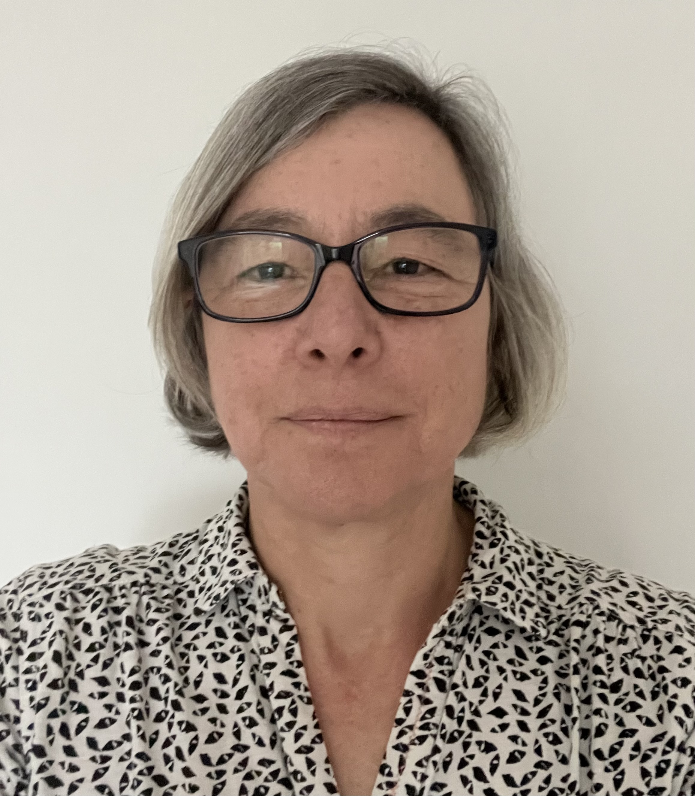
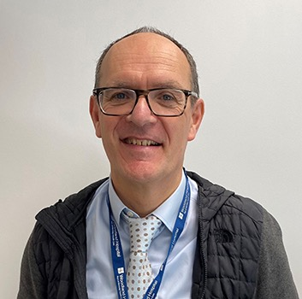
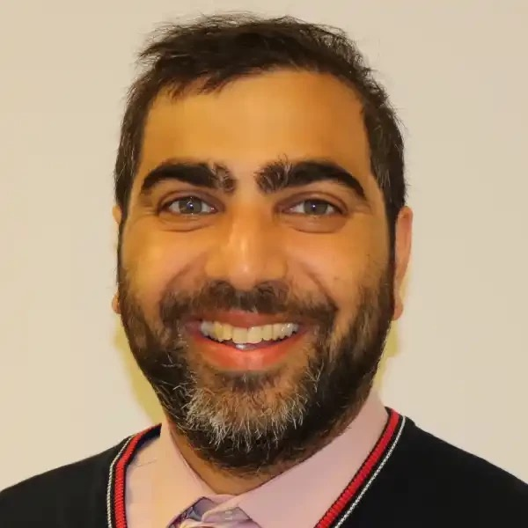
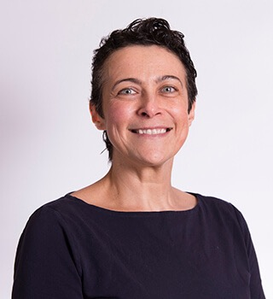
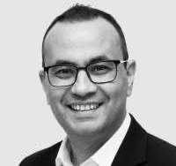
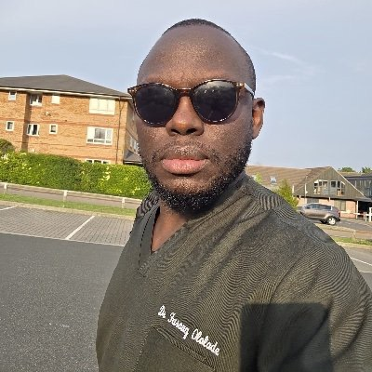
PLT Wed 13 May 2026
1:30 Issues affecting GP Retention in Northamptonshire
  Dr Cathy Appleton
  Programme Director Northamptonshire GP Retention Scheme
1:50 Issues affecting the Dermatology Interface
Interview with Dr Olivia Stevenson
2:10 Improving Communication in Dermatology
Farouq Ololade
Interface GP in Dermatology
2:30 Tea Break
2:40 Improving the Interface Nationally and Locally
  Dr Cathy Appleton
3:00 Improving Communication in Urology
Mr David Payne Consultant Urologist & Clinical Director
Ammar Ghouri GP Partner Lakeside Practice Corby
3:30 Use of AI in the Interface Communication
Mr Shady Nafi Consultant Urologist KGH
3:50 Improving the Interface at UHN
Dr Emily Winters
Associate Medical Director Primary and Secondary Care
4:00 Questions and Conclusion – Going forward
Introduction of New Interface GPs

Slide 2



Slide 3
Red Tape Challenge -Wes Streeting in Oct 2024 to reduce bureaucracy building on progress with Primary Care Recovery Plan ( May 2023) and the recommendations of the Association of Medical Royal Colleges (AoMRC) report.
Review covered primary, secondary, community and mental health and looked into:
﻿﻿﻿﻿Outputs:
﻿﻿Top 10 Recommendations
﻿﻿GIRFT "Bridging the Gap" on the interface
﻿﻿Good practice case studies presented at monthly national interface group
﻿﻿Example templates for discharge & referrals

Slide 4
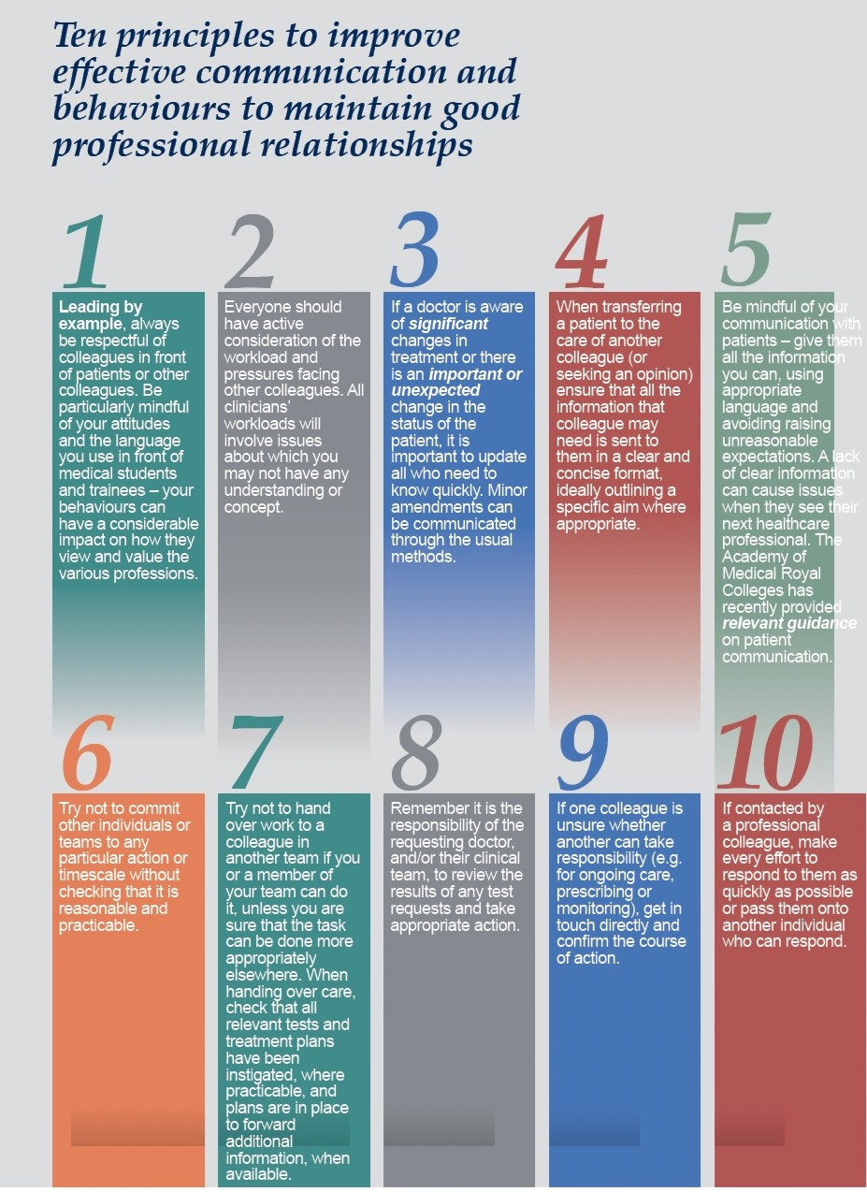
Northamptonshire System Clinical Interface Group
Primary Care
UHN Consultants
NHFT
LMC
ICB
Pharmacists
“Standards at the interface between primary and secondary care”

Slide 8
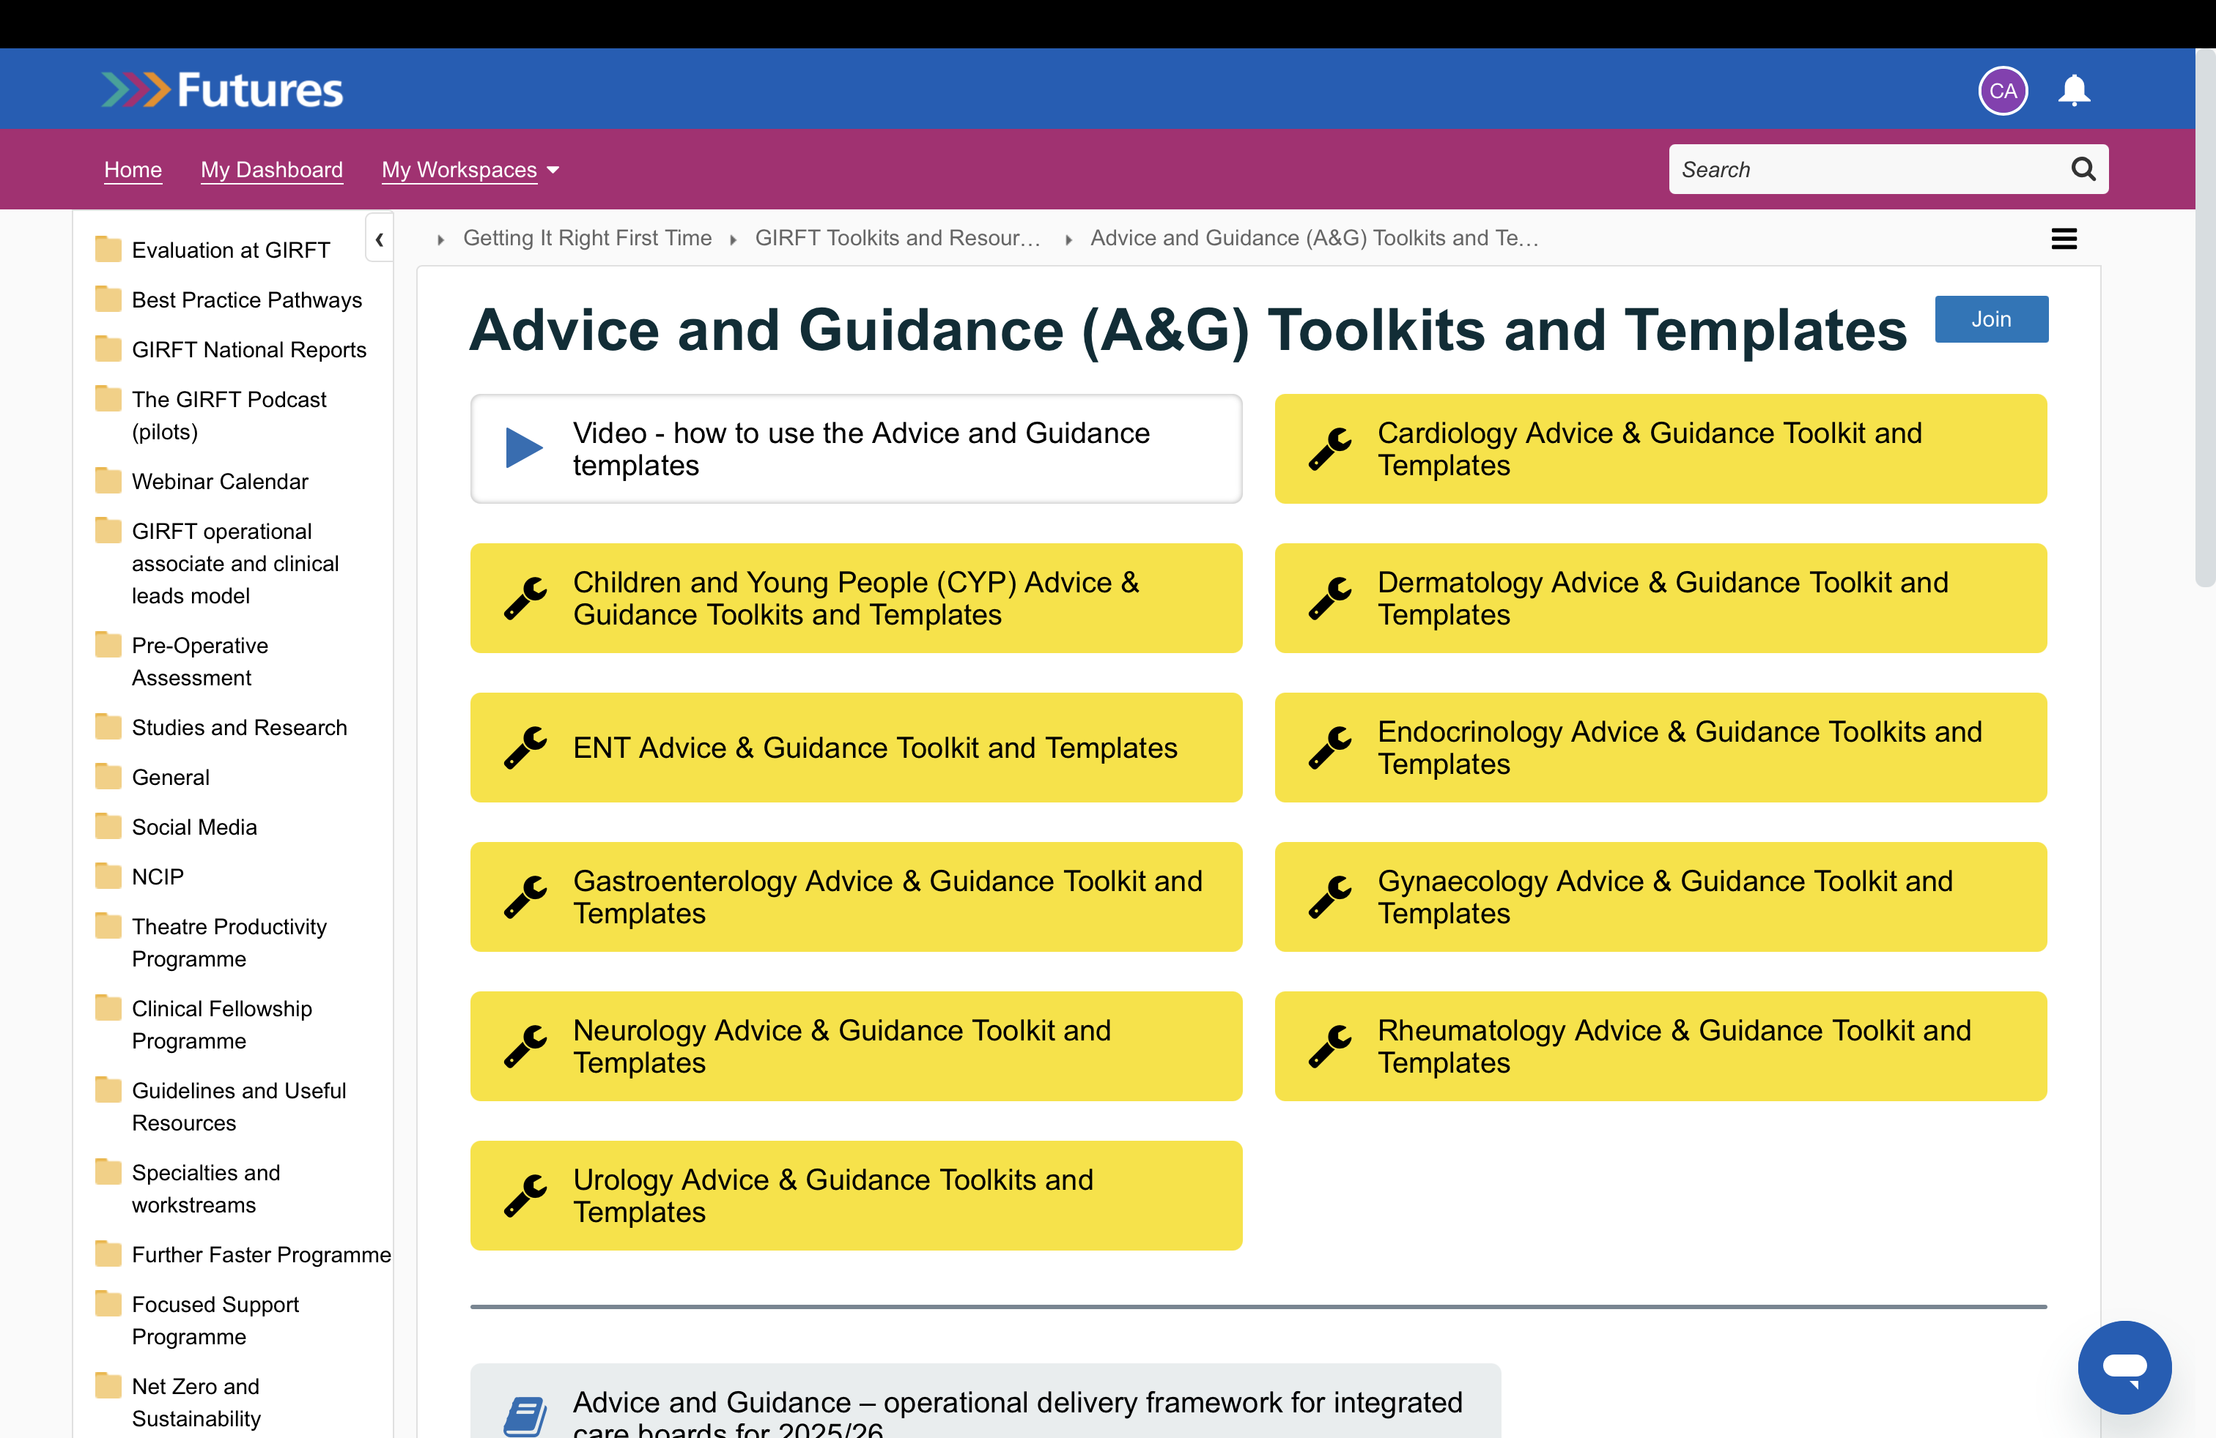

Slide 9
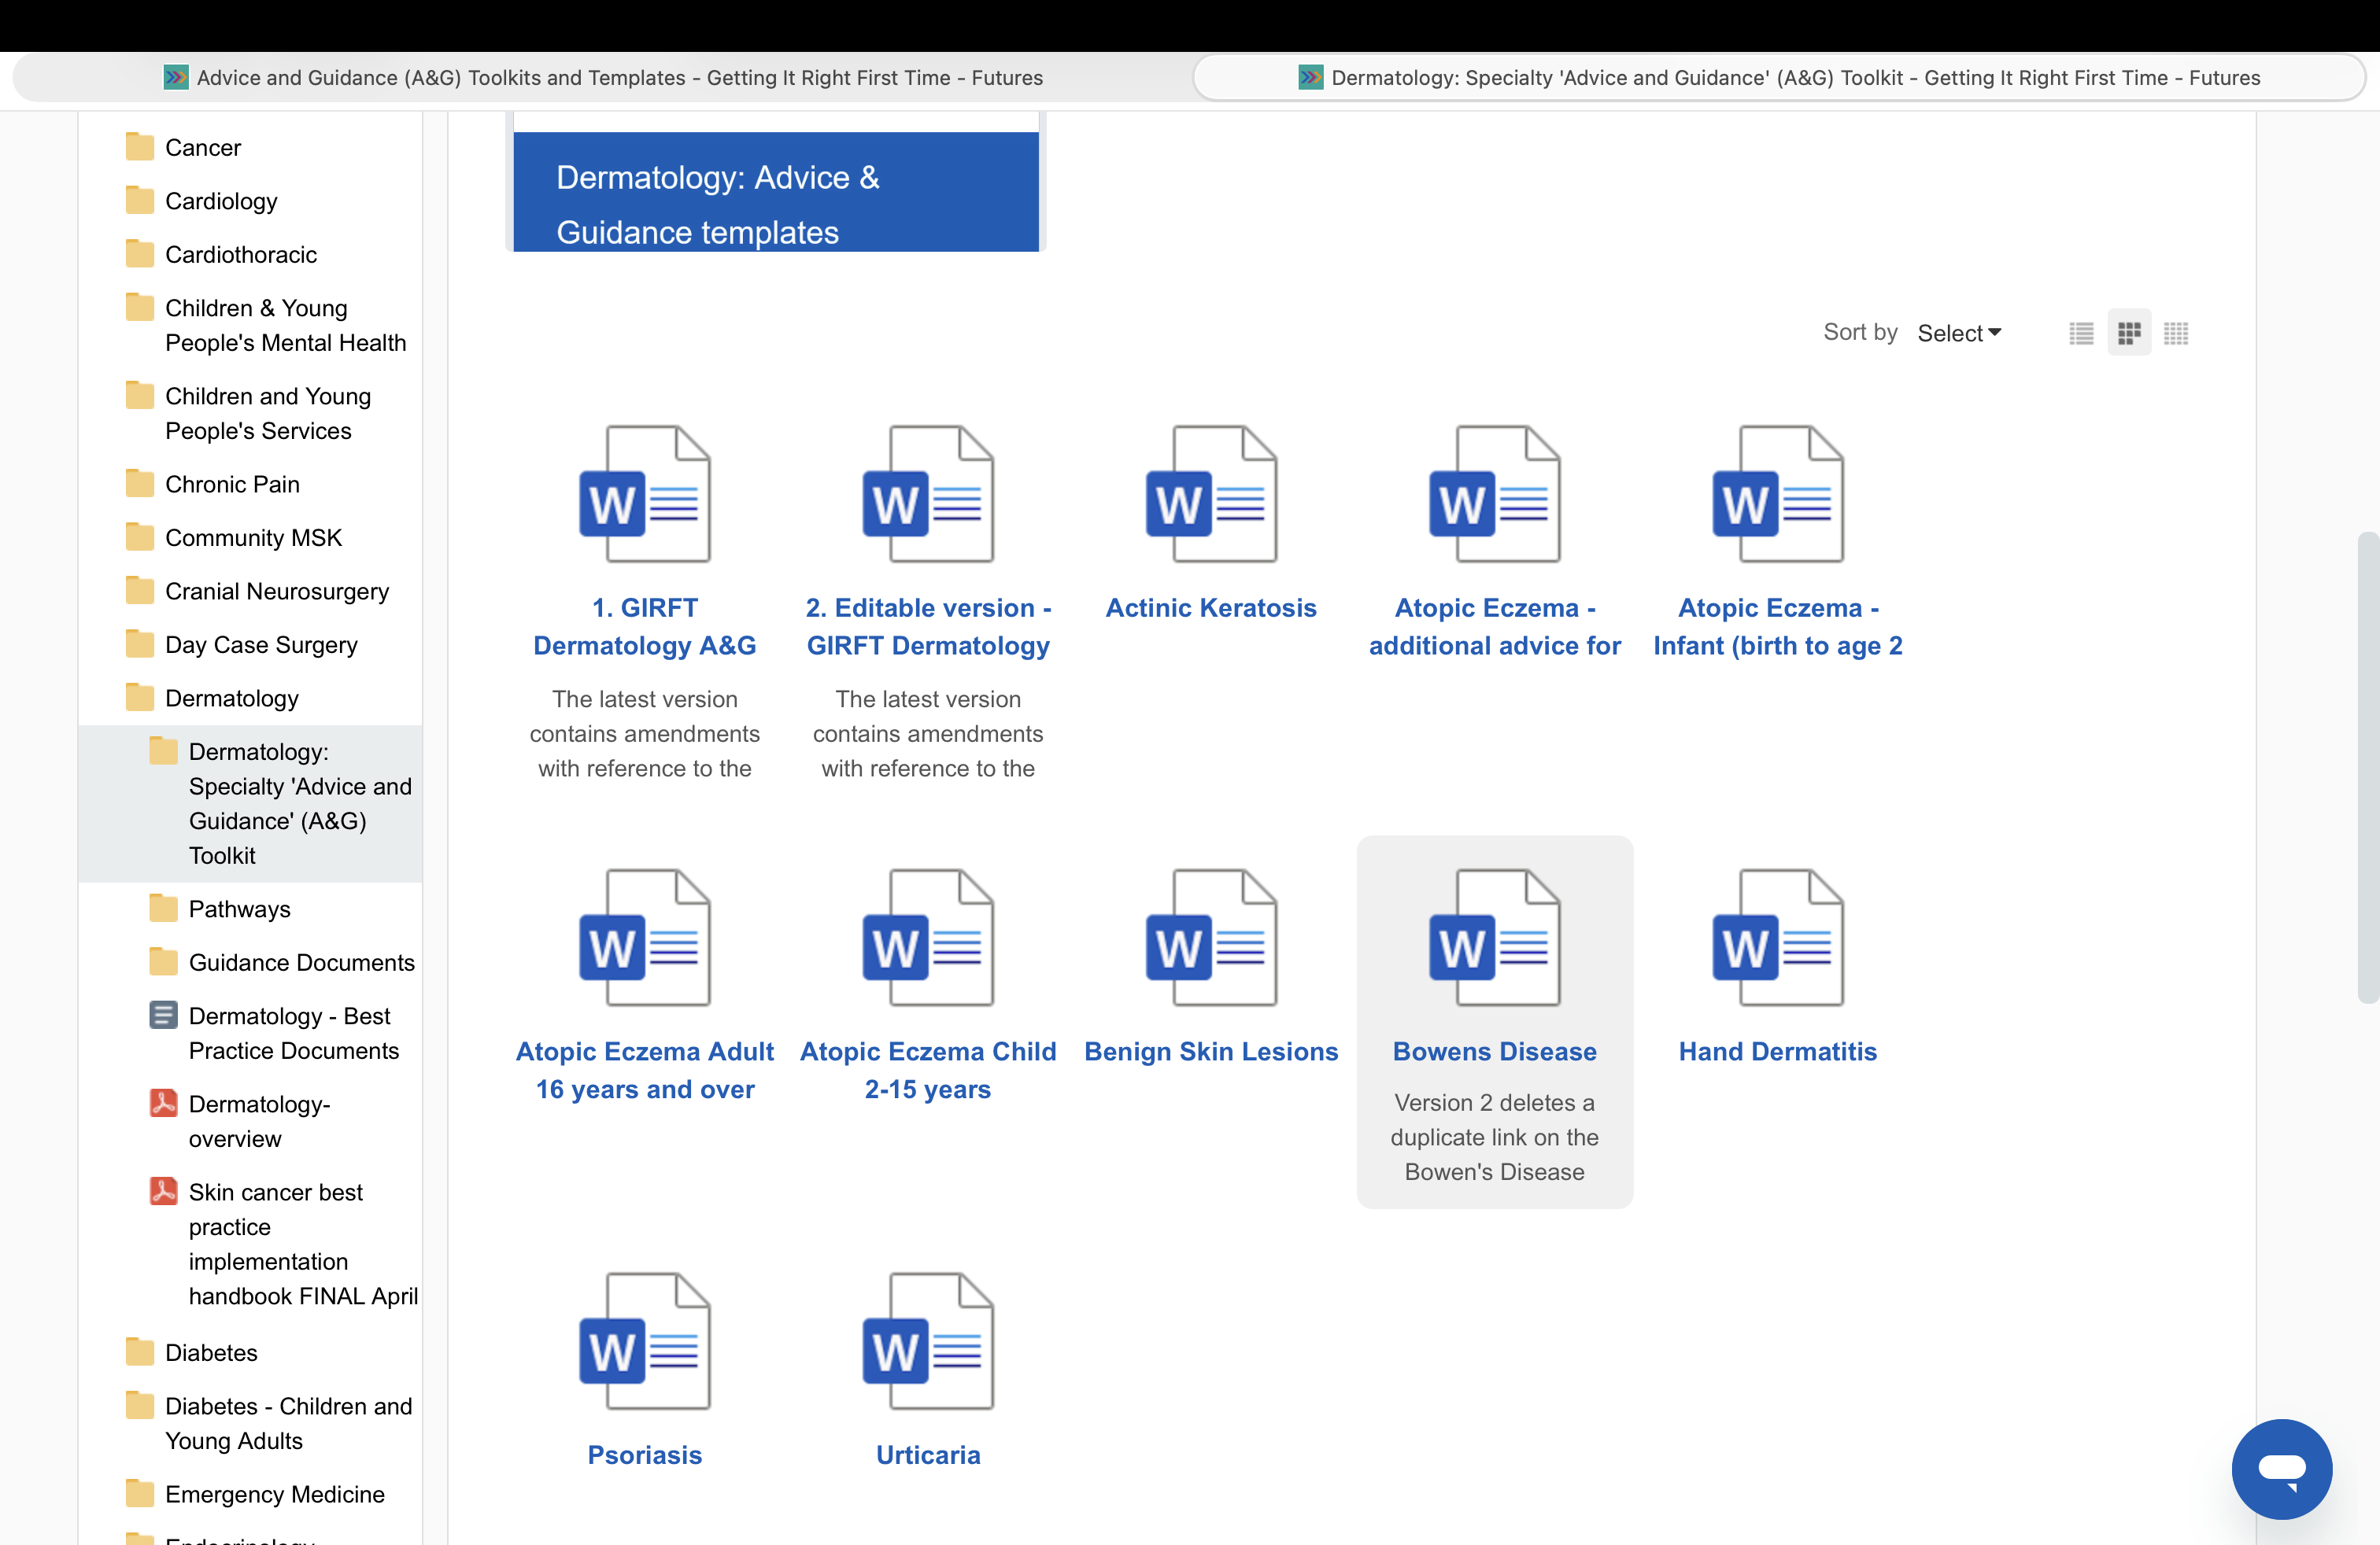

Slide 10
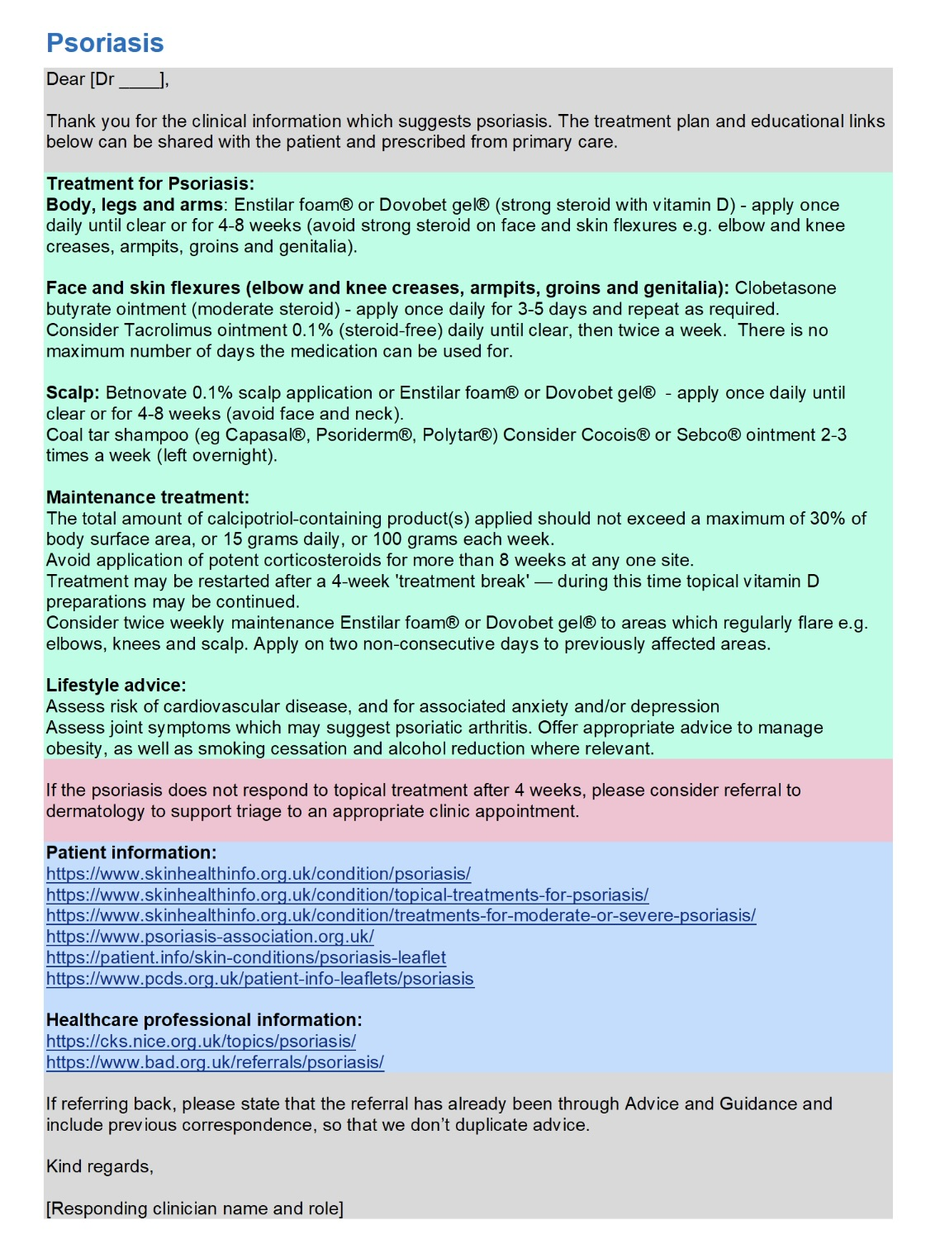

Slide 11
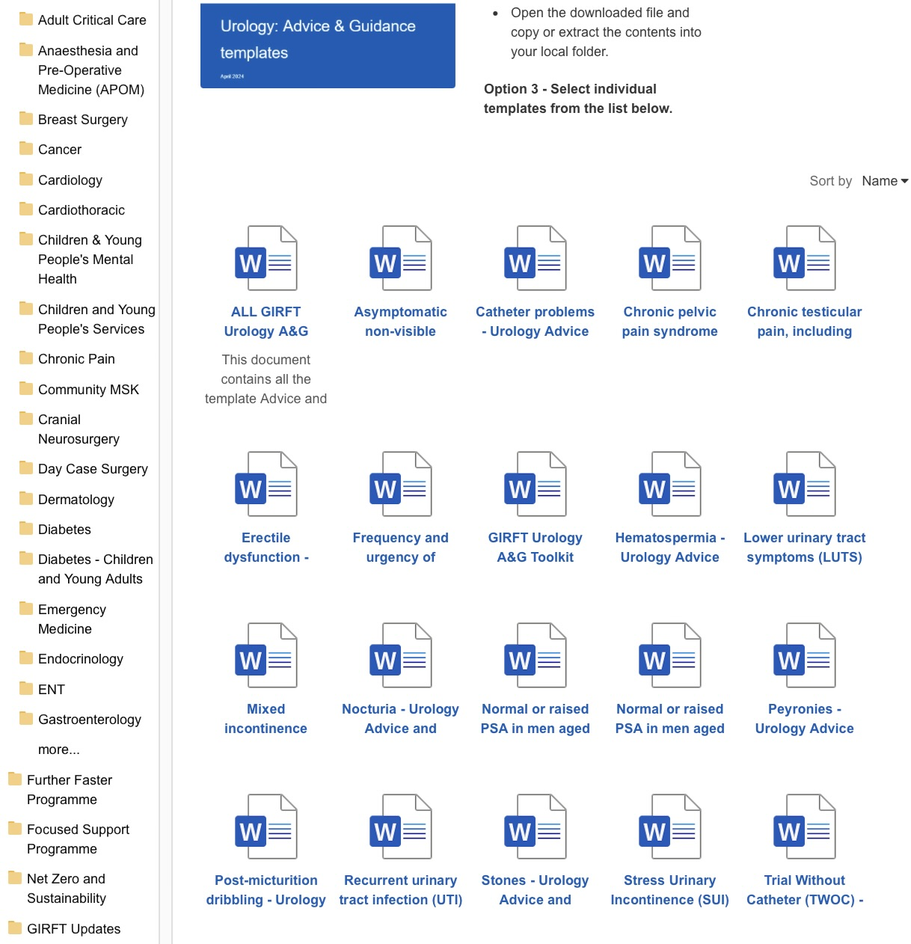

Slide 12
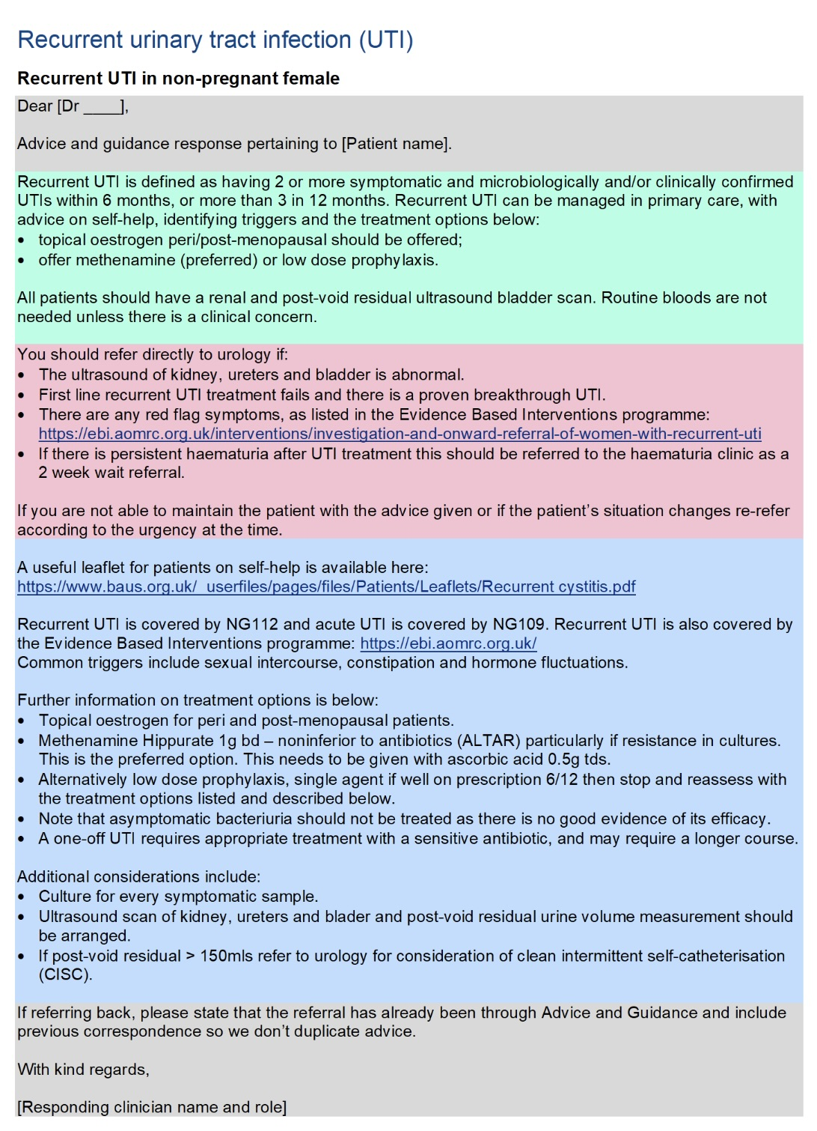
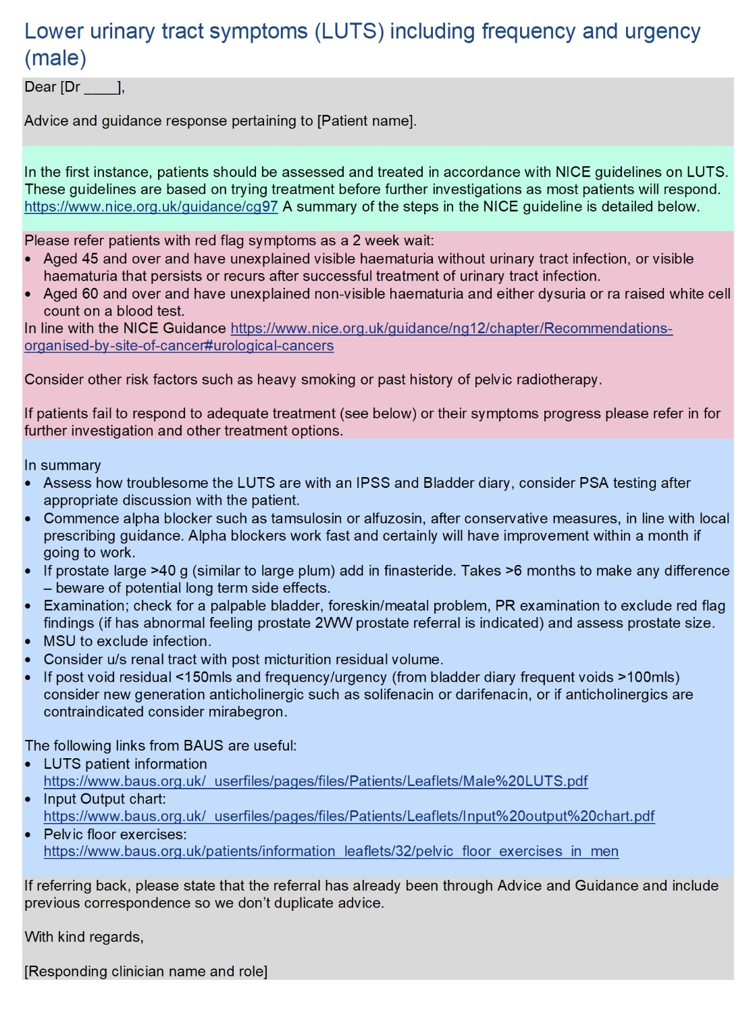

Slide 13
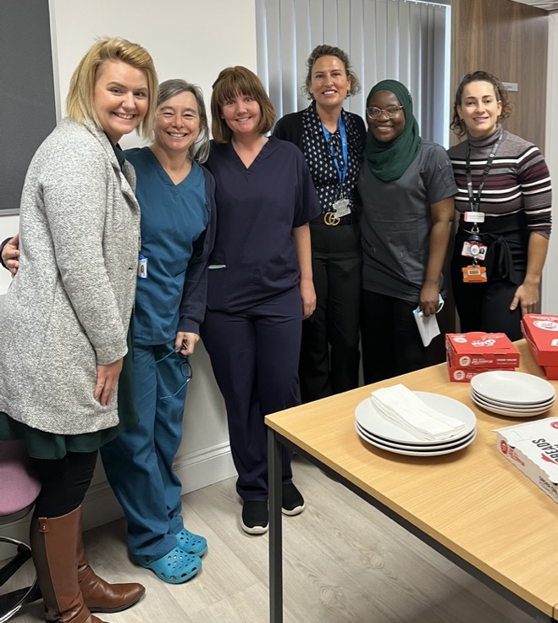
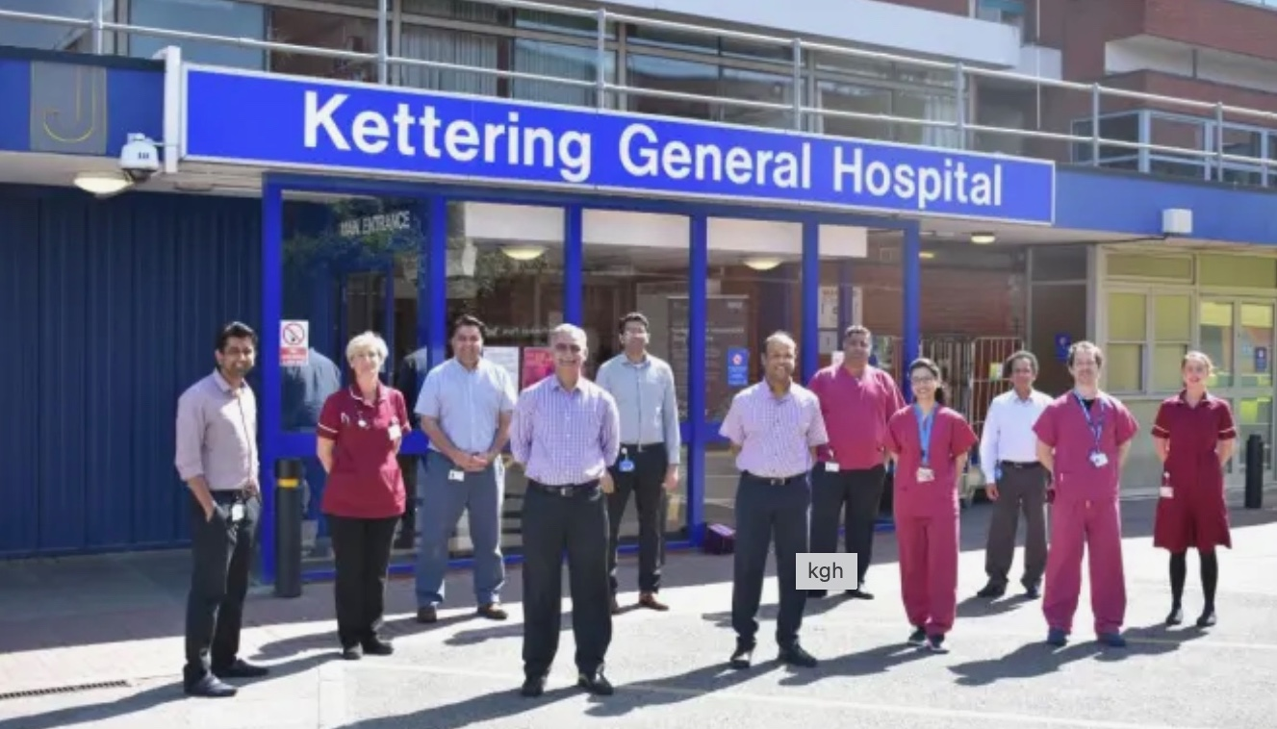
Clinical Interface GP Programme

Slide 14
