Slide 1
Audit of Dermatology Advice & Guidance Requests from Primary Care
Dr Ololade Farouq A.
Salaried GP Aspiro healthcare
Dr Cathryn Appleton
KGH Dermatology department interface GP
May 2026

Slide 2
Background
What is Advice & Guidance (A&G)?
            Enables GPs to seek specialist input without formal referral
            Aims to reduce outpatient demand
            Supports timely patient management
Why Dermatology?
            High referral volume
            Visual diagnosis dependent on image quality
            Delayed in patient care in primary care if responses are not received in a timely manner
            Increasing pressure on both primary and secondary care services
Why this audit is important:
              Service efficiency : Improve efficiency
              Patient outcomes : Ensure patient safety
              Workload management : Optimize service use

Slide 3


Aim of the Audit
To evaluate the quality, appropriateness, and outcomes of A&G requests sent from GPs to the dermatology department
To evaluate the quality and timeframe of responses from Dermatology department to GPs

Slide 4
Objectives
Assess:
  Appropriateness of A&G requests
  Quality of information provided (history, images, etc.)
  Response time
  Outcomes (advice only vs referral)
  Impact on Primary and secondary care workload
  Identify areas for improvement

Slide 5
Standards
≥90% requests include adequate clinical history
≥80% include images
≥70% images are of good quality
≥90% responses within 72 hours
Advise given are clear enough without ambiguity or leading to uncommission work
High proportion managed without face-to-face referral

Slide 6
Methodology
Retrospective audit
Time period: 3-month period
Sample size: 300
Data collected:
          Indication for A&G
          Presence & quality of images
          Response time
          Outcome

Slide 7
Results Overview
Total A&G requests audited: 300
Breakdown by condition:
Unknown Lesions
Eczema/Sebk/ Moles, AK
Acne, Hyperhidrosis
Other

Slide 8
Quality of Requests
77 % with adequate clinical history:
55.7% with good-quality images:
27.3% with poor images:
17% with no images:
Common issues:
Missing duration/history
Missing reason for request
Missing details of medications tried and response
No differential diagnosis
Poor image focus/lighting / missing images
Missing dermatoscope images in some instances

Slide 9
Response Times
Mean response time: 6 weeks
Range: 2 weeks to 12 weeks
Issues identified:
Shortage of manpower
Very limited of time allotted for A/G per week
Back and forth between service providers

Slide 10
Outcomes
Advice only: 64.2%
Converted to referral: 17.8%
No advice offered (Closed):13.1%
Urgent/2WW escalation: 4.9%

Slide 11
Response appropriateness for GP
Inappropriate / Unclear action for GP in approximately 32%

Slide 12
Key Findings
Majority of cases managed without referral ✅
Variable quality of images ❗
Incomplete clinical information in significant proportion
Response times is not within target
Inappropriate / Unclear action for GP in appreciable proportion

Slide 13
Discussion
A&G is effective in reducing outpatient referrals
Quality of submissions directly impacts efficiency
Poor images → increased follow-up or referrals
Opportunity for GP education
Response time is far below expected time frame
More time needs to be allocated to A/G processing.
More hands needs to be on deck from secondary care

Slide 14
Recommendations
For GPs:
Include focused history (duration, symptoms, red flags) : Template
Provide high-quality images
For Dermatology:
Standardised response templates
Clear guidance for A&G submissions

Slide 15
Action Plan
Develop A&G guideline request/ Template
Standardised response templates
GP education session
Information for patient and clinician on providing quality images: links
Introduce checklist for Admin team both ways

Slide 16
Improving A/G pathway
Check images prior to upload
IN FOCUS
3 images
  Macro whole site
  Macro close up
  +- dermatoscope
Avoid duplicates (Takes time)
Ensure adequate history

Slide 17
Minimum requirement for A/G and referrals
Good history:
duration and evolution
Treatment tried: including dose, duration, response or partial response
Quality pictures

Slide 18
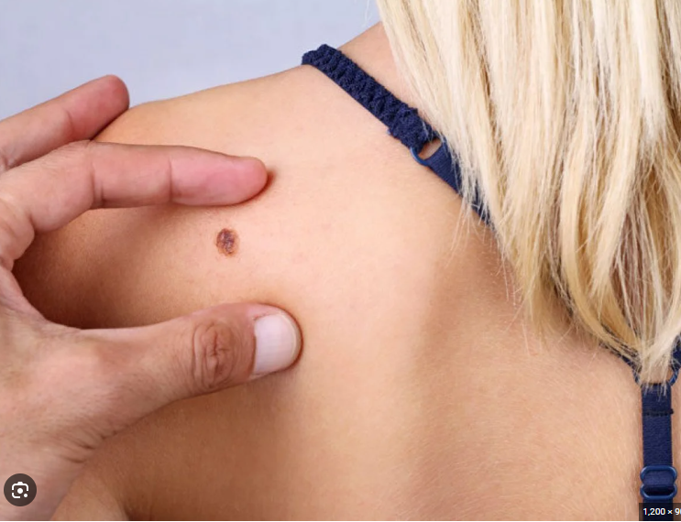
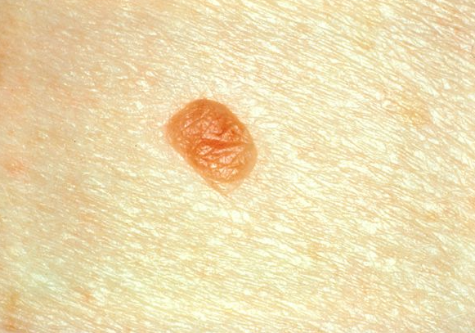
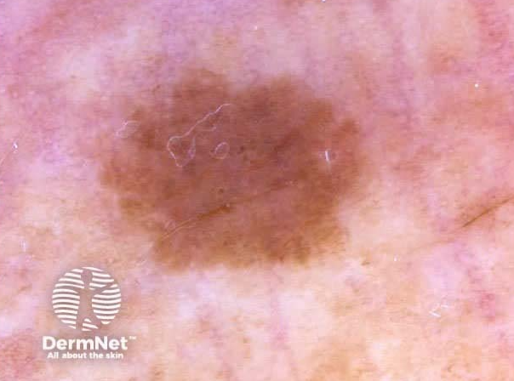
Good picture criteria. IN FOCUS
3 pictures: Distant picture - extent of involvement or site of the lesion.
Close up (If multiple lesion in the close up, please mark the one(s) of concern.
Dermatoscope pictures.
Avoid multiple pictures of the same area or lesion
If patients are taking pictures themselves, kindly give them a guide on how to take good picture.

Slide 19
Role of Admin team
Scrutinise
Scrutinise referral
ensure the standards are met
Scrutinise
Scrutinise images
Send picture guide back to patient to retake pictures if quality of pictures not met.
Liaise
Liaise with clinician (and or patient )
ensure full history included

Slide 20
Patient / clinician picture taking guide
https://www.pcds.org.uk/clinical-guidance/photography-how-to-take-a-good-dermoscopic-photograph advise patient to read the clinical picture part
https://www.youtube.com/watch?v=zRFhiDlZjNQ video for patient clinical picture
https://www.youtube.com/watch?v=7Vz08Qr1wi0 Video for Dermatoscopy picture for clinicians

Slide 21
Conclusion
A&G is a valuable tool in dermatology
Significant proportion managed without referral
Key improvements needed in:
Image quality
Clinical information
Timely response from Dermatology
Clear action plan to GP from Dermatology

