Slide 1
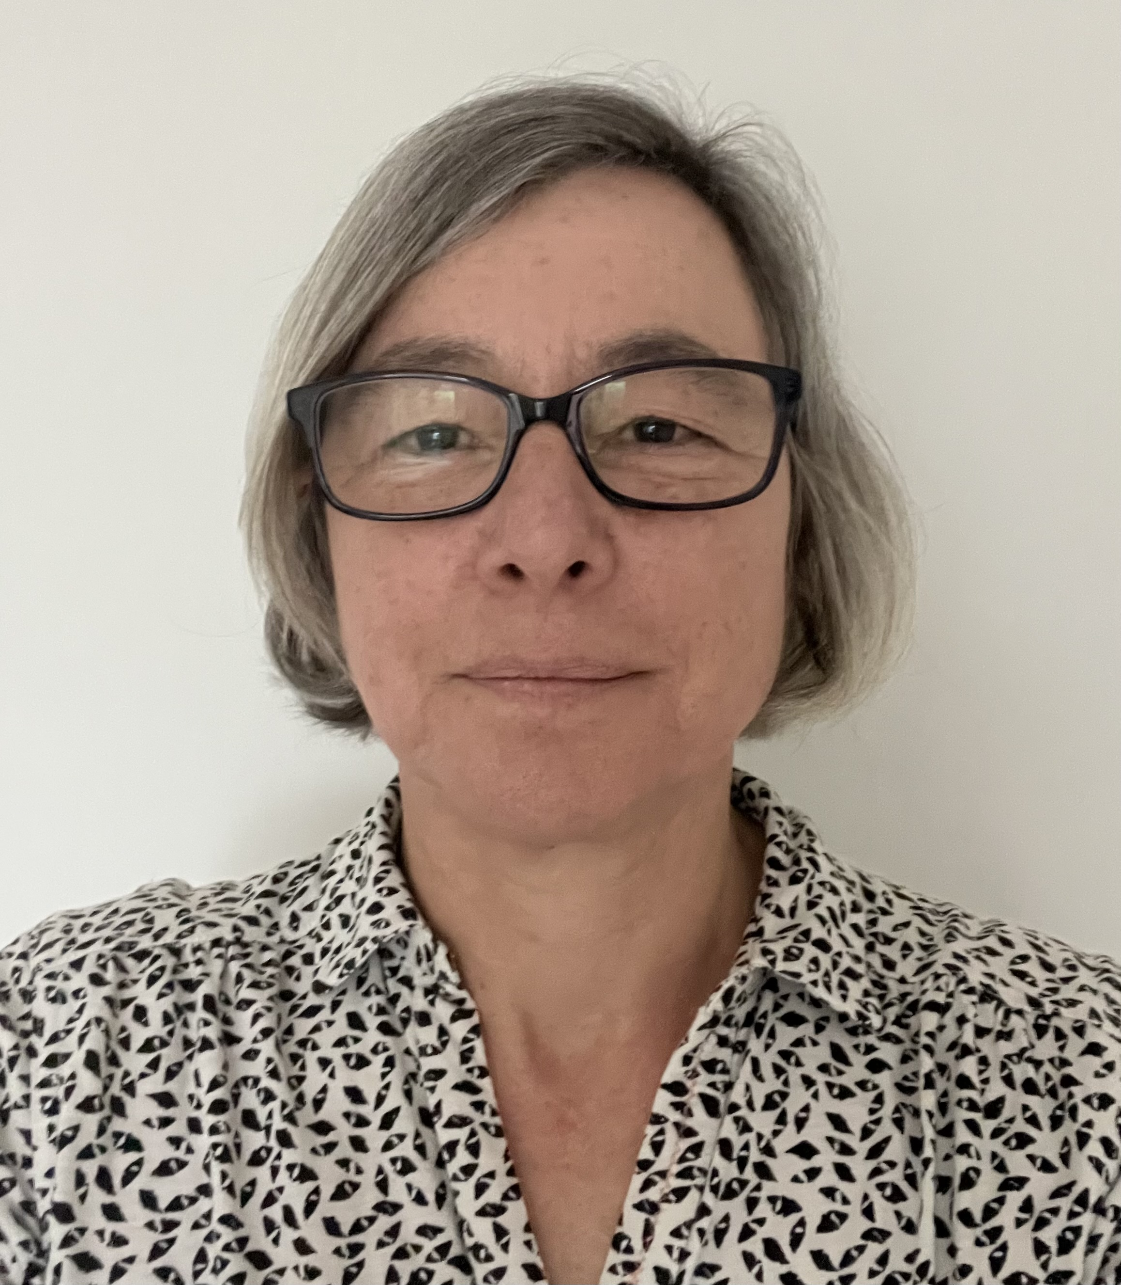
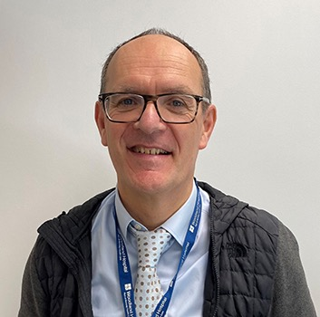
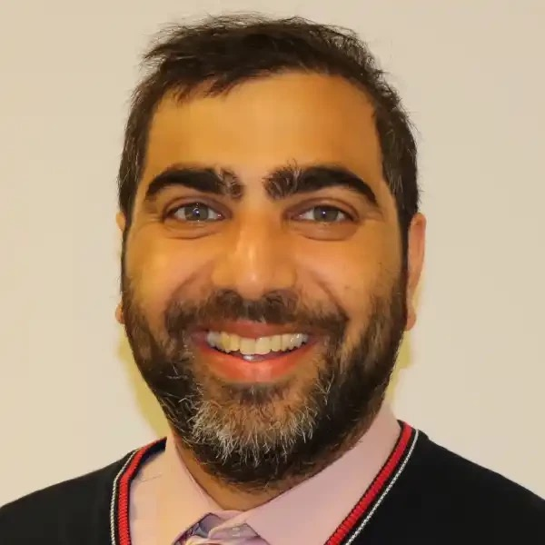
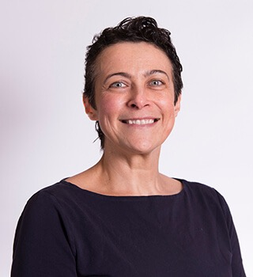
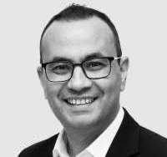
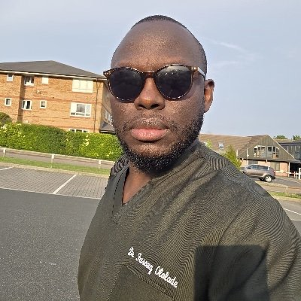
PLT Wed 13 May 2026
1:30 Issues affecting GP Retention in Northamptonshire
  Dr Cathy Appleton
  Programme Director Northamptonshire GP Retention Scheme
1:50 Issues affecting the Dermatology Interface
Interview with Dr Olivia Stevenson
2:10 Improving Communication in Dermatology
Farouq Ololade
Interface GP in Dermatology
2:30 Tea Break
2:40 Improving the Interface Nationally and Locally
  Dr Cathy Appleton
3:00 Improving Communication in Urology
Mr David Payne Consultant Urologist & Clinical Director
Ammar Ghouri GP Partner Lakeside Practice Corby
3:30 Use of AI in the Interface Communication
Mr Shady Nafi Consultant Urologist KGH
3:50 Improving the Interface at UHN
Dr Emily Winters
Associate Medical Director Primary and Secondary Care
4:00 Questions and Conclusion – Going forward
Introduction of New Interface GPs

Slide 2
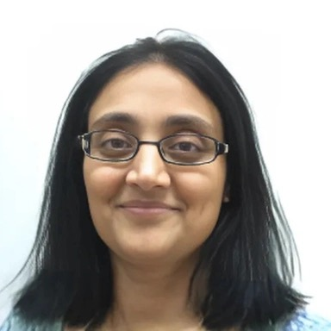
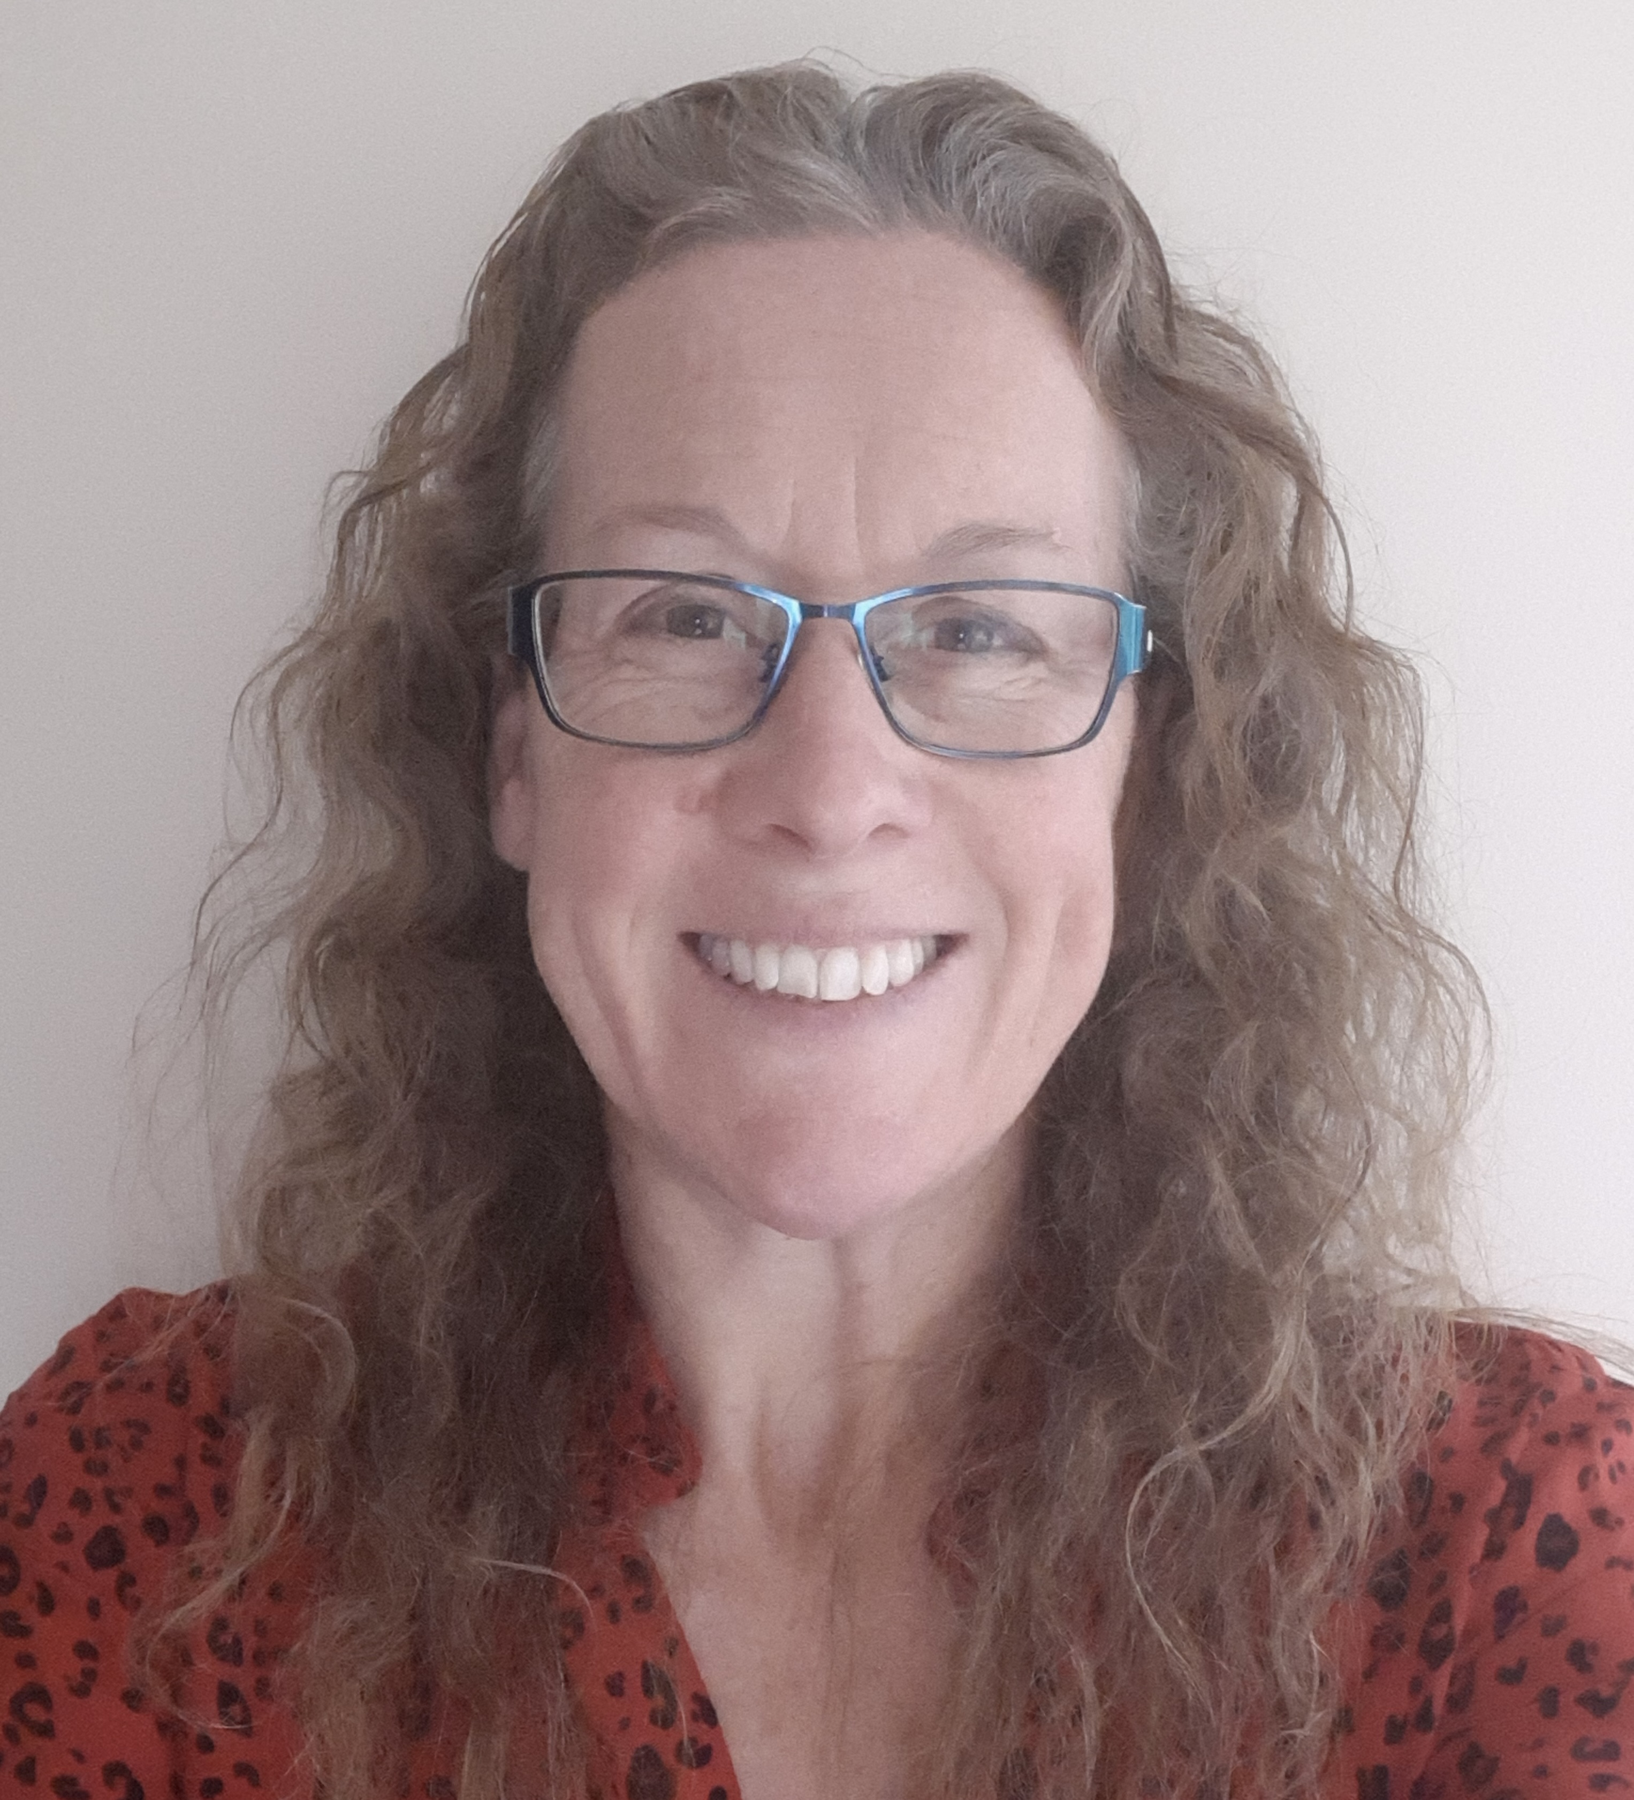
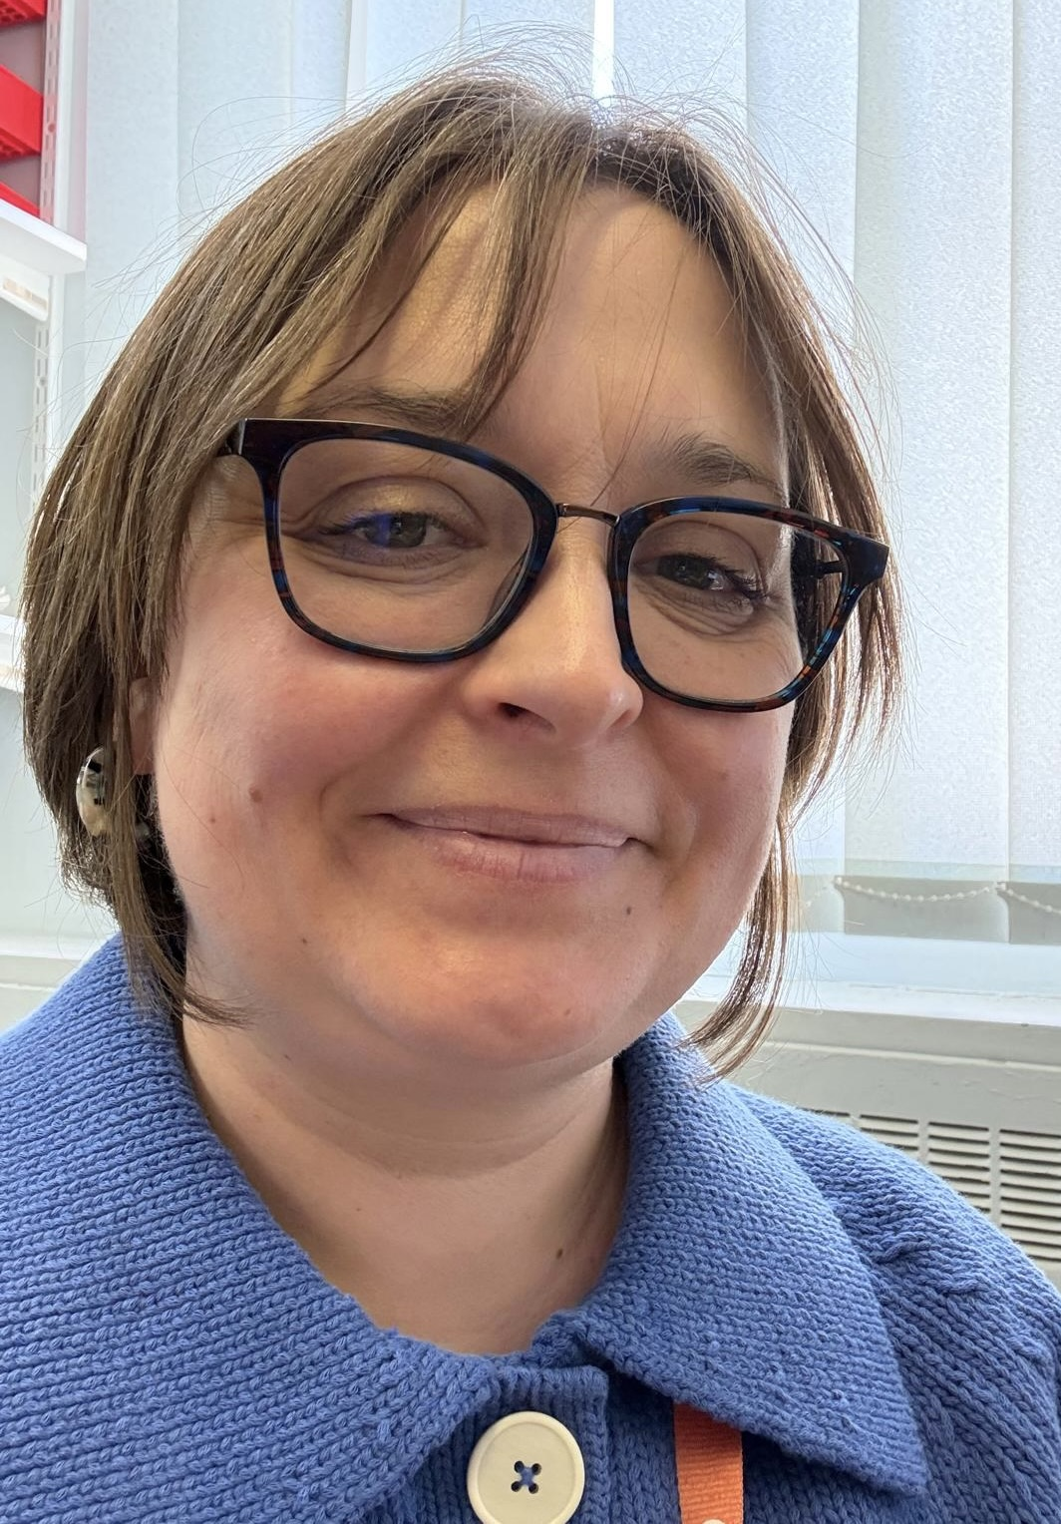
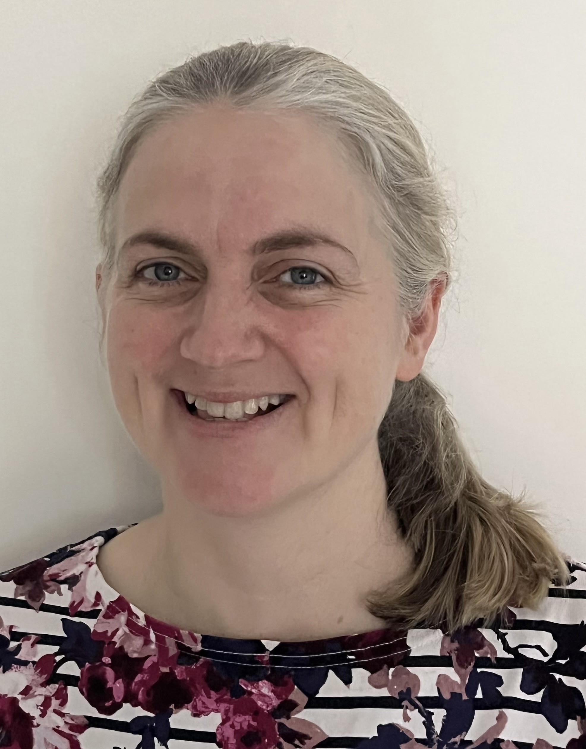
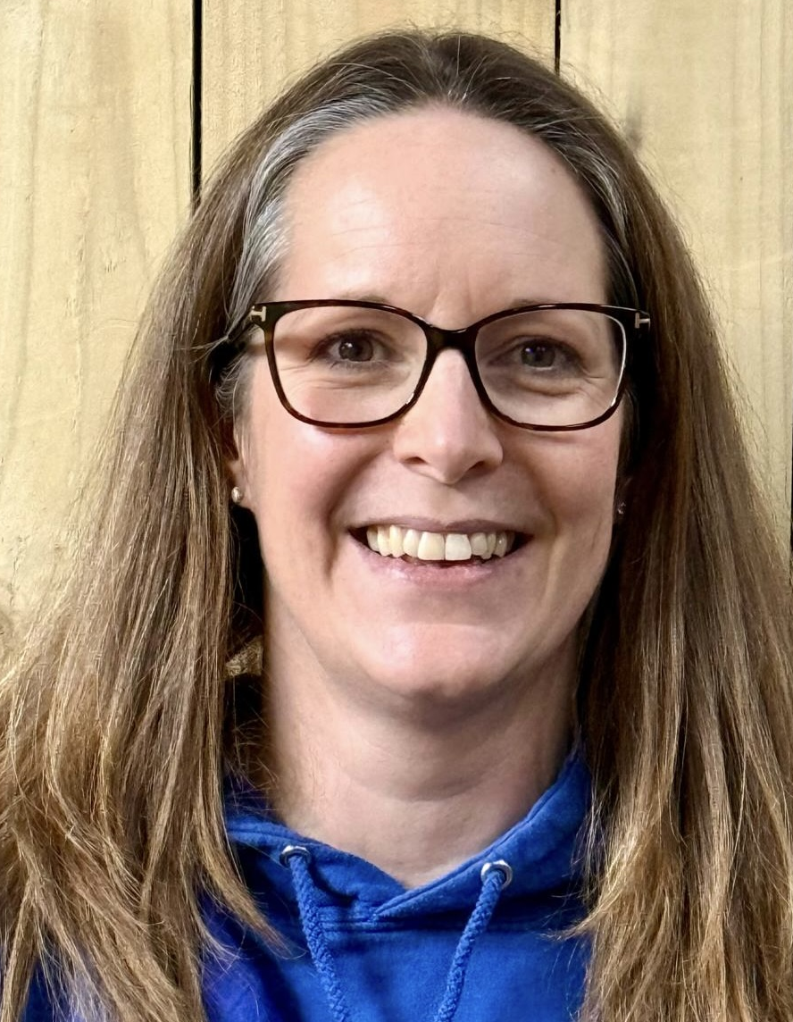
New Interface GPs and Consultants
Mrs Ami Shukla
Consultant Gynaecologist
NGH
Dr Imogen Norton
Consultant Paediatrician
NGH
Dr Emily Jackson
Dr Sian Loe
Dr George Bennett

Slide 3
