Slide 1
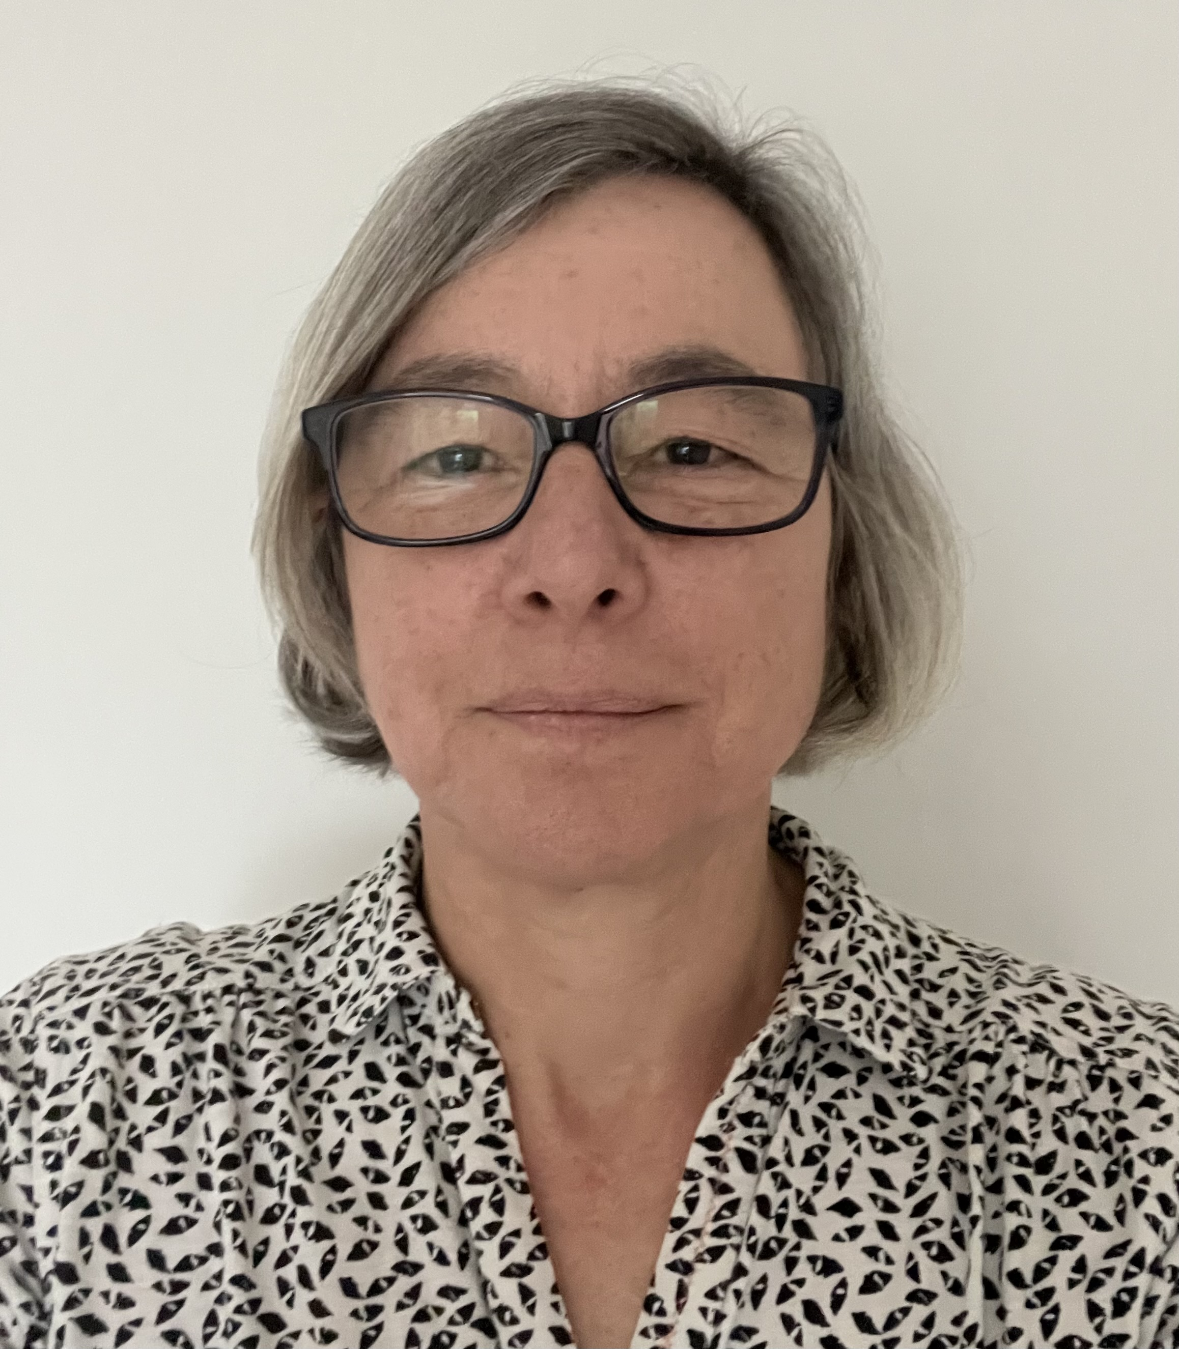
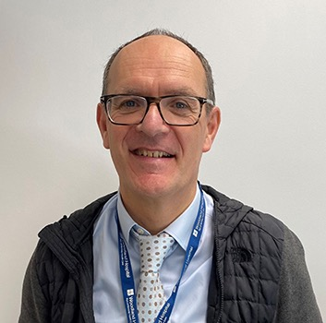
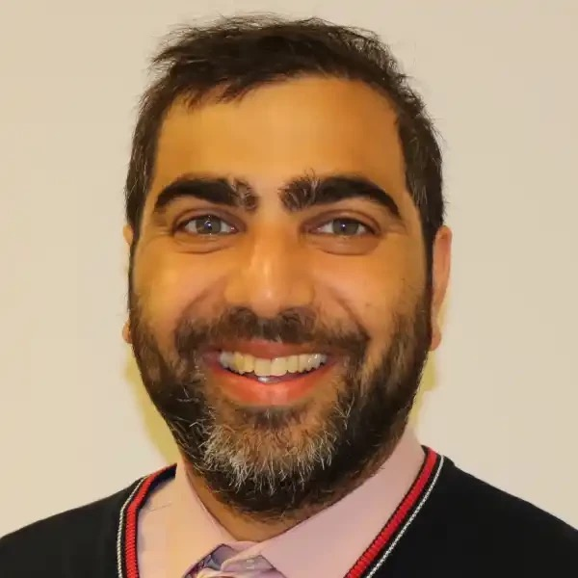
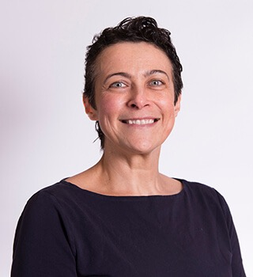
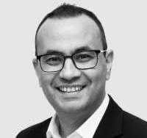
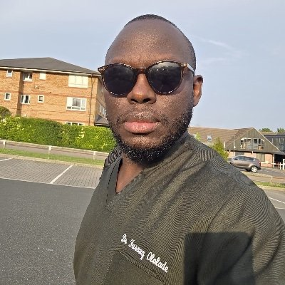
PLT Wed 13 May 2026
1:30 Issues affecting GP Retention in Northamptonshire
  Dr Cathy Appleton
  Programme Director Northamptonshire GP Retention Scheme
1:50 Issues affecting the Dermatology Interface
Interview with Dr Olivia Stevenson
2:10 Improving Communication in Dermatology
Farouq Ololade
Interface GP in Dermatology
2:30 Tea Break
2:40 Improving the Interface Nationally and Locally
  Dr Cathy Appleton
3:00 Improving Communication in Urology
Mr David Payne Consultant Urologist & Clinical Director
Ammar Ghouri GP Partner Lakeside Practice Corby
3:30 Use of AI in the Interface Communication
Mr Shady Nafi Consultant Urologist KGH
3:50 Improving the Interface at UHN
Dr Emily Winters
Associate Medical Director Primary and Secondary Care
4:00 Questions and Conclusion – Going forward
Introduction of New Interface GPs

Slide 2
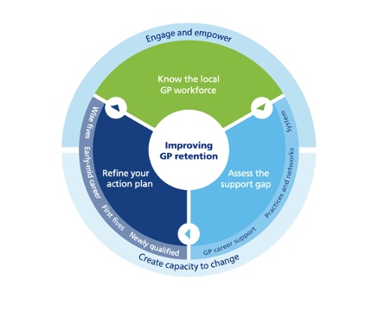
GP Survey September 2023
130 Replies to present GP survey (out of 500)

Slide 3
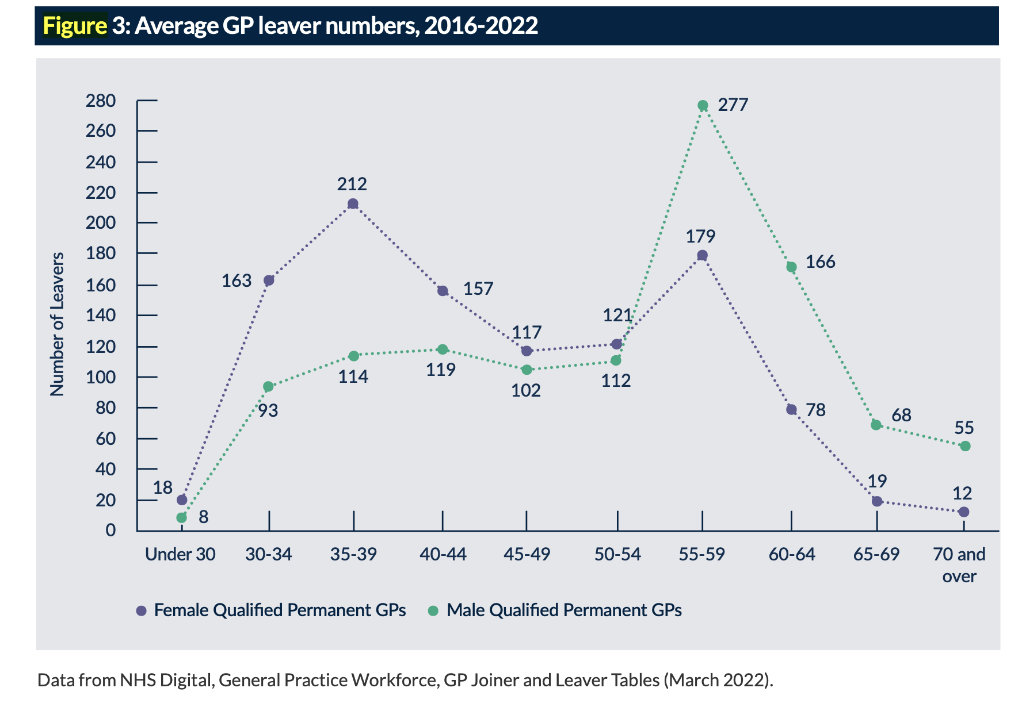
RCGP Fit for the Future Report Sept 22
High leaving rates in GPs aged 55-64 and female GPs in the 30-44 age cohort

Slide 4
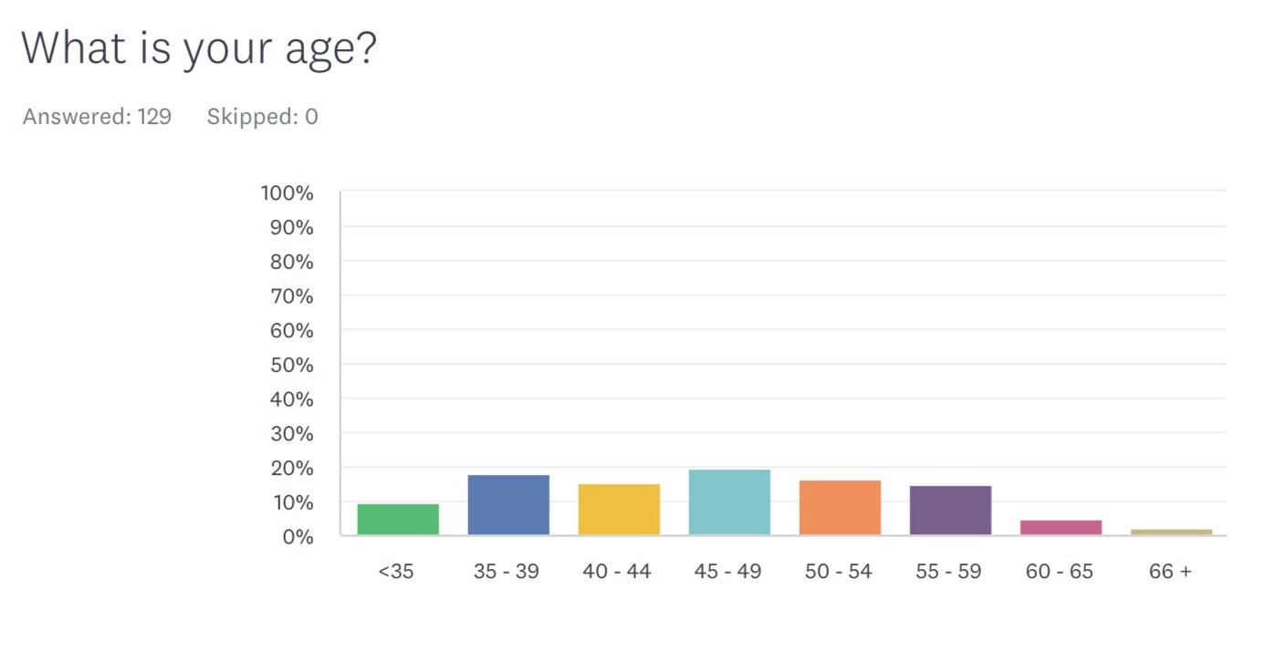
Northamptonshire GP Retention Survey September 23

Slide 5
Factors impacting your job satisfaction or resilience over the past year

Slide 6
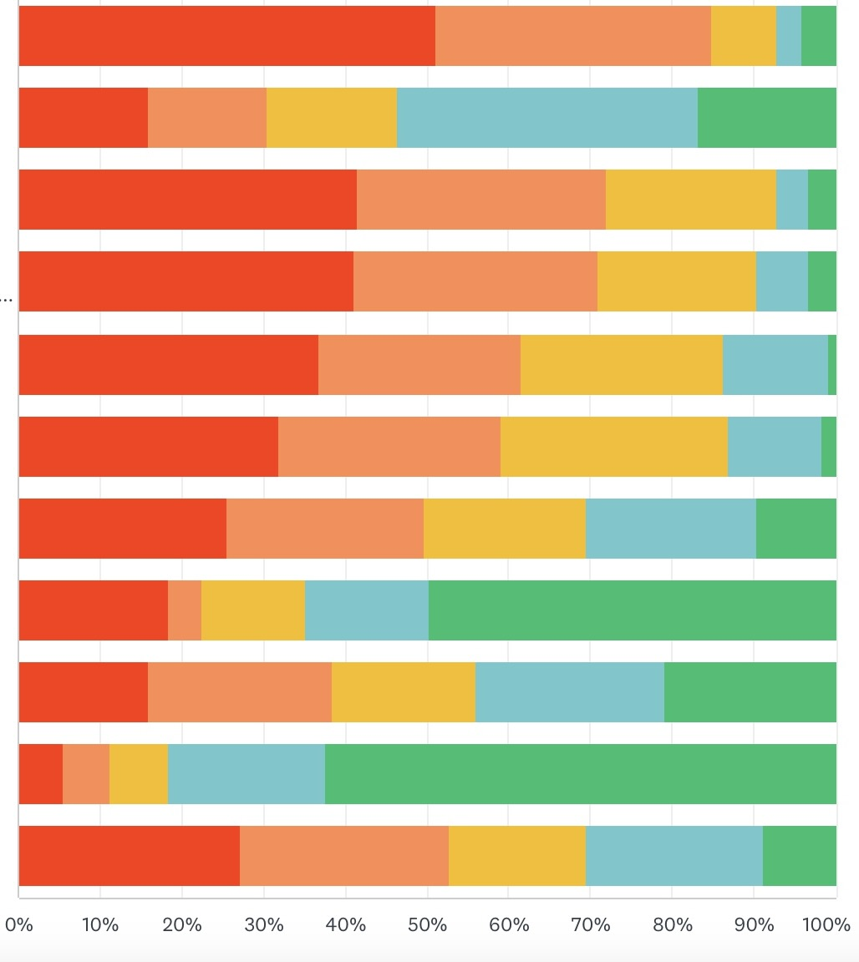
Factors impacting your job satisfaction or resilience over the past year
Excessive Primary Care Workload
Dissatisfaction with role/place of work/practice culture
Excessive workload from Secondary Care
Poor Communication with Secondary Care
Worry about errors / medicolegal risk
Regulation
Work becoming unsustainable due to financial reasons
Desire to move abroad
Work becoming unstainable due to family reasons
Personal Chronic Illness
Personal Lack of Resilience/ Burnout

Slide 7
Results from our local GP retention survey
Top 3 factors having a negative impact upon job satisfaction and resilience
    Excessive primary care workload (83% rated as very high/high impact)
    Excessive inappropriate secondary care workload (72% rated as very high/high impact)
    Poor communication with secondary care (70% rated as very high/high impact)

Slide 8
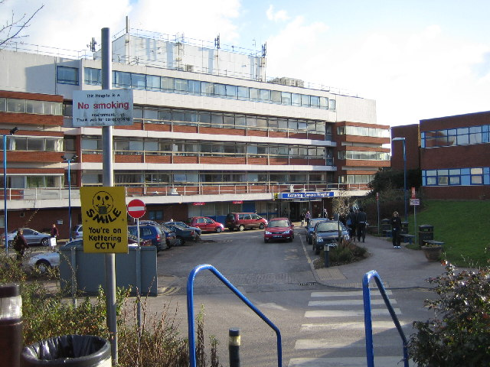
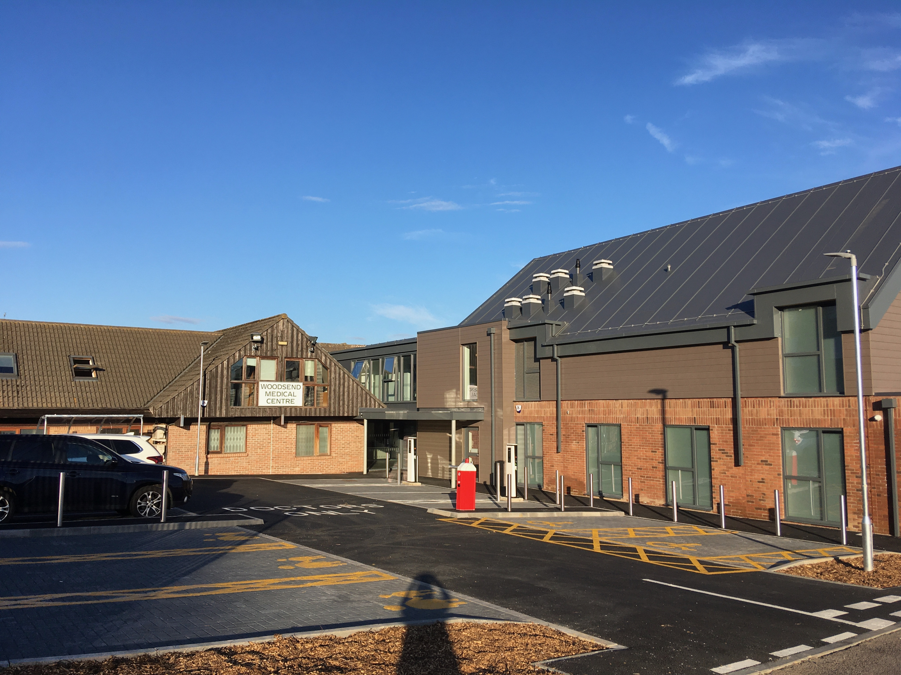
Clinical Interface GP Programme
This Photo by Unknown Author is licensed under CC BY-SA
Dr Cathy Appleton
Clinical Lead for GP Retention in Northamptonshire

Slide 9
Project commenced Sept 25
Recruited GPs in 5 specialities:
Urology ,Dermatology ( Sept 25)
Paediatrics and Gynaecology NGH, Breast and Gastroenterology ( April 26 )
Each Clinical Interface GP has a named consultant mentor.
GP practices appropriately funded to enable backfill.
Benefit to Secondary Care in improved communication and potentially reduced workload to compensate for time provided by supervising consultant

Slide 10
The Interface GP Role
The Interface GP’s main role is to act as a point of contact for consultants and GPs in addressing interface issues between primary and secondary care in a particular speciality
The role covers:
  Review of Speciality correspondence out to the GP and the patient
  Review of GP referrals into speciality
  Identify any difficulties relating to clinical investigations (ensure appropriate transfer of work to and from primary care).
  Review and Development of any referral guidelines and pathways.
  Review and Develop prescribing guidelines to encourage consistent prescribing in primary and secondary care
  Improve education of fellow GPs by facilitating education by consultants to GPs or delivering that education themselves if they are appropriately qualified.
  Generally promote “joined up” working with secondary care.

Slide 11
Suggested benefits
Improving communication and relationships between secondary and primary care
Reducing inappropriate workload being transferred between secondary to primary care
Increased capacity released in both secondary and primary care through reducing administration related to the above
New opportunities for clinical education of both primary and secondary care clinicians.
Benefits GP retention by:
  offering additional portfolio roles and
  reducing negative impact upon job satisfaction and resilience of all other GPs

Slide 12
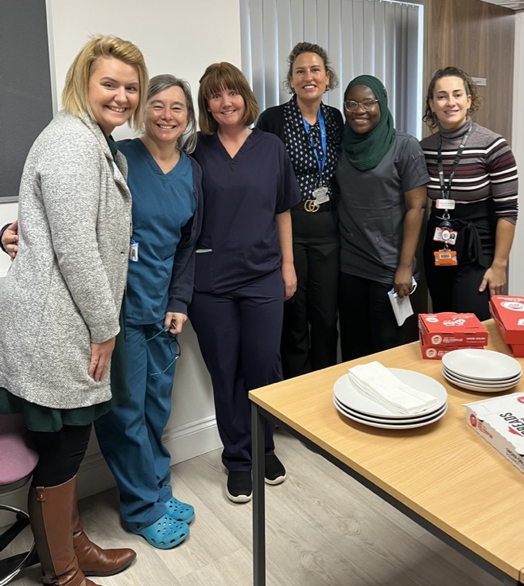
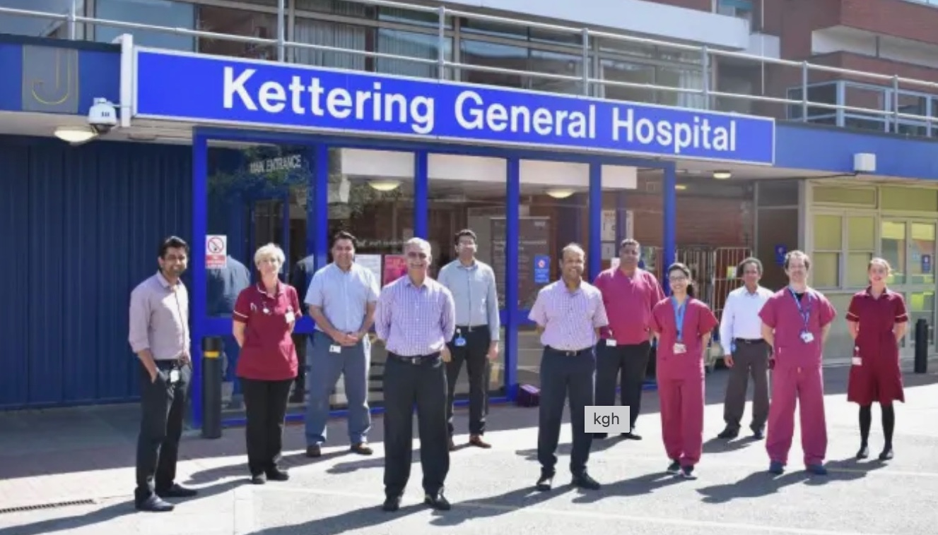
Clinical Interface GP Programme

