Slide 1
Urology Interface Role
Ammar Ghouri

Slide 2
Background
GP Partner – Lakeside Corby
LMC Rep – Lakeside Corby
Locality Lead – Corby & Oundle

Slide 3
Objectives
Communication
  Letters
  Complaints
  A&G queries and responses
Pathways
  Optimise utilisation of 1-stop clinic
  A&G vs C&B vs 2ww
  C&B Referral Delays – DP only had one in the last few weeks!
  GIRFT
Educational/engagement activities
  PLT

Slide 4
Results from our local GP retention survey
Top 3 factors having a negative impact upon job satisfaction and resilience
    Excessive primary care workload (83% rated as very high/high impact)
    Excessive inappropriate secondary care workload (72% rated as very high/high impact)
    Poor communication with secondary care (70% rated as very high/high impact)

Slide 5
An example….
Good afternoon,
I just had a quick question as I believe you are the GP liaison? If I am incorrect please let me know.
When we triage the patients from the GP referrals on ERS, some of them are being referred a while ago and then ending up a month or two later for us to triage... we just want to clarify if this is down to the patient not booking an appointment until a time after the referral has been made or if it's down to the gp not sending the referral off right away? I have had Mr Payne just enquiring about this during our triage session yesterday
an example we had was a patient whose referral was made on the 20th October but was only just added for us to triage in the last week - this patient has actually been upgraded to a 2ww from Mr Payne - so Mr Payne was concerned as its been over a month before he actually got to asses the referral
thanks
XXXXX
Urology Outpatient Waiting List Officers

Slide 6
Triaging C&B Urology Referrals – the benefits
Small number of patients however, out of 51 patients triaged
26% declined freeing up valuable space, some moved to correct pathways
  Adrenal mass on C&B changed to 2ww
  2x Patients Upgraded to 2ww
Of those accepted, urgent cases identified and care expedited
  2x Ureteric stone patients identified & Mx expedited
  2x patients upgraded
Tests requested to facilitate current clinic appointments identified
Triaging identified tests required for future One Stop clinics
  USS, Flexi, Flow, X-rays
Urgent waits/2ww reduced
IPSS / FVC don’t forget

Slide 7
Key Themes
Communication – it needs to improve (both ways)
  Understanding of pathways/systems mutually
  Responsive access
  Development of relationships
Consistency
  Pathways (agreed and accessible) to support referrals
  Responses to add value, especially A&G
  Reduce admin burden
Technology
  AI to help with aiding clinical decision making
  Assisting OPD with data to aid triage/appointment value e.g. IPSS/FVC/UTI etc

Slide 8
We need to talk more to each other….

Slide 9

WHICH CAUSES FRUSTRATION IN GENERAL PRACTICE
THE PROBLEM IS SAME DAY URGENT COMMUNICATION BETWEEN NUH AND GENERAL PRACTICE
WHICH CAN SIGNIFCANTLY DELAY OR IMPACT THE PATIENT JOURNEY
The
RIPPLE
EFFECT
A call can ensure efficient and timely discussion and review of a patient at their time of need
GPs spend a proportion of their day dealing with urgent, same day issues
GP has no choice but to send patient to the Emergency Department (which doesn’t solve the problem but just results in an admission happening later in the day
A call can prevent an unnecessary ED attendance and means that the patient can be admitted (if required) in daylight hours as apposed to later in the day (or into the night)
GPs struggle to get through to colleagues in secondary care and have no means of escalating the problem feeling helpless
Time lost due to delays in contacting secondary care specialties with on the day, response to urgent issues
Delay in patient being advised what the next step of the patient journey will be
GPs are restricted to making calls during or between patient appointments
Patient left worried and concerned about their health for longer than necessary
Colleagues in secondary care are often unavailable and unable to answer the phone straight away
Do GPs have easy access to key secondary care phone numbers?
Opportunity lost to redirect to an alternative service e.g outpatients/hot clinic or SDEC (or defer until next day) which can be a big disadvantage to the specialty
Phones may not have been diverted appropriately in secondary care
The impact of a GP not being able to reach the Trust should not be underestimated and can significantly affect the Trusts reputation.

Slide 10

NUH Fix It (WhatsApp Group) implementation
on the day response to urgent issues for when things don’t work
Implementation
A 2 week pilot commenced in November 2023 inviting a small (closed group) of GPs to report urgent issues directly to a newly created WhatsApp group. It’s aim to respond to issues as they arise to find a sensible solution. Due to the success of the pilot, over time the group has grown organically and now includes around 71 members (as at March 2026).
Secondary Care members of the group
Deputy MD/Digital and Information representation/Operations representation/Integration Project Lead for the Primary/Secondary Care Interface and
Ground rules
Clear ground rules were created from its inception and colleagues are reminded of these at regular intervals.
Feedback
We have received positive feedback from participants to date and it is breaking down the traditional barriers that previously existed between Primary and Secondary Care
Impact
In 2 years, over 200 issues have been raised through the group.
On average each issue is acknowledged, responded to and resolved within an hour of the issue being raised.
Work to review the themes is ongoing, however, the initial observation is that the majority of issues escalated are linked to human factors, such as the phone not being answered/going through to voicemail etc or digital issues.

Slide 11
Kettering and Corby CMHT
Team Contact Number: 03000 274 422 |  | Email
Operational Manager | Claire Barron | claire.barron@nhft.nhs.uk
Clinical Lead | Nicolle Chamberlain | nicolle.chamberlain@nhft.nhs.uk
Consultant Psychiatrist | Dr Tanner | eloise.corner@nhft.nhs.uk
Clinical Administrator | Eloise Corner | eloise.corner@nhft.nhs.uk
Specialist Nurse | Jessica Walker Leigh Green | jessicajane.walker@nhft.nhs.uk leigh.green@nhft.nhs.uk
Principal Psychologist | Katharine Law | Katharine.law@nhft.nhs.uk
Base:
Carey Block,
St Mary’s Hospital,
77 London Road,
Kettering,
NN15 7PW
CMHT Catchment surgeries:
Headlands Surgery
Rothwell Surgery
Studfall Medical Centre
Studfall Partnership
Lakeside Healthcare
Great Oakley Medical Centre
Please continue to make new referrals through the Integrated Response Hub: irhreferrals.south@nhft.nhs.uk
The Integrated Response Hub can also be contacted 24/7 on 0800 448 0828 or NHS 111 option 2 and choosing option 3 for the professional line for clinical advice and support.
Referrals for urgent same day assessments must still be made to the Urgent Care and Assessment Team (West) on 0300 11 11 004
For generic CMHT enquiries, you can email: cmhtadultnorth@nhft.nhs.uk

Slide 12
Kettering and Corby Urology
Team Contact Number: 03000 274 422 |  | Email
Operational Manager | Claire Barron | claire.barron@nhft.nhs.uk
Clinical Lead | Nicolle Chamberlain | nicolle.chamberlain@nhft.nhs.uk
Consultant Psychiatrist | Dr Tanner | eloise.corner@nhft.nhs.uk
Clinical Administrator | Eloise Corner | eloise.corner@nhft.nhs.uk
Specialist Nurse | Jessica Walker Leigh Green | jessicajane.walker@nhft.nhs.uk leigh.green@nhft.nhs.uk
Principal Psychologist | Katharine Law | Katharine.law@nhft.nhs.uk
Base:
Kettering General Hospital
Rothwell Road
Kettering
Northamptonshire
NN16 8UZ
Would this be more helpful with the local Urology team’s details ????
Catchment surgeries:
Headlands Surgery
Rothwell Surgery
Studfall Medical Centre
Studfall Partnership
Lakeside Healthcare
Great Oakley Medical Centre
Please continue to make new referrals through the Integrated Response Hub: irhreferrals.south@nhft.nhs.uk
The Integrated Response Hub can also be contacted 24/7 on 0800 448 0828 or NHS 111 option 2 and choosing option 3 for the professional line for clinical advice and support.
Referrals for urgent same day assessments must still be made to the Urgent Care and Assessment Team (West) on 0300 11 11 004
For generic CMHT enquiries, you can email: cmhtadultnorth@nhft.nhs.uk
Role | Name | Email
Consultant Urologist | Mr David Payne | david.payne4@nhs.net
Urology Nurse Practitioner | XXXXXX | xxxxxx@nhs.net
Uro-Oncology Nurse | XXXXXX | xxxxxx@nhs.net
Urology Clinic Coordinator | XXXXXX | xxxxxx@nhs.net

Slide 13
Ask a UHN Clinical Director…….
Looking beyond Urology
Primary/Secondary care Interface
Challenges and how to overcome
Northamptonshire Portal
Role of Technology

Slide 14
The future of referral triage/A&G
https://kgh-triage.vercel.app/
Working with Mr Nafie who is doing a qualification in AI
Commercial opportunities
Compliance work

Slide 15
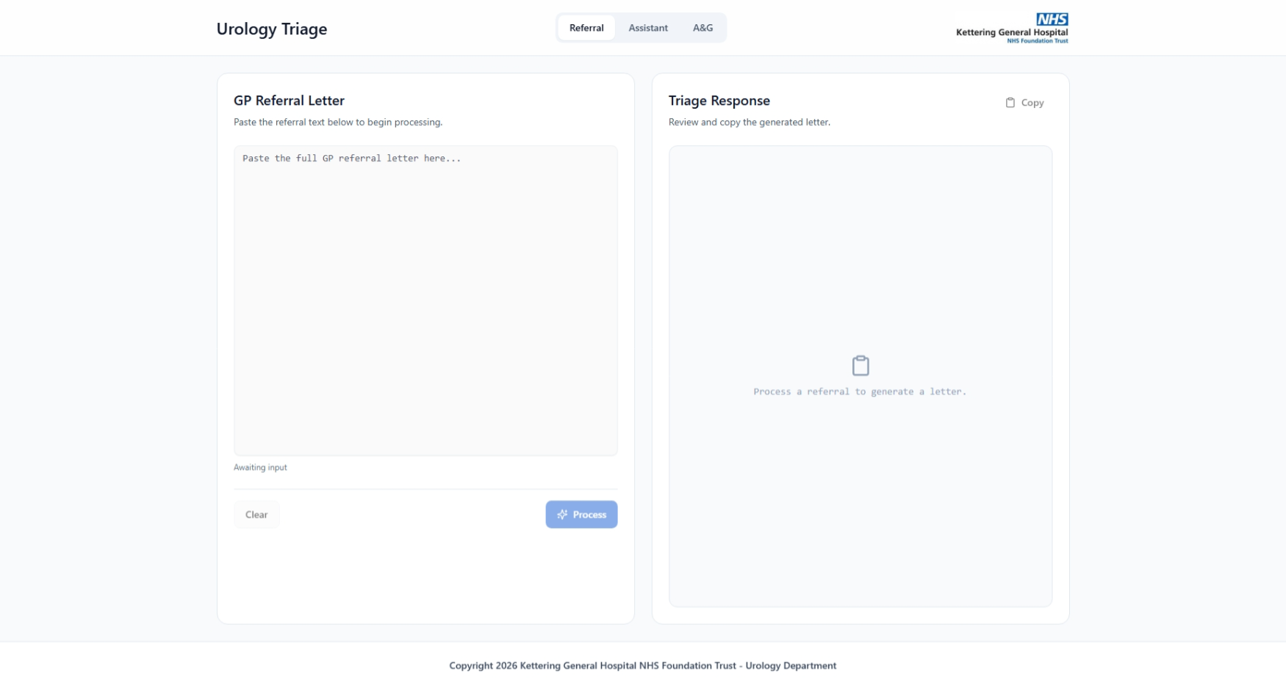

Slide 16
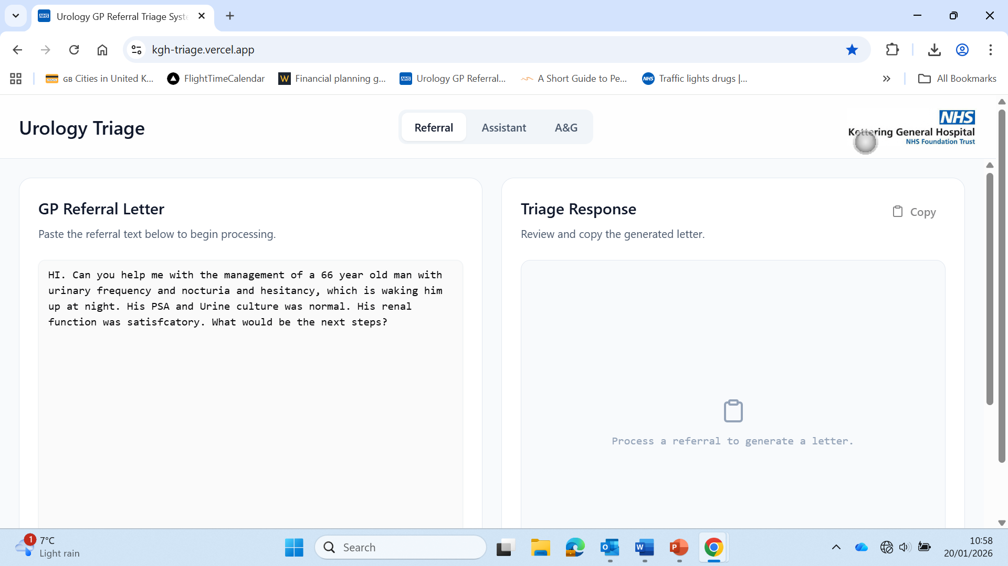

Slide 17
Questions, Thoughts & Thank You’s
Thank you to David Payne, Shady Nafie & Dan (Their secretary) for being friendly and accommodating
Thank you to Cathy and Mike for the opportunity
Thank you to Jayne Chambers (Transformation Manager @ KGH) for opening doors!
Interface role vital for better relations between primary/secondary care and improving the patient journey and outcomes

