Slide 1


SMI Heath Check Incentive Scheme
Northamptonshire Primary Care Networks

Slide 2
Purpose of the incentive scheme
Support Primary Care networks to deliver comprehensive (12-point) Physical Health Checks (including any/all indicated follow-up interventions) to >60% of people with an SMI each year.
Increase this level of care to >80% of people with an SMI, by 31st March 2024.
Provide education and awareness of the needs of people with SMI including how to engage them to feel comfortable with participating in the annual health check process and addressing any identified needs.

Slide 3
Who is included in this scheme?
Any patient on a Northamptonshire GP practice register coded as having a Severe Mental Illness. This should include any patient with diagnoses of:
schizophrenia
bipolar affective disorder
other psychoses
And
any patient on lithium therapy
Note: those in remission are not included

Slide 4
Previous measures extracted by NHS England and NHS Improvement
BMI/ Waist Circumference
Blood pressure & pulse check
Blood lipid including cholesterol
Blood glucose test
Assessment of alcohol use
Assessment of smoking status
Notes:
Targets were set in the Mental Health Five Year Forward View, and subsequent NHS Long Term Plan for Mental Health, to ensure that at least 60% of people with an SMI received an annual physical health check.

Slide 5
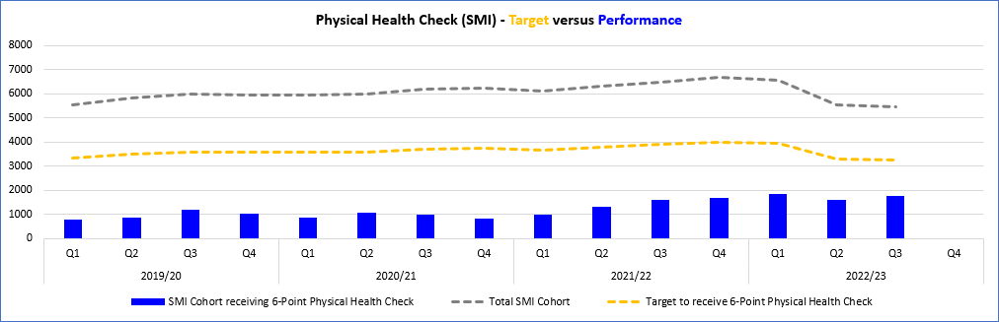
Physical health checks In Northamptonshire
Notes:
Performance (blue bars) compared to target (orange line) for the 6 Core elements of the health check, over the past few years.

Slide 6
Physical Health Check template – new required content
BMI/ Waist Circumference
Blood pressure & pulse check
Blood lipid including cholesterol
Blood glucose test
Assessment of alcohol use
Assessment of smoking status
Assessment of nutritional status, diet and level of physical activity
An assessment of use of illicit substance/non prescribed drugs
Access to relevant national screenings
Medicines reconciliation and review
General physical health enquiry into sexual health and oral health
Indicated follow-up interventions
Notes:
The Long Term Plan seeks to raise the annual standard to 80% of the SMI cohort, by 2023/24 and include 12 elements.
Enhanced payments will be calculated on the basis of data submitted by practices onto the ARDENs Manager platform. Therefore, if data is available on System One/ EMIS, but not uploaded onto ARDENs, practices will not receive enhanced payments.
Qualification for enhanced payments under this scheme will be monitored and awarded at practice Level, but GP Practices within each Primary Care Network can still work together to understand the needs of their ‘neighbourhood’ and agree a shared strategy for achieving the outcomes for this patient cohort. Primary Care Networks are also encouraged to work closely with the Secondary Care Mental Health (now arranged around PCN footprints) to understand/ agree division of responsibilities, set up clear Shared Care protocols and ensure appropriate Information Sharing Agreements are in practice for System One data entry.
Remission and exception reporting has been reviewed under the policy of Personalised Care Adjustments. Under this new guidance, a patient can be seen as being in remission (and not requiring an annual physical health check) if there has been no evidence of SMI symptoms, not prescribed psychotropic medication and not been in contact with secondary mental health services for a period of five years.
Also under the Personalised Care Adjustment guidance, a patient can be exception reported for individual elements of the health check if they choose not to engage with those elements. Patients can also be exception reported from certain follow-up interventions if they are deemed clinically unsuitable for that intervention. Exception report codes for non-response or DNAs have now been removed from the Business Rules for Patient-Level Data Extract.

Slide 7
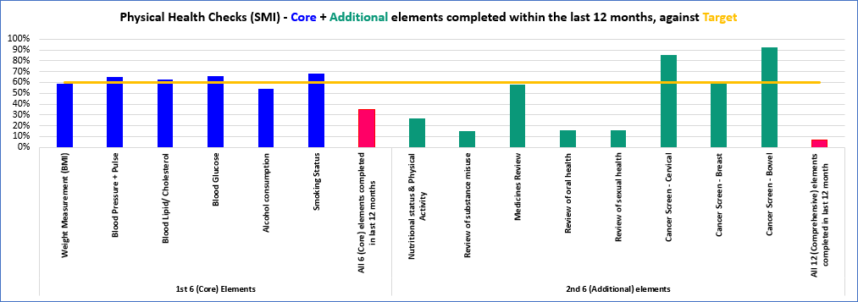
Physical health checks In Northamptonshire
Notes:
Most of the first 6 checks meet the target but people not receiving all six. Many of the second 6 checks fall below target.

Slide 8
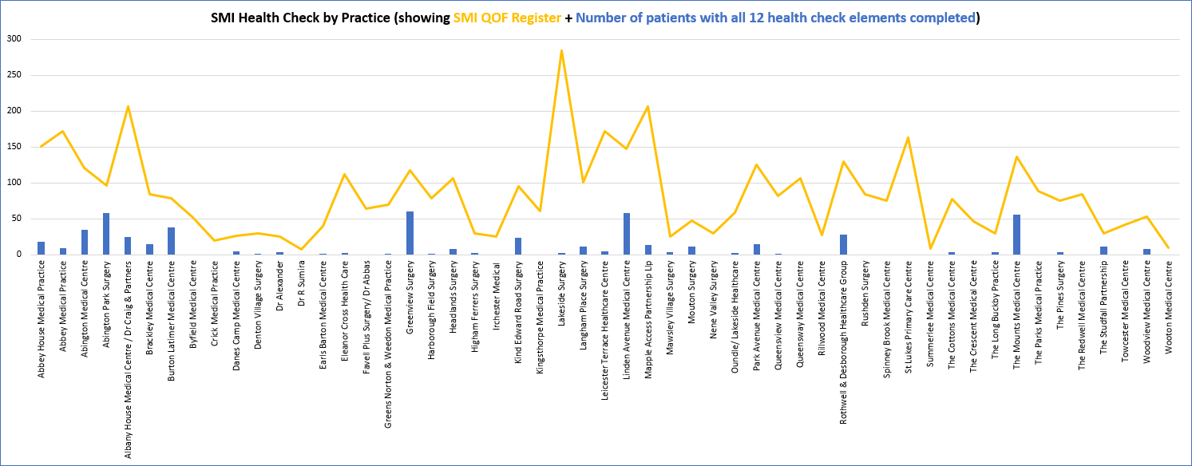
Physical health checks by practice
Notes:
Shows the number of people on SMI QOF Register by Practice (yellow line) + the number of patients who have received a 12-point AHC (blue bars)
No data available:
Woodsend Medical Centre
The Saxon Spires Practice
The Meadows Surgery
Springfield Surgery
Parklands Surgery
Danetre Medical Practice
Bugbrooke Medical Centre

Slide 9
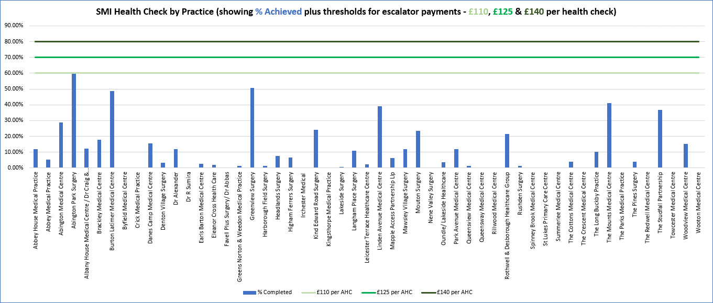
Physical health checks by practice
Notes:
Shows the %of AHC completed (blue bars), plus the thresholds for obtaining escalated payments under the Enhanced Scheme (three green lines)
No data available:
Woodsend Medical Centre
The Saxon Spires Practice
The Meadows Surgery
Springfield Surgery
Parklands Surgery
Danetre Medical Practice
Bugbrooke Medical Centre

Slide 10
Follow up interventions
Advice and/or referral for further behavioural support:
Diet
Exercise
Smoking
Alcohol
Specialised services:
Diabetes
Alcohol
Substance misuse
Medication:
Statins
Antihypertensives
Sexual health
Cancer
Oral health
Notes:
Note – not an exhaustive list. Interventions will be dependant on the situation of each individual patient.

Slide 11
The role of WORTH
Provision of :
Training for clinicians and administrators
Support for clinicians
Advice for practices
An evaluation of the project

Slide 12
Training for clinicians
It is recommended that clinicians attend both sessions listed below.
Face to face training to ensure they have the knowledge they need to carry out effective health checks.
Online training to ensure they know how to code all elements of the health check into the patient’s record.

Slide 13



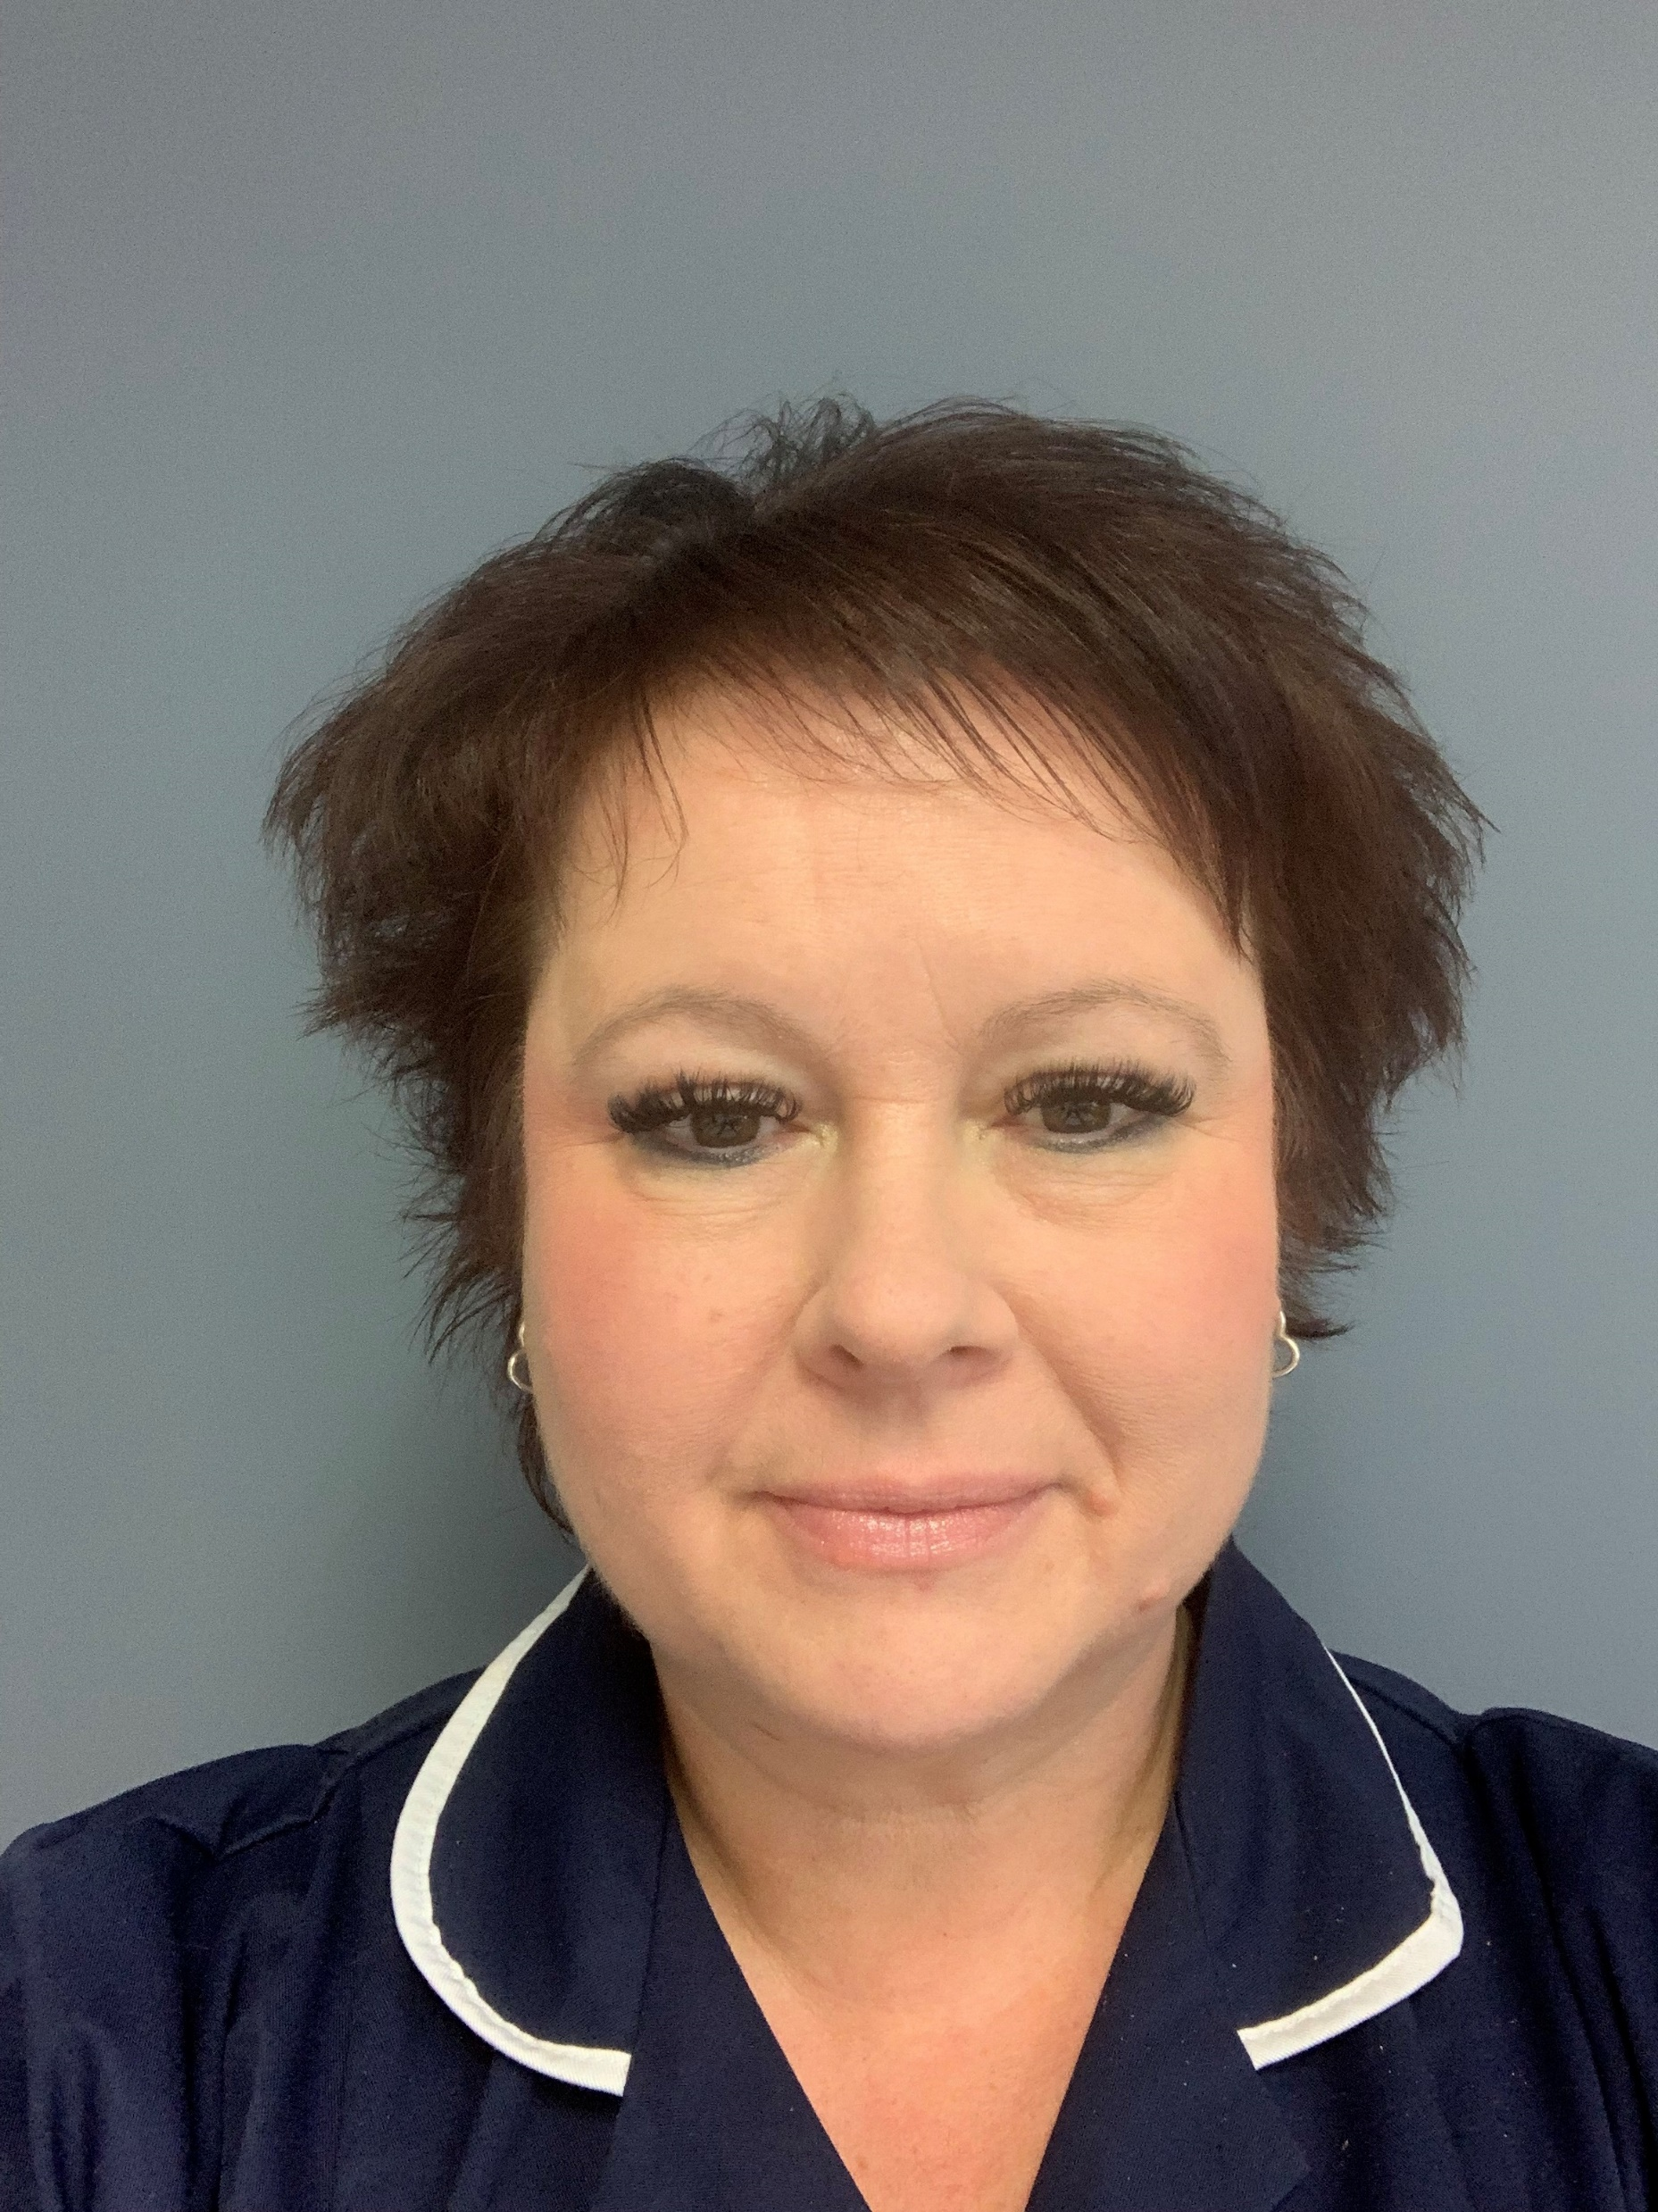

Meet the clinical trainers
Notes:
Lucinda Godfrey
Georgie Callard
Darren Whiting
Fleur Matthews

Slide 14
Training for administrators
Online training to show administrators how to ensure all elements of the health check completed are coded correctly to trigger payment

Slide 15

Book your training
https://www.worthwellbeing.co.uk/smi-physical-health-checks/

Slide 16
Support
Clinicians can access support and information following their training by contacting their trainer directly
Other members of the practice team can contact our administrator Lisa Chambers lisa.chambers11@nhs.net who will pass queries to the appropriate member of the WORTH team
Posters for you to display to your patients with SMI will be provided

Slide 17
Evaluation
We aim to find out whether:
Staff delivering training and assisting primary care staff feel prepared and supported in this role
Staff providing the health checks understand the needs of people with SMI and know how to deliver the best care for this group
Managers of staff carrying out the health checks are able to facilitate the delivery of recommended care
Staff providing the health checks feel supported to carry out the role
There is a significant increase in the county of each element of the health check completed
There is a significant increase in the county of all elements of the health check completed
People with SMI attending a health check are offered help to change any identified unhealthy behaviours
People with SMI want to engage in activities to improve their health

Slide 18
Thank you!

