Slide 1

PLT Wound care clinics
Sam Stairs , Head of Nursing and AHP’s Adult community services

Slide 2
Tier 1 and 2 assessment
Rising complexity of wounds , requiring specialist intervention
Northamptonshire tiered wound model developed to support hard to heal wounds with specialist intervention
All wound triaged and assessed by TVN
Important that all wounds are assessed and treated comprehensively
Consider and record patient factors , co morbidities , diabetes , vascular disease , mobility and nutrition
Wound factors type , size depth , exudate , odour pain , infection indicators , length of time present

Slide 3

Lower limb assessment (Northamptonshire lower limb wound pathway)
Doppler /ABPI
Capillary refill
Temperature gradient
Oedema
Foot deformity and off loading

Slide 4
Red flags
Suspected ischemia
Spreading infection
Sepsis indicators
Necrosis
New ulcer in diabetic foot (Refer to diabetic high risk foot within 24 hours )
Documentation using local wound template Ardens
Include photography
Consider atypical wounds (vasculitic , malignant, osteomyelitis )

Slide 5
Lower limb wounds – ABPI thresholds
ABPI ,0.5 stop any compression urgent vascular referral
ABPI 0.5-0.8 mixed disease – refer to vascular / TVN
ABPI 0.8-1.3 suitable for 40mmHg venous
ABPI >1.3 possible calcification waveform assessment

Slide 6
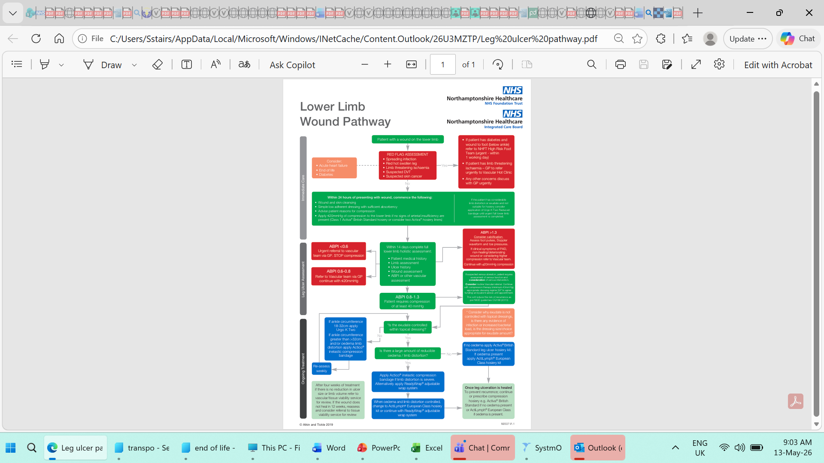
Lower limb wound pathway

Slide 7
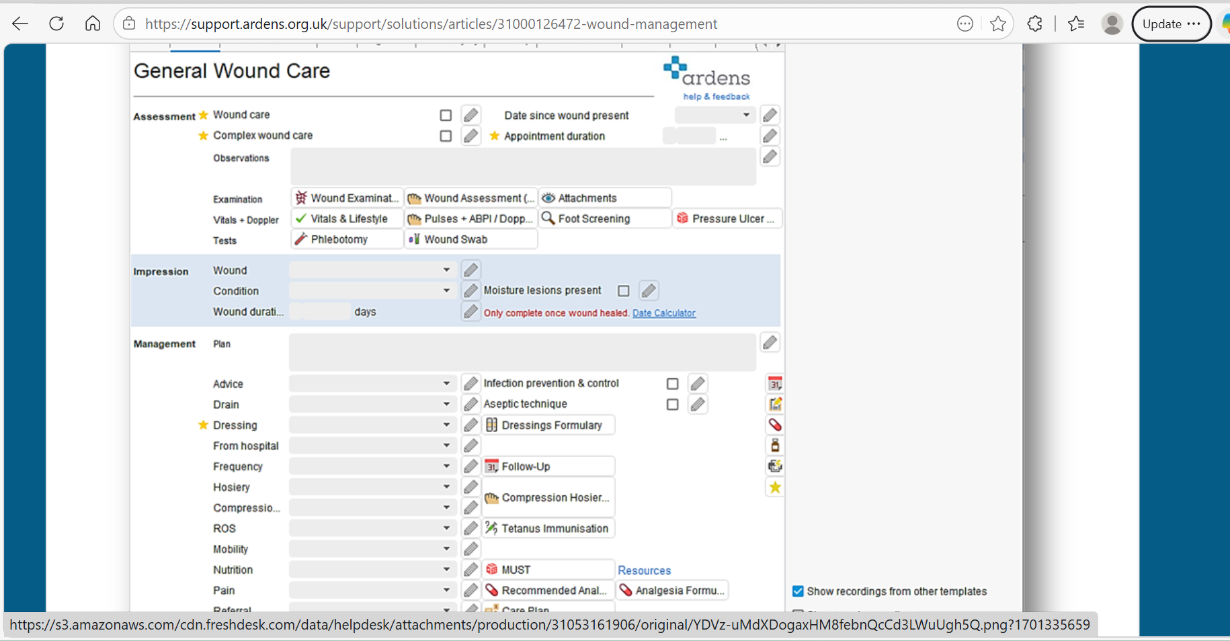
Ardens template

Slide 8
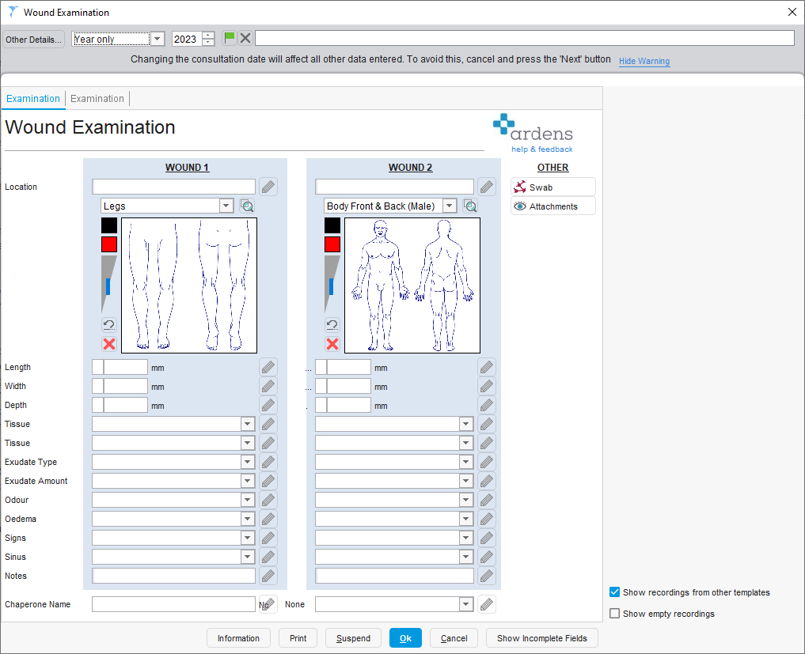
Body mapping

Slide 9
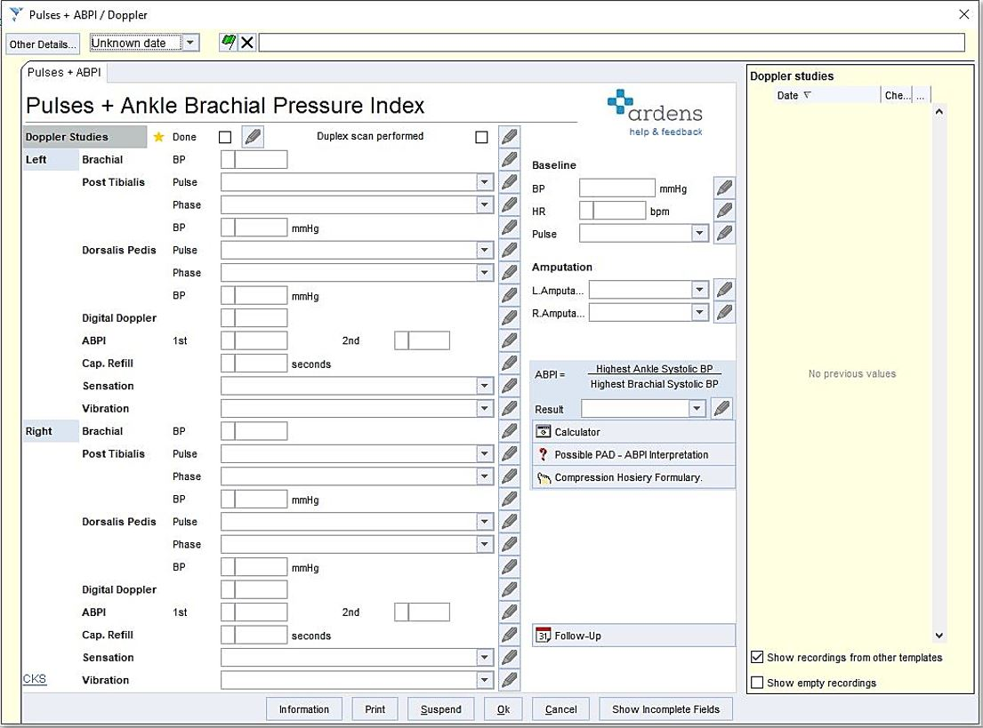
Pressure index

Slide 10
Wound healing
Factors that delay wound healing
Poor perfusion
Infection
Uncontrolled oedema
Diabetes
Pressure or shear
Inappropriate dressing selection
Suboptimal compression
Wounds should reduce in size 20-30% in 4-6 weeks
Should have healthy granulation
Reduced exudate
No odour
Pain improving
Edges contracting and epilthlisation

Slide 11
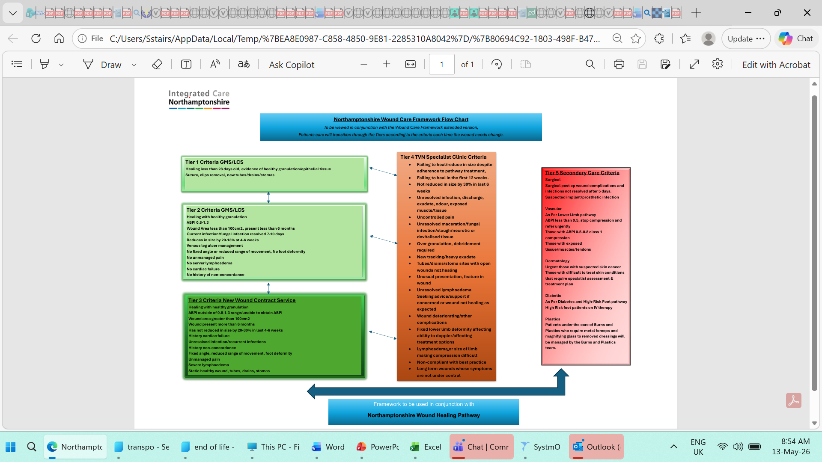
Northamptonshire Tiered Wound Pathway

Slide 12
Tier 1 and 2
Simple wounds
Healthy granulation
Signs of healing
Post op drains and stomas
ABPI 0.8-1.3
Wounds less than 100cm2 and less than 6 months old
Venous leg ulcer management
No foot deformity
No severe lymphoedema
Assess and refer to tier 3/4 if assessment suggests

Slide 13
Tier 3 and tier 4 escalation triggers
No wound improvement 2-6 weeks despite following all plans
ABPI <0.8 >1.3
Suspected arterial disease
Diabetic foot ulcer
Spreading infection
Necrosis
Pain out of proportion
Recurrent ulceration

Slide 14
Upward referral
Full assessment documented
ABPI results (if appropriate)
Wound photographs
Complete referral to tier 3 or 4
Triage will occur within 5 working days
An appointment will be offered, or contact will be made within 7 working days please continue to see the patient until this is confirmed
If a patient declines, you will receive communication from us
The patient will then be seen in clinic at agreed location

Slide 15
Downward referral
Tier 3 clinic staff will
Provide a clear treatment plan
Reescalation advice
Confirmation will be sought from receiving practice prior returning appointments to the practice.

Slide 16
Delegation of care
Registered nurses remain clinically responsible for care
Delegated tasks to HCA’s require clinical oversight from registered nurses
Wounds should be seen regularly by registered staff
All wounds referred to tier 3 should have registered nurse oversight

Slide 17
Pressure relief
Must occur across the whole system
Pressure ulcer prevention training for all
Millbrook low level training and PIN’s for equipment ordering for all
Risk assessments completed on all wounds waterlow or Purpose T , MUST , ASSKING
Check heels , sacrum and bony prominences
Assess footwear , check any equipment used
Consideration for provision of pressure relieving equipment
Supporting community teams for patients under your care
Giving advice to patients on :
Movement
Nutrition
Hydration
Links with age well who can provide basic cushions

Slide 18
Across the whole system
Primary care early identification , risk assessment and prevention equipment and advise
Community nursing intervention for those who are unable to access health in another setting education and monitoring
Therapy seating , mobility , posture and equipment
Patients and carers self care , repostioning , reporting changes to professionals
Culture if you see the patient own it don’t assume it is someone elses responsibility
Early action will prevent harm
Everyone can contribute

