Slide 1

Fungal Infections
Charlotte Anderson
Tissue Viability Team

Slide 2
Learning objectives
Recognising Fungal Infection​
Differentiation from Other Conditions​
Clinical Diagnosis and Investigations​
Effective Treatment Strategies​
Notes:
Training focuses on distinguishing fungal infections from bacterialinfections and other skin conditions for accurate treatment.​
Emphasis on clinical diagnosis while outlining when further tests like skinscrapings or referrals are necessary.​
Knowledge of topical antifungals, moisture control, cautious use ofcombination products, and criteria for escalation is provided.​

Slide 3
Clinical Impact of Missed Fungal Infection in TV
Impact of Missed Diagnosis​
Missed fungal infections cause prolonged discomfort and worsen skin breakdown in vulnerable patients.​
Complications in Wound Healing​
Fungal infections delay healing by increasing wound maceration and causing recurrent deterioration.​
Antibiotic Misuse Consequences​
Inappropriate antibiotic use disrupts skin microbiome and promotes fungal overgrowth, worsening outcomes.​
Importance of Early Recognition​
Early fungal infection detection enables targeted treatment and reduces healthcare burden.​
Notes:
Fungal infections commonly coexist with: Moisture‑associated skin damage (MASD)
Pressure ulcers (especially sacral, groin, breast folds)
Venous leg ulcers
Often mistaken for: Cellulitis
Peri‑wound maceration
Contact dermatitis

Slide 4
Common Settings Where Fungal Infection Occurs
Warm and Moist Skin Folds​
Fungal infections commonly occur in warm, moist skin folds like groin, abdominal folds, under breasts, and between toes.​
Peri-wound and Pressure Ulcers​
Fungal infections often affect peri-wound skin and pressure ulcers, especially with moisture and occlusion present.​
Incontinence and Exudate Exposure​
Patients with incontinence are at higher risk due to prolonged exposure to urine or feces creating fungal-friendly environments.​
Medical Devices Impact​
Catheter sites and orthotic equipment can cause localized fungal infections from heat and friction.

Slide 5
Common Fungal Organisms Encountered in Wounds
Candida Infections​
Candida species thrive in moist environments causing erythema with satellite pustules in intertrigo and peri-wound skin.​
Dermatophyte Infections​
Dermatophytes cause drier, scaly, well-defined lesions.​
Clinical Presentation Differences​
Candida presents with erythema and pustules; dermatophytes show scaly lesions with central clearing and defined edges.
Notes:
Classic signs:
Bright red or dusky red skin
Well‑defined edges
Satellite lesions (small red spots beyond main rash)
Itching/burning (common clue)
Maceration
White film or residue (sometimes)
)
📌 Pain is often mild compared to bacterial infection

Slide 6
Risk Factors That Predispose to Fungal Infection​
Moisture and Occlusion​
Moisture from incontinence, sweating, or wound exudate increases fungal risk, worsened by occlusive dressings creating warm, airless environments.​
Metabolic and Physical Factors​
Diabetes and obesity impair skin integrity and immune response, increasing fungal infection likelihood and persistence.​
Reduced Mobility and Hygiene​
Limited mobility decreases hygiene and repositioning, raising fungal infection risk in vulnerable patients.​
Immunosuppression and Antibiotics​
Immunosuppressed patients and those on prolonged antibiotics have disrupted skin flora, facilitating fungal proliferation.​
Notes:
Moisture (urine, sweat, exudate) Occlusion (dressings, folds) Diabetes Obesity Poor mobility Repeated antibiotic use Immunosuppression

Slide 7
Comparison
Feature | Fungal | Bacterial
Pain | Mild–moderate | Often painful
Borders | Well‑defined | Diffuse
Satellite lesions | ✔ Common | ✖ Rare
Exudate | Minimal | Purulent
Odour | Usually minimal | Often unpleasant
Response to antibiotics | ✖ No improvement | ✔ Improves

Slide 8
How Fungal Infection Is Confirmed in Practice
Clinical Diagnosis Approach​
Fungal infection is primarily diagnosed clinically through visual assessment, symptom history, and treatment response.​
Role of Laboratory Tests​
Lab tests like skin scrapings aid diagnosis in uncertain, recurrent, or treatment failure cases but should not delay treatment.​
Swabbing
Swab affected area and ensure on swab request to provide rational for swab. Ie fungal infection, please breakdown any coliforms.
Specialist Referral and Treatment​
Referral to specialists is advised for atypical cases or immunocompromised patients; treatment should start confidently when fungal signs are clear.​

Slide 9
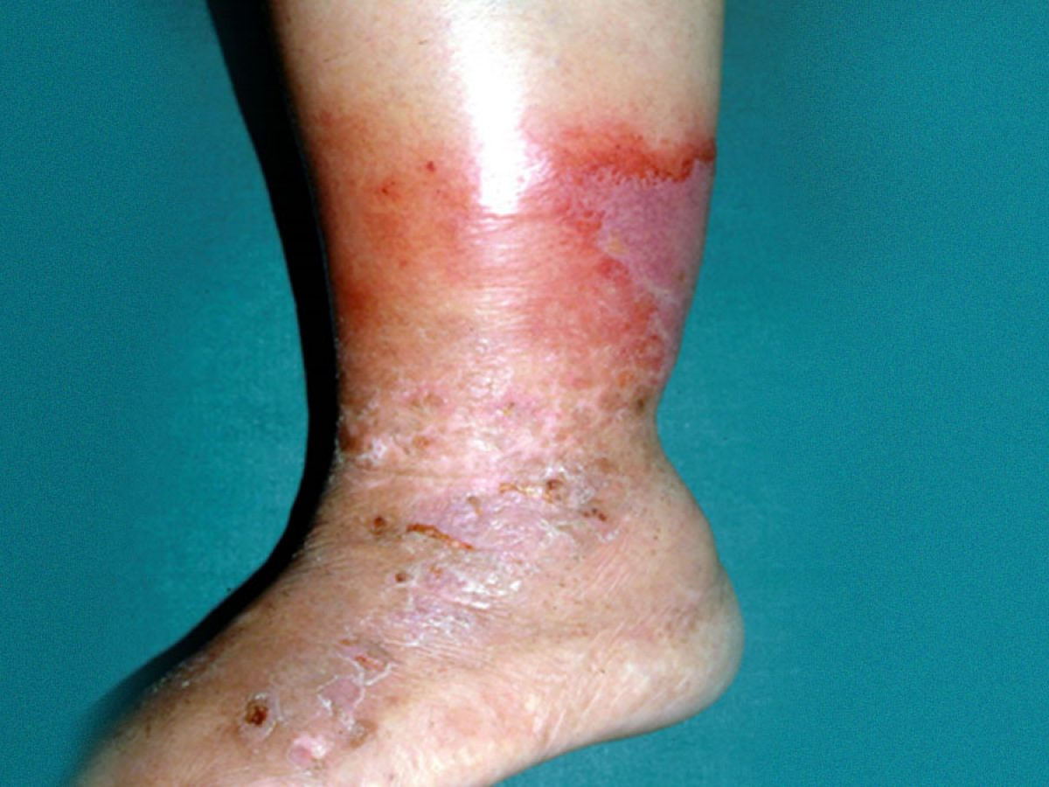
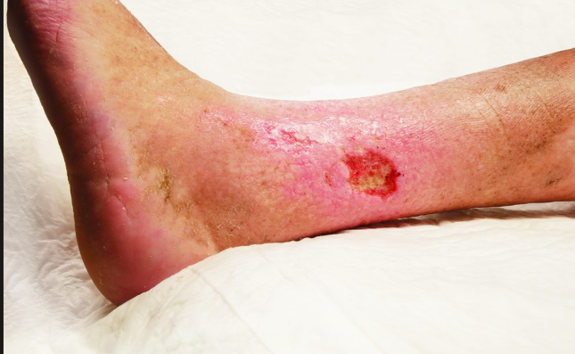

Slide 10
Treatment Options and Management Principles
Moisture Reduction Strategies​
Reducing moisture through continence management, absorbent dressings, and skin fold separation is essential for fungal infection control.​
Topical Antifungal Treatment​
Topical antifungal agents like clotrimazole and miconazole are applied thinly and extended beyond visible infection margins for 2-4 weeks.​
Use of Combination Therapies​
Short-term use of antifungal-steroid combinations may reduce inflammation but should be avoided long-term to prevent skin thinning.​
Systemic Therapy and Escalation​
Systemic antifungal therapy is reserved for severe or recurrent cases and requires medical review with timely treatment escalation.
Notes:
Its important to remember to ensure treatment with cream is used as per instructions – twice daily for 2 weeks to ensure that fungal infection is treated effectively
First‑line options
Clotrimazole 1%
Miconazole 2%
Econazole
Apply:
Thin layer
Beyond visible rash
Usually 2–4 weeks
📌 Continue for 1–2 weeks after visible resolution

Slide 11
Common Pitfalls
Repeated Antibiotics.
Mistaking Maceration for infection.
Overuse of steroid creams.
Stopping treatment too early

Slide 12
Key Take-Home Messages and Clinical Application​
Recognising Fungal Infections​
Clinicians should identify red, moist, itchy skin areas and look for satellite lesions and clear borders.​
Assessing Treatment Factors​
Evaluate antibiotic failure and consider moisture or occlusion as contributing factors to skin deterioration.​
Environmental and Therapeutic Care​
Treat the environment alongside antifungal therapy, ensuring full treatment completion to prevent recurrence.​
Improved Patient Outcomes​
Early recognition and management reduce discomfort, promote healing, and support antimicrobial stewardship.

Slide 13
Questions

