Slide 1
Wound Care Northamptonshire 2026
Nicky Sellars- Patient Safety Quality Assurance and Improvement Nurse – Out of Hospital

Slide 2
Introduction
Northamptonshire ICB Quality Directorate were made aware that GP practices advised they could not provide care for patients with certain wound care requirements-audits were undertaken to understand how many patients.
NHFT were commissioned to work with primary care to deliver the Framework.
GPs are contracted to deliver wound care for Tier 1 and 2 on the framework
Healing wounds, less than 28 days old with evidence of healthy granulation/epithelial tissue.
Healing wounds, greater than 28 days old with evidence of healthy granulation/epithelial tissue.
People living with a long term healthy static wound for maintained care and symptom control.
It is important that General Practice nurses/community nursing teams are up to date with information on wound care and use this in care planning with patients to maximize their potential for wound healing.
It is vital to collaborate between Primary Care, community and the wider systems, where appropriate, to mitigate the risk of barriers to care and improve access/equity to achieving best practice.

Slide 3
Improvement to wound management across Northamptonshire
Consideration for how to manage hard to heal wounds defined as
Static for 4- 6 weeks of treatment- however if this is leg ulcer management and the lower leg pathway has been followed, and treatment is regarded as simple management these can be managed in primary care.
Deteriorating wounds despite advice received from specialist tissue viability service – and that have been treated if infection present.
Wounds with increased exudate that require dressings daily due to this.
Deep wounds.
Surgical wounds – not expected to heal in 4- 6 weeks (consideration that they may need to be referred to acute care).
Cavity wounds that require packing (consideration for referral to TVN back to acute care if surgical).
For diabetic patients understand if they are being seen by diabetic teams and if shared care is required.
Understanding when wounds will be seen by specialist services.

Slide 4
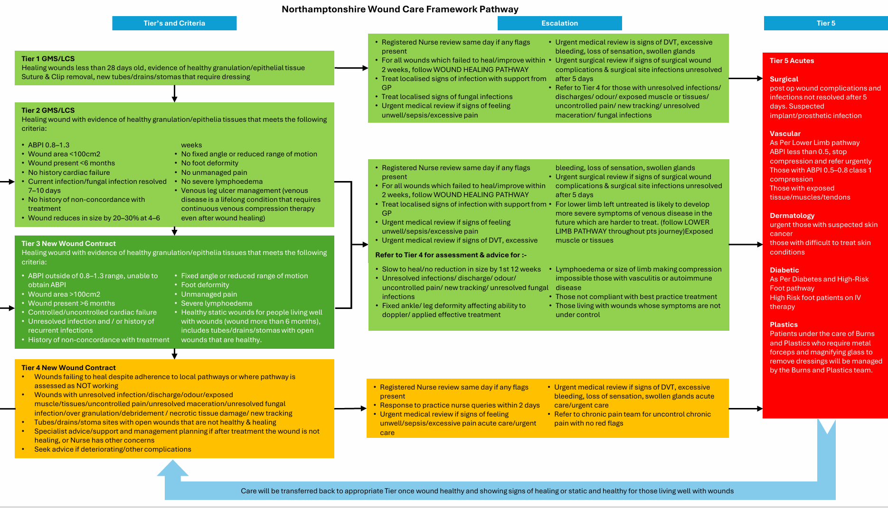
Wound Care Framework

Slide 5
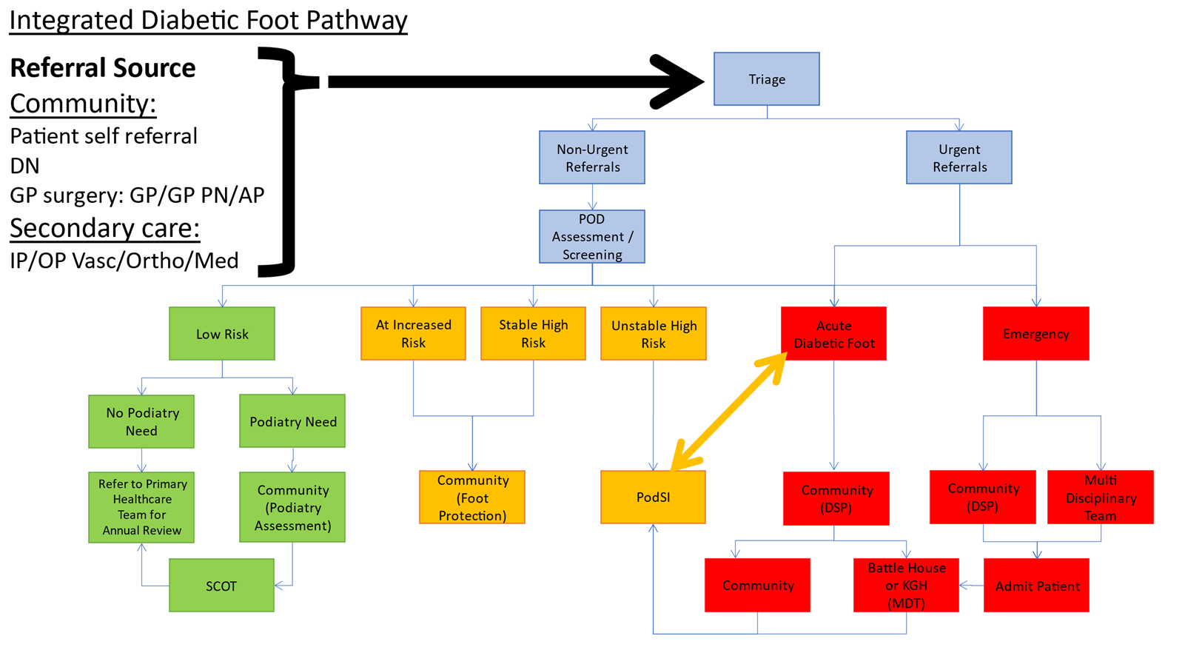
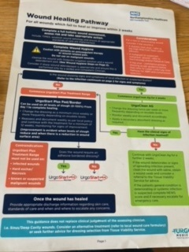
The Northamptonshire Wound Care Framework is in conjunction with the below guidance & pathways

Slide 6
Training In Action and Outcomes
Training for those delivering wound care.
TVN service provide training on pressure ulcer prevention and wound management.
Tier 1 and 2 eLearning via the primary care training hub.
NHFT have guidelines for the assessment and management of wounds.
Lower limb pathway in place.
Wound care pathway launched.
Shared care agreements – skin bundle and ordering of pressure relieving equipment.
Tiered approach to training & competencies aligned to to manage each type of wound.

Slide 7
What is Quality Improvement
The combined and unceasing efforts of everyone – healthcare professionals, patients and their families, researchers, payers, planners and educators – to make the changes that will lead to better patient outcomes (health), better system performance (care) and better professional development (learning)
Ref – Batalden and Davidoff (2007) What is quality improvement and how can it transform healthcare? (BMJ)

