Slide 1

Weight Management: Services & Approaches
Behavioural Overweight & Obesity Management Services
Physical Literacy & Compassionate Approach
Children & Young People
Discussion / Q&A
Primary Care Protected Learning Time
8th July 2026
2-3 pm

Slide 2
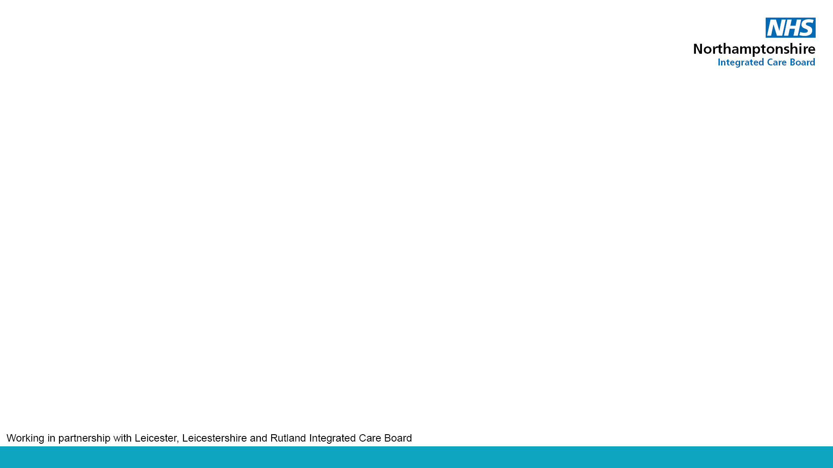
Agenda
Introduction: Available Services & Flowchart
Behavioural Overweight & Obesity Management Services (‘Tier 2’)
  Local Authority services
    Patsy Richards, Public Health Principal, NNC.
    Emily Cox, Public Health Practitioner, WNC.
Children & Young People
  Emily Cox, Public Health Practitioner, WNC
  Patsy Richards, Public Health Principal, NNC
  Kerrie Pearson, Children’s Weight Management Specialist & Clinical Team Lead, NHFT
Digital Weight Management Programme – Sara Carter, Long Term Conditions and Prevention.
Physical Literacy & Compassionate Approach –Steph Steventon, Public Health Officer, NNC.
Discussion: What support would you like from us?
Q&A
Notes:
Need a volunteer to kick off with the first few slides (plus final closing slide)
Timings:
Introduction: Available Services & Flowchart [5mins]
Behavioural Overweight & Obesity Management Services (‘Tier 2’)
Digital Weight Management Programme [10mins]
Local Authority services
NNC [5mins]
WNC [5mins]
Physical Literacy & Compassionate Approach [5mins]
Children & Young People
WNC [5mins]
NNC [5mins]
NHFT [5mins]
Discussion / Q&A [15mins]

Slide 3
Weight Management Services Available to Refer Patients
Overview of Current Eligibility Criteria
Service | Criteria
Local Authority Behavioural Overweight and Obesity Management Services | BMI of 30 or more (adjusted to ≥27.5 for people from black, Asian and ethnic minority backgrounds).
NHS Digital Weight Management Service (DWMP) | Adults*. BMI of 30 or more (adjusted to ≥27.5 for people from black, Asian and ethnic minority backgrounds) and have a diagnosis of diabetes (type 1 or type 2), hypertension or both.
NHS Diabetes Prevention Programme (NDPP): | HbA1c between 42-47 mmol/mol (6.0%-6.4%) or fasting plasma glucose between 5.5-6.9 mmol/l within the last 12mths.
Type 2 Diabetes Path to Remission Programme (T2DR) | Aged 18-65, Diagnosed with type 2 Diabetes within the last 6 years. BMI of 27kg/m2 or higher in people from a white background (or 25kg/m2 or higher) in people from all other ethnic groups, HbA1c measurements within the last 12 months of 43-87 mmol/mol if not taking diabetes medication. Engaging with services.**
Notes:
Need a volunteer to kick off with the first few slides
Overweight and obesity management services – terminology (often referred to as tiers) - https://www.nice.org.uk/guidance/ng246
universal services such as health promotion or primary care (sometimes referred to as tier 1 services)
behavioural overweight and obesity management services (sometimes referred to as tier 2 services)
specialist overweight and obesity management services (sometimes referred to as tier 3 and tier 4 services).
* DWMP age criteria: Participants must be aged 18 or over. For individuals over 80 years old, the referring GP must confirm that a weight management programme is likely to provide greater benefit than harm. Full Exclusion Criteria
- Patients recorded as having moderate or severe frailty
- Patients who are pregnant
- Patients who have an active eating disorder
- Patients who have had bariatric surgery in the last two years
- People for whom a weight management programme is considered to pose greater risk of harm than benefit.
** Full Type 2 Diabetes Path to Remission Programme T2DR criteria: Aged 18-65, Diagnosed with type 2 Diabetes within the last 6 years. Have a BMI of 27kg/m2 or higher in people from a white background (or 25kg/m2 or higher) in people from all other ethnic groups, HbA1c measurements within the last 12 months of 43-87 mmol/mol if not taking diabetes medication. Patient has attended a diabetes review when this was last offered, inc. retinal screening and commits to continue attending annual reviews, even if remission is achieved. (If a patient is newly diagnosed, then there is no requirement to wait for retinal screening to take place before offering referral). Please see the website for exclusion criteria and further information. https://www.england.nhs.uk/diabetes/treatment-care/diabetes-remission/
Lower thresholds than GLP-1s (NICE guidance of BMI of at least 35 kg/m² (ethnicity adjusted by 2.5 kg/m²⁾ and at least 1 weight-related comorbidity. 4 Implementation | Tirzepatide for managing overweight and obesity | Guidance | NICE We’re conscious that there is a lot of demand for GLP-1 medication from patients, some of whom will not be eligible or suitable for them – we hope that summarising these other services can help direct these patients to appropriate services and promote the prevention agenda.

Slide 4
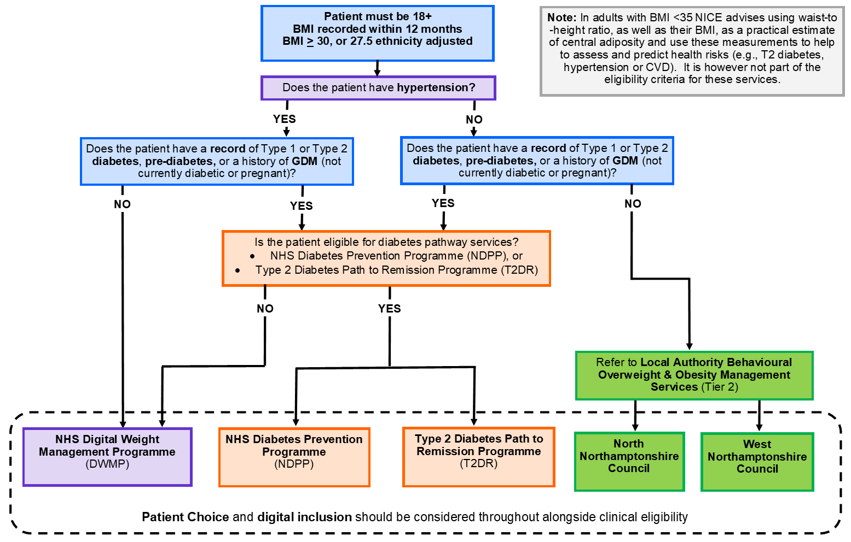
Weight Management Referral Pathway
Notes:
Need a volunteer to kick off with the first few slides
Please note:
This is a simplified flowchart to aid running patient searches and text message campaigns, as opposed to a detailed clinical checklist. Furthermore, patient choice and digital inclusion should be considered.
In adults with BMI <35 kg/m2, NICE advises using waist-to-height ratio, as well as their BMI, as a practical estimate of central adiposity and use these measurements to help to assess and predict health risks (e.g., T2 diabetes, hypertension or CVD). It is however not part of the eligibility criteria for these services. https://www.nice.org.uk/guidance/ng246/chapter/Identifying-and-assessing-overweight-obesity-and-central-adiposity
NNC are currently tendering for a new Integrated Healthy Lifestyles Service (IHLS) , which I due to launch April 2027 and will shift away from the description ‘Tier 2’ and will likely reference behaviour change support instead.

Slide 5


North Northamptonshire Tier 2 Adult Weight Management Current Provision
Gro Health
Free digital weight management programme (app-based)
Personalised support: nutrition, activity, sleep & mental wellbeing
Coaching, tracking tools and educational resources
Flexible and accessible format
Living Well Taking Control
12-week Weight Management Programme
Practical advice on balanced nutrition, exercise and mindset
Delivered via group-based sessions or online
Current provision in place until 31st March 2027
Customer
-focused
Respectful
Efficient
Supportive
Trustworthy
Notes:
Order of presentation – LA, NHFT, ICB – should match the overivew
Put LA slides in the beginning

Slide 6
North Northamptonshire Provision Eligibility and Referral Route
Eligibility criteria for all weight management services;
Live in North Northamptonshire
Are 18 years old or over
BMI over 30 from white ethnic backgrounds (27.5 or higher if you are from another ethnic group)
Are not pregnant
Individuals can only access one route of support at a time
Referral routes into weight management services;
The referral route into all weight management services is the same (outlined below)
Completion of a self-referral or professional referral via the below link
Weight management | North Northamptonshire Council
Customer
-focused
Respectful
Efficient
Supportive
Trustworthy

Slide 7
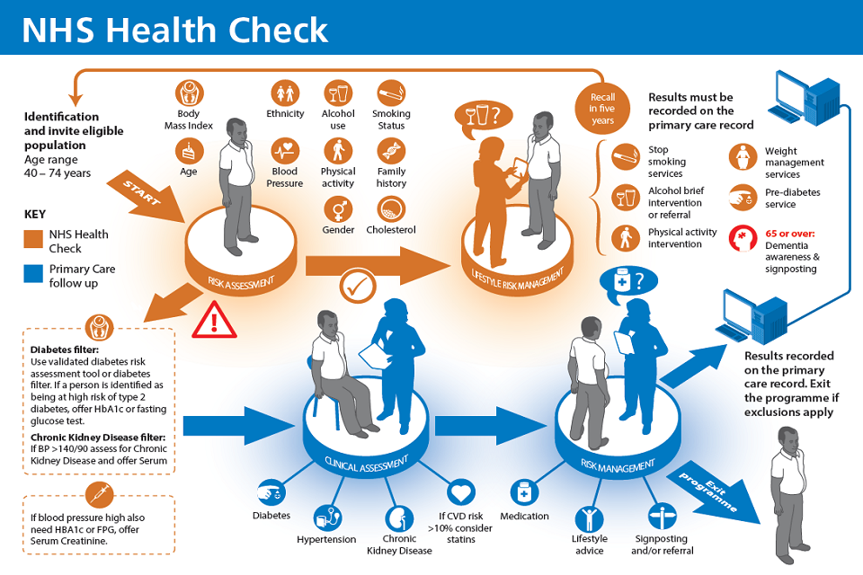
NHS Health Checks
An NHS Health Check is a 5-yearly check-up for adults aged 40-74 without existing CVD, designed to identify early risk of conditions like heart disease, stroke, diabetes and kidney disease
NHS Health Checks are a critical gateway to weight management pathways – early identification and timely referrals can significantly reduce long term CVD and diabetes risk
Individuals will be given brief advice, signposting or referral to a weight management service
Customer
-focused
Respectful
Efficient
Supportive
Trustworthy

Slide 8
North Northamptonshire Transition – Integrated Healthy Lifestyle Service
North Northamptonshire Council will be moving to an Integrated Healthy Lifestyle service from 1st April 2027
Single front door to access and receive triage to the right level of support
Three levels of support:
  Self‑help – signposting, health promotion campaigns, web and digital content self-help
  Health coaching – behaviour change support, brief advice, goal setting and referrals
  Targeted interventions - support for service users with a higher level of need, e.g. NHS Health Checks (Community and Workplace)
Aim to support more residents to make sustainable changes to the key modifiable risk factors across the adult life course, enabling them to live longer in better health
Customer
-focused
Respectful
Efficient
Supportive
Trustworthy
Notes:
Introduce the HLS slides with something along the lines of:
'The Integrated Healthy Lifestyles Service is currently subject to a live procurement process. The information shown is a high-level summary of the service model already published through the tender documentation.'
Any questions specifically about the tender should be directed through the formal clarification process rather than answered during the session.

Slide 9
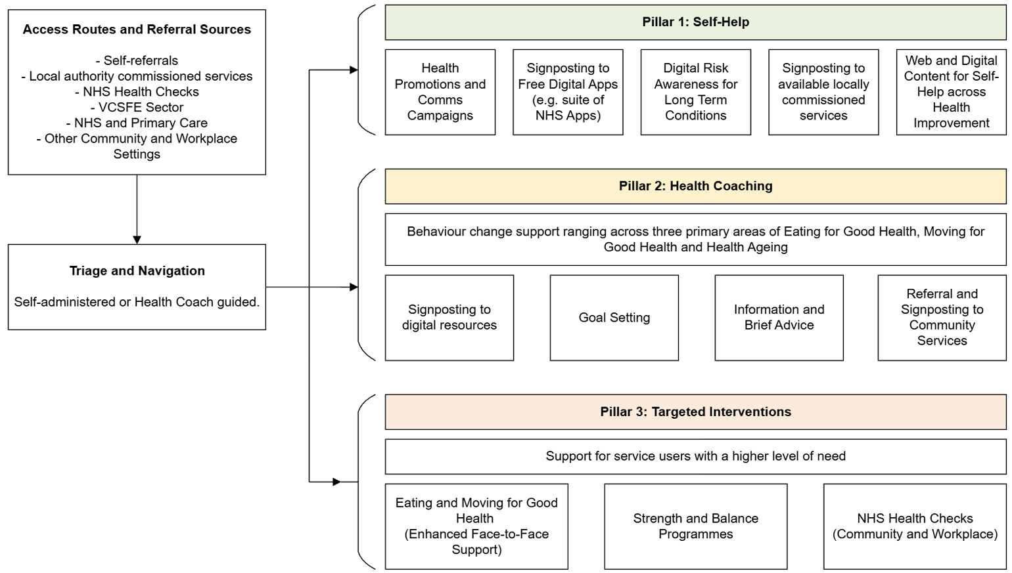
Integrated Healthy Lifestyle Service Model
Customer
-focused
Respectful
Efficient
Supportive
Trustworthy

Slide 10
North Northamptonshire Compassionate and Alternative Approaches to Weight
Exploring the topic and Local Direction
Limited impact of weight-focused interventions
Wider determinants drive health outcomes
Importance of wellbeing and body image
Harms of weight stigma
Customer
-focused
Respectful
Efficient
Supportive
Trustworthy

Slide 11
Starting the shift - New Compassionate Model
From Weight central to Weight-inclusive approach
Health at any size
Focus on behaviours and wellbeing
Non-judgemental, inclusive care
Customer
-focused
Respectful
Efficient
Supportive
Trustworthy

Slide 12
Implications & Next Steps
Reframed services and language
Workforce training and culture change
Positive shift in attitudes
Develop principles and long-term plan
Progressing the weight inclusive compassionate approach across adults and children's
Customer
-focused
Respectful
Efficient
Supportive
Trustworthy

Slide 13
Compassionate and Alternative Approaches to Weight – Recommendations
In practice, this looks like;
Using a person‑centred approach - focus on what matters to the individual, not just weight
Keep conversations focused on health behaviours (e.g. diet, physical activity, wellbeing) rather than weight alone
Be mindful of language and weight stigma. Small changes in wording can improve engagement
Recognise that weight is not always an accurate measure of health
Support patients to set realistic, meaningful goals (e.g. improving energy, mobility, mental wellbeing)
Consider the wider determinants of health (e.g. deprivation, mental health, social factors)
Use referral routes into local support where patients would benefit from additional help
Customer
-focused
Respectful
Efficient
Supportive
Trustworthy

Slide 14

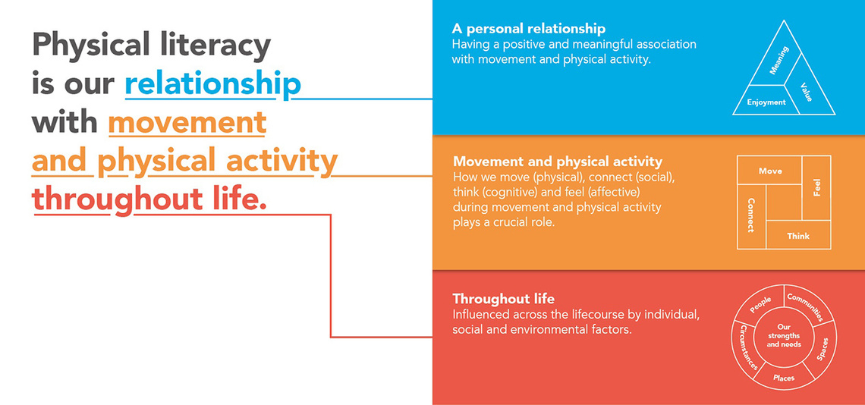
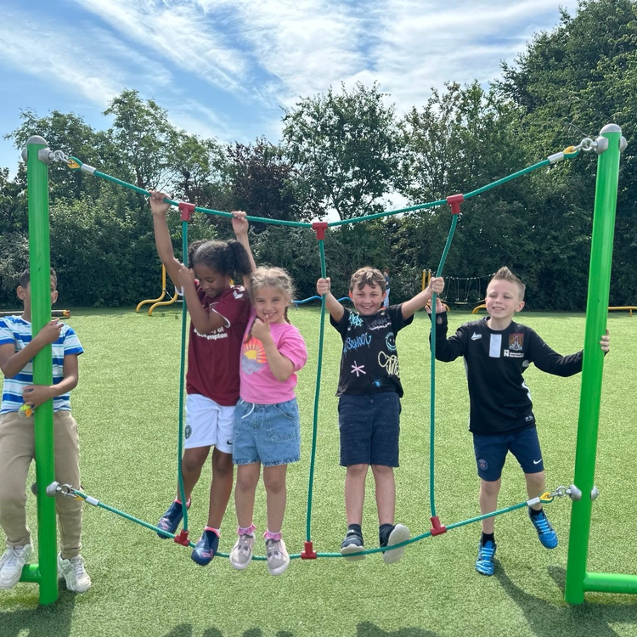



PHYSICAL LITERACY | CONSENSUS STATEMENT
PHYSICAL LITERACY CONSENSUS STATEMENT (2023)
The Physical Literacy Consensus Statement for England has been developed to facilitate a shared understanding of physical literacy for those working in the sport, education, physical activity, recreation, play, health and youth sectors.
WHAT IS PHYSICAL LITERACY?
Physical literacy is defined as our relationship with movement and physical activity throughout life. That’s why our ambition is for all children and young people to develop a positive and meaningful relationship with sport, physical activity and movement through positive experiences, helping to build the foundations for an active life.

Slide 15

PHYSICAL LITERACY | WHY DOES PHYSICAL LITERACY MATTER?
47%
of children are meeting the Chief Medical Officers’ guidelines
30%
of children do less than an average of 30 minutes activity a day
1 in 5
children will experience a mental health issue
19%
of children have 2 characteristics of inequality
49%
of children strongly agree they have a +ve relationship with activity
Importance of Physical Literacy
Physical literacy fosters a positive relationship with movement, improving health, wellbeing and quality of life.
Impact on participation
Individuals with high physical literacy are twice as likely to participate in sport and physical activity and sustain active lifestyles.
Promoting lifelong activity
Encouraging physical literacy builds capability and enjoyment, supporting lifelong engagement in physical activity
Recognising that physical literacy is unique to each individual helps develop inclusive programmes, reduce inequalities, fosters positive relationships with movement & supports lifelong participation in physical activity

Slide 16
OUR PROJECT | SHAPING HEALTH THROUGH MOVEMENT
OUR ASPIRATION FOR CHANGE
Our aspiration is to use physical literacy as a transformative framework to offer an alternative, strengths-based approach to
supporting children and their families who have been identified as having an unhealthy weight through the NCMP.
We seek to create inclusive, empowering environments that support long-term health and wellbeing for children both within and beyond the school setting.
OUR PROJECT OBJECTIVES
1. To upskill a workforce that truly understands physical literacy and can apply a physical literacy informed approach.
2. Use physical literacy to design a coordinated and consistent approach to working and supporting children and their families to increase their enjoyment and create long-term sustainable healthy habits.
3. Identify schools with higher concentrations of children with an unhealthy weight and look to co-design bespoke delivery models to suit the needs of the children.
4. Use youth voice to better understand the issues and reluctances of engaging in physical activity and movement.
5. Create environments where positive physical activity and movement experiences become habitual and sustainable for everyone involved.
North Northamptonshire Council
Northamptonshire Sport
Northamptonshire Healthcare NHS Foundation Trust

Slide 17


Healthy Weight Services (Public Health)
Adults: Deborah Mbofana deborah.mbofana@westnorthants.gov.uk
Children & young people: Emily Cox emily.cox@westnorthants.gov.uk
Notes:
Emily Cox, WNC

Slide 18
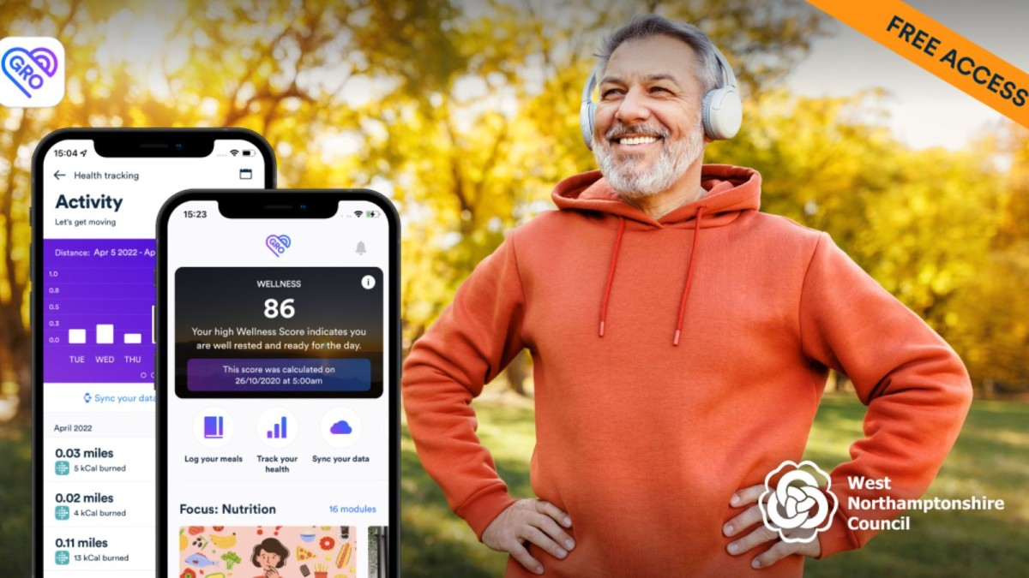
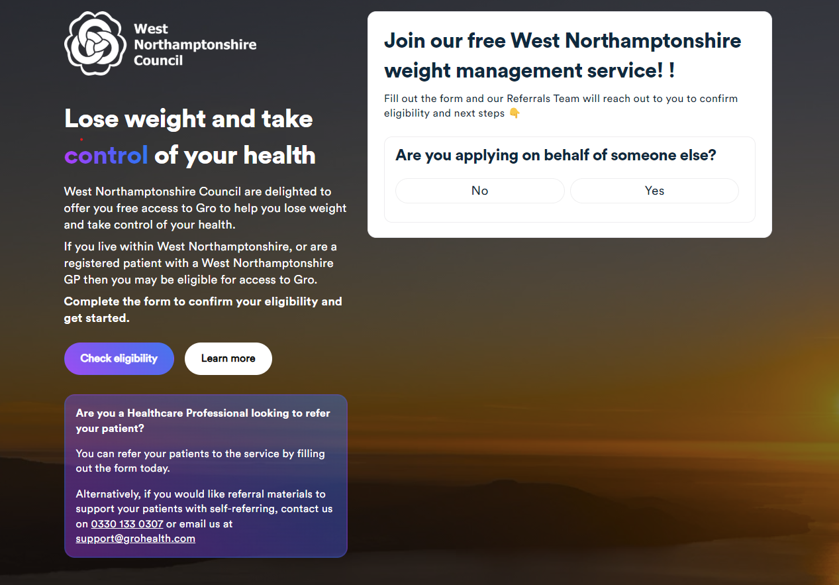
Tier 2 Adult Services – Local Authority
‘Gro-Health’ – West Northants Council
With ‘Gro Health’, residents can get free access to digital or face-to-face support (depending on eligibility), which includes a structured 12-week support programme to help people lose weight, improve their health and reach their goals.
‘Gro Health’ will also provide those eligible with continued support from a dedicated health coach for up to 12 months.
The service is available to anyone 18 and over who has a BMI of 30 or over, or a BMI of 27.5 for adults from South Asian, Chinese, other Asian, Middle Eastern, Black African or African-Caribbean family background. It is a self-referral service with a phone review of an application.
0330 133 0307
Gro-health
Notes:
Emily Cox, WNC
1. Scarborough, P., Bhatnagar, P., Wickramasinghe, K.K., Allender, S., Foster, C. and Rayner, M., 2011. The economic burden of ill health due to diet, physical inactivity, smoking, alcohol and obesity in the UK: an update to 2006–07 NHS costs. Journal of public health, 33(4), pp.527-535.

Slide 19
Tier 1 and 2 Children’s Services
Identified gap: A clear pathway for tier 1 / early tier 2 weight management and healthy lifestyle support for children and young people, to compliment the work of the NHFT 0–19 service.
What works: Research highlights best outcomes from interactive, family-based programmes combining:
  Basic cooking skills
  Nutrition education
  Access to opportunities to be more physically active
Procurement of a service:
  A programme to educate, support and empower children and parents / carers to adopt and sustain healthy lifestyle habits
  Aligned to a compassionate approach – non ‘weight centric’ focusing on holistic health and wellbeing
  Targeted in areas of highest need (IMD & NCMP data)
  For primary age children and their parents / carers
  In place by summer 2027.
Notes:
Emily Cox, WNC

Slide 20
Digital Weight Management Programme (“DWMP”) – Tier 2
The Digital Weight Management Programme is part of the 10 Year Health Plan
There is an ambition to make 250,000 referrals to DWMP a year by March 2029
Available via all General Practices in England
Delivered over 12 consecutive weeks
Option to participate via an App or web-based platform
Focus on the individual changing behaviours and lifestyle interventions - The patient is able to choose a weight management plan to help develop healthier eating habits, be more active and lose weight
Each of the plans provide:
  Recipes and Nutrition support
  Wellbeing support
  Tips for activity levels
Provided at no cost to local systems
Notes:
Plain slide with subhead and bullets

Slide 21
DWMP – Who can be referred?
Any member of the General Practice healthcare team who has access to e-RS can make a direct referral
We have a DWMP healthcare professional toolkit
Eligibility criteria for patients
Over the age of 18
Has a BMI of 30+ (adjusted to >27.5 for people from Black, Asian and ethnic minority backgrounds)
Has a diagnosis of diabetes (type 1 or type 2) or hypertension or both
Ineligible referrals
Moderate or severe frailty
Pregnant
Active eating disorder
Had bariatric surgery in the last 2 years
Where the programme poses risk of harm
Notes:
Plain slide with subhead and bullets

Slide 22
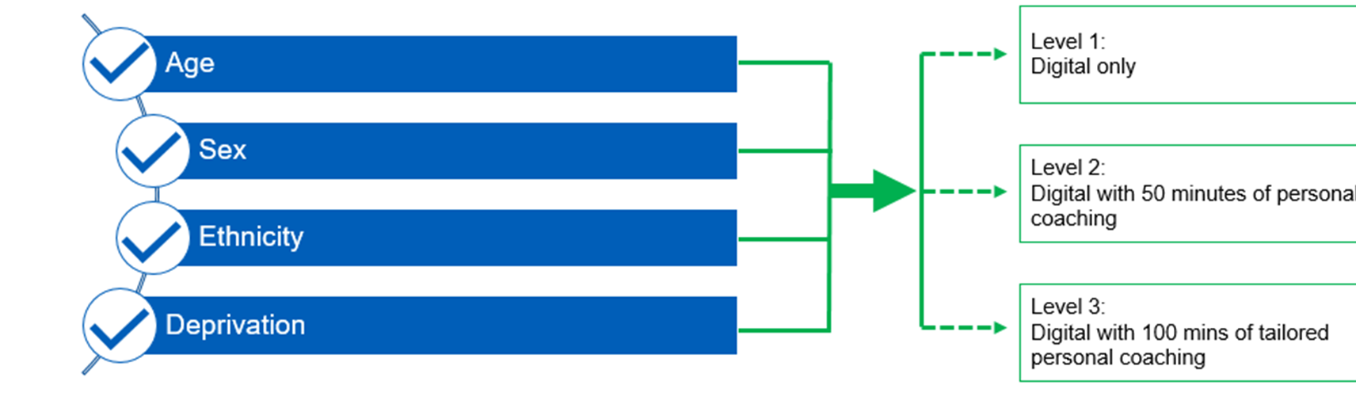
DWMP Referral Hub
Triages people based on the likelihood of non completion of the programme (based on data from the NHS Diabetes Prevention Programme)
Its aim is to ensure those least likely to complete the programme are offered a higher level of intervention and support
Notes:
Plain slide with subhead and bullets

Slide 23
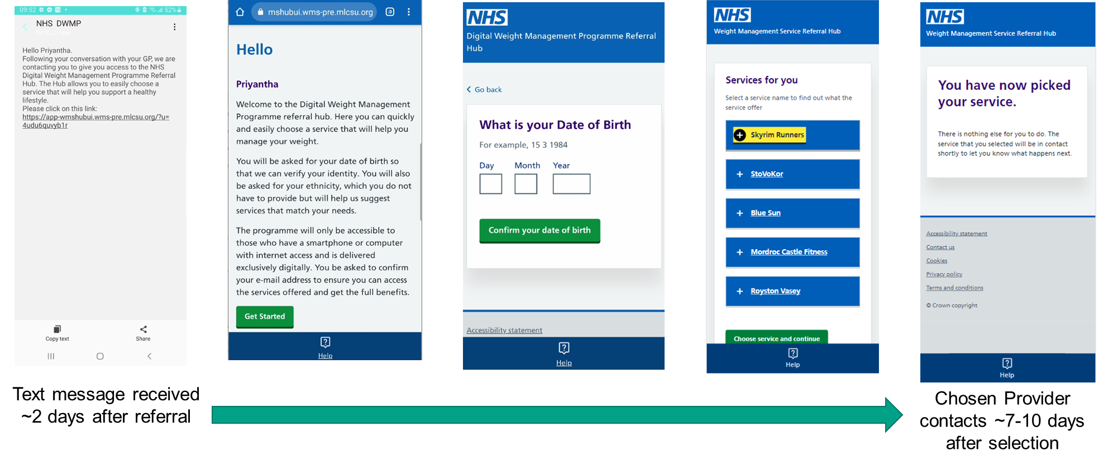
DWMP Referral Hub
Facilitates and supports service user choice
Notes:
Plain slide with subhead and bullets

Slide 24
Benefits for Practices
Supports QOF and long‑term condition management
Reduces clinical workload by offering self‑directed support
Provides a standardised, evidence‑based intervention
Enhances patient engagement in lifestyle change
QOF Indicator OB004 | Points | Thresholds
The percentage of patients aged 18 or over living with obesity, appropriately adjusted for ethnicity in line with NICE guidelines (either with a BMI greater than or equal to 30 kg/m2 recorded in the preceding 12 months, or a BMI greater than or equal to 27.5 kg/m2 recorded in the preceding 12 months for patients with a South Asian, Chinese, other Asian, Middle Eastern, Black African or African-Caribbean family background) who have been referred to a weight management programme within 90 days of the BMI being recorded. | 5 | 10-30%
Notes:
Sara/Remya, NHSE
Quality and Outcomes Framework guidance for 2026/27

Slide 25
Resources for General Practice Teams
The National NHS England and Improvement Obesity Team have created a General Practice toolkit, poster and extensive FAQs to support general practices to refer into the programme.
These resources can be distributed to general practices to support healthcare professionals in referring and promoting the programme within their GP practice.
These resources are available to download from the template site via the NHS England website: https://www.england.nhs.uk/digital-weight-management/
The FAQs are aimed at healthcare professionals and are based on feedback the programme has received to date.
The ICB can support with suggested searches and text message templates.
PDF versions to download here:
FAQs:
Technical FAQs:
General Practice poster:
General Practice Toolkit:
General Practice TV Screensaver:
50 mins
Animated videos in English & 8 other languages are available from NHSE website.
Notes:
Sara/Remya, NHSE
All resource materials are also saved here on NHS Futures - https://future.nhs.uk/NHSpp/view?objectID=29965424
Animations on ‘NHS Digital Weight Management Programme‘ and ‘What to expect when you enrol on to the NHS Digital Weight Management Programme‘ are available in English, and with Urdu, Bengali, Turkish, Punjabi Shahmukhi, Punjabi Gurmukhi, Polish, French and Arabic subtitles are available on the NHSE website alongside case studies - https://www.england.nhs.uk/ourwork/prevention/obesity/digital-weight-management-programme/

Slide 26
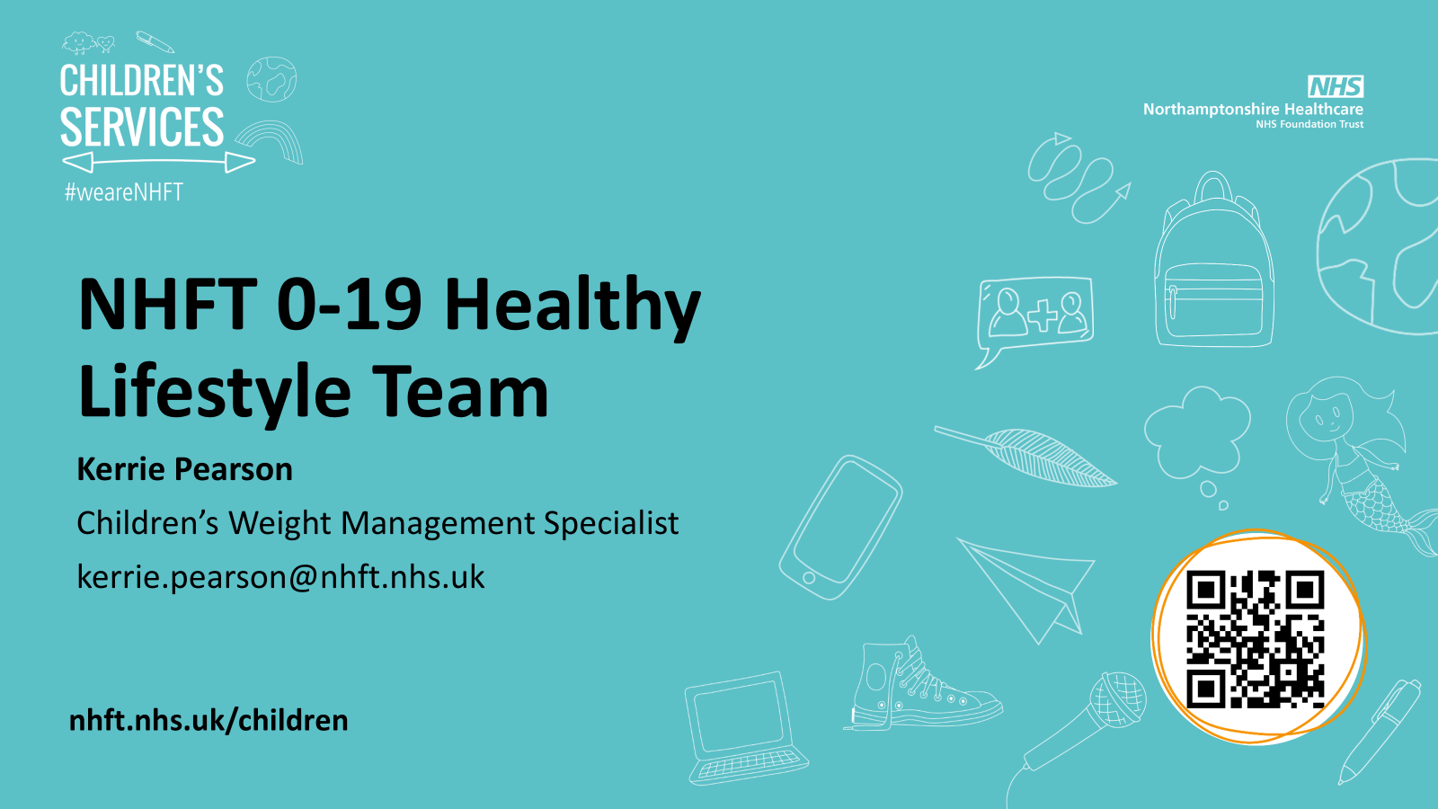
Notes:
Kerrie Pearson, NHFT

Slide 27

What do we do?
Small team that sits within Health Visiting & School Nursing who support children, young people and their families with healthy eating/weight management. Promoting physical activity and movement. Encouraging healthy swaps to guide meaningful lifestyle change.
Ages 2 years (child is taking solids) to 19 years.
School, home or community setting
Referrals from:
Schools
GP’s
Paediatricians
Self referral (young person or parent)
Other health professionals
Notes:
Kerrie Pearson, NHFT

Slide 28
National Child Measurement Programme
0-19 Team screen all Reception Year & Year 6 children every year (unless parent opts out)
This data contributes to national guidance and funding around child obesity in England
More importantly the Programme also supports families on a local level with guidance and resources around family lifestyle choices. Including referrals to 0-19 and Dietetics.
All parents of children who are above or below a healthy weight will receive a call from us to discuss their child's health and growth. These are often difficult conversations. They will then receive a letter with resources and signposting including MY contact details.
National Child Measurement Programme: operational guidance 2025 - GOV.UK
WE NEED YOUR HELP
Please support us by having those conversations with parents yourselves. 🙏🏼🙏🏼🙏🏼
Notes:
Kerrie Pearson, NHFT

Slide 29
Children’s BMI Categories
BMI or weight category Clinical BMI centile category Approximate BMI centile line on growth chart
Very overweight Severe Obesity ≥99.6th
Very overweight Very Overweight (clinical obesity) ≥98th
Overweight Overweight ≥91st
Above the expected weight range
Healthy weight Healthy Weight >2nd to <91st
Growing as expected
Underweight Underweight (low BMI) ≤2nd
Below the expected weight range
Underweight Very Thin ≤0.4th
Notes:
Kerrie Pearson, NHFT

Slide 30
Healthy Weight Referral Pathway
NHFT Healthy Lifestyle Team
Children with a BMI ≥ 91st centile
Refer to NHFT 0-19 Admin HUB
0-19 Referral Form
NHFT Weight Management Dietetics
Children with a BMI ≥ 99.6th centile or ≥ 98th centile with co-morbidities or complex needs
Refer to Dietetics via Referral Management Centre (RMC)
Referral Management Centre | NHFT
Notes:
Kerrie Pearson, NHFT

Slide 31
Discussion: What support do you need from us?
What support do you need from us?
Good practice to share?
Any questions?
Thank you for your time
Contact details:
Gwyn Roberts
Primary Prevention and Health Inequalities Lead Officer,
NHS Leicester, Leicestershire and Rutland and NHS Northamptonshire Integrated Care Boards
gwyn.roberts1@nhs.net
Notes:
Close – volunteer for this slide?
Want this presentation to be an opportunity to share good practice & offer support – for example, support may be needed with suggested patient searches & text message wording

