Slide 1
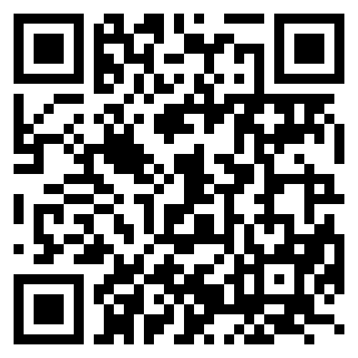

Nikki Stanley
Implementation Lead
nikkistanley@cthesigns.net

Slide 2
Thank you for your time today

Slide 3
ANY QUESTIONS?

