Slide 1
Clinical Management of Migraine
Angela Abdallah, Headache Specialist Nurse
Pooi Lim, High-cost drugs Pharmacist
12th March 2025

Slide 2
Disclaimer
Speaker fees:
Abbvie
Eli Lilly
Lunbeck
Information sources:
Pfizer
Abbvie
Dr David Watson (Scottish Headache Guideline Committee)

Slide 3
Learning Objectives:
The ‘Gepants’ –
Targeted Therapies
In Primary Care
Overview of Acute &
Preventive treatments
Understanding the Science
of Migraine
Migraine Diagnosis
Migraine Burden

Slide 4
Migraine Burden

Slide 5




Migraine is a highly prevalent condition
Migraine is the third most common health condition in the world¹
In the UK, more people live with migraine than diabetes, asthma and epilepsy combined²
Around 1 in 4 people aged 15‒49 in the UK are living with migraine³
1. Steiner TJ, et al. J Headache Pain. 2013;14(1):1; 2. The Migraine Trust. State of the Migraine Nation Dismissed for too long: Recommendations to improve migraine care in the UK. September 2021. https://migrainetrust.org/wp-content/uploads/2021/09/Dismissed-for-too-long_Recommendations-to-improve-migraine-care-in-the-UK.pdf [Last accessed Jan 2024]; 3. The Migraine Trust. Who is living with migraine in the UK? January 2020. https://migrainetrust.org/wp-content/uploads/2021/08/State-of-the-Migraine-Nation-population-rapid-review.pdf [Last accessed Jan 2024].

Slide 6

What is the individual burden of migraine?
Migraine impacts multiple aspects of patients’ lives
Daily activities, with reduced ability to²:
Contribute to housework
Take part in social activities
Emotional and mental health issues are common in migraine patients
Mood change and anxiety disorders
2–5 times more common
in patients with migraine than in the general population⁴
Migraine is the second highest cause of global disability in the general population*, but takes first place in females aged 15−49^{†1}
Work productivity
and professional lives³
Negative effect on relationships with family and friends²
1. Steiner TJ, et al. J Headache Pain. 2020;21(1):137. 2. The Migraine Trust. State of the Migraine Nation Dismissed for too long: Recommendations to improve migraine care in the UK. September 2021. https://migrainetrust.org/wp-content/uploads/2021/09/Dismissed-for-too-long_Recommendations-to-improve-migraine-care-in-the-UK.pdf [Last accessed Jan 2024]; 3. Begasse de Dhaem O, et al. eNeurologicalSci. 2022;27:100408; 4. Minen MT, et al. J Neurol Neurosurg Psychiatry. 2016;87(7):741–49.
*The level-3 grouping of headache disorders in the GBD Study 2019 includes only specific diseases: migraine and tension-type headache, each with medication overuse headache as a sequela factored in according to the proportion of MOH attributed to it²; †Expressed as years lived with disability².

Slide 7
Migraine Diagnosis

Slide 8
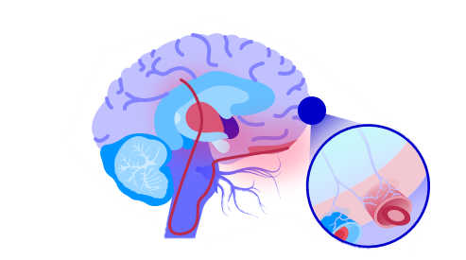
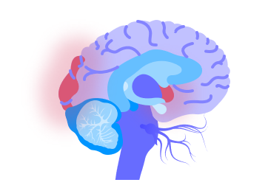

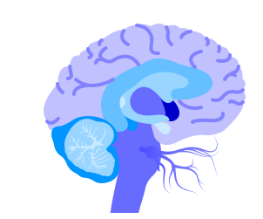

What do people experience during a migraine attack?
Activation of
hypothalamic region
Cortical spreading depression
Activation of trigeminovascular system
Altered brain-blood flow*
Neck pain
Fatigue
Poor concentration
Mood change
Food craving
Reversible
Neurological changes – visual, sensory, motor, speech
Headache
Nausea
Photophobia
Phonophobia
Osmophobia
Fatigue
Cognitive changes
Muscle pain
Triggers
Triggers
Multifactorial
predisposition
Multifactorial
predisposition
Interictal phase
Prodrome¹
Aura¹
Headache¹
Postdrome¹
Interictal phase
Few hours–days
5–60 minutes
4–72 hours
24–48 hours
*Postdrome is the least studied and understood phase.
1. Ferrari MD, et al. Nat Rev Dis Primers 2022;8:2.
Adapted from Ferrari et al. 2022.1

Slide 9
Patients presenting to primary care mostly have migraine
Landmark Study
Conclusion is “consider all disabling episodic headache with a normal physical examination to be migraine” : 94%
If patients were given a diagnosis of migraine by the assessing primary care physician, 98% met ICHD criteria for migraine
Of patients with non-migraine diagnosis of primary headache, diary evidence showed 82% had migraine, most common misdiagnosis is tension type headache or sinus headache
Tepper et al. Headache 2004 Oct 44(9):856-64

Slide 10
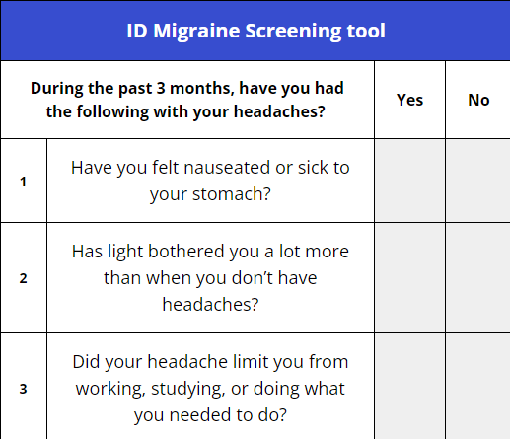
ID Migraine: 3 screening questions
Brief, practical diagnostic tool.
Two or more positive responses suggests the patient has migraine.
The positive predictive value is high at 0.93%.
In other words, for 100 patients diagnosed as having migraine by the ID Migraine screener, 93 will have migraine.
Cousins G et.al. Headache. 2011; 51(7): 1140-1148

Slide 11
Understanding the Science of Migraine
How to explain to patients how the targeted treatment works

Slide 12
So, what is migraine?
Migraine is a neurological condition which features amplification of a number of sensory pathways¹. Some studies suggest that genetic components contribute to susceptibility to the condition⁵
May be lifelong but varies in impact, severity and frequency throughout life (epigenetics)²
Is a spectrum condition; attacks may be mild, moderate or severe¹
Can lead to attacks which may start at any age; usually in early adulthood³
Has a natural history, often eventually improving with age²
Migraine is NOT just a bad headache⁴
1. Brennan K., Pietrobon D. A systems neuroscience approach to migraine. Neuron. 2018;97(5):1004-1021. 2. Kelman L. Migraine Changes with Age: IMPACT on Migraine Classification. Headache. 2006;46(7):1161-71. 3. Migraine Trust. What is Migraine? Available at: https://migrainetrust.org/wp-content/uploads/2023/05/What-is-migraine-factsheet.pdf . Accessed October 2023. 4. Lai C. Flashing lights and poor funding: more than a headache. Lancet. 2017 (Radio). 5. Bron et al. Exploring the Hereditary Nature of Migraine. Neuropsychiatric Disease and Treatment. 2021;17. 1183-1194.

Slide 13

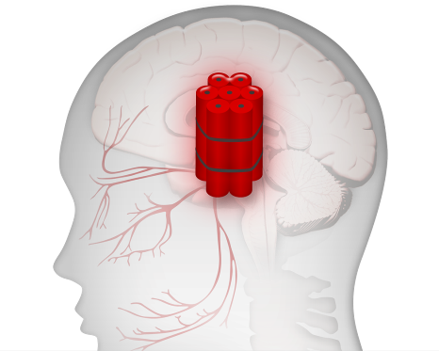
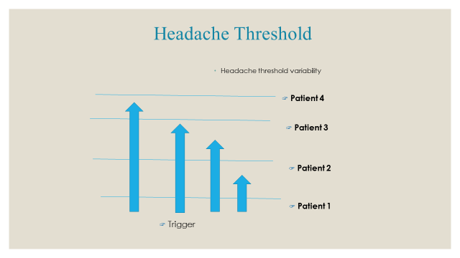

Consider the migraine brain to be sensitive to normal life events
Dehydration
Sleep
disturbance
Diet
Environmental
stimuli
Hunger
Stress
Changes in oestrogen
level in women
Coppola G et al. Cephalalgia. 2007;27:1429–1439; Kelman L. Cephalalgia. 2007; 27:394–402; Pietrobon D et al. Nat Rev Neurosci. 2003;4:386–398.
Notes:
The triggers (with their frequencies) in this study were stress (79.7%), hormones (eg, estrogen levels in women) (65.1%), hunger (57.3%), sleep disturbance (49.8%),
References:
1. Coppola G, Pierelli F, Schoenen J. Is the cerebral cortex hyperexcitable or hyperresponsive in migraine? Cephalalgia. 2007;27(12):1429–1439.
2. Pietrobon D, Striessnig J. Neurobiology of migraine. Nat Rev Neurosci. 2003;4(5):386–398.
3. Kelman L. The triggers or precipitants of the acute migraine attack. Cephalalgia. 2007;27(5):394–402.
R1, p 1434, C2,
Par 2, L 1-4
R1, p 1434, C2,
Par 3, L 1-2, 14-16
R1, p 1434, C2,
Par 3, L 4-13
R3, p 1, Abs,
Par 1, L 1-2
R3, p 1, Abs,
Par 1, L 7-8
R3, p 1, Abs,
Par 1, L 8-12
R2, p 391, C1,
Par 2, L 6-9
R2, p 390,
Legend to Fig. 3
Kelman, p 394, C1,
Par 1, L 1-15
Kelman, p 396, Fig 2

Slide 14
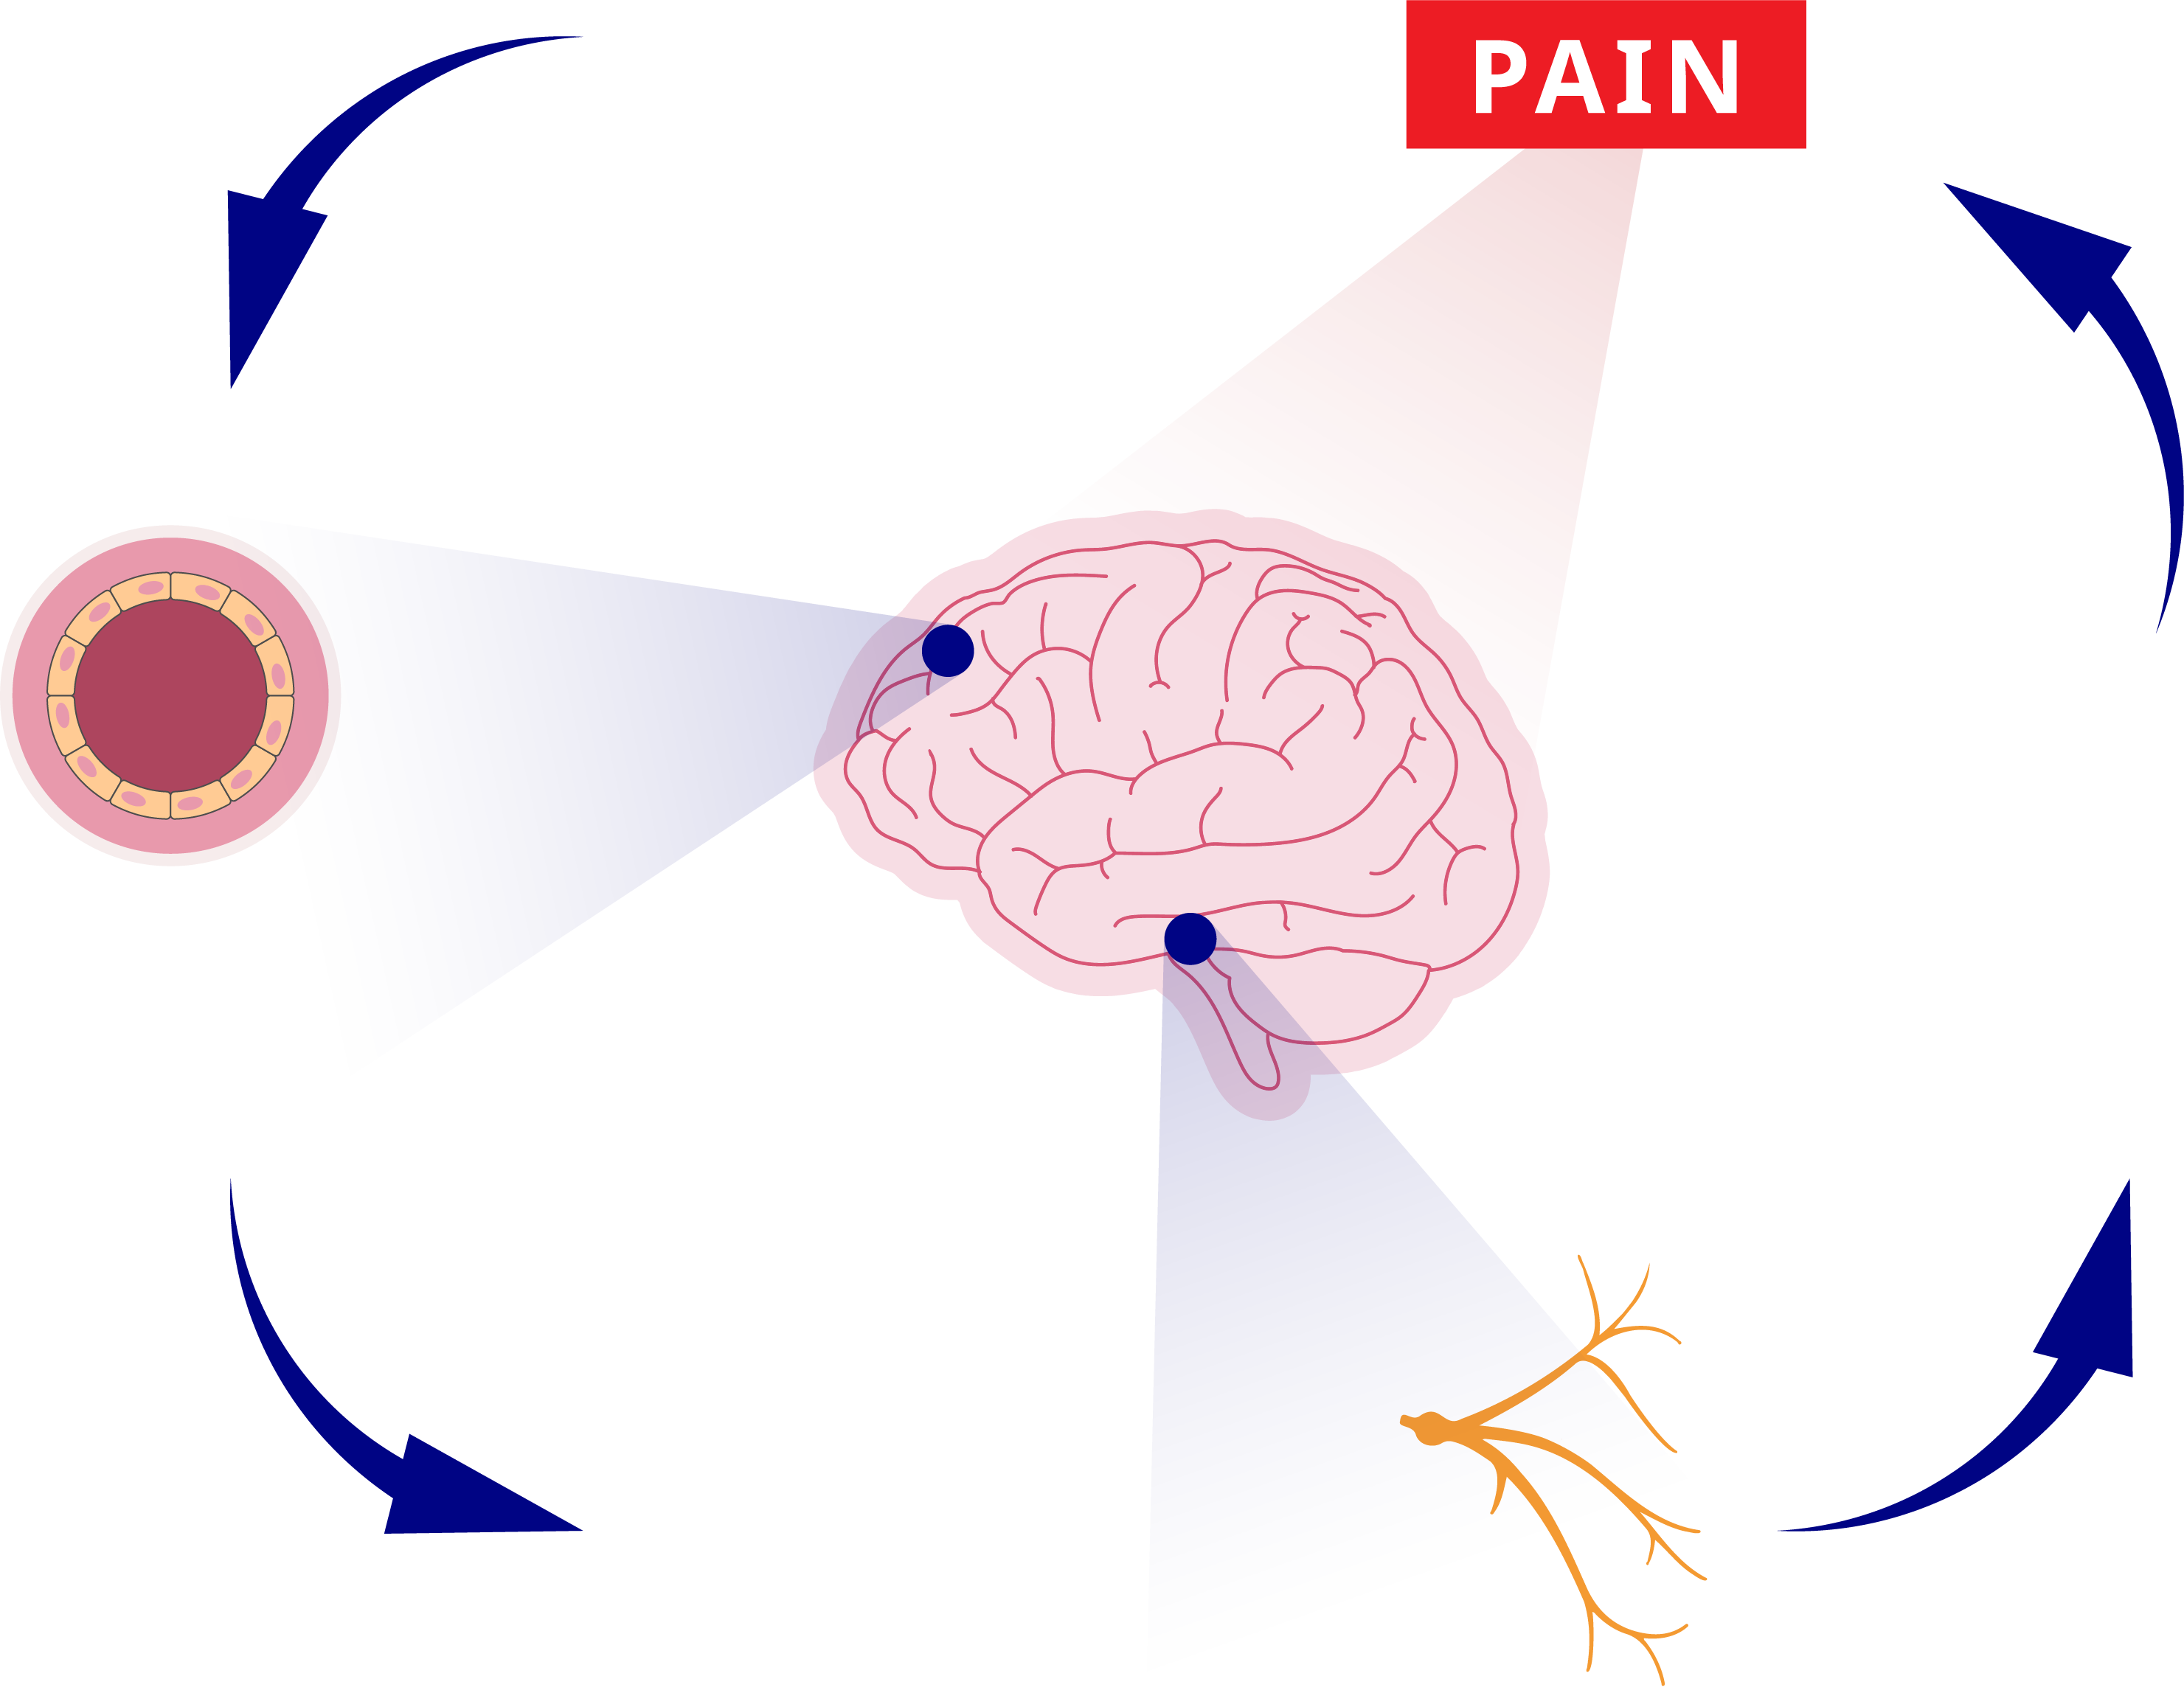
Migraine Pain Is Believed To Be Caused By The Activation Of The Trigeminal Sensory Pathways¹
Migraine triggers
The pain associated with headache is experienced in the frontal, temporal, parietal, occipital and high cervical regions¹
Central sensitisation
Migraine pain is believed to be caused by the hyperactivation of trigeminal sensory pathways that innervate pain sensitive structures (e.g., eye, dura, cerebral blood vessels), together termed the
trigeminovascular system¹
Activation of trigeminal sensory nerve
Release of pain
enhancing neuropeptides
Activation of the cortical pain centre
Thalamus, PAG region
and cortex
Vascular permeability changes causing vasodilation
Trigeminal nerve
Trigeminal ganglion
Activation of the trigeminal nucleus caudalis
PAG, periaqueductal gray.
1. Goadsby P, et al. Physiol Rev 2017;97:553–622; 2. Durham P, Papapetropoulos S. Headache 2013;53:1262–1277.
Adapted from Durham P, Papapetropoulos S. Headache 2013.

Slide 15
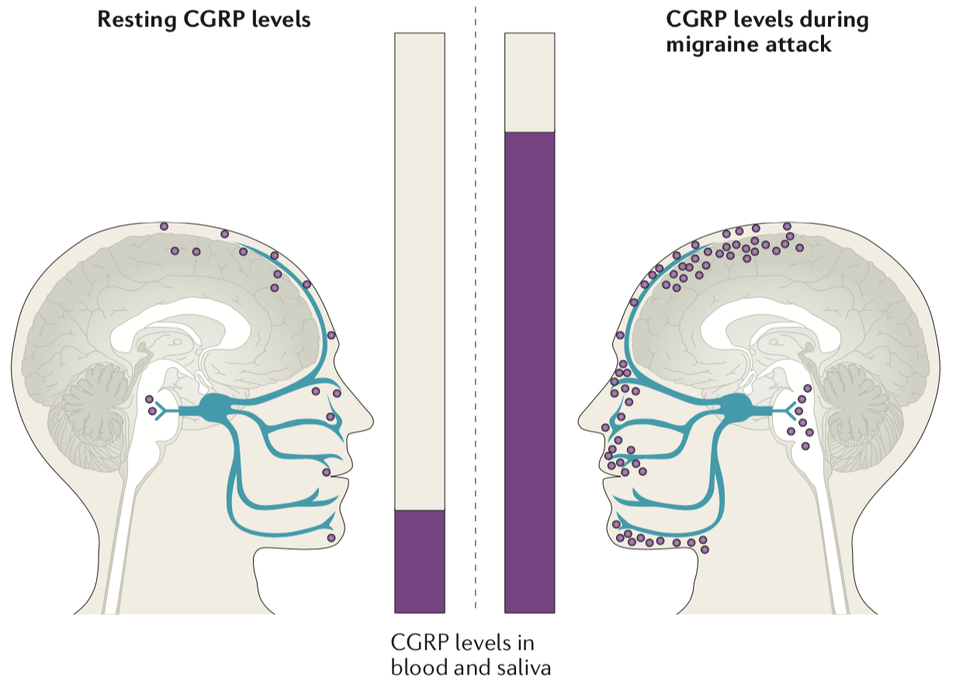
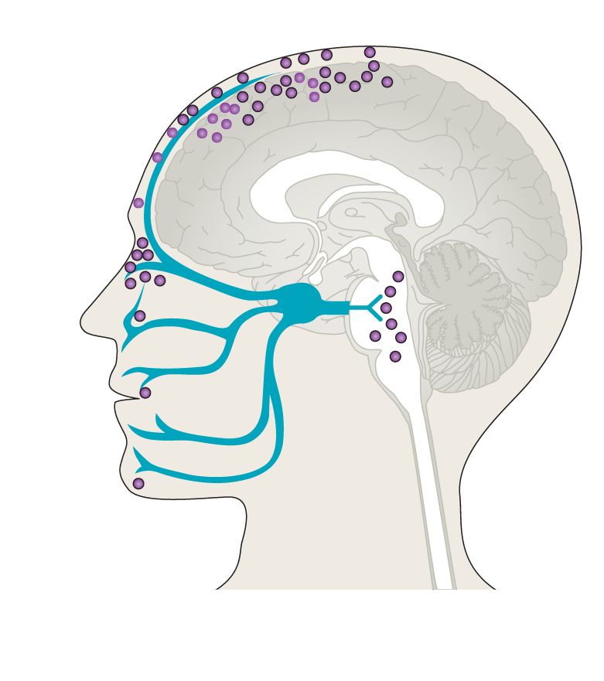
What is CGRP (calcitonin gene-related peptide)?
CGRP is an important mediator of migraine and one of the targets of migraine treatment.
Plasma CGRP levels increase during migraine attack
CGRP is a pain-signalling neuropeptide and potent vasodilator³
  Released from trigeminal sensory afferents and the spinal trigeminal nucleus⁴
Studies have shown that CGRP^{3,6}:
  Plasma levels are elevated during and outside of migraine attacks in people
  with migraine
  Infusion into patients with migraine can trigger a migraine attack
Resting CGRP level in blood and saliva
CGRP level during migraine attack
CGRP levels

Slide 16
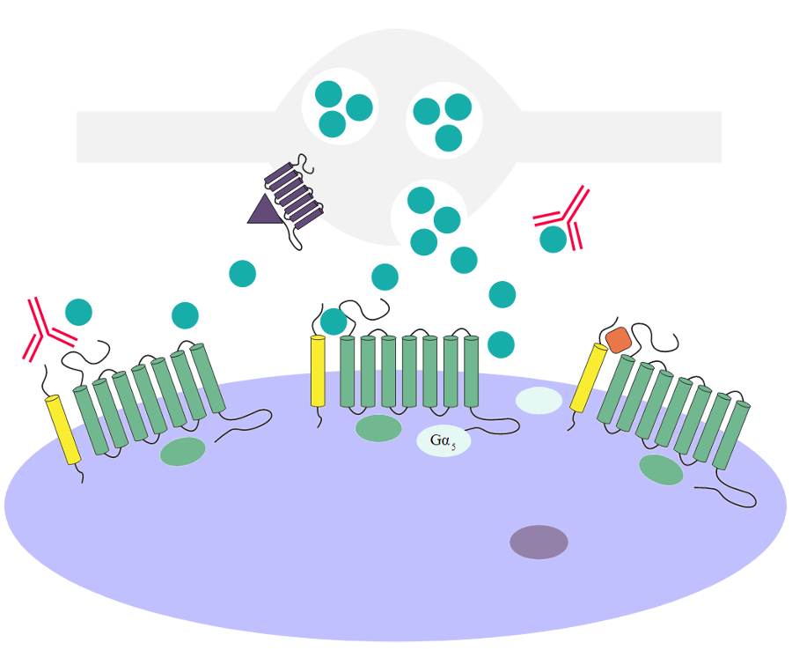
CGRP inhibitors are a class of drug developed for the treatment of migraine, which specifically target the CGRP pathway¹
Trigeminal nerve
5-HT_{1B} or 5-HT_{1D}
Triptans
Anti-CGRP antibody
CGRP
Adenylate cyclase
Anti-CGRP receptor antibody
Gepants
cAMP
CGRP receptor
Cerebrovascular smooth muscle cell
Protein kinase A
Vasodilation
5-HT, 5-hydroxytryptamine; cAMP, cyclic adenosine monophosphate; CGRP, calcitonin gene-related peptide.
1. Edvinsson L, et al. Nat Rev Neurol. 2018;14(6):338–50.
Adapted from Edvinsson, Lancet 2018.

Slide 17
Overview of acute and preventative treatments

Slide 18
Pharmacological Management of Migraine in Primary Care
Acute treatment
Preventive treatment
Mild to Moderate Attacks | NSAID If NSAIDs contraindicated or not tolerated: paracetamol
When to consider preventive treatment?
1st Line | Candesartan** (target dose 16mg daily) OR Propranolol (target dose 80mg twice daily) OR Amitriptyline (target dose 50mg at night)) Topiramate (MHRA Update)
Moderate to Severe Attacks
1st Line | Oral Triptan
2nd Line | If one triptan is ineffective, try another triptan OR Triptan +/- anti-emetic +/- NSAID* OR For nausea/vomiting: add anti-emetic +/- use non-oral triptan +/- non-oral NSAID
Triptan Non-Responders/ Triptans Contraindicated
Gepants | Rimegepant
2nd line | With specialist recommendation: Gepants Rimegepant (4 – 14 migraine attacks/month) OR Atogepant (≥ 4 migraine attacks/month)
Notes:
Dr David Watson

Slide 19
Targeted Preventative Treatments
Class | Drug | NICE | Indication(s) | Standard recommended dose
Botulinum toxin (C Fibres) | Onabotulinumtoxin A | TA260 (June 2012) | Prophylaxis of headaches in adults with chronic migraine | 155–195 units by injection to 31–39 sites every 12 weeks
CGRP monoclonal antibodies | Erenumab ▼ (Receptor) | TA682 (March 2021) | Prophylaxis of migraine in adults who have ≥ 4 migraine days per month | 70 mg or 140 mg SC every 4 weeks
 | Fremanezumab ▼ (Ligand) | TA764 (February 2022) |  | 225 mg SC once monthly or 675 mg SC every 12 weeks
 | Galcanezumab▼ (Ligand) | TA659 (November 2020) |  | 240 mg SC loading dose, then 120 mg SC once monthly
 | Eptinezumab▼ (Ligand) | TA871 (March 2023) |  | 100 mg or 300 mg IV every 12 weeks
CGRP receptor antagonist | Rimegepant ▼ | TA906 (July 2023) | Prophylaxis of episodic migraine in adults who have ≥ 4 migraine attacks per month | 75 mg sublingually every other day
 | Atogepant ▼ | TA973 (May 2024) | Prophylaxis of migraine in adults who have ≥ 4 migraine days per month | 60mg orally once daily
Notes:
Dr David Watson

Slide 20
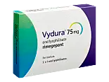
Targeted Acute Treatment
RIMEGEPANT

Slide 21
Unmet need
Acute
Triptan Non responders
80% patients respond to triptans
Consider timing, dose and non-oral routes
Triptan Contra-Indicated
Triptan Intolerant

Slide 22
Rimegepant Prescribing Information: Part 1
Acute
Licenced Indication
​
Rimegepant 75 mg can be considered for patients who have not responded to adequate trials of at least 2 triptans
or
If triptans are contraindicated or not tolerated or inadequate pain relief with NSAIDs and paracetamol
Acute treatment dosing regimen​
Rimegepant 75 mg taken at the onset of a moderate to severe migraine (maximum 10 days/month or on average 2 days/week)
The maximum dose in 24 hours is 75mg and a 2nd dose should not be taken if ineffective or pain recurs

Slide 23
Rimegepant Prescribing Information: Part 2
Acute
Side effects
​
Rimegepant is generally well tolerated.
Nausea is the main adverse effects in 1.2% of patients.
Hypersensitivity reactions have been reported but are uncommon occurring in <1%.
Drug Interactions
​
If patient is prescribed a strong CYP3A4 inhibitor (e.g. Clarithromycin, Itraconazole) then concurrent administration is not recommended.
If prescribed with a moderate CYP3A4 inhibitor (e.g. Erythromycin, Fluconazole), a 2nd dose should be delayed for 48 hours.
Pregnancy and Breastfeeding​
Rimegepant is not recommended in pregnancy, if planning a pregnancy, or in breastfeeding

Slide 24
Cardiovascular Safety:
Acute
BNF and SmPC – no cardiovascular contra-indications listed
The three Rimegepant acute studies allowed patients with contraindications to triptans (1% of study population) to enrol provided that they met the other inclusion criteria. However patients with uncontrolled, unstable or recently diagnosed cardiovascular disease were excluded.
  SMC “Due to the assumed absence of vasoconstrictive properties with rimegepant and the apparent favourable cardiovascular risk profile, no cardiovascular contraindications were noted for rimegepant.”
Hutchinson, S, Schim J, Lipton R, et al. ”Oral rimegepant 75 mg is safe and well tolerated in adults with migraine and cardiovascular risk factors: results of a multicenter, long-term, open-label safety study." Presented at: American Academy of Neurology 2021 Virtual Annual Meeting; April 17-21, 2021z
  Of the 1800 rimegepant-treated subjects, 59.2%, 28.8%, and 12.1%, respectively, had 0, 1, or ≥2 CV risk factors; 7.0% had a moderate to high 10-year CV risk.
  Serious AEs were reported by a similar proportion of subjects with 0, 1, or ≥2 CV risk factors (2.3-2.7%) and among those with low and moderate to high 10-year CV risk (2.4-2.6%); no SAEs were considered by the investigator to be related to rimegepant.
Bhardwaj et al. Clinically relevant electrocardiogram effects of single therapeutic/supratherapeutic rimegepant doses in health adults. Clin. TRANSL.SCL.2024
  300 mg dose rimegepant ( representing 10.8 fold plasma concentration compared to 75 mg dose) did not cause any ECG abnormality including QTc

Slide 25
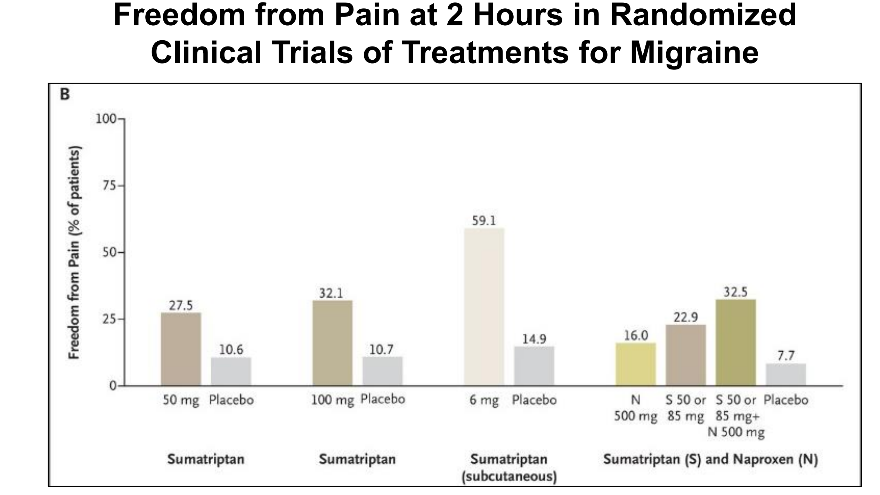
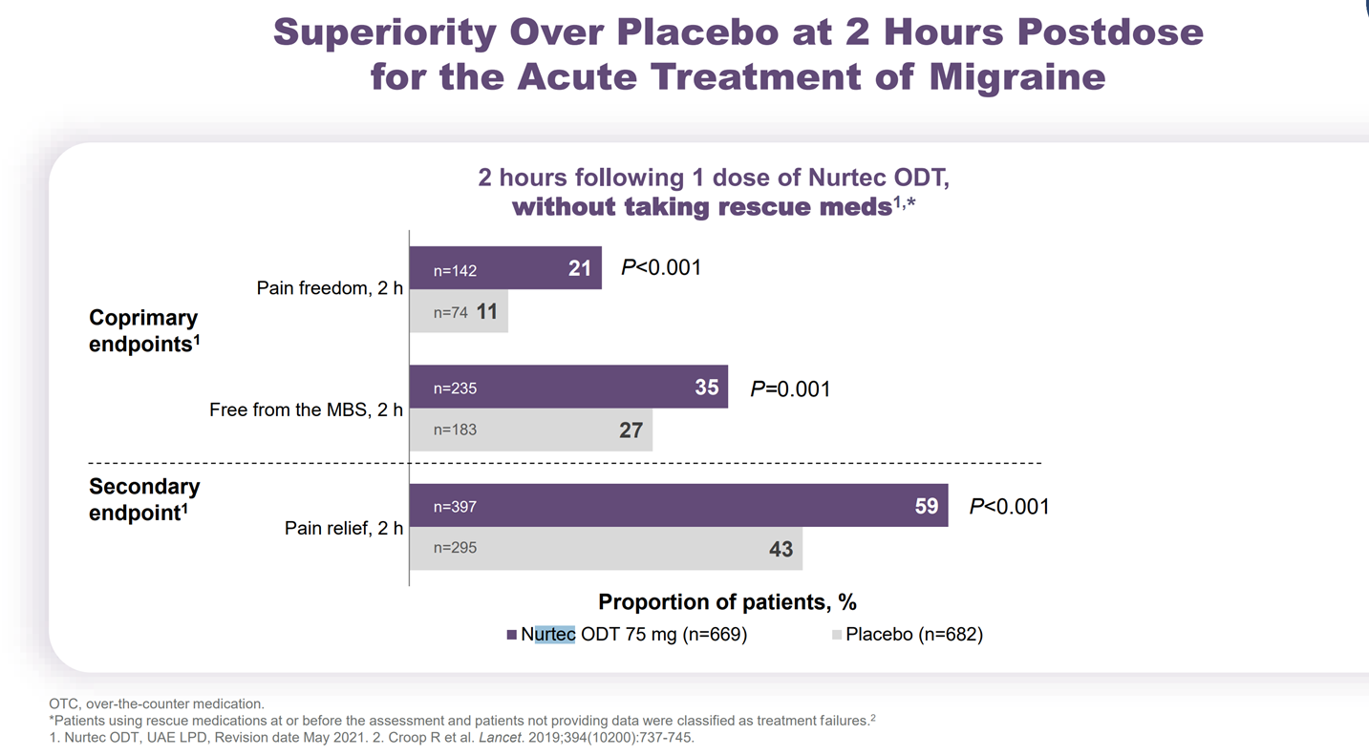
Study 303: Rimegepant
Acute
MBS most bothersome symptoms

Slide 26

Sumatriptan Pooled Data for comparison
Acute
Ashina NEJM. 2020; 383:1866-76

Slide 27
Post-hoc analysis: Pain and MBS freedom 2 hours post dose by prior triptan experience¹
Acute
Co-primary endpoints in the pooled population
Triptan naïve
(n=1677)
Current triptan use
(n=595)
History of treatment failure,
1 triptan
(n=910)
History of treatment failure,
≥2 triptans
(n=325)
P<0.001
P=0.06
P<0.001
P<0.001
P=0.007
P<0.001
P>0.001
P=0.013
Rimegepant*, n=
 | 866 | 866 |  | 285 | 285 |  | 450 | 450 |  | 148 | 148
 | 811 | 811 |  | 310 | 310 |  | 460 | 460 |  | 177 | 177
Placebo, n=
Adapted from Lipton RB, et al. Cephalalgia. 2023.¹
*A different oral dosage form of rimegepant that was bioequivalent to Vydura was used in Study 301 and 302.^{2,3}
The formulation of rimegepant used within the UK is oral lyophilisate 75 mg.⁴
MBS, most bothersome symptom.
1. Lipton RB, et al. Cephalalgia. 2023;43(2):03331024221141686; 2. Lipton RB, et al. Headache. 2018;381(2):142–9 (Abst PS123LB); 3. Lipton RB, et al. N Engl J Med. 2019;381:142–149; 4. Vydura® (rimegepant) Summary of Product Characteristics
for Great Britain; Vydura® (rimegepant) Summary of Product Characteristics for Northern Ireland.
Notes:
Dr David Watson

Slide 28
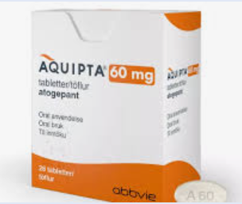
Targeted Preventative Treatment
RIMEGEPANT
ATOGEPANT

Slide 29
Rimegepant: as a Preventer
Preventive
BNF/SmPC indication:
Prophylaxis of migraine in adults who have at least 4 migraine attacks per month
Episodic migraine only
NICE/SMC Restriction
Episodic migraine (4-14 days headache a month) which has failed to respond to three or more prior oral prophylactic treatments.
Dose
Rimegepant 75mg alternate days
Tolerability
Nausea 1.4% as preventer compared 1.2% as acute
Prescribed in Primary Care

Slide 30
Study 305: Rimegepant demonstrated a reduction in MMD, starting at Week 1 and continuing through to Week 12 versus placebo¹
Preventive
49.1% achieved ≥50% reduction from baseline in mean number of moderate or severe migraine days per month during Weeks 9–12¹
Reduction in MMD levels from baseline over
16 month treatment period¹
Patients received rimegepant 75 mg every other day, plus as needed on non-scheduled dosing days without exceeding advisable daily dose¹
7.6% difference, p=0.044
(95% Cl: 0, 15)​
Rimegepant 75 mg (n=348)
0
Double-blind treatment
Months
1 to 3
Open-label rimegepant
75 mg Months 4 to 16
100
-1
Placebo (n=347)
-2
80
49.1%
(95% CI: 44 to 54)
-3
60
41.5%
(95% CI: 36 to 47)
Change from baseline in Monthly Migraine Days
Percentage of participants, %
-4
40
-5
20
-6
0
-7
n=171
n=144
-8
1
2
3
4
5
6
7
8
9
10
11
12
13
14
15
16
Baseline
Adapted from Croop R et al. 2021.
Month
Rimegepant 75 mg
CI, confidence interval; MMD, monthly migraine days.
1. Croop R, et al. Lancet. 2021;397:51–60.
348
348
332
314
276
276
265
252
253
248
239
236
225
218
213
209
203

Slide 31
Atogepant as a preventer
Preventive
BNF/SmPC Indication
Prophylaxis of migraine in adults who have at least 4 migraine days per month
Episodic and chronic migraine
NICE/SMC Restriction
For the prophylaxis of migraine in adults who have at least 4 migraine days per month who have had prior failure on three or more migraine preventive treatments. Approval for episodic and chronic migraine
Take at Night
Dose
Atogepant 60 mg daily
Tolerability
constipation (7%), nausea (7%) and somnolence (5%)
Prescribed in Primary Care

Slide 32
Atogepant Prescribing Information:
Preventive
Cautions​
Atogepant should be avoided in severe hepatic impairment and dose reduction to 10mg is required in severe renal impairment. Baseline U&Es, LFTs should be considered if clinical concern.
Routine monitoring is not required for patients with normal renal and liver function.
Drug Interactions​
If patient is prescribed a strong CYP3A4 inhibitor (e.g. Clarithromycin, Itraconazole) or a strong OATP inhibitor (e.g. Rifampicin, Atazanavir, Ritonavir, Tipranavir, Ciclosporin, Telmisartan) then the dose should be reduced to 10mg.
For those where the strong CYP3A4 inhibitor or OATP inhibitor is prescribed for a short course of treatment then it is acceptable to temporarily stop Atogepant and re-start when treatment course is completed.
Pregnancy and Breastfeeding​
Rimegepant is not recommended in pregnancy, if planning a pregnancy, or in breastfeeding

Slide 33
Atogepant Evidence:
Preventive
ADVANCE¹: Episodic migraine.
12-week trial, 60.8% (135/222) vs 29% (62/214) [p <0.001] placebo patients
achieved ≥ 50% ↓ in mean monthly migraine days
ELEVATE²: Episodic migraine with prior 2 – 4 treatment failure.
12-week trial, 51%(78/154) vs 18% (28/155) [p <0.0001] placebo patients achieved
≥ 50% ↓ in mean monthly migraine days
PROGRESS³: Chronic migraine.
12-week trial, 41%(105/256) vs 26% (64/246) [p =0.0009] placebo patients
achieved ≥ 50% ↓ in mean monthly migraine days
1. Ailani et. al. NEJM 2021; 385:695-706
2. Tassorelli et.al Lancet Neurol. 2024; 23:382-92
3. Pozo-Rosich et.al. Lancet 2023; 402:775-85

Slide 34
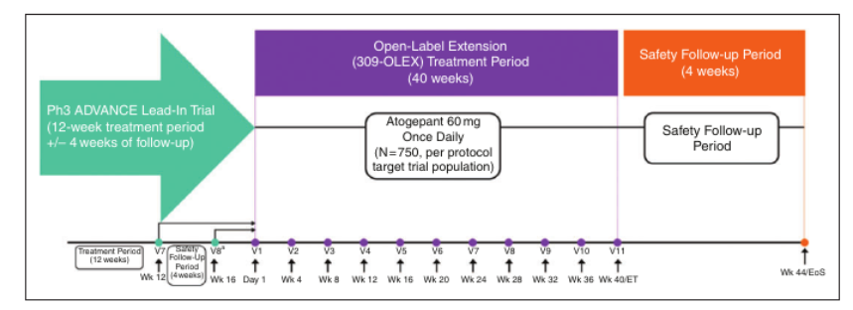
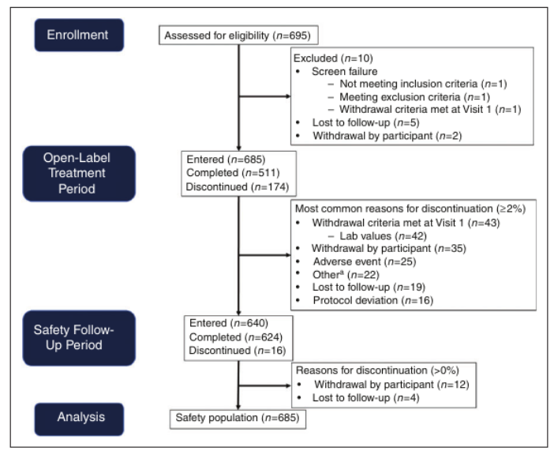
ADVANCE long-term, open label 40-weeks extension study, n= 685 ⁴
Preventive
No deaths; no new safety signals vs pivotal phase 3 trials
  Treatment-emergent ADR (≥ 2%) include upper RTIs, UTIs, nasopharyngitis, sinusitis, constipation, nausea, weight decreased
  0.6% (4/683) had ALT/AST ≥ 3 x ULN
Atogepant 60mg once daily is deemed safe and tolerated in trial patients. No discontinuation reported due to CVS events
4. Klein et. al. Cephalalgia 2022; 43(1):1-11

Slide 35
Practical Issues
Can a patient on a monthly monoclonal against CGRP have Rimegepant as an acute therapy?
YES
Can a patient on Rimegepant for prevention use Rimegepant as an acute therapy?
YES
Can a patient on Atogepant as an preventer therapy use Rimegepant as an acute therapy ?
YES

Slide 36
Northants Migraine Pathway
https://www.icnorthamptonshire.org.uk/download/northamptonshire-migraine-pathway.pdf?ver=65289

Slide 37
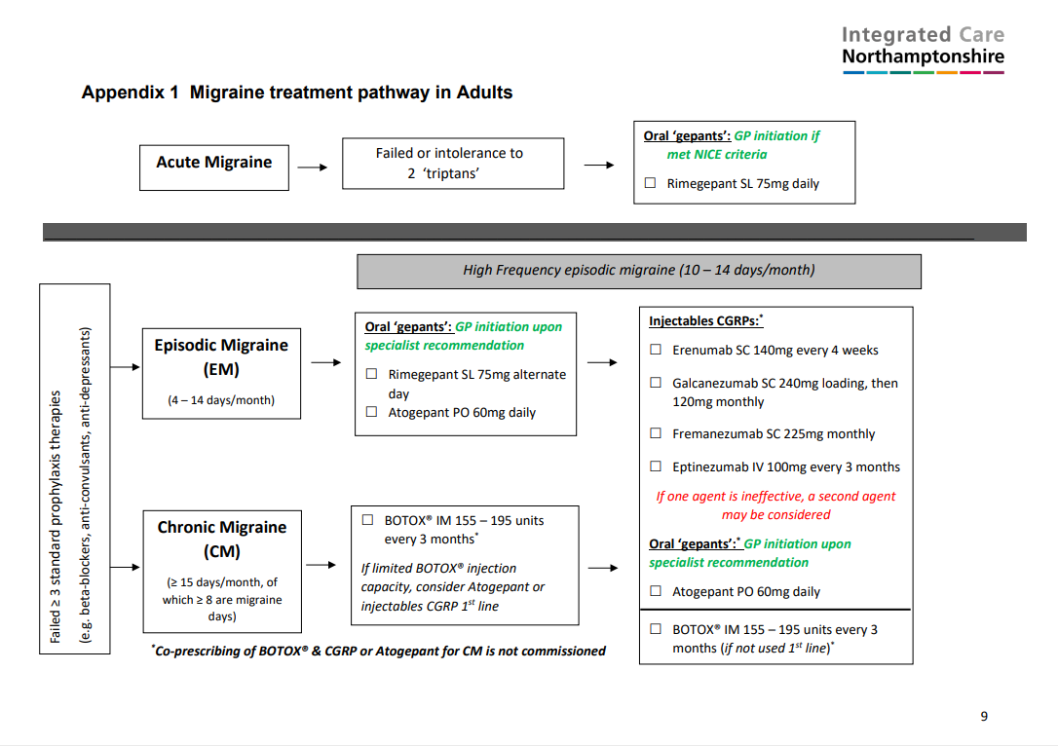

Slide 38
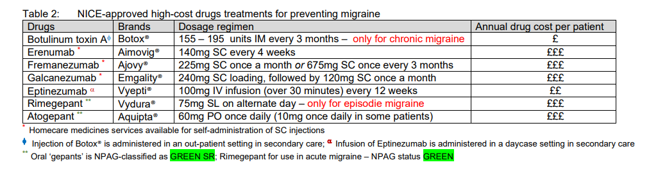
Drug Cost Comparison
BOTOX® injection is no longer classed as a high-cost drug

Slide 39
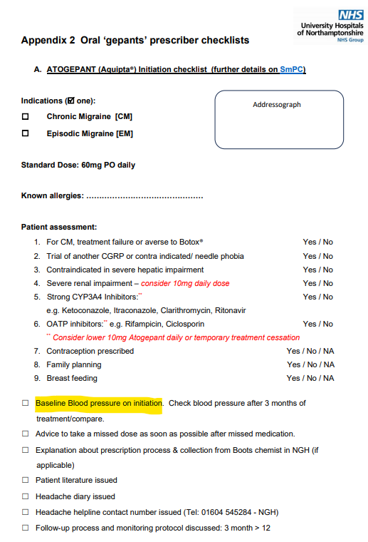
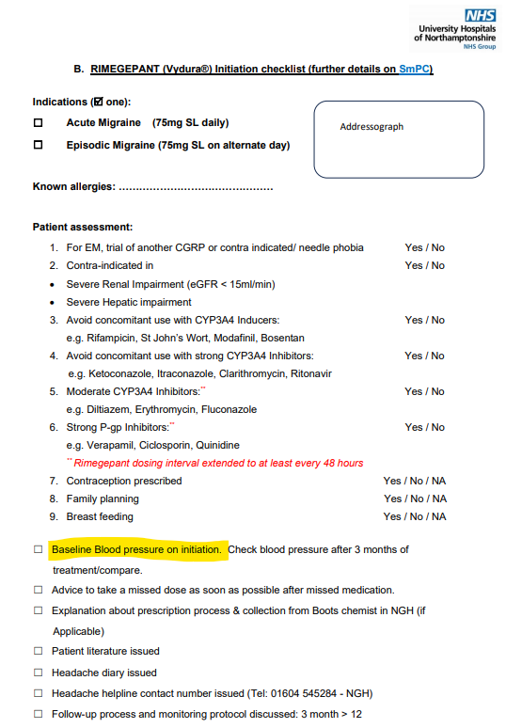
CGRPs (including ‘gepants’) are known to raise both systolic and diastolic BP by 5mmHg within first 2 weeks of starting treatment

Slide 40
Case Studies
https://www.pfizerpro.co.uk/therapy-areas/migraine/learning

Slide 41
Case Study 1
Patient Background & History
56yo male; married; marketing manager
Daily headache started suddenly in Oct-12
Saw private consultant, diagnosed new daily persistent headache (migraine variant)
All investigations (MRI head 2012; CT head 2014): Normal
No family history; social History: alcohol 4 units/week; caffeine intake – 2 cups of coffee/day; non-smoker
Seen in NGH 2014
Headache Diary
Episodic migraine until Oct-12.
New daily persistent headache (Oct-12).
Some similarity to old migraine pain in temples, throbbing; worse on exercise.
Nausea sometimes a feature; no visual aura or aura.
2014: CM diagnosed

Slide 42
Case Study 1 (cont.)
Treatment History
Timeline | Interventions | Additional comments
2012 | Amitriptylline 75mg/d x 3/12 | Ineffective
2013 | Indometacin | Ineffective, no further details recalled
2013 | Topiramate 50mg BD x 2/12 | Ineffective, no significant s/e, but didn’t help
 | Pregabalin 75mg BD
2015 | BOTOX® 155units/3mths | Helpful, wearing-off effect. Naproxen added and Sumatriptan PRN
2016 | Candesartan | In combination with BOTOX®. Dose optimised to 32mg/d in 2017 (better pain control)
2018 | Hospital admission with severe migraine atypical to his usual, received a course of prednisolone
2019 | Flunarizine 10mg/d | Switched from Candesartan, but developed somnolence s/e
2020 | Galcanezumab 120mg/3mths | Increased headache severity. Pandemic – resumed Topiramate, resumed BOTOX®.
2021/22 | BOTOX 155units/3mths + Candesartan 32mg/d
2022/23 | Erenumab 140mg/3mths ; Eptinezumab 100mg/3mths - Ineffective
Dec-23 | Atogepant 60mg/d | Assessed at 12 weeks: No severe migraine, sleepiness (to take tablets in the morning) May-24: significant QoL improvement: headache 3/10, previously 7-8/10. remained off BOTOX®; Sumatriptan 100mg PRN (rarely ~1 dose/3mths)

Slide 43
Case Study 2
Patient Background & History
49yo female; married; medically retired, previously a bank manager.
Chronic migraine started at puberty.
Also suffers from chronic neck pain, hyper-flexibility, gastric reflux and connective tissue disorder.
Investigations (MRI head 2010, 2016; MRI spine 2016) = NAD; neuro and neurophysiological examination = NAD.
Abdominal pains investigations = NAD.
No family history; social History: no alcohol; smoker 7-10/day; on pension.
Headache Diary
Saw Consultant in NGH 2020 – chronic migraine.
Trials of medications – not effective, most not tolerated/side-effects. Refused BOTOX® and clinically agreed not safe option. Awaited CGRPs.
Offered Galcanezumab 2023 – DNA, fear of side-effects.
Offered Eptinezumab 2023 after clearance with Cardiology (re: chest pain), cardiac investigations NAD; continues with CM.
2024 – Trial of Atogepant

Slide 44
Case Study 2 (cont.)
Treatment History
Timeline | Interventions / Additional comments
Pre-2012 | Amitriptylline, Propranolol, Flunarizine, Sodium valproate, Pizotifen (under NGH Consultant) – intolerance to all BOTOX® felt to be unsafe due to allergic reactions; patient anxiety
2019 | Refused Erenumab – fear of side-effects
2023 | Declined Eptinezumab infusion
June-24 | Atogepant 60mg/d | Assessed at 12 weeks: < menstrual migraine only s/e reported: vivid dreams, for further 3/12 review.
Feb-25 | Remained on Atogepant 60mg/d

Slide 45


In summary, small molecule CGRPs (oral ‘gepants’) are generally safe and well-tolerated.
Can GPs initiate oral ‘gepants’ under A&G from secondary care?
(session feedback) https://forms.office.com/e/tg0pHwMpLM

