Slide 1
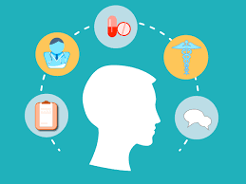
Healthcare literacy
A person's ability to find, understand, evaluate, and use health information and services to make informed decisions about their health and healthcare.
Notes:
Good afternoon everyone,
My name is Helen Macmillan, and I’m the Personalised Care Lead for the General Practice Alliance. I’m joined today by Emily Skinner, our Project Manager, who has been instrumental in coordinating the work we’ll be sharing with you today.
We’re here to talk about a topic that’s fundamental to improving patient outcomes and reducing health inequalities—healthcare literacy.
Healthcare literacy is about more than just reading ability. It’s about people being able to find, understand, and use health information and services to make informed decisions about their care. And unfortunately, many of our patients face significant barriers in doing just that.
Today, we’ll be looking at this challenge from a primary care perspective. We know that general practice is often the first point of contact for patients, and it’s where many of these barriers become visible—whether it’s difficulty understanding appointment letters, navigating digital systems, or making sense of treatment plans.
Our aim is to not only highlight the scale and impact of low healthcare literacy, but also to share some practical tips, tools, and resources that can help primary care colleagues support patients more effectively. We hope this session gives you insight, ideas, and inspiration to make health information more accessible and empowering for everyone.

Slide 2
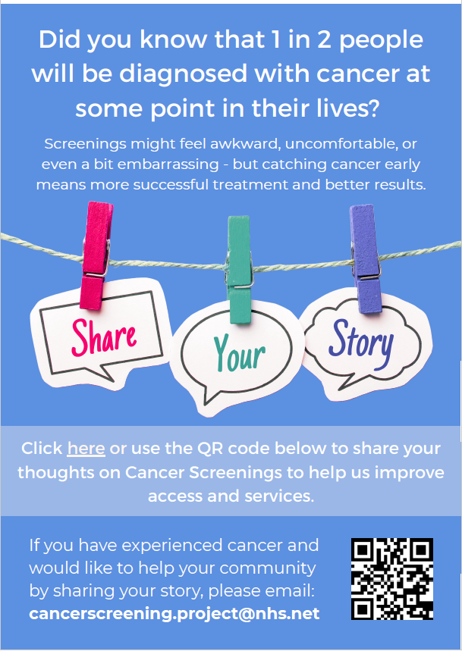


Early insights from the cancer screening awareness project related to health literacy…
My English isn’t good, so my son translates. I was on hold for 45 minutes at 8am, my son had to go to work so I couldn’t make an appointment
Phone appointments are hard, the doctor doesn’t always understand what I say and I can’t point or show what hurts. I don’t feel like they hear me
Notes:
Emily:
we’ve been running a project focused on increasing awareness of cancer screening in communities across Northamptonshire where uptake is particularly low.
We concentrated our efforts in Central and East Northampton and the Wellingborough West LAP areas—places that experience high levels of deprivation and are home to large Asian and Afro-Caribbean populations.
Through community outreach, our team built trusted relationships and engaged in meaningful conversations—both in groups and one-to-one. We created safe spaces for people to share their experiences.
Importantly, we also engaged with the homeless community and individuals facing substance misuse issues—groups that are often overlooked in mainstream health messaging. These individuals face unique and significant barriers. If you’re homeless, how do you receive a FIT kit for bowel screening? How do you get a letter, or book an appointment, when you don’t have a fixed address or access to digital services? These are real, practical challenges that prevent people from accessing even the most basic preventive care.
The message that’s come through loud and clear is that the issue isn’t just about cancer screening—it’s about access to healthcare more broadly. Many of the people we spoke to are struggling to navigate the system, which points to a deeper issue: low healthcare literacy.

Slide 3
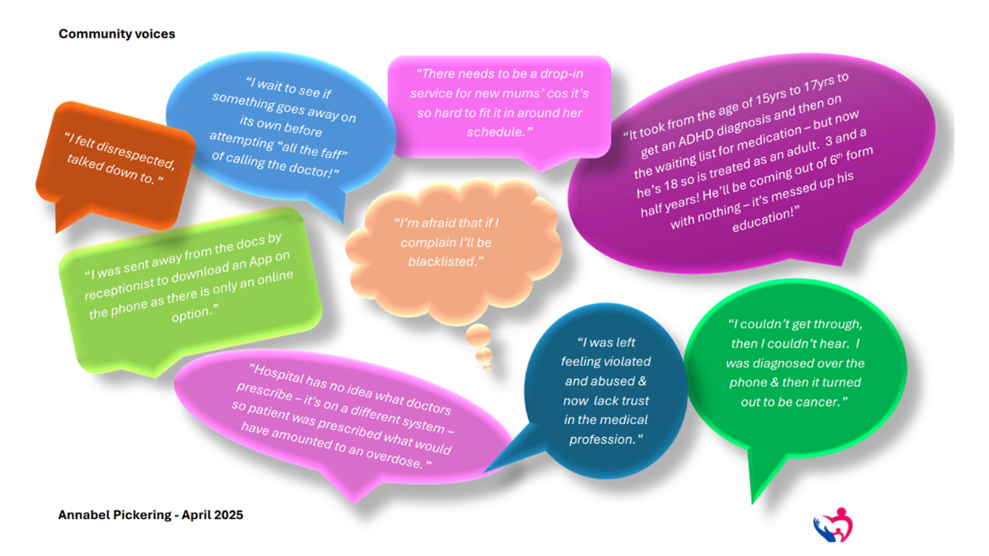
Womens health inequalities pilot project
Notes:
Helen
These findings have been echoed in another local project led by Anabel Pickering from C2C Social Action, which explored why health inequalities persist among hard-to-reach and seldom-heard women in Central Northampton.
Anabel and her team held 59 conversations, and what they heard was powerful.
34 women spoke about a lack of trust between patients and medical services.
25 described difficulties accessing healthcare systems.
Many felt they were being sidelined because of their ethnicity, or that decisions—like not being given prescriptions—were made to save the NHS money.
Booking appointments was often seen as intentionally difficult, and both language barriers and lifestyle constraints—such as caring responsibilities or work commitments—made accessing services like e-consultations even harder.
We acknowledge that some of these concerns might not be intentional or even part of a real systemic problem, but perception matters. When people feel unheard, excluded, or mistrustful of the system, it affects their willingness to engage with healthcare services—and that has real consequences.

Slide 4

Barriers to accessing GP Services
Perceived Eligibility and Stigma
Patients often feel ineligible for care due to past negative experiences or social stigma, limiting access to GP services.
Language and Communication Barriers
Non-English speakers and low literacy individuals struggle with booking appointments and understanding medical advice.
Digital Exclusion and Systemic Mistrust
Lack of internet access and mistrust among ethnic minorities reduce engagement with healthcare services.
Logistical and Financial Barriers
Inflexible appointments, transport issues, and fears of costs or immigration checks further hinder access to care.
Health Foundation, NHS England
Notes:
He;en
People experiencing health inequalities in the UK face a wide range of systemic, social, and practical barriers that make it difficult to access GP services. These insights are drawn from recent research by the Health Foundation, NHS England, and other health equity studies—and they reflect what many of us see in practice every day.
One of the key issues is something known as “candidacy”—the idea of perceived eligibility. Some individuals simply don’t see themselves as entitled to seek care. This is especially true for people who’ve had negative past experiences, or who feel judged or dismissed when they do try to access services. It’s a common theme among those experiencing homelessness, migrants, and people living with mental health conditions.
Language and communication barriers are another major challenge. Non-English speakers and those with low literacy levels often struggle to understand how to book appointments or describe their symptoms. And when there’s a lack of interpreters or translated materials, these difficulties are compounded.
We also need to talk about digital exclusion. Many people in deprived communities don’t have access to smartphones, reliable internet, or the digital skills needed to use online booking systems or video consultations. As services become increasingly digital-first, this gap becomes even more problematic.
Then there’s the issue of cultural and systemic mistrust. Some ethnic minority groups report feeling dismissed or not taken seriously by healthcare professionals. Historical discrimination and a lack of cultural competence in services can lead to deep-rooted mistrust, which understandably deters people from seeking care.
Inflexible appointment systems also play a role. Rigid 8am phone lines or online-only booking options disadvantage people who work irregular hours, have caring responsibilities, or live with mental health conditions or neurodivergence. These systems don’t reflect the realities of many people’s lives.
Transport and location are further barriers. People living in rural areas or underserved urban communities may face long travel times or lack affordable transport options to reach GP practices.
And finally, there’s the fear of costs or immigration checks. Some migrants and asylum seekers avoid GP services altogether because they’re worried about being charged or reported to immigration authorities—even though GP care is free.
We also want to acknowledge that there are ongoing efforts across the system to address these barriers, improve healthcare literacy, and rebuild trust. Many teams are working hard to make services more inclusive, accessible, and responsive to the needs of diverse communities. However, these findings remind us that there is still more to do—and that listening to lived experience must remain at the heart of that work.
These local projects and the wider data, have shown us that improving healthcare literacy is not just a nice-to-have—it’s essential if we want to reduce inequalities and improve outcomes across our communities.

Slide 5
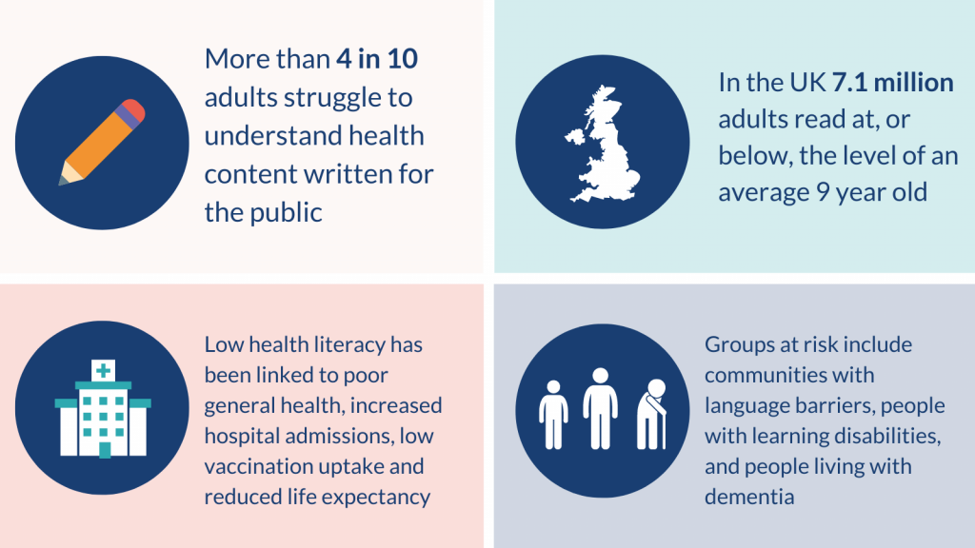
Why healthcare literacy matters
Better Health Outcomes
Reduced Healthcare Costs
Increased Patient Safety
Empowerment and Confidence
Health Equity
Notes:
Emily
When we talk about healthcare literacy, it’s important to recognise the scale of the challenge. In the UK, more than 4 in 10 adults struggle to understand health information that’s written for the general public. That’s nearly half of the population who may not be able to fully grasp the details of their diagnosis, treatment plans, or even basic health advice.
To put that into perspective, 7.1 million adults in the UK read at or below the level of a typical 9-year-old. This has serious implications for how we communicate health messages and support people in making informed decisions about their care.
The consequences of low health literacy are far-reaching. It’s been linked to poorer general health, increased hospital admissions, lower vaccination uptake, and even reduced life expectancy. These aren’t just statistics—they reflect real lives impacted by a system that isn’t always accessible or inclusive.
And certain groups are especially at risk. This includes people facing language barriers, those with learning disabilities, and individuals living with dementia. These communities often face additional challenges in understanding and navigating healthcare services, which can further widen existing health inequalities.
For example - Romanian boy who missed an MRI scan as family couldn’t read the letter stating fast before surgery – as a result the boy
So improving healthcare literacy isn’t just about simplifying leaflets or translating materials—it’s about creating a system that meets people where they are, and empowers them to take control of their health.
Good healthcare literacy is absolutely critical—it directly influences a person’s ability to manage their health and navigate the healthcare system effectively.
When someone has strong health literacy, they’re more likely to understand their diagnosis and treatment options, follow medication instructions correctly, attend follow-up appointments, and manage long-term conditions like diabetes or asthma with confidence. All of this contributes to better health outcomes.
It also helps reduce healthcare costs. People with good health literacy tend to make better use of preventive services like screenings and vaccinations, and they’re less likely to end up in A&E or require hospital admissions due to avoidable complications. It also means fewer unnecessary tests or treatments caused by misunderstandings.
Patient safety improves too. When individuals understand their care, they’re more likely to spot errors, ask questions, and clarify instructions. They can give informed consent with confidence, which is a vital part of safe and ethical healthcare.
Beyond the clinical benefits, health literacy empowers people. It gives them the confidence to make informed decisions, advocate for themselves, and feel more in control of their health. It also helps reduce the anxiety and confusion that many people feel during medical appointments.
And finally, improving health literacy is a powerful tool for tackling health inequalities. It helps level the playing field for groups who often face barriers—such as people with disabilities, older adults, non-native speakers, and those with lower education or income levels.
So when we talk about improving healthcare access and outcomes, health literacy isn’t just part of the solution—it’s foundational.

Slide 6

What are our legal obligations?
Ensure patients can contact the practice via phone, online, through other forms of digital messaging and in-person methods.
Provide an appropriate response based on patients' needs and urgency of clinical needs (appointment, advice, signposting), clearly communicating timeline and next steps.
Reasonable adjustments:
  physical access, eg ramps, accessible toilets
  communication support, e.g. sign language interpreters and easy read materials
  process changes e.g., longer appointments, quiet waiting areas, home visits or video consultations for house bound patients.
Equality Act 2010
General Medical Services (GMS) contract
Notes:
Helen
As we all know, GP practices in the UK have clear legal and contractual responsibilities to ensure that patients with accessibility needs can access services and appointments. These obligations are not new—they’re well established, and they’re something we all strive to uphold in our day-to-day work. But it’s always helpful to revisit them as a reminder of the important role we play in making healthcare inclusive and equitable.
Under the General Medical Services (GMS) and Personal Medical Services (PMS) contracts, practices must ensure patients can contact the surgery in a variety of ways—whether that’s in person, by telephone, through online consultation tools, or other electronic methods. We’re also expected to provide an appropriate response based on the patient’s needs. That might mean offering an appointment—whether face-to-face, by phone, or video—or signposting to another service, or simply providing advice. Crucially, we must communicate clearly about next steps and timelines, and ensure that responses are timely and reflect both the urgency of clinical need and the patient’s preferences.
In addition to these contractual duties, we’re also bound by the Equality Act 2010, which requires us to make reasonable adjustments for disabled people. These adjustments can take many forms—from physical changes like ramps and accessible toilets, to communication support such as sign language interpreters or easy-read materials, and even procedural changes like offering longer appointment times or quiet waiting areas.
These adjustments must be made when a disabled person would otherwise be at a substantial disadvantage compared to others. And in practice, we see this every day—whether it’s offering home visits or video consultations for patients with mobility issues, providing booking options via text or email for those with hearing impairments, or ensuring our staff are trained in disability awareness and communication support.
These are all things we’re already doing. But as we continue to tackle health inequalities and improve healthcare literacy, it’s important to keep these principles front and centre. Because accessibility isn’t just about meeting legal requirements—it’s about making sure every patient feels seen, heard, and supported.

Slide 7
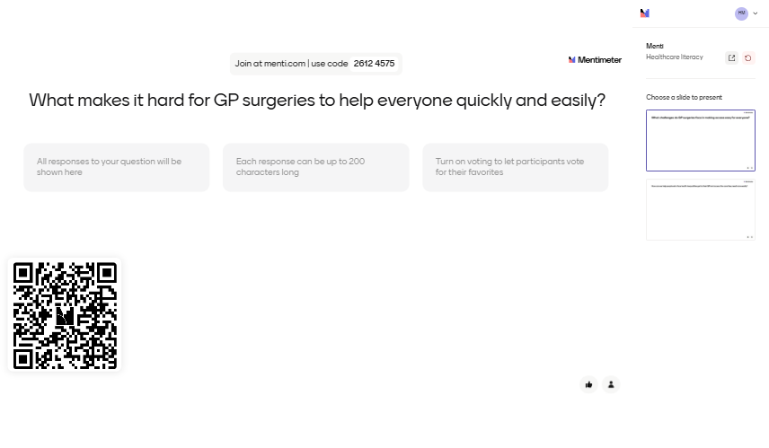
Notes:
Emily
Before we move on, I’d really like to open up the conversation and hear from you.
We know that accessibility and inclusive care are priorities across all our practices, and many of the principles we’ve discussed today—whether around healthcare literacy, reasonable adjustments, or communication—are already part of the way we work.
But we also know that real-world challenges can make this difficult.
You might be facing:
Time and capacity pressures that limit the ability to tailor communication or follow up with patients.
Or physical constraints in your building—like limited space for quiet areas or accessible facilities.
So now, we’d love to hear from you. Please log into Mentimeter on your phones or computers by hovering over the QR code or entering the code shown on the screen at menti.com. Share what you’re facing in your practice?

Slide 8

What our healthcare literacy group say…
Time and capacity pressures
Limited awareness of patient-specific challenges
Telephone translation services are time-consuming, may lack language availability, and are not always appropriate
Preferred language and communication needs often not captured at registration
Gathering communication data sets unrealistic expectations due to limited time and ability to translate medical information
Systemic challenges not driven or monitored at a contractual level
Low priority in a stretched system – wider approach needed for quality improvement
Notes:
Emily
To help us better understand and address these challenges, we’ve established a Healthcare Literacy Working Group
The group brings together a range of voices from across the system—including GPs, practice managers, personalised care staff, and members of the ICB population health team. Its aim is to develop a toolkit of practical resources to support improved healthcare literacy and reduce access barriers for those experiencing health inequalities.
As part of this work, the group has identified several key challenges that many of you will recognise:
Time and capacity pressures that make it difficult to personalise communication.
Limited awareness of the specific barriers some patients face.
Telephone translation services can be time-consuming to arrange, may not offer the required language, and aren’t always appropriate for the patient’s needs.
Preferred language and communication needs are often not captured at registration, which limits our ability to respond effectively.
Even when we try to gather this data, it can set unrealistic expectations—because translating medical information confidently and accurately takes time, skill, and resources that may not be available.
And many of these challenges are systemic. They’re not driven or monitored at a contractual level, which means they often fall down the priority list in an already stretched system.
We know these issues are not new—but they are persistent. And that’s why we’re inviting anyone on today’s session who’s interested in this work to join the steering group. If you’d like to be involved, please email Emily or myself. We’ll be sharing our contact details along with the slides after the session.

Slide 9
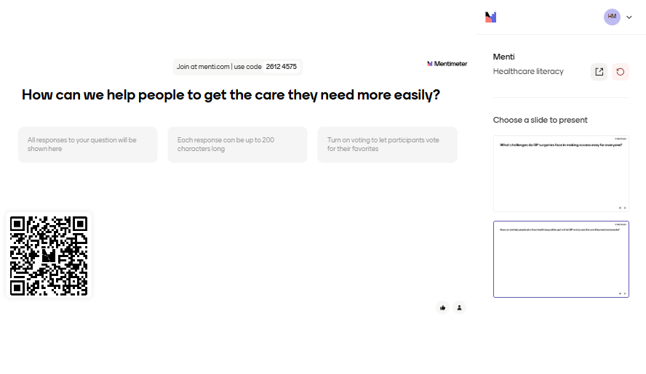
Notes:
Helen
Now we’d love to hear your thoughts.
We’ve been talking about some of the barriers people face when trying to access their GP—especially those experiencing health inequalities. So we’d like to ask:
How can we help people who face health inequalities get to their GP and access the care they need more easily?
Please take a moment to log into Mentimeter on your phone or computer by hovering over the QR code or entering the code shown on the screen at menti.com. Pop your answers in—we’re really keen to hear your ideas, experiences, and suggestions.
Your input will help shape the work we’re doing and ensure it reflects the realities of practice.
We’d also be really keen to hear offline about the amazing work already happening in your practices to address these challenges. If you’re doing something that’s working well, or have ideas you’d like to share more directly, please do reach out after the session—we’d love to hear from you.

Slide 10

Some tips and tricks from our healthcare literacy group
Raise awareness of the challenges people are talking about in surgery.
Don’t be concerned to double book appointments if they are needed – it will save time in the long run!!
Use your personalised care staff who can give people time to talk, create a personalized plan (including accessibility and communication needs) and address the social determinants of health.
Word maps or flags at reception can help identify language
Ensure GP websites have accessibility and language plug-ins
Use medically approved translation tools (e.g., Canopy Speak, MediBabble) for basic communication
Interpreters –display the telephone line number in every consultation room
Please come and join us, you are welcome ☺
Notes:
Emily
Before we finish, we wanted to leave you with a few practical ideas that have come out of our work and conversations with colleagues across the system:
Raise awareness of the challenges patients are talking about in your surgery—sometimes just naming the issue can make a big difference.
Don’t be afraid to double book appointments if needed—it may take more time upfront, but it can save time and improve outcomes in the long run.
Make use of your personalised care staff—they can give people time to talk, help create personalised care plans (including accessibility and communication needs), and support with the wider social determinants of health.
Word maps or flags at reception can help identify language needs early on.
Ensure your GP websites have accessibility and language plug-ins.
Use medically approved translation tools like Canopy Speak or MediBabble for basic communication.
Display the interpreter telephone line number in every consultation room to make it easy for staff to access.

Slide 11
Thank you for listening
You are welcome to join our healthcare literacy group
Notes:
Helen
That brings us to the end of our presentation. Thank you all so much for listening and for your contributions today.
We’ll be working in the background to develop a toolkit of resources to help address healthcare literacy challenges. Once ready, it will be hosted on the Primary Care Training Hub website, and we hope it will be a valuable support for you and your teams.
We’ll also share our contact details along with the slides after the session—so if you’d like to get involved or share examples of great work happening in your practice, please do get in touch.
Thanks again, and we look forward to continuing this work together.

