Slide 1

Health Inequalities in Northamptonshire
The Local Picture
Paul Birch and Caroline Thickens

Slide 2

ICB Population Health Team
Paul Birch – Assistant Director Population Health and Health Intelligence
Caroline Thickens – Head of Population Health
Gwyn Roberts – Population Health Programme manager – Prevention lead
Oana Ciurdarean – Population Health Programme Manager –Inequalities lead
Chenyu Shang – Lead Population Health Analyst
Email: northantsicb.northantspophealth@nhs.net

Slide 3
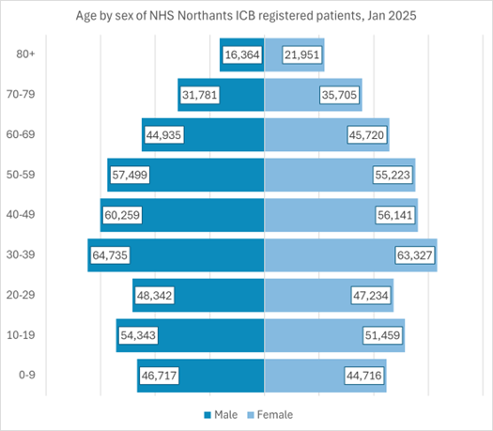
Northamptonshire’s registered population
The ICB currently has a registered population of ~850k.
Over the last 5 years we have experienced 8.09% growth, which is significantly higher than ONS projections showed.
Current ONS projections show growth of 2.54% over the next 5 years and 0.5% next year however it should be noted that if current growth trends continue it would be double that rate.
Nearly half of this population consists of working-age adults between 30 and 59 years old.
Children and young people under the age of 20 make up nearly a quarter of the total population; young adults aged 20 to 29 years account for roughly one in eight people.
Adults aged 70 years and older make up over 1 in 10 of the total population.
The population is broadly balanced between males and females across most age groups; a slightly higher number of females is observed in the older age categories, particularly among patients aged 80+.
Source: Primary Care Dataset, NHS Northamptonshire ICB, January 2025

Slide 4
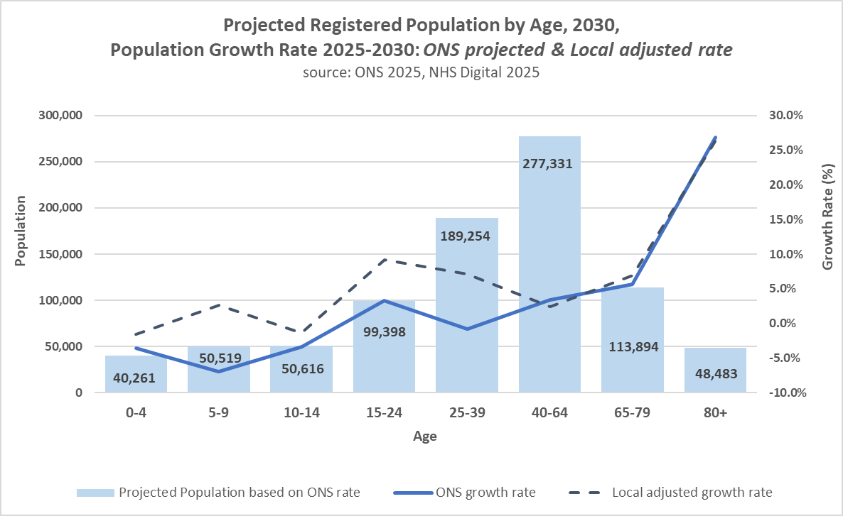
Northamptonshire’s registered population
Over the last 5 years we have experienced 8% growth, which is significantly higher than expected.
Current projections to 2030 show growth of 2.54% over the next 5 years
The population aged 80 years and older is expected to grow the fastest, increasing 26.8% by 2030.
It is estimated that half of the population will fall within the 25-64 age range (53.5%), while nearly 1 in 5 residents (18.6%) will be aged 65 or older. The latter with a growth rate of 11.2% over the next 5 years.

Slide 5
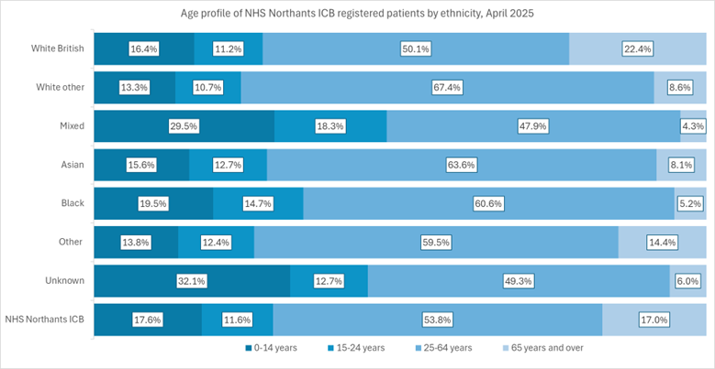
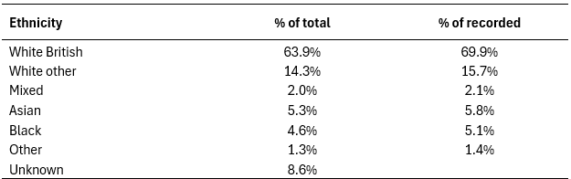
Ethnicity
White British group account for approximately two thirds of the registered population (63.9%; 69.9% of those with a recorded ethnicity).
The largest ethnic minority group in Northamptonshire is White other (14.3%, 15.7% of recorded), with individuals of East European origin making up the largest group within this category (ONS 2021).
The age profile of NHS Northamptonshire ICB’s registered population varies considerably by ethnicity.
Source: Northamptonshire Analytical Reporting Platform (NARP), April, 2025
Note that Unknown category includes Refused, Not stated and Unavailable ethnicity groups.
Source: Northamptonshire Analytical Reporting Platform (NARP), April 2025
Notes:
For example, the Mixed and Black groups have a younger population compared to the ICB average; the proportion of people aged 0-14 years in the Mixed ethnic group is nearly double that of White British. Conversely, White British has the highest older (65+ years) population.

Slide 6
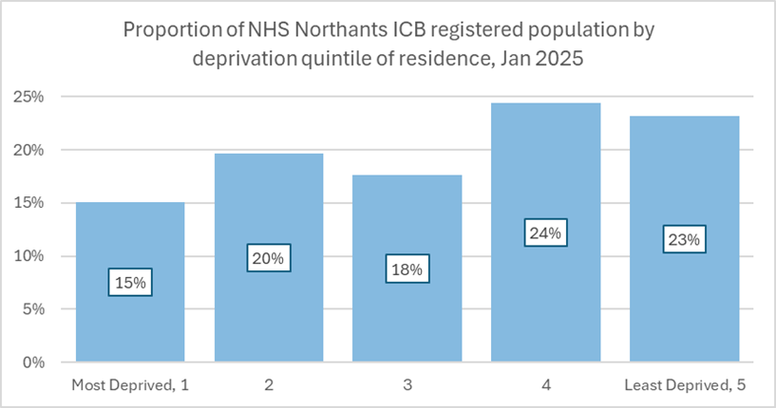
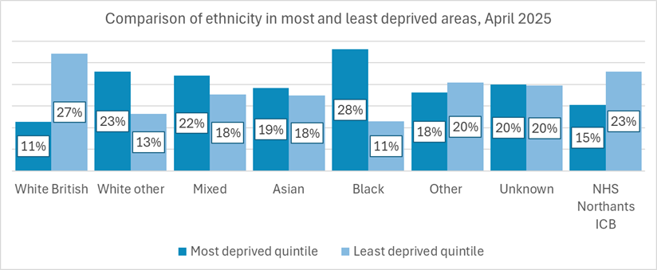
Deprivation
In Northamptonshire, 15% of the population live within the 20% most deprived areas (~130k people). This is concentrated in the main towns of Northampton, Wellingborough, Kettering, Rushden, Corby and Daventry. There remain significant pockets of rural deprivation however, this can sometimes be “hidden” within more affluent areas.
The distribution of population living in the most deprived areas varies across ethnic groups in Northamptonshire
Source: Primary Care Dataset, NHS Northamptonshire ICB, 2025
Notes:
Black, White other and Mixed ethnic groups have the largest proportions who live in the most deprived areas.
The proportion of Black ethnic groups living in the most deprived areas is more than twice that of those living in the least deprived areas.

Slide 7
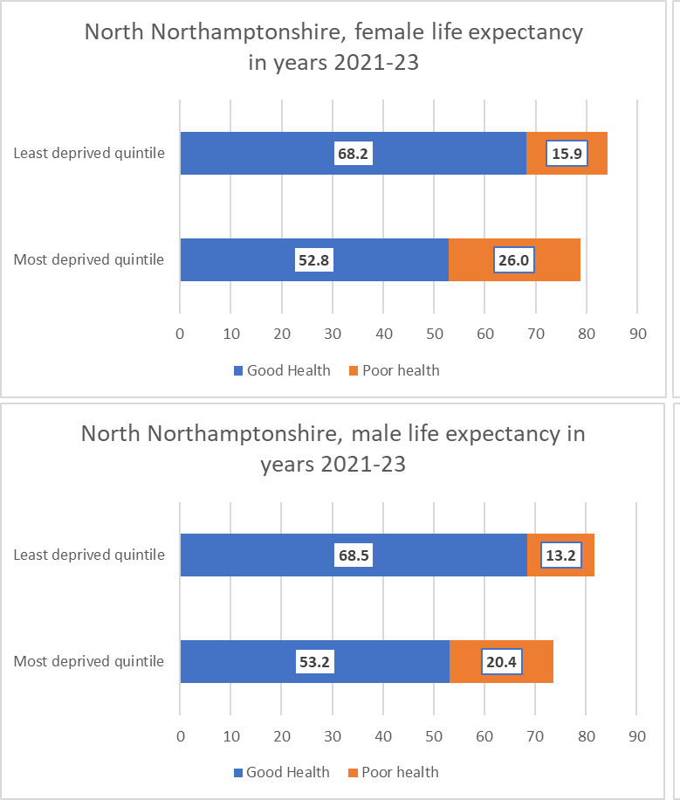
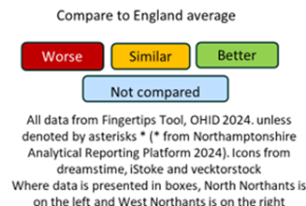
The population is living longer but not always in good health
Life expectancy varies by place. People in the West live longer and spend more years in good health than those in the North
Females live longer than males but spend more years and a greater proportion of their lives in poor health.
Inequalities exists between the most and least deprived quintiles.
On average, it is estimated that people living in the least deprived areas of North and West Northamptonshire can expect to live 15-16 years longer in good health than those living in the most deprived quintile. This is similar for both males and females.
Notes:
Life expectancy varies by place. People in the West live longer and spend more years in good health than those in the North
West: 83.4F/79.4M, with 62.7F/62.4M years in good health;
North: 82.2F/78.7M, with 59.9F/60.3M years in good health).
Females live longer than males but spend more years and a greater proportion of their lives in poor health.
Across North and West Northamptonshire the inequality in life expectancy by deprivation is highest for males. The largest inequality in deprivation is seen within West Northamptonshire with a gap of 10 years for males and 6.2 years for females between the most and least deprived areas.

Slide 8
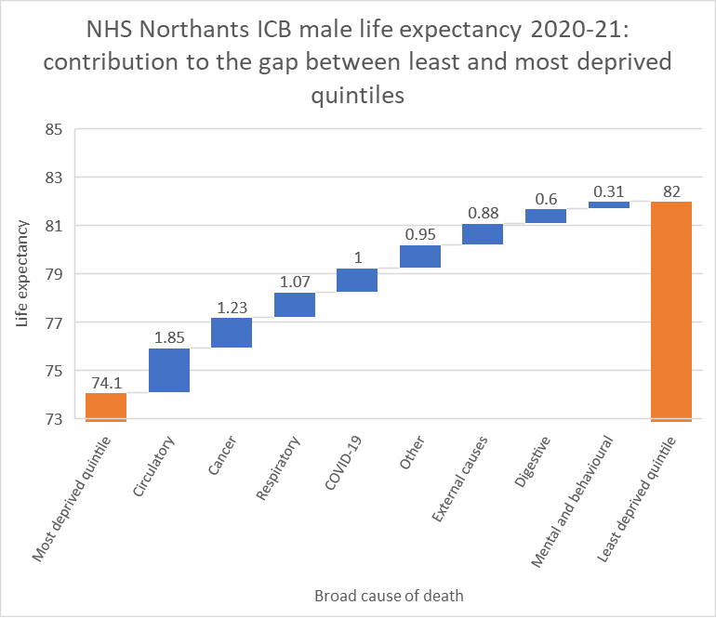
Northamptonshire Health Inequalities
CVD, Cancer and Respiratory disease contribute more than half of the inequalities in Life Expectancy. They are also the leading causes of death
Cancer (28.0%)
Cardiovascular diseases (22.2%)
Respiratory diseases (12.8%).
Mental health and MSK (especially Lower Back Pain and depression) are most common causes of ill health in Northamptonshire.
The top 10 risk factors account for 41% of all ill-health and mortality in Northamptonshire
Tobacco is the leading risk factor followed by high BMI. Other notable risk factors include, diet, high blood sugar, alcohol use and hypertension.

Slide 9
Northamptonshire Health Inequalities
On a scale of 1–10, how confident do you feel in identifying health inequalities in your day-to-day practice? - https://forms.office.com/e/43xLKAwEuY?origin=lprLink
Which groups in your local population do you think experience the greatest health inequalities? - https://forms.office.com/e/HpiXAYddCn?origin=lprLink
Which conditions, we have mentioned, do you think are important in relation to health inequalities in your practice? - https://forms.office.com/e/gPtVEBctD8?origin=lprLink

Slide 10
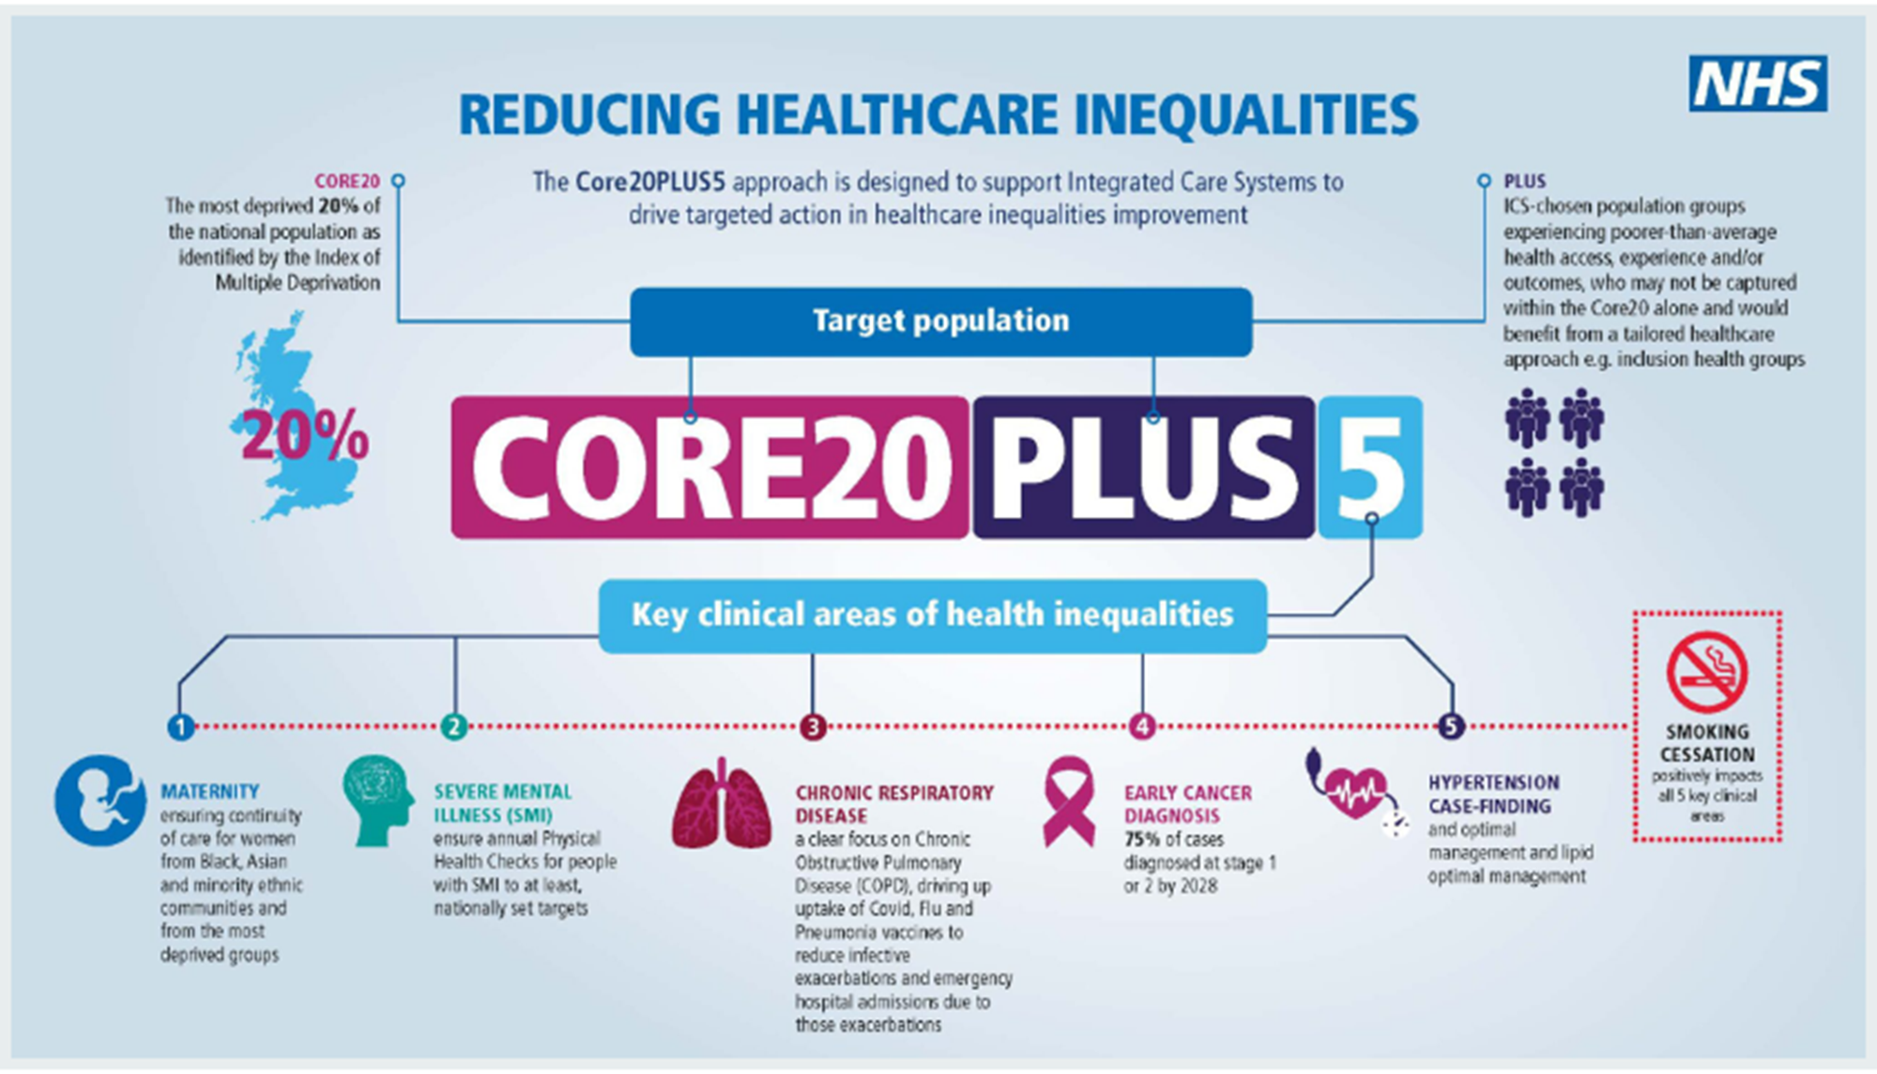
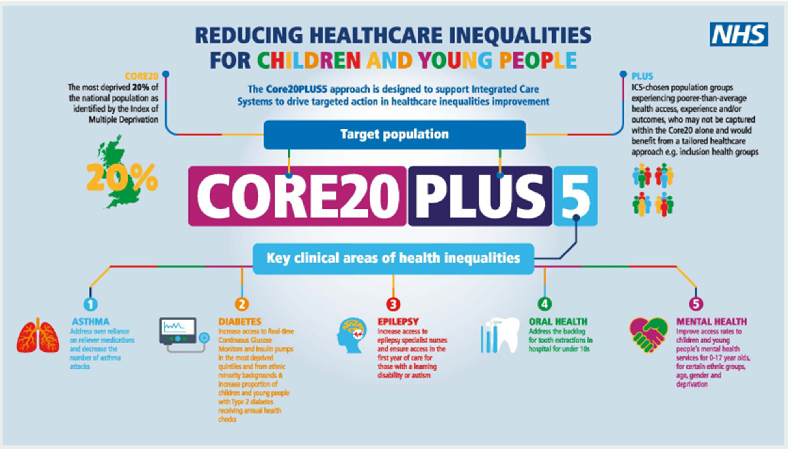
National Health Inequalities Approach
Core20Plus5: NHS framework for addressing healthcare inequalities.
Core20 refers to the 20% most deprived neighbourhoods nationally. For Northamptonshire this is 15.4% of registered patients (<1% to >50% across England).
Plus refers to groups experiencing poorer health outcomes not covered by the Core20
5 clinical priorities
  Adults: Maternity, mental illness, chronic respiratory disease, Cancer, Hypertension
  Children: Asthma, diabetes, epilepsy, oral health, mental health

Slide 11
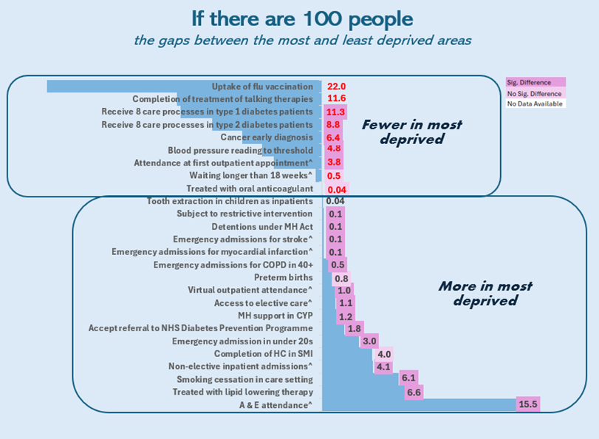
Health Inequalities Annual Report findings
Our recent Health Inequalities Annual Report looked at health inequalities across Northamptonshire.
Age – younger populations
Longer elective care waits
Poorer mental health outcomes (e.g. health checks)
Lower chronic condition management (e.g. blood pressure control).
Deprivation - more deprived populations
Higher emergency care and lower planned care.
Lower uptake of preventive care, e.g. flu vaccines, LTC management.
Lower early diagnosis of cancer
Poorer LTC management and outcomes
Ethnicity
Racialised communities: higher emergency care use, lower vaccination uptake and LTC management.
Widening of inequalities identified for males and Black populations for hypertension control.
Variation by ethnic group presented in the report.
No deprivation breakdown in health checks among people with learning disability.
^ numbers are based on age standardised rate.

Slide 12
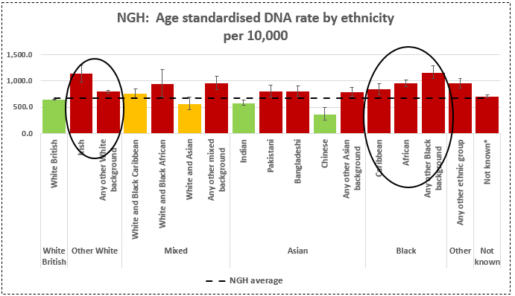
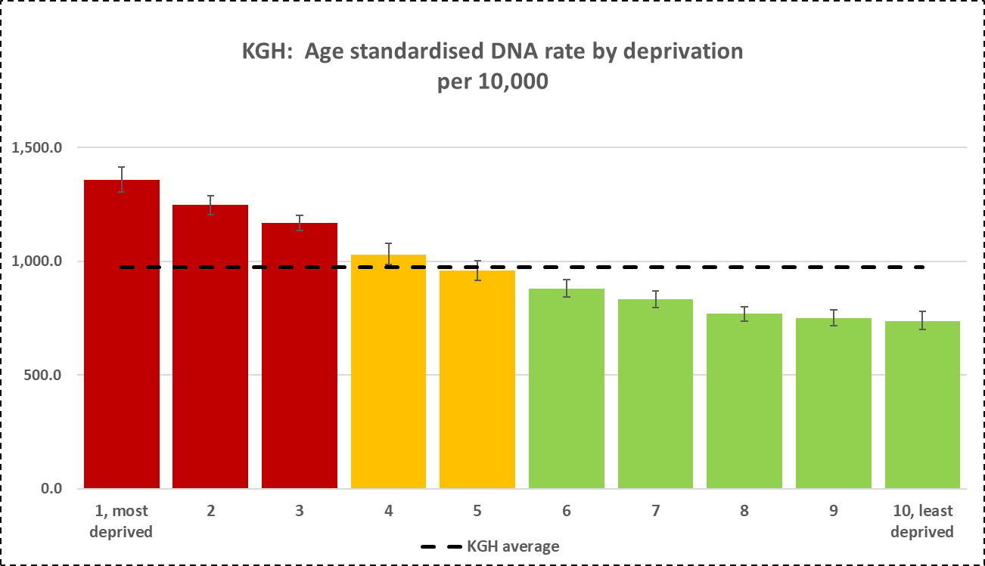
How inequalities impact – missed outpatient appointments
Patients from more deprived areas, and those from ethnic minority backgrounds are more likely to miss appointments
This is due to a range of factors and it is reflective of barriers to them accessing all areas of care
This contributes to underdiagnosis, later presentation for treatment and poorer outcomes
Notes:
This data is age standardised which helps interpret it correctly

Slide 13
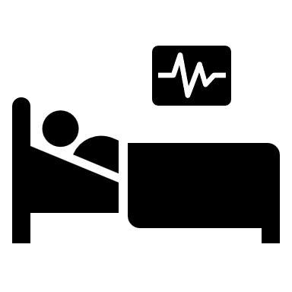




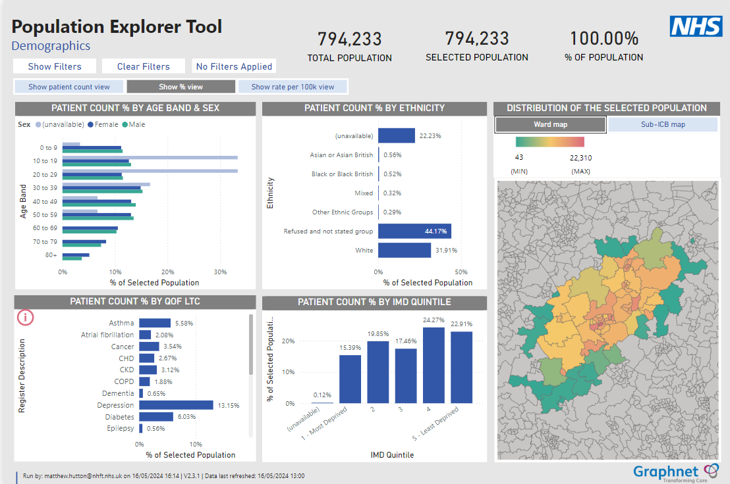






Northamptonshire Analytical Reporting Platform (NARP)
Hospital
Care Plans
Encounters
Mental Health
Vaccinations
Medicines
Emergency
Community Health
GP Results
Social Care
Hospital Results

Slide 14
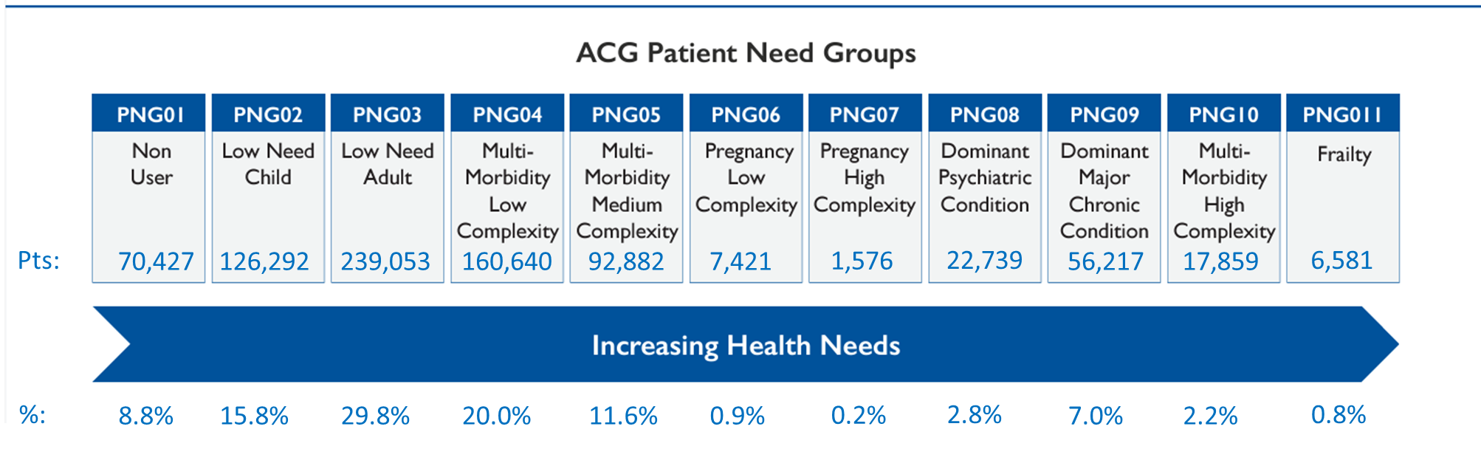
Segmenting Population by Need
Nearly a third of our population are in PNG 3, classified as Low Need Adult.
A fifth of the population are in PNG 4, classified as having multi morbidity but low complexity; 1 in 10 with medium complexity multi morbidity.
These lower need and medium complexity cohorts represent 500k of the population.
3% of the population are grouped into the higher complexity and frailty categories and represent over 24k people.
Our most deprived communities are more likely to have dominant and/or multimorbid high-complexity conditions compared to those in the least deprived quintile. 60% of the most deprived population aged over 50 years fall in the higher need groups compared to 49% of the least deprived population in this age group.

Slide 15
Review of Barriers to accessing care
Inspired by the work in Newham on their Health Equity Toolkit, Northamptonshire ICB's Population Health Team has started to pull together the insights on barriers local communities face when they try to access healthcare services.
Below are the common themes identified from this initial review.
Main themes
Transport
Finance
Language
Trust
Physical accessibility / location
Information accessibility
Employment
Awareness
Health literacy
Digital exclusion
Lifestyle commitments
Family/social support
Race
Age
Gender

Slide 16
Focus: Primary Care
Specific insights related to primary care.
Within this, there is significant overlap, e.g., between language, awareness, health literacy & information accessibility.
Topic | Description
Language | Understanding how to register with a GP, book an appointment, and navigate the system/rights. Understand complex communications regarding diagnoses, treatments, or prevention advice. Ensuring people where English is not their primary language have properly understood the information. Lack of translation services.
Trust | Considerable mistrust with professionals e.g. for the GRT community due to both perceived and experienced discrimination.
Physical Accessibility / Location | Patients often struggle to make pre-booked appointments or even make appointments.
Information Accessibility | Patients often lack trusted contacts, face stigma, and can struggle to access information about services & how to access them
Awareness | Lack of awareness regarding how to access GP services and other health and care services, often higher for those not born in the UK.
Health Literacy | Challenges in navigating the health system, including primary care

Slide 17
Comments, Questions?
Are there small changes your team could make to address inequalities? - https://forms.office.com/e/4de8vf6NH3?origin=lprLink
Have you seen good examples of tackling inequalities from elsewhere? - https://forms.office.com/e/de8WP8ehkw?origin=lprLink
Please share after the session

