Slide 1

HEALTH AND CARE RESEARCH FOR ALL
Strengthening Eastern European Voices

Slide 2

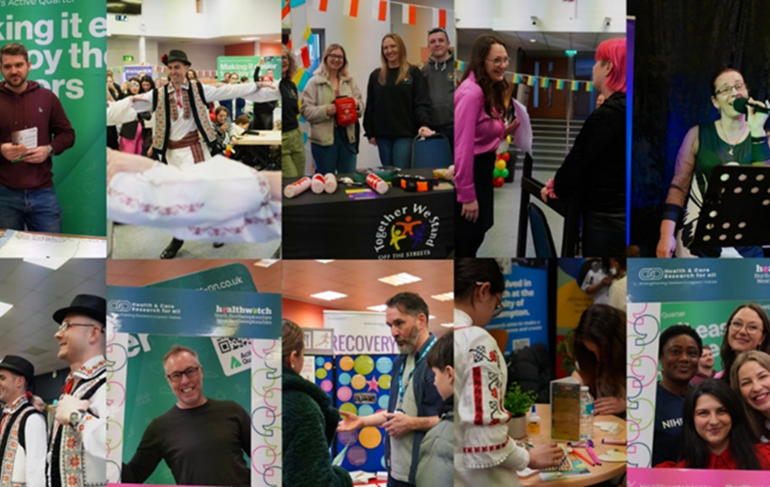
Health and Care Research For All:
Strengthening Eastern European Voices
Working to improve access and opportunities for research involvement among Northamptonshire’s Eastern European communities through a programme managed by the ICB and delivered by Healthwatch West and North Northamptonshire.

Slide 3
REN Project
Identify a cohort within our community that has low levels of engagement in research, representation in patient voice and is experiencing health inequalities and structure the project around supporting this cohort.
  Largest cohort of the "White Other" category (76%), with Polish and Romanian communities making up 51% - 2021 Census.
  Discussions within the community revealed significant challenges around language barriers, cultural differences and limited knowledge of the healthcare system.
  Hesitancy to participate in research, often largely driven by misinformation from non-English social media platforms, as well as past negative experiences in their home countries, especially before the fall of the Communist block.
Notes:
Our approach builds on insights from our previous REN work, and recommendations from our LCRN funded research project on understanding healthcare inequities faced by EE communities in Northamptonshire

Slide 4
Project Aims
To Build Trust
To Build Relationships with the Eastern European Community
To Explore Barriers
To Build Knowledge and to Encourage Participation in Research
To Identify Best Practice for Engagement

Slide 5
Project Approach and Delivery
Worked with trusted intermediaries and cultural groups within the community
Attended local events and used existing community assets to engage with the community
Community Mapping Exercises (CME), online research and building trusted and sustained relationships
Used the MECC approach to complement the project and inform communities on vaccination and system functionality and operations
Focused on innovation to enhance productivity and increase target audience numbers by using their primary languages for information

Slide 6
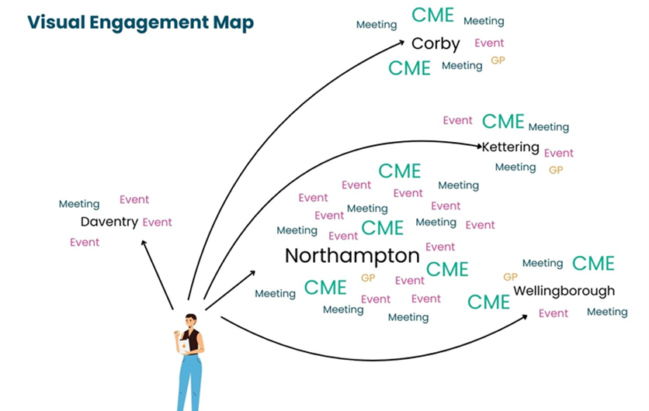
Community Mapping Exercises (CME)
The team utilised the footprint of Northamptonshire and, through research, identified places, spaces, and people to engage with within the various Eastern European communities.
“On the ground” engagement made this possible.

Slide 7
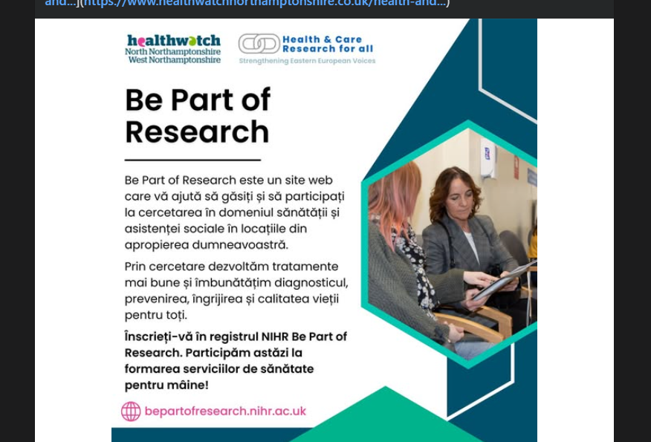
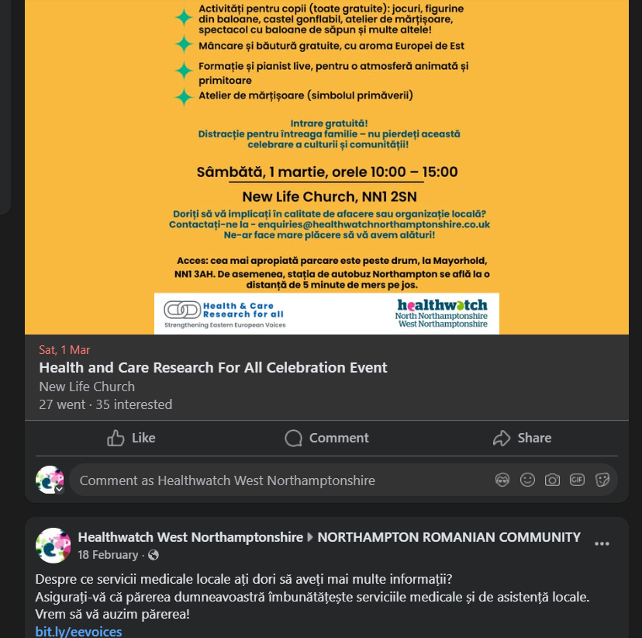
Digital Connections
The team worked to engage both in person and online; we found that we were able to reach many individuals through the use of social media and our website.
We shared key information on research opportunities, events, and the videos we created with the AI-assisted platforms - all in Eastern European groups, often in their own languages
Social Media Platform | Impressions | Likes | Shares
Instagram total | 783 | 28 | 0
Facebook total (inc groups) | 11,750 | 34 | 39
Facebook total (exc groups) | 8,959 | 24 | 39
Twitter total | 431 | 7 | 0
TikTok total | 7,835 | 45 | 1
Total | 20,799 | 114 | 40

Slide 8
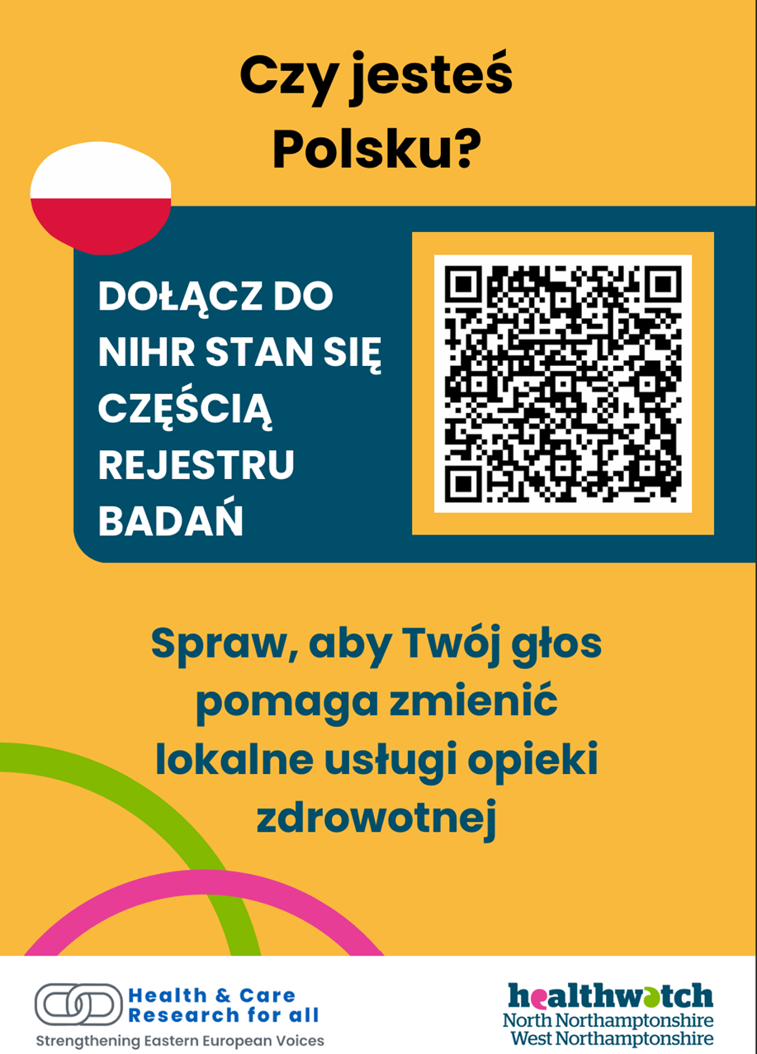
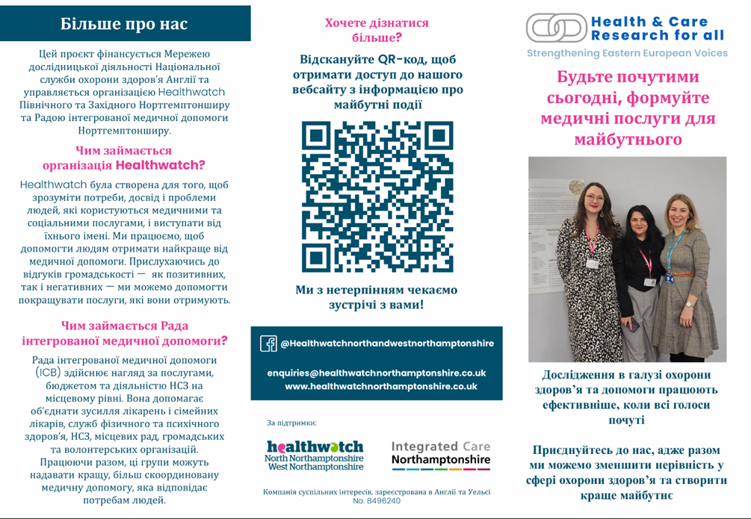
Approachable Materials
A key part of the EE REN work was ensuring that we provided informational materials in individuals’ own languages.

Slide 9
Impacts
Increased Research Awareness and Participation
Strengthened Community Trust
Developed a bank of multilingual, culturally appropriate resources, which were sustainable and could be used beyond the project’s timeline
Increased collaboration with partners across the system, encouraging further work with underrepresented communities
Reduced barriers to participation in research
System influence – due to the success of the project, this is seen as best practice in different instances nationally, e.g. migrant health

Slide 10
Lessons and Recommendations
We identified a need for proactive on the ground and in-person engagement to maximise impact.
By investing into the communities, including hiring someone from the community, it allowed us to have a genuine understanding of their experiences and needs, for impactful engagement.
Collaborating across the system and with cultural partners, allowed us to ensure oversight and enabled us to gather previous learnings to support delivery
We learned the importance of having on-the-ground engagement activities, removing the power imbalance, listening and conducting genuine engagement with communities.
We understood that language and literacy are major barriers in communication and innovation and accessibility expand reach.
We observed that partnerships across the system amplify impact and offer legitimacy to common efforts.

Slide 11
Putting it into Practice
Identify your patients, what type of ethnic groups attend your practice, and what are the demographics of your community
Provide translated information (leaflets, texts, online resources) in key Eastern European languages.
Actively promote interpreter services so patients know they are entitled to them. Use clear, jargon-free language and visuals to improve understanding.
Build trust through continuity — same staff/clinician where possible.
Work with community connectors (trusted local people/organisations) to bridge cultural gaps.
Recognise cultural diversity — avoid assumptions and respect different health beliefs.
Offer flexible, accessible appointments (evenings, walk-ins, multi-language reminders).
Support digital inclusion — don’t rely solely on NHS App or online systems.
Explain how UK primary care works and promote prevention (screening, vaccines, research).Invest in staff training & partnerships to strengthen cultural competence and collaboration with local community groups.

Slide 12
Sustainability
The programme has concluded in line with its original objectives; however, a sustainability plan is in place.
Resources remain available, and the work continues through the 2025/26 REN, with an emphasis on recruiting patients into studies.
System Explainer videos can be found on the ICN YouTube page: https://www.youtube.com/@ICNorthamptonshire/videos.
For more details, accessing resources, and/or getting involved please contact Gabriella van Beek – Healthwatch West Northamptonshire (gabriella@healthwatchwestnorthants.com) or Oana Ciurdarean – Northamptonshire ICB (oana.ciurdarean@nhs.net).

Slide 13
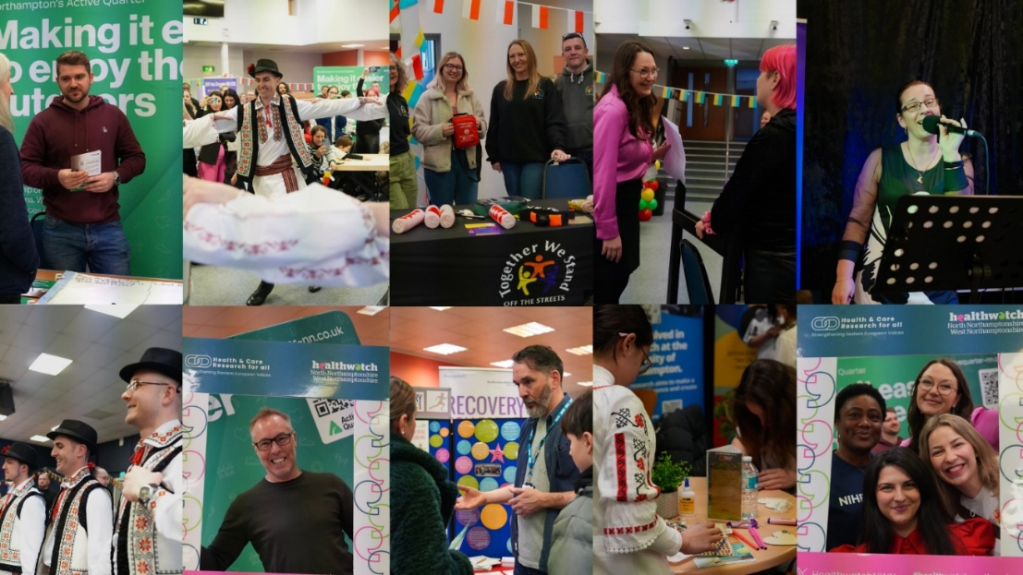
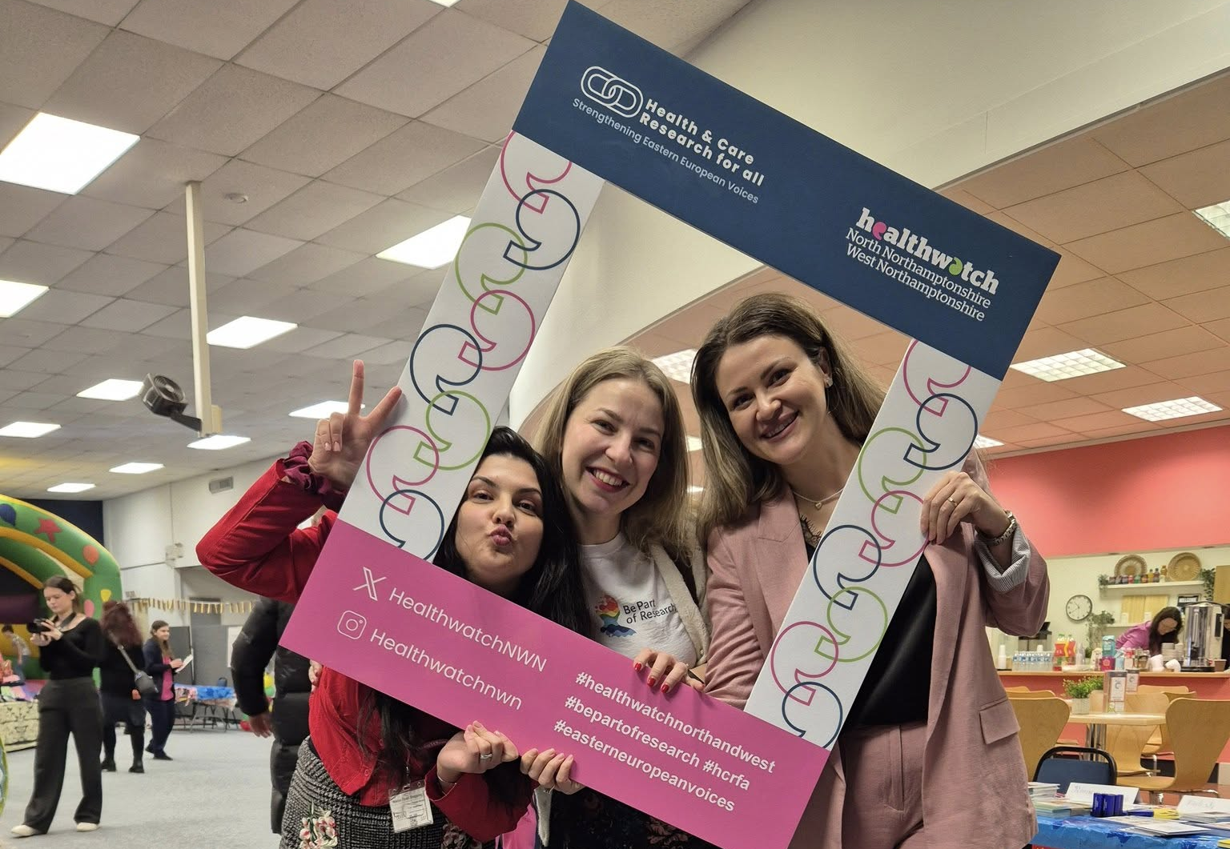
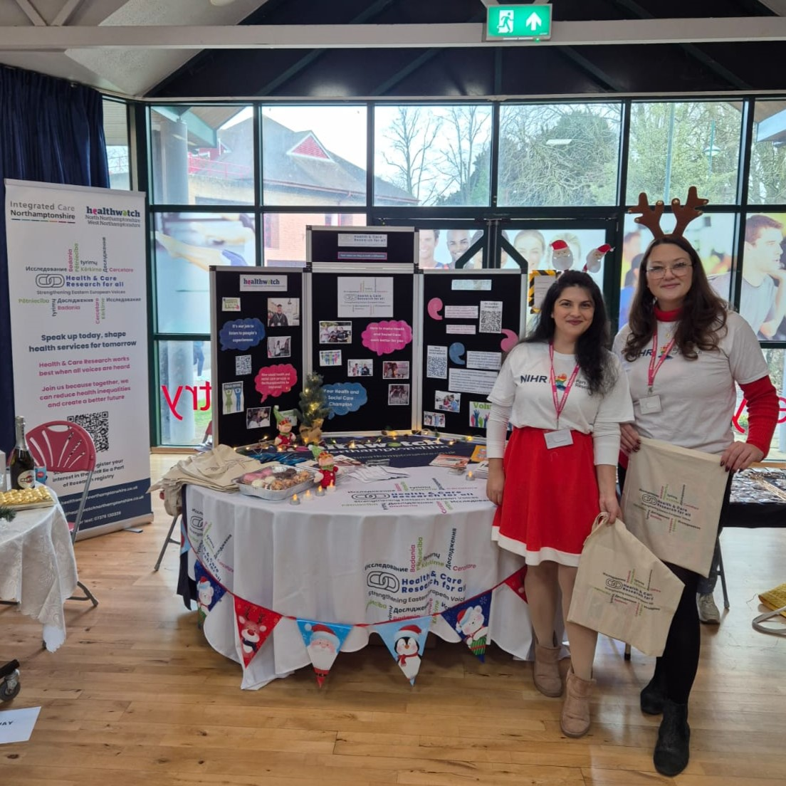
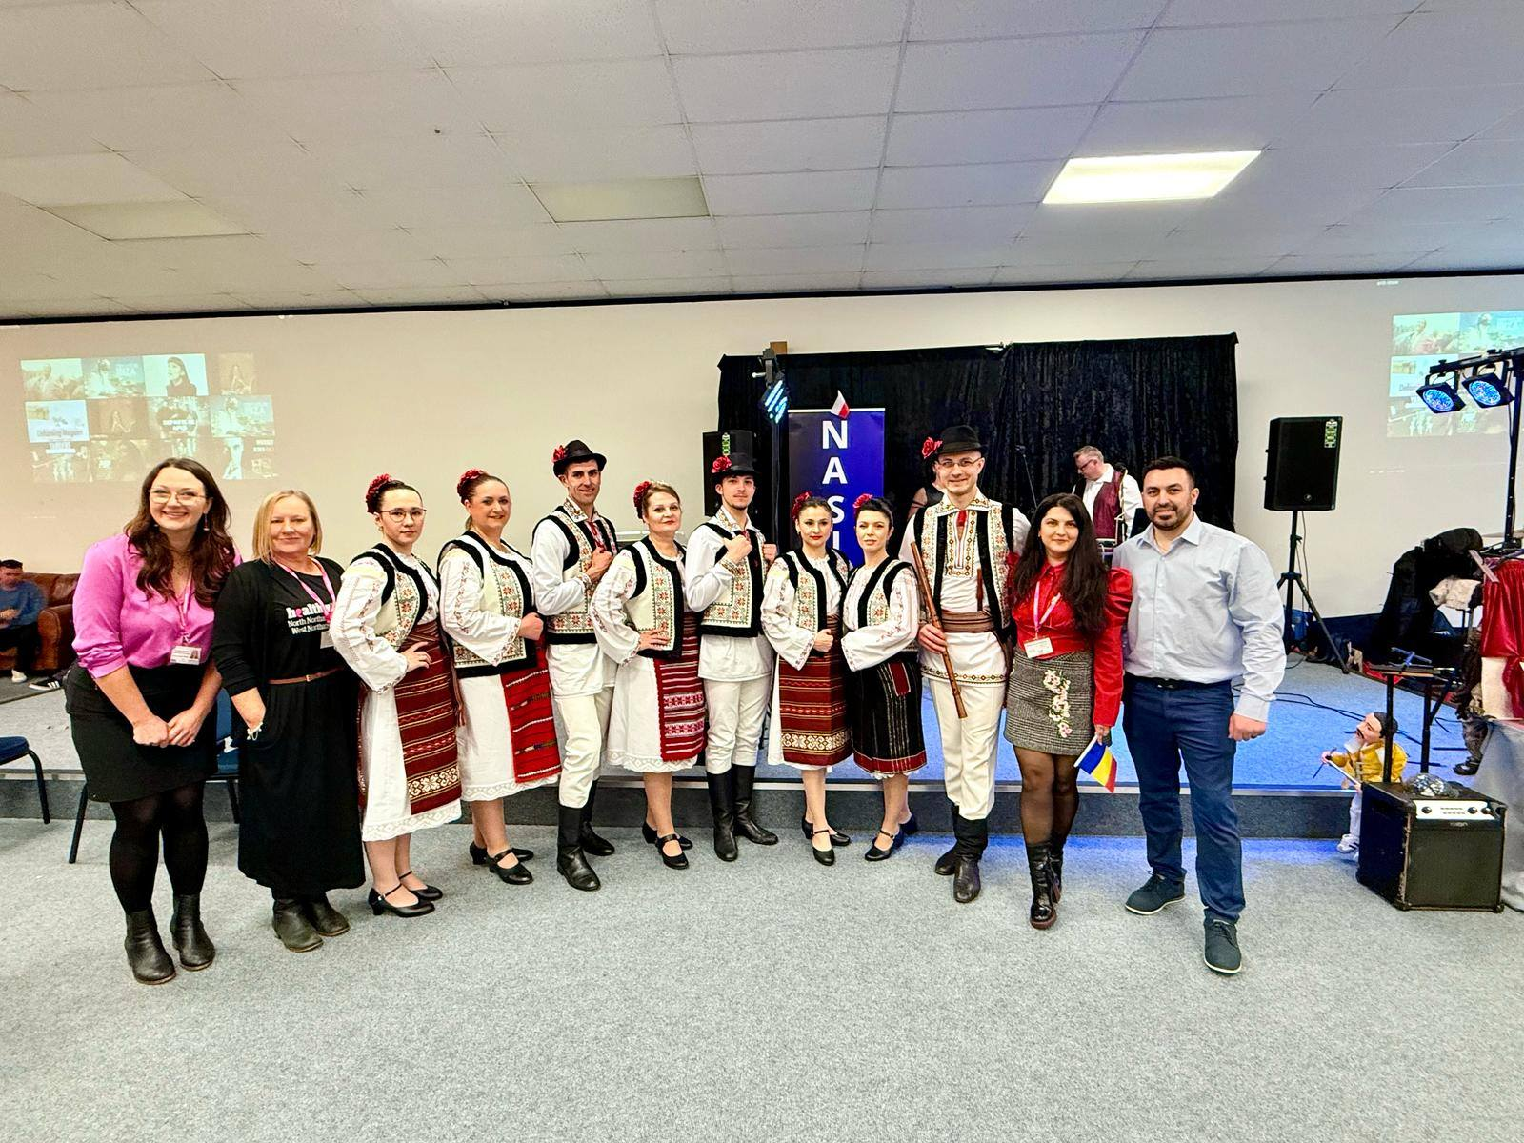
Pictures

