Slide 1
ReSPECT Update
An introduction to the Electronic Palliative Care Coordination System (EPaCCS) for Northamptonshire
An Introduction to the Electronic Palliative Care Co ordination System (EPaCCS) for Northamptonshire (an e form function of the Northamptonshire Care Record (NCR)).
An Introduction to the Electronic Palliative Care Co ordination System (EPaCCS) for Northamptonshire (an e form function of the Northamptonshire Care Record (NCR)).
An Introduction to the Electronic Palliative Care Co ordination System (EPaCCS) for Northamptonshire (an e form function of the Northamptonshire Care Record (NCR)).
Claire Mansfield, Macmillan palliative and end of life care transformation lead, Northamptonshire ICB claire.mansfield8@nhs.net
Naomi Caldwell, Deputy CMO, Northamptonshire ICB
An Introduction to the Electronic Palliative Care Co ordination System (EPaCCS) for Northamptonshire (an e form function of the Northamptonshire Care Record (NCR)).

Slide 2

Digital ReSPECT
(Recommended Summary Plan for Emergency Care and Treatment)
Digital ReSPECT was launched in November 2024 on the Northamptonshire Care Record, supported by system champions.
ReSPECT promotes shared decision-making between individuals and healthcare professionals to create personalised emergency care recommendations.
It involves structured conversations to understand the person’s condition, values, and preferences, resulting in a documented plan for care if the individual cannot make decisions during an emergency.
ReSPECT plans have replaced DNACPR forms, it is no longer appropriate to complete a DNACPR form. We acknowledge there will be legacy DNACPR forms in the system and these will be recognised.
A person can have a ReSPECT plan and still be for active resuscitation.

Slide 3
Northamptonshire Care Record (NCR)
Launched in 2023
Digitally connects over 829,000 patient records
Allows providers of health and care services in Northamptonshire to instantly access patient information held by other health and care organisations for the purpose of direct care.
Access via:
Systm One users (blue button)
EMIS users (Graphnet Portal, left hand menu)
Careflow at KGH (direct record link)
Web link via clinical systems on The Street at NGH (future plan to link into Nervecentre)
External agencies have a web portal via URL (Uniform Resource Locator)
Northamptonshire Care Record | Integrated Care Northamptonshire (includes both patient and professional information inc. easy read)

Slide 4
Northamptonshire Care Record (NCR) Access
UHN
NHFT
Lakelands Hospice
Marie Curie
DHU (Derbyshire Health United) Corby urgent care
DHU OOH and 111
DHU Palliative Care Urgent Response Service
Hope Centre, Northampton
Continuing Healthcare
Some Primary Care Network hubs
West Northants Council (social care data)
North Northants Council (social care data)
Community pharmacies (small number – pilot)
Rainbows Hospice –awaiting governance sign off
Northamptonshire Carers – Breathing Space – awaiting governance sign off
Oxford University Hospitals Trust – South Northants Community Palliative Care Team – nearing testing phase

Slide 5
ReSPECT- Key points
ReSPECT plans must be completed and stored digitally via Northamptonshire Care Record (NCR). This way all system partners can view the plan in real time, ensuring the most up to date version is considered.
A ReSPECT plan should be coded in the local system and the document completed in the NCR.
The plan should be printed to ensure the person has a copy. The plan does not need to be printed in colour - black and white printing is acceptable.
There is a print button at the top right had corner of the plan. The plan will print onto two pages.

Slide 6
If a person does not consent to information sharing
Where patients have not consented to share information (and as such an entry cannot be made on the NCR), a paper copy of a ReSPECT plan should be issued and where possible uploaded to a local system and the GP be made aware. The patient should be encouraged to share with all health care professionals they have contact with that they have a ReSPECT plan and keep a printed copy. If a person has not consented to their record being shared, this may be a genuine request, and as such would be appropriately upheld.
In some cases, a person may be unaware of dissenting to share their information or may have changed their mind. In these cases, if the person wishes to consent to sharing their information, then this request needs to be made by the person directly to their GP surgery. The GP would need to agree to this change prior to the surgery making the change.
Once any amendment is made to consent on the local GP system, this change will pull through to the NCR overnight and where consent has been given allow access to an NCR record for that person.

Slide 7
Hints and Tips
Use the person’s own words where appropriate
You can copy and paste form the local record
Be aware the plan will be considered in both acute and community settings
Clear listed points are helpful and clear to a reader in an urgent situation
The plan must be completed by an authorised clinician
What information would you like to know at 03:00?
The plan can be completed following one or more conversations

Slide 8
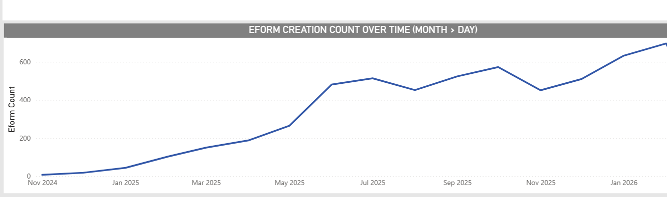
ReSPECT plan creation Nov 2025 - February 2026

Slide 9




5,960
plans live in the system (March 26)
9,729
Total digital ReSPECT plans have been created in the NCR since November 2024
As the ReSPECT plan is a live digital document, people do not have to repeat conversations; live information is accessible to all partners, plans are legible, and the person holds a printed copy
A ReSPECT Champions Forum takes place quarterly, the future focus being around shared learning, quality and audit
Future Plans include NCR being available to broader stakeholders and the implementation of an EPaCCS (Electronic Palliative Care Coordination System)

Slide 10

Electronic Palliative Care Coordination System (EPaCCS)

Slide 11
EPaCCS
Long term system aspiration
EPaCCS will sit on the Northamptonshire care Record (NCR) alongside a digital ReSPECT Plan.
The benefits of EPaCCS are far-reaching:
For patients and families:
  Empowers individuals to have their care preferences recorded and respected, including where and how they wish to be cared for.
  Reduces the likelihood of individuals needing to repeat their story or experience unwanted interventions.
  Provides reassurance that care is joined-up, responsive, and aligned with people’s wishes.
For the system:
  Reduces duplication and delays by improving information flow between services.
  Supports more efficient use of resources, reducing inappropriate hospital admissions and facilitating more care to be delivered in preferred settings (e.g., home or hospice).
  Enables population-level insights into end-of-life care, helping commissioners and providers to plan and improve services based on real-time data.
For professionals:
  Enhances clinical decision-making by ensuring access to accurate, up-to-date information.
  Reduces administrative burden by streamlining documentation and reducing the need to continually contact system colleagues for information.
  Supports improved multidisciplinary working and continuity of care across organisational boundaries.

Slide 12
Colleagues feedback
Contact details
Spiritual and psychological needs
Plan for pets
Advance care planning
Medications
Equipment
Access
Family / carer involvement

Slide 13
User feedback
Key contacts
Record what I want in my own words
My husband had dementia, words had to be used carefully
Access and equipment
My pet
Who you can speak to “about me”
Less repeating information
The 3am “need to know”

Slide 14
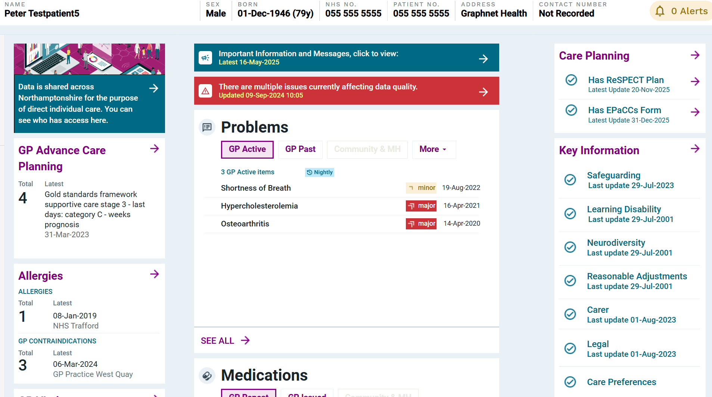



NCR home page

Slide 15
Additional Information
Shared platform for documenting key information
Very few mandatory fields
Real time updates – live document
Local helpdesk first port of call (as with NCR/ digital RESPECT queries)
EMAS will have future access via the National Records Locator Service

Slide 16
Where are we now?
Requirements analysis and broad user consultation including clinicians and users by experience completed
Form amendments with Graphnet (digital provider) to create final version
Links established with provider governance, communications, clinical safety and education teams for awareness
Communications, guidance video and document will be circulated, including A5 patient leaflet
View to go live during April/May 2026
On going support to users through May 2026 (socialisation through team meetings / forums, PLT, comms)

Slide 17
Coming soon in NCR….Key contacts list
Allowing system wide colleagues to enter appropriate contact information for a person to support the sharing of key information
Contacts could include health and social care professionals, including details of domicillary care providers and care homes, specialist services, next of kin, spiritual leaders and any VCSE support
Allows identification of both carers and any carer responsibilities the person has
A phone number, email, role and organisation can be recorded as appropriate
There is a free text option to add any relevant information in relation to the contact

Slide 18

The Hummingbird Bereavement Service was launched in partnership with AGE UK in June 2025
What do we offer?
A specialist bereavement service for adults living in Northamptonshire affected by a Palliative or end-of-life diagnosis.
Who is the service for?
Patients considered to be in their last year of life. Patients' families, carers and close friends both before and after the loss.
How are referrals made?
Health or other professionals can complete a referral form on behalf of the patients, their relatives, carers or friends on their behalf with consent.
The referral form can be found on the Cransley Hospice or Cynthia Spencer Trust websites.
Contact can be made by via email onenquiries@hummingbirdbereavement.org.uk or by telephone on 01604 379916
Self-referrals can be made

Slide 19
sAge Bereavement Service
Individual Bereavement Counselling
Up to 8 Bereavement Counselling sessions, each session lasts 50 minutes and is offered face to face, online or via telephone.
Bereavement Support Groups
A closed Bereavement Support Group by invitation, with 8 fortnightly meetings, each meeting lasting 1.5 hours
How are referrals made?
Health or other professionals can complete a referral form on behalf of adults with their consent.
The sAge Bereavement Service referral form can be found on the Age UK Northamptonshire website
Contact can be made via email bereavement@ageuknorthants.org.uk or by telephone on 01604 215839
Self-referrals are accepted

Slide 20
Further Information
Care & Support - Cransley Hospice Trust
How we can help you - Cynthia Spencer Hospice | Northampton
NHS England » Ambitions for palliative and end of life care
ICN All-Age Palliative and End of Life Care Strategy 2023-2026 (icnorthamptonshire.org.uk)
NCR User Guide Video https://youtu.be/iF7Bq7p1CuU?si=CdUUSMgiMl6OI6b5

Slide 21
ReSPECT Resources
Joe’s ReSPECT journey – a ReSPECT explainer for people and their families – YouTube
ReSPECT | Resuscitation Council UK
National FAQs: ReSPECT: Frequently asked questions for adopters | Resuscitation Council UK

