Slide 1

Northamptonshire Training Hub
Legacy Nurse Mentor Project

Slide 2
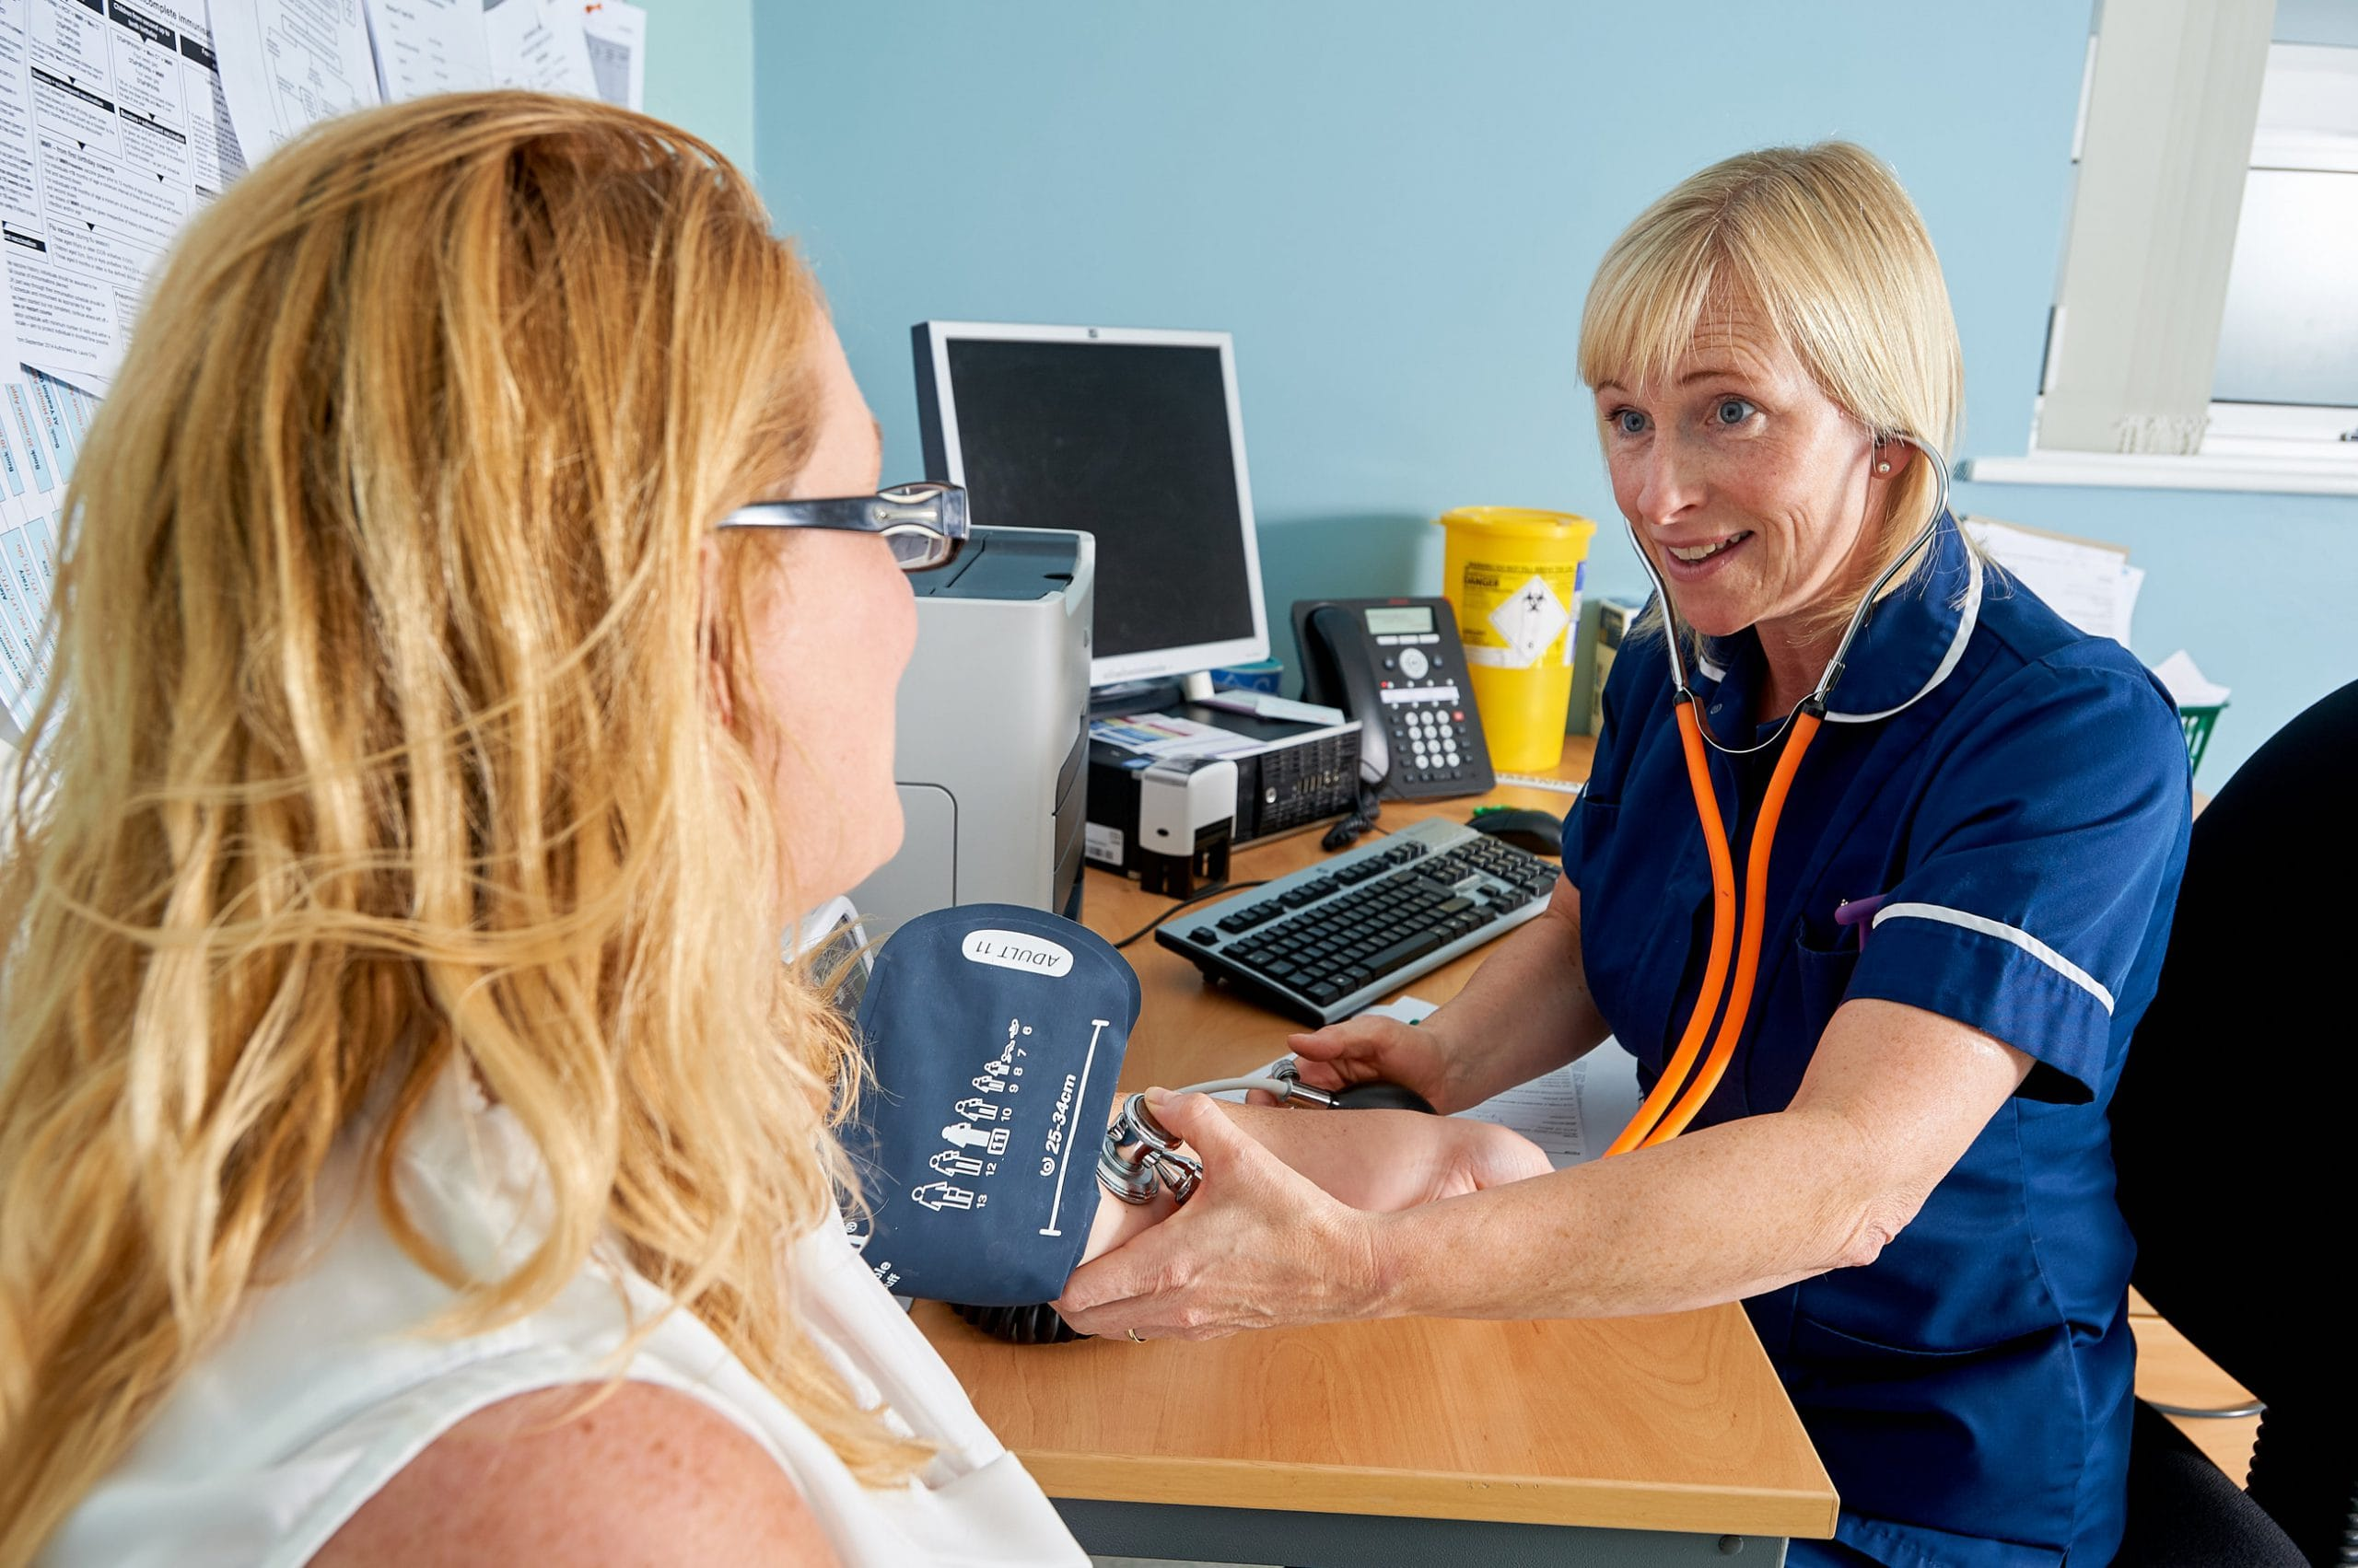
Background
Recruiting new general practice nurses (GPNs) is difficult!
Once they have been recruited some practices are unable to offer their new GPNs appropriate supervision and support as they don’t have experienced staff to do this.
The attrition rate for new to practice nurses is a concern.
Northamptonshire has a large proportion of GPNs who are eligible for retirement within the next 5 years.
Once these experienced GPNs retire, their knowledge and expertise will be lost!

Slide 3



Legacy Nurse Mentors
We don’t want to lose the knowledge and skills of our experienced nurses before they share it with our up and coming ones!
Development of a bid for funding from NHS England to run a year-long pilot project to employ Legacy Nurse Mentors.
Part-time, flexible role to fit in around substantive role in general practice.
Eligibility: significant experience in GPN role, up to date with cervical cytology, immunisations & vaccinations, SSSA training (or willingness to undertake), ability to travel to different practices.
Provide 48 hours of legacy mentorship to a mentee (over 12 months).
Expressions of interest via MS forms, conversation with project lead, onboarding via Lantum staff bank.
This Photo by Unknown Author is licensed under CC BY-SA

Slide 4
Training Hub Education offer for new GPNs
Back-fill funding attached for the practice
Fully funded Practice Nursing PG cert/BSc at DeMontfort University (Year 1)
Up to 48 hours of GPN Legacy Mentorship over 12 months (Year 1)
NTP GPN Fellowship programme (Year 2)
NHSE New to Practice (NTP) GPN Fellowship (2 year programme)

Slide 5
Mentor perspective
Legacy Nurse Mentoring
Motivation
Protected time
Dedicated support
Idea provoking
Information and advice
Goal setting
Clinical supervision
Retention of experienced GPNs
Mentoring within their specialist field
Attractive pay
Flexible around substantive post
Sit outside of mentees practice/PCN (confidentiality)
Mentee by location
Supported by TH
Mentor network (to be set up)
CPD and RCS available

Slide 6

Mentee perspective
Full package of training and support
Accredited training
Professional development
Confidence building
Flexible protected time
Clinical supervision
Skills competency sign-off
Mentors sit outside of practice/PCN (confidentiality)

Slide 7
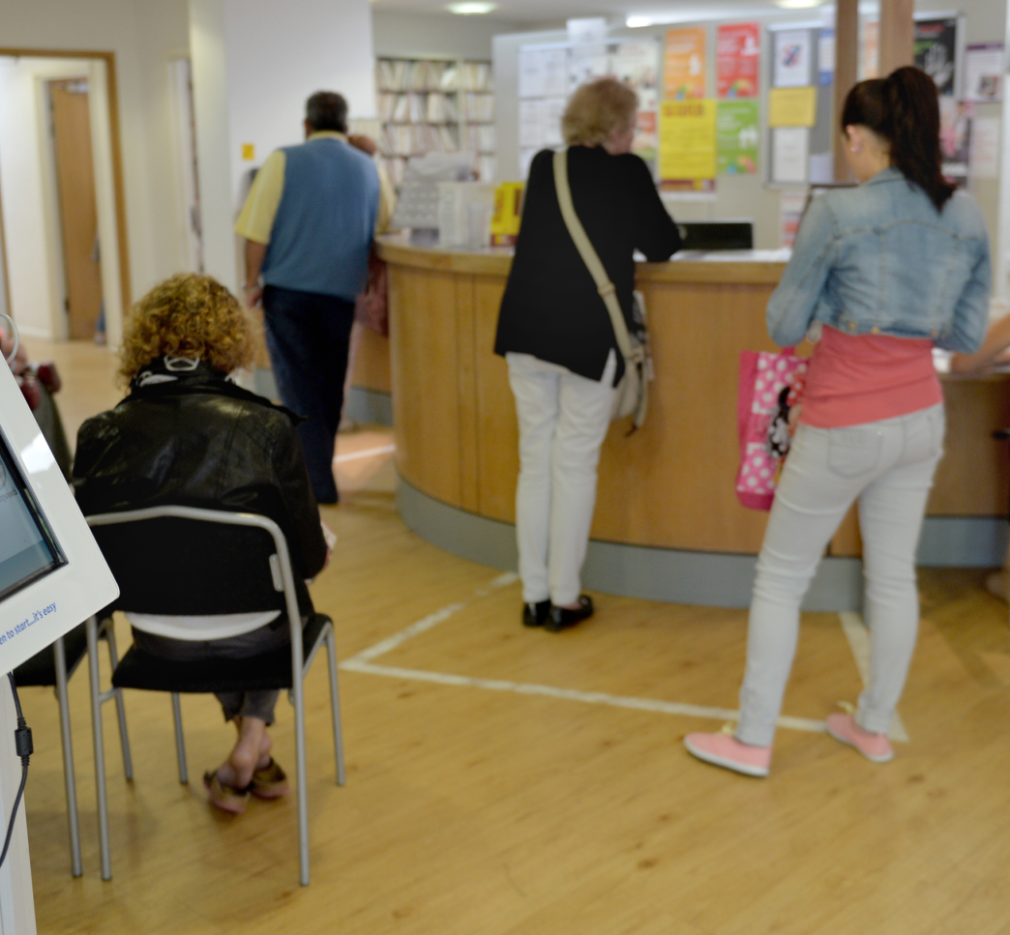
Practice perspective
Attractive offer to support recruitment – fully funded training and additional funding to the practice
Supports workforce capacity and practice resilience
New way of working, fresh perspective
Can support other nursing learners within practices – such as Nurse Associate apprentices

Slide 8

To find out more, or express an interest in becoming a Legacy Nurse mentor, please visit our website:
Job Role (northantstraininghub.nhs.uk)

