Slide 1

NMC 2018 SSSA
Supervisor and Assessor
Transition Training
For Mentors in Primary and Social Care Settings

Slide 2
Introduction to your NMC Supervisor & Assessor transition training package
Dear colleagues,
Northamptonshite Training Hub (NTH)is working to ensure that every NMC registrant working in Primary and Social Care is ‘suitably prepared’ in line with our NMC code of conduct to undertake the new roles of practice supervisor and/or assessor for student nurses' and trainee nursing associates' placements.
This slide deck has been created for those of you with a mentor qualification to allow you to develop your knowledge and skills at a pace and a time that suits you.
Ordinarily, this would be delivered in person but in these current circumstances this package is here to enable you to complete the learning independently.
However if you have any further questions or support needs after completing the training please contact me. My email is enquiries.nth@nhs.net
Once completed you will receive a certificate which includes the NMC revalidation reflection account form for you to record this training as part of your participatory CPD hours.

Slide 3
About this learning package
This package is aimed at Nurses with a Mentorship qualification to update them on the new NMC standards.
All the information needed for this module is within this package
Further information is included in the notes at the bottom of each page (you can “pull up” the box at the bottom of the screen).
At the end of this course there will be a link to a short quiz to assess your knowledge.
  You will need to pass 80% of the questions to receive your training certificate but do not fear as all of the answers are within this package.
This package will take between 1-1.5 hours to do and with the assessment is expected to be 2 hours of CPD.

Slide 4

Over view
The MYEPLG is a group of 33 universities working together with each other and practice partners across the region.
Practice partners across the East Midlands have contributed to the core content of this transition training package.
For quality assurance purposes there is a local agreement in place that you can undertake this training in your own or fellow organisation and that your training certificate will be recognised by the local universities and NHS, private and voluntary sector employers.
The MYEPLG have developed the new electronic Midlands, Yorkshire & East Practice Assessment Document (MYEPAD)
Student nurses on the new programmes commencing from September 2019 will all be using the same documentation (MYEPAD)
The MYEPLG have a website which provides regionally agreed training and resources to support supervisors and assessors.

Slide 5
Learning Outcomes
By the end of this transition training you will
Have a clear understanding of the responsibility of practice supervision and assessment.
Understand the process of student supervision, assessment and feedback
Be able to help your practice area develop a learning experience for students identifying their specific needs at their level of training including consideration of equality, diversity and reasonable adjustments
Understand the collaboration required between the Practice Supervisor (PS), Practice Assessor (PA) and Academic Assessor (AA) who all contribute to the student’s assessment in practice
Have knowledge about the Practice Assessment Document and written forms of evidence to support student assessment and progression
Understand the student’s programme of study and the proficiencies to be achieved

Slide 6
Introduction
The Future Nurse Standards have made some fundamental changes to the way in which students are supported in practice.
Supervising students is now every registrant's responsibility.
Students on the new standards will now qualify 'supervisor-ready'. Student nurses must support the learning of others to pass their placement under Annexe A of the Future Nurse proficiencies.
All existing mentors will need transition training on these changes and the impact of the supervising and assessing model in practice.
Supervisor training courses for staff without a current NMC mentor qualification will be rolled out shortly and will replace the traditional mentor preparation courses.

Slide 7

Overview of the new
Standards for Education & Training
These can be found on the NMC website

Slide 8
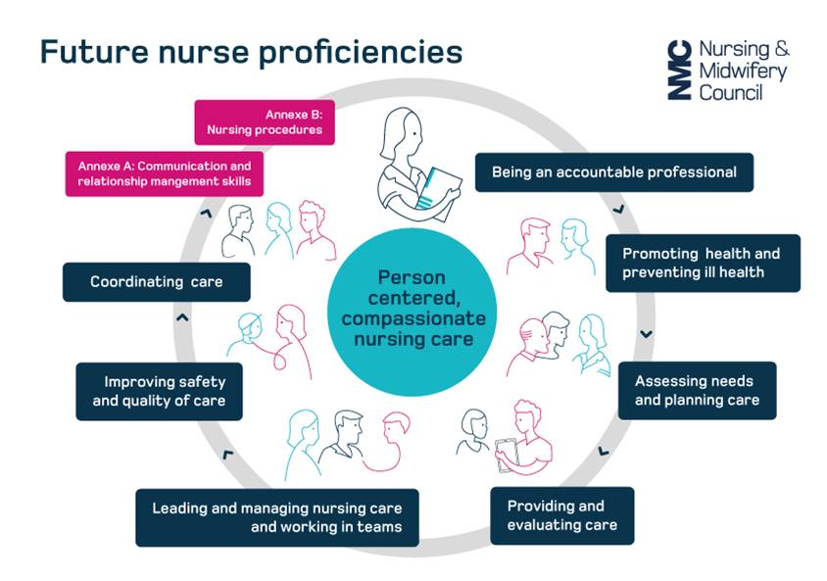
Future Nurse Proficiencies
Key differences
Annex A- refers to a stronger emphasis on the students professional conduct
Annex B- refers to the changes to students proficiencies.
These are now to be achieved across all branches, by the end of each year, at an increasing level of competency based on the part of the programme they are currently undertaking (years 1,2 & 3)
New proficiencies include
Chest auscultation
Venepuncture and cannulation
ECG acquisition and interpretation
NMC 2018

Slide 9



New model of team student supervision and assessment in practice
Academic Assessor
Practice Assessor
Supervisor
NMC 2018

Slide 10

Proposed model
Based on 3 placements per year
Placement A
Placement B
Placement C
If the student is progressing well the Academic Assessor will only be involved on the final placement of each year to confirm progression with the Practice Assessor.
PS
PS
PS
PS
PS
PS
PS
PS
PS
Team of supervisors
Team of supervisors
Team of
supervisors
PA
PA
PA
AA

Slide 11

Future Supervision of Students
All Students on an NMC approved programme are supervised while learning in practice
Practice supervision ensures safe and effective learning experiences that uphold public protection and the safety of people
The level of supervision provided to students reflects their learning needs and stage of learning
There is sufficient coordination and continuity of support and supervision of students to ensure safe and effective learning experiences
All students on an NMC approved programme are supervised in practice by NMC registered nurses and midwives and other registered health and social care professionals

Slide 12
Principles of the New NMC standards for student Supervision and assessment (SSSA)
Separate Supervision and Assessment roles to "Increase consistency in assessment judgements- Avoid ‘failing to fail’ situations."
Supporting students becomes every NMC registrant's responsibility (it is in The Code). Everyone will have an input to assessment.
Each area must have a named supervisor to quality-assure the student's placement experience (PLT representative).
Local agreement that there will be a named supervisor each shift.
Improved inter-professional working and student supervision.
Enhance joint working between AEIs and practice placement partners.

Slide 13
Each area must have a named supervisor to quality-assure
the placement experience.
What does this mean?
Each placement must have a named person who is responsible for:
Completing educational audits
Receiving student allocations
Ensuring the team knows the student is coming and ensuring a practice supervisor is available to complete their initial interview and induction to the placement area
Allocation of named Practice Assessor for the student
Links with the local university/ attends practice learning meetings
Updating the team on any curriculum changes
Agreeing placement capacity
Being the person the student can come to if they have any concerns
You will know this role as the Practice Learning Team (PLT) representative

Slide 14
Why do we the team need a named supervisor daily?
This is so that there is one person in the team who knows where the student is on a day –to-day basis.
They record the student's hours/ attendance/sickness.
They are the person who is responsible for ensuring the student is engaged with their learning and acting in a professional manner.
They are the person who the student knows they can come to that shift with any concerns.
They are the person responsible for escalating any concerns regarding the student to the students practice assessor.
Lessons learned from practice
Students need to feel safe and supported and having a named person per shift will provide that for them.
If the student doesn’t attend placement somebody needs to be responsible for finding out why and reporting concerns to the university.
There is a risk as we move into team supervision in a busy environment that everybody believes that somebody has acted/informed the student's practice assessor of any concerns when nobody actually has.
Student can get missed or feel unsupported if someone is not responsible for ensuring they have learning opportunities / tasks for the shift clarified with them.

Slide 15

Lessons learned – Case Study
Issue with students professional conduct in a busy theatre environment.
Background
The placement PLT representative returned from a period of sickness absence and asked to see a student to discuss their progress and review their practice assessment document.
The PLT representative's signature was next to several competencies which they could not have signed-off.
This led to an escalation of concern and further investigation.

Slide 16

Case Study continued
Findings
The student had forged the signatures of several staff to sign-off their own competencies and practice hours over a 3 week period.
The fob required to access theatres had recorded the student being on the premises for only 12hrs in total.
The student admitted that the busy theatre environment had allowed them to attend handover, walk out behind the different theatre teams, and leave the building (they lived on-site in student accommodation).
Each theatre team had believed the student was working in a different theatre.
There was an overreliance on a system in which the PLT representative was the only member of staff responsible for the coordination, monitoring and support of student activity.
Outcome
The student was removed from the course after a fitness to practise hearing at the university.
The placement had to be re-audited as a safe and suitable environment for students with reassurances and evidence that:
  Staff had been made aware of their own failings and new procedures were in place to monitor students' whereabouts and attendance and uphold student and public safety.
  One of these measures was to introduce a daily supervisor rota for all students in the theatre placement.
  New documentation to record students' attendance was put in place.
  The role of the daily supervisor became part of the theatres daily co-ordinator's responsibility.

Slide 17
Key changes for existing mentors
The roles of mentor and sign off mentor no longer exist.
In 2018 the NMC introduced the new Standards for Student Supervision and Assessment (SSSA) and the new roles of Practice Supervisor and Practice Assessor
Today you will all be transitioned to the roles of supervisor and assessor regardless of your previous role differences under the NMC 2008 SLAIP standards.
The roles of supervisor and assessor are interchangeable but distinct.
You cannot be a practice supervisor and a practice assessor to the same student at the same time.
You may be the named assessor for one student whilst supervising others on placement.
Practice Assessor
Mentor role is now separated into
Practice Supervisor

Slide 18
Key changes for existing mentors
The three-yearly (triennial) review is no longer a requirement.
You will not need to supervise a minimum number students to maintain your status as a supervisor and assessor.
Students are to be supported as individuals with the level of supervision being tailored to their current level of competence and the learning outcomes they need to achieve.
The 40% rule is no longer a requirement for individuals supervising students.
If supporting a student for the achievement of a specific competency you may spend more time supervising them for that skill for the purposes of consistency than your other colleagues, especially if its your specialism.
To be an assessor you do need to be a nurse, however you no longer need to be on the same part of the register as your student as you will be confirming the testimony of your colleagues (supervisors) and the evidence provided by the student themselves.
It has been locally agreed that you must update on the new standards every two years.

Slide 19

Who can be Practice Supervisors?
Any registered / regulated professional (after preparation)
Registered Nurses
Nursing Associates*
Doctors
AHP Colleagues
Teachers
Social workers
Phlebotomists (for the skills of venepuncture and cannulation only)
*Nursing Associates can supervise and contribute to the assessment of student nurses in years one and two of their training.

Slide 20
Examples of what proficiencies the wider team can support
Chest osculation
Venepuncture & cannulation
Dietary requirements
Communication/ documentation skills
Moving and handling
Medicines management
ECG’s
Professional conduct
Infection control
Safeguarding
Care planning
Health promotion
Activities of daily living
Leadership/Management skills
Assessments/ risk assessments
Sign posting & referrals
Inter-professional learning
Safe use of equipment
With these new standards, We have an opportunity to re-think how we can all help each other, to support learners in practice!

Slide 21

How is the role of the Practice Supervisor different to that of mentor?
Nothing is different!
You have the same responsibilities.
However instead of one person being responsible for the student a team of supervisors will support them, sharing the daily responsibility ensuring the student is supervised & supported 100% of the time.
Some of you will support clinical skills development, others will monitor professional behaviours.
All will provide feedback to the student and their Practice Assessor.

Slide 22


The role of the Practice Supervisor
Serve as role models for safe and effective practice in line with their code.
Support learning in line with their scope of practice to enable the student to meet their proficiencies and programme outcomes.
Support and supervise students, providing feedback on their progress towards, and achievement of, proficiencies and skills.
Have current knowledge and experience of the area in which they are providing support, supervision and feedback; and
Receive on-going support to participate in the practice learning of students.
Contribute to a student's assessment to inform decisions for progression.
Appropriately raise and respond to student conduct and competence concerns and are supported in doing so.

Slide 23

The role of the Practice Supervisor
Practice Supervisors undertake the student's initial interview.
Contribute to the mid-point professional values assessment.
Sign-off Service User Feedback
Escalate concerns regarding the student's competency or professional conduct to the practice assessor, if it is felt the student requires an action plan to support their progress.
Take some time to think about the role of the wider team and how team supervision could work in your area.

Slide 24
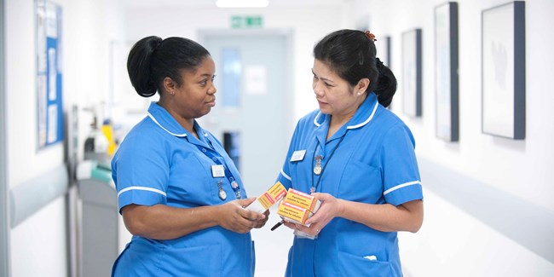

The role of the Practice Assessor
What are the key differences to the role of the Practice Supervisor?
Your role is to conduct objective, evidence based assessments of students competencies based on your periodic observations and the evidence and feedback provided from the student themselves and their supervisors.
Practice Assessors must be an NMC registrant.
An experienced Nursing Associate can be an Assessor for trainee nursing associate as they are on the same part of the register.
Practice assessors must have the opportunity to periodically observe their named student in practice.
  An example would be observing them conducting a drug round.
  However you do not supervise them on a day-to-day basis.

Slide 25

Role of the Practice Assessor (continued)
Responsibilities
Practice assessors conduct the mid and final point interviews, but must read and sign the initial interview conducted by the Practice Supervisor.
If an action plan is required for a student who is struggling this is completed by the practice assessor with the student and academic assessor.
You will need sufficient opportunities to gather and coordinate feedback from practice supervisors and other relevant people to be assured about decisions for assessment and progression.
You will need to identify if the student has any practice based assessments (episodes of care) that need to be completed during the placement. These will need to be planned with the student.

Slide 26
Role of the Practice Assessor (continued)
Responsibilities
If an action plan is required you will need to ensure that the practice supervisors are aware to enable them to support the student.
The Practice assessor in the last placement of each year will need to work in partnership with the academic assessor to evaluate and recommend progression to the next year of the programme or entry onto the NMC register.
Practice assessors are responsible for signing-off clinical practice but do need to be aware of the student's academic progress through communication with the academic assessor and the student's documentation.

Slide 27
Long-arm supervision and assessment
Practice Supervisors
Practice Assessors
Practice supervisors in the base placement can supervise students 'long-arm' if the student is attending other areas to gain experience and knowledge to enhance their skills in places like:
Day centres
Insight visits
Voluntary and private sector experiences
Staff supporting students in these areas can contribute to the overall feedback regarding the student's competencies and professional conduct whilst visiting their areas. Using the relevant electronic form in the student's practice assessment document
Do not have to work in the same building, team or department as the student they are assessing.
As they will have constant and instant access to the student's electronic practice assessment document and the feedback being left by practice supervisors.
Practice assessors will need to ensure that they check the communications section and the testimonies from practice supervisors regularly.
Long-arm practice assessors will need to co-ordinate visits and telephone conversations with the base placement's practice supervisors and the student.

Slide 28
The responsibilities of each role when supporting students and completing documentation and assessment
Practice Supervisors
Practice Assessor
Initial interview per placement
Mid-point professional values
Contributes to assessment of proficiencies (based on own scope of practice in liaison with the Practice Assessor)
Signs-off Service User Feedback
Provides feedback via the inter-professional working page
Confirm initial interview per placement
Mid-point and final interview per placement
Assessment and confirmation of proficiencies
Final professional values per placement
Episode(s) of care
Medicines Management
Completes On-going Achievement Record (OAR) at end of each placement and progression point

Slide 29

The Role of the Academic Assessor
Collates and confirms student achievement of proficiencies and programme outcomes in the academic environment.
Makes and records objective evidence based decisions on conduct, proficiency and achievements and makes recommendations for progression.
Work in partnership with a practice assessor to evaluate and recommend the student for progression for each part of the programme.
Enables scheduled communication and collaboration between academic and practice assessors.
Objectivity is maintained as the academic assessor cannot support a student for sequential parts of the 3yr programme.

Slide 30
Students' responsibilities
Students are responsible for letting their supervisors and assessor know if they have a learning contract in place.
Students must take a key role in their supervision and assessment in practice.
Prepare for and have a sound understanding of the proficiencies they need to achieve
They should actively seek out practice supervisors to support their learning and encourage feedback to be recorded in their practice assessment documents (MYPAD)
Be aware of the person they should to speak to in the practice area if they have concerns

Slide 31

Equality and Diversity
Students should be supported as individuals and have the same rights and protected characteristics under equality and diversity legislation as any employee.
Students may have a learning contract in place with the university and if disclosed reasonable adjustments should be made in practice where possible.
Students learning and support should be tailored to the needs of the individual and they should be supervised and assessed at the appropriate level to the part of the programme (e.g. year) they are undertaking.

Slide 32
Equality and Diversity – things to think about
Think about:
Mental health needs
Impairment
Disability
Long term conditions
Long term impairment:
Physical
Mental
or both
Impairment:
Dyslexia
Dyspraxia
Dyscalculia
Hearing
Vision
Speech
Long-term
Disability:
Physical
and/or
emotional
Mental health needs:
Long or short term?
Anxiety
Depression
Stress
Dual diagnosis
Bereavement
What reasonable adjustments can be made?
How can you as a team support a student with a learning contract?

Slide 33
Suggested PCN placement model
By moving away from traditional individual placements to the PCN becoming a placement pathway, primary and social care will increase the experiences of students who may wish to make this a first destination career choice.
PCN supporting Student Nurses & Trainee Nursing Associates
Practice 1:
1 GPN
Physiotherapist
Phlebotomist
GPs
Practice 2:
3 GPNs
Nursing Associate
1 ACP
GPs
Care Home:
4 Nurses
Practice 3:
2 GPNs
Nursing Associate
Phlebotomist
Clinical Pharmacist
GPs
Primary care and social care is made up of numerous individual practices and care homes which may not individually have enough capacity to support the new model
Educational placement tariff could be paid to the PCN to increase education and supervision capacity.
Increasing capacity to take students across the PCN in turn increase tariff income.
Sharing and coordinating supervision and assessment responsibilities across the network enables the involvement of practice settings that would not otherwise be able to support student placements.

Slide 34
Changes to the assessment process
Practising independently with minimal supervision, leading and coordinating care with confidence
Active participation in care, minimal guidance, performing with increased confidence and competence
Students are no longer assessed at Bondi levels 1-3.
However Bondi remains integral as the levels are incorporated into the level students are to work at per part (i.e. year or shortened or part-time programme equivalent).
Guided participation in care and performing with increasing confidence
End Part 1
End Part 2
Knowledge
Skills
Attitude
End Part 3
Students proficiencies are now assessed in the MYEPAD under the 3 categories below, as a simple Yes or No with new assessment guidance.
Knowledge | Skills | Attitude and values

Slide 35
New Assessment Criteria - Part 1
Guided participation in care and performing with increasing confidence and competence |  | Active participation in care with minimal guidance and performing with increased confidence and competence |  | Practising independently with minimal supervision and leading and coordinating care with confidence
 | Part 1 |  | Part 2 |  | Part 3
'Achieved' must be obtained in all three criteria by the student.
Achieved | Knowledge can be achieved across the part | Skills can be achieved across the part | Attitude and Values Must be achieved every placement
Yes | Is able to identify the appropriate knowledge base required to deliver safe, person-centred care under some guidance. | In commonly encountered situations is able to utilise appropriate skills in the delivery of person-centred care with some guidance. | Is able to demonstrate a professional attitude in delivering person-centred care. Demonstrates positive engagement with own learning.
No | Is not able to demonstrate an adequate knowledge base and has significant gaps in understanding, leading to poor practice. | Under direct supervision is not able to demonstrate safe practice in delivering care despite repeated guidance and prompting in familiar tasks. | Inconsistent professional attitude towards others and lacks self-awareness. Is not asking questions nor engaging with own learning needs.

Slide 36
Assessment Process
Parts 1, 2 & 3
Assessment items
You will need to look at each individual AEI’s MYEPAD documentation to see where the student's assessments and level of competency relates to parts 1,2 & 3 of study.
Each placement would be advised to review a copy of each document on the MYEPLG website and check what can be achieved in your placement.
Each MYEPAD has this information documented for you.
Professional Values - must be achieved every placement. If not the student fails the whole placement.
Proficiencies - can be achieved across the Part. Don’t worry if they cannot achieve all proficiencies in your placement area.
Episodes of Care - across the Part
Feedback - obtained from supervisors, assessors, other staff, patients/service users, peers.
Confirmation of achievement and progression – OAR.
Medicines Management - across the Part

Slide 37
Key Components of the MYEPAD
Patient/Service User/Carer Feedback Form
Feedback will be sought in relation to how the student cared for the person receiving care. This is not formally assessed but will contribute to overall student feedback.
Recording Additional Experiences and Feedback
There additional pages for the student to record reflections on their own learning and pages to record communication and additional feedback from all those supporting learning and assessment.
On-going Achievement Record
The OAR summarises overall achievements and provides a comprehensive record of student development and overall performance.

Slide 38
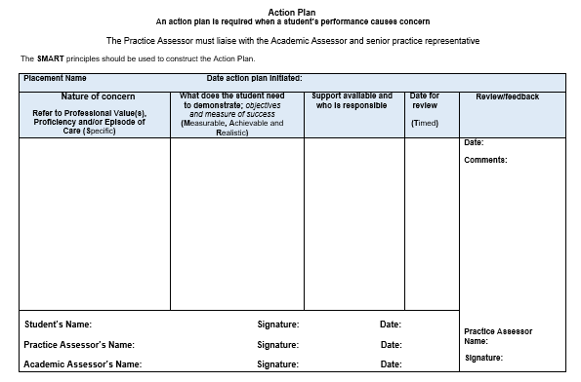
What happens if an action plan is required?
This is completed if a Practice Assessor identifies a cause for concern in a student’s performance.
Academic Assessors will liaise with Practice Assessors and sign the action plan.
Monitored by the Practice Assessor .

Slide 39
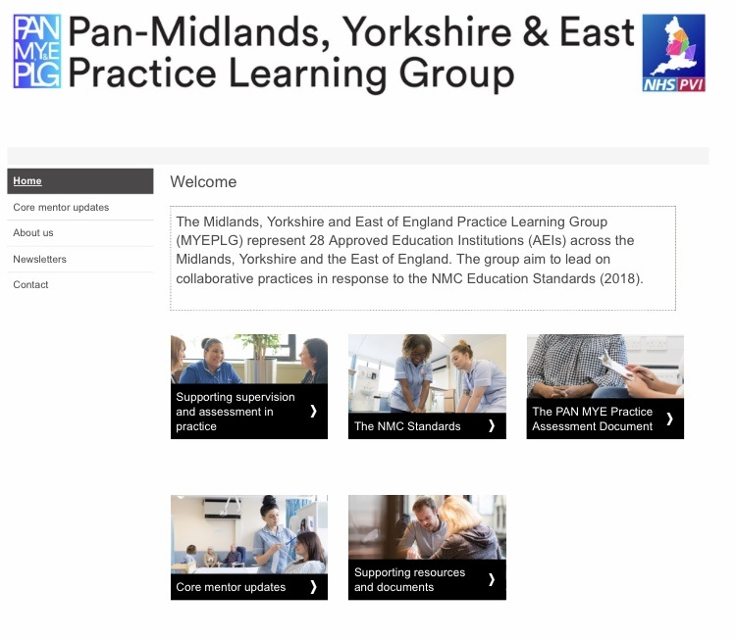
MYEPLG Website
Resources for supervisors and assessors
Copy of practice assessment document (MYEPAD)
Regional updates to practice supervision and assessment
NMC SSSA link
Online supervisor and assessor update

Slide 40
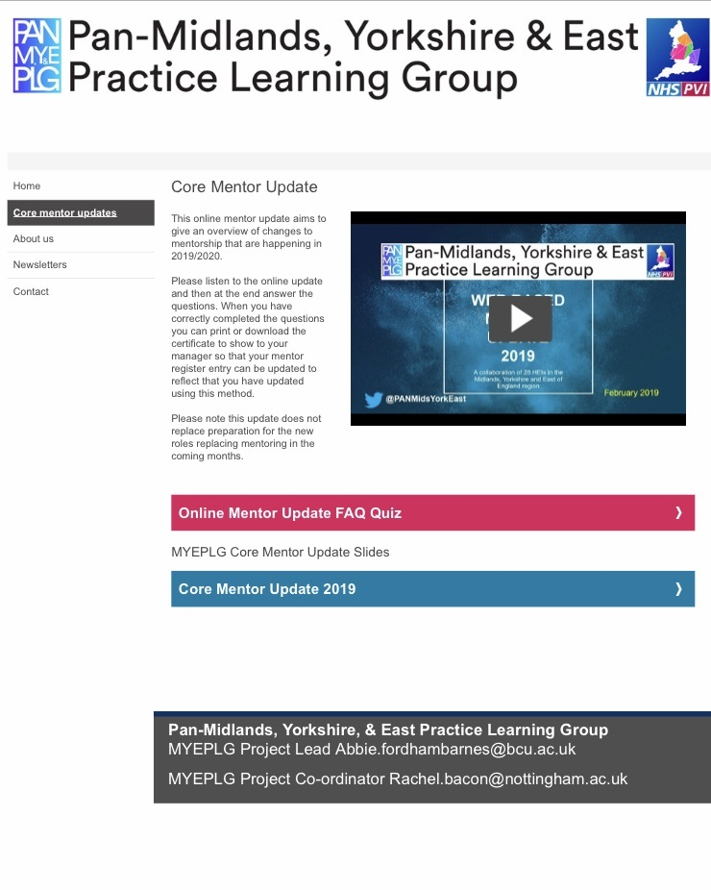
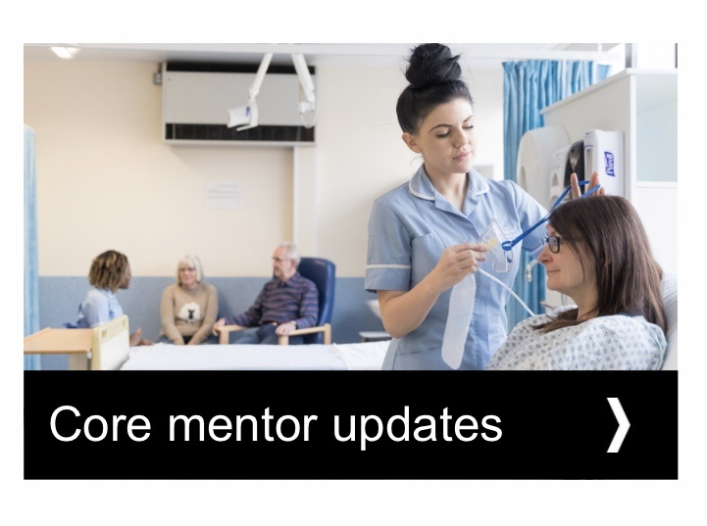
Accessing online update
You can complete your 2 yearly update online by accessing the video or slide deck then completing the questionnaire.
The MYEPLG will then email you with confirmation you have completed your update. Forward the confirmation email to whoever holds your register.

Slide 41

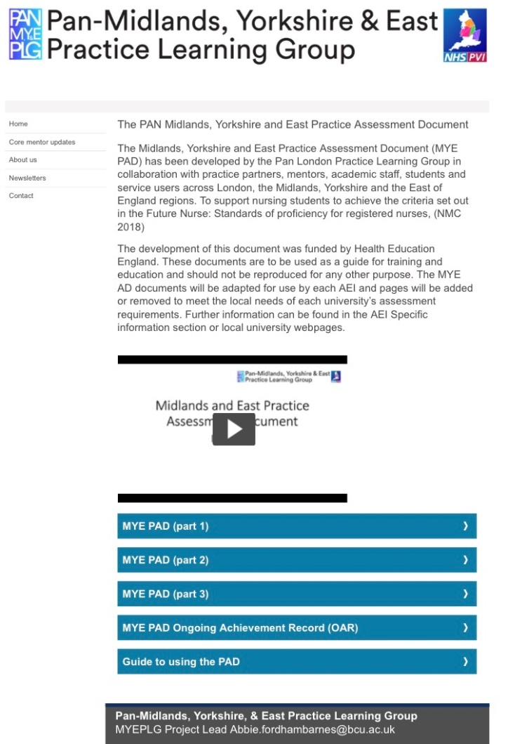
Practice Assessment Documents
This is where you can open and download copies of the student's practice assessment documents

Slide 42
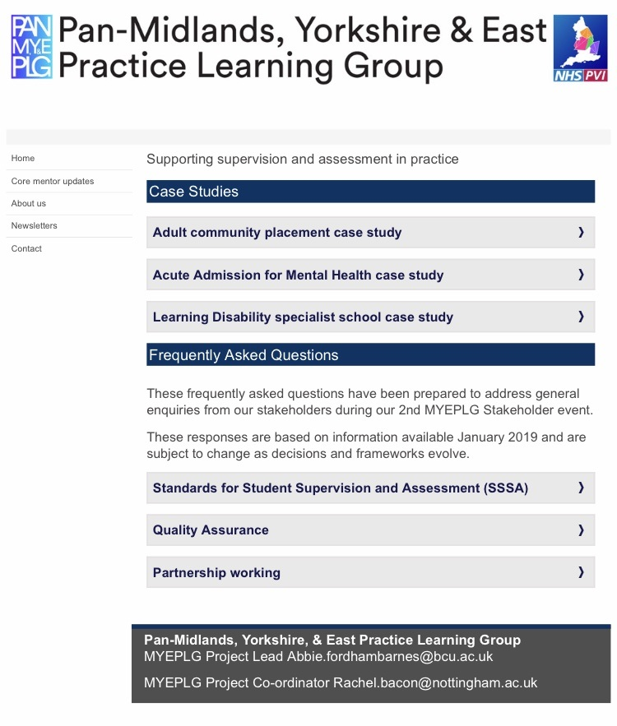
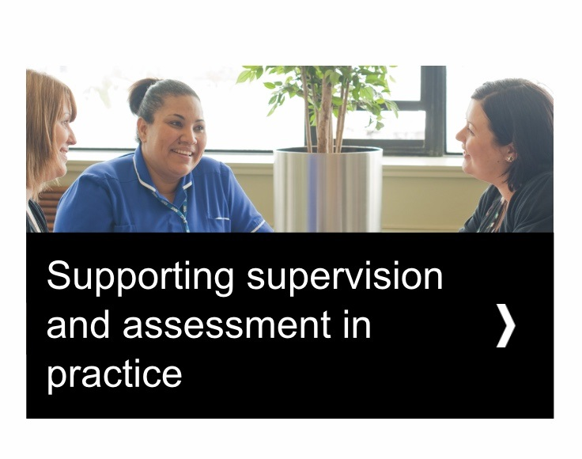
Helpful resources
In this section you can find case studies to use for team discussions and updates

Slide 43
What else you will need
All supervisors and assessors will require a PebblePad account with each university you take students from to be able to access and record information in the student's MYEPAD.
You should use the same username and password for each account to make it easier to remember.
There is also an app you can download which automatically directs you to the correct university's PebblePad site once you have been given the student's unique identification number.
The student providing you with their unique identification number is giving you permission under GDPR to access their information.
Your PebblePad account is your own unique electronic signature.
The app is called PebblePocket and can be downloaded for free from your app store.

Slide 44
Further information
Pan-Midlands, Yorkshire & East Practice Learning Group
https://www.myeplg.ac.uk/
SSSA supporting Information
https://www.nmc.org.uk/supporting-information-on-standards-for-student-supervision-and-assessment/

Slide 45
NMC SSSA Knowledge Test
Now you must complete the post course NMC SSSA Knowledge Test to assess your learning (via online test) and to receive a certificate of completion.
Link to the Knowledge Test: https://forms.office.com/r/Awpz21vbGD
If you experience any difficulties please email enquiries.nth@nhs.net with <Your Name> - SSSA Supervisor and Assessor Training in the email subject title

