Slide 1
NMC 2018 SSSA
SUPERVISOR TRAINING
Standards for student supervision and assessment in practice for Primary and Social Care
Training utilises the agreed Core Content Developed by PAN Midlands Yorkshire and East Practice Learning Group for use and amendments under the Creative Commons licence. Details at https://creativecommons.org/licenses/by-nc-nd/3.0/

Slide 2
Introduction to your NMC Practice Supervisor Training Package
Dear colleagues,
Northamptonshire Training Hub (NTH) is working to ensure that every NMC registrant working in Primary and Social Care is ‘suitably prepared’ in line with our NMC code of conduct to undertake the new roles of practice supervisor and/or assessor for student nurses' and trainee nursing associates' placements.
This slide deck has been created for those of you who have not had a previous mentor qualification, to allow you to develop your knowledge and skills at a pace and a time that suits you.
Ordinarily, this would be delivered in person but in these current circumstances this package is here to enable you to complete the learning independently.
However if you have any further questions or support needs after completing the training please contact me. My email is enquiries.nth@nhs.net
Once completed you will receive a certificate which includes the NMC revalidation reflection account form for you to record this training as part of your participatory CPD hours.

Slide 3

Over View
The MYEPLG is a group of 33 universities working together with each other and practice partners across the region.
Practice partners across the East Midlands have contributed to the core content of this transition training package.
For quality assurance purposes there is a local agreement in place that you can undertake this training in your own or fellow organisation and that your training certificate will be recognised by the local universities and NHS, private and voluntary sector employers.
The MYEPLG have developed the new electronic Midlands, Yorkshire & East Practice Assessment Document (MYEPAD)
Student nurses on the new programmes commencing from September 2019 will all be using the same documentation (MYEPAD)
The MYEPLG have a website which provides regionally agreed training and resources to support supervisors and assessors.

Slide 4
Learning Outcomes
By the end of this transition training you will
Have a clear understanding of the responsibility of practice supervision and assessment.
Understand the process of student supervision, assessment and feedback
Be able to help your practice area develop a learning experience for students identifying their specific needs at their level of training including consideration of equality, diversity and reasonable adjustments
Understand the collaboration required between the Practice Supervisor (PS), Practice Assessor (PA) and Academic Assessor (AA) who all contribute to the student’s assessment in practice
Have knowledge about the Practice Assessment Document and written forms of evidence to support student assessment and progression
Understand the student’s programme of study and the proficiencies to be achieved

Slide 5

Overview of the New
Standards for Education & Training
These can be found
on the NMC website

Slide 6
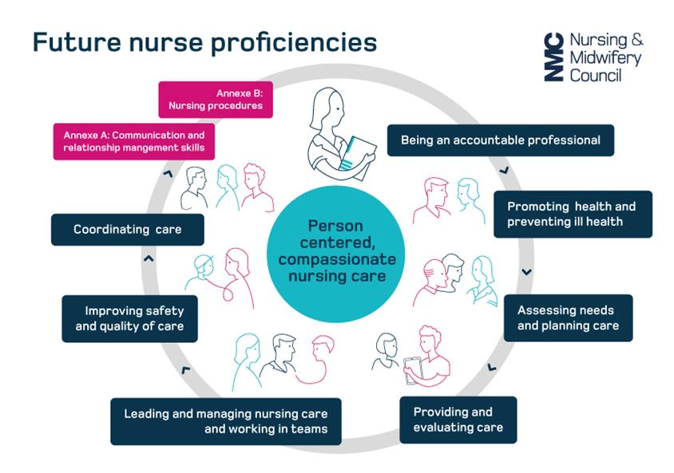
Future Nurse Proficiencies
Key differences
Annex A- refers to a stronger emphasis on the students professional conduct
Annex B- refers to the changes to students proficiencies.
These are now to be achieved across all branches, by the end of each year, at an increasing level of competency based on the part of the programme they are currently undertaking (years 1,2 & 3)
New proficiencies include
Chest auscultation
Venepuncture and cannulation
ECG acquisition and interpretation
NMC 2018

Slide 7
Key Changes
The Future Nurse Standards have made some fundamental changes to the way in which students are supported in practice.
Supervising students is now every registrant's responsibility.
Students on the new standards will now qualify 'supervisor-ready'. Student nurses must support the learning of others to pass their placement under Annexe A of the Future Nurse proficiencies.
All existing staff who qualified before September 2018 who haven't previously undertaken a mentorship qualification, need to undertake training to ensure they are ‘suitably prepared’ for the role of the Practice Supervisor.
Ensuring a sooth transition to the new team model of student supervision and assessment in practice.

Slide 8

Why Were These Changes Made?
Principles of the New NMC Standards
for Student Supervision and Assessment (SSSA)
Separate Supervision and Assessment roles to "Increase consistency in assessment judgments - Avoid ‘failing to fail’ situations."
Supporting students becomes every NMC registrant's responsibility (it is in The Code). Everyone will have an input to assessment.
Each area must have a named supervisor to quality-assure the student's placement experience (PLT representative).
Local agreement that there will be a named supervisor each shift.
Improved inter-professional working and student supervision.
Enhance joint working between AEIs and practice placement partners.

Slide 9
Rather than an individual ‘mentor’ being responsible for the students supervision as on the 2008 SLAIP standards.
Under the 2018 SSSA standards the whole team works together to support and supervise the students achievement of their identified learning outcomes and competencies for the placement
New model of team student supervision and assessment in practice
Academic Assessor
Practice Assessor
Supervisor
NMC 2018

Slide 10

Proposed Model
Based on 3 Placements per Year
Placement A
Placement B
Placement C
PS
PS
PS
PS
PS
PS
PS
PS
PS
Team of supervisors
Team of supervisors
Team of supervisors
PA
PA
PA
AA
If the student is progressing well the Academic Assessor will only be involved on the final placement of each year to confirm progression with the Practice Assessor.

Slide 11

Who can be Practice Supervisors?
Any registered / regulated professional (after preparation)
Who will form a team of supervisors that will support the student, sharing the daily responsibility ensuring the student is supervised & supported 100% of the time.
Registered Nurses
Nursing Associates*
Doctors
AHP Colleagues
Teachers
Social workers
Phlebotomists (for the skills of venepuncture and cannulation only)
Nursing Associates can supervise and contribute to the assessment of student nurses in years one and two of their training.

Slide 12
Examples of What Proficiencies the
Wider Team Can Support
Chest osculation
Venepuncture & cannulation
Dietary requirements
Communication/ documentation skills
Moving and handling
Medicines management
ECG’s
Professional conduct
Infection control
Safeguarding
Care planning
Health promotion
Activities of daily living
Leadership/Management skills
Assessments/ risk assessments
Sign posting & referrals
Inter-professional learning
Safe use of equipment
With these new standards, We have an opportunity to re-think how we can all help each other, to support learners in practice!

Slide 13
Suggested PCN Placement Model
PCN supporting Student Nurses & Trainee Nursing Associates
Practice 1:
1 GPN
Physiotherapist
Phlebotomist
GPs
Practice 2:
3 GPNs
Nursing Associate
1 ACP
GPs
Care Home:
4 Nurses
Practice 3:
2 GPNs
Nursing Associate
Phlebotomist
Clinical Pharmacist
GPs
By moving away from traditional individual placements to the PCN becoming a placement pathway, primary and social care will increase the experiences of students who may wish to make this a first destination career choice.
Primary care and social care is made up of numerous individual practices and care homes which may not individually have enough capacity to support the new model
Educational placement tariff could be paid to the PCN to increase education and supervision capacity.
Increasing capacity to take students across the PCN in turn increase tariff income.
Sharing and coordinating supervision and assessment responsibilities across the network enables the involvement of practice settings that would not otherwise be able to support student placements.

Slide 14
What Else Are Practice Supervisors Responsible For?
Practice Supervisors undertake the students Initial interview on the first day of the students placement for the practice assessor to review and counter sign.
The practice assessor will ask you to complete the Mid-point professional values assessment paperwork and contribute to the assessment for the students mid and final point interviews.
Practice Supervisors will provide the practice assessor with written evidence that that the student is competent in the skills they have supported the student to undertake.
Practice supervisors approach appropriate service users and relatives to complete the relevant feedback form on the students behalf and signs off Service User Feedback in the students documentation.
Practice supervisors are responsible for escalating concerns regarding the students competency or professional conduct to the practice assessor, if it is felt the student requires an action plan to support their progress.

Slide 15
Each Area Must Have a Named Supervisor to
Quality-Assure the Placement Experience
What does this mean?
Each placement must have a named person who is responsible for:
Completing educational audits
Receiving student allocations
Ensuring the team knows the student is coming and ensuring a practice supervisor is available to complete their initial interview and induction to the placement area
Allocation of named Practice Assessor for the student
Links with the local university/ attends practice learning meetings
Updating the team on any curriculum changes
Agreeing placement capacity
Being the person the student can come to if they have any concerns
You will know this role as the Practice Learning Team (PLT) representative

Slide 16
Why Do We the Team Need a Named Supervisor Daily?
This is so that there is one person in the team who knows where the student is on a day-to-day basis.
They record the student's hours/ attendance/sickness.
They are the person who is responsible for ensuring the student is engaged with their learning and acting in a professional manner.
They are the person who the student knows they can come to that shift with any concerns.
They are the person responsible for escalating any concerns regarding the student to the students practice assessor.
Lessons learned from practice
Students need to feel safe and supported and having a named person per shift will provide that for them.
If the student doesn’t attend placement somebody needs to be responsible for finding out why and reporting concerns to the university.
There is a risk as we move into team supervision in a busy environment that everybody believes that somebody has acted/informed the student's practice assessor of any concerns when nobody actually has.
Student can get missed or feel unsupported if someone is not responsible for ensuring they have learning opportunities / tasks for the shift clarified with them.

Slide 17

Lessons Learned – Case Study
Issue with students professional conduct in a busy theatre environment.
Background
The placement PLT representative returned from a period of sickness absence and asked to see a student to discuss their progress and review their practice assessment document.
The PLT representative's signature was next to several competencies which they could not have signed-off.
This led to an escalation of concern and further investigation.

Slide 18

Case Study Continued
Findings
The student had forged the signatures of several staff to sign-off their own competencies and practice hours over a 3 week period.
The fob required to access theatres had recorded the student being on the premises for only 12hrs in total.
The student admitted that the busy theatre environment had allowed them to attend handover, walk out behind the different theatre teams, and leave the building (they lived on-site in student accommodation).
Each theatre team had believed the student was working in a different theatre.
There was an overreliance on a system in which the PLT representative was the only member of staff responsible for the coordination, monitoring and support of student activity.
Outcome
The student was removed from the course after a fitness to practise hearing at the university.
The placement had to be re-audited as a safe and suitable environment for students with reassurances and evidence that:
  Staff had been made aware of their own failings and new procedures were in place to monitor students' whereabouts and attendance and uphold student and public safety.
  One of these measures was to introduce a daily supervisor rota for all students in the theatre placement.
  New documentation to record students' attendance was put in place.
  The role of the daily supervisor became part of the theatres daily co-ordinator's responsibility.

Slide 19
Long-arm Supervision and Assessment
Practice Supervisors
Practice Assessors
Practice supervisors in the base placement can supervise students 'long-arm' if the student is attending other areas to gain experience and knowledge to enhance their skills in places like:
Day centres
Insight visits
Voluntary and private sector experiences
Staff supporting students in these areas can contribute to the overall feedback regarding the student's competencies and professional conduct whilst visiting their areas. Using the relevant electronic form in the student's practice assessment document
Do not have to work in the same building, team or department as the student they are assessing.
As they will have constant and instant access to the student's electronic practice assessment document and the feedback being left by practice supervisors.
Practice assessors will need to ensure that they check the communications section and the testimonies from practice supervisors regularly.
Long-arm practice assessors will need to co-ordinate visits and telephone conversations with the base placement's practice supervisors and the student.

Slide 20
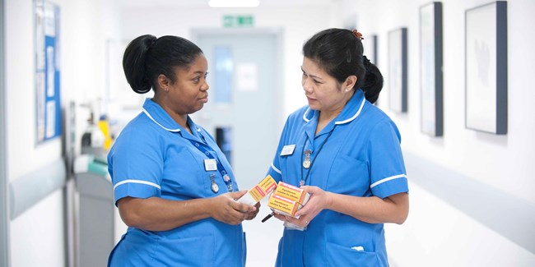

The Role of the Practice Assessor
What are the key differences to the role of the Practice Supervisor?
Your role is to conduct objective, evidence based assessments of students competencies based on your periodic observations and the evidence and feedback provided from the student themselves and their supervisors.
Practice Assessors must be an NMC registrant.
An experienced Nursing Associate can be an Assessor for trainee nursing associate as they are on the same part of the register.
Practice assessors must have the opportunity to periodically observe their named student in practice.
  An example would be observing them conducting a drug round.
  However you do not supervise them on a day-to-day basis. That is the role of the teams practice supervisors.

Slide 21

Role of the Practice Assessor (Continued)
Responsibilities
Practice assessors conduct the mid and final point interviews, but must read and sign the initial interview conducted by the Practice Supervisor.
If an action plan is required for a student who is struggling this is completed by the practice assessor with the student and academic assessor.
You will need sufficient opportunities to gather and coordinate feedback from practice supervisors and other relevant people to be assured about decisions for assessment and progression.
You will need to identify if the student has any practice based assessments (episodes of care) that need to be completed during the placement. These will need to be planned with the student.

Slide 22
Role of the Practice Assessor (continued)
Responsibilities
If an action plan is required you will need to ensure that the practice supervisors are aware to enable them to support the student.
The Practice assessor in the last placement of each year will need to work in partnership with the academic assessor to evaluate and recommend progression to the next year of the programme or entry onto the NMC register.
Practice assessors are responsible for signing-off clinical practice but do need to be aware of the student's academic progress through communication with the academic assessor and the student's documentation.

Slide 23

The Role of the Academic Assessor
Collates and confirms student achievement of proficiencies and programme outcomes in the academic environment.
Makes and records objective evidence based decisions on conduct, proficiency and achievements and makes recommendations for progression.
Work in partnership with a practice assessor to evaluate and recommend the student for progression for each part of the programme.
Enables scheduled communication and collaboration between academic and practice assessors.
Objectivity is maintained as the academic assessor cannot support a student for sequential parts of the 3yr programme.

Slide 24
Students' Responsibilities
Students are responsible for letting their supervisors and assessor know if they have a learning contract in place.
Students must take a key role in their supervision and assessment in practice.
Prepare for and have a sound understanding of the proficiencies they need to achieve
They should actively seek out practice supervisors to support their learning and encourage feedback to be recorded in their practice assessment documents (MYPAD)
Be aware of the person they should to speak to in the practice area if they have concerns

Slide 25
Key Components of the MYEPAD
Patient/Service User/Carer Feedback Form
Feedback will be sought in relation to how the student cared for the person receiving care. This is not formally assessed but will contribute to overall student feedback.
Recording Additional Experiences and Feedback
There additional pages for the student to record reflections on their own learning and pages to record communication and additional feedback from all those supporting learning and assessment.
On-going Achievement Record
The OAR summarises overall achievements and provides a comprehensive record of student development and overall performance.

Slide 26
The responsibilities of each role when supporting students and completing documentation and assessment
Practice Supervisors
Practice Assessor
Initial interview per placement
Mid-point professional values
Contributes to assessment of proficiencies (based on own scope of practice in liaison with the Practice Assessor)
Signs-off Service User Feedback
Provides feedback via the inter-professional working page
Confirm initial interview per placement
Mid-point and final interview per placement
Assessment and confirmation of proficiencies
Final professional values per placement
Episode(s) of care
Medicines Management
Completes On-going Achievement Record (OAR) at end of each placement and progression point

Slide 27
The assessment process
Students are assessed at a different level each year/part of their training.
It is important that when supervising students you are ensuring they are working to the expected level for where they are in their training based on this model
Practising independently with minimal supervision, leading and coordinating care with confidence
Active participation in care, minimal guidance, performing with increased confidence and competence
Guided participation in care and performing with increasing confidence
End Part 1
End Part 2
Knowledge
Skills
Attitude
End Part 3
Students proficiencies are now assessed in the MYEPAD under the 3 categories below, as a simple Yes or No with new assessment guidance.
Knowledge | Skills | Attitude and values

Slide 28
Assessment Process Continued:
Parts 1, 2 & 3
Assessment items
You will need to look at each individual AEI’s MYEPAD documentation to see where the student's assessments and level of competency relates to parts 1,2 & 3 of study.
Each placement would be advised to review a copy of each document on the MYEPLG website and check what can be achieved in your placement.
Each MYEPAD has this information documented for you.
Professional Values - must be achieved every placement. If not the student fails the whole placement.
Proficiencies - can be achieved across the Part. Don’t worry if they cannot achieve all proficiencies in your placement area.
Episodes of Care - across the Part
Feedback - obtained from supervisors, assessors, other staff, patients/service users, peers.
Confirmation of achievement and progression – OAR.
Medicines Management - across the Part

Slide 29
The assessment criteria for a student undertaking Part/year 1
Guided participation in care and performing with increasing confidence and competence |  | Active participation in care with minimal guidance and performing with increased confidence and competence |  | Practising independently with minimal supervision and leading and coordinating care with confidence
 | Part 1 |  | Part 2 |  | Part 3
'Achieved' must be obtained in all three criteria by the student.
Achieved | Knowledge can be achieved across the part | Skills can be achieved across the part | Attitude and Values Must be achieved every placement
Yes | Is able to identify the appropriate knowledge base required to deliver safe, person-centred care under some guidance. | In commonly encountered situations is able to utilise appropriate skills in the delivery of person-centred care with some guidance. | Is able to demonstrate a professional attitude in delivering person-centred care. Demonstrates positive engagement with own learning.
No | Is not able to demonstrate an adequate knowledge base and has significant gaps in understanding, leading to poor practice. | Under direct supervision is not able to demonstrate safe practice in delivering care despite repeated guidance and prompting in familiar tasks. | Inconsistent professional attitude towards others and lacks self-awareness. Is not asking questions nor engaging with own learning needs.

Slide 30

Equality and Diversity
Students should be supported as individuals and have the same rights and protected characteristics under equality and diversity legislation as any employee.
Students may have a learning contract in place with the university and if disclosed reasonable adjustments should be made in practice where possible.
Students learning and support should be tailored to the needs of the individual and they should be supervised and assessed at the appropriate level to the part of the programme (e.g. year) they are undertaking.

Slide 31
Equality and Diversity – Things to Think About
Think about:
Mental health needs
Impairment
Disability
Long term conditions
Long term impairment:
Physical
Mental
or both
Impairment:
Dyslexia
Dyspraxia
Dyscalculia
Hearing
Vision
Speech
Long-term
Disability:
Physical
and/or
emotional
Mental health needs:
Long or short term?
Anxiety
Depression
Stress
Dual diagnosis
Bereavement
The NMC are very clear that each students placement experience should be tailored to the needs of the individual and the relevant assessment criteria for the part/ year they are currently undertaking.
As part of the initial interview please remember to ask the student if they have a learning contract in place or any issues or concerns they need to make you aware of. Then you can decide:
What reasonable adjustments can be made?
How can you as a team support a student with a learning contract?

Slide 32


The Role of the Practice Supervisor in
Supporting Students with Varying Needs
Ensuring you and the team have a positive attitudes towards supporting students to learn without compromising standards and patient safety
Not all students will feel confident to disclose everything at the initial interview so ensure you create a positive environment for further disclosure.
Ensure the learning environment is free from harassment, victimisation and discrimination .
Facilitate inclusion/ make reasonable adjustments.
Ensure you let the students Practice Assessor know of any extra support the student requires so that they can contact the students Academic Assessor.

Slide 33

RESOURCES FOR COMPETING YOUR
SELF DIRECTED LEARNING
AND GAIN YOUR TRAINING CERTIFICATE
The role of the Practice Supervisor: resources and information to help you feel confident to create a safe and welcoming learning environment

Slide 34
ACTIVITY 1
Equality and Diversity- Reflective Activity

Slide 35

Equality and Diversity Case Studies
Reflection:
Please think about yourself as a learner, what are you feeling or thinking when asked whether you have a disability? If you do, would you be happy to disclose this?
Now think about the role you will have as a practice supervisor, what you may be feeling or thinking when asking a student, you are supporting, whether they may have a disability?
As a practice supervisor, what would be your role and responsibility to a student (who has declared a disability) in terms of patient care delivery, patient safety, working within your organisation and to the standards of the Code (NMC, 2018)?
Would you know when to seek assistance in supporting a student with a disability and whom to refer to?
Please read the 2 case studies on the bottom of the RCN’s Peer Support Services page link.

Slide 36
RCN- Practice Supervisor Resources
The full suite of RCN resources can access in your own time to further develop your confidence and understanding of the role of the Practice Supervisor can be found by clicking the link provided.

Slide 37
ACTIVITY 2
Navigate your way to the MYEPLG website and familiarise yourself with the resources as directed

Slide 38
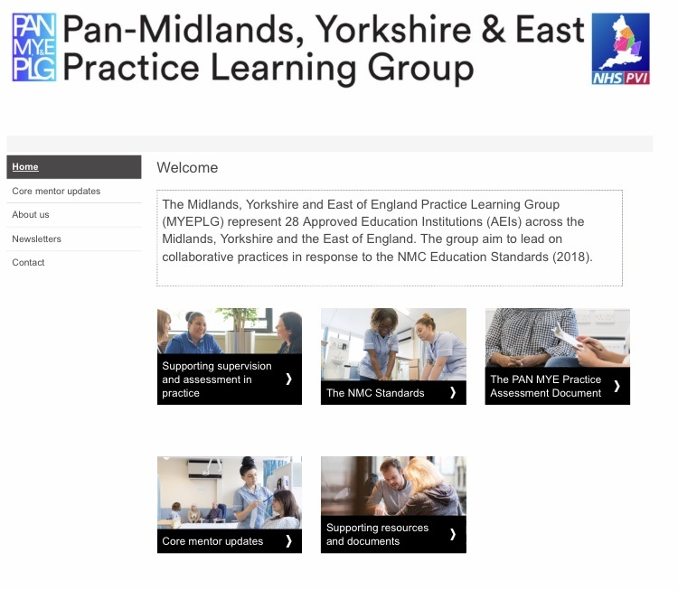
MYEPLG Website
Resources for supervisors and assessors
Copy of practice assessment document (MYEPAD)
Regional updates to practice supervision and assessment
NMC SSSA link
Online supervisor and assessor update
For Activity 2 please open the link to the website – Then view the next slide.

Slide 39

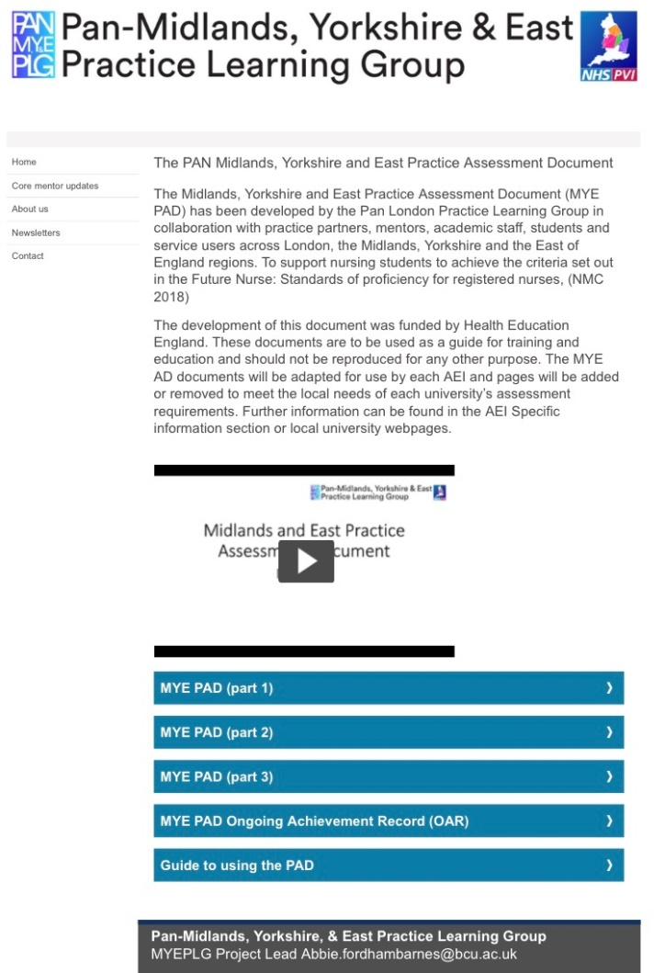
Activity 2: Practice Assessment Documents
This is where you can open and download copies of the student's practice assessment documents. To familiarise yourself with the content, required paperwork and assessment criteria for each part of the programme.
Please ensure you watch the MYEPLG Assessment Document Podcast as part of your self directed learning.

Slide 40
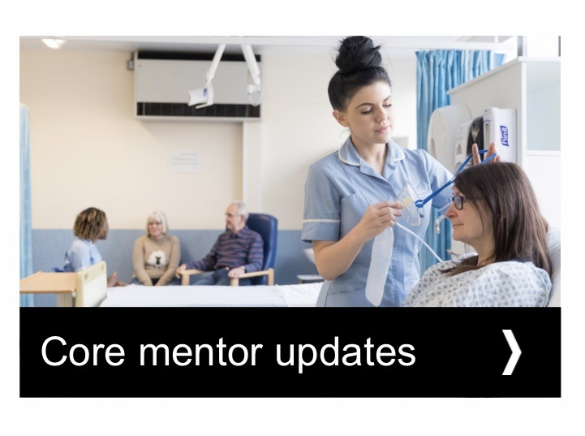
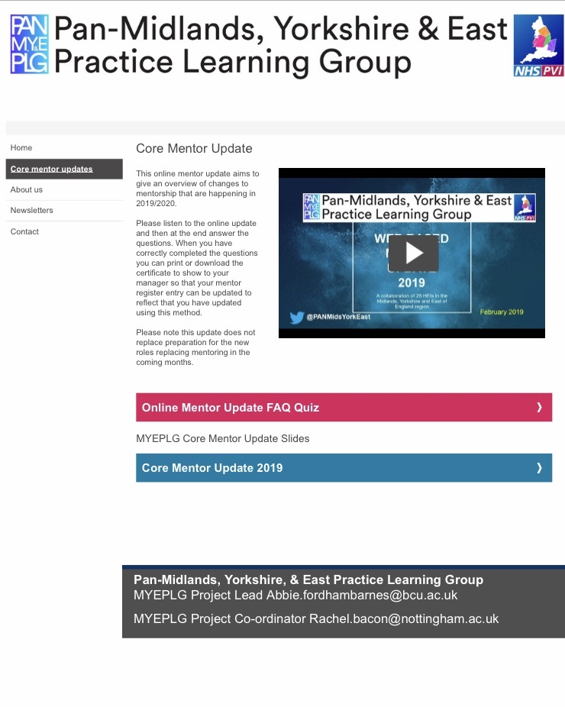
Accessing online update
You can complete your 2 yearly update online by accessing the video or slide deck then completing the questionnaire.
The MYEPLG will then email you with confirmation you have completed your update. Forward the confirmation email to whoever holds your register.

Slide 41
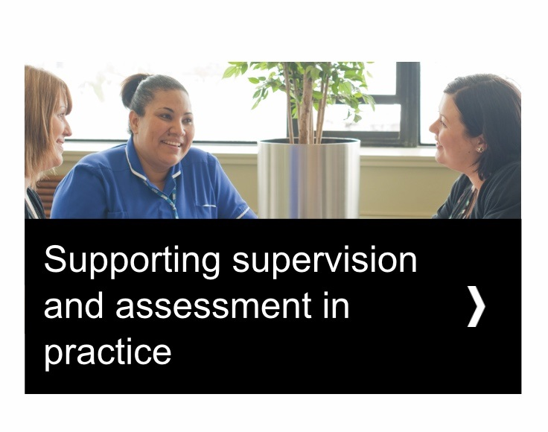
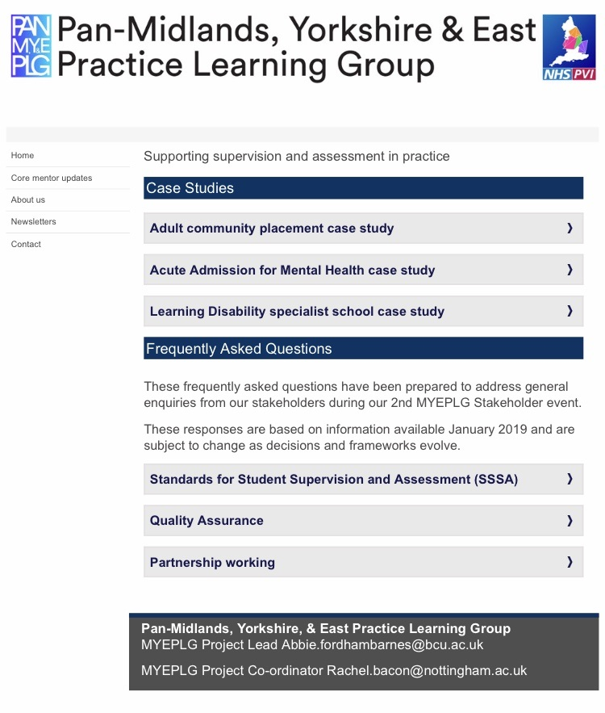
Helpful resources
In this section you can find case studies to use for team discussions and updates

Slide 42
ACTIVITY 3
Creating a supportive learning environment

Slide 43
Creating a Supportive
Learning Environment for Students
The most important part is making your student feel welcome and part of the team during their time with you. The first day is the most important one! Ensure that everyone knows they are coming and that one of the team has the time to welcome them and complete their induction and initial interview.
Promote a culture and acceptance that supporting education and placement experience is a shared expectation and responsibility for all registered healthcare professionals and not just some (HEE 2018).
Form a learning community, where students feel safe and supported and where supervisors can be approached to explore challenges and where you all learn with and from each other.
Encourage discussion, reflection and innovation.
Support development.
Ensure you have a robust induction policy for all new learners.

Slide 44
Overcoming Problems in the
Practice Learning Environment Before They Occur
One of the best ways to prevent the need to overcome problems that develop in practice is to have a comprehensive induction process.
Think of what you need in an induction plan for a learner
This may have differences from an induction for an employed staff member?
Some examples of things you might want to think about:
Does your area have an induction pack specifically for Students?
Are all members of the team aware of this? / happy to facilitate this on the students first day?
Does this have to be one of the clinical team? As students tend to arrive when your clinical staff are already seeing patients, could you involve the non-clinical team in this so that the students get to engage and work with wider members of the team and welcome the student until clinics are over?
What activities can the student do on their first morning that help them adjust to a new clinical setting?

Slide 45
Induction: Why is Workplace Culture So Important?
Workplace culture is rarely discussed at induction and transgressing it is a very common way for issues to develop between the student and other members of the practice.
It is the set of unspoken rules surrounding “How we do things around here”.
We never arrive late, we are all usually here at least 20 minutes before the surgery/handover starts
We all have our own personal mugs/ wash our own cups
If you are make a drink you are expected to offer to make one for everyone
You have to pay to use the tea & coffee
We take it in turns to bring milk to work at the start of each week
It is not fair to get annoyed or cross with a new team member unless they know what you usually like and have a chance to tell you whether it’s fair or not!
Ask yourselves what do students need to be aware of- what reasonable adjustments request are appropriate that cover work base culture without making them feel uncomfortable? I.e.- asking students to make a small contribution to the tea and coffee fund, having mugs available for students to us?

Slide 46
ACTIVITY 4
Giving Feedback, facilitating reflection and on-going development

Slide 47
Helpful information and guidance for supervisors conducting the initial interview, facilitating reflective practice and giving feedback.
The GROW model will help you construct the initial interview conversation with your student, forms the basis for reflective practice and decision making based on the opportunities available to them.
Remember your student will know what they need to achieve on their placement with you. Things to think about during the initial interview are:
Who can best support the student with specific competencies they need to achieve
What opportunities can your team provide the student with?
Are there any reasonable adjustment you need to make?
Watch this short video

Slide 48
Giving feedback
Giving feed back is an integral part of the clinical supervision process and aids the reflection of both the supervisee and supervisor.
The Principle of giving feedback:
Aims to promote insight.
NOT.
To judge or offer quick solutions
For some of us giving feedback to a struggling student can be quite anxiety provoking.
It need not be…there are ways to do it.

Slide 49
The Keys to Providing Effective Feedback
in Student Supervision
Good Communication Skills:
Good listening allows us to demonstrate that we are paying attention to the thoughts, feelings and behaviours of the other person (seeing the world through their eyes).
This is crucial to maintaining productive relationships, and sometimes the only way to establish communication.
There are five key active listening techniques you can use to help you become a more effective listener:
Pay Attention. Give the speaker your undivided attention, and acknowledge the message. ...
Show That You're Listening. ...
Provide Feedback. ...
Defer judgment. ...
Respond appropriately

Slide 50
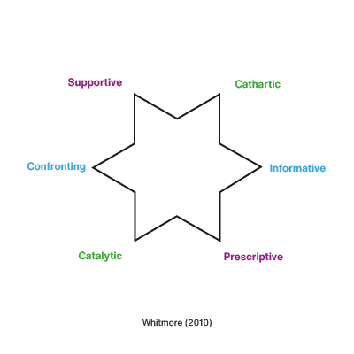
Challenging skills
Heron split these skills into two groups.
Authoritative Interventions
“Prescriptive” – You explicitly direct the person you are helping by giving advice and direction.
“Informative” – You provide information to instruct and guide the other person.
“Confronting” – You challenge the other person’s behaviour or attitude. Not to be confused with aggressive confrontation, “confronting” is positive and constructive. It helps the other person consider behaviour and attitudes of which they would otherwise be unaware.
Facilitative Interventions
“Cathartic” – You help the other person to express and overcome thoughts or emotions that they have not previously confronted.
“Catalytic” – You help the other person reflect, discover and learn for him or herself. This helps him or her become more self-directed in making decisions, solving problems and so on.
“Supportive” – You build up the confidence of the other person by focusing on their competences, qualities and achievements.

Slide 51
Encouraging Reflection
and Giving Reflective Feedback
Reflective Practice
From a humanistic perspective, reflective practice refers to professional self-reflection that includes a self-assessment of skills and strengths alongside a consideration of areas in need of further development
(Kaslow, Dunn and Smith, 2008 ).
These capacities are essential skills for the student and their supervisors as part of our on-going professional development and regulation/ revalidation with the NMC
Student Supervision focuses on working with the student as they reflect on the subjective experience of being with clients, practicing clinical skills , evidencing knowledge and their professional behaviours in the learning environment.
Student Supervision provides both the placement supervisors and the student an opportunity to promote awareness of the students on-going learning needs as well as celebrating the things that have gone well during the placement.

Slide 52
Gibbs reflective cycle
Description
What happened?
Evaluation
What was good and bad about the experience?
Analysis
What sense can you
make of the situation?
Conclusion
What else could you have done?
Action Plan
If it arose again,
what would you do?
Feelings
What were you thinking
and feeling?
(Gibbs, 1988)

Slide 53
The Driscoll model provides a framework to consider the What? So What?
and Now What? relating to a students challenging event.
What? Returning to the situation
What is the purpose of returning to this situation?
What exactly occurred?
What was your reaction?
What do you see as key aspects of this situation?
So What? Understanding the context
What were you feeling at the time?
What are you feeling now? Are there any differences and, if so, why?
What troubles you, if anything?
What are the main reasons for feeling differently from your colleagues?
Now what? Modifying future outcomes
What are the implications for you?
What needs to happen to alter the situation?
What information do you need to face a similar situation again?
What are the best ways of getting information about the situation should it arise again?
What?
So what?
Now what?
Driscoll's model of reflection Source: Driscoll, 2000, p. 52

Slide 54
https://www.youtube.com/watch?v=fWHnbCRYvbc
Watching this reflective supervision video will give you an idea of how to support a students reflection on their practice and help them work out their on-going development needs.
Click here to watch!

Slide 55
Remember that students are adult learners:
Characteristics of Adult Learners (CAL)
Adults are autonomous and self-directed
  They need to be free to direct themselves.
Adults have accumulated a foundation of life experiences and knowledge
  That may include work-related activities,
  Family responsibilities, and previous education. They need to connect learning to this knowledge/experience base.
Adults are goal-oriented
  They usually know what goal they want to attain.
Adults are relevancy-oriented
They must see a reason for learning something. Learning has to be applicable to their work or other responsibilities to be of value to them.
Adults have accumulated a foundation of life experiences and knowledge
In focusing on the aspects of a lesson most useful to them in their work.
In knowledge for its own sake. Instructors must tell participants explicitly how the learning will be useful to them on the job.
Adults are goal-oriented
Facilitators must acknowledge the wealth of experiences that adult participants bring to the classroom. These adults should be treated as equals in experience and knowledge and allowed to voice their opinions freely in class.

Slide 56
What Else You Will Need
All supervisors and assessors will require a PebblePad account with each university you take students from to be able to access and record information in the student's MYEPAD.
You should use the same username and password for each account to make it easier to remember.
There is also an app you can download which automatically directs you to the correct university's PebblePad site once you have been given the student's unique identification number.
The student providing you with their unique identification number is giving you permission under GDPR to access their information.
Your PebblePad account is your own unique electronic signature.
The app is called PebblePocket and can be downloaded for free from your app store.

Slide 57
In this section you will find:
The NMC SSSA Knowledge Test and
Work-Based Learning Assessment
You need to complete both of these
to achieve your certificate and Supervisor Pebble Pad account

Slide 58
IMPORTANT INFORMATION!
Before requesting a PebblePad account to access the students MYEPAD
You must have completed this package, passed the post course NMC SSSA Knowledge Test with a minimum score of 80% and completed your Work-Based Learning Assessment (Activity 5 Workbook) to gain your training certificate.
The Knowledge Test is completed on SurveyMonkey and responses are checked monthly. Once you receive your training certificate you can then apply to the relevant university for your PebblePad account.
The Training Hub database holder will only share your training information with the relevant universities accessing your placement area once you have signed the privacy agreement on the post training quiz form.
Pebble Pad MYE PAD access to students from the University of Nottingham.
Pebble Pad MYE PAD access to students from the University of Derby.

Slide 59
NMC SSSA Knowledge Test
To assess your learning, you must now complete our NMC SSSA Knowledge Test (via a SurveyMonkey quiz)
Link to the Knowledge Test: https://www.surveymonkey.co.uk/r/LHK62GZ
If you experience any difficulties please email alliance.hub1@nhs.net with <Your Name> - SSSA Supervisor Training in the email subject title

Slide 60
ACTIVITY 5
Work-Based Learning Assessment

Slide 61
Work-Based Learning Assessment
The Workbook for your Work-Based Learning Assessment can be downloaded from the NorthamptonshireTraining Hub website here:
Once you have completed your Workbook, please email the Practice Assessor feedback section to enquiries.nth@nhs.net
Set the email subject title as <Your Name> - SSSA Supervisor Training Activity 5 Workbook
When NTH have received your Workbook and you have passed the NMC SSSA Knowledge Test, a member of the Training Hub will email you with your certificate

