Slide 1


Professional Nurse Advocate (PNA) Programme Regional Guidance
September 2021

Slide 2
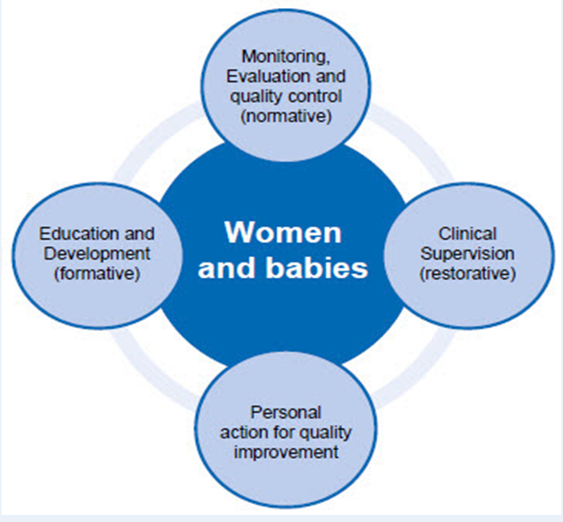

Overview of PNA
The A–EQUIP Model
A-EQUIP is an acronym for “Advocating and Educating for Quality ImProvement”
The national ambition is to implement the A-EQUIP model for nurses – the “Professional Nurse Advocate” role is crucial for the deployment of the model.
The “model” supports a culture of continuous improvement with the aim of building personal and professional resilience of the nurse, enhancing quality of care and supporting preparedness for appraisal and professional revalidation.
The A-EQUIP model is made up of four distinct functions:
Clinical supervision – (restorative supervision) aimed at supporting needs of staff and supporting the development of resilience.
Monitoring, evaluation and quality control (normative) aims to improve professional accountability and self-awareness
Personal action for quality improvement requires practitioners to recognise and contribute to the quality improvement agenda and improvements in patient care
Education and training (formative) are used to improve knowledge and skills

Slide 3
Benefits of the PNA Role
Benefits
Improved retention of Nursing & Midwifery staff
Supporting co-production
Improved professional code of conduct, reflective practice and revalidation
Meets requirements of clinical supervision stated within NHS contracts
Reduced Sickness
Improved patient experience
Positive impact on immediate wellbeing of staff
Influence a significant reduction in stress/ burnout
Improved team working/ civility
Improve compassion and job satisfaction
Professional staff voice heard
Notes:
Claire to develop

Slide 4
What is a PNA?
Facilitates the 4 functions of the A-EQUIP model
Requires additional skills, expertise and knowledge to undertake PNA role
Selected by their employer to undertake the role and has successfully completed the pre-requisite PNA training programme
The role of the PNA involves empowering registered nurses as they practice autonomously by undertaking the following:
Guiding a nurse with their clinical decision making
Facilitating a process and discussion using a reflective cycle
Acting as a role model promoting safe and effective evidence-based care for patients and their families
Providing visible clinical leadership in the workplace
Supporting nurses during challenging situations- using the restorative function of the A-EQUIP model
Advocating for patients
Assisting a nurse to create a personal action plan for quality improvement
Providing assistance and support with their clinical, professional and career development

Slide 5
The PNA in Action
Support staff well-being
Promote well-being orientated culture
Support following a traumatic or stressful event
Support to other multi-professionals
Monitoring quality improvement
Support for preceptors and students
Check-in before you go home
Revalidation/ Appraisal preparation
Team and individual sessions
Support for those returning to work following long-term sickness or maternity
Support through SI’s, performance management and critical de-briefs
Colleagues working from home

