Slide 1


SPLW Programme
By Kareema McCarthy

Slide 2

Content
What is Social Prescribing
system one
Measuring outcomes
Case study's
Working in the community
Paper work and procedures
Resources of support and courses

Slide 3
Definition of Social Prescribing Link Worker
Takes a holistic approach to people’s health and well-being
Gives people time to focus on what matters
Support people with a wide range of social and emotional needs
Mild mental health issues
Financial difficulties
Housing
Bereavement
Loneliness / isolation
Weight management
Connect people to community groups
social care/OT referrals

Slide 4
How to Refer
How to Refer?
How long is the Appointment?
Send a task
Social Prescribing
Who can refer
Patients – self-referral at reception
Receptionists
Every patient is unique some may need just 20mins others will need 1 hour.
All clinicians and community teams
For community fill in the SPLW referral form

Slide 5

Examples

Slide 6

Video
https://youtu.be/O9azfXNcqD8

Slide 7
Feedback
Link worker was supporting & understanding to my needs of not being able to open up straight away, extended appointment to accommodate and made me feel at ease to open up and gave me tools to build myself up slowly to give me something to build with. Didn't know something like this available and was insightful and very informative, would recommend to many people as gives you focus.
After losing my husband I felt very lonely and isolated and found it difficult to find groups etc to help me. By seeing Kareema I have found a lot of things I can do.
Sam Hendry Lakeside Corby was my Social Prescriber. Fantastic help. Thank you so much. If Sam can read this feedback i am really sorry I couldn't take your call today. I am doing very well. Thank you so much for your help.
What a fantastic source of support. Paula has been amazing and invaluable to me during a very difficult time. I called the surgery, in complete honesty, wanting a 'magic pill' and was initially very adverse to this route. How glad I am that months down the line I am feeling stronger and glad that medication wasn't prescribed to 'fix' me

Slide 8
Feedback
Lynsey Carson has been amazing! I always feel better after speaking with her. She took the time to research help for my transgender daughter. She signposted me to IAPT and therefore I have been able to access CBT. She has made a real difference in that whilst I still have anxiety it is much more manageable
I was extremely low when I first had contact with Caroline. She is brilliant at how see seems to know what I need. Either to listen to me when I need it or to advise when I need. I don't know how I would have got through the list few months without her. She has the time to support you. I am feeling a lot more positive than I was.
I just wanted to say a huge thank you to you and your colleagues for the volume of referrals you’ve sent our way this year. Since April Lakeside has referred more than 100 patients to the Northamptonshire Stop Smoking Service, and many of them have gone on to successfully stop smoking with our support. Lakeside is one of the top referring practices in the county, and for that we are truly grateful.

Slide 9
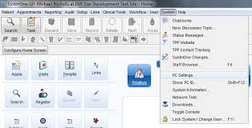
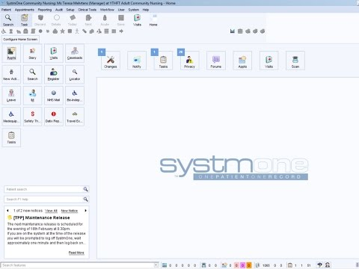
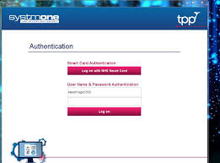
Systmone

Slide 10
Measuring outcomes
PAM
Well-being star
ONS4
SMWEB

Slide 11
Case study
35- year- old Gemma comes in today to talk about her moods, she has 2 children aged 3 and 7. Gemma tells you from the age of 11 Gemma felt anxious and shy in social settings.
Kim age 49 single mum has two children, age 9 and 12. Kim tells you she’s just lost her job, her partner left her and she is financially struggling doesn’t know where to turn to?
28-year-old Dave comes in today to tell you he has an addiction to alcohol and cocaine, wants to give up but doesn’t know how to go about it? Dave goes on to tell you that he has two children and he is a single dad, drives the kids to school on a daily basis. Dave continuing to work to support his children.
Jimmy is 25 years old; he has 2 children and a partner they live in a 1 bedroom house. Jimmy tells you he is frustrated about his housing situation, the council will not help him, when asked why he says he doesn’t know. Jimmy also tells you that he struggling with low moods, at time he takes this out on the children and his partner , when asked jimmy to clarify what he means by taking out on the children and his partner, he tells you he has hit his partner few times but he didn’t mean it.

Slide 12
Let us talk about working in the community safely

Slide 13
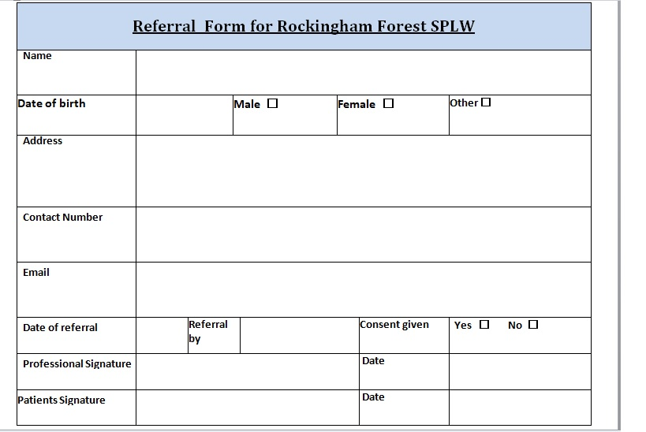
SPLW Referral Form

Slide 14
Induction week sign off
Observations with GP | Sign……………………………………. | Date………………
Observations Nurse | Sign……………………………………. | Date………………
Observations SPLW | Sign……………………………………. | Date………………
Observations HCA | Sign……………………………………. | Date………………
Observations Receptionist | Sign……………………………………. | Date………………

Slide 15
Feedback forms
Feedback form links:
https://forms.office.com/Pages/DesignPage.aspx?lang=en-US&origin=OfficeDotCom&route=Start&fromAR=1#FormId=DQSIkWdsW0yxEjajBLZtrQAAAAAAAAAAAAa__Yldb19UM1lVRU5RSUdKNjNBRUlSVkJXQVZQOFlLVy4u
https://forms.office.com/Pages/DesignPage.aspx?auth_pvr=WindowsLiveId&auth_upn=rutlander2001%40hotmail.com&lang=en-US&origin=OfficeDotCom&route=Start#FormId=DQSIkWdsW0yxEjajBLZtrQAAAAAAAAAAAAa__Yldb19UNkFZQVZXQkw3WUk4Q0kxTkhLNUVCUENQNi4u

Slide 16
Training
Social Prescribing
Awareness of Domestic Violence and Abuse Training
Understand Palliative care
Gang Related Issues and County Lines
Introduction to Mindfulness
Suicide & Self Harm Prevention
Supporting Teenagers and Young People
Awareness of Mental Health problems level 2
Working Difficulties and Disabilities
Dementia
Level 3 Safeguarding Children and adults
Level 2 Safeguarding Children and adults
Mental health first aid

Slide 17
Resources/ Training
Link below :
List of training for SPLWx21.pdf
Access to work Link:
https://www.gov.uk/access-to-work

Slide 18
References
England, N. (2019). NHS England. Supporting link workers in primary care networks. [online] NHS. Available at: https://www.england.nhs.uk/personalisedcare/social-prescribing/support-and-resources/ [Accessed 24 Sep. 2019].
Melam, S. (2019). Social Prescribing link worker. [online] NHS confederation. Available at: https://www.nhsconfed.org/blog/2019/08/social-prescribing-link-workers-aka-the-glue-in-health-and-social-care [Accessed 24 Sep. 2019].
The King's Fund. (2019). What is social prescribing? [online] Available at: https://www.kingsfund.org.uk/publications/social-prescribing?gclid=EAIaIQobChMIgP2igNDp5AIVCbLtCh1U5AKNEAAYASAAEgKe4_D_BwE [Accessed 21 Sep. 2019].

