Slide 1


Slide 2
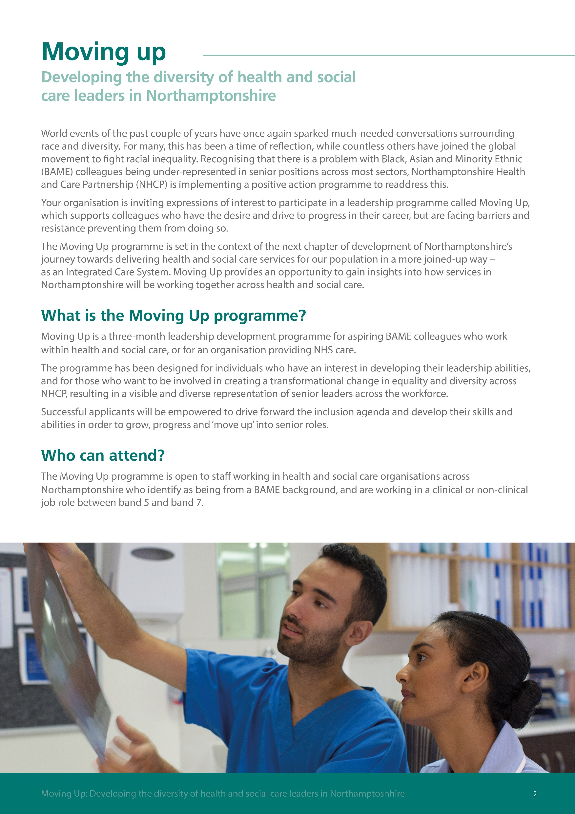

Slide 3
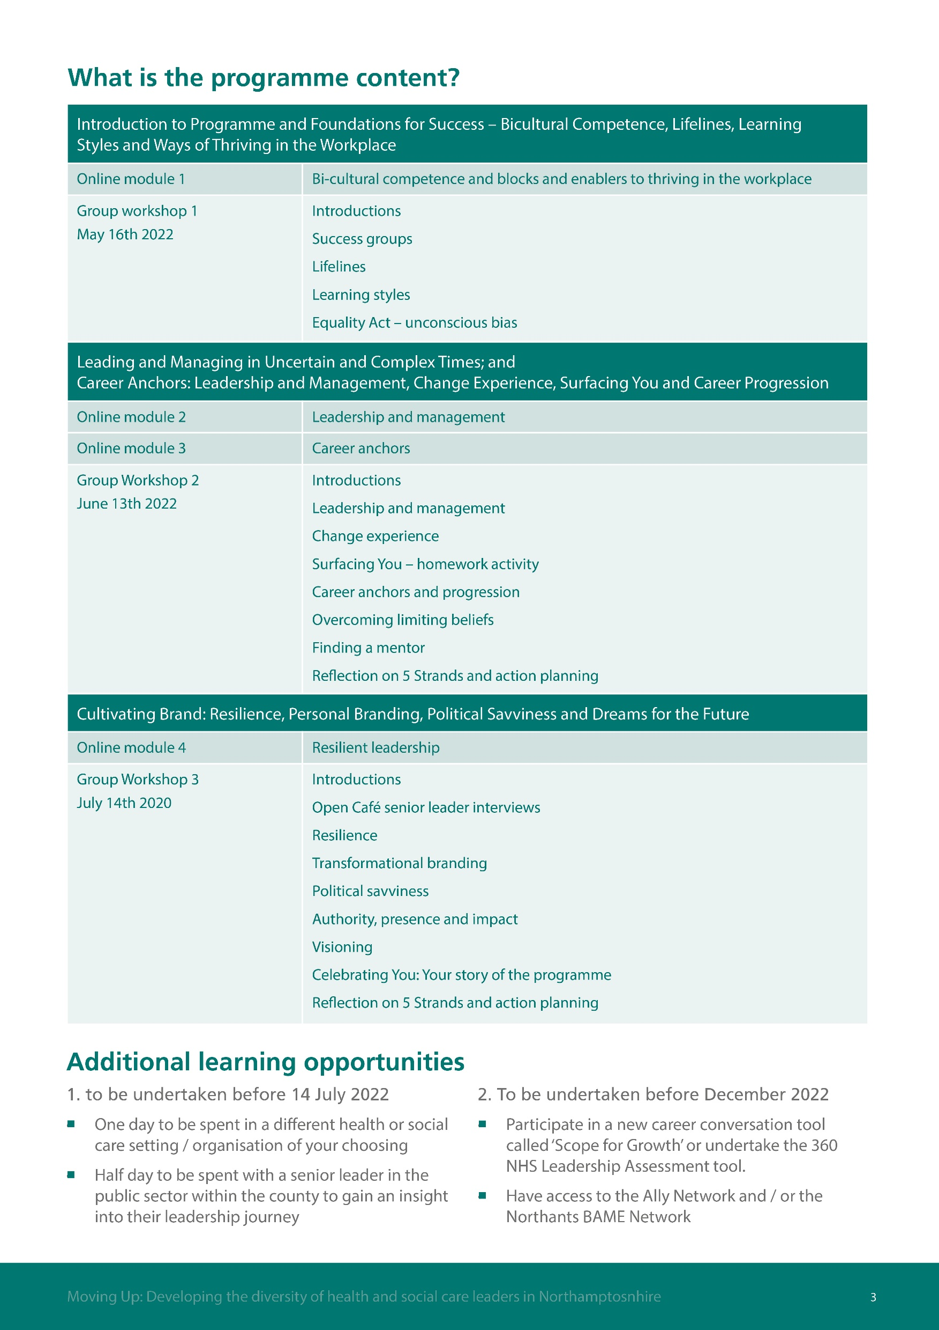

louise.bennett@nhft.nhs.uk
Applications should be completed no later than Monday 4 April 2022

