Slide 1
General Practice Referral to Community Pharmacist Consultation Service

Slide 2
What is GP CPCS?
Care Navigators formally refer patients with a minor ailment to a NHS Community Pharmacist for a consultation
CPCS is well established in Community Pharmacy across England and has been managing referrals for minor illness conditions from 111 since October 2019
267 GP Practices are live in the Midlands and 404 are engaged for implementation
A key factor for successful delivery of this new service will be good working relationships between the Practices and the Pharmacies

Slide 3
Benefits of the service
Helps patients get seen by the right professional at the right time in the right place
Frees up practice appointments to see patients with more complex needs
Builds relationships between the Practice and the Pharmacy
Protects the Care Navigator as the referral is documented in the patient’s notes
GP receives information on the consultation outcome
Gives Care Navigators a way to help patients

Slide 4
Benefits of the service cont.
6-10% of all GP and Nurse consultations can be safely transferred to a Community Pharmacist. This equates to referring up to 55 GP Practice appointments per Practice each week to Pharmacists
GP Practices that have implemented GP CPCS have seen a reduction in repeat calls, DNAs, secondary care activity and having to turn patients away because appointment ledgers are full

Slide 5
Benefits of the service cont.
Supports patients to self-manage their health more effectively with the support of Community Pharmacists
Educates patients to attend Community Pharmacy for minor ailments in the future

Slide 6

General Practice Referral to CPCS – Process
GP Reception / Care Navigation
Patient Contact Received
Simple Care Navigation Conducted
Open Referral Form In Clinical Database
Complete Form and save to EPR
Upload the received form in to Patient Medical Record
END
Call or
walk-in
Locally agreed minor ailment identification process
Using Locally agreed referral method and forms
NO
Includes an entry “Seen by Pharmacist”
GP/ IT Admin
Referral form is emailed or sent electronically to the chosen respective pharmacy
Following the locally agreed process and timescales
Pharmacy
Referral picked up. Patient is contacted by Community Pharmacist
Consultation is conducted
Consultation completed in PharmOutcomes and sent to referring Practice
Is Another Service Required?
Community Pharmacist will contact the referring Practice
YES
Phone, Face to Face or Via Video Consultation
Following Locally Agreed Process
GP Reception Manager / Team Lead
Make any further appropriate arrangements with Patient

Slide 7
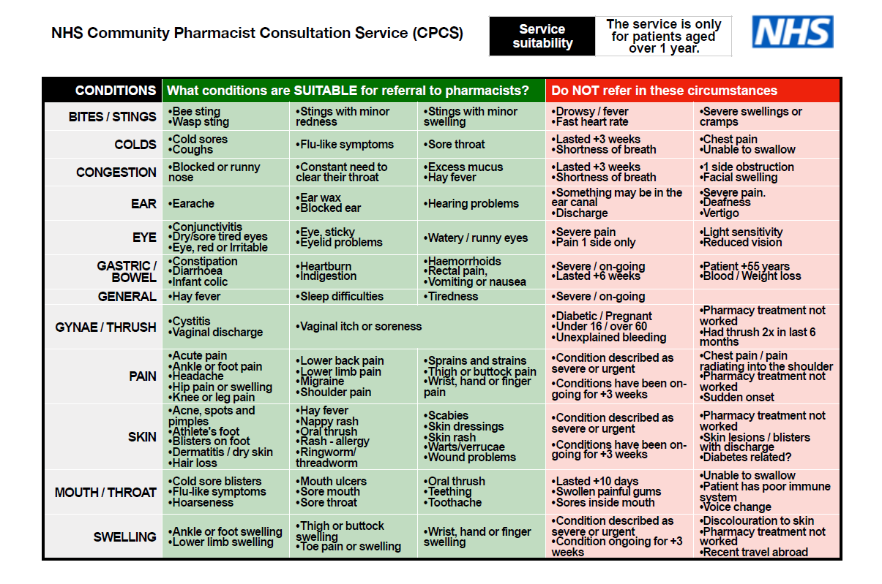

Slide 8


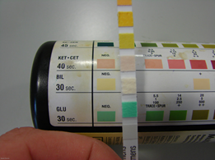


Potential outcomes from the consultation with the pharmacist
Advice only
Advice + sale of an Over The Counter (OTC) product
Advice + referred on to another NHS service
Advice + signpost
Advice + refer
Adult with sleep difficulties - during consultation patient explains recently started working shifts or new mother and discussion with pharmacist leads to appropriate advice. All consultations end with “if”.
Adult with headache - during consultation pharmacist eliminates red flags and identifies it as a tension headache. Pharmacist provides self care advice and suggests the patient buys paracetamol.
Female between 16 and 65 with a simple urinary tract infection- during consultation the pharmacist uses the Extended Care PGD.
Patient with lower back pain - during consultation pharmacist eliminates red flags and provides self-care advice to patient. Patient advised that if it doesn't resolve then they may need to see a physiotherapist and explain how to access physio services in their local area.
Young adult male with headache but during consultation explains they received a blow to the head during boxing training the day before. Pharmacist contacts GP practice using the agreed number to refer the patient back to them.

Slide 9
Electronic Referral Process
Locally, the Ardens template is being used. Guides on how to access and complete this form can be found on the Primary Care Portal
Once completed, the practice can send the referral via NHS mail to the patient’s chosen pharmacy. The address books have been updated with the pharmacy’s email addresses
The Community Pharmacist can open the attachment during their consultation and transfer the relevant information to PharmOutcomes, once completed the post event message goes back to the referring GP practice

Slide 10
GP CPCS Training Film
https://vimeo.com/565521252
Password: CPCS

Slide 11
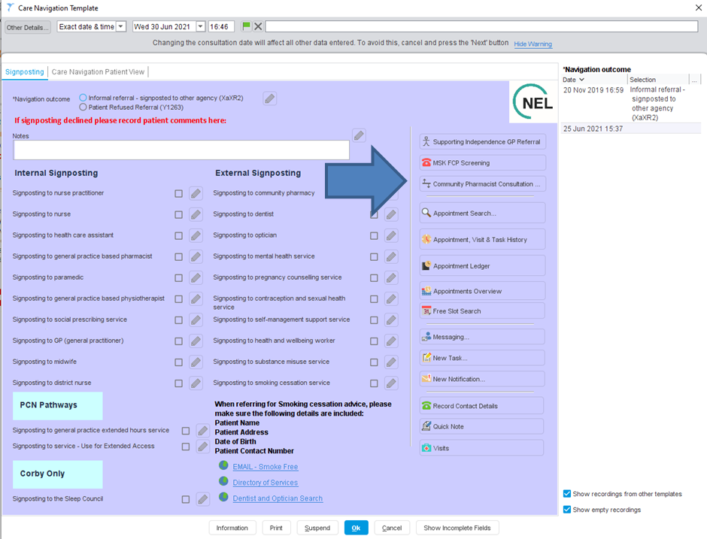

Slide 12
Emis Training Film
https://support-ew.ardens.org.uk/support/solutions/articles/31000159192-community-pharmacist-consultation-service

Slide 13
Top referring Practices
ICS Area | Practice Go Live date | Number of referrals sent | GP/Nurse time saved in Practice since go live (in hours)
Herefordshire and Worcestershire | 26/04/2021 | 764 | 114
Birmingham and Solihull | 21/06/2021 | 717 | 107
Leicester, Leicestershire and Rutland | 18/06/2021 | 710 | 106

Slide 14
Northamptonshire referrals
(as of 28/10/2021)
Agreed go-live date | Count of referrals | Practice list size | Referrals per 1000 patients | National average referral rate
01/03/2021 | 183 | 9062 | 20.19 | 7.04
10/01/2021 | 90 | 12866 | 7.00 | 7.04
11/05/2021 | 44 | 6211 | 7.08 | 7.04
21/09/2021 | 28 | 5879 | 4.76 | 7.04
19/07/2021 | 17 | 12567 | 1.35 | 7.04
16/02/2021 | 3 | 5667 | 0.53 | 7.04
25/07/2021 | 2 | 14202 | 0.14 | 7.04
21/01/2021 | 1 | 11726 | 0.09 | 7.04
20/06/2021 | 1 | 6828 | 0.15 | 7.04

Slide 15
Northamptonshire
Working group
Tablet Press Extras
Primary Care Bulletin
LPC newsletter
Locality Meetings
PCN Pharmacist meeting
Care Navigation champions
Including in Care Navigation training
Future PLT training session
Resources available on Primary Care Portal

Slide 16
Next steps for
PCNs and General Practices
Make contact with PCN Community Pharmacies
  Advising that the Practice will be implementing GP CPCS
  Advise when they should expect to see referrals from
  Agree which conditions to refer first (some or all)
  Agree testing to build confidence and test the pathway
  Agree how Community Pharmacists can contact Practices when they have a patient who needs to be referred back to a GP (preferably a back office line and not asking the patient to call again)
  Agree a post implementation review meeting date to iron out any wrinkles that arise in the first few days/weeks of implementation
  Email addresses set up with Pinnacle

Slide 17
Next steps for Reception/Top tips
Visit the GP CPCS area of the Primary Care Portal https://gp.northamptonshireccg.nhs.uk/medicinesoptimisation/gp-cpcs.htm
Discuss with your Practice
  Implementation plan and go-live date
  Conditions (some or all)
  Time of day
Print key documents and ensure they are in the best place for you and your team
Test referral process

Slide 18
FAQs
What if a Pharmacist escalates patients back to the Practice unnecessarily?
  Discuss at the review meeting, speak directly to the Pharmacist or inform your local or regional GP CPCS Lead
The Pharmacy have a Locum and are saying they can’t provide the service today
  The service has to be provided all hours so this is not an acceptable reason. Please discuss with regular pharmacist and inform your local GP CPCS team
Some of my pharmacists haven’t been opening their referrals?
  If you have a specific problem, either call the pharmacy, the PCN Community Pharmacist Lead or us

Slide 19
Local contact details
CCG Medicines Optimisation Pharmacist:
Arti Chauhan
arti.chauhan@nhs.net
CCG Assistant Primary Care Development Manager:
Olivia Williams
olivia.williams16@nhs.net
Local Pharmaceutical Committee Chief Officer:
Anne-Marie King chiefofficer@pharmacynorthamptonshire.co.uk

Slide 20
Any questions?

