Slide 1
Improving Health Outcomes for People with Learning Disabilities
Presented by Michelle martins &nyasha KANHUKAMWE

Slide 2
SUBJECTs OF INTEREST
Definition of LD
Health Risks Prevalent in People with Learning Disabilities
Annual Health Checks
Health Action Plans
Communication
Reasonable Adjustments and Equality Act
Mental Capacity Act and Liberty protection safeguards
Useful Resource for LD

Slide 3
Background information
Over the years there has been an increase of premature deaths recorded for people with learning disabilities
Confidential Inquiry into the deaths of people with learning disabilities (CIPOLD) established in 2010 ​
Learning from Lives and Deaths People with a Learning Disability - LeDer
Notes:
They were established by the government to look into the deaths of people with learning disabilities. Their aim is to drive improvements in the equality of health and social care for people with LD and to reduce premature mortality and health inequalities.​
According to The 2018, Learning Disabilities Mortality Review (LeDeR) the median age at death for men was 60 and for women was at 59(ages between 4 and over who died April 2017-December 2018).This is significantly less than the median age of 83 for men and 86 for women in the general population.​

Slide 4
What is a learning disability?
​The Department
The Department of Health defines it as: “a significant reduced ability to understand
new or complex information, to learn a new skill (impaired intelligence), with a
reduced ability to cope independently (impaired social functioning), which started
before adulthood.”
Please also see below a link to further information from CTPLD
https://www.youtube.com/watch?v=WmI_Ceh5S_A
Impaired Intelligence
Impaired Social Functioning Low IQ < 70
Started before adulthood
About 1.5million people in the UK have a learning disability according to Mencap

Slide 5
INTELLIGENCE QUOTIENT (IQ)
A person with an IQ of less than 20 would be described as having a profound Learning Disability.​
A person with an IQ of 20-34, would be described as having a severe learning disability.​
A person with an IQ of 35-49, would be described as having a moderate learning disability.​
A person with an IQ of 50-70, would be described as having a mild learning disability.​

Slide 6
Questions to consider | Yes | No
Did person attend any special schools or were they statemented in mainstream school? Do they have an educational health care plan?
Is there a diagnosis of a learning disability/mental handicap in any notes? IQ under 70 (please refer to read code list of definite and potential diagnosis of a learning disability)
Is the person known to the Learning Disability Service?
Is the person under the care of a consultant psychiatrist for learning disabilities?
Has anyone ever told the person that they have a learning disability?
Did the person achieve qualifications at school?(GCSE at low grades could indicate LD but high grade GCSE, A Levels or university education then LD is not likely
How does the person function in society? Does the person need support with activities of daily living? Tell me what you do during the day. Does this indicate that they require support to undertake daily living activities?
Does the person need help to read i.e. appointment letters or other official letters?
Does the person have problems with simple numerical calculations? (i.e. “If I gave you £5 to buy milk. Milk costs £1.50 – how much change would you have left?)
Does the person need assistance with transport? (unable to get around independently?)

Slide 7
These conditions alone do not constitute a Learning disability
•Autism Spectrum Disorder​
•Cerebral Palsy​
•Stroke​
•Mental illness​
•Brain tumours​
•Chronic alcohol use​
•Substance abuse​
•Acquired brain injury​
•Infection of the brain or of the covering of the brain and spinal cord (meningitis)​
Someone with Asperger's may not have a learning disability
Notes:
Although people with a learning disability may experience these as well as their learning disability.

Slide 8
What is A LEARNING DIFFICULTY
DYSLEXIA
DYSPRAXIA
DYSCALCULIA
ADD OR ADHD
AUDITORY PROCESSING DISORDER
(INFORMATION /STIMULATION OVERLOAD)
Notes:
Although people with a learning disability may experience these as well as their learning disability.

Slide 9
Health Risks prevalent in people with ld
Epilepsy
Constipation
Swallowing Issues
Gastro-intenstinal
problems
Underweight
&
overweight
Dementia
Respiratory including aspiration pneumonia

Slide 10
Other health risks relevant to people with ld
Continence​
Oral/Dental health​
Mobility issues​
Screening for cervical/breast/testicular/bowel cancers​
Hearing and visual problems​
Immunisations​
Medication and side effects​
Higher risk of developing Diabetes
Eating and drinking problems including special diets
Cardiac conditions
Thyroid conditions
Notes:
Constipation or incontinence. Some medications can effect dental health.

Slide 11
Annual Health Checks
Provides an opportunity for a systematic enquiry of potential signs, symptoms and potential risks to health and for health promotion activity.
Who is eligible for AHC ?
Anyone above the age of 14 who is on a GP LD Register is eligible for an AHC once every year.
They are important to identify conditions that need to be investigated and treated at the earliest opportunity
What happens during an AHC?
A physical health check is conducted Discuss with the patient or carer about staying health and accessing screening
There are Two Annual health check templates available to use – Ardens and TPP tool are both accessible on Systm One and Emis, there is also an EMIS template
Notes:
Physical check- bloods and urine samples, weight, heart rate,blood pressure etc
Discuss health issues that are more common if a person has a learning disability​

Slide 12


Annual Health Check Templates
EMIS
SYSTM ONE
Or ARDENS
All these templates cover the required sections as per Enhanced Service Contract

Slide 13
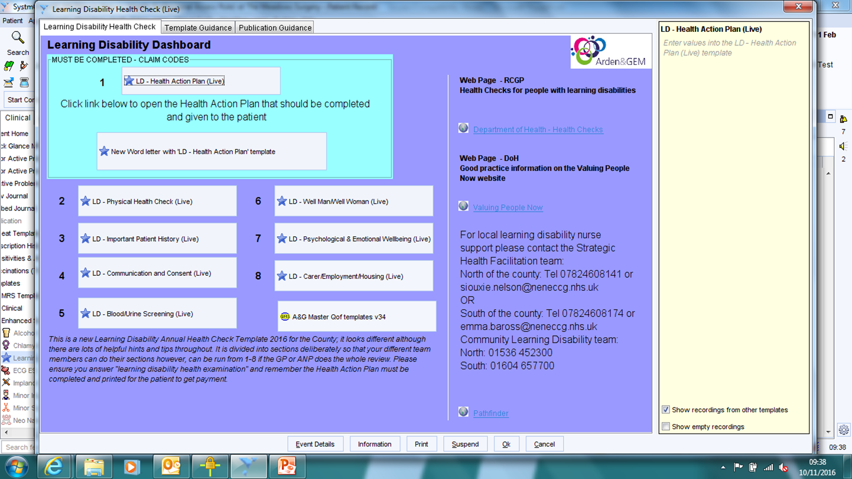
Templates

Slide 14
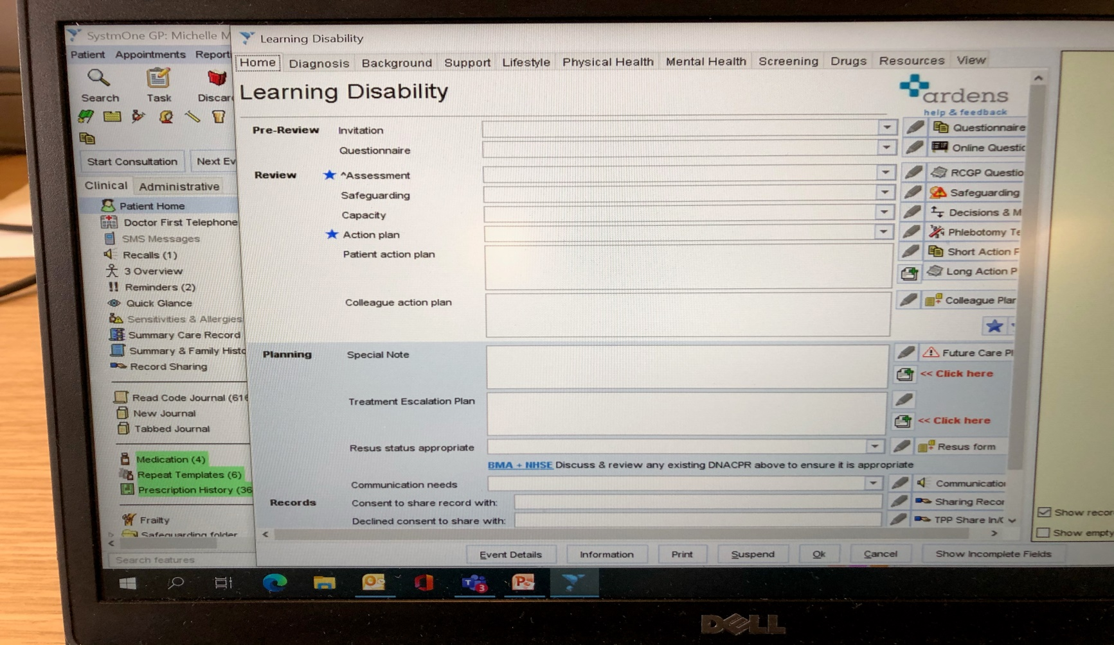
Templates

Slide 15
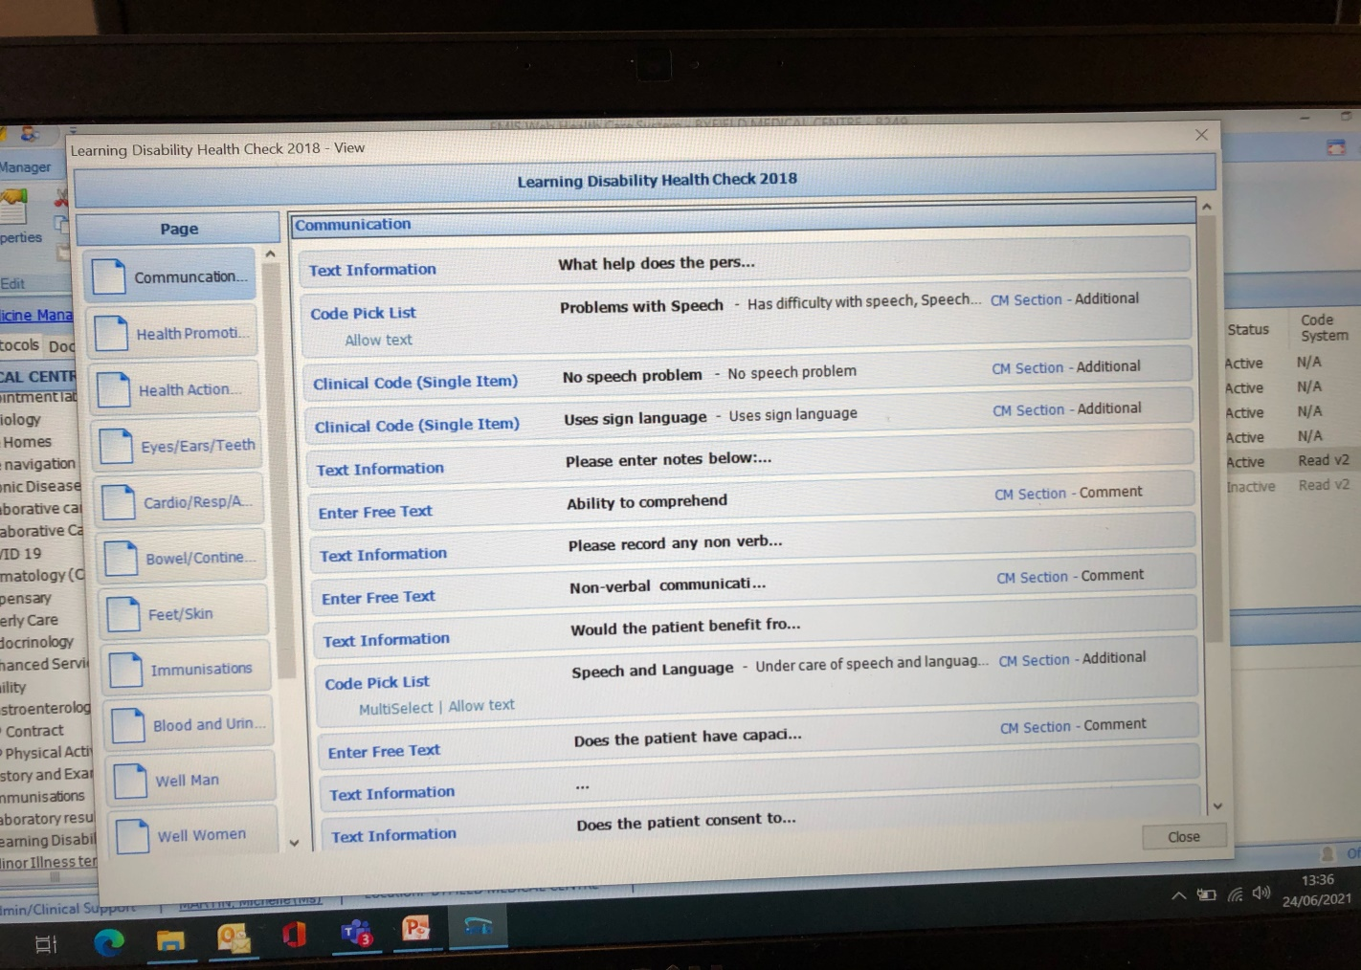
Templates

Slide 16
Annual Health Checks
They are a systematic review of the patients physical and mental health.
A yearly holistic assessment of the person’s medical needs.
Both the Arden ,Emis and TPP template allow you to carry out a top to toe assessment
All templates take in to consideration specific conditions that can experienced by people with a learning disability
An initial invitation letter can be sent out with a checklist of questions related to the template used
If the person is unable to read – the initial checklist could be completed by way of a telephone call.
The annual health check could be completed in one appointment or over a few appointments.

Slide 17

Top to toe assessment
Eyes – glasses worn? Last optician appointment?
Ears – Any hearing problems? Tinnitus, aids worn, referral to audiology – any wax build up.
Any dental issues – last visit to dentist?
Any eating and drinking problems – appetite
Any cough when eating, swallowing problems
Any reflux/ abdominal pains
Bowel and bladder issues
Foot care – seeing a podiatrist/ referral to foot clinic?
Circulation
Mobility
Height and weight to measure BMI

Slide 18
Other areas to be considered in the Annual Health Check
Mental health needs
Discuss Lifestyle choices/ family circumstances
Does the person have a care provider?
Do they have an occupation?
Support the person and family/carers to develop a health action plan
Review of medication – antipsychotic medications can have numerous side effects such as :-
                Weight gain
                Heart problems
                Low BP
                Osteoporosis
                Parkinson’s type symptoms

Slide 19
HEALTH ACTION PLANS
They are Person centered plans (PCP) that are devised by the patient and with their GP, nurse or another health professional as well as family and carers.
They identify patients health needs and specific targets that need to be achieved.​
The role of the GP and the primary care team is integral to HAPs in terms of providing and updating information, and in meeting primary healthcare needs.​
Health action planning is a shared responsibility and each agency or professional is expected to play a role.
Health action plans can be written in easy read format – link below:-
https://www.easyhealth.org.uk/​ They offer a wider variety of easy read leaflets​
They are a summary of identified actions from carrying out the annual health check.
Notes:
Review medication and side effects​
Explain any current health problems​
Checks to see if the person has any other health appointments​
Enquire if the family/carers are getting the support they need.​

Slide 20
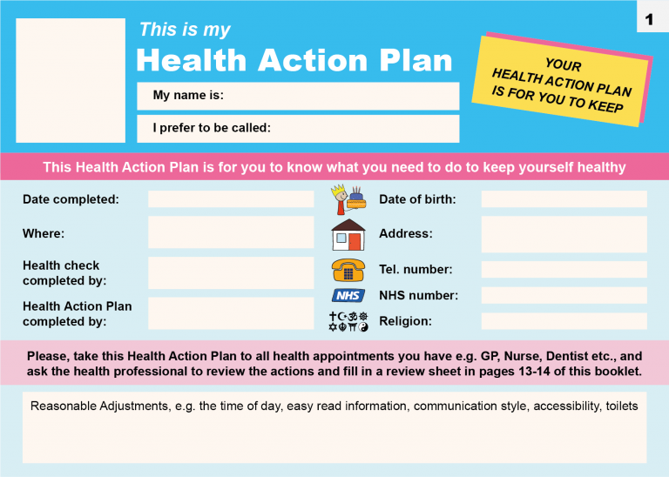
Health action plan

Slide 21

Active listening!
(Listen with your Eyes)

Slide 22
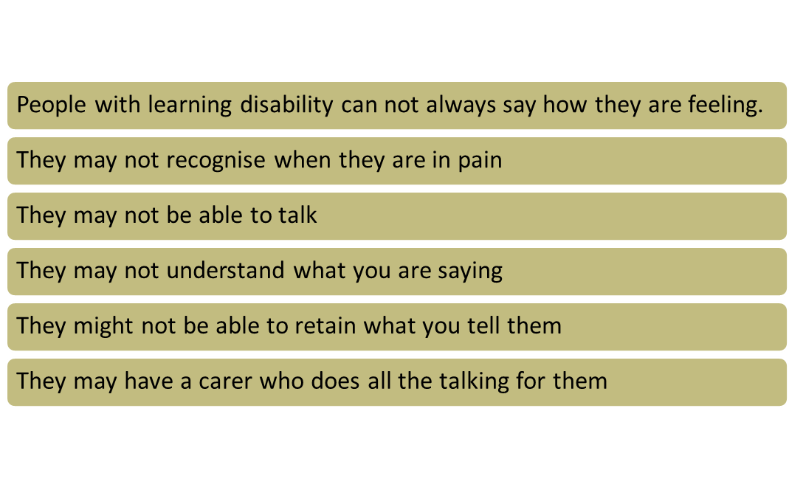
Communication difficulties for people with LD

Slide 23

Don’t be Dr Gobbledegook!
Notes:
Play video straight from you tube site as hyperlink does not work.

Slide 24

How you can help to support better communication

Slide 25
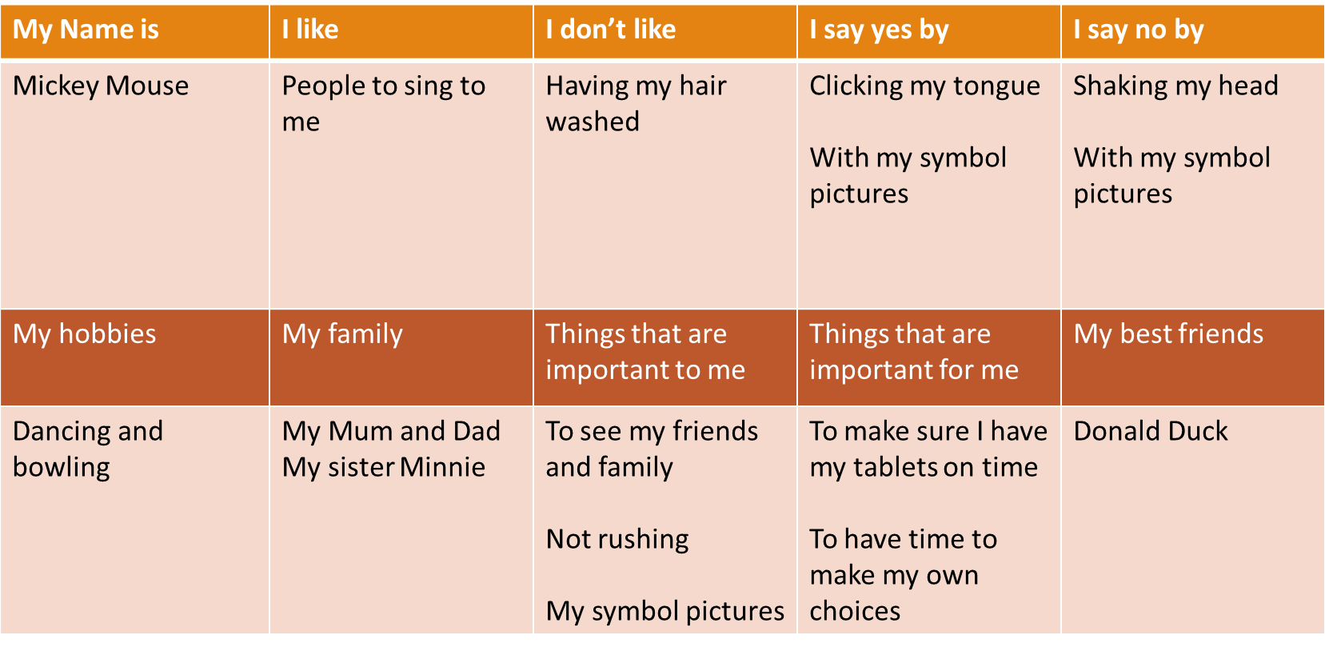




Do they have a communication passport?

Slide 26


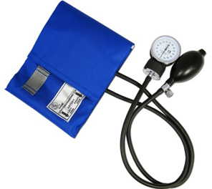

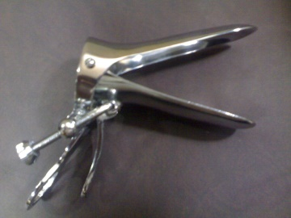



Present information in an accessible format
Easy Read
Objects of reference
Health Check
Date
Time
Doctor
Notes:
Also Makaton and intensive interaction

Slide 27


Allow more time
Break it down

Slide 28

Don’t use Jargon or complex medical terms
HTN
C.V.A
AAA
T2DM
PE
CKD
MI
CABG

Slide 29

Observe Body Language
Flinching when touched
Facial expressions
Appearing withdrawn
Increase in behaviours
Decrease in usual behaviour
Lethargy

Slide 30

Overshadowing
Don’t put any change in behaviour just down to their Learning disability.
All changes in behaviour are for a reason

Slide 31
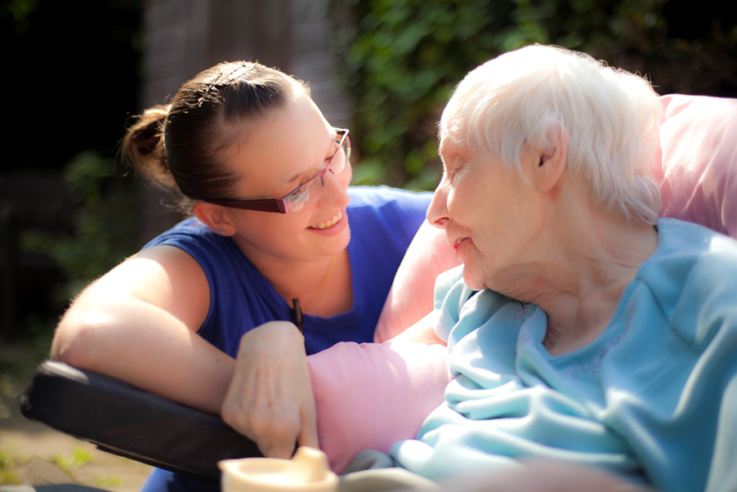
Build a rapport with your patient and their family or carers.
Listen to the people who know the person with a learning disability well
Talk to the person with a learning disability too. Even if they can’t speak.
Check the person with learning disability and/or their carer has understood

Slide 32
Equality Act 2010
It is against the law to discriminate someone in relation to:-
Age
Gender reassignment
Being married or in a civil partnership
Disability
Race
Religion
Sex
Sexual orientation

Slide 33
In relation to learning Disability
Reasonable adjustments need to be put in place to allow your patients the access they need to your service:-
Wheelchair access for those with a physical disability
Easy read invitation letters to appointments ( available in different languages)
Offering priority appointments so there is less waiting around
Longer appointment times
Considering the lighting – some people may have sensory overload
Offering appointments at less busy times
Having handrails to hold onto in the corridors or appointment rooms
Sending out reminders for appointments

Slide 34
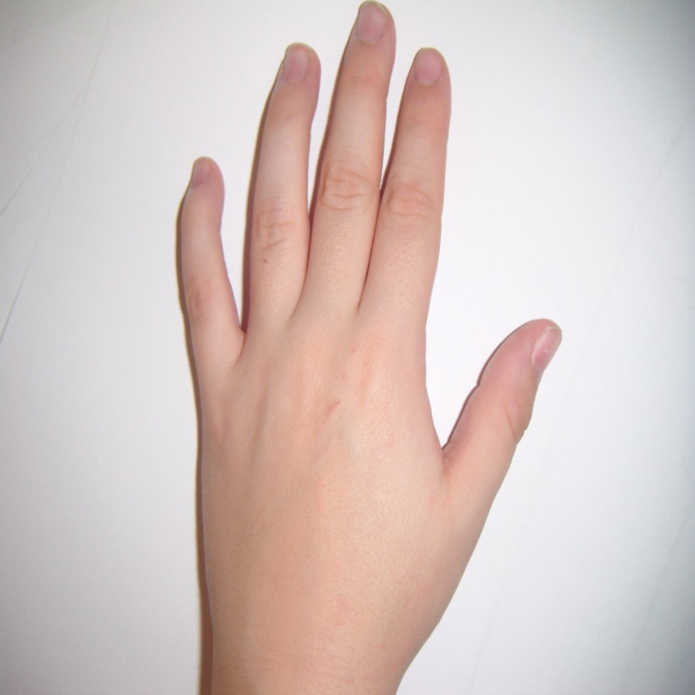
Mental Capacity Act
Five principles
Use the least restrictive practice
If the person has capacity they can make their own choices, even if it is an unwise choice
Always act in the person’s best interest
Provide information in an accessible format to allow the person to make their own choices
Assume the person has capacity unless proved otherwise
Notes:
Don’t assume that the person is not able to make their own decisions just because they have a learning disability.
Provide the person with as much information as possible in a format they are most likely to understand and give every opportunity practicable for them to make their own choices.
The person has the right to make their own decisions, even if we might think the decision they are making is not a wise decision. If they have capacity, the decision is their’s alone.
For those who lack capacity, then any decision made on their behalf should be within their best interest. This should be an MDT decision and not just based on one person’s opinion.
Always choose the option that is the least restrictive for that individual.

Slide 35
Assessment of Capacity
Assessment of capacity should be related to the particular decision to be made at that particular point in time.
Two Stage Capacity Assessment
The Diagnostic approach
Does the person have an impairment or disturbance of the functioning of the mind or brain?
The decision Making process
Does the person understand the information regarding the decision?
Can the individual retain the information long enough to make a decision?
Does the individual understand the implications of their decision?
Can the person communicate their decision to you?

Slide 36
Best Interest decisions checklist
Consider whether the person will ever have capacity to make the decision.
Involve the person who the decision is about.
Have regard for previous wishes in relation to the decision
Consult those who are involved in the care of the individual
Do not make assumptions in relation to age, appearance, condition or behaviour.
Do not make a decision based on a desire to bring about death in relation to life-sustaining treatments.
Use a multi-disciplinary approach if possible
If the person does not have a carer, or someone who can speak on their behalf, consider an independent mental capacity advocate
Take account of Advanced decisions and Lasting power of attorney for welfare.

Slide 37
Liberty protection guidelines
Where a person lacks capacity, any treatment carried out must be necessary and proportionate.
Any act that deprives the person of their liberty must use the least restrictive option.
Three assessments will form the basis of the liberty protection safeguards:-
Capacity assessment
Medical assessment
A necessary and proportionate assessment
Those involved in the care of the individual MUST be consulted
Consult those with a vested interest in the person’s welfare
The role of the approved mental capacity professional, where needed.
Now extended to 16 and 17 year olds.
Also now applies in domestic settings such as the person’s own home.
Notes:
MCA does not apply to anyone held under the Mental Health Act – which is a separate piece of legislation.
The approved mental capacity professional becomes involved, for example where someone may need to be treated in a placement they may not wish to reside in.

Slide 38
USEFUL INFORMATION- Acute Liaison Nurses
Northampton
Kettering
Northampton General Hospital ​
Debbie Wigley
tel:01604545431;
mob:07725496888;​
email:debbie.wigley1@nhs.net​
​Supports acute staff when working with people with a learning disability > reasonable adjustments​
​A&E Hospital Grab sheet/hospital passport​
​If you stipulate on your referral letters to secondary/tertiary care that the individual has a learning disability this should then alert the acute LD nurses and reasonable adjustments should be made prior to​ individual arriving wherever possible.
Kettering General Hospital ​
Leanne Farmer
tel:01536491241;
mob:07966775169;​
email: leanne.farmer@nhs.net​
​Supports acute staff when working with people with a learning disability > reasonable adjustments​
​A&E Hospital Grab sheet/hospital passport​
​If you stipulate on your referral letters to secondary/tertiary care that the individual has a learning disability this should then alert the acute LD nurses and reasonable adjustments should be made prior to individual arriving wherever possible​
​

Slide 39
Learning Disability Health Facilitators
Michelle Martin
LD Strategic Health Facilitator
Transformation and Delivery
NHS Northamptonshire Clinical Commissioning Group
Corby Enterprise Centre/Priors Hall/Corby/NN17 5EU
Frances Crick House/Summerhouse Road/Moulton Park/Northampton/ NN3 6BF
TEL: 01604 651283
EMAIL: michelle.martin60@nhs.net
MOB: 07775542305
Nyasha Kanhukamwe
LD Health Facilitator
Transformation and Delivery
NHS Northamptonshire Clinical Commissioning Group
Corby Enterprise Centre/Priors Hall/Corby/NN17 5EU
Frances Crick House/Summerhouse Road/Moulton Park/Northampton/NN3 6BF
TEL: 01604 651283
Email: nyasha.kanhukamwe@nhs.net
MOB: 07775412745

Slide 40
Community team for people with a learning disability
SOUTH CTPLD​
Campbell House, Northampton, ​
NN1 3EB​
Tel: 01604 657700​
•​
•Community LD Nurses, Psychiatry, Psychology, SALT, Physiotherapy, Occupational Therapy.​
•​
•Work with adults and children with learning disabilities and require a health intervention​
•​
•Referrals for children are now sent to a Referral Management Centre​
​
SOUTH CTPLD

Slide 41
COMMUNITY TEAM FOR PEOPLE WITH A LEARNING DISABILITY
NORTH CTPLD
North CTPLD​
•Carey Suite, St Mary’s Hospital, London Road, Kettering, NN15 7PW​
•Tel: 01536 452300​
•​
•Community LD Nurses, Psychiatry, Psychology, SALT, Physiotherapy, Occupational Therapy.​
•​
•Work with adults and children with learning disabilities and require a health intervention​
•​
•Referrals for children are now sent to a central point instead of the CTPLD​
​

Slide 42
OTHER USEFUL CONTACT
Sue Freeman: Sue.freeman5@nhs.net Learning Disability Commissioner Northamptonshire CCG​ ​
Dr Tom Howseman​: Tom.Howseman@nhs.net​
GP Clinical Lead (LD, Dementia & MH: job share portfolio 2session/wk),​
Julie Lee: Julie.Lee@westnorthants.gov.uk Commissioning & Quality Outcomes Manager Learning Disability & Autism, West Northamptonshire Council | One Angel Square | Angel Street | Northampton | NN1 1ED Tel: 07841784962| www.westnorthants.gov.uk
Fiona Steinhardt: Fiona.Steinhardt@northnorthants.gov.uk Commissioning, Quality and Outcomes Manager Learning Disabilities and Autism, North Northamptonshire Council One Angel Square | Northampton | NN1 1ED T:07912891750 Twitter: @NNorthantsC Facebook: @NorthNorthants www.northnorthants.gov.uk

