Slide 1

Continuous Glucose Monitoring
The expanding role of continuous glucose monitoring in glycaemic management in
primary care.
Northamptonshire
November 2022
Notes:
Intro

Slide 2
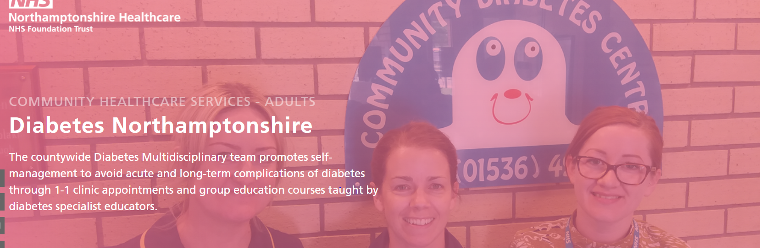
Referrals diabetes.northants @nhs.net

Slide 3
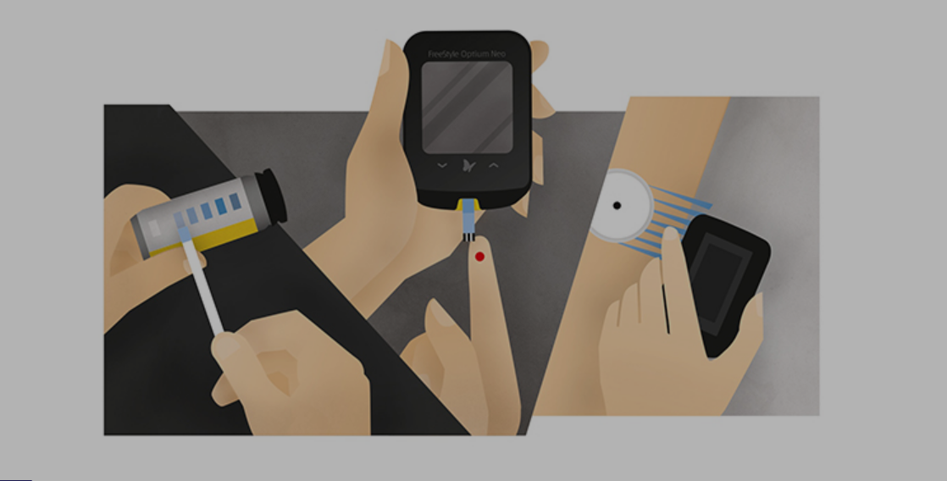
1960 1980 2016
Notes:
Glucose testing began as far back as 1925, when eight drops of urine were mixed in a test tube with 6 cc of Benedict’s solution and put into boiling water for five minutes¹. The colour of the liquid would indicate how high the sugar content was. The late 1940s saw a major improvement in this crude methodology with the introduction of the “dip-and-read” urine test (Clinistix), allowing instant monitoring of blood glucose levels³.
The biggest benefit of using CGM or Flash is gaining better insight into your blood glucose levels so you can adjust your strategies for better glucose management. For people living with diabetes, these solutions mean fewer finger-prick testing, more insight and more peace of mind.

Slide 4
What is CGM
Monitoring of glucose levels is essential to effective diabetes management. Over the past 100 years, there have been numerous innovations in glucose monitoring methods. The most recent advances have centred on continuous glucose monitoring (CGM) technologies
Improving technology and decreasing cost have increased the uptake of use of continuous glucose monitoring (CGM) for glycaemic management in primary care
Notes:
Continuous glucose monitoring refers to the activity of constantly measuring blood sugar levels 24-hours a day – either in real-time or retrospectively. This is achieved with the help of wearable technology called a continuous glucose monitor (CGM).
A CGM device has three parts: a sensor (worn on the arm or belly), a wireless transmitter and a display device. The display device could be a handheld reader, a mobile phone or even an insulin pump monitor.
A CGM works by measuring the amount of glucose in your interstitial fluid – the fluid between your cells. Unlike a finger-prick test, the blood glucose reading from your interstitial fluid has a slight delay. However, the biggest advantage of CGM is that it tells you what your current levels are, where they have been and whether they are trending up or down. This allows you to make informed decisions about what action to take, if any.

Slide 5

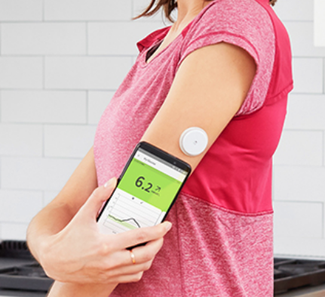
A continuous glucose monitor is a wearable device that measures blood sugar, or glucose. Because it is attached to your body, it takes measurements throughout the day and night, and you can view the results on a device, such as a smartphone.
Continuous glucose monitors (CGMs) were developed for people with diabetes to help them monitor and manage changes in blood glucose levels.

Slide 6
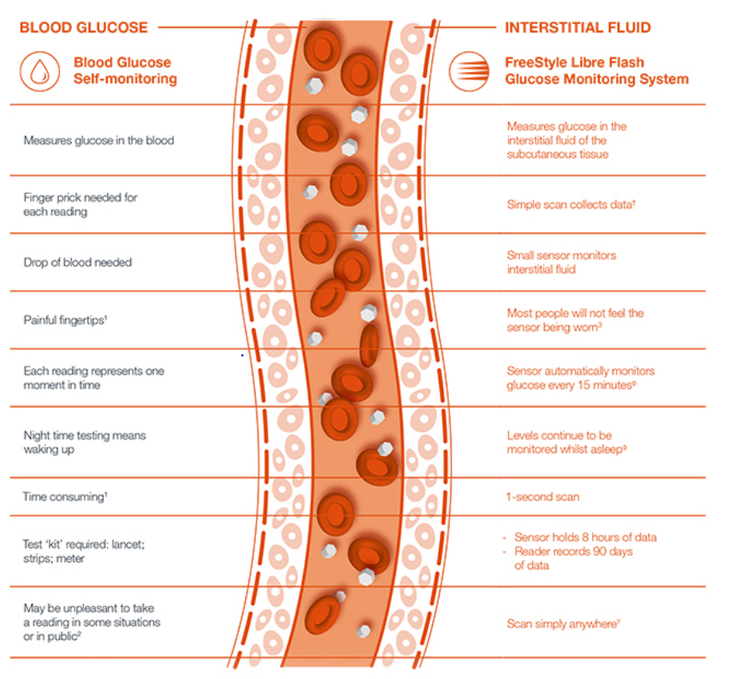

Slide 7

NICE Updates
The latest updates to the NICE NG17 and NG28 guidelines recommend wider access to real-time continuous glucose monitoring (rtCGM) and intermittently scanned CGM (isCGM, commonly known as “flash”) for people living with diabetes.
Historically, these types of technology were limited to some people with type 1 diabetes, who received support from specialist teams in secondary care. However, the updated NICE guidance recommends that all people with type 1 diabetes and some people with type 2 diabetes using multiple daily insulin injections be offered this technology.
Notes:
NICE has published updated guidelines for clinicians and commissioners about how to manage type 1 diabetes in adults, and type 1 or type 2 diabetes in children and young people.
The NICE guidelines recommend that people with type 1 diabetes be offered a choice of intermittently scanned glucose monitoring (otherwise known as ‘flash’) or real-time continuous glucose monitoring (CGM) on the NHS.
Will all people with type 1 diabetes be able to access CGM or flash on the NHS?
A: Yes, in time – at the discretion of your healthcare team. For those with type 1, there are no longer any criteria to meet to access CGM and Flash.
(NG28 type 2 diabetes in adults: management) • Offer intermittently scanned continuous glucose monitoring (isCGM) to adults with type 2 diabetes on multiple daily insulin injections if any of the following apply: - they have recurrent or severe hypoglycaemia - they have impaired hypoglycaemia awareness - they have a condition or disability (including a learning disability or cognitive impairment) that means they cannot self-monitor their blood glucose by capillary blood glucose monitoring but could use an isCGM device (or have it scanned for them) - they would otherwise be advised to self-test at least 8 times a day.

Slide 8

NICE NG28 recommendations on offering continuous glucose monitoring to people with type 2 diabetes. Offer intermittently scanned continuous glucose monitoring (isCGM), or real-time CGM (rtCGM) if it is available for the same or lower cost, to adults with type 2 diabetes on multiple daily insulin injections if any of the following apply:
They have recurrent hypoglycaemia or severe hypoglycaemia.
They have impaired hypoglycaemia awareness.
They have a condition or disability (including a learning disability or cognitive impairment) that means they cannot self-monitor their blood glucose by capillary blood glucose monitoring but could use a CGM device (or have it scanned for them).
They would otherwise be advised to self-measure at least 8 times a day. Offer CGM to adults with insulin-treated type 2 diabetes who would otherwise need help from a care worker or healthcare professional to monitor their blood glucose.

Slide 9
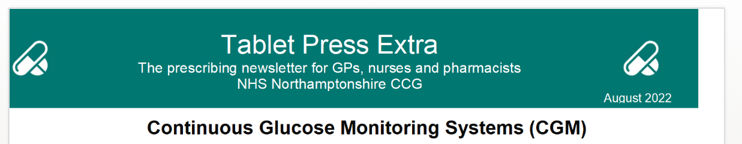
Which patients can be prescribed CGM?
Currently patients should only be considered for CGM if they fit within one of the following cohorts:
Patients with Type 1 diabetes and
¨ already performing ≥ 8 SMBG (self-monitoring of blood glucose) per day
¨ HbA1c ≥8.5% (69mmoL/moL) or disabling hypoglycaemia. (This is in line with criteria for pump therapy as in NICE TA151; a successful trial of continuous glucose monitoring may avoid the need for pump therapy)
¨ recent onset of impaired awareness of hypoglycaemia. (CGM may reduce hypoglycaemia)
¨ frequent admissions (> 2 per year) with DKA or hypoglycaemia
¨ those who require third parties to carry out monitoring and where conventional blood testing is not possible (e.g. mentally or physically unable to undertake blood glucose testing)
¨ women who are trying to conceive.
¨ patients with learning disability and Type 1 or 2 Diabetes who are prescribed insulin
¨ any patient with any form of diabetes on haemodialysis and on insulin treatment
¨ any patient with diabetes associated with cystic fibrosis on insulin treatment
¨ any patient with Type 1 diabetes for whom the specialist diabetes MDT determines that occupational/psychosocial circumstances warrant a trial of CGM monitoring.

Slide 10
Type 2 Diabetes
Dexcom One, GlucoRx AiDEX and Freestyle Libre 2 currently are not currently routinely commissioned for patients with Type 2 diabetes.
For patients with Type 2 diabetes who are on insulin and who have difficulty using blood glucose test strips or who have severe or problematic hypoglycaemia a prior approval request may be submitted by the GP DMDT .

Slide 11
Types of CGM
Specialist rtCGM –
Not available on FP10
Specialist or Secondary care initiation
Supply chain only. - Speciality features appropriate for specific clinical conditions or compatibility with certain CSII devices
Dexcom G7
Dexcom G6
Guardian 4
Libre 3
FP10 rtCGM and Flash
Available on FP10
All have optional low and high glucose alerts - No compatibility with CSII devices - All devices have sharing capability for HCP’s but not all offer sharing with relatives/carers
Libre 2
Dexcom One
GlucoRX Aidex
Notes:
A CGM device is always working and recording your blood sugar levels – whether you’re awake, asleep, eating or exercising. There are several types of CGMs available with different features that work with the blood glucose data that is collected 24 hours a day. Some special features might include:
You can typically programme alarms for when your blood sugar goes too high or too low.
You might be able to share your data with a family member or partner and programme alarms in case your blood sugar goes too high or too low (this is especially helpful in the case of monitoring your child).
You can download the data onto a computer or tablet to easily see trends and patterns in your levels.
You can use your smartphone instead of an additional reader.

Slide 12

Benefits to patients
24/7 glucose Monitoring​
Comfortable & Easy to Wear​
Glucose results on phone smart watch or reader
No Calibration​
Readings Every 5 Minutes​
Customizable Alerts and Notification
Real Time Alarms​
Hi / Lo BG Alert​
Waterproof​​
Access and analyse glucose readings from any web browser
Notes:
Continuous glucose monitoring refers to the activity of constantly measuring blood sugar levels 24-hours a day – either in real-time or retrospectively. This is achieved with the help of wearable technology called a continuous glucose monitor (CGM).
A CGM device has three parts: a sensor (worn on the arm or belly), a wireless transmitter and a display device. The display device could be a handheld reader, a mobile phone or even an insulin pump monitor.
A CGM works by measuring the amount of glucose in your interstitial fluid – the fluid between your cells. Unlike a finger-prick test, the blood glucose reading from your interstitial fluid has a slight delay. However, the biggest advantage of CGM is that it tells you what your current levels are, where they have been and whether they are trending up or down. This allows you to make informed decisions about what action to take, if any.

Slide 13
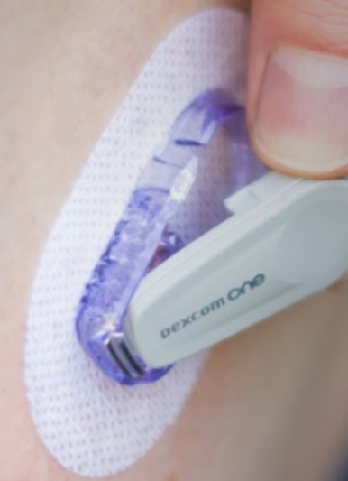
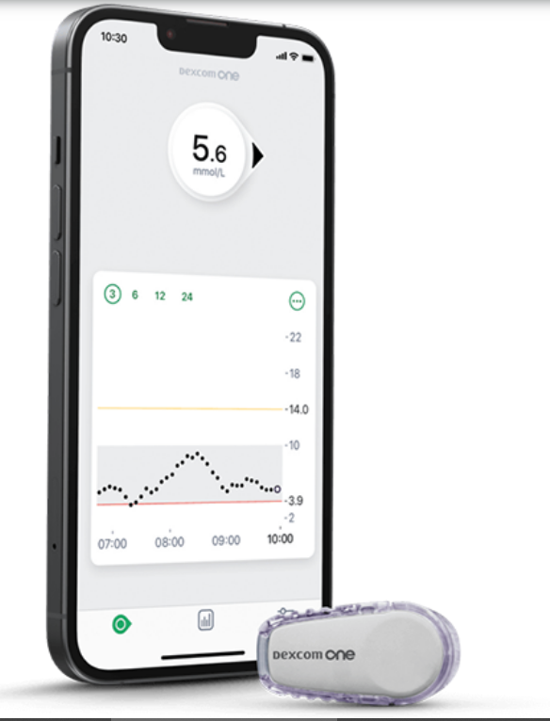
Dexcom One
The glucose sensor can be worn up to 10 days and has a slim profile, making it nearly invisible under clothing.
Notes:
Dexcom One and GlucoRx AiDEX are new CGM systems that like Freestyle Libre 2 can be prescribed on FP10. It was previously recommended that Freestyle Libre 2 should only be prescribed in primary care following the Diabetes Multidisciplinary Team (DMDT) advising that the patient had attended training session on using the device and advice on the aims of monitoring. However it has been agreed that since there is now considerable experience in primary care with Freestyle Libre that these devices can now be initiated in primary care.

Slide 14
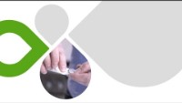

Slide 15
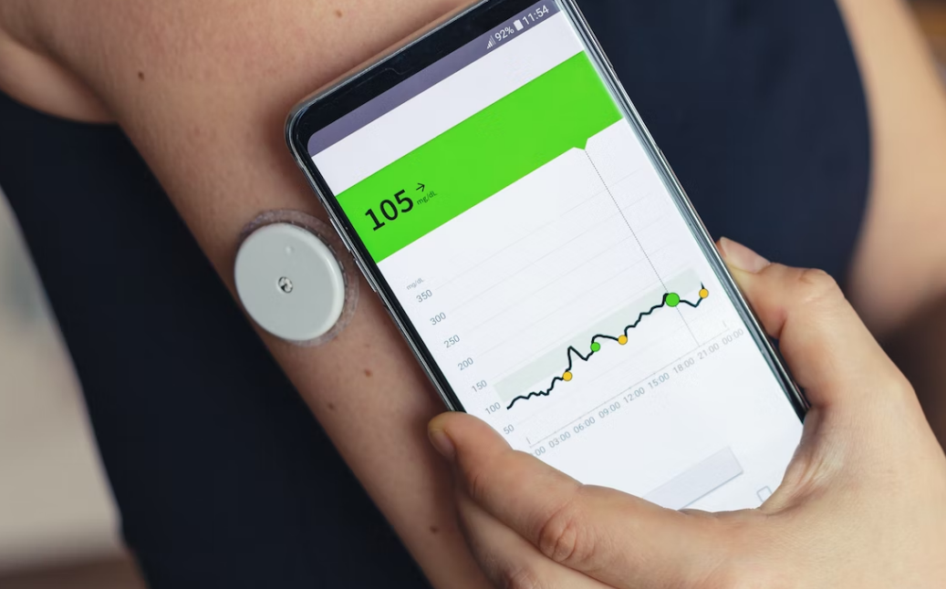
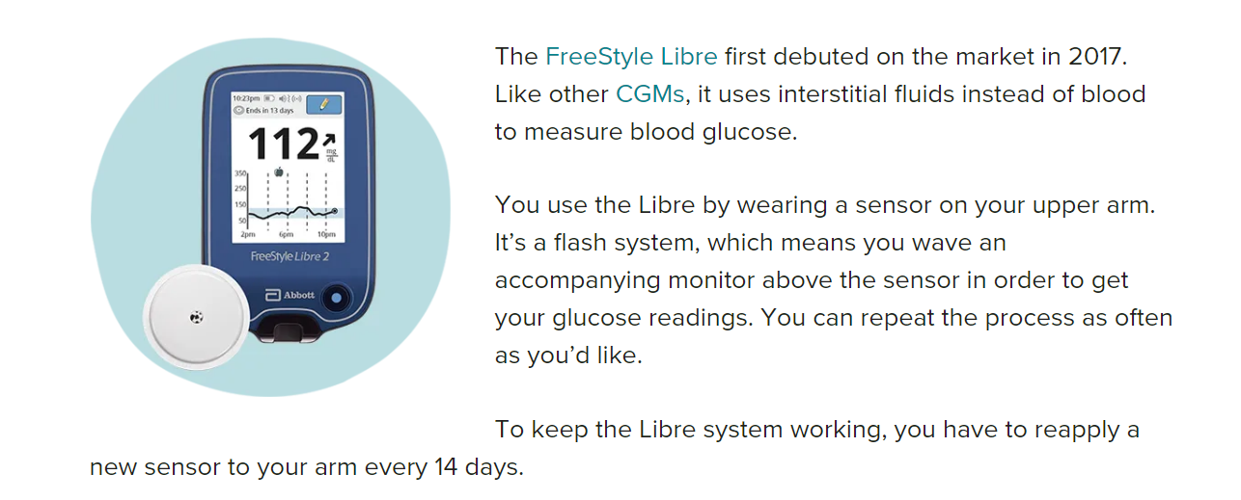
Freestyle Libre 2
Notes:
Libre 2 is

Slide 16
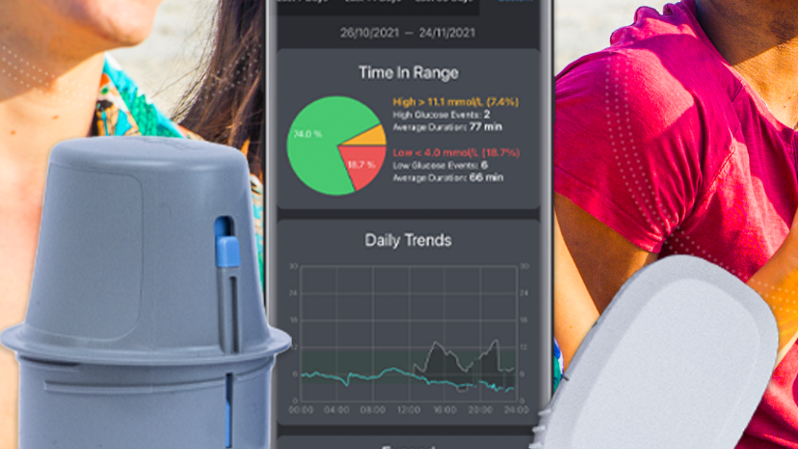
Gluco Aidex

Slide 17

Benefits to clinicians
Patients with intensive insulin therapy may benefit more from CGM/is-CGM
CGM was more effective at reducing HbA1c compared with usual care
Connected care Simple upload, clinician can access data remotely Clear, easy-to-read reports
CGM/is-CGM improves TIR, TAR, or TBR over usual care.
Reduce hypoglycemia events
staff/patient satisfaction is high.
Notes:
How effectiveness of continuous glucose monitoring (CGM) vs self-monitoring of blood glucose (SMBG) in maintaining glycaemic control among people with type 1 diabetes mellitus. Findings from RCT have demonstrated CGM is superior to SMBG in improving glycaemic control among individuals with type 1 diabetes in the community, especially in those with uncontrolled glycaemia. Individuals with type 1 diabetes with HbA_{1c} >64 mmol/mol (>8%) are most likely to benefit from CGM.

Slide 18
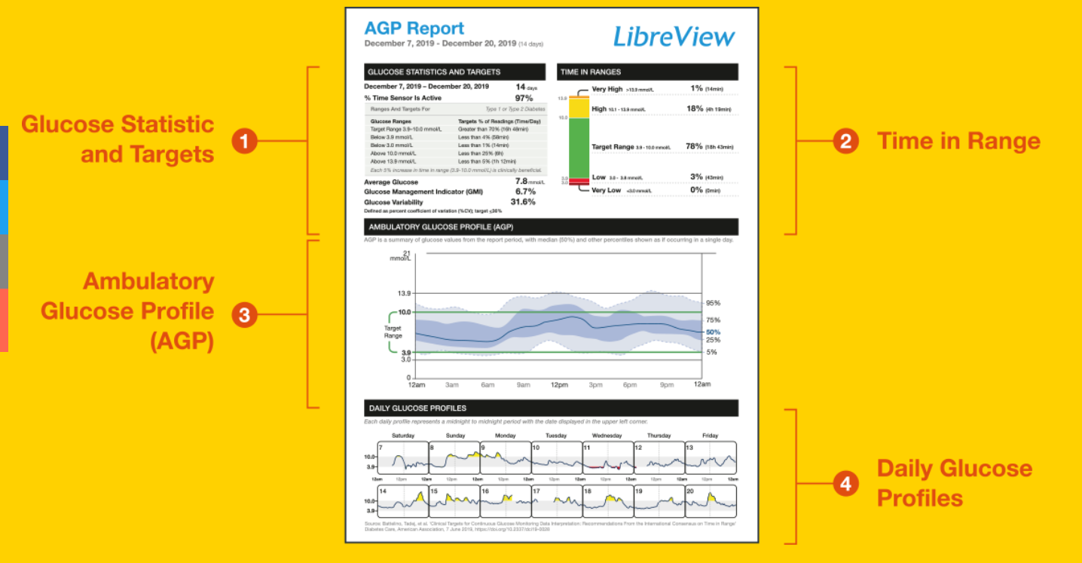
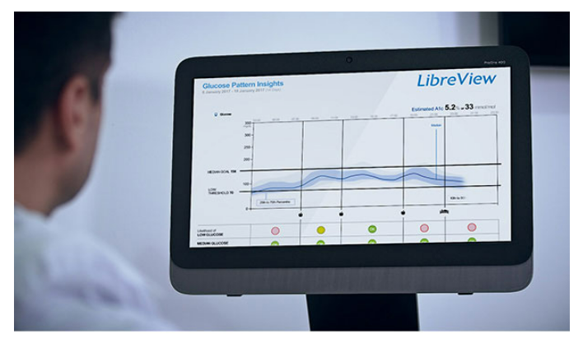

Slide 19
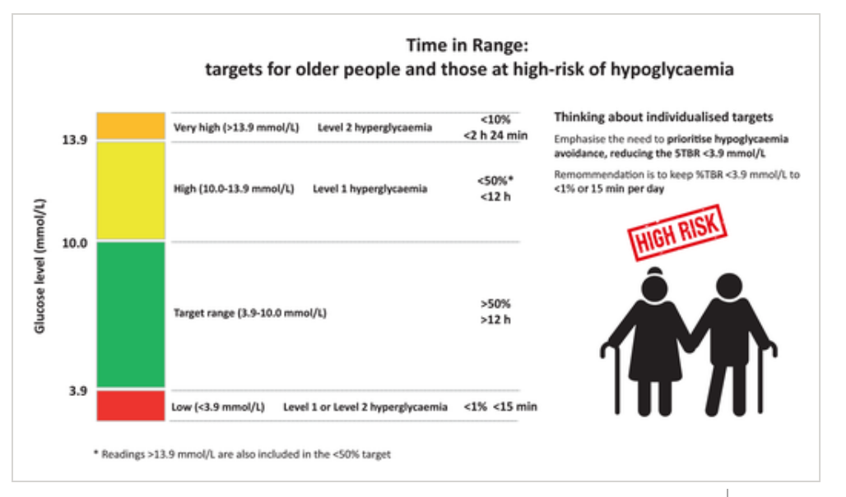
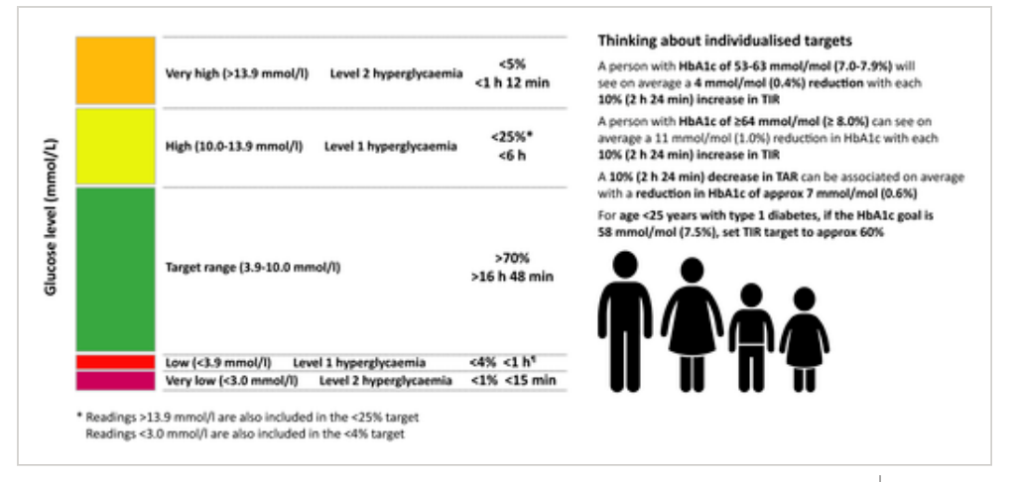
Time in Range

Slide 20
With the change in guidance, primary care will play an increasing role in the initiation and prescribing of these technologies. This inevitably creates a need for healthcare professionals to increase their knowledge and confidence around these technologies
 | Flash and CGM education pack for primary care now available Healthcare professionals working in primary care can increase their knowledge of and confidence in flash glucose monitoring and continuous glucose monitoring (CGM) thanks to a new suite of resources. They have been put together by the award-winning EDEN&nbsp;(Effective Diabetes Education Now) www.edendiabetes.com

Slide 21
HCP Resources
Information on the updated NICE Guidelines can be found on our HCP website.
Training for HCP's on Dexcom ONE and how to get your patients started on Dexcom ONE can be found on the HCP website
Upcoming Webinars for healthcare professionals from Dexcom can be accessed and registered for here Dexcom Webinars
Information on how to set up Glooko for your Clinic
As well as the wealth of information on our healthcare professional website there is a dedicated Pharmacy FAQ page that is particularly helpful for Dexcom ONE
The Patient Care specialist team can be contacted on ukie.pcs@dexcom.com
You can find all the resources you need to get your patients started on Dexcom ONE, ‘Get Started Decks’ and ‘Patient handouts’ on our clinic resources page

Slide 22
CGM Educational Resources
For those NEW to rt-CGM, Eden have developed an excellent
Education pack for Primary Care
Glooko Academy is an excellent education platform for diabetes technology, certified by the Association of British Clinical Diabetologists (ABCD) and can be accessed . Modules you may find beneficial include:
Continuous Glucose monitoring
Continuous Glucose monitoring in pregnancy
Virtual consultation
Trend Diabetes has a comprehensive set of resources to support nurses and other HCPS’s working in Diabetes and can be accessed

Slide 23
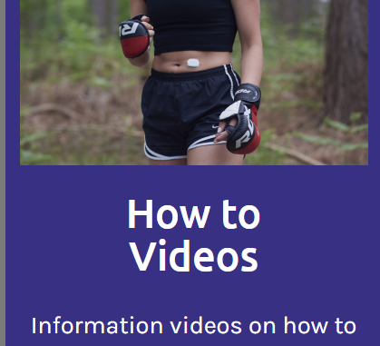
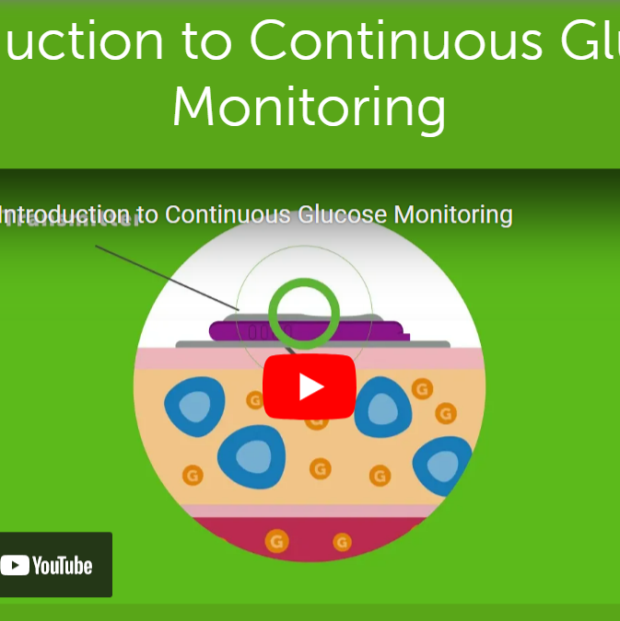
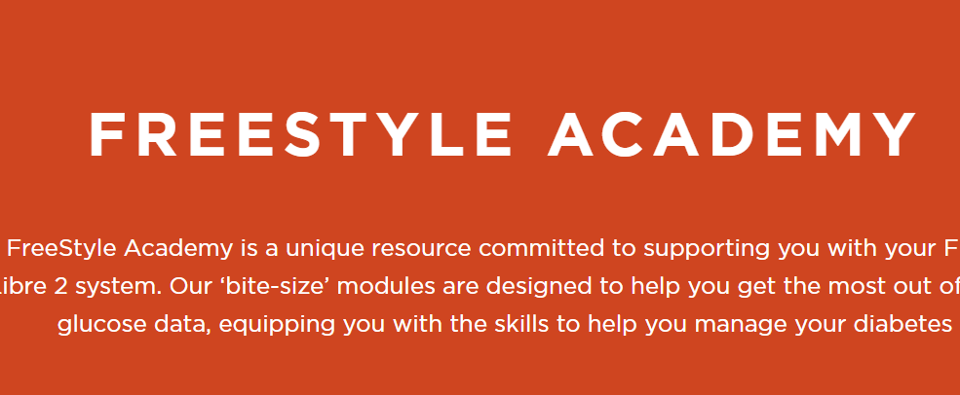
Patient resources

Slide 24
Questions ?

