Slide 1
TARGET Antibiotics
“There are few public health issues of potentially greater importance for society than antibiotic resistance”
2013 CMO Prof Dame Sally Davies
www.rcgp.org.uk/TARGETantibiotics
Notes:
1. The top part of this notes section is for presenters to use during the workshop, and can be used verbatim or paraphrased.
Extra notes below contain extra background information about the evidence base for the information on the slides and details about the references quoted, or how to obtain particular information or resources.
Underlined notes are instructions.
If you want to use the voice over at any time please make sure your laptop or PC has functional speakers and they are not on mute.
While you are waiting for staff to arrive it is really useful to get them to think about their current antibiotic prescribing practice by
getting them to complete the self-assessment checklist available at Antibiotic stewardship tools, audits and posters: Self-assessment checklist (rcgp.org.uk) (see slide 2)
Giving them the TARGET patient leaflet to look at (available at Leaflets to discuss with patients: How to use these leaflets (rcgp.org.uk) )
Print out and ask the group to consider and chat about some of the case studies in the presentation.
Lets begin!
Slide one presenter notes:
Although this quote from Dame Sally Davies is now 9 years old, it is still as relevant today and it was in 2013. U. Next slide.

Slide 2
Workshop agenda
Context and background of antimicrobial resistance
Improving our antibiotic prescribing
  Strategies and resources
  Evidence for using the TARGET resources
  Clinical scenarios
The link between antibiotic prescribing and resistance in your patients
Benefits of reducing antibiotic prescribing on AMR and on patient consultations
www.rcgp.org.uk/TARGETantibiotics
Notes:
Presenter notes:
The aims of this workshop are to discuss with you, using clinical scenarios, the need for optimising antibiotic prescribing, by showing you the:
evidence that there is a link between antibiotic prescribing and resistance in GP patients
how reducing antibiotic prescribing can not only reduce antibiotic resistance, but also patients’ future expectations for an antibiotic and a consultation.
We will also discuss and share materials and strategies (and the evidence behind them) that can help us together with our hospital and veterinary colleagues improve our antibiotic prescribing

Slide 3
Workshop Outcomes
By the end of this workshop you should have a clear understanding of…
The consequences of antimicrobial resistance and the role we all play in contributing to, and addressing AMR
The TARGET toolkit and how it can support you - where to find it and how to use it
What you, and your practice, can do to help tackle AMR safely and responsibly
Coding, back-up prescriptions & TARGET leaflets
www.rcgp.org.uk/TARGETantibiotics
Notes:
Presenter notes:
By the end of the workshop today you should have a clear understanding of;
The consequences of antimicrobial resistance and the role we all play in contributing to, and addressing AMR
The TARGET toolkit and how it can support you - where to find it and how to use it
What you, and your practice, can do to help tackle AMR safely and responsibly
The value of using appropriate SNOMED/Read codes
And have started to think about/create an action plan of how you can implement changes in your practice to help tackle AMR

Slide 4
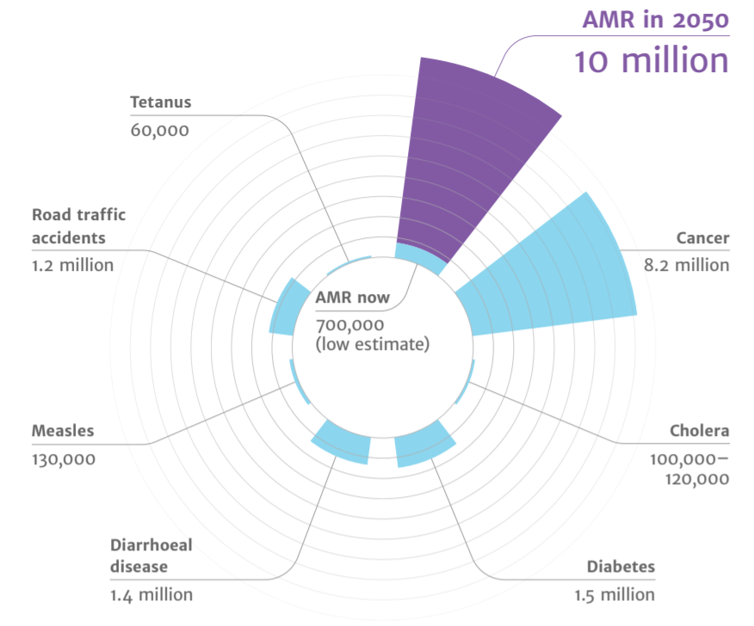
Deaths attributable to AMR each year
Context
AMR
2050
Diabetes
and cancer
combined
AMR in 2050
10 million
Tetanus
60,000
10,000,000
Road traffic accidents
1.2 million
9,700,000
Cancer
8.2 million
AMR now
700,000
(low estimate)
Cholera
100,00 – 120,000
Measles
130,000
Diarrhoeal disease
1.4 million
Diabetes
1.5 million
(O ’Neill, 2015)
Notes:
There is much information out there about the threat and consequences of antimicrobial resistance but lets just put that into context. A recent UN report (April 2019) highlighted that by 2050, AMR could kill 10 million people per year, in its worst-case scenario.
https://amr-review.org/sites/default/files/Antimicrobials%20in%20agriculture%20and%20the%20environment%20-%20Reducing%20unnecessary%20use%20and%20waste.pdf

Slide 5

The Iceberg of Gram Negative Resistance
Carbapenemases<2%
ESBL
Some resistance
Sensitive
www.rcgp.org.uk/TARGETantibiotics
Notes:
Presenter notes:
On a daily basis we see the results of multi resistant infections, but they are only the the tip of the iceberg; there is much resistance hidden within the community setting.
7% of the general population in England in a 2014 stool collection survey carried Extended beta lactamase producing E.coli in their gut
And we are seeing this across the globe, “Pakistani authorities recently reported a new strain of typhoid, which was resistant to the last affordable oral antibiotic in the area”. Prof Claire Chandler, LSHTM
And you all know from your daily practice that antibiotic resistance in UTIs is increasing to trimethoprim, even though these organisms may not be multiresistant

Slide 6
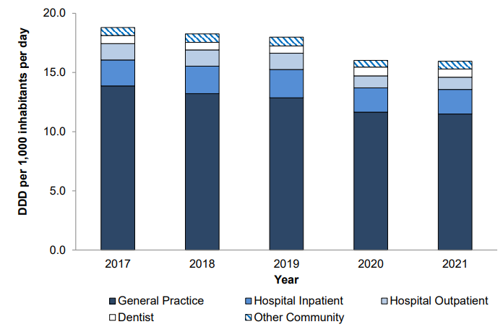
UK prescribing: 72.1% of antibiotics are prescribed in the community
ESPAUR Report 2021-22
(ESPAUR Report, 2021-22)
Notes:
What does that mean for us in general practice?
Interviews with GPs indicate that:
GPs recognise the wider importance of resistance
But they don’t really think that it is a problem in their own practice
And they believe that hospitals and other prescribers such as vets are as important or more important contributors to resistance.
However this data shows that 72.7% of antibiotics are prescribed in the community and therefore GP staff hold much of the responsibility for rising use and antibiotic resistance.
However this doesn’t mean that the other groups antibiotic prescribing is not important. In deed it is and that is why there is the Start Smart Then Focus strategy in hospitals, a campaign with dentists with posters saying “antibiotics do not cure toothache,” and a strategy to improve antibiotic prescribing in animals.
The good news is that in 2015 we saw the first fall in antibiotic use in general practice for some years and this trend has continued.
https://webarchive.nationalarchives.gov.uk/ukgwa/20211124171706/https://www.gov.uk/government/publications/english-surveillance-programme-antimicrobial-utilisation-and-resistance-espaur-report

Slide 7
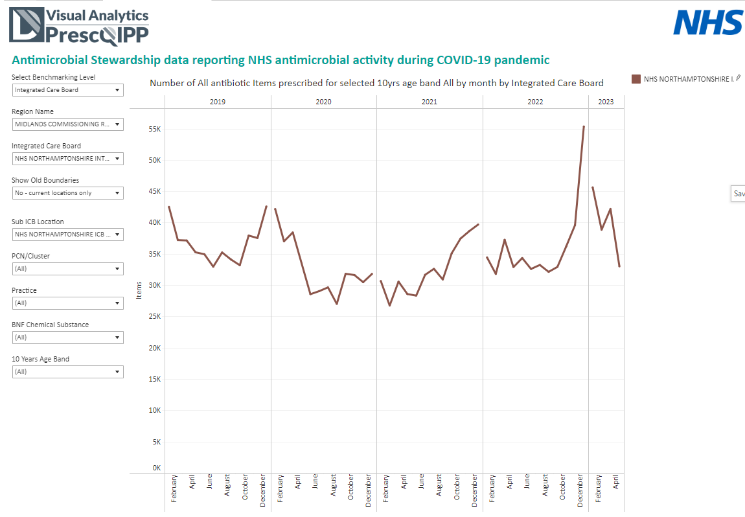
Primary care antibiotic prescribing - Northamptonshire

Slide 8
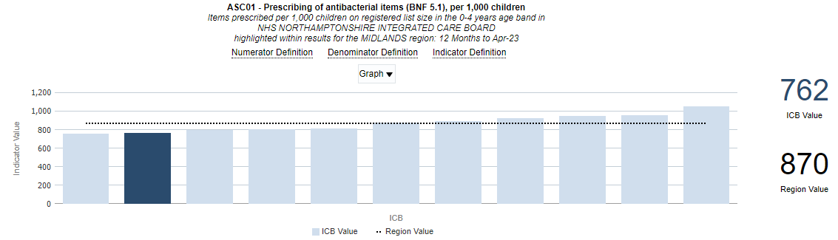
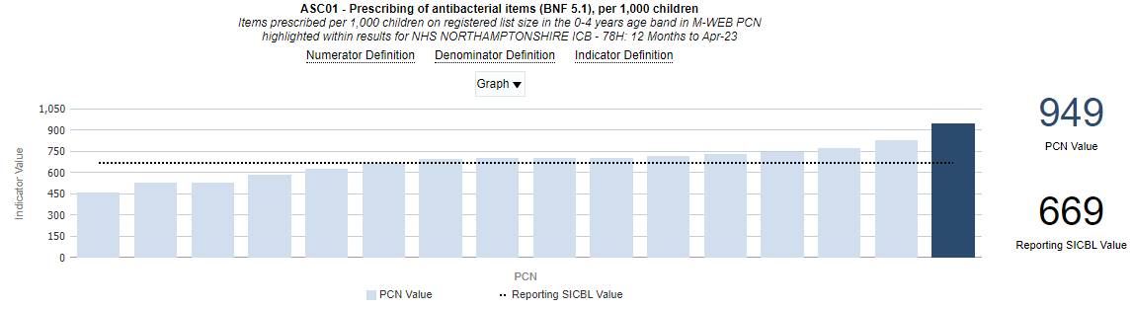
Antibiotic prescribing for children in Northamptonshire

Slide 9
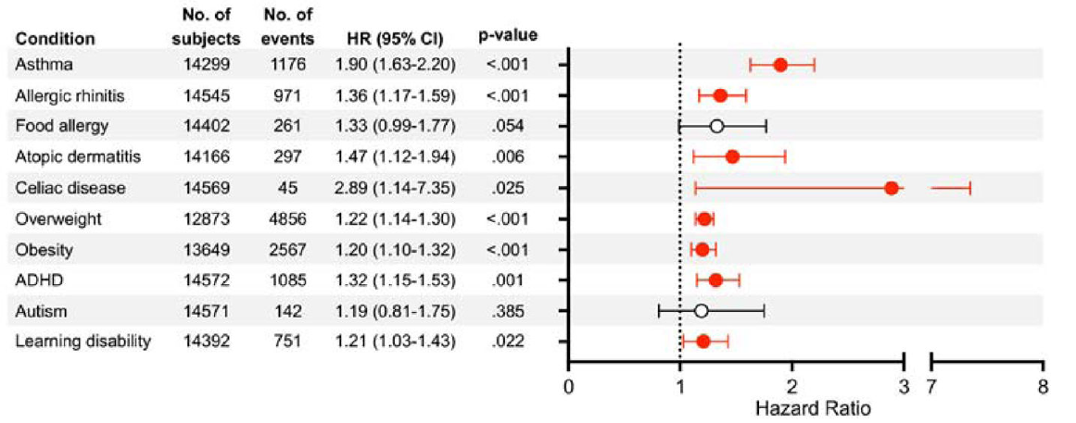
Association studies – impact of exposure to antibiotics in first 2 years of life
Aversa, Z. et al. Association of Infant Antibiotic Exposure With Childhood Health Outcomes. Mayo Clinic proceedings. 2021; 96(1), 66–77
Slide courtesy of Dr S Patel, UHS NHS Trust

Slide 10
Antibiotic prescribing in Primary Care vs European Targets
Condition/syndrome | Actual prescription (THIN data) | Ideal prescription: UKHSA EE median (IQ range) | Ideal prescription: ESAC EE acceptable range
Acute cough | 40% | 10% (6 – 16%)
Acute bronchitis | 92% | 13% (6 – 22%) | 0 – 30 %
Acute sore throat | 60% | 13% (7 – 22%) | 0 – 20% (tonsillitis)
Acute rhinosinusitis | 92% | 11% (5 – 18%) | 0 – 20%
Acute otitis media 6mo – 2yr 2yr – 18yr | 96% 94% | 19% (9 – 33%) 17% (8 – 30%) | 0 – 20%
URTI | 19% |  | 0 – 20%
UTI | 94% | 75% (61 – 86%) | 80 – 100%
J Antimicrob Chemother. 2018 Feb 1;73(suppl_2)
www.rcgp.org.uk/TARGETantibiotics
Notes:
So where are we at the moment compared to where we want to get. There has been some good news about primary care antibiotic prescribing. Between 2016 to 2019, antibiotic consumption reduced by 6.6%, with a further decrease of 10.9% between 2019 to 2020.
These studies show that GPs still prescribe antibiotics in more than half of all respiratory infections. Targets set by the European Surveillance on Antimicrobial Consumption suggest we still have a long way to go and that we need to reduce prescribing by 2/3rds.
1. http://bmjopen.bmj.com/content/4/10/e006245.ful
2. http://qualitysafety.bmj.com/content/early/2011/03/21/bmjqs.2010.049049.abstract
Slide table shows: Percentage of patients prescribed antibiotics (THIN) and the percentages that experts believe are appropriate (results from PHE expert elicitation (EE) work and EE by ESAC). Conditions in bold show the greatest discrepancy between expert opinion and actual prescribing proportions.

Slide 11
What do we know so far?
AMR is a real and present danger to health
Primary care antibiotic prescribing contributes to AMR
There is room for improvement in England
There are seasonal trends; recent spike December 2022
Antibiotic prescribing may impact long term health of young children

Slide 12


Why do we prescribe antibiotics?
Relief of symptoms
Relief of symptoms
Worry about complications
Worry about complications
Previous experience
Previous experience
Patient pressure
Want information and treatment
Notes:
In order to consider how to communicate with patients about the need for antibiotics, its important to understand WHY we prescribe antibiotics in the first instance.
For much of the research available we see clinicians and patients tell a similar story
They want to relieve the symptoms
Worry about complications
Previous experience – On the part of clinicians it is important they are aware of and implement any updated prescribing guidance, on the part of the patient – if they had received antibiotics for a sore throat in the past they may expect it again.
However research also highlights areas of misunderstanding. Evidence shows that prescribers often overestimate patients' expectations for antibiotics and that patients' satisfaction is related to:
Having a careful and thorough examination.
Having their concerns identified and addressed.
Having advice on how to manage their symptoms.
Past research demonstrates that perceived patient demand is correlated with antibiotic prescribing and that clinicians often perceive patient demand where it does not exist. Kohuts findings help explain why clinicians would perceive such demand. Respondents reported risks that come with failing to identify and satisfy inconvincible patients: the emotional drain of trying unsuccessfully to convince them (26) and the conviction that antibiotic prescribing adversely affects patient satisfaction metrics (12,27,28)
So what can we do to change the narrative.

Slide 13
Symptom benefit from antibiotics
 | Total Duration untreated | Beneficial effect from antibiotics | NNT for one additional patient to benefit | NNT for one additional adverse effect
Otitis media | 4 -12 days | 8-12 hours | 18 | 9
Sore throat | 8 days | 12-18 hours | 6-20 | 15
Sinusitis | 12-15 days | 24 hours | 18 | 8
Bronchitis | 20-22 days | 11-24 hours | 10-22 | 24
And how do we communicate this information to patients?
Cochrane reviews Otitis media: Venekamp et al (2015); Sore throat: Spinks et al. 2013; Sinusitis: Leminengre M et al. (2012); bronchitis: Smith et al. (2017)
Notes:
Presenter notes:
How useful are antibiotics for common respiratory tract infections? This table includes much of the research on what we know about common respiratory tract infections, how long the symptoms usually last, and how much patients benefit from taking antibiotics. As you can see from the circled column, antibiotics reduce symptoms for between 8 and 24 hours. So at best about 12 hours in otitis media, an illness that lasts for 4 to 8 days; taking a look at the NNT Benefit and NNT Harm columns – 18 patients with OM need to be treated with antibiotics for one patient to benefit, but for 9 patients receiving antibiotics one will experience an adverse effect. For bronchitis, an illness that lasts for about three weeks, the reduction in days with cough was less than half a day and the reduction in days feeling ill was just over half a day with antibiotics.
Any benefit that our patients achieve from antibiotics is tiny and the numbers needed to treat to achieve one satisfactory earlier resolution needs to be weighed against the one in 10 chance of causing side effects such as diarrhoea, vomiting, rash, allergic reaction (1 in 15) or the risk of carrying a resistance bacteria. So, unless symptoms are particularly severe, there is no reason for using antibiotics in the majority of patients presenting with respiratory symptoms because they do not help.
Evidence
This evidence is all outlined in the PHE antibiotic guidelines and NICE CG69, but most recent systematic reviews include:
Otitis media
Venekamp et al (2015) Antibiotics for acute middle ear infection (acute otitis media). Cochrane
http://www.cochrane.org/CD000219/ARI_antibiotics-for-acute-middle-ear-infection-acute-otitis-media-in-children
This systematic review included 13 RCTs involving 3401 children with otitis media (3938 episodes). Pain was not reduced by antibiotics at 24 hours. A third fewer had residual pain at 2-3 days (at which point pain levels are usually substantially reduced) and NNT for an additional beneficial outcome was 20. Antibiotics reduced the number of Tympanic Membrane perforations, but NNT for Benefit is 33. Severe complications were rare and did not differ between children given antibiotics and those given placebo. Antibiotics are most beneficial for children aged <2 yrs with bilateral AOM (NNTB 4) or with both AOM and discharge (NNTB 3). Immediate antibiotics were associated with a substantial increased risk of vomiting, diarrhoea or rash compared with no treatment (NNTH9).
Sore throat
Spinks A et al. (2013) Antibiotics for sore throat. Cochrane
http://onlinelibrary.wiley.com/doi/10.1002/14651858.CD000023.pub4/pdf/abstract
27 RCTs of antibiotics for sore throat vs placebo including 12 835 cases. Antibiotics were most beneficial if given at day three if throat swabs were positive for streptococcus (NNTB 6) compared to NNTB at day 7 of 21. Antibiotics reduced duration of symptoms by 16 hours on average. 90% resolve in 7 days. Advantages may be greater in low income countries (possibly recent travelers from these countries – personal communication Dr L Hendricks) where the risk of rheumatic fever is higher. NNTH is 15.
Little P et al (2013) – 2 studies within the PRISM trial used a Clinical score compared to rapid antigen detection test to guide antibiotic use for sore throats. The RCT using clinical scores to predict streptococcal infection in patients and found that the use of FeverPAIN is likely to moderately improve symptom control and reduce antibiotic use. PHE and NICE guidance suggests Consider immediate antibiotics if symptoms severe or a short 48 hour back-up strategy may be appropriate, when the FeverPAIN score is 4 or over. Consider back-up or no antibiotic if score 2-3.
https://www.bmj.com/content/bmj/347/bmj.f5806.full.pdf
Sinusitis
Leminengre M et al. (2012) Antibiotics for clinically diagnosed acute rhinosinusitis in adults. Cochrane.
http://onlinelibrary.wiley.com/doi/10.1002/14651858.CD006089.pub4/pdf/abstract
10 RCTs of antibiotics vs placebo including 2450 participants. Irrespective of treatment group 47% of patients were cured after 1 week, 71% after 14 days. 18 patients need to be treated for a faster cure rate between 7 and 14 days. If several of: purulent nasal discharge; severe localised unilateral pain; fever; marked deterioration after initial milder phase, patients were more likely to benefit from antibiotics, when PHE and NICE recommend a back-up antibiotic. One disease related complication (brain abscess) occurred in patient treated with antibiotics, but complications are rare.
Bronchitis/LRTI (without pneumonia)
Smith S et al. (2017) Antibiotic treatment of people with clinical diagnosis of acute bronchitis. Cochrane
http://www.cochrane.org/CD000245/ARI_antibiotic-treatment-people-clinical-diagnosis-acute-bronchitis
17 trials with 5099 participants were included. The number needed to treat for one additional beneficial outcome was 22 (NNTB 22). The reduction in days with cough was 0.46 days and days feeling ill was 0.64 days (CI 1.16-0.13). NNT for an additional adverse effect was 24.

Slide 14
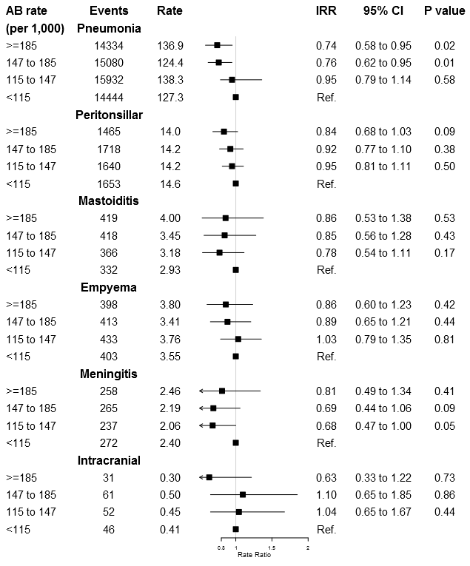
Complications with lower antibiotic use:
High vs low prescribing practices
In a practice of 7,000,
a 10% reduction in antibiotic prescribing for RTI might expect:
  1 additional peritonsillar abscess each 10 years
  1 additional pneumonia each year
BMJ 2016 Gulliford http://www.bmj.com/content/354/bmj.i4245
www.rcgp.org.uk/TARGETantibiotics
Notes:
Presenter notes:
Now lets look at complications. If we prescribe less do we see more complications? The short answer, perhaps, but hardly any. In a practice of 7000 patients, a 10% reduction in antibiotic prescribing for RTI may result in 1 additional pneumonia each year and 1 additional peritonsilar abscess every 10 years.
This study stratified practices by their antibiotic prescribing rates into four quartiles. (>185, 147-185, 115-147 and less than 115 antibiotic prescriptions per 1000 patients. They then looked at infection related complications – pneumonia, peritonsillar abscess, mastoiditis, empyema, meningitis and intracranial abscess.
There was no significant reduction in peritonsilar abscess, mastoiditis, empyema, or intracranial abscess, in practices where antibiotics were given much more often, as you can see the confidence intervals cross one and the p values are over 0.05. Although the slight increase in peritonsilar abscess they suggested would result in one additional peritonsilar abscess every 10 years.
There was a significant reduction in pneumonia, indicating that this equated to one additional pneumonia per year. This indicates that we need to be careful in this area – and consider the age and risk of patients with suspected pneumonia, and consider using CRP too.

Slide 15
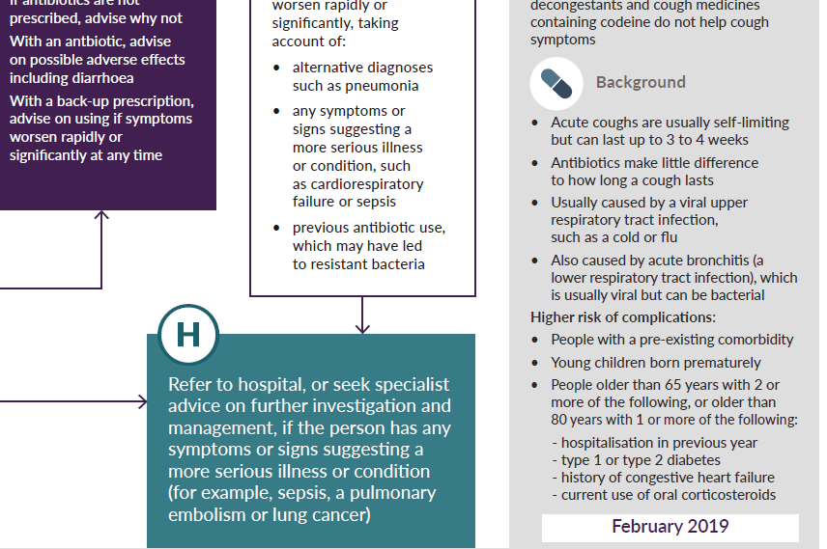
Antibiotics and complications
Serious complications rare after URTI
Sore throat and otitis media NNT>4000
Pneumonia more common after LRTI
  >65 years: NNT 39
  < 65 years: NNT >100
  Highlighted in NICE/PHE summary tables
www.rcgp.org.uk/TARGETantibiotics
Notes:
Presenter notes:
Serious complications are rare after URTI, sore throats and otitis media. There are some patient groups at slightly higher risk of complications after LRTI or bronchitis and the current guidelines target prescribing for those at highest risk, for example in those aged 65 or older with 2 or more of: recent hospitalisation, diabetes, CCF or recent steroid use. and even then you still have to treat a number of patients for one to benefit.

Slide 16

Clinical Scenario:
Acute Sore Throat
Last review: Feb 2023
Next review: Feb 2026
Notes:
Presenter Notes
This clinical scenario of acute sore throat, can be used instead of the acute cough scenario, if you wish to increase awareness of the FeverPAIN score recommended in NICE guidance, specifically Target prescribing for this condition or undertake an audit in this area, or of course all of the above!
The case can be just put up on the projector or printed out and discussed in pairs or groups, or with the group as a whole.
Allow the participants to discuss the case for 2 minutes and specifically ask several different people what they would do and /or prescribe.

Slide 17
Clinical Scenario:
Acute Sore Throat
Consider the following details:
18 year old female
4/7 days sore throat, “high” fever last night, tiredness, cough
Difficulty swallowing
Temp 37.5°C
Slough on swollen tonsils, palatal petechiae
Cervical and axillary lymphadenopathy
‘Antibiotics helped’ for tonsils last year
Last review: Feb 2023
Next review: Feb 2026
Notes:
Presenter notes
These cases are examples that can be printed out and discussed in pairs or groups, or with the group as a whole.
Allow the participants to discuss the case for 2 minutes and specifically ask several different people what they would do and /or prescribe.
If you wish to increase awareness of the FeverPAIN score recommended in NICE guidance, specifically target prescribing for this condition or undertake an audit in this area, or of course all of the above!
The case can be just put up on the projector or printed out and discussed in pairs or groups, or with the group as a whole.
When you put up the scenario, ask the group to discuss what will determine their decision to prescribe in this case , and other cases. Do they use any scoring system? And if so what? And can they see any advantages to one scoring system over another.

Slide 18
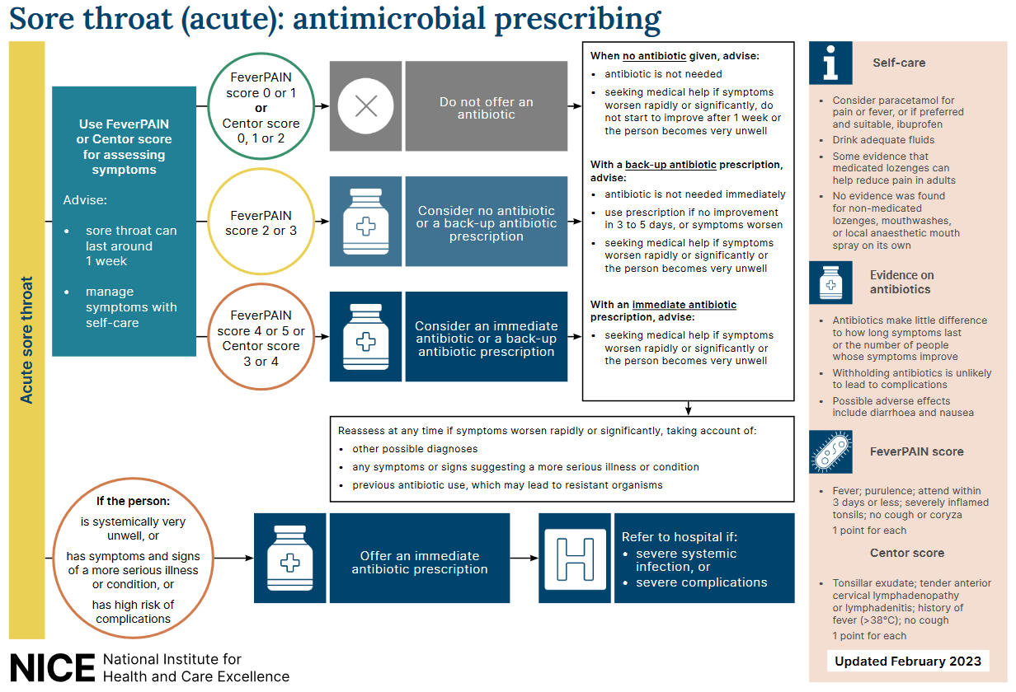
Sore throat: antimicrobial prescribing
Last review: Feb 2023
Next review: Feb 2026
NICE: Sore throat (acute) in adults: antimicrobial prescribing [NG84]
Notes:
Presenter notes:
This is an overview of the NICE guidelines that recommend the use of clinical scoring systems. Lets have a look at the scoring systems in a bit more detail
Slide reference:
Sore throat (acute): antimicrobial prescribing
NICE guideline [NG84] Published: 26 January 2018
https://www.nice.org.uk/guidance/ng84

Slide 19
Clinical scoring systems
Centor criteria
(scores 0-4)
Tonsillar exudate
Tender anterior cervical lymphadenopathy or lymphadenitis
History of fever (over 38 degrees Celsius)
Absence of cough
FeverPAIN criteria
(scores 0-5)
Fever (in last 24 hours)
Purulence (pus on tonsils)
Attend rapidly (within 3 days of symptom onset)
(severely) Inflamed tonsils
No cough or coryza (inflammation of mucus membranes in the nose)
Last review: Feb 2023
Next review: Feb 2026
NICE: Sore throat (acute) in adults: antimicrobial prescribing [NG84]
Notes:
Presenter talk
NICE suggest that clinicians should use either the Fever PAIN or CENTOR score to help decide on the management of adult acute sore throat. Many of you will be familiar with one or both of these clinical scoring tools.
Centor has been around since 1981 and was developed to predict the probability of the presence of Streptococcus pyogenes or group A β haemolytic Streptococcus (GABHS) in a throat swab culture.
Centor criteria
Tonsillar exudate
Tender anterior cervical lymphadenopathy or lymphadenitis
History of fever (over 38 degrees Celsius)
Absence of cough
Each of the Centor criteria score 1 point (maximum score of 4). A score of 0, 1 or 2 is thought to be associated with a 3 to 17% likelihood of isolating streptococcus. A score of 3 or 4 is thought to be associated with a 32 to 56% likelihood of isolating streptococcus.
The FeverPAIN score was developed with over 500 UK general practice patients, and then tested in a further cohort of over 600 patients, so the findings of the study are really robust.
The score was not just used to predict Group A strep sore throats like the Centor score, but also other streptococcal sore throats such as C, G.
Each of the FeverPAIN criteria score 1 point (maximum score of 5). A score of 0 or 1 is thought to be associated with a 13 to 18% likelihood of isolating streptococcus. A score of 2 or 3 is thought to be associated with a 34 to 40% likelihood of isolating streptococcus. A score of 4 or 5 is thought to be associated with a 62 to 65% likelihood of isolating streptococcus (NG84).
Fever (during previous 24 hours)
Purulence (pus on tonsils)
Attend rapidly (within 3 days after onset of symptoms)
Severely Inflamed tonsils
No cough or coryza (inflammation of mucus membranes in the nose
You can link to a scoring system at https://ctu1.phc.ox.ac.uk/feverpain/index.php
Whilst both scoring systems are very similar, the Fever PAIN score found that cervical lymphadenopathy was not predictive of streptococcal sore throat, and this may not surprise us as this occurs also in viral sore throats, so does not help to differentiate the two.
Presenter Notes
See NG 84 for more details
Slide references
Centor R, Witherspoon J, Dalton H, et al. The diagnosis of strep throat in adults in the emergency room. Med Decis Making 1981;1:239–46
Little P, Moore M, Hobbs FDR, et al. BMJ Open 2013, 2013;3:e003943. doi:10.1136/bmjopen-2013-003943
***Centor however was specifically developed for adults, so in 2004 McIsaac and team developed modified criteria, which add the age of the patient (+1 if age 3–14, 0 if age 15–44 and -1 if age ≥45), taking into account the fact that GABHS is more prevalent in the age group of 5–15 years. Still, several studies have shown that neither signs and symptoms, nor signs and symptoms combined as prediction rules, were reliable to distinguish between GABHS and non-GABHS pharyngitis.

Slide 20
Clinical Scenario: Acute Sore Throat Feedback FeverPAIN
18 year old girl
4/7 days sore throat, “high” fever last night, tiredness, cough. difficulty swallowing
Temp 37.5°C
Slough on swollen tonsils, palatal petechiae
Cervical and axillary lymphadenopathy
‘Antibiotics helped’ for tonsils last year
FeverPAIN is a five-item score based on Fever, Purulence, Attend rapidly (3 days or less), severely Inflamed tonsils and No cough or coryza
FeverPAIN score 0-1: only 13-18% have streptococcus, close to background carriage. NO antibiotic strategy appropriate with discussion
FeverPAIN score 2-3: 34-40% have streptococcus. A back-up/ delayed antibiotic is appropriate with discussion
Fever PAIN score of >4: 62-65% have streptococcus, consider immediate antibiotic if symptoms are severe, or a short delayed prescribing strategy may be appropriate (48 hours)
Patient above scores 3
Last review: Feb 2023
Next review: Feb 2026
NICE: Sore throat (acute) in adults: antimicrobial prescribing [NG84]
Notes:
Presenter talk
So lets take a look at using the FeverPAIN score in adults (note for presenter: double check guidance in children (see slide 8)
The Fever PAIN score gives the likelihood of having a streptococcal sore throat, which can be discussed with the patient.
So the FeverPAIN is a five-item score based on Fever (during previous 24 hours), Purulence (pus on tonsils), Attend rapidly (within 3 days after onset of symptoms), Severely Inflamed tonsils, No cough or coryza (inflammation of mucus membranes in the nose)
(FeverPAIN)
You can link to a scoring system at https://ctu1.phc.ox.ac.uk/feverpain/index.php
Bring in scoring and what they represent – each bullet will come in on a separate mouse click.
If the FeverPAIN score is 0 or 1 then the likelihood of a patient having a streptococcus in their throat is 13-18% which is close to the background carriage of streptococci, and therefore antibiotics are not warranted.
This patient has 3 of the 5 FeverPAIN criteria (fever in last 24 hours, purulence, and severe inflammation) – and therefore has a 34-40% likelihood of a beta haemolytic streptococcus. She could warrant a back-up/delayed antibiotic and this needs to be discussed with the patient.
If the Fever PAIN score is >4: there is a 62-65% of having a streptococcus, therefore consider an immediate antibiotic if symptoms are severe, or a short delayed prescribing strategy may be appropriate if symptoms are not severe and the patient is happy to wait and see how their symptoms progress. (48 hour)
In this case our patient has a FEVERPAIN score of 3 suggesting bask-up/delayed antibiotics.
It may be worth discussing some slightly different scenarios, and what factors makes a clinician more likely to prescribe – and if this is a correct approach.
Presenter additional background information
References for FeverPAIN score development and testing
Little P, Moore M, Hobbs FDR, et al. BMJ Open 2013, 2013;3:e003943. doi:10.1136/bmjopen-2013-003943
ABSTRACT: Objective: To assess the association between features of acute sore throat and the growth of streptococci from culturing a throat swab. Design: Diagnostic cohort. Setting: UK general practices.
Participants: Patients aged 5 or over presenting with an acute sore throat. Patients were recruited for a second cohort (cohort 2, n=517) consecutively after the first (cohort 1, n=606) from similar practices. Main outcome: Predictors of the presence of Lancefield A/C/G streptococci. Results: Variables significant in multivariate analysis in both cohorts were rapid attendance ( prior duration 3 days or less; multivariate adjusted OR 1.92 cohort, 1.67 cohort 2); fever in the last 24 h (1.69, 2.40); and doctor assessment of severity (severely inflamed pharynx/ tonsils (2.28, 2.29)). The absence of coryza or cough and purulent tonsils were significant in univariate analysis in both cohorts and in multivariate analysis in one cohort.
A five-item score was suggested based on Fever, Purulence, Attend rapidly (3 days or less), severely Inflamed tonsils and No cough or coryza (FeverPAIN) had moderate predictive value (bootstrapped area under the ROC curve 0.73 cohort 1, 0.71 cohort 2) and identified a substantial number of participants at low risk of streptococcal infection (38% in cohort 1, 36% in cohort 2 scored ≤1, associated with a streptococcal percentage of 13% and 18%, respectively). A Centor score of ≤1 identified 23% and 26% of participants with streptococcal percentages of 10% and 28%, respectively
This score was further tested in an RCT: Little P, Hobbs FDR, Moore M. et al. Clinical score and rapid antigen detection test to guide antibiotic use for sore throats: randomised controlled trial of PRISM (primary care streptococcal management). 2013. BMJ. Available from: http://www.bmj.com/content/347/bmj.f5806.
Rationale: A multicentre randomised controlled trial in UK general practices designed to determine the effect of clinical scores that predict streptococcal infection or rapid streptococcal antigen detection tests compared with delayed antibiotic prescribing in patients aged >3 with acute sore throat.
This study compared three strategies for limiting or targeting antibiotic using a validated FeverPAIN score in 631 patients with sore throat: they compared delayed antibiotic prescribing, the use of a clinical score designed to identify streptococcal infection, and the targeted use of rapid antigen tests according to the clinical score. Findings suggest that across a range of practitioners and practices, use of either the simple FeverPAIN clinical score or the clinical FeverPAIN score with a rapid antigen test is likely to moderately improve symptom control and reduce antibiotic use; the addition of the Rapid antigen test to the FeverPAIN score gave no clear advantages compared with use of the FeverPAIN score alone. Use of antibiotics in the clinical score group (60/161) was 29% lower (adjusted risk ratio 0.71, 95% confidence interval 0.50 to 0.95; P=0.02) and in the antigen test group (58/164) was 27% lower (0.73, 0.52 to 0.98; P=0.03). There were no significant differences in complications or reconsultations. The authors therefore suggest the use of the following scoring system and clinical management: With a low FeverPAIN score of 0-1: only 13-18% have streptococcus, close to background carriage and therefore a no antibiotic strategy is appropriate with discussion. With a FeverPAIN score of 2-3: 34-40% have streptococcus, therefore a back-up/delayed antibiotic is appropriate with discussion. With a FeverPAIN score of >4: 62-65% have streptococcus, therefore consider immediate antibiotic if symptoms are severe or a short 48 hour delayed antibiotic prescribing strategy may also be appropriate after agreement with the patient and safety netting advice.
If a patient is unwell with a Centor score of 3-or-4 then the chance of developing Quinsy is 1:60.

Slide 21
Clinical Scenario: Acute Sore Throat Feedback CENTOR
18 year old girl
4/7 days sore throat, “high” fever last night, tiredness, cough, difficulty swallowing
Temp 37.5°C
Slough on swollen tonsils, palatal petechiae
Cervical and axillary lymphadenopathy
‘Antibiotics helped’ for tonsils last year
Centor Criteria: History of fever; absence of cough; tender anterior cervical lymphadenopathy and tonsillar exudates.
Centor score 0-2: has a high negative predictive value (80%) and indicates low chance of Group A Beta Haemolytic Streptococci
Centor score 3 or 4: suggests the chance of GABHS is 40%.
If a patient is unwell with a Centor score of 3-or-4 then the chance of developing Quinsy is 1:60.
Patient scores Centor criteria 3
Last review: Feb 2023
Next review: Feb 2026
NICE: Sore throat (acute) in adults: antimicrobial prescribing [NG84]
Notes:
Presenter talk
Lets have a look at the same scenario but using the Centor score.
As we saw before the Centor scoring system is very similar but includes lymphadenopathy which this patient has – giving a score of 3, and suggesting an immediate or back-up antibiotic.
Centor Criteria: History of fever; absence of cough; tender anterior cervical lymphadenopathy and tonsillar exudates. A low Centor score (0-2) has a high negative predictive value (80%) and indicates low chance of Group A Beta Haemolytic Streptococci (GABHS). A Centor score of 3-or-4 suggests the chance of GABHS is 40%. If a patient is unwell with a Centor score of 3-or-4 then the chance of developing Quinsy is 1:60.
This patient has 3 of the 4 Centor criteria (because they have a history of fever, lymphadenopathy, and exudate) – and is therefore more likely to have a group A beta haemolytic Streptococcus. She could warrant an immediate or back-up/delayed antibiotic – however the benefit with immediate antibiotics may still be quite small and needs to be discussed with the patient. Centor leads to more prescribing than Fever PAIN
It may be worth discussing some slightly different scenarios, and what factors makes a clinician more likely to prescribe – and if this is a correct approach.
Slide reference
Centor RM, Whitherspoon JM, Dalton HP, Brody CE, Link K. The diagnosis of strep throat in adults in the emergency room. Med Decision Making 1981;1:239-46.
Studies that back up the use of Centor
Aalbers J, O'Brien KK, Chan WS, Falk GA, Teljeur C, Dimitrov BD, and Fahey T (2011) Predicting streptococcal pharyngitis in adults in primary care: a systematic review of the diagnostic accuracy of symptoms and signs and validation of the Centor score. BMC Medicine, 9:67.
https://www.ncbi.nlm.nih.gov/pmc/articles/PMC3127779/pdf/1741-7015-9-67.pdf
Fine AM, Nizet V, and Mandl KD (2012) Large-scale validation of the Centor and McIsaac scores to predict group A streptococcal pharyngitis. Arch Intern Med, 172(11):847-852.
https://jamanetwork.com/journals/jamainternalmedicine/article-abstract/1157417
Hassan MF, Eida MM, Metwally LA, and Mahmoud HA (2015) Evaluation of Appropriateness of Antibiotic Use and Validation of the Mclsaac-Modified Centor Score for Group A Beta Hemolytic Streptococcal Acute Pharyngitis in Suez Canal Area. Suez Canal University Medical Journal, 18(2):117-124.
https://journals.ekb.eg/article_45612_a3c5f8106208278c29773deb5a076b0e.pdf

Slide 22
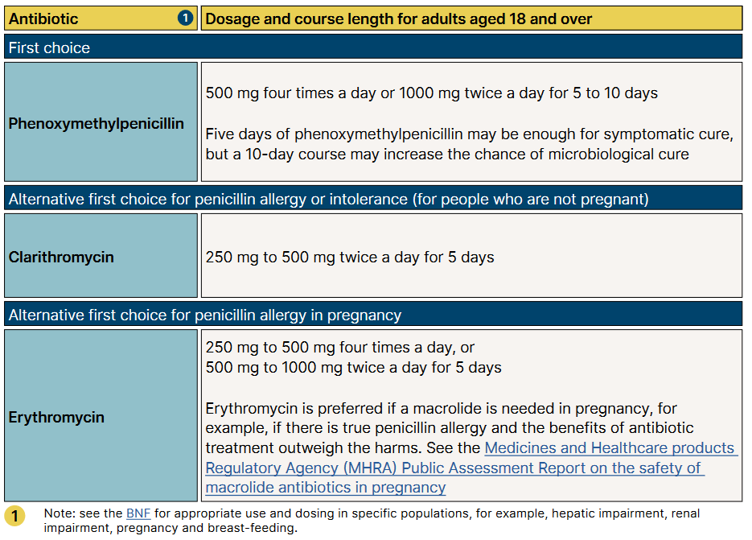
NICE antimicrobial prescribing guidelines for acute sore throat in adults
Last review: Feb 2023
Next review: Feb 2026
NICE: Sore throat (acute) in adults: antimicrobial prescribing [NG84]
Notes:
Presenter notes
We suggest you take your local antibiotic guidance with you – and show them the sore throat section, and your local recommendations. You may wish to edit the above slide if there are any major differences.
Presenter talk
So we have managed this case in line with National NICE guidance. This is a snapshot of the aims and principles of treatment section of the Antibiotic Prescribing Implementation Tool for acute sore throat. As you can see each section has links to other guidance, comments on when antibiotics should be used, recommended first and second line antibiotics dose and duration.
The guidance recommends oral penicillin V for AST as first line
Presenter please tell the participants where to find your local guidance and how locums can get extra copies if needed.

Slide 23
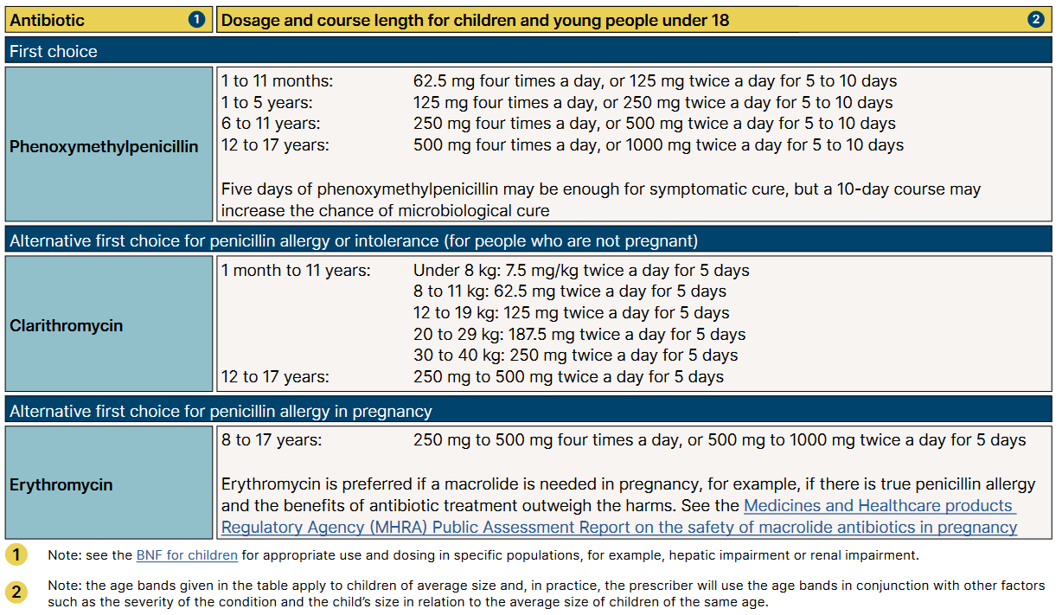
NICE antimicrobial prescribing guidelines for acute sore throat in children
NICE: Sore throat (acute) in adults: antimicrobial prescribing [NG84]
Notes:
Presenter notes
We suggest you take your local antibiotic guidance with you – and show them the sore throat section, and your local recommendations. You may wish to edit the above slide if there are any major differences.
Presenter talk
So we have managed this case in line with National NICE guidance. This is a snapshot of the aims and principles of treatment section of the Antibiotic Prescribing Implementation Tool for acute sore throat. As you can see each section has links to other guidance, comments on when antibiotics should be used, recommended first and second line antibiotics dose and duration.
The guidance recommends oral penicillin V for AST as first line
Presenter please tell the participants where to find your local guidance and how locums can get extra copies if needed.

Slide 24
Prescribing can influence patients understanding and expectations
English RCT comparing treatment strategies for respiratory tract infection (n=889)
Last review: Feb 2023
Next review: Feb 2026
Little 2014, BMJ, Extracted from supplementary table 2
Notes:
Presenter Talk
There has been much discussion about the use of giving delayed antibiotic prescriptions in acute uncomplicated infections, to reduce antibiotic use and reduce patient expectations
This slide covers one study within that review conducted by Little et al in in 2014 focused on upper respiratory tract infections and included patients 889 patients over 3 years of age from 25 practices. Patients who were not judged to need an immediate antibiotic, were randomised into no antibiotic or delayed prescribing group (n=556).
There was no significant effect of antibiotic prescribing strategy on symptom severity or temperature. Higher levels of satisfaction were reported for the patient led and collection approaches, although the limited sample size for this outcome resulted in no significant differences overall (2.38, P=0.667). Those given antibiotics were more likely to believe that antibiotics were effective (click for arrow) despite immediate antibiotics having no significant effect on symptom severity or duration.
The back-up prescription is very useful to give to patients who have a high expectation for antibiotics, and can be given using the patient leaflet I will show you.
Presenter notes
Additional information on delayed prescribing you can cover:
A 2017 Cochrane review found that symptoms for sore throat were only modestly improved by immediate antibiotics compared with delayed antibiotics (5 studies - Spurling 2017) also found no significant difference in patient satisfaction in delayed vs. immediate groups in studies focusing on respiratory tract infections (6 studies).
You can also include information about safety by covering the DESCARTE study:
A study of acute sore throat (the DESCARTE study – Little 2013) showed that complications in those who received immediate were similar to those receiving a back-up prescription even though 30% did not collect the prescription, and in the study complications were higher in the no antibiotic group. Thus giving more control to the patient does help prevent complications, but with a back-up antibiotic safety netting instructions are important.
Little 2014 study:
Health professionals decided in negotiation with patients whether immediate antibiotics were needed. Total of 889 patients, of these 333 (37%) were prescribed immediate antibiotics
If antibiotics were not needed, patients were randomised into four delayed prescribing groups (n=556, 63%):
Recontact for prescription (n=123)
Post-dated prescription (n=114)
Collection of the prescription (n=105)
Or patient led (the patient was given to use if needed) (n=106)
Immediate antibiotics given (n=333) symptoms documented (n=280)
For symptom severity, we saw no evidence of a significant interaction between antibiotic strategy and analgesia use
For the randomised no/delayed groups
There was no significant effect of strategy on symptoms severity, duration and small differences in temperature control.
Antibiotic use did not differ significantly between no/delayed prescribing strategies, with the lowest use reported in the no prescription group
Consultations in the following month were similar (RR: 2.97, P=0.563) and were not significantly different after the first month (RR: 4.11, P=0.391).
Belief in antibiotics was strong but not significantly different between no or delayed groups,
Inclusion of the non-randomised immediate prescription group
No significant effect of antibiotic prescribing strategy on symptom severity or temperature
Antibiotic use differed significantly with 97% of patients reporting antibiotic use in the immediate arm
More patients believed antibiotics were very effective despite immediate antibiotics having no significant effect on symptom severity or duration.
There was no significant difference in satisfaction rates across the groups
A 2017 Cochrane review of delayed prescriptions for respiratory infection found that:
A strategy of immediate antibiotics is more likely to confer the modest benefits of antibiotics on clinical outcomes such as symptoms for acute otitis media and sore throat than delayed antibiotics (moderate certainty evidence according to GRADE assessment).
Immediate antibiotics had similarly high levels of patient satisfaction to delayed antibiotics (91% versus 86% - moderate certainty evidence according to GRADE assessment).
Delayed antibiotics had higher levels of patient satisfaction than no antibiotics (87% versus 82% - moderate certainty evidence according to GRADE assessment).
Delayed antibiotic prescribing strategies achieved markedly lower rates of antibiotic use compared to immediate antibiotics (31% versus 93% - moderate certainty evidence according to GRADE assessment).
Requiring the patient to return for a prescription resulted in even lower antibiotic use (27%) than giving a prescription at the time of the consultation with instructions to fill the prescription if symptoms worsened (38%).
No antibiotics achieved lower rates still of antibiotic use compared to delayed antibiotics (14% versus 28%)- moderate certainty evidence according to GRADE assessment).
Slide References
Spurling GKP, Del Mar CB, Dooley L, Clark J, Askew DA. Delayed antibiotic prescriptions for respiratory infections. Cochrane Database of Systematic Reviews 2017, Issue 9. Art. No.: CD004417. DOI: 10.1002/14651858.CD004417.pub5. Accessed 23 January 2023.
Little P, Moore M, Kelly J, Williamson I, Leydon G, McDermott, L, Mullee M, Stuart B. Delayed antibiotic prescribing strategies for respiratory tract infections in primary care: pragmatic, factorial, randomised controlled trial. BMJ 2014;348.
Moore M, Little P, Rumsby K, Kelly J, Watson L, Warner G, Fahey T, Williamson I. Effect of antibiotic prescribing strategies and an information leaflet on longer-term reconsultation for acute lower respiratory tract infection. Br J Gen Pract. 2009 Oct;59(567):728-34. doi: 10.3399/bjgp09X472601. PMID: 19843421; PMCID: PMC2751917.
Little P, Stuart B, Hobbs FD, Butler CC, Hay AD, Campbell J, Delaney B, Broomfield S, Barratt P, Hood K, Everitt H, Mullee M, Williamson I, Mant D, Moore M; DESCARTE investigators. Predictors of suppurative complications for acute sore throat in primary care: prospective clinical cohort study. BMJ. 2013 Nov 25;347:f6867. doi: 10.1136/bmj.f6867. PMID: 24277339; PMCID: PMC3898431.
Little P, Stuart B, Hobbs FD, Butler CC, Hay AD, Delaney B, Campbell J, Broomfield S, Barratt P, Hood K, Everitt H, Mullee M, Williamson I, Mant D, Moore M; DESCARTE investigators. Antibiotic prescription strategies for acute sore throat: a prospective observational cohort study. Lancet Infect Dis. 2014 Mar;14(3):213-9. doi: 10.1016/S1473-3099(13)70294-9. Epub 2014 Jan 17. PMID: 24440616.

Slide 25
Finding the right words: Why?
Evidence shows that effective communication skills
  Increase patient satisfaction & understanding of prescribing decisions
  Reduce consultations
  Reduce antibiotic prescribing
Notes:
Prescribers already have good general communication skills and have their own individual approaches. However, given short consultations, it is easy to miss out an important element of a consultation or rush over an explanation. This can have a big impact on whether patients are happy with a prescribing decision.
Tweaking your discussions with patients can help:
Increase patient satisfaction: Patients report high levels of satisfaction and enablement in managing their infection, and are more informed about the appropriate use and harms of antibiotics when prescribers discuss antibiotics effectively and when they discuss leaflets interactively.
Reduce consultations: Prudent antibiotic prescribing with effective discussions about antibiotics help reduce re-consultations and future consultations. So it is worth investing a bit of time in these consultations in order to get future benefits.
Reduce your antibiotic prescribing: The examples of how you may tweak your discussions with patients presented here have been shown to be effective in reducing antibiotic prescribing when trialled with prescribers in UK general practice.
This approach and the examples provided in the presentation focus on things to say to patients with acute infections but you may also find them helpful for other consultations.
Additional notes: Evidence of benefits
Evidence shows that prescribers often overestimate patients' expectations for antibiotics and that patients' satisfaction is related to:
Having a careful and thorough examination.
Having their concerns identified and addressed.
Having advice on how to manage their symptoms.
The examples and the CHESTSSS acronym provided in this presentation are based on enhanced communication skills training that has been shown to be effective in a trial [1] with experienced GPs in the UK and on the STAR training [2] also shown effective in a UK-based trial [3]. Evidence from a recent systematic review [4] and a Cochrane overview of reviews [5] also found support for the use of communication skills training and shared decision making as effective strategies to optimise antibiotic prescribing in primary care.
References
Little et al. (2013). Effects of internet-based training on antibiotic prescribing rates for acute respiratory-tract infections: a multinational, cluster, randomised, factorial, controlled trial. The Lancet. 2013; 382(9899):1175-82. https://doi.org/10.1016/S0140-6736(13)60994-0
STAR training. https://www.healthcarecpd.com/course/star-stemming-the-tide-of-antibiotic-resistance
Butler et al. (2012). Effectiveness of multifaceted educational programme to reduce antibiotic dispensing in primary care: practice based randomised controlled trial. BMJ. 2012; 344:d8173. https://doi.org/10.1136/bmj.d8173
Köchling et al. (2018). Reduction of antibiotic prescriptions for acute respiratory tract infections in primary care: a systematic review. Implementation Science. 2018;13(1):47. https://implementationscience.biomedcentral.com/articles/10.1186/s13012-018-0732-y
Tonkin-Crine et al. (2017). Clinician‐targeted interventions to influence antibiotic prescribing behaviour for acute respiratory infections in primary care: an overview of systematic reviews. Cochrane Database of Systematic Reviews. 2017(9). https://doi.org/10.1002/14651858.CD012252.pub2

Slide 26
Finding the right words: How?
Key elements of effective consultations (CHESTSSS)
C: Ask specifically about concerns | ‘What are the things you are most worried about?’
C: Ask specifically about concerns | ‘What are the things you are most worried about?’
H: Discuss history and exam | While doing an examination provide ‘no problem’ commentary ‘Your heart rate is normal, your temperature isn’t raised’
C: Ask specifically about concerns | ‘What are the things you are most worried about?’
H: Discuss history and exam | While doing an examination provide ‘no problem’ commentary ‘Your heart rate is normal, your temperature isn’t raised’
E: Ask specifically about expectations | How do you think I could most help you today?’ or ‘How do you feel about antibiotics?’
C: Ask specifically about concerns | ‘What are the things you are most worried about?’
H: Discuss history and exam | While doing an examination provide ‘no problem’ commentary ‘Your heart rate is normal, your temperature isn’t raised’
E: Ask specifically about expectations | How do you think I could most help you today?’ or ‘How do you feel about antibiotics?’
S: Provide non-serious explanation for symptoms | ‘Your body produces phlegm as a normal reaction to inflammation in your airways. The phlegm catches particles and helps keep your lungs clear.’
C: Ask specifically about concerns | ‘What are the things you are most worried about?’
H: Discuss history and exam | While doing an examination provide ‘no problem’ commentary ‘Your heart rate is normal, your temperature isn’t raised’
E: Ask specifically about expectations | How do you think I could most help you today?’ or ‘How do you feel about antibiotics?’
S: Provide non-serious explanation for symptoms | ‘Your body produces phlegm as a normal reaction to inflammation in your airways. The phlegm catches particles and helps keep your lungs clear.’
T: Be specific about illness timeline/usual course | ‘A typical cough can take 3-4 weeks to clear completely.’
C: Ask specifically about concerns | ‘What are the things you are most worried about?’
H: Discuss history and exam | While doing an examination provide ‘no problem’ commentary ‘Your heart rate is normal, your temperature isn’t raised’
E: Ask specifically about expectations | How do you think I could most help you today?’ or ‘How do you feel about antibiotics?’
S: Provide non-serious explanation for symptoms | ‘Your body produces phlegm as a normal reaction to inflammation in your airways. The phlegm catches particles and helps keep your lungs clear.’
T: Be specific about illness timeline/usual course | ‘A typical cough can take 3-4 weeks to clear completely.’
S: Explain shortcomings of antibiotics | Antibiotics don’t help with pain but side effects, such as diarrhoea, nausea and rash, can be experienced by up to 1 in 10 people.’
C: Ask specifically about concerns | ‘What are the things you are most worried about?’
H: Discuss history and exam | While doing an examination provide ‘no problem’ commentary ‘Your heart rate is normal, your temperature isn’t raised’
E: Ask specifically about expectations | How do you think I could most help you today?’ or ‘How do you feel about antibiotics?’
S: Provide non-serious explanation for symptoms | ‘Your body produces phlegm as a normal reaction to inflammation in your airways. The phlegm catches particles and helps keep your lungs clear.’
T: Be specific about illness timeline/usual course | ‘A typical cough can take 3-4 weeks to clear completely.’
S: Explain shortcomings of antibiotics | Antibiotics don’t help with pain but side effects, such as diarrhoea, nausea and rash, can be experienced by up to 1 in 10 people.’
S: Self-care advice | ‘Pain in the chest or throat is normal due to inflammation, you can take paracetamol, and/or ibuprofen, which will help the pain and soothe the inflammation.’
C: Ask specifically about concerns | ‘What are the things you are most worried about?’
H: Discuss history and exam | While doing an examination provide ‘no problem’ commentary ‘Your heart rate is normal, your temperature isn’t raised’
E: Ask specifically about expectations | How do you think I could most help you today?’ or ‘How do you feel about antibiotics?’
S: Provide non-serious explanation for symptoms | ‘Your body produces phlegm as a normal reaction to inflammation in your airways. The phlegm catches particles and helps keep your lungs clear.’
T: Be specific about illness timeline/usual course | ‘A typical cough can take 3-4 weeks to clear completely.’
S: Explain shortcomings of antibiotics | Antibiotics don’t help with pain but side effects, such as diarrhoea, nausea and rash, can be experienced by up to 1 in 10 people.’
S: Self-care advice | ‘Pain in the chest or throat is normal due to inflammation, you can take paracetamol, and/or ibuprofen, which will help the pain and soothe the inflammation.’
S: Safety-netting advice | Provide patients with specific information on red-flag symptoms and when they should seek further help
Notes:
The CHESTSSS acronym was developed and tested in a randomised-controlled trial [1] which resulted in improved antibiotic prescribing and patient satisfaction when used by experienced GPs in the UK.
CHESTSSS presents specific communication techniques. These techniques have been developed based on patient expectations and needs specific to antibiotic discussions so can be more useful and effective than general approaches (e.g., 'ICE' or 'Calgary-Cambridge' models).
CHESTSSS can help you to remember specific phrases which:
Reassures patients
Increase patient understanding and satisfaction with a prescribing decision
May be particularly helpful for patients who are expecting antibiotics
C- ask specific concerns
Asking the patient specifically about their concerns. This can be difficult as, if not careful, one can sound patronising or give the impression that you have not been listening. However, if concerns are not specifically asked about, the patient will sometimes not share their main worries for fear of being seen as ‘overly-anxious’.
Example phrases you can use:
‘There are probably a number of things that are worrying you about this illness, but what would you say are the things that you are most worried about?’
‘You’ve mentioned the high temperature; is that the thing that is causing you most worry at the moment, or is it something else?’
H – history
A good history and examination, conducted prior to providing the patient with advice and/or reassurance, is an essential component of reassuring patients that their illness is being taken seriously.
Consider:
Providing a "running commentary", especially a "no problem commentary" [7,8], to the patient while doing an examination, for example:
'Your heart rate is normal', 'Your temperature isn't raised', 'Your lungs sound good.“
E- Expectations
Research has shown that there is often a mismatch between what GPs think patients are expecting and what they actually want. A patient that appears ‘demanding’ may actually just want reassurance that the infection has not ‘gone down to the chest’, rather than antibiotics.
Consider:
Asking the patient specifically about their expectations, for example:
'How do you think I could most help you today?'
'Some people have a clear idea about what they are expecting when they come to see me. Is there something that you were hoping for or expecting that we haven't talked about yet?’
S – Symptoms
Telling patients that you can find no sign of serious illness when they are worried about symptoms, might not be enough to make them feel reassured – they just think you have failed to detect how serious their illness is!
Consider:
Finding out what symptoms the patient is concerned about and then providing convincing non-serious explanations for these symptoms [7,8]. For example:
‘Your body produces phlegm as a normal reaction to inflammation in the airways to your lungs. The phlegm catches particles in your airways and helps keep your lungs clear.’
It can be helpful to acknowledge that these non-serious symptoms can still be very disruptive for patients so showing empathy that they are feeling very unwell is important.
T - Timelines
Prescribers might not always set realistic expectations and sometimes suggest that patients will get better ‘in a few days’, when we now know that it often takes much longer than this to recover.
In addition, patients often have unrealistic expectations about how quickly they will recover, and these can lead to unnecessary anxiety and re-consultation.
Consider:
Research has provided us with valuable information on expected duration of common infections. It is useful to tell these durations to patients to reassure them that their symptoms are not unusual.
S - Shortcomings
Prescribers don't always discuss pros and cons of antibiotics with patients, and patients often are not aware that antibiotics have no or very limited benefit for several common infections.
Consider:
Several trials have shown no or limited benefit of antibiotics for several types of common infections. Antibiotics are not usually indicated in sore throat, sinusitis, acute otitis media and acute cough where pneumonia is not suspected. Consider expanding on antibiotics effects on illness duration, AMR and side effects.
S – Self-care
Most patients are looking for something positive that they can do to feel better more quickly.
Consider:
Asking patients what they have done already to manage their symptoms and reassure them that what they are doing will help. Giving reassurance and advice on other things they can do can go a long way to make patients feel more in control and comfortable.
Reinforcing the fact that the patient’s own immune system is their best source of defence, and advise on what they can do themselves to help their body fight the infection. Patient leaflets can support how you discuss self-care advice.
S – Safety netting
Lastly it is important that patients understand what they should be looking out for, and when they should re-consult.
Consider:
Providing patients with specific information on 'red-flag symptoms' and advising them on what to do if symptoms get worse.
Supporting the safety-netting advice by discussing a patient leaflet.
Finally, it can be useful for you to summarise key messages - the natural history, reassurance that nothing serious is going on (assuming you have found no indication for antibiotics) and to check that the patient understands and is happy with the management plan.

Slide 27
Finding the right words: How?
Key elements of effective consultations (CHESTSSS)
C: Ask specifically about concerns | ‘What are the things you are most worried about?’
C: Ask specifically about concerns | ‘What are the things you are most worried about?’
H: Discuss history and exam | While doing an examination provide ‘no problem’ commentary ‘Your heart rate is normal, your temperature isn’t raised’
C: Ask specifically about concerns | ‘What are the things you are most worried about?’
H: Discuss history and exam | While doing an examination provide ‘no problem’ commentary ‘Your heart rate is normal, your temperature isn’t raised’
E: Ask specifically about expectations | How do you think I could most help you today?’ or ‘How do you feel about antibiotics?’
C: Ask specifically about concerns | ‘What are the things you are most worried about?’
H: Discuss history and exam | While doing an examination provide ‘no problem’ commentary ‘Your heart rate is normal, your temperature isn’t raised’
E: Ask specifically about expectations | How do you think I could most help you today?’ or ‘How do you feel about antibiotics?’
S: Provide non-serious explanation for symptoms | ‘Your body produces phlegm as a normal reaction to inflammation in your airways. The phlegm catches particles and helps keep your lungs clear.’
C: Ask specifically about concerns | ‘What are the things you are most worried about?’
H: Discuss history and exam | While doing an examination provide ‘no problem’ commentary ‘Your heart rate is normal, your temperature isn’t raised’
E: Ask specifically about expectations | How do you think I could most help you today?’ or ‘How do you feel about antibiotics?’
S: Provide non-serious explanation for symptoms | ‘Your body produces phlegm as a normal reaction to inflammation in your airways. The phlegm catches particles and helps keep your lungs clear.’
T: Be specific about illness timeline/usual course | ‘A typical cough can take 3-4 weeks to clear completely.’
C: Ask specifically about concerns | ‘What are the things you are most worried about?’
H: Discuss history and exam | While doing an examination provide ‘no problem’ commentary ‘Your heart rate is normal, your temperature isn’t raised’
E: Ask specifically about expectations | How do you think I could most help you today?’ or ‘How do you feel about antibiotics?’
S: Provide non-serious explanation for symptoms | ‘Your body produces phlegm as a normal reaction to inflammation in your airways. The phlegm catches particles and helps keep your lungs clear.’
T: Be specific about illness timeline/usual course | ‘A typical cough can take 3-4 weeks to clear completely.’
S: Explain shortcomings of antibiotics | Antibiotics don’t help with pain but side effects, such as diarrhoea, nausea and rash, can be experienced by up to 1 in 10 people.’
C: Ask specifically about concerns | ‘What are the things you are most worried about?’
H: Discuss history and exam | While doing an examination provide ‘no problem’ commentary ‘Your heart rate is normal, your temperature isn’t raised’
E: Ask specifically about expectations | How do you think I could most help you today?’ or ‘How do you feel about antibiotics?’
S: Provide non-serious explanation for symptoms | ‘Your body produces phlegm as a normal reaction to inflammation in your airways. The phlegm catches particles and helps keep your lungs clear.’
T: Be specific about illness timeline/usual course | ‘A typical cough can take 3-4 weeks to clear completely.’
S: Explain shortcomings of antibiotics | Antibiotics don’t help with pain but side effects, such as diarrhoea, nausea and rash, can be experienced by up to 1 in 10 people.’
S: Self-care advice | ‘Pain in the chest or throat is normal due to inflammation, you can take paracetamol, and/or ibuprofen, which will help the pain and soothe the inflammation.’
C: Ask specifically about concerns | ‘What are the things you are most worried about?’
H: Discuss history and exam | While doing an examination provide ‘no problem’ commentary ‘Your heart rate is normal, your temperature isn’t raised’
E: Ask specifically about expectations | How do you think I could most help you today?’ or ‘How do you feel about antibiotics?’
S: Provide non-serious explanation for symptoms | ‘Your body produces phlegm as a normal reaction to inflammation in your airways. The phlegm catches particles and helps keep your lungs clear.’
T: Be specific about illness timeline/usual course | ‘A typical cough can take 3-4 weeks to clear completely.’
S: Explain shortcomings of antibiotics | Antibiotics don’t help with pain but side effects, such as diarrhoea, nausea and rash, can be experienced by up to 1 in 10 people.’
S: Self-care advice | ‘Pain in the chest or throat is normal due to inflammation, you can take paracetamol, and/or ibuprofen, which will help the pain and soothe the inflammation.’
S: Safety-netting advice | Provide patients with specific information on red-flag symptoms and when they should seek further help
First 5 min of the consultation
Covered in the patient information leaflets
Notes:
Clinicians will usually cover the first 4-5 elements of CHESTSSS in the consultation but tell us they often run out of time to cover E-S-S-S. Patient information leaflets can be a really useful tool to help ensure that all elements of CHESTSSS are being covered and allow patients to digest the information at their own pace.

Slide 28
Discussing a patient leaflet: Why?
Best way to support your verbal advice & help patients remember it
Addresses patient concerns
Empowers patients to self-manage
Improves patient recall
Improves patient satisfaction
Standardises advice given by different prescribers

Slide 29

Discussing a leaflet: How?
Use patient leaflets interactively – not as a parting gift
Personalise leaflet by drawing attention to the parts relevant to the patient

Slide 30
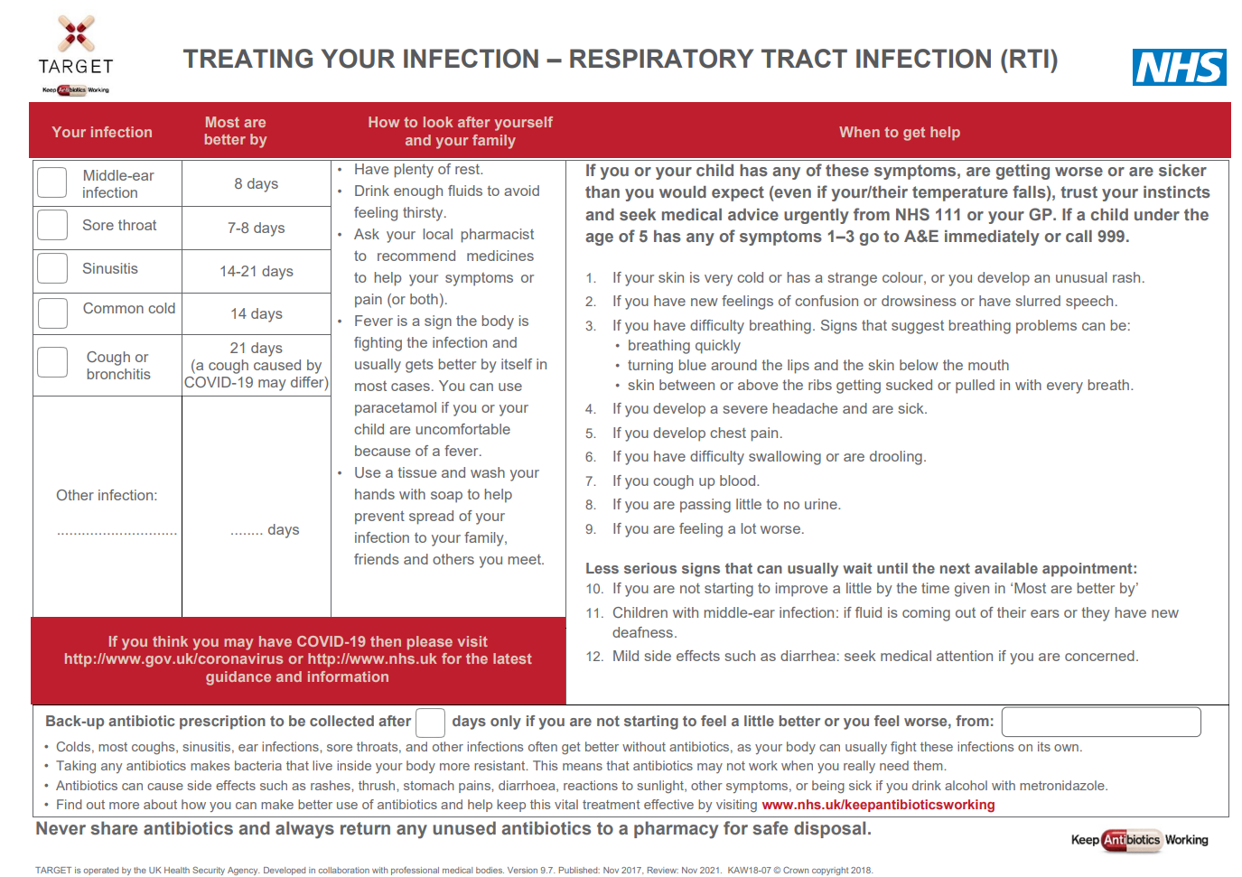
TARGET: Patient Information Leaflets
‘Most are better by’ section to help patients know when to (re) consult
Safety netting
Covid-19 Information
Back-up prescription
Information about antibiotics & AMR
Last review: Feb 2023
Next review: Feb 2026
Notes:
Presenter notes
It would be useful to print off a copies of this leaflet and take enough with you for each GP. They can be found at
Leaflets to discuss with patients: How to use these leaflets (rcgp.org.uk)
Presenter Talk
It can be difficult having the to prescribe or not to prescribe discussion with patient. The treating your infection leaflet has been developed through extensive feedback with patients and clinicians over the last 2 years. It is designed to be shared with the patient and completed with them during the consultation. Its aim is to increase the patients confidence to self-care, and to facilitate the use of back-up antibiotics, but it also allows the patients to go away with something, so ending the consultation on a positive note.
All leaflets are now available in HTML format and can be sent to patients via SMS using AccuRx
Bring in ‘most get better by’ text box
The ‘usually lasts’ section allows patients to understand not only for this consultation but also others when they should consult. This section has consistently been seen as very useful by patients of all ages.
Bring in safety netting box
Whatever the infection, in this era of antibiotic resistance and with increasing numbers of elderly or vulnerable patients, it is extremely important to give some clear safety netting instructions. These are some that can be used and saved by patients.
Bring in COVID-19 box
There is information on where patients can go for more information if they are concerned about COVID-19
Bring in back-up prescription box
The back-up prescription can reduce antibiotic prescribing by about 40%, and is extremely useful for particularly demanding patients or just before a weekend to reduce visits to out of hours services. These different options are given, so that the patient understands where to pick up the leaflet, a recent study by Little et al shows that either of the options leads to similar % of antibiotics being taken, but that giving the patients the prescription and advising them when to pick the antibiotic up –leads to slightly greater patient satisfaction.
Bring in information box
Although most patients know they shouldn’t take antibiotics for coughs and colds, far fewer know that sinusitis, ear infections and sore throats and many other infections get better on their own without antibiotics.
Likewise they know little about antibiotic resistance, so we should take every opportunity to educate them.
This final statement is important – as in January 2017 16% of patients given oral antibiotics in the last year reported having some left-overs, and this was 28% of 16-24 year olds. Of those with left-overs 30% kept them for future use just in case. So take the opportunity to stress not to share antibiotics, and to return left-overs to a pharmacy.
There is a READ code for delayed/ back-up antibiotics or leaflet given and if you Read code the infections featured the leaflet with EMIS and some other systems this leaflet will appear on your computer via the patient.co.uk system.
Extra notes for presenter:
Most prescribers have access to many leaflets, both paper ones and ones that can be printed off their computer system or the web. However, not all information resources are based on the best available evidence or have been developed through rigorous processes. The Antibiotic Information Leaflet has been developed through over 24 months of literature searching, consultation, focus groups with patients and staff, drafting and revision.
Overview of the leaflet
To use this leaflet properly, it is important that clinicians use it as a tool to interact with patients, rather than just handing it to them as a ‘parting gift’. In order to communicate this effectively you must make sure that you are very familiar with its content. Please make sure that, in addition to completing this training, you take some time to thoroughly familiarise yourself with the leaflet before you start using it.
.

Slide 31
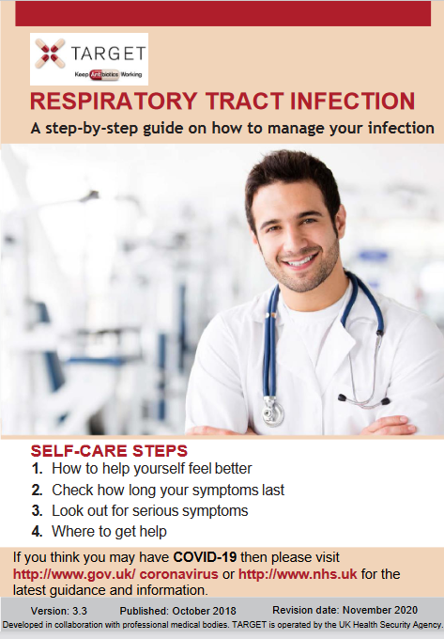
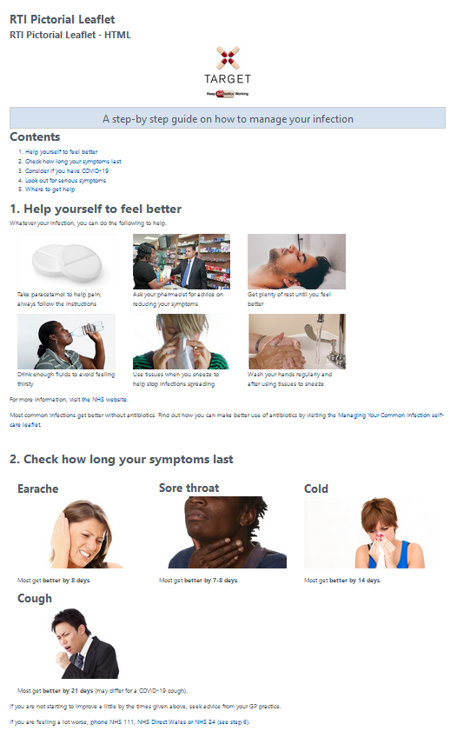
TARGET: Treating Your Infection RTI Leaflet
Pictorial leaflet
Digital leaflets
Notes:
The target RTI leaflets are available in a pictorial word/pdf version that can be printed off and used in a consultation
The standard and pictorial versions of the leaflets are also available in HTLM and can be embedded in GP system SMS templates so they can be texted or emailed after a consultation.

Slide 32
What do we know now?
Using a clinical scoring tool can help clinical decision making for sore throat
  Recommend FeverPAIN
Tip: Video on how to include this in the patient journal:
  https://www.youtube.com/watch?v=0evTlTH5vvg
Structure consultation using CHESTSSS and use TARGET RTI leaflet
Prescribing antibiotics can reinforce beliefs about antibiotics which can drive re-consultations

Slide 33
But my patient still wants antibiotics!
Consider a back up prescription…

Slide 34
Why use back-up antibiotic prescriptions?
Reduce patient use of antibiotics
Useful if unsure whether immediate antibiotic is needed
Little difference in symptomatic benefit with immediate vs. back-up antibiotics
Increase patient’s ability to self-manage infections
Prevent complications
Reduce re-consultations
Notes:
Speaker notes
Here are 6 reasons for why should you use back-up/delayed antibiotic prescriptions
In the following few slides we will examine the evidence behind these statements.

Slide 35
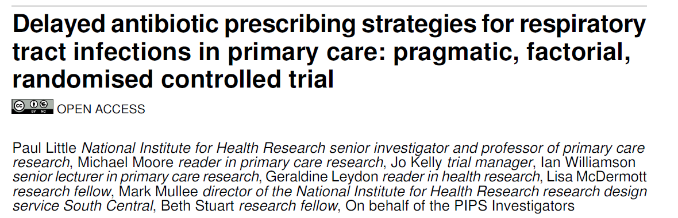
Back-up antibiotic prescriptions - Why?
1. Reduce patient use of antibiotics
  2014 trial: Only one third of patients use antibiotics when given a back-up prescription
Little P, et al. BMJ 2014; 348 :g1606
doi:10.1136/bmj.g1606
Notes:
Speaker notes
Reduce patient use of antibiotics
Using delayed or back-up antibiotics can actually reduce patient use of antibiotics as many patient will not actually get the antibiotics.
In 2014 - A Large randomized control trail in the UK looked to estimate the effectiveness of different strategies involving delayed antibiotic prescription for acute respiratory tract infections
The study looked at 889 patients aged 3 years and over with acute respiratory tract infection
The study found that only <40% of patients use antibiotics when given a back-up prescription.
Fast forward to 2021 – a telephone survey of 1676 members of the English general public found that only 3% were offered a delayed antibiotic throughout 2020 – note that 75% of these found it completely acceptable and only 4% stated it was unacceptable. – but of these 3%, again only about 40% took the antibiotic.
Additional notes on the 2014 trial (Little et al. 2014)
Patients who were judged not to need immediate antibiotics were randomised to undergo 4 different types of delayed prescription: (1) recontact for a prescription, (2) post-dated prescription, (3) collection of the prescription, (4) and be given the prescription (patient led). During the trial, a strategy of no antibiotic prescription was added as another randomised comparison.
Symptom severity: Minimal differences in mean symptom severity between the strategies involving no prescription and delayed prescription
Symptom duration: Duration of symptoms rated moderately bad or worse also did not differ between no prescription and delayed prescription strategies combined (median 3 days v 4 days; 4.29, P=0.368). There were modest and non-significant differences in patients very satisfied with the consultation between the randomised groups
Strategies of no prescription or delayed antibiotic prescription result in fewer than 40% (around one third) of patients using antibiotics, and are associated with less strong beliefs in antibiotics, and similar symptomatic outcomes to immediate prescription. If clear advice is given to patients, there is probably little to choose between the different strategies of delayed prescription.

Slide 36
Back-up antibiotic prescriptions – Why?
2. Useful if unsure whether immediate antibiotic is needed at that time
English RCT comparing three treatment strategies for sore throat (n=582)
Little, Williamson, Warner et al. BMJ . (1997) 314:722 - 727
Notes:
Presenter notes: There has been much discussion about the use of giving delayed antibiotic prescriptions in acute uncomplicated infections, to reduce antibiotic use and reduce patient expectations (although patients understand the term back-up more easily – so we have now changed to this term. A Cochrane review has recently shown the benefits of this approach, without increasing complications in patients.
This study in acute sore throat is an exemplar. patients in 11 English GP practices were randomised into immediate antibiotics, delayed antibiotics and no antibiotics groups.
There was no difference in recovery rates and high levels of satisfaction with all strategies. Compared to immediate antibiotics those given no antibiotics or delayed antibiotics had a reduction in belief in antibiotics for sore throat and were less likely to visit the GP again for similar symptoms. A more recent study of acute sore throat (the DESCARTE study) in fact showed that complications in those who received immediate were similar to those receiving a back-up prescription even though 30% did not collect the prescription, and in the study complications were higher in the no antibiotic group. Thus giving more control to the patient does help prevent complications, but with a back-up antibiotic safety netting instructions are important.
The back-up prescription is very useful to give to patients who have a high expectation for antibiotics, and can be given using the patient leaflet I will show you.
Detailed results of Little et al: Median duration of antibiotic use differed significantly in the three groups (10 v 0 v 0 days, P < 0.001); 69% of patients in group 3 did not use their prescription. The proportion of patients better by day 3 did not differ significantly (37% v 35% v 30%, P = 0.28), nor did the duration of illness (median 4 v 5 v 5 days, P = 0.39), days off work or school (median 2 v 2 v 1, P = 0.13), or proportion of patients satisfied (96% v 90% v 93%, P = 0.09), although group 1 had fewer days of fever (median 1 v 2 v 2 days, P = 0.04). More patients in group 1 thought the antibiotics were effective (87% v 55% v 60%, P < 0.001) and intended coming to the doctor in future attacks (79% v 54% v 57%, P < 0.001). "Legitimation" of illness-to explain to work or school (60%) or family or friends (37%)-was an important reason for consultation. Patients who were more satisfied got better more quickly, and satisfaction related strongly to how well the doctor dealt with patient's concerns.
In other studies delayed prescriptions have led to the greatest reduction in future consultation in sore throat (Little 2007) and LRTI (Moore 2009).
A Cochrane review of 10 studies has shown that delayed prescriptions reduce antibiotic prescriptions without reducing satisfaction
Antibiotic use (%) Satisfaction (%)
Immediate 93 92
Delayed 32 87
No 14 83

Slide 37
Back-up antibiotic prescriptions - Why?
3. Little difference in symptomatic benefit with immediate vs. back-up
 | Total Duration untreated | Beneficial effect from antibiotics | NNT for one additional patient to benefit | NNT for one additional adverse effect
Otitis media | 4 -12 days | 8-12 hours | 18 | 9
Sore throat | 8 days | 12-18 hours | 6-20 | 15
Sinusitis | 12-15 days | 24 hours | 18 | 8
Bronchitis | 20-22 days | 11-24 hours | 10-22 | 24
Cochrane reviews Otitis media: Venekamp et al (2015); Sore throat: Spinks et al. 2013; Sinusitis: Leminengre M et al. (2012); bronchitis: Smith et al. (2014)
Notes:
Presenter notes:
How useful are antibiotics for common respiratory tract infections? This table includes much of the research on what we know about common respiratory tract infections, how long the symptoms usually last, and how much patients benefit from taking antibiotics. As you can see from the circled column, antibiotics reduce symptoms for between 8 and 24 hours. So at best about 12 hours in otitis media, an illness that lasts for 4 to 8 days; taking a look at the NNT Benefit and NNT Harm columns – 18 patients with OM need to be treated with antibiotics for one patient to benefit, but for 9 patients receiving antibiotics one will experience an adverse effect. For bronchitis, an illness that lasts for about three weeks, the reduction in days with cough was less than half a day and the reduction in days feeling ill was just over half a day with antibiotics.
Any benefit that our patients achieve from antibiotics is tiny and the numbers needed to treat to achieve one satisfactory earlier resolution needs to be weighed against the one in 10 chance of causing side effects such as diarrhoea, vomiting, rash, allergic reaction (1 in 15) or the risk of carrying a resistance bacteria. So, unless symptoms are particularly severe, there is no reason for using antibiotics in the majority of patients presenting with respiratory symptoms because they do not help.
Evidence
This evidence is all outlined in the PHE antibiotic guidelines and NICE CG69, but most recent systematic reviews include:
Otitis media
Venekamp et al (2015) Antibiotics for acute middle ear infection (acute otitis media). Cochrane
http://www.cochrane.org/CD000219/ARI_antibiotics-for-acute-middle-ear-infection-acute-otitis-media-in-children
This systematic review included 13 RCTs involving 3401 children with otitis media (3938 episodes). Pain was not reduced by antibiotics at 24 hours. A third fewer had residual pain at 2-3 days (at which point pain levels are usually substantially reduced) and NNT for an additional beneficial outcome was 20. Antibiotics reduced the number of Tympanic Membrane perforations, but NNT for Benefit is 33. Severe complications were rare and did not differ between children given antibiotics and those given placebo. Antibiotics are most beneficial for children aged <2 yrs with bilateral AOM (NNTB 4) or with both AOM and discharge (NNTB 3). Immediate antibiotics were associated with a substantial increased risk of vomiting, diarrhoea or rash compared with no treatment (NNTH9).
Sore throat
Spinks A et al. (2013) Antibiotics for sore throat. Cochrane
http://onlinelibrary.wiley.com/doi/10.1002/14651858.CD000023.pub4/pdf/abstract
27 RCTs of antibiotics for sore throat vs placebo including 12 835 cases. Antibiotics were most beneficial if given at day three if throat swabs were positive for streptococcus (NNTB 6) compared to NNTB at day 7 of 21. Antibiotics reduced duration of symptoms by 16 hours on average. 90% resolve in 7 days. Advantages may be greater in low income countries (possibly recent travelers from these countries – personal communication Dr L Hendricks) where the risk of rheumatic fever is higher. NNTH is 15.
Little P et al (2013) – 2 studies within the PRISM trial used a Clinical score compared to rapid antigen detection test to guide antibiotic use for sore throats. The RCT using clinical scores to predict streptococcal infection in patients and found that the use of FeverPAIN is likely to moderately improve symptom control and reduce antibiotic use. PHE and NICE guidance suggests Consider immediate antibiotics if symptoms severe or a short 48 hour back-up strategy may be appropriate, when the FeverPAIN score is 4 or over. Consider back-up or no antibiotic if score 2-3.
Sinusitis
Leminengre M et al. (2012) Antibiotics for clinically diagnosed acute rhinosinusitis in adults. Cochrane.
http://onlinelibrary.wiley.com/doi/10.1002/14651858.CD006089.pub4/pdf/abstract
10 RCTs of antibiotics vs placebo including 2450 participants. Irrespective of treatment group 47% of patients were cured after 1 week, 71% after 14 days. 18 patients need to be treated for a faster cure rate between 7 and 14 days. If several of: purulent nasal discharge; severe localised unilateral pain; fever; marked deterioration after initial milder phase, patients were more likely to benefit from antibiotics, when PHE and NICE recommend a back-up antibiotic. One disease related complication (brain abscess) occurred in patient treated with antibiotics, but complications are rare.
Bronchitis/LRTI (without pneumonia)
Smith S et al. (2014) Antibiotic treatment of people with clinical diagnosis of acute bronchitis. Cochrane
http://www.cochrane.org/CD000245/ARI_antibiotic-treatment-people-clinical-diagnosis-acute-bronchitis
17 trials with 5099 participants were included. The number needed to treat for one additional beneficial outcome was 22 (NNTB 22). The reduction in days with cough was 0.46 days and days feeling ill was 0.64 days (CI 1.16-0.13). NNT for an additional adverse effect was 24.

Slide 38
Back-up antibiotic prescriptions - Why?
4. Increase patient’s ability to self-manage infections
Did not take the delayed antibiotic
97% not given a delayed script
(n=1676)
59%
41%
3% given a delayed script
75% of all respondents felt that it was acceptable to be offered a delayed script by their GP
PHE 2021 General Public Health Seeking Behaviour for RTI survey – in press
Notes:
Presenter notes:
A 2021 telephone survey of 1676 members of the English general public found that only 3% were offered a delayed antibiotic in the previous 12 months. Note that 75% of all respondents found it completely acceptable and only 4% stated it was unacceptable. Of this 3%, again only about 40% took the antibiotic.

Slide 39
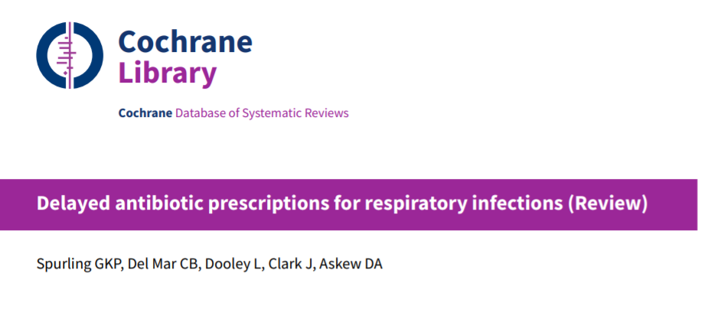
Back-up antibiotic prescriptions - Why?
5/6. Prevent complications (as effectively as immediate antibiotic) & reduce re-consultations (‘doctor shopping’/visits to OOH, A&E)
Little/no difference in:
  Re-consultation
  Adverse effect
  Complications
Spurling GKP, et al. 2017
DOI: 10.1002/14651858.CD004417.pub5.
Notes:
Key presenter point:
Delayed prescriptions do not lead to complications or adverse events
Presenter notes: There has been much discussion about the use of giving delayed antibiotic prescriptions in acute uncomplicated infections, to reduce antibiotic use and reduce patient expectations (although patients understand the term back-up more easily – so we have now changed to this term. A Cochrane review has recently shown the benefits of this approach, without increasing complications in patients.
A Cochrane review from 2017 of 11 studies has shown that:
Comparing delayed vs immediate antibiotics, there was not difference in re-consultation rates
Compared to no antibiotics, delayed antibiotics led to a small reduction in how long pain, fever, and cough persisted in people with colds.
There was little difference in antibiotic adverse effects, and no significant difference in complications.
Spurling GKP, Del Mar CB, Dooley L, Foxlee R, Farley R. Delayed antibiotic prescriptions for respiratory infections. Cochrane Database of Systematic Reviews 2017, Issue 9. Art. No.: CD004417. DOI: 10.1002/14651858.CD004417.pub5.

Slide 40
How to give back-up/delayed antibiotics?
889 UK GP patients > 3 years with acute respiratory tract infection
Last review: Feb 2023
Next review: Feb 2026
Little BMJ 2014
Notes:
Presenter Talk
Which way should we give back-up antibiotics?
This 2014 trial by Little et al in UK general practice indicates it doesn’t really matter. Patients judged not to need immediate antibiotics were randomised to undergo four strategies of delayed prescription: recontact for a prescription, post-dated prescription, collection of the prescription, and be given the prescription (patient led). During the trial, a strategy of no antibiotic prescription was added as another randomised comparison. Patients had similar symptom severity scores. Each of the strategies resulted in similar antibiotic use, belief in antibiotics and satisfaction, although patient led pick up had slightly greater satisfaction and use and less belief – but neither were significant.
That being said UK STEP UP team examined Public preferences for delayed or immediate antibiotic prescriptions in UK primary care using A choice experiment. Their findings suggest that prescribing choices for sore throat may need additional explanation to ensure patient acceptance, and parents in particular may benefit from reassurance about the usual duration of these illnesses.
So do what works for your practice, your way of working and of course the day of the week.
Slide References
Paul Little, Michael Moore, Jo Kelly, et al Delayed antibiotic prescribing strategies for respiratory tract infections in primary care: pragmatic, factorial, randomised controlled trial. BMJ 2014; 348 doi: https://doi.org/10.1136/bmj.g1606
Morrell L, et al; STEPUP team. Public preferences for delayed or immediate antibiotic prescriptions in UK primary care: A choice experiment. PLoS Med. 2021 Aug 30;18(8):e1003737. doi: 10.1371/journal.pmed.1003737. PMID: 34460825; PMCID: PMC8439451.

Slide 41
Back-up antibiotic prescriptions - How?
***Don’t forget to code your treatment choice***
READ codes (Emis, Vision) | SNOMED code (System One) | Definition
8BP0 | 2549788011 | Deferred antibiotic therapy
8CAk | 406111000000113 | Patient advised to delay filling of prescription
8OAN | 2462831000000113 | Provision of TARGET Managing Your Common Infection (Self-Care) Leaflet with back-up antibiotic prescription issued
Last review: Feb 2023
Next review: Feb 2026
Notes:
Presenter Talk
Don’t forget to code your treatment choice. Much of the evidence presented today use Read/Snomed codes to trawl the data, if you haven’t coded its makes it difficult for researchers to understand the benefit or not of any treatment. It also helps if you want to look back and audit your prescribing.

Slide 42
How else can TARGET resources support your practice?

Slide 43

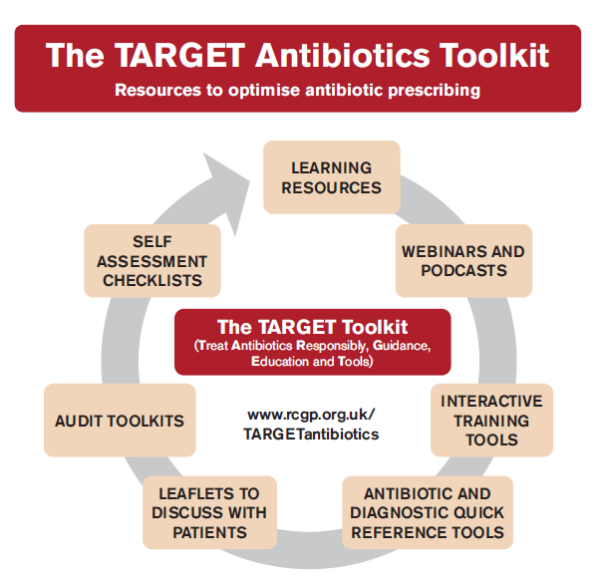
TARGET toolkit
www.rcgp.org.uk/TARGETantibiotics
Notes:
What is TARGET?
Developed by the UK Health Security Agency (UKHSA), the Royal College of General Practitioners (RCGP) and the Antimicrobial Stewardship in Primary Care (ASPIC) Group, TARGET is the central resource to help primary care healthcare professionals and commissioning organisations improve antibiotic prescribing. Using the TARGET Antibiotics Toolkit resources will also enable primary care organisations to demonstrate compliance with the Health and Social Care Act 2008: Code of Practice on the prevention and control of infections and related guidance.
Who is the toolkit for and how can it be used?
To get maximum effect regarding antibiotic use, all or as many as possible of the resources should be used with action planning by those involved in antimicrobial stewardship activities such as those from clinical commissioning groups (CCGs) and primary care networks (PCN), prescribers working in primary care, and those involved in training prescribers around infection management. Collectively, the TARGET resources will support practices in planning, implementing and reviewing activity in delivering quality improvement programmes relating to antimicrobial stewardship. A recent rigorous RCT evaluation in routine general practice showed that a one hour TARGET workshop given by local GPs, microbiologists or medicine managers, combined with demonstrating the resources, significantly reduced antibiotic use.
It is essential to plan and monitor implementation of the TARGET Antibiotics Toolkit appropriately and this is best achieved by developing a local antibiotic action plan, either for your CCG or your practice. It is important that this plan is developed using a whole team approach so that everyone who is involved in communication and prescribing around antibiotics has had the opportunity to contribute.
Each CCG, PCN and Practice has different prescribing pressures and priorities. It is therefore also important that prescribers take ownership of the planning process as well as the adaptation and implementation of resources at a local level. Before beginning the planning process we recommend you appoint a local antibiotic champion from within the CCG or the practice. This could be a prescribing lead, GP with a specialist interest in infection management, nurse practitioner, clinical pharmacist, or any other person who can be responsible for antimicrobial stewardship in your practice, your PCN or CCG. This is someone who has responsibility for leading on all issues relating to antibiotics and leads the development and implementation of the antibiotic action plan.
In order to maximise effectiveness of the TARGET resources, users should plan, monitor and review the implementation as part of a cyclical process as follows:

Slide 44

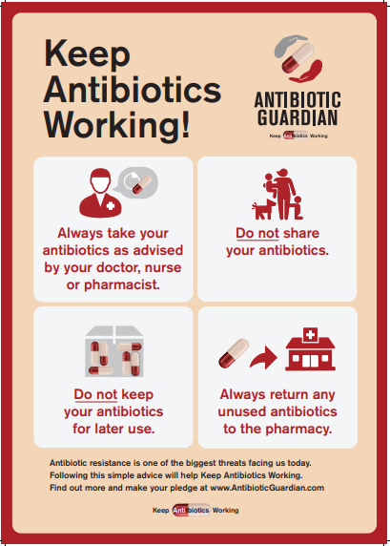
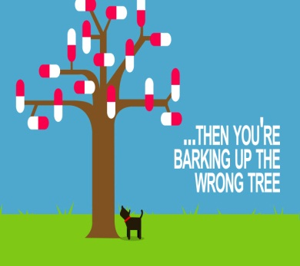
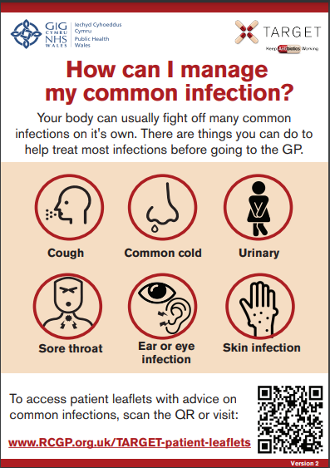
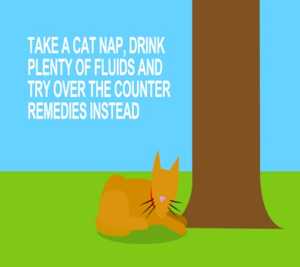

TARGET: Additional supportive tools
Posters for Display
Videos for patient waiting areas
Last review: Feb 2023
Next review: Feb 2026
Notes:
Presenter notes:
These posters and videos may make a difference to patient expectations about when to expect antibiotics, IF used in the waiting room where patients can see them and IF they have the time to digest the information. In 2014 25% of the general public surveyed remembered seeing the first poster and 95% of these correctly answered that antibiotics don’t help most coughs and colds. Used alone without any other strategies posters will make little difference to patients expectations for antibiotics, but they can be used to reduce expectations and can be used as a prompt for dialogue –
“you may have seen from the posters or videos in the waiting room that we in this practice encourage responsible antibiotic prescribing”
The videos were developed with patients and each animal cartoon video appealed to different people. A recent small survey of their use showed that those patients who saw them remembered the messages – however often the video sound was muted, chairs were pointing in the wrong direction or the video screen was off. If you intend to use them please don’t make this mistake.

Slide 45
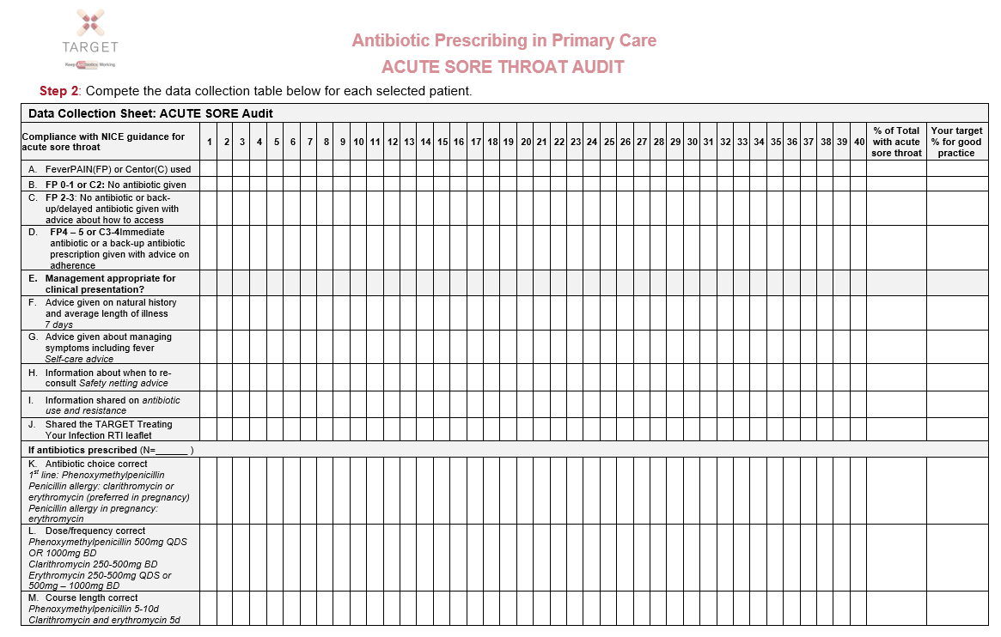
TARGET: Audits
Could your practice commit to doing an audit this year?
The TARGET website has audit templates for :
    Acute Sore Throat
    UTI
    Acute cough
    Acute otitis media
    Otitis externa
    Acute rhinosinusitis
Excel template auto calculates prescribing compliance for you!
Last review: Feb 2023
Next review: Feb 2026
Notes:
Presenter Talk
Have you done any personal or practice wide antibiotic audits in the last year?
The self-assessment check list suggests
a biannual practice wide antibiotic audit
You keep a personal action plan following audits.
Read coding facilitates audits
The TARGET website has audit templates with appropriate guidance and Read codes to use for:
Otitis media, sore throat, acute cough, UTI, otitis externa, acute rhinosinusitis.
These will also help you comply with your CPD and revalidation.

Slide 46
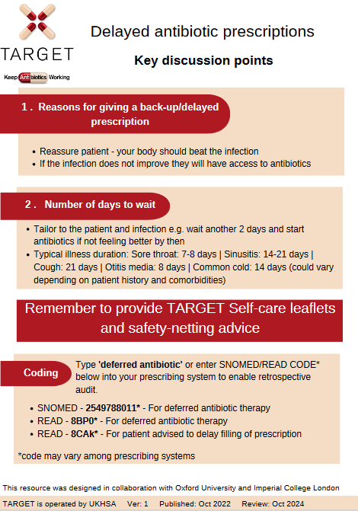
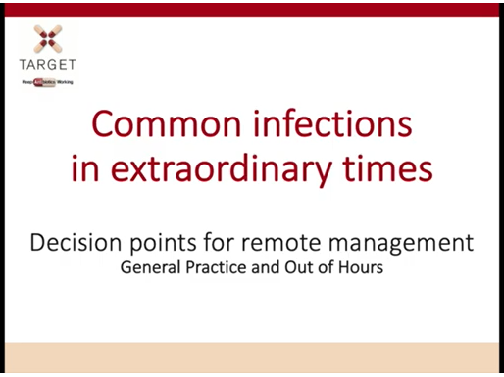
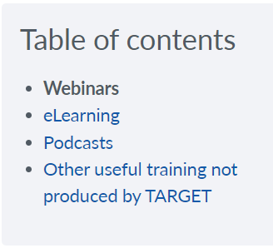
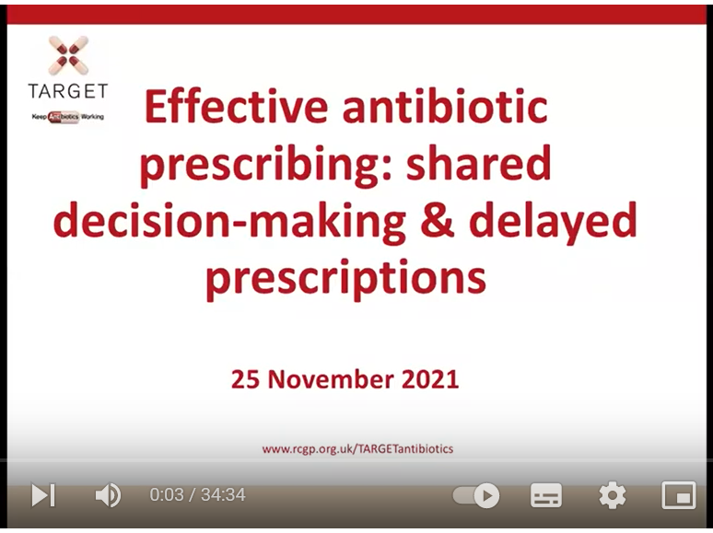
TARGET: Learning Resources
Last review: Feb 2023
Next review: Feb 2026
Notes:
Presenter notes:
These are examples of the training resources available on the TARGET antibiotics website.
Many of the most recent TARGET webinars are specific to antibiotic use covering topics like delayed prescribing and remote consultations

Slide 47

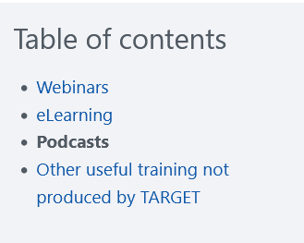
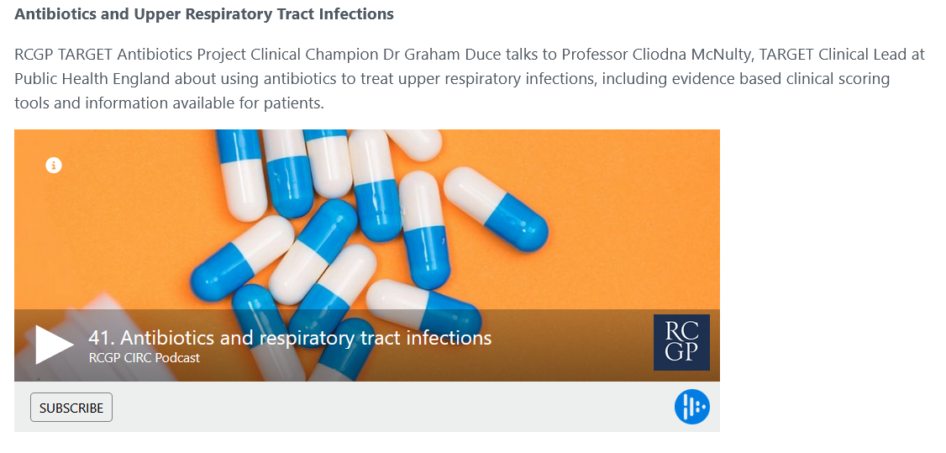
TARGET: Learning Resources
Podcasts
Last review: Feb 2023
Next review: Feb 2026
Notes:
Presenter Talk
These are examples of the training resources available on the TARGET antibiotics website.
Check out these podcasts to learn more about resistance and management for Upper respiratory tract infections.

Slide 48
In summary
Reducing antibiotic prescribing in your practice
Makes difference to resistance in your patients
Helps to slow future antibiotic resistance
Increase patient self-care
Helps to reduce future consulta-tions
www.rcgp.org.uk/TARGETantibiotics
Notes:
Presenter notes:
Thus in summary, I hope you agree that the evidence suggests that by improving the antibiotic prescribing in your practice – you can:
Make a difference to the care of individual patients.
Help to slow the development of future resistance in our community.
AND as a bonus help to increase patient self-care and reduce future consultations for self-limiting infections.

Slide 49
Actions
What can and will you do?
www.rcgp.org.uk/TARGETantibiotics
Notes:
Presenter notes:
So what can and will you as an individual and as a practice do to help?
Please can we discuss a plan?
Need to discuss a plan with each practice
They are all evidence based
Get them to do the planning – so moves on within the practice
Get them to prioritise
Get them to plan review with audit.
Identify a person to take forward
Find the individual with computer interest and get them to help with a computer reminder linking to the TARGET patient shared information.
Action plan, timescale, review date
1 year plan – as a lot going on and can’t do it all now
Need to show them the scale of change which can be attained

Slide 50
Action Planning
Action planning for next 12 months: Agree What, How, Who, When
Familiarise staff with, and use FeverPAIN/Centor score
Use TARGET RTI patient leaflet in consultations
Use coded back-up/ delayed antibiotic prescribing when indicated
Set up computer reminders for leaflets and back-up antibiotics
Use delayed date on electronic prescription
Agree who will put up posters/videos in the surgery
Complete an audit of management of acute sore throat
Last review: Feb 2023
Next review: Feb 2026
Notes:
Presenter notes:
Developing a definite action plan with responsibilities will help to reduce antibiotic use in acute sore throat.
Here are some of the ideas – but how they will be taken forward needs to be discussed – this will depend on local guidance, computer clinical systems, etc
Use the Centor or Fever pain scoring system to see whom they could delay antibiotics safely in
Use the TARGET leaflets to encourage self-care
Use back-up/ delayed antibiotic prescribing: How do they want to do this? - can they issue a Electronic Prescribing System token, which allows you to print off the prescription to be picked up later from the surgery; post date the prescription for at least 24 hours. Arrange for them to not pick it up from the pharmacy for at least 24 hours.
Set up computer reminders for leaflets and back-up antibiotics – who can do this? Available on EMIS and SystmOne
Use electronic prescribing “token” and get patient to pick up later from the surgery

Slide 51
Workshop Outcomes
By the end of this workshop you should have a clear understanding of…
The consequences of antimicrobial resistance and the role we all play in contributing to, and addressing AMR
The TARGET toolkit and how it can support you - where to find it and how to use it
What you, and your practice, can do to help tackle AMR safely and responsibly
Coding, back-up prescriptions & TARGET leaflets
www.rcgp.org.uk/TARGETantibiotics
Notes:
Presenter notes:
By the end of the workshop today you should have a clear understanding of;
The consequences of antimicrobial resistance and the role we all play in contributing to, and addressing AMR
The TARGET toolkit and how it can support you - where to find it and how to use it
What you, and your practice, can do to help tackle AMR safely and responsibly
The value of using appropriate SNOMED/Read codes
And have started to think about/create an action plan of how you can implement changes in your practice to help tackle AMR

Slide 52

Many thanks!
Please complete the evaluation form
https://surveys.phe.org.uk/TARGETNorthamptonshire
to receive your CPD certificate
TARGETantibiotics@phe.gov.uk
www.rcgp.org.uk/TARGETantibiotics
Notes:
This slide is for training sessions where you have cascaded TARGET training and will take users to a general evaluation form, which will generate a certificate when they have completed the evaluation.
Please contact the TARGET team if you would like the evaluation feedback.

