Slide 1
Menopause and HRT
Non-Medical Nurse Prescribing
Programme
4th July 2023
Dr Joanne Watt
GP with special interest in sexual health and menopause
Great Oakley Medical Centre

Slide 2
What is menopause
“Menopause is the permanent cessation of menstruation that results from loss of ovarian follicular activity.
Natural menopause is recognised to have occurred after 12 consecutive months of amenorrhoea for which no other obvious pathological or physiological cause is present.
Menopause occurs with the final menstrual period and thus is known with certainty only in retrospect one year after the event. No adequate biological marker exists. “ British Menopause Society, -Management of the menopause 2021
Median age of menopause in the UK is 51 years

Slide 3
What is Perimenopause
“Perimenopause includes the period beginning with the first clinical, biological and endocrinological features of the approaching menopause, such as menopausal symptoms and menstrual irregularity, and ends 12 months after the last menstrual period” British Menopause Society 2021

Slide 4
Who experiences menopause?
Menopause is predominantly experienced by women and most existing research is based upon cisgender women, this presentation focuses on that experience and I will use she/her pronouns for brevity.
However, it is important to acknowledge that transgender, non-binary and intersex people may also experience the menopause.
They will also have specific needs and experiences, and specialist input may be required to support trans, non-binary and intersex people.

Slide 5

Symptoms
Hot sweats/flushes (Vasomotor symptoms)
Sleep disturbance
Change in menstrual pattern
Brain fog/mood changes/lack of energy (other psychosocial factors may co-exist)
Loss of libido
Joint and muscle pains
Palpitations (may have other causes)
Vaginal dryness/dyspareunia/pruritus/burning
Urinary symptoms- frequency/dysuria/urgency/incontinence, may have recurrent UTIs
Dry skin/hair
Median duration of symptoms is 7 years, may persist beyond 60 yrs

Slide 6
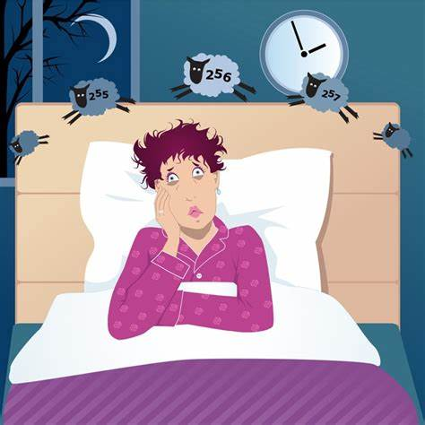

Slide 7
Staff wellbeing and retention-NHSE menopause policy
Approximately 75% of women experience menopause symptoms and nearly a quarter of these are reported as severe.
47% of NHS staff are aged over 45, over half are female.
This affects many of us, our friends, family, colleagues and employees.
Over 70% of women report that they feel unsupported at work, even though one in five (19 per cent) say their symptoms have a detrimental effect on their work. One in ten women said they have even considered leaving their job.
NHSE regional team pilots aim to support this cohort of staff and to aid staff retention (including a primary care pilot).
This is therefore not just an issue for female colleagues - although the physical and psychological symptoms of menopause do mainly affect women, menopause can also directly and indirectly affect others both within the workplace and at home. This can include male and female colleagues, non-binary and intersex colleagues, family members, and same sex partnerships.

Slide 8
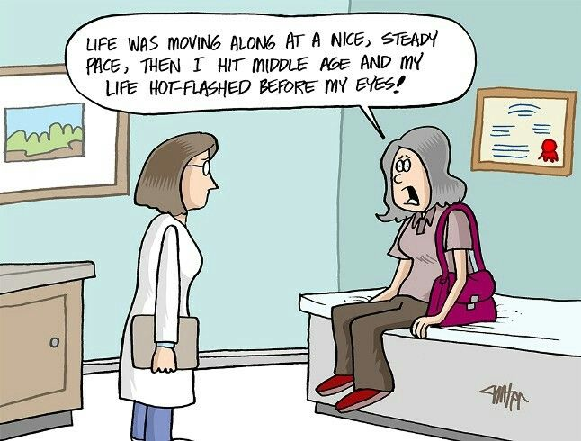
Practical Management Of Menopause

Slide 9
When should we do tests? (NICE guidance 2015)
No need to do a blood test if >45 and typical symptoms
Test if atypical symptoms/other differentials
If 40-45 yrs consider FSH >30 (twice 6/52 apart) = early menopause
If <40 yrs check FSH >30 (twice 6/52 apart) = premature ovarian insufficiency (POI), will need other checks in addition to Rx HRT

Slide 10
Lifestyle advice for everyone
Healthy diet esp adequate calcium and vitamin D intake
Optimal BMI, may do better on low GI diet than low fat if trying to lose weight (obesity increases risk of breast cancer more than HRT),
Exercise esp weight bearing if increased risk of Osteoporosis/menopause <45 yrs
Address CVD risk factors including, stop smoking, BP, DM control and lipids
Alcohol-less than 2 units a day
Sleep hygiene
Pelvic floor exercises
Skin esp sun-protection
Screening programmes for breast, bowel and cervix if eligible

Slide 11
HRT overview
Effective for vasomotor symptoms
Mood changes
Sexual function
MSK symptoms
Bone density
Transdermal HRT usually improves migraines
Urogenital changes (might need local treatment too)
No need to wait for periods to stop or blood tests to change to start Rx
Treat POI with HRT until age 51
HRT does not provide contraception

Slide 12
HRT contra-indications/cautions
Current/recurrent VTE HRT is CI until anticoagulated-then use transdermal
Avoid oral HRT if thrombophilic disorder
Liver disease
Uncontrolled hypertension-ok to start once controlled
Undiagnosed vaginal bleeding
Untreated endometrial hyperplasia

Slide 13
Non-HRT alternatives-not first line unless HRT CI
CBT for low mood, especially if used with exercise
Uncertain content/safety for Isoflavones/black cohosh
Bio-identical hormones not regulated so safety/effectiveness concerns
SSRI/SNRI (do not use paroxetine/fluoxetine with tamoxifen)
Clonidine
Gabapentin for flushes
B blockers for anxiety/palpitations

Slide 14
Which HRT to prescribe
Oestrogens are the most cost-effective treatment for menopausal Sx, available as patch/gel/spray/oral
If uterus still present also need progestogens for endometrial protection (even if ablation), IUS/combined patch/oral/utrogestan off licence vaginally
Use sequential HRT until menopause then switch to continuous combined once 12/12 amenorrhoea(better endometrial protection than sequential)
Start with low dose and adjust as needed every 6-12/52
Transdermal oestrogen has lowest risk of VTE/CVA so should be first line if any risk factors
Micronised progesterone (Utrogestan) seems to have the lowest risk of VTE/CVD/risk of breast cancer
No arbitrary limit to duration of therapy

Slide 15
Indications for transdermal therapy
Individual preference
Poor symptom control with oral therapy
GI disorder affecting oral absorption
Previous or FH VTE
BMI >30
Variable BP control
Migraine
Current use of hepatic enzyme inducing meds
Gallbladder disease

Slide 16
Systemic HRT Overview
Uterus?
Yes
No
Postmenopausal?
Mirena fitted and in date
Y
N
VTE/CVA risk?
If yes –continuous combined HRT
If perimenopausal use sequential HRT
Consider progesterone/progestogen choice for endometrial protection, combined patch oral or IUS
+
Y
N
Transdermal oestrogen
Can use transdermal or oral oestrogen

Slide 17
Testosterone??
Currently only indicated for low libido in fully oestrogenised women where other symptoms have resolved, including urogenital symptoms treated
No licensed female formulation in the UK
Need to use male formulations and monitor levels at 6-12/52(to check stays in female range) but response should be judged clinically at 6/12
40mg sachets should last approx 8/7, 50mg sachets should last 10/7 (use a Klippet)
See BMS website for guidance

Slide 18
Don’t forget urogenital symptoms
Always ask-women may not volunteer this information otherwise
Ask at smear tests and routine swabs etc
Consider vaginal lubricants (not KY jelly!) eg Yes!, SYLK (can be used with condoms),
Consider moisturisers for regular use (compatible with condoms) eg replens, regelle
Lubricants/moisturisers can be used with vaginal oestrogens
Consider offering vaginal oestrogens for 6 weeks before a smear test if sore last time
Vaginal oestrogens are very effective, minimal systemic absorption so can be used for as long as needed
The only contraindications are active breast cancer or undiagnosed bleeding

Slide 19

It’s hard to be happy when your nether regions are not!

Slide 20
Vaginal Oestrogens
Oestradiol:
Estring vaginal ring-replace every 90 days
Vagirux pessaries 10mcg (replaces vagifem), daily for 2/52 them twice a week (can be bought otc as Gina)
Oestriol:
Generic vaginal cream 0.01%
Ovestin cream 0.1%, daily for 4/52 then twice a week
Imvaggis pessary, daily for 3/52, then twice a week
Blissel vaginal gel, daily for 3/52, then twice a week
Intrarosa –vaginal DHEA (activates oestrogen and androgen receptors), daily use

Slide 21
And contraception…..
Most methods can be used by healthy women up to age 50 (stop CHC at 50)
CuIUD fitted at 40+yrs can be used until menopause confirmed
IUS fitted under 45 yrs can now be used for 6 years for contraception (5 years if part of HRT)
IUS fitted over 45yrs can be used for contraception until menopause confirmed (or age 55) (5 years if part of HRT)
Depo not ideal due to bone density effect
SDI and POP safe and effective (cannot be the progestogen part of HRT)
Barrier methods still suitable, natural methods less reliable
Use contraception for 2 years if menopause under 50 yrs
Use contraception for 1 year if menopause over 50 yrs
Fertility can be assumed to cease at age 55 if using amenorrhoeic method
Sterilisation may be an option
Don’t forget to check for Chlamydia if IMB or new partner

Slide 22
When to refer/ask for advice?
Undiagnosed/unexpected vaginal bleeding esp if continues more than 6/12 after starting HRT
Breast/other oestrogen dependent cancer
Check with oncology before using HRT (even vaginal oestrogens) if previous breast/hormonal dependent cancer
Complex co-morbidities
Difficulties with ineffective HRT or if not tolerated

Slide 23
Reviewing and stopping HRT
Annual review once stable (AccuRx template)
Check: effective? unexpected bleeding? latest guidance re HRT? Health promotion
Consider 6/52 vaginal oestrogens prior to cervical smear if atrophic changes/discomfort

Slide 24
Practical tips-especially AccuRx
Send useful websites links via SMS when the appointment is booked
Consider supporting a response option for further questions to information links
Create AccuRx templates for vaginal dryness, low carb diet
AccuRx florey to review HRT
Remember about the HRT annual prepayment certificate-(patient applies for it)

Slide 25
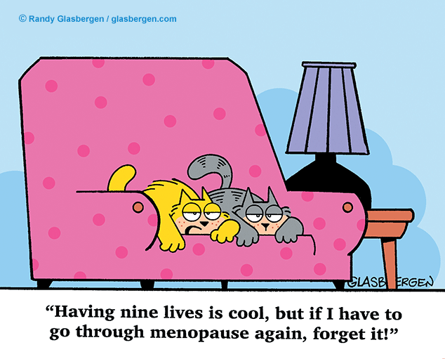

Slide 26
Useful websites
British Menopause Society -https://thebms.org.uk/ has guide to progesterone/progestogen options, especially useful if there are supply issues
HRT prepayment application-https://www.gov.uk/get-a-ppc
Self care: https://www.selfcareforum.org/wp-content/uploads/2022/11/22-Menopause-fs-v2.3.pdf
Menopause diet: https://www.bda.uk.com/resource/menopause-diet.html?fbclid=IwAR3Z_MkXUWTKQhrFLXmKAt4RgZN8jSE13srxXzoB6gLmTkxzrT4LXfqNNew

Slide 27
Any Questions?

