Slide 1
Northamptonshire ICB and the importance of NMPs
Matt Metcalfe
ICB Chief Medical Officer

Slide 2
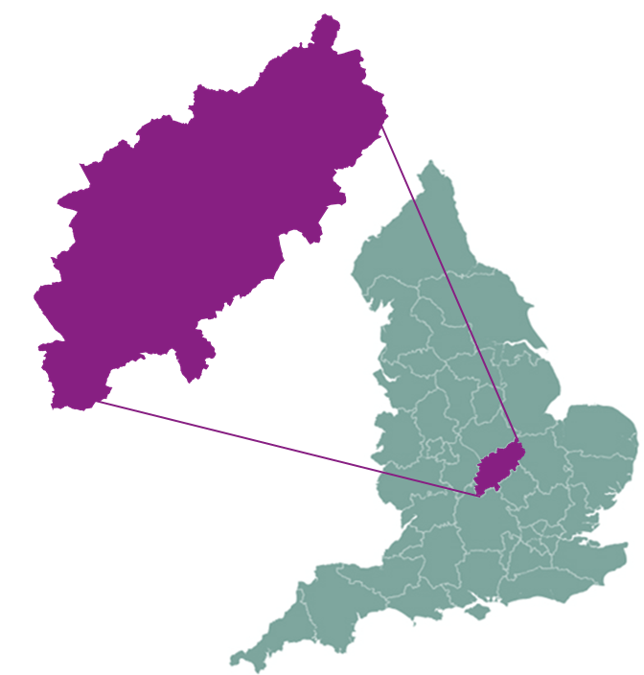
Introduction and background
Integrated Care Northamptonshire formally established on 1 July 2022
Government legislation sets out powers and responsibilities of ICSs
[PRESENTER DELETE NOTE - If you make any amends for your stakeholder audience for core message alignment and consistency, please help us maintain a record and message consistency by sending your amended version to nhcp.communications@nhs.net]
What does this mean for Northamptonshire?
Formalises existing joint working arrangements
Simplifies partnership working and decision-making
What is integrated care?
Joined-up care and support across all partners
Removing barriers and gaps between services / organisations
2
2
Notes:
We are one of 42 ICS areas to be created across England, and now government legislation is in progress to give all of these Integrated Care Systems statutory status, most likely by April 2022.
This will formally set out the powers and responsibilities of ICSs to support their populations to live healthy lives and get the care and support they need, when they need it.
What does this mean?
Here in Northamptonshire, ICS status will allow us to formalise some of the existing joint working arrangements we have successfully developed through NHCP, involving many partners.
It will enable us to simplify the way we work together and improve our ability to make decisions together in the same place.
An important part of the national ICS vision is that decisions about how services are arranged should be made as closely as possible to those who use them.
For most people their day-to-day health and care needs will be met locally in the town or district where they live or work. Partnership in these ‘places’ is therefore an important building block of integration.
But one of the strengths of the system is that arrangements can be adapted to reflect what makes sense locally.
What is integrated care?
Integrated care is about giving people the support they need, joined up across the NHS, local councils, voluntary and community organisations and other partners.
It is about removing any barriers or gaps that exist between different parts of health and care – for example, between hospitals and GP practices, between physical and mental health, or between the NHS and council services.
In the past, these barriers and gaps have resulted in too many people experiencing disjointed care.

Slide 3
Why this? Why now?
The ICS will provide a step change in how we:
Improve outcomes in population health and healthcare
Tackle inequalities in outcomes, experience and access
Enhance productivity and value for money
Help the NHS support broader social and economic development
3
Notes:
December 2021 NHSEI confirmed the new target date in 2022/23 priorities and operational planning guidance to allow sufficient time for remaining parliamentary stages
February 2022 Three other Executive Director roles are currently out for recruitment
February 2022 Non-Executive Directors are Afzal Ismail, Andrew Hammond and Janet Gray. A fourth NED role (Chair of Primary Care and Joint Commissioning Committees) is currently out for recruitment

Slide 4
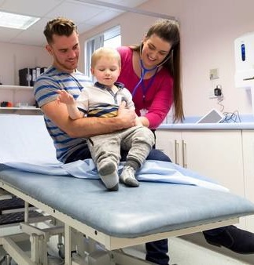
It will do this by:
Building on the successes of the COVID system response
Creating a combined leadership for the health and care system
Emphasising collaboration, for system wide service redesign, transformation and delivery
Breaking down the bureaucratic barriers between organisations
Embedding closer working between NHS and local government overseeing ‘place-based’ commissioning and delivery
Driving neighbourhood arrangements for the tailoring and integration of services to meet local need
4
Notes:
Aligning action between partners to achieve shared purpose of:
Improving outcomes for local people and patients
Tackling health inequalities
Making best use of health and care resources
Strengthening contribution to local communities
Building on NHS Long Term Plan priorities
Building on experiences of system working during Covid response
Moving to greater collaboration (not competition) within the NHS
Closer integration between the NHS and local government

Slide 5
The shape of our ICS
Integrated Care System
Combined leadership for health
and care system
Integrated
Care Board
Integrated Care Partnership
Developing collaboratives as a
focus for system-wide service
redesign, transformation and
delivery (Lead Provider/Alliance)
System-wide
Children and Young People
Mental Health, Learning Disability
and Autism
iCAN
(Ageing well)
Elective
Care
Oversee place-based joint
commissioning and delivery
Place
Place
North Northamptonshire
Health and Wellbeing
Board
West Northamptonshire
Health and Wellbeing
Board
Neighbourhood (sub-place)
arrangements will be needed,
as a basis of effective integration
and tailoring of services to local needs.
Delivery and business is done at this level
Sub-Place
Sub-Place
Sub-Place
Sub-Place
Sub-Place
Sub-Place
All activity to be informed by a collective focus on outcomes for our communities

Slide 6
Non-Medical Prescribing

Slide 7
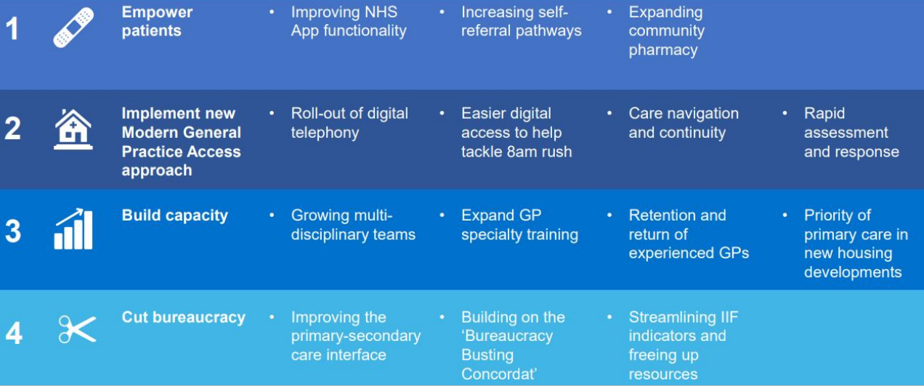
Recovering access to primary care

Slide 8
Expanding Community Pharmacy Services
The Recovery Plan promises a focus on driving activity in Community Pharmacy for services that should be more appropriately accessed closer to the community. There is significant funding over the next two years (£645m) for Community Pharmacy to support this as described in the following slides. The Northamptonshire ICB will need to work closely with Community Pharmacy to support the successful delivery of this as well as the wider ‘hosted’ primary care team (former NHSE) and the other ICBs within the East Midlands.
Pharmacy First
Pharmacy First will enable pharmacists to supply prescription only medicines such as antibiotics and antivirals, in order to treat the following seven common conditions (all without the need to visit a GP):
Sinusitis, sore throat, earache, infected insect bite, impetigo, shingles, uncomplicated urinary tract infections in women.
The service is proposed to launch before the end of 2023 (subject to national negotiations with the Pharmaceutical Services Negotiating Committee).

Slide 9
Expanding Community Pharmacy Services
Community pharmacy blood pressure check service and oral contraceptives
New funding will be used by NHSE to increase access to the blood pressure checks advanced service (which was launched in October 2021).
From April 2023 community pharmacy started to manage ongoing oral contraception for women. This will be expanded following review of pilots. The ICB is waiting on further detail from NHSE for both of these services, but will again work with Community Pharmacy, the hosted primary care team, and the other East Midlands ICBs to develop these.

