Slide 1
What I want to talk about
Understanding how humans make decisions
What this means for:
  Staying up to date in an efficient way
  Having meaningful conversations with people about their medicines choices
  Decision hygiene and safer prescribing

Slide 2
Summary of cognitive psychology session
Dual process theory and the importance of pattern recognition is central to understanding and improving decision making.
Pattern recognition leads to efficient and technically correct decision making most of the time.
But it can also lead us astray if we allow it to guide our decision making without checks and balances.
Sometimes our intuition lets us down
Importance of decision hygeine

Slide 3
Do consultation skills really make that much a difference?

Slide 4
“Consultation”: David
It’s the middle of Friday evening and it’s been another long week at work. At last the chores are done, the house is quiet, and you have just settled down with your current favourite series on Netflix.
Your phone rings. It’s David, a close friend. He’s in a panic having just failed a Masters module. With two young children and a busy A&E post which he isn’t enjoying, you know he’d not had enough time to commit to this module.
How do you reply?

Slide 5
OPTION A
“Don’t worry. After all, you knew you hadn’t had time to prepare properly so really you could have expected this result. I’m sure you’ll pass next time.”

Slide 6
OPTION B
“I’m really sorry.”
“How are you?”
“What are you thinking at the moment?”
“I can imagine how difficult this is”.
“What do you think are your options?”
“Would it help to meet up early next week and chat about this?”
“I’ll do everything I can to help you with this.”
“Please ring me anytime”.

Slide 7
What do people want from a consultation?

Slide 8
The top factors influencing whether people believe they have experienced quality care are:
good interpersonal skills from clinicians and associated staff, including communication and empathy
easy access to care, including convenient appointments with a familiar clinician; and
involvement in care processes, including participation in decisions and self-care support.
Technical stuff is not mentioned….

Slide 9
The majority of clinical errors are not due to a lack of factual knowledge, but due to errors in cue recognition and communication.
e.g. https://jamanetwork.com/journals/jamainternalmedicine/fullarticle/486642

Slide 10
Communicate better.
Conversation can “solve” most complex problems.
More data doesn’t.

Slide 11
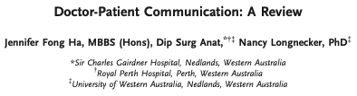
The evidence for good communication between clinician and patient... www.ncbi.nlm.nih.gov/pmc/articles/PMC3096184/
Helps regulate patients' emotions, facilitate comprehension of medical information, and allow for better identification of patients' needs, perceptions, and expectations
Patients are more likely to be satisfied with their care, share pertinent information for accurate diagnosis of their problems, follow advice, and adhere to the prescribed treatment
Patients' agreement with the doctor about the nature of the treatment and need for follow-up is strongly associated with their recovery
Correlations between a sense of control and the ability to tolerate pain, recovery from illness, decreased tumor growth, and daily functioning. Enhanced psychological adjustments and better mental health have also been reported
Decrease in length of hospital stay
Satisfied patients are less likely to lodge formal complaints or initiate malpractice complaints.
Clinicians reported greater job satisfaction, less work-related stress, and reduced burnout

Slide 12
What consultation models have you used / do you use / have you heard of?

Slide 13
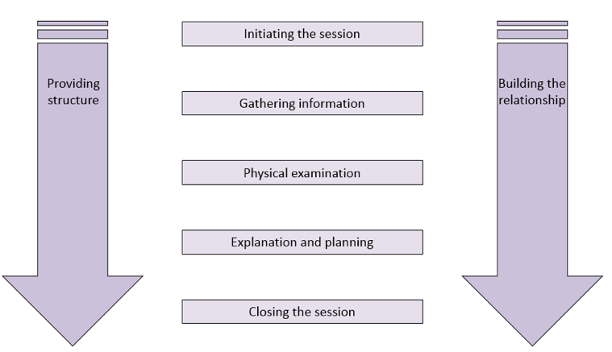
Calgary-Cambridge (78 items)

Slide 14
Going on a Date / Meeting his / her parents for the first time / First day in a new job
How did you talk to the new person/people you met?
  Did you memorise 78 things to say?
  Did you write out a script?
No!!
You had a rough idea of a few topics
  Introduce yourself.
  Ask open questions….”What can I help with?”
  How long have they worked / lived there?
  Where did they work / live before?
  Interests / hobbies / recent TV / music / sport / cinema, theatre?
  Etc.

Slide 15
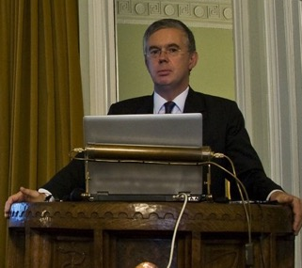
Shut up (open questions).
Listen.
Know something.
Be kind.
Prof Sir David Haslam
Former Chair of NICE

Slide 16
Has Communication Occurred?
“The single biggest problem in communication is the illusion that it has taken place”
  George Bernard Shaw
75% of orthopaedic surgeons asked believed they had communicated effectively
Only 21% of patients reported effective communication

Slide 17
Interruption
After asking the initial question (“How can I help?”), how long before an average professional interrupts?
About 10 seconds
  As little as 3 seconds!
How will long patients talk for?
  Around 30 seconds

Slide 18
Interruption Data
GPs, nurses and pharmacists let the patient finish their agenda 20% of the time
  Weiss et al., 2013
In another study, Dr’s identified the patients agenda 6% of the time
    https://academic.oup.com/fampra/article/30/6/712/526669
Notes:
https://academic.oup.com/fampra/article/30/6/712/526669
Solicitations in GP, nurse and pharmacist prescriber consultations: an observational study

Slide 19
Impact of Communication
Actual Words – 7%
The way we speak – 38%
Facial expressions – 55%
Maybe not accurate, but makes a valid point
  Communication is about more than words!
Mehrabian, A., & Ferris, S. (1967). Inference of attitudes from nonverbal communication in two channels. Journal of Consulting Psychology, 31, 248-2
Lapakko, D., 1997. Three cheers for language: A closer examination of a widely cited study of nonverbal communication. Communication Education, 46(1), pp.63-67.

Slide 20

What is shared decision-making?

Slide 21
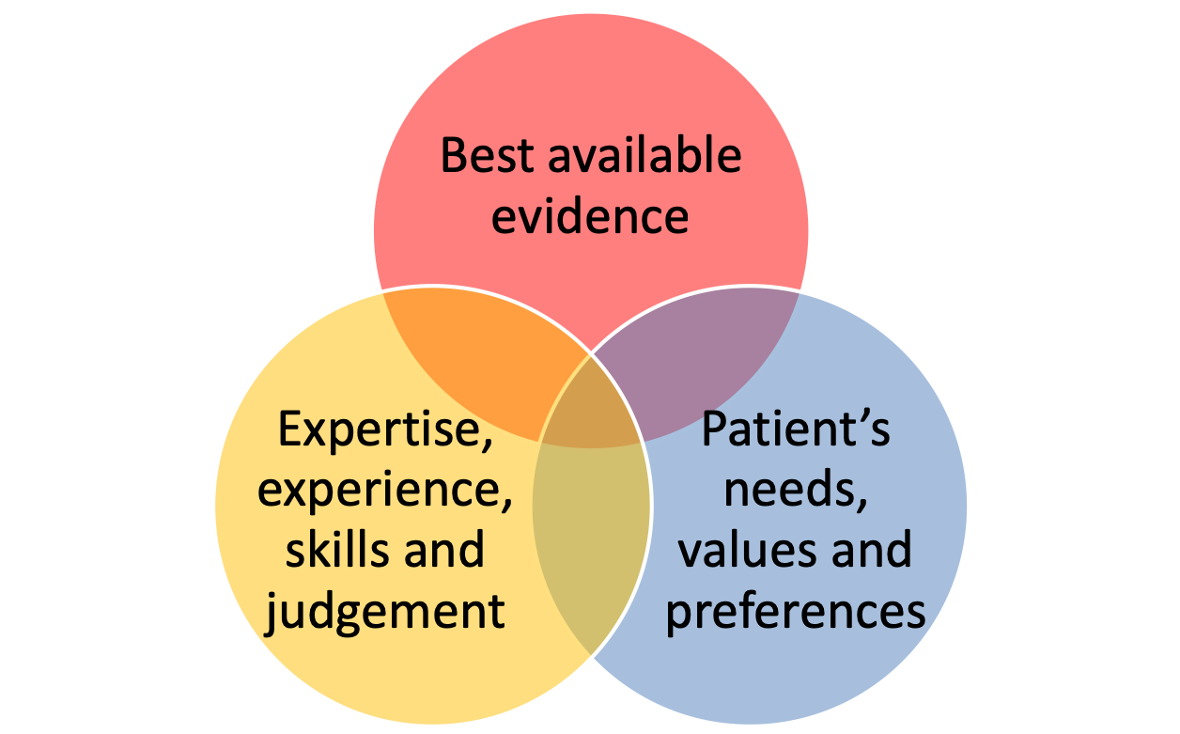
Evidence-based medicine
Sackett D, et al. BMJ 1996;312:71-2
Notes:
“Evidence based medicine is the conscientious, explicit, and judicious use of current best evidence in making decisions about the care of individual patients.
Increased expertise [includes]… especially more effective and efficient diagnosis and…more thoughtful identification and compassionate use of individual patients' predicaments, rights, and preferences in making clinical decisions”

Slide 22
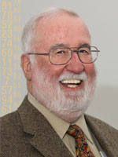
Shared decision-making: a key part of expertise in evidence-based medicine
Sackett D, et al. BMJ 1996;312:71–72
‘The practice of evidence based medicine means integrating individual clinical expertise with the best available external clinical evidence from systematic research.’
‘Increased expertise is reflected in many ways, but especially in more effective and efficient diagnosis and in the more thoughtful identification and compassionate use of individual patients' predicaments, rights, and preferences in making clinical decisions about their care.’
Notes:
Sackett D et al. Evidence based medicine: what it is and what it isn’t. BMJ 1996;312:71–72
The GMC Consent guidance: Part 1: Principles (2008) states:
Whatever the context in which medical decisions are made, you must work in partnership with your patients to ensure good care. In so doing, you must listen to patients and respect their views about their health, discuss with patients what their diagnosis, prognosis, treatment and care involve; share with patients the information they want or need in order to make decisions; maximise patients’ opportunities, and their ability, to make decisions for themselves; respect patients’ decisions.
http://www.gmc-uk.org/guidance/ethical_guidance/consent_guidance_part1_principles.asp

Slide 23
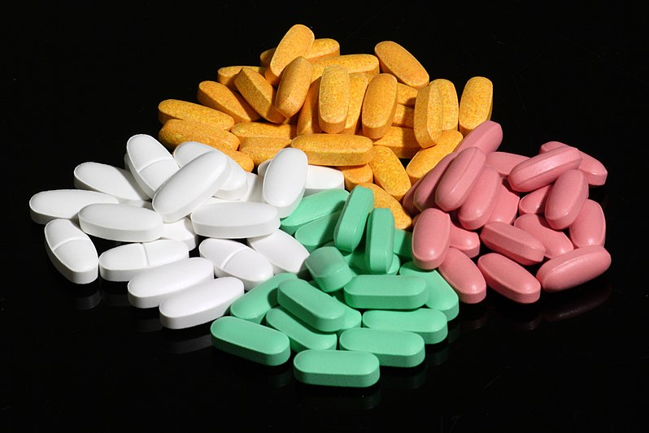
Thought experiment
Imagine an ‘ideal’ tablet
It can make you live longer!
No side-effects, no cost, no prescription needed, you can stop whenever you like
All you have to do is take 1 every day for the rest of your life
Photo by Sage Ross (ragesoss.com), from Wikimedia Commons. Creative Commons Attribution-Share Alike 3.0 Unported.
Notes:
360 members of the general public in north-west London
Median increase in lifespan required was 6 months (IQR 1 to 36 months)
34% people would take the medicine if it would increase their lifespan by <1 month
12% would take it only if it would increase their lifespan by 10 years or more
The authors calculate that 99% of the population would gain <2 years extra lifespan by lifelong statin prophylaxis

Slide 24

Write down how much extra lifespan this tablet would have to give you for you to be prepared to take it:
less than 3 months
about 3 to 6 months
about 6 months to 1 year
about 1 to 5 years
about 5 to 10 years
more than 10 years
I would never want to take it

Slide 25
Medicines disutility: what’s the trade-off?
Fontana M, et al. (2014) Circulation 129: 2539-46
360 members of the general public in north-west London
  Equal number of men and women, mean age 38 years
Median increase in lifespan required was 6 months (IQR 1 to 36 months)
12% would take it only if it would increase their lifespan by 10 years or more
  The authors calculate that 99% of the population would gain <2 years extra lifespan by lifelong statin prophylaxis
Notes:
12% is 1 in 8 people

Slide 26
‘By patient values we mean the unique preferences, concerns and expectations each patient brings to a clinical encounter and which must be integrated into clinical decisions if they are to serve the patient.’

Slide 27
NICE: Guidelines, not tramlines
Every NICE guideline states, on its landing page:
The recommendations in this guideline represent the view of NICE, arrived at after careful consideration of the evidence available. When exercising their judgement, professionals are expected to take this guideline fully into account, alongside the individual needs, preferences and values of their patients or service users
It is not mandatory to apply the recommendations, and the guideline does not override the responsibility to make decisions appropriate to the circumstances of the individual, in consultation with them and their families and carers or guardian.
Notes:
?

Slide 28

Guidelines.
Not tramlines..

Slide 29

Shared decision making is..
www.nice.org.uk/guidance/ng197/chapter/Context
A collaborative process that involves a person and their healthcare professional working together to reach a joint decision about care
  It could be care the person needs straightaway or care in the future, for example through advance care planning
It involves choosing tests and treatments based both on evidence and on the person’s individual preferences, beliefs and values
It means making sure the person understands the risks, benefits and possible consequences of different options through discussion and information sharing.
This joint process empowers people to make decisions about the care that is right for them at that time (with the option of choosing to have no treatment or not changing what they are currently doing always included)
  In maternity services SDM may be referred to as 'informed decision making'
Notes:
www.nice.org.uk/guidance/ng197/chapter/Context

Slide 30
Shared Decision Making
a patient and a clinician
work together,
have a conversation,
partner with each other
to identify the best course of action,
the best treatment or test
at this point in time.
It is a about sharing what matters
Clinicians share information about the alternatives, benefits, harms
Patients share prior experience, goals, expectations, values.
is a process by which
Not just throwing numbers!
Victor Montori

Slide 31
Moving the emphasis from
What’s the matter with you? to
What matters to you?

Slide 32
NICE SDM Guideline Highlights…….
Implications for individual healthcare practitioners
Implications for organisations
Meaningful conversations
Resources to help you

Slide 33
Why should we do SDM?

Slide 34

“Six years ago, after major surgery, I was diagnosed with Leiomyosarcoma, a soft tissue cancer. In the months - years even - leading up to that diagnosis, I experienced the exact opposite of shared decision making. Decisions were taken for me, not with me. There was no full discussion of the various options available, nor explanation of their likely consequences. In retrospect, I received the wrong course of treatment for me.”
Why it matters: a patient experience of non-shared decision making
Siân Phipps is Patient and Community Leader at the Velindre Cancer Centre and lay member of the NICE shared decision making guideline committee
Notes:
Although the benefits of shared decision making are increasingly being recognised it is not yet routinely practised. National surveys have shown that many people want to be more involved in decisions about their care (44% of inpatients and over 30% of primary care patients).

Slide 35
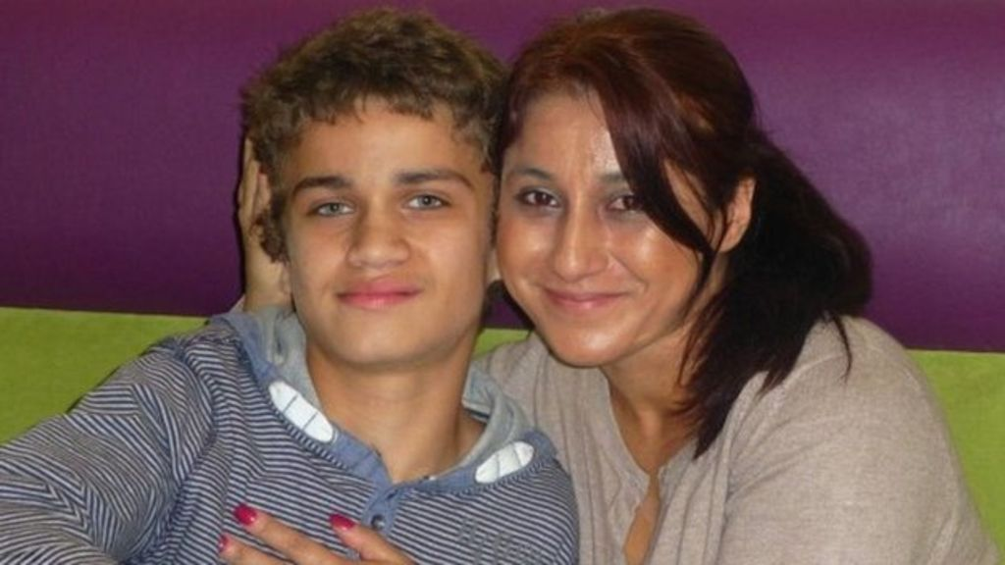
Notes:
Nadine Montgomery and her son Sam

Slide 36
Consent and the Montgomery judgment
Sokol D (2015) BMJ 350: h1481
Healthcare professionals must take reasonable care to ensure that the patient is aware of any material risks involved in any recommended treatment, and of any reasonable alternative or variant treatments
The test of materiality is
  a risk to which a reasonable person in the patient’s position would be likely to attach significance or
  a risk that the healthcare professional knows — or should reasonably know — would probably be deemed of significance by this particular patient

Slide 37
SDM is recommended in professional guidance
GPhC standards for pharmacy professionals
  ‘give the person all relevant information in a way they can understand, so they can make informed decisions and choices’
  ‘ask questions and listen carefully to the responses, to understand the person’s needs and come to a shared decision about the care [you] provide’
GMC consent guidance
  ‘doctors must try to find out what matters to patients so they can share relevant information about the benefits and harms of proposed options and reasonable alternatives, including the option to take no action’
NMC professional standards
  ‘encourage and empower people to share decisions about their treatment and care’

Slide 38

Shared decision making
NICE guideline NG197
Guideline published June 2021
Notes:
Full title of guideline:
Shared decision making NICE guideline [NG197] Published: 17 June 2021
Available from www.nice.org.uk/guidance/ng197

Slide 39
Implementing SDM: Lessons from MAGIC
Joseph-Williams N et al, BMJ 2017; 357: j1744
‘We do it already’
  How can we help you do it (even) better?
‘We don’t have the right tools’
  Skills trump tools, and attitudes trump everything
‘Patients don’t want shared decision-making’
  Many patients feel unable rather than unwilling to share in decision making
‘How can we measure it?’
  A challenge, but tools do exist
‘We have too many other demands and priorities’
  A challenge to leaders and managers

Slide 40
Putting SDM into practice
Recommendations 1.2.5 to 1.2.21
The guideline has detailed recommendations on implementing SDM:
Before a discussion
  Including offering resources and additional support
During a discussion
  Including agreeing an agenda, explaining the options, making a joint decision and recording the discussion and decisions
After or between discussions
  Including offering resources and support, and writing clinical letters (in line with Academy of Medical Royal Colleges' guidance on writing outpatient clinic letters to patients)

Slide 41


Tasks in shared decision-making
Elwyn G, et al. J Gen Intern Med 2012; 27:1361–7
The first task of shared decision-making is to ensure that individuals are not making decisions in the face of avoidable ignorance
  Healthcare professionals and patients generally overestimate the likely benefits of treatments and underestimate the risks
  Healthcare professionals may ‘misdiagnose’ the patient’s priorities

Slide 42
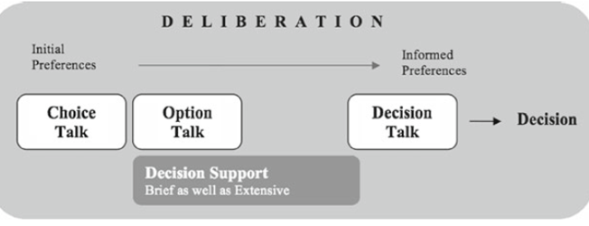
Three-talk model
Terms used in the guideline; Elwyn G et al (2012) J Gen Intern Med 27:1361–7
The three-talk model is a practical model of how to do shared decision making. It has 3 steps:
  introducing choice
  describing options, often by integrating the use of patient decision support
  helping people explore their preferences and make decisions
Notes:
Permission to use this figure has been granted by Professor Adrian Edwards, one of the authors of the paper
https://www.nice.org.uk/guidance/ng197/chapter/Recommendations#terms-used-in-this-guideline

Slide 43
‘Chunk and check’ and ‘Teach back’
Terms used in the guideline
Chunk and check
A technique to break down information into smaller, more manageable chunks rather than providing it all at once. In between each 'chunk', methods such as teach back are used to check for understanding before moving on
Teach back
The teach back method is a useful way to confirm that the information provided is being understood by getting people to 'teach back' what has been discussed and what instruction has been given. This is more than saying 'do you understand?' and is a check of how well things have been explained and understood
Notes:
https://www.nice.org.uk/guidance/ng197/chapter/Recommendations#terms-used-in-this-guideline
Chunk and check
A technique to break down information into smaller, more manageable chunks rather than providing it all at once. In between each 'chunk', methods such as teach back are used to check for understanding before moving on.
Teach back
The teach back method is a useful way to confirm that the information provided is being understood by getting people to 'teach back' what has been discussed and what instruction has been given. This is more than saying 'do you understand?' and is a check of how well things have been explained and understood.

Slide 44
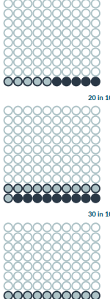
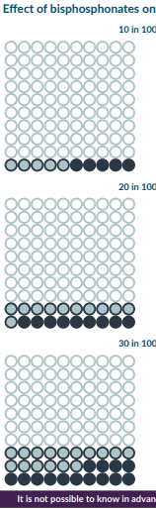
Communicating risks, benefits and consequences

Slide 45
Communicating risks, benefits and consequences
Recommendations 1.4.1 and 1.4.2
Discuss risks, benefits and consequences in the context of each person’s life and what matters to them
  Be aware that risk communication can often be supported by using good-quality patient decision aids or graphical presentations such as pictographs (see recommendations on PDAs)
Personalise information on risks, benefits and consequences as much as possible
  Make it clear to people how the information you are providing applies to them personally and how much uncertainty is associated with it.
  For more on dealing with uncertainty, see the General Medical Council’s guidance on decision making and consent
Notes:
1.4.1 Discuss risks, benefits and consequences in the context of each person’s life and what matters to them. Be aware that risk communication can often be supported by using good-quality patient decision aids or graphical presentations such as pictographs (see recommendations 1.3.1 to 1.3.3).
1.4.2 Personalise information on risks, benefits and consequences as much as possible. Make it clear to people how the information you are providing applies to them personally and how much uncertainty is associated with it. For more on dealing with uncertainty, see the General Medical Council’s guidance on decision making and consent.

Slide 46
Discussing numerical information (1)
Recommendations 1.4.5 to 1.4.7
Think about using a mixture of numbers and pictures, for example numerical rates along with pictograms or icon arrays, to allow people to see both positive and negative framing at the same time
Use numerical data to describe risks if available. Be aware that different people interpret terms such as 'risk', 'rare', 'unusual' and 'common' in different ways
Use absolute risk rather than relative risk. For example, the risk of an event increases from 1 in 1,000 to 2 in 1,000, rather than the risk of the event doubles
Notes:
1.4.5 Think about using a mixture of numbers and pictures, for example numerical rates along with pictograms or icon arrays, to allow people to see both positive and negative framing (see recommendation 1.4.11) at the same time.
1.4.6 Use numerical data to describe risks if available. Be aware that different people interpret terms such as 'risk', 'rare', 'unusual' and 'common' in different ways.
1.4.7 Use absolute risk rather than relative risk. For example, the risk of an event increases from 1 in 1,000 to 2 in 1,000, rather than the risk of the event doubles.

Slide 47
Discussing numerical information (2)
Recommendations 1.4.8 to 1.4.11
Use natural frequencies (for example, 10 in 100) rather than percentages (10%)
Be consistent when using data
  For example, use the same denominator when comparing risk: 7 in 100 for one risk and 20 in 100 for another, rather than 1 in 14 and 1 in 5
Present a risk over a defined period of time (months or years) if relevant
  For example, if 100 people are treated for 1 year, 10 will experience a given side effect
Use both positive and negative framing
  For example, treatment will be successful for 97 out of 100 people and it will be unsuccessful for 3 out of 100 people
Notes:
1.4.8 Use natural frequencies (for example, 10 in 100) rather than percentages (10%).
1.4.9 Be consistent when using data. For example, use the same denominator when comparing risk: 7 in 100 for one risk and 20 in 100 for another, rather than 1 in 14 and 1 in 5.
1.4.10 Present a risk over a defined period of time (months or years) if relevant. For example, if 100 people are treated for 1 year, 10 will experience a given side effect.
1.4.11 Use both positive and negative framing. For example, treatment will be successful for 97 out of 100 people and it will be unsuccessful for 3 out of 100 people.

Slide 48
NHS England and Improvement resources (1)
www.england.nhs.uk/shared-decision-making/guidance-and-resources/
Shared decision making summary guide and implementation checklist
SDM measurement guidance
  GP patient survey item 28
  CollaboRATE: service-user-reported measure with 3 brief questions
  SDM Q-9 and SDM-Q-DOC: 9-item questionnaire completed by the person and their healthcare professional

Slide 49
NHS England and Improvement resources (2)
www.england.nhs.uk/shared-decision-making/guidance-and-resources/
Skills for Health, Skills for Care and Health Education England:
  e-learning introduction to person centred approaches
Association of Medical Royal Colleges and University of Cambridge risk communication toolkit:
  e-learning course designed for health care professionals to help them develop skills for communicating effectively about the potential harms and benefits of treatment options
Health literacy resources: multiple resources
  National health literacy toolkit
  See also www.e-lfh.org.uk/programmes/health-literacy/

Slide 50
NHS England and Improvement resources (3)
www.england.nhs.uk/shared-decision-making/guidance-and-resources/
Ask 3 questions resources
BRAN resources
  Choosing Wisely UK and Association of Medical Royal Colleges campaign
    Benefits
    Risks
    Alternatives
    No change

Slide 51
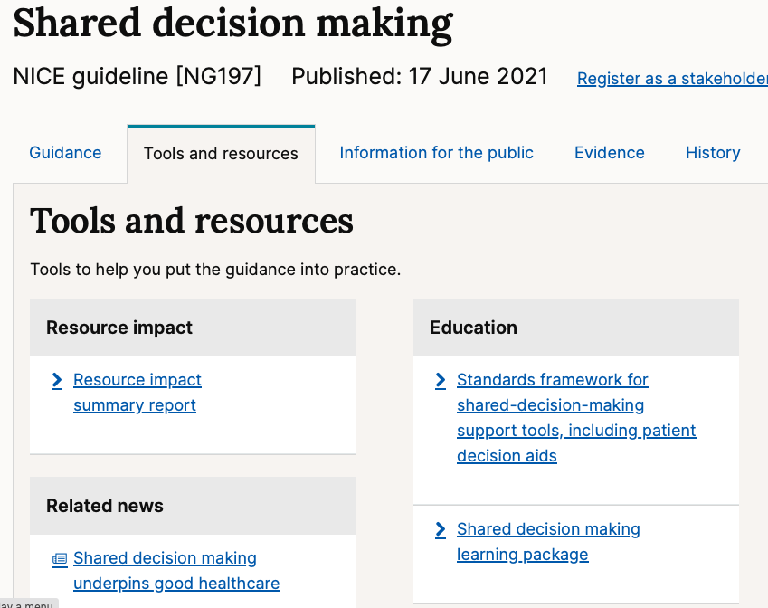

Keele/NICE e-learning package www.nice.org.uk/guidance/ng197/resources
Keele University and NICE have worked in partnership to develop a free online learning package
This is suitable for all healthcare professionals and aims to equip people with the skills and knowledge they need have good quality shared decision making conversations with the people they are caring for
It is made up of 6 modules:
  Orientation and background
  Cognitive psychology: the science of how we all make decisions
  Evidence-based medicine
  Probability and uncertainty
  Consultation skills
  Knowledge: getting and staying up to date – virtual patients
Notes:
To support implementation of the NICE guideline on shared decision making, Keele University and NICE have worked in partnership to develop an online learning package. This is suitable for all healthcare professionals and aims to equip people with the skills and knowledge they need to have good-quality shared decision-making conversations with the people they are caring for. The learning package is free to access and users can do so by completing the registration form. It is made up of 6 modules:
Orientation and background
Cognitive psychology: the science of how we all make decisions
Evidence-based medicine
Probability and uncertainty
Consultation skills
Knowledge: getting and staying up to date

Slide 52
Learning a new skill
Instruction (nodes of knowledge, stringing them together, effort required)
Demonstration (seeing others do it routinely and well and seeing that it works)
Practice (repeated, supportive feedback)
Assessment

Slide 53


Slide 54
Avatar
www.keelevp.com/virtual-patient/eidm
https://www.personalisedcareinstitute.org.uk/virtual-patients/

Slide 55
Take home messages
Conversations are a skill
SDM can help improve medicines optimisation (for the population and individuals)
What can you do as an individual?
What can you do for your team?
How can you show leadership for your organisation?
Resources that can help

Slide 56

What does good care look like?
Data and evidence
Recommendations
Explore health beliefs
*Person-centred*
Discussion and explanation of risks

Slide 57
EBM and medicines optimisation for the 21st Century
Makes the ethical care of the person our top priority
Demands individualised evidence in a format that clinicians and patients can understand
Is characterised by expert judgment rather than mechanical rule following
Shares decisions with patients through meaningful conversations

Slide 58

“Knowledge is knowing a tomato is a fruit;
“Wisdom is not putting tomatoes in a fruit salad”
Miles Kington (via Peter Kay)
J.L.Underhill@keele.ac.uk
Jonathan.Underhill@nice.org.uk

