Slide 1


Transforming Primary Care Cancer detection

Slide 2



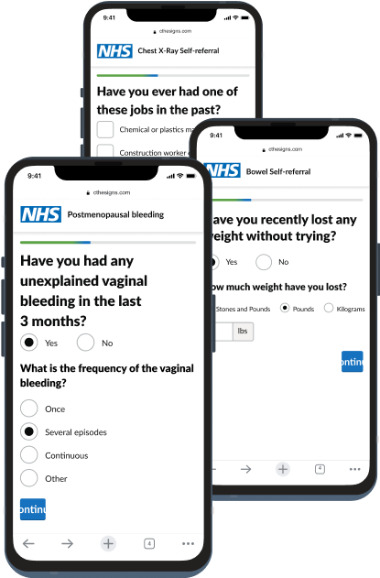
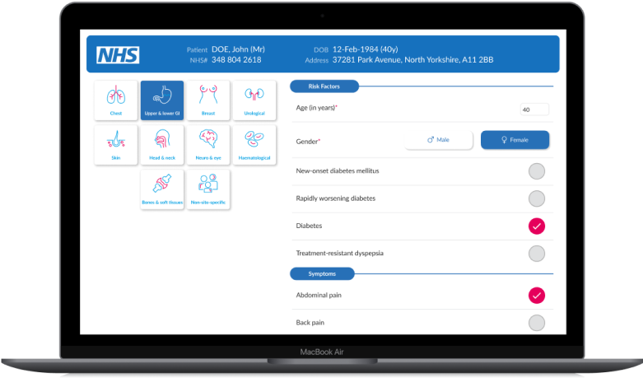
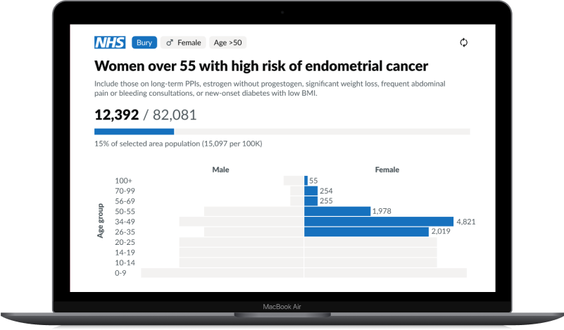





01
02
03
How we implement
Point of care decision support
Patient assessment
Population case finding
Primary care receives real-time guidance when patients present with symptoms on cancer risk and pathway navigation
On completing a risk assessment, eligible patients are navigated to a diagnostic or a specialist
AI scans EMRs to identify high-risk patients, sends a patient assessment for further review, and if eligible, navigates patients to a diagnostic or a specialist

Slide 3




Improving early cancer diagnosis with AI-led decision support
 | 2018-19 (pre-pandemic & pre-C the Signs) | 2023-24 (post- C the Signs implementation) | % relative Improvement
Bladder cancer | 91.4% | 99.0% | 8.3%
Breast cancer | 60.0% | 79.0% | 31.7%
Colorectal cancer | 42.1% | 56.0% | 33.2%
Endometrial cancer | 81.6% | 95.3% | 16.8%
Lung cancer | 16.5% | 38.3% | 132.2%
Lymphoma | 40.0% | 46.6% | 16.4%
Oesophagus cancer | 24.3% | 29.2% | 19.9%
Ovarian cancer | 35.0% | 70.0% | 100.0%
Pancreatic cancer | 30.8% | 37.5% | 21.7%
Prostate cancer | 80.0% | 84.2% | 5.3%
Renal cancer | 74.4% | 81.8% | 10.0%
Stomach cancer | 12.5% | 60.0% | 380.0%
36.8% improvement in early stage diagnosis
Method:
A retrospective study in Somerset ICB looked at cancer staging performance in the pre-pandemic period in comparison to C the Signs after 3 years of implementation.
The largest differences were seen in some of the most deadly cancers: Lung cancer, pancreatic cancer, stomach cancer and colorectal cancer.

Slide 4




Safer, automated workflows
C the Signs uses AI to triage every patient in primary care — identifying those at risk of cancer, ruling out those who aren’t, and guiding each to the most appropriate next step. Whether that’s a test, diagnostic investigation, or routine or urgent referral, each decision is driven by individual cancer risk and a 94% accuracy in predicting tumour origin.
By removing unnecessary referrals and reducing duplication, C the Signs ensures earlier diagnoses for those who need it, and reassurance for those who don’t. On average, 20% of patients are safely removed from cancer pathways, and fewer than 1% require multiple urgent referrals — saving time, capacity, and lives.
High risk
Emergency referral
High risk urgent suspected cancer referral
Low risk
Test first
C the Signs Cancer Risk Assessment
C the Signs Al Model
Low risk
Non-urgent pathway
No risk
Cancer ruled out

Slide 5








C the Signs in the NHS
REAL-WORLD IMPACT
Performed equally across demographic groups and in areas of deprivation
94%
50%
20-50%
Accuracy in predicting tumor origin
Reduction in cancers diagnosed in the emergency department
Improvement in time to diagnosis
<1%
SENSITIVITY FOR CANCER
Of Patients identified with cancer risk have multiple specialist referrals

Slide 6
Primary Care technology
Features
Save time and increase cancer detection
Risk Asses
Safety Net
Fast
Referral
Early Cancer detection
Surveillance
Reporting

Slide 7
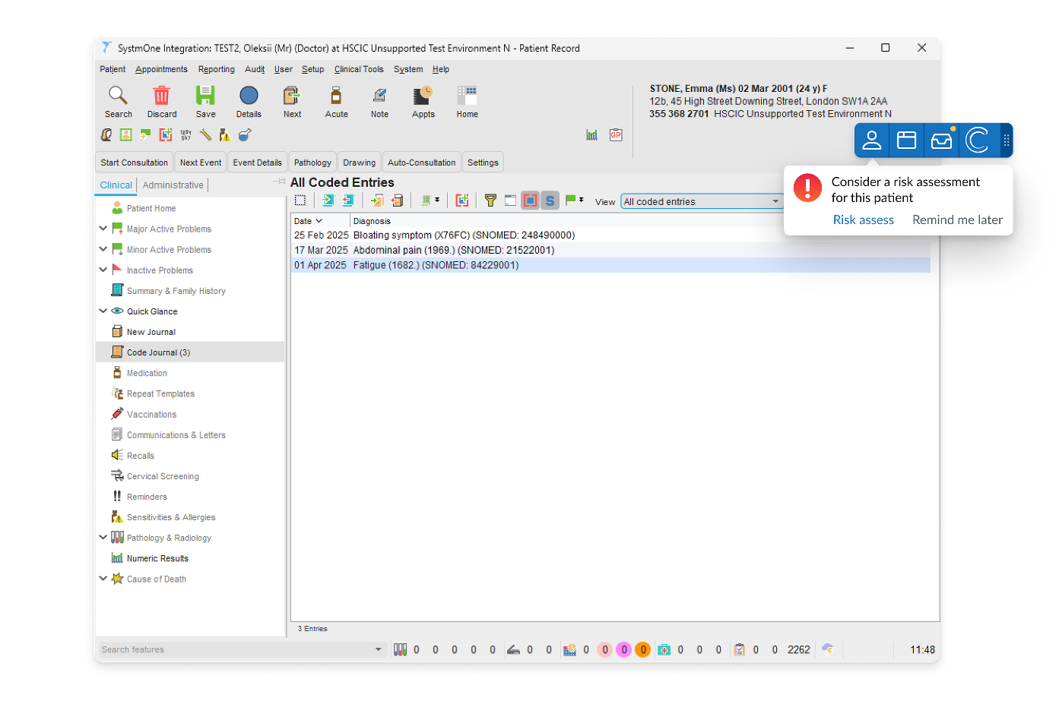

Automating Jess Rule
AUTOMATIC FLAGGING
C the Signs automatically flags patients with high-risk indicators — such as abnormal test results, clinical signs, demographics, and other risk factors — in real time, across pan-cancer or tumour-specific models. These signals are identified from both structured and unstructured data within the medical record. By surfacing what may otherwise be missed, the platform helps clinicians consider cancer earlier — even when it’s not yet suspected.

Slide 8
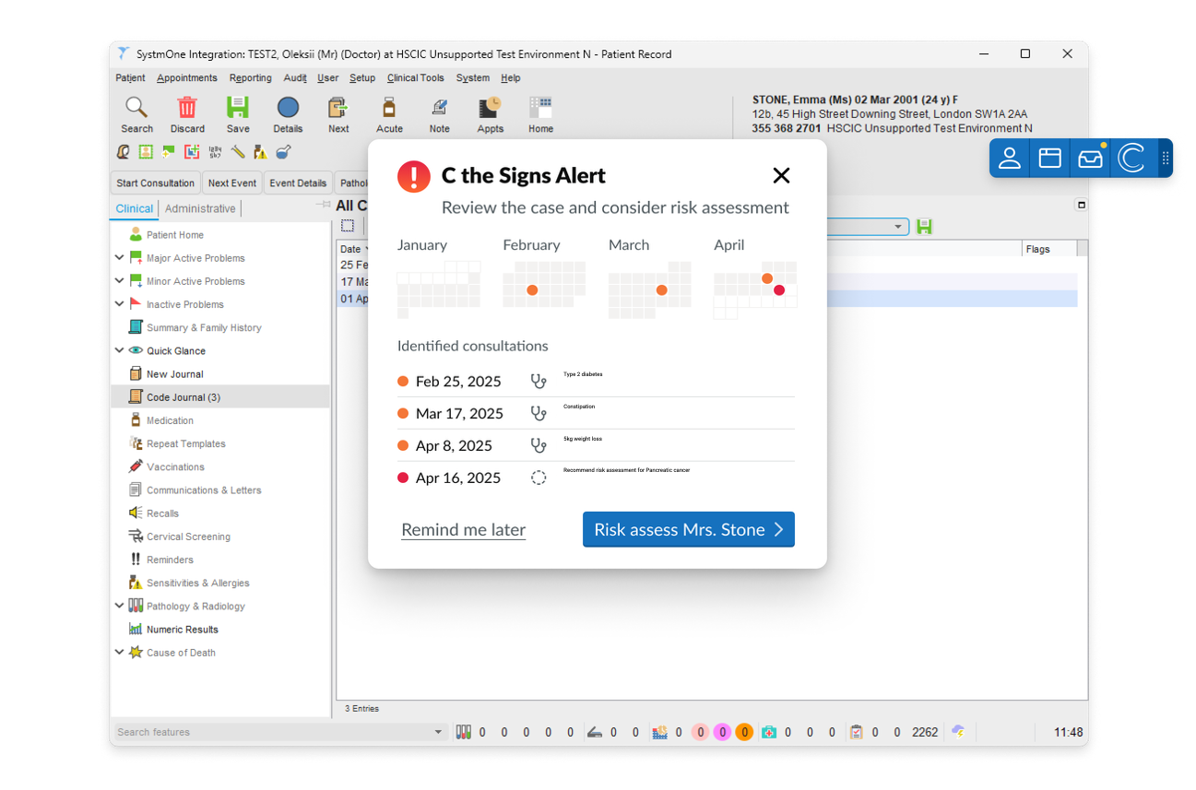
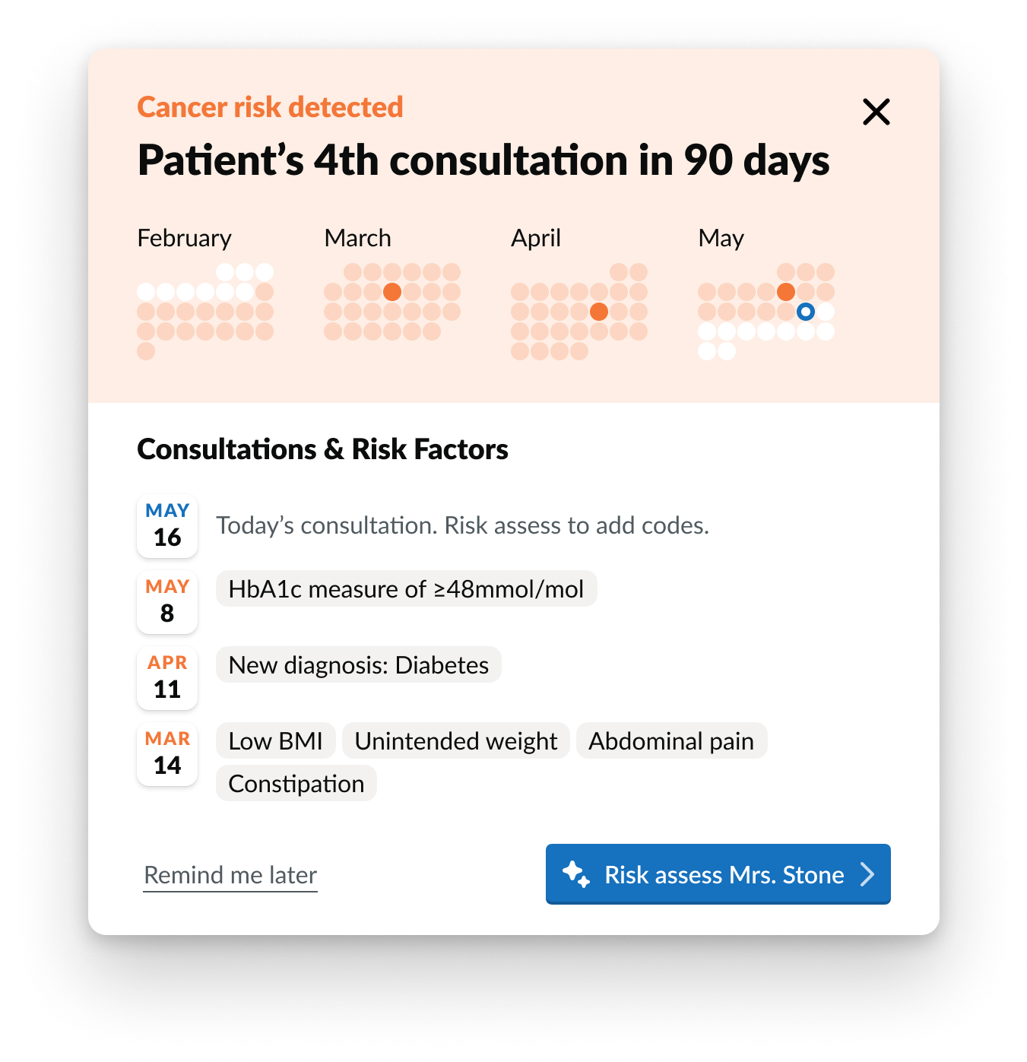
Identifying patients at risk - and taking action
REAL-TIME UPDATES
Clinicians can see potential cancer risks in real time — including red flag symptoms, when they occurred, and the tumour types they may indicate. With one click, they can launch a pre-filled risk assessment and refer the patient into the right pathway. The feature can be configured for pan-cancer alerts or tailored to specific tumour types — enabling faster, more accurate decisions when it matters most.

Slide 9
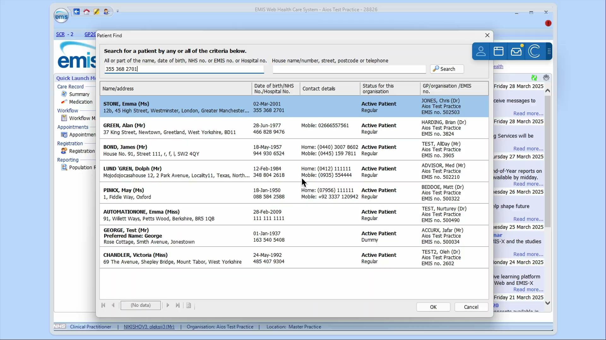
Delivering information needed to guide consultation
TIMELY DELIVERY

Slide 10

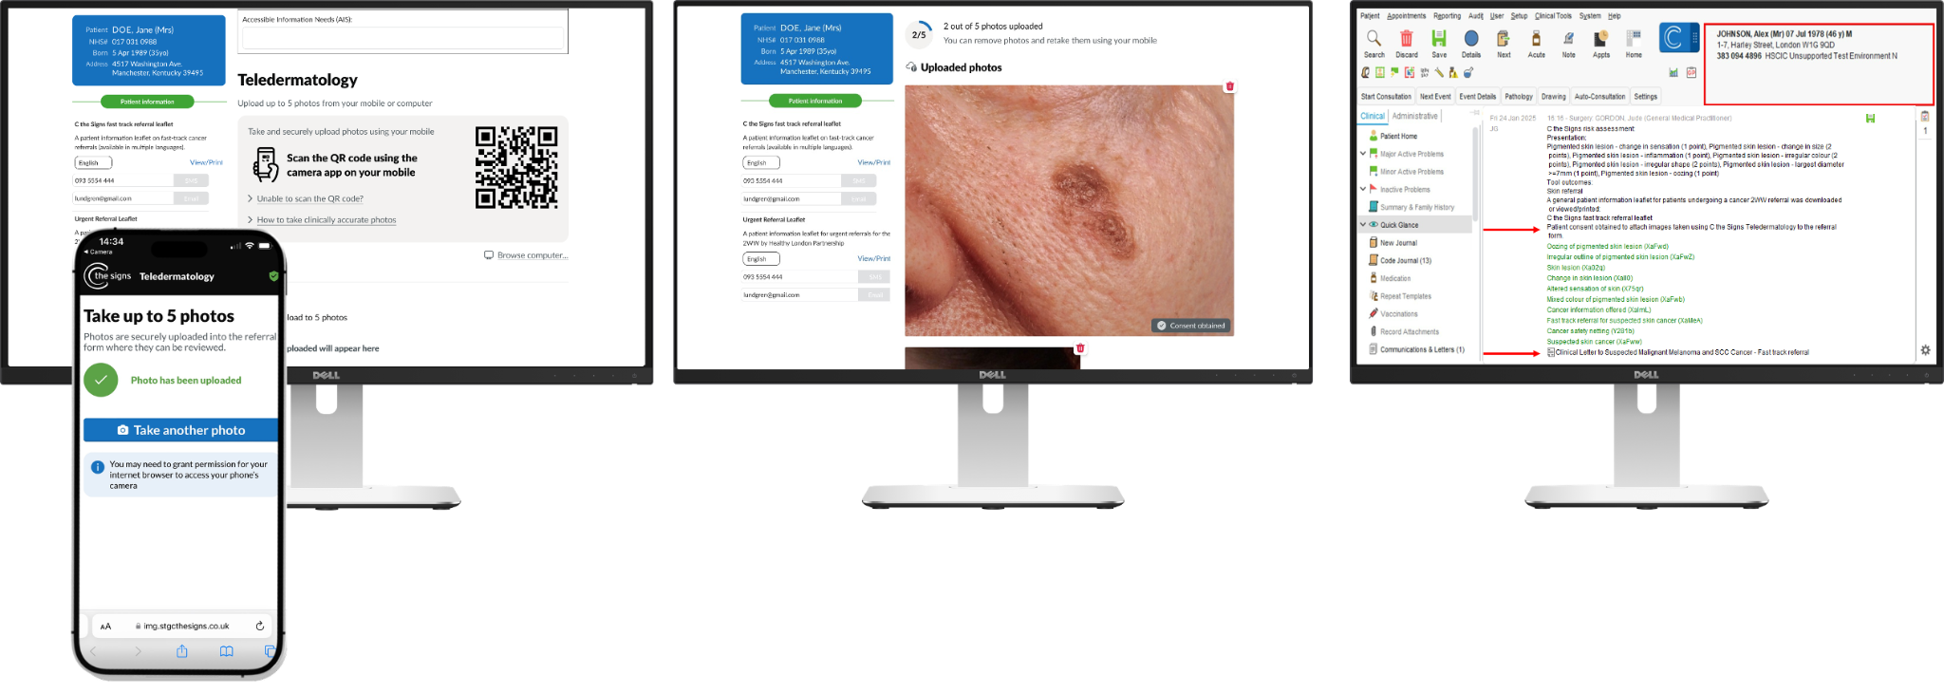
Fast, integrated teledermatology across primary and community care
TELEDERMATOLOGY
Healthcare professional anywhere can securely upload dermatoscopic and macroscopic images directly to the urgent suspected skin cancer referral — with no additional software required. It takes less than 30 seconds, automatically codes and saves to the patient record, and compresses the image for optimal quality before sending via eRS.

Slide 11
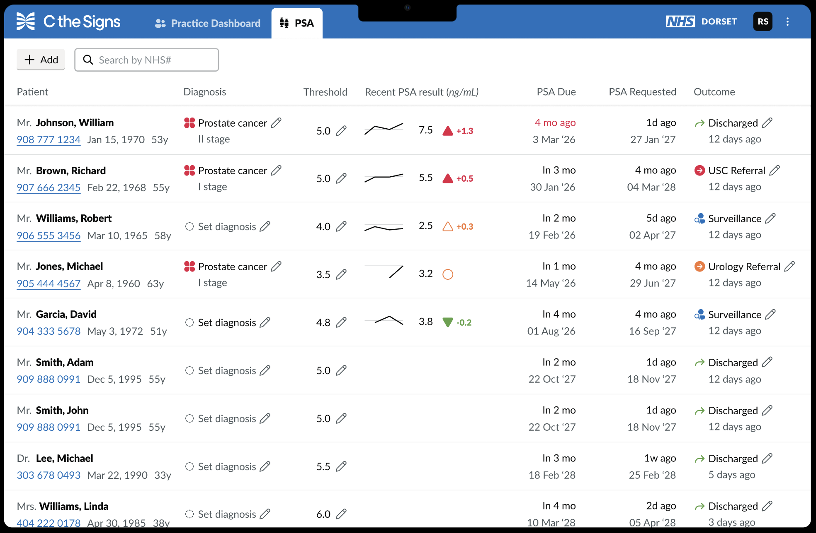
PSA Monitoring
TIMELY DELIVERY
Set patient protocols, follow up, frequency and PSA threshold in dashboard
Patients needing repeat PSA tests viewable in PSA dashboard with automated flags for when PSA tests need requesting on ICE and flags for when a test result is abnormal
Automated symptom questionnaire to patient with abnormal PSA result
Clinical protocol for actioning patients with abnormal PSA results
NHS app integration enabling patients to see their PSA appointment plan, test results and submit symptom questionnaires
Track PSA test result & trend over time to identify patients with a rising PSA results below threshold (e.g. would not be flagged as abnormal)
Assess patients on hormone therapy which can artificially reduce PSA levels

Slide 12
AI-Powered Case Finding
Enabling pre-programmed and customised searches across the electronic medical record, covering both structured (coded) and unstructured (free text) data.
Automated Identification
Automated Invites
Cancer risk assessment
Automated Reminders
Tracking & Confirmation
Outcome
patients managed through to confirmation or exclusion of cancer diagnosis, with automated letters back to GP.
Patients who are eligible for symptomatic and asymptomatic pathways, aligned to national and local screening programmes, and targeted tumour specific cancer case finding.
with tailored communication to patients from their GP to book in for screening or to complete a tailored assessed. Translated SMS messages based on language.
includes qualifying questions to determine eligibility for screening programmes and symptomatic cancer pathways, with the ability to identify gaps in the EHR and offer tailored questions.
for patients to book appointments, collect diagnostic kits, or navigate in to care services. With patient information and safety-netting provided throughout pathway.
of patient within pathway, ensuring adherence, with time to diagnosis tracked and any bottlenecks identified, and automated referral on to an Urgent Suspected Cancer Pathway for eligible patients.

Slide 13
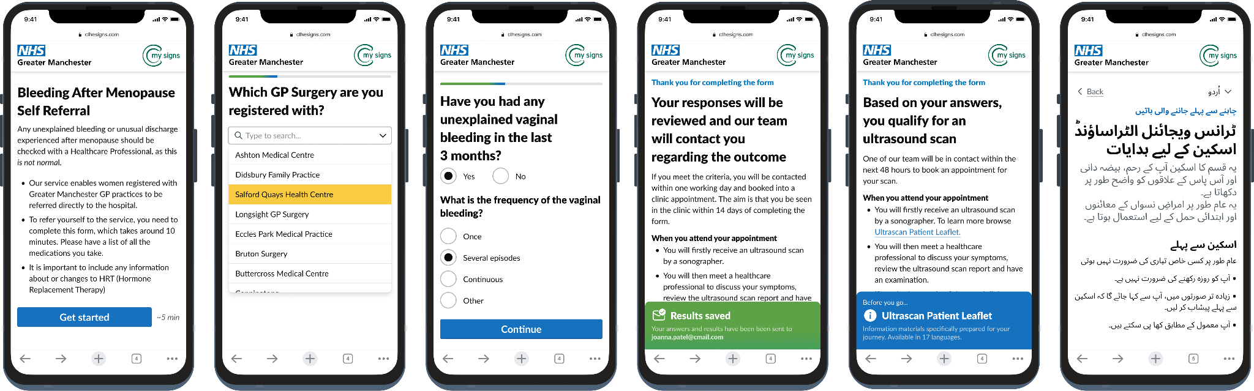
Digital assessment
PATIENT EXPERIENCE
Lung, Pancreatic, Eosphocial, Breast, Endometrial,
Family History and many more

Slide 14
Making FIT tests accessible
Request
Assess
Send
13%
35%
0 min
Colorectal Pathway:
The self-assessment pathway reducing pressure on primary care, making FIT tests easier to access & reducing cost
Patient can request FIT or sent invite
patients completes eligibility assessment
Patient sent FIT to their home or collected
FIT Positive rate
Polyps removed and/or now on bowel surveillance
No GP time required

Slide 15
Real-world impact & Research - NHS

Slide 16

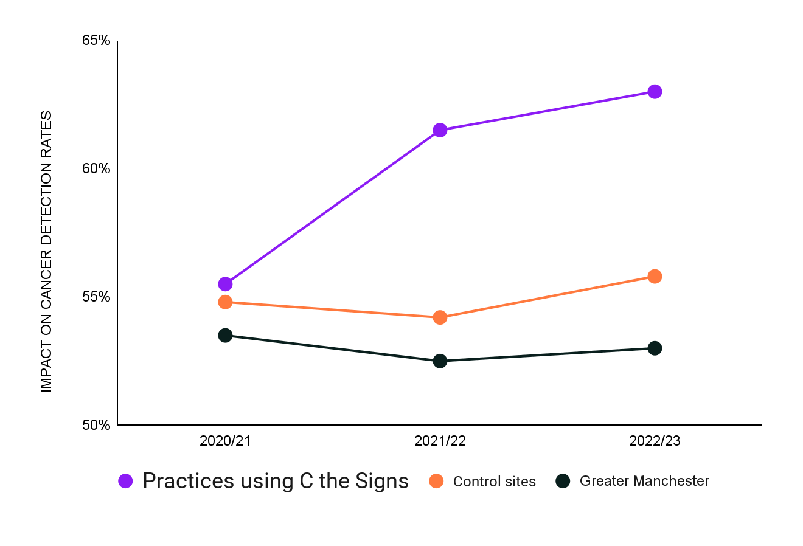
Enhancing Early Detection of Cancer: A Retrospective Analysis Using C the Signs Clinical Decision Support System
C THE SIGNS IMPLEMENTED
12.9% Increase in cancer detection rate from 55.7% to 62.9%)
60.2% of cancers diagnosed at stages 1 and 2 compared to only 56.5% across Greater Manchester ICB
Method:
Comparison of CDR in Horizon Bury with Greater Manchester & NHS England over 12 months (April 2023–March 2024). Data from PHE Fingertips, C the Signs & EMIS.
Results:
Horizon PCN’s CDR rose from 55.7% to 62.9% (12.9% improvement). Of 495 cancers (275 male, 220 female, ages 4–98), 60.2% were diagnosed at Stage 1/2, exceeding GM’s 56.5%.
Early detection was higher for prostate (77.8% vs. 55.1%), bladder (91.3% vs. 71.1%), colorectal cancer (58.9% vs. 45.1%), lung cancer (40.0% vs. 36.6%).

Slide 17

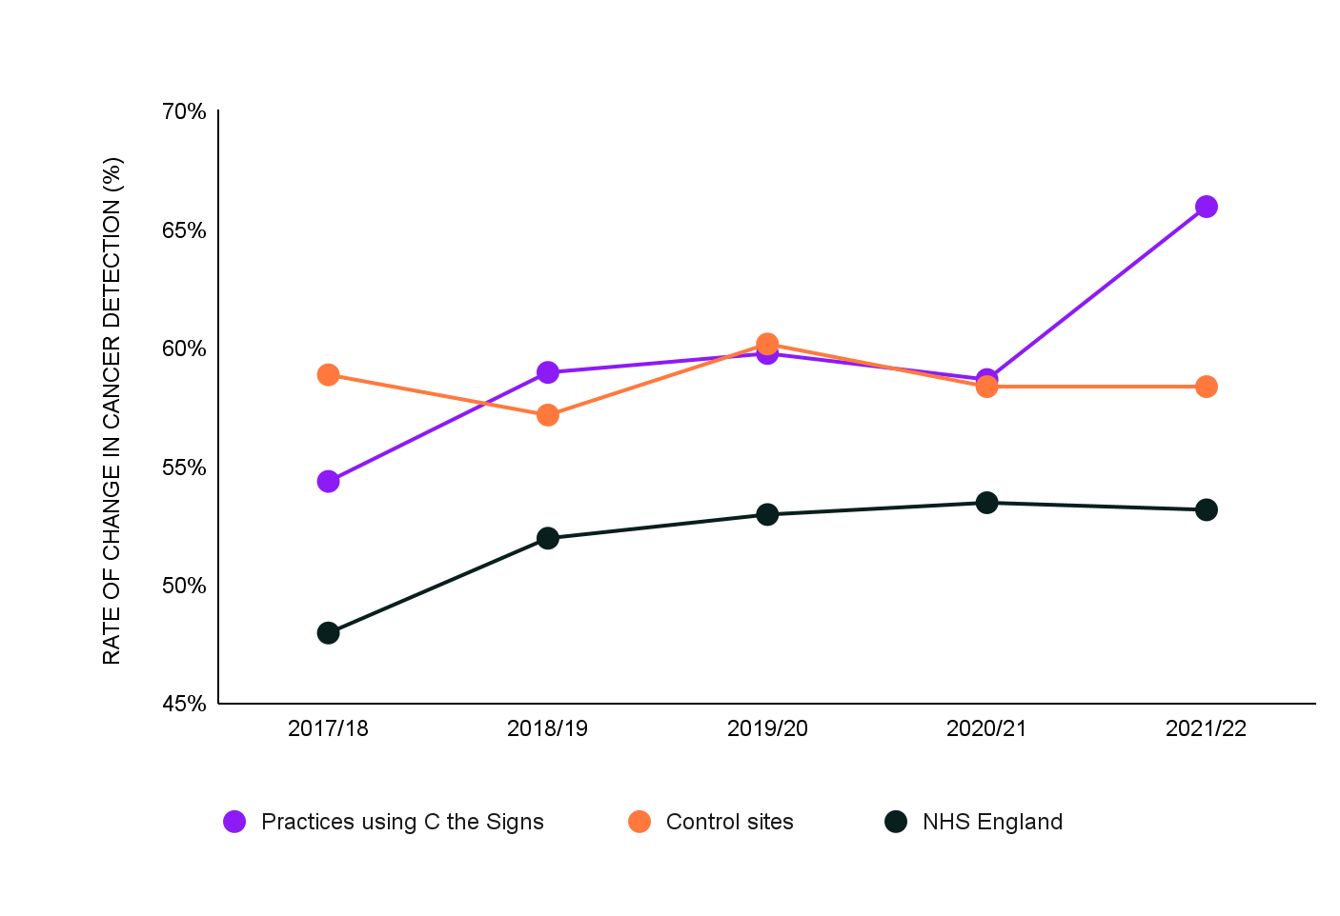
Using an artificial intelligence platform to enhance cancer detection rates in primary care
C THE SIGNS IMPLEMENTED
In GP practices using C the Signs the cancer detection rate increased from 58.7% to 66.0%,reflecting a rate of increase of 12.3% (p <0.05)
In contrast, control site GP practices and NHS England saw no improvements to the cancer detection rate.
Method:
Across 35 GP practices C the Signs was implemented in half of the GP practices with the remaining GP practices acting as an in-area control
Study was conducted between May 2021 and October 2022 and evaluated using data published from Public Health England FingerTips.

Slide 18


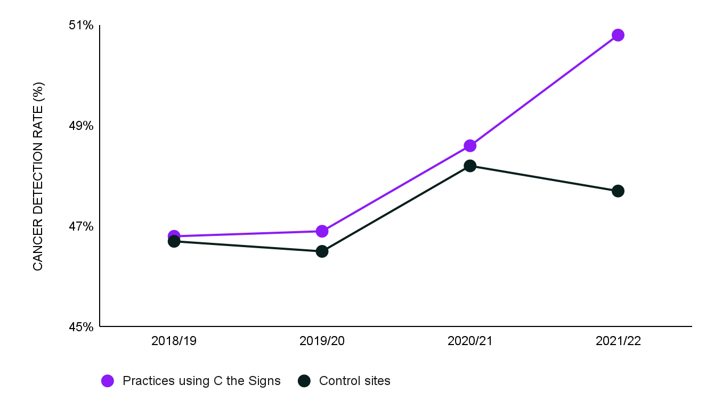
The role of clinical decision support systems in reducing cancer diagnosis disparities from patients with socio-economic deprivation
C THE SIGNS IMPLEMENTED
In practices using C the Signs, Cancer detection rates improved from 48.6% to 50.8% (p <0.05). Compared to control site GP practices which saw a decline in their cancer detection rates.
Method:
South Yorkshire is in the top quartile of the Index of Multiple Deprivation 2019.
Across the ICB, 106 practices used C the Signs, and the other 78 the practices were used as controls (they continued with existing standards of care human-led decision making)
Study was conducted between June 2021 and March 2022 and evaluated using data published from Public Health England FingerTips.

Slide 19

Implementing an AI-Led Cancer Prediction Platform to Manage Patients with Suspected Cancer Risk, Enhancing Elective Recovery Post-Pandemic
Method:
USC referrals have been up 27% from pre-pandemic levels. This study evaluated the impact of the C the Signs risk assessment to triage patients in primary care, directing at-risk individuals to appropriate diagnostics or referrals while excluding those not at risk. Data from C the Signs was evaluated from 2020–2024 across all commissioned NHS Sites. This included 235,662 risk assessments across 1,084 GP practices.
Results:
61,099 patients (21.5%) appropriately triaged away from USC pathways (safely excluded from cancer risk, triaged to non-urgent, straight to test or diagnostic pathways.
7.3% cancer conversion rate (20.9% above the NHS England average of 6.0%).
1.5% of patients required multiple USC referrals, & 0.0% required urgent admission.
If applied to NHS England, C the Signs could reduce USC referrals by 505,196 (17.5%) without compromising cancer detection rates, diagnostic safety or outcomes.
Independent Health economic evaluation led by Health innovation East demonstrated an ROI of £1 spent and £9 saved.
21.5%
Of patients triaged appropriately away from a urgent suspected cancer pathway
7.3%
Cancer conversion rate (20.9%) above NHS England average

Slide 20


C the Signs Evaluation South Yorkshire & Bassetlaw Cancer Alliance (SYBCA)
Method:
Evaluation on the effectiveness of CTS across SYBCA between June 2021 to May 2024, where it was adopted by 179 GP practices, with 3,926 users.
Results:
Emergency presentation rates went from 15.3% (2019/20 pre-pandemic) to 21% (2020/21 pre-implementation) down to only 6% in 2023/24) following the implementation of C the signs. A reduction of more than 50%.
Cancer detection rates increased to 61.7% post implementation
Earlier identification when CTS was used on the first presentation: patients were more likely to be referred at the 1st or 2nd consultation compared to cases where C the Signs was not used.
Cancer conversion rate increased to 8.2% compared to 6% national average.
Time to diagnosis from first presentation reduced to 67 days from 85 days, a 21% reduction.
50%
Reduction in emergency presentation rate
21%
Reduction in time to diagnosis
Increased
Cancer detection rate

Slide 21



Improving the Faster Diagnostic Standard (FDS) for colorectal cancer in the NHS
Method:
A retrospective analysis of Somerset Cancer Registry data compared colorectal USC referrals in Somerset ICB before (May–Oct 2019) and after (May–Oct 2023) implementing C the Signs in October 2021. FDS (percentage of cases diagnosed within the recommended time) was assessed using an independent t-test.
Results:
Pre-intervention, 46.4% of 1,282 colorectal USC referrals met the FDS standard. Post-intervention, this increased significantly to 69.5% of 1,415 referrals (p<0.001), driven by improved triage, risk assessment, and referral pathways.
49.8%
Improvement in the colorectal Faster Diagnosis performance
“Prior to C the signs, our turnaround time for referrals to be triaged was over 6 days, sometimes 18, 20 days, waiting for information from GPs. We’re now triaging within 24 hours.”
Rosie Edgeley,
Cancer Program Manager

Slide 22
Accuracy of an AI prediction platform in predicting tumour origin: A real-world study.
Method:
An observational study was conducted between January 2021 and October 2022, utilising all patients who were risk-assessed by C the Signs in the NHS. There was no pre-selection criteria for the patient population assessed. All patients were followed up for 6 months post-risk assessment.
Results:
122,193 patients from 878 GP practices were risk assessed using the C the Signs platform.
7,673 were diagnosed with cancer between the ages of 0 to 94 years.
Of the patients diagnosed with cancer, 7,622 patients were identified at risk of cancer by C the Signs, (99.3% sensitivity).
The platform predicted cancer origin accurately in 93.9% of patients.
Of the 7,305 patients who were identified as not at risk of cancer using C the Signs, 7,254 were identified correctly. Resulting in a 99.30% negative predictive value.
122,193
Patients risk assessed
by the C the Signs system in a real-world setting across 878 GP practices
99%
Negative predictive value
99% Sensitivity
getting it right first time, preventing duplicate referrals
93.9%
accuracy in predicting tumour origin

Slide 23
Accuracy of an AI prediction platform in predicting tumour origin: A real-world study.
 | Under 65 yrs. | 65 yrs & older | Male | Female
Brain and CNS | 100.00% | 83.30% | 100.00% | 80.00%
Breast | 97.30% | 95.80% | 100.00% | 96.60%
Cancer of unknown origin | 44.40% | 65.90% | 55.20% | 63.30%
Chest | 88.90% | 86.10% | 84.50% | 89.50%
Childhood only | 100.00% | N/A | 100.00% | N/A
Gynecological | 98.50% | 92.70% | N/A | 95.30%
Hematological | 62.50% | 73.00% | 65.10% | 72.80%
Head and neck | 93.00% | 93.40% | 91.90% | 94.50%
Lower gastrointestinal | 97.50% | 97.60% | 98.10% | 97%
Sarcoma | 85.00% | 63.20% | 73.70% | 75.00%
Skin | 95.30% | 97.60% | 96.40% | 97.60%
Upper gastrointestinal | 90.10% | 85.90% | 89.20% | 84.10%
Urological | 94.50% | 93.90% | 94.50% | 87.90%
Average | 93.10% | 93.30% | 92.70% | 93.80%
93.9% Tumour Accuracy
Accuracy in predicting tumor origin was 93.9% (more accurate than studies of liquid biopsy tests available today).
The impact and accuracy of the system performed equally across all demographic groups (65+, under 65, male, female and across ethnic minority groups the system performed better then existing standards of care).

Slide 24
Links to studies
4th NCI Symposium on Cancer Health Disparities Program Booklet
Disparities in Early Cancer Detection in Areas of High Deprivation Using an AI Platform
Journal of Cancer Policy
Artificial intelligence-enhanced clinical decision support system for early detection of ovarian cancer in primary care: A real-world study
Cancer Research (AACR Abstract 2518)
Implementing an AI triage platform for early cancer detection: Reduced diagnostic burden with improved cancer detection and equity
JCO Oncology Practice (ASCO Abstract 74)
Improving the sensitivity of early cancer detection: Interim findings of an AI-based prediction platform
Journal of Clinical Oncology
(ASCO Abstract 1560)
Using an AI platform to enhance cancer detection rates in primary care
Journal of Clinical Oncology
(ASCO Abstract 1562)
Performance of an AI model in predicting tumor origin across over 50 cancer types using primary care data
San Antonio Breast Cancer Symposium (SABCS)
Challenges and Opportunities in Early Diagnosis of Breast Cancer Through Primary Care AI Integration
Journal of the National Comprehensive Cancer Network (JNCCN)
AI-driven risk prediction and case finding for pancreatic cancer in primary care
Journal of Clinical Oncology (ASCO Abstract 54)
Colorectal cancer risk stratification and referral optimization using an AI-based system in real-world primary care data
Journal of Clinical Oncology
(ASCO Abstract 371)
Prostate cancer detection through AI-driven primary care triage: Results from a real-world evaluation
Ca-PRI Conference 2025 (page 97)
Enhancing early-stage cancer detection in primary care: evaluating the impact of C the Signs in Manchester
2025 ASCO Annual Meeting
Leveraging electronic medical records for early lung cancer diagnosis: An evaluation of the C the Signs AI cancer prediction platform using the Mayo data platform

Slide 25
Summary

Slide 26

Early Detection, better outcomes.
SUMMARY
C the Signs is transforming how cancer is found — using advanced AI to support earlier, faster, and more accurate decisions across the NHS. Built from within the system and validated in real-world care, the platform works across the full pathway: from the first GP consultation to diagnostics and beyond. It gives clinicians real-time risk assessments, automates triage, and connects patients to the right care without delay.
Because when it’s easier to spot cancer early, more lives can be saved — and better outcomes become possible for everyone. We’re building a future where every patient has the chance to be seen in time.

