Slide 1
Section 4 examples for ReSPECT plans
Section 4 should reflect clinical recommendations and what is most important to the person. The purpose is not to have a standard Section 4.
To ensure the language used should be understood and relevant to all professionals in each clinical situation e.g. it is not appropriate to state “not for hospital” or “ward-based care” without supporting reasoning.

Slide 2
Examples available
Frailty / dementia; no capacity
Parkinson's and dementia; no capacity
Cardiac but not frail
Advanced cancer
Epilepsy / stroke with a disability
Personalised, frail, stay at home
Learning disability
Severe COPD
Frailty / care home and DOAC
Last days of life
Young Patient with Head injury - Cognitive and physical impairment in long term care home

Slide 3

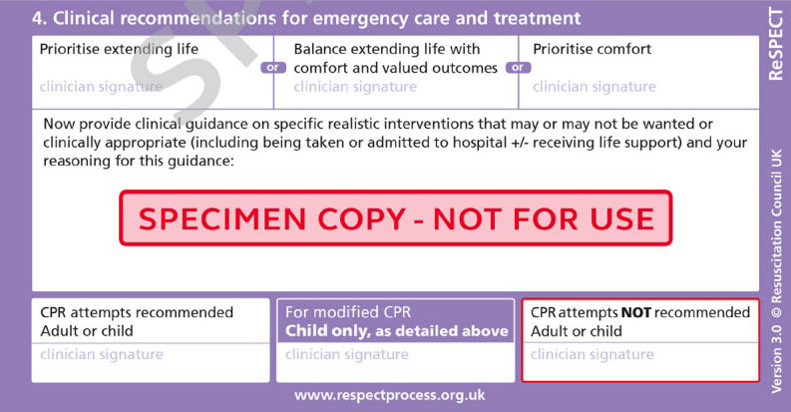
Frailty / dementia
RESPECT Example - Frailty / Dementia. Female patient. No capacity. Has a daughter and pet.
Sign here
Prioritise quality of life overall, dignity and autonomy. Discuss relative merits of all treatments and interventions, checking capacity and including daughter (insert name) who has Power of Attorney. She hates taking tablets and wants them kept to essential for quality of life only. Preferred Place of Care is at home. Not for Resus although would like infections treated actively. No invasive hospital treatments. Refer to ADRT. Hospital admission / transfer only for major trauma or immediately life-threatening conditions. Her dog is a high priority for her and will need care if she is admitted.
For advice or support call GP or urgent community response insert telephone number
Sign here

Slide 4
Frailty / dementia
RESPECT Example – Parkinsons and dementia. No capacity. Has a daughter.
Sign here
Always prioritise comfort. No life prolonging treatments as per ADRT. See mental capacity information (attached). Liaise with daughter (power of attorney) and live in carers for care decisions. Preferred place of care = home. Not for resuscitation. No hospital admissions under any circumstances. Antibiotics appropriate at home for comfort. Anticipatory medication at home for treatment of pain and anxiety. Hospice at home input appropriate if needed.
For urgent advice call GP, hospice or care provider - (insert relevant telephone numbers)
Sign here

Slide 5
Frailty / dementia
RESPECT Example – Cardiac, not frail.
Sign here
Check blood pressure lying & standing if falls/dizziness and review medication. Prone to postural hypotension. Preferred place of care = home but preferred place of death = Hospice. For CPR in arrest. Hospital assessment appropriate if acute life-threatening condition e.g. MI, sepsis. Other conditions to be treated at home.
Implantable Cardioverter Defibrillator (ICD)in situ. Review need for deactivation in event of deterioration.
For urgent advice call GP, hospice or care provider - (insert relevant telephone numbers)
Sign here

Slide 6
Frailty / dementia
RESPECT Example – Advanced Cancer.
Sign here
Prioritise comfort care in all situations. No life prolonging treatments or hospital admissions. NOT FOR RESUS. Preferred place of care = home. Preferred place of death = home with Hospice support. Anticipatory meds in place and for significant risk of significant arterial bleed. Known to the Hospice and community nurses.
For urgent advice call GP, hospice or care provider - (insert relevant telephone numbers)
Sign here

Slide 7
Frailty / dementia
RESPECT Example – Epilepsy / Stroke with a disability.
Sign here
Prioritise comfort and symptom control. Has emergency meds for seizures and spasms (Buccolam, Midazolam, and Baclofen). Would consider Botox index injections if needed. Preferred place of care = home. Preferred place of death = hospital or hospice. Wife struggling to cope even with full care package. Does not want any invasive treatments e.g. NG Tube, IV fluids, IV antibiotics. Hospital/hospice admission ONLY for last days care.
For urgent advice call GP, hospice or care provider - (insert relevant telephone numbers)
Sign here

Slide 8
Frailty / dementia
RESPECT Example – Personalised. Frail. Stay at home
Sign here
Prioritise comfort care and support needed to be cared for at home. Hospital transfer only appropriate in case of major fracture or for essential comfort care. Prone to acute urinary retention - Contact district nurses after assessment at home should this be suspected. Anticipatory medications in the home. Attempting CPR not appropriate due to severe frailty. Discuss any new interventions with power of attorney son (name) and daughter (name).
For urgent advice call GP, hospice or care provider - (insert relevant telephone numbers)
Sign here

Slide 9
Frailty / dementia
RESPECT Example – Learning disability
Sign here
To remain in the care home. Infections should be treated in the community unless severe aspiration pneumonia with sats under 92%. Discuss with mother or brother prior to any transfer decision - has limited capacity – see locally completed MCA. LD liaison nurse should be informed if admitted to support her. She has rescue meds for aspiration in the home - refer to care plan. CPR is deemed to be not in her best interests. Avoid sedating and antipsychotic medications - adverse reactions.
For urgent advice call GP, LD Nurse - (insert relevant telephone numbers)
Sign here

Slide 10
Frailty / dementia
RESPECT Example – Severe COPD
Sign here
Prioritise comfort care and support for care at home. Hospital transfer only appropriate if major bone fracture. No invasive procedures. Usual resting sats are 90% and does not improve with oxygen. COPD exacerbation should be managed at home. Consider rescue pack and use of fan plus relaxation techniques. Anticipatory meds are available for symptom control. Known to community respiratory nurses and the Hospice. DOES NOT WANT RESUS.
For urgent advice call GP, respiratory nurse, hospice - (insert relevant telephone numbers)
Sign here

Slide 11
Frailty / dementia
RESPECT Example – Frailty, Care Home and DOAC (Direct Oral Anticoagulants)
Sign here
Prioritise comfort care. Preferred place of death = care home. NO hospital admissions including a fall / head injury (aware of small risk of bleed). Anticipatory meds available. Consider the use of DOAC in relation to the number of falls (increasing). Stop DOAC when considered to be in last week/ days of life.
For urgent advice call GP, hospice - (insert relevant telephone numbers)
Sign here

Slide 12
Frailty / dementia
RESPECT Example – Last days
Sign here
Prioritise comfort care. Preferred place of care and death = home. NO hospital admissions under any circumstances. Has live in carer (who also cares for wife who has dementia). Anticipatory meds available. May require a syringe pump to manage pain. Hospice community team and district nurses supporting carer. Catheter flushing needed twice weekly.
For urgent advice call GP, DN, hospice - (insert relevant telephone numbers)
Sign here

Slide 13
Frailty / dementia
RESPECT Example – Young Patient with Head injury - Cognitive and physical impairment in long term care home
Sign here
Patient has stable health and lived in care home for several years. Family and carers feel he has good quality of life and copes well with hospital admissions and usually returns to his baseline following infections. Lacks capacity to discuss himself. No information about his wishes prior to loss of capacity. After discussion with family and care home staff they feel currently it's in best interests to have full active management and would want CPR. It would be appropriate to admit to hospital for reversible conditions. Please rediscuss if his health status changes.
For urgent advice call GP, DN (insert relevant telephone numbers)
Sign here

Slide 14
RESPECT Example – Add text to create a further condition specific example
Add Text here

