Slide 1
CSA
Communicating with children

Slide 2
Context
Professionals often worry about how to start a conversation with a child, what words to use, and what should be avoided, as health professionals you are already skilled in holding difficult conversations.
There is so much that those working across all areas of health can do to give children the confidence and opportunity to communicate about sexual abuse.
Notes:
Research shows children want us to ask direct questions and to talk to them about what may be happening in their lives. “I wanted them all to notice “The onus is on us as professionals to talk to children, to ask direct questions and not on children

Slide 3
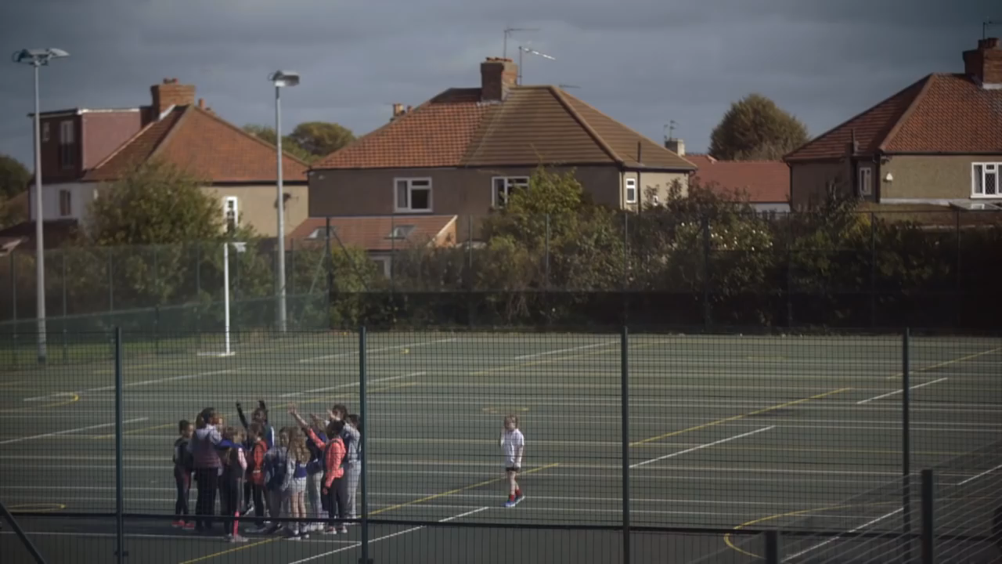
Notes:
Say something
NSPCC
Some participants may have seen this advert previously, however it is a useful one to play to remind people of the mirroring of anxieties in professionals and children – and the need for us, as adults, to help children tell.
Here is the YouTube link to video if needed.
NSPCC TV ad, 'Say Something' 60 SEC – YouTube
https://www.youtube.com/watch?v=VrAwP79Dmn8
How does it make you feel?
What are your thoughts on the clip?
Link back to how we can break down the barriers for children and for practitioners-

Slide 4
Children face a number of barriers that prevent them communicating about CSA to professionals.
Fear
May not know abuse has taken place
Pre or non-verbal/may not have the language
Opportunity
Shame
Guilt
Responsibility
Notes:
Not exhaustive list but highlights why as professionals we need to have professional curiosity and communicate with children where we suspect CSA has taken place.
Child Safeguarding Practice Review Panel report on intrafamilial child sexual abuse is titled “I wanted them all to notice”, which is an extract of a quote from one of the children at the heart of the reviews; “I couldn’t talk about the sexual abuse. It was too difficult. I wanted them all to notice and to ask me what was going on.”

Slide 5
Additional barriers may include
Childs sexuality
Ethnicity
Religious and cultural beliefs
Childs relationship with abuser
Disability and special educational needs.
Notes:
Childrens perceptions or experiences of racism make it harder for children from Ethnic Minority backgrounds to speak up.
Culutral beliefs- Honour, shame, suitability for marriage. Family member may ask for abuse to be kept secret.
Or fear of disclosing to someone from same ethnic background- small communities
Language- no direct translation
Fears of deep shame linked to religious beliefs
Closed communities, lack of access to education settings, poorunderstanding of body etc.

Slide 6
Talking to the child
Comment rather than interpret – “I notice you crying”​
Open a door – “I am here”​
Be aware of your body language​
Give the child time “I’m going to come and see you again next week and we can talk a bit more about this if you would like to”​
Use resources - “I’m going to show you an online resource so that if there is something that is worrying you, you can work out how to get some help”​
Give them an alterative - Suggest a third person example and talk about that person. E.g. If you had a friend who was experiencing something difficult, what do you think would stop them telling? Or help them tell? ​
And……….
Notes:
if a child wants to tell about their abuse, they need to choose who they will tell. The likelihood of telling a particular person will depend on: • how that person behaves towards them generally • whether they have a trusting and reliable relationship with that person • whether they have the opportunity to tell, or are asked • whether they feel they will be believed. Alternatively, a child’s communication about their abuse may not be spontaneous. It may occur only when prompted during a medical examination, a child protection inquiry or assessment of their needs, an interview or a therapeutic session, for example – or when someone notices that something may be wrong and asks about it.

Slide 7
Let them know what will happen if they tell​
​
“The only grown up that spoke to me about what would happen if I spoke about my abuse was the person who was abusing me.”​
(May Baxter-Thornton)
Notes:
And it was not their fault.

Slide 8
Taking a graduated approach
‘Sometimes we worry about what may happen if we tell someone what is going on (e.g. that we’ll get into trouble/that we’ve been told to keep it a secret/that we’ll upset people) – can you tell me what you are worried may happen if you tell someone what is going on?’
“I have noticed you don’t seem yourself at the moment”
“Help me understand”
“I have noticed you shouting a lot at the moment”
“Can you tell me more about that”
‘Sometimes things happen that young people find really difficult to talk about”
“I notice you are very quiet at the moment”
“I have noticed X and would like to understand more about that”

Slide 9
Asking specific questions.
To ensure the young person’s safety, you may need to ask them specific questions, particularly questions beginning with ‘who’, ‘what’, ‘where’ and ‘when’: ​
​
Typical questions might be ​
“Who will be at home when you go home later?” ​
“What else happened?”​
Can you tell me where they touched you?”​
“Tell me when that last happened.” ​
​
If the child has told you they have been hurt by someone but hasn’t given you enough detail to know who the person is, you may ask, “Can you tell me who that is?
Notes:
If the child uses ambiguous language (e.g., referring to “my flower”) you may need to clarify their meaning. You may say, “Children often use different words to describe things; can you tell me what you mean when you say ‘flower’?
Questions beginning with ‘why’ should be avoided as they can sound blaming to the child and can be interpreted as accusatory
If you want to understand more about the reasons for a child’s fear of going home, for example, ask instead: “What is it you are afraid will happen if you go home?”

Slide 10
Not being believed
Children rarely give fictitious accounts about having been abused and false allegations have been found to be rare.​
“The stigma of sexual abuse and trauma of disclosure should never be underestimated and the damage caused to children when they are not believed is immeasurable.”

Slide 11
Resources to use in practice.
Communicating with children | CSA Centre
Signs and indicators of child sexual abuse | CSA Centre

Slide 12

Notes:
The video shows the introduction to the Communicating with children resource

Slide 13

Signs and Indicator Guide
Notes:
Can be used to discuss concerns in supervision/ GP MDT or to add to MASH referral.
To create a common language among professionals to discuss, record and share concerns that a child is being, or has been sexually abused. ​
​
It aims to help you:​
Consider, identify and clearly record signs which indicate that sexual abuse is orhas been taking place​
Discuss and explore concerns that a child is being or has been sexually abused,and communicate these concerns to other organisations and agencies ​
​

